Slide 1
River Ecology and Environmental Flows
Eric S. Hersh
The University of Texas at Austin
Center for Research in Water Resources
Arc Hydro River Workshop
December 1, 2010

Slide 2
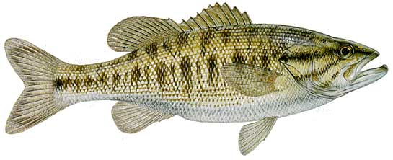
Outline
Context within Arc Hydro River
Motivation
Environmental Flows
Flow
Biota
Habitat

Slide 3
Arc Hydro River
Maidment and Brown, 11/24/2010
river network component
3D river channel
flood modeling and mapping component
river ecology and morphology component
  characterization of stream habitat
  mapping of fish and biota distributions
  morphological description of stream environments
  characterization of the sediment characteristics of the river, its bed and banks

Slide 4
Arc Hydro River
river network component
3D river channel
flood modeling and mapping component
river ecology and morphology component
  Goal: to facilitate the characterization, classification, mapping, and bioassessment of fish and biota in the riverine and riparian zones to support conservation and wise use

Slide 5
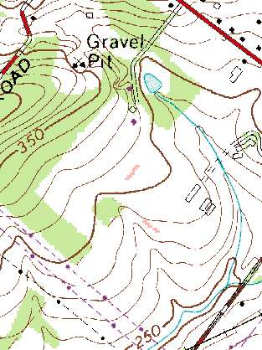
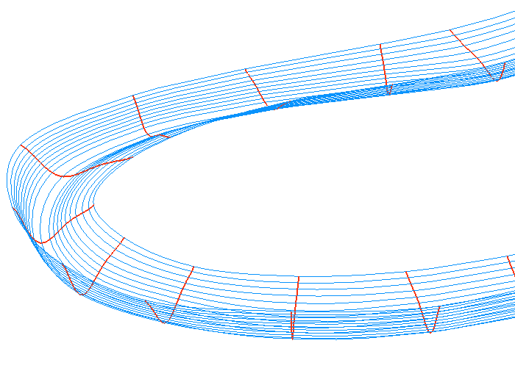
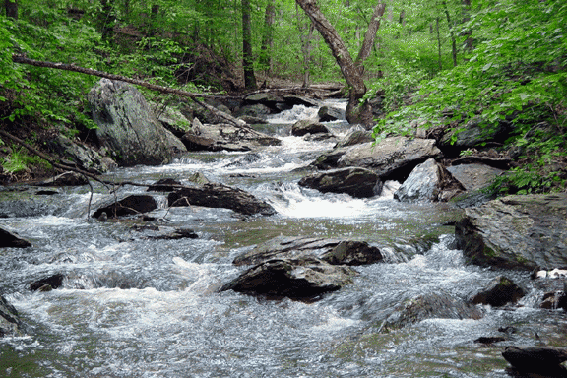
?
The study of ecology requires (and adds) complexity and nuance

Slide 6
Outline
Context within Arc Hydro River
Motivation
Environmental Flows
Flow
Biota
Habitat

Slide 7
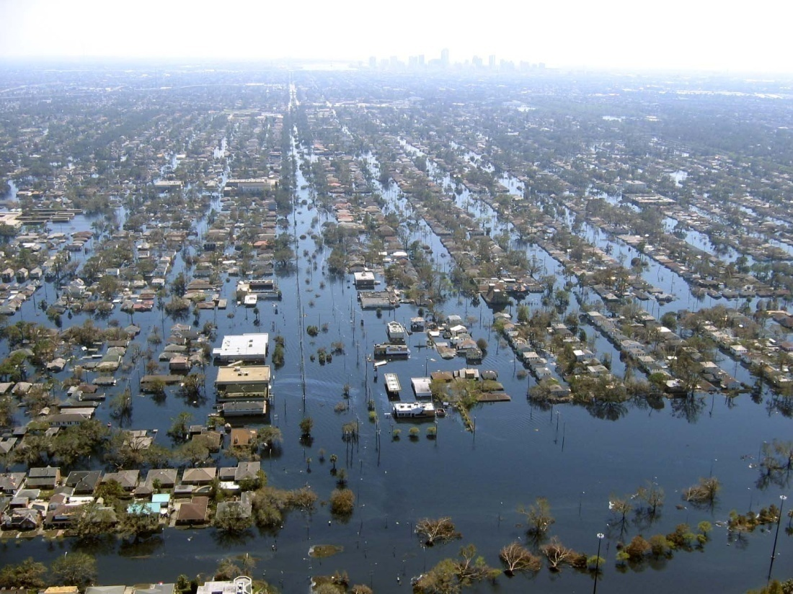
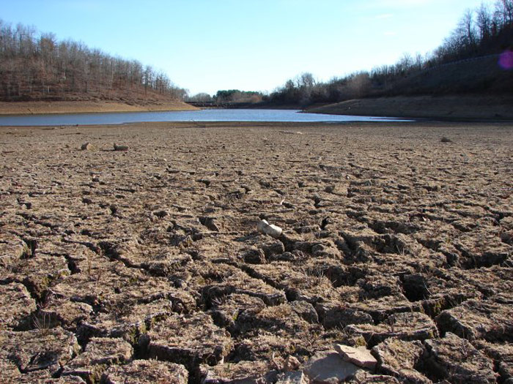
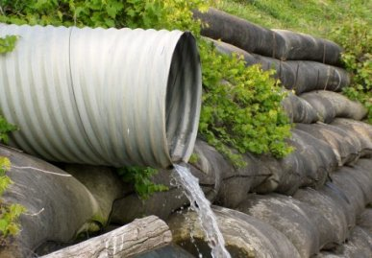
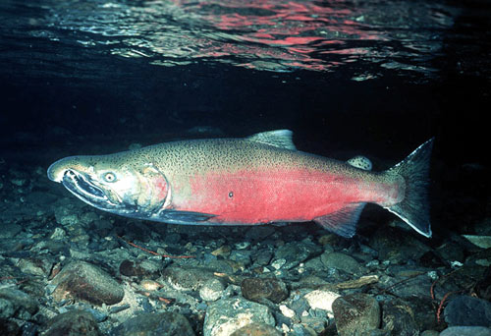
Too little water
Too much water
Water environment
Water quality

Slide 8
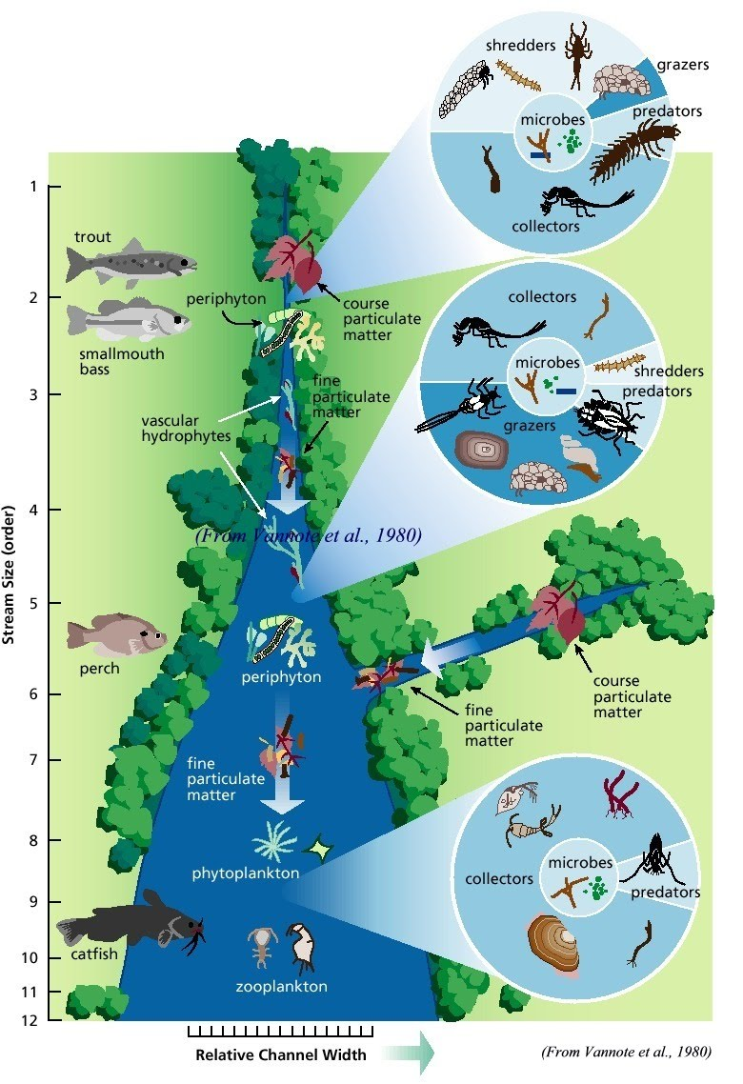
Flow
Biota
Habitat
… and water quality

Slide 9
Ecosystem Services
  Fish and wildlife: biodiversity, conservation, habitat
  Endangered species protection
  Fisheries (commercial and recreational)
  Navigation
  Hydropower
  Recreation
  Ecotourism
  Waste assimilation
  Water supply
  Food supply
  Flood and drought mitigation
  Nutrient delivery
  Sediment transport
  Coastal salinity regulation
  Aesthetics

Slide 10
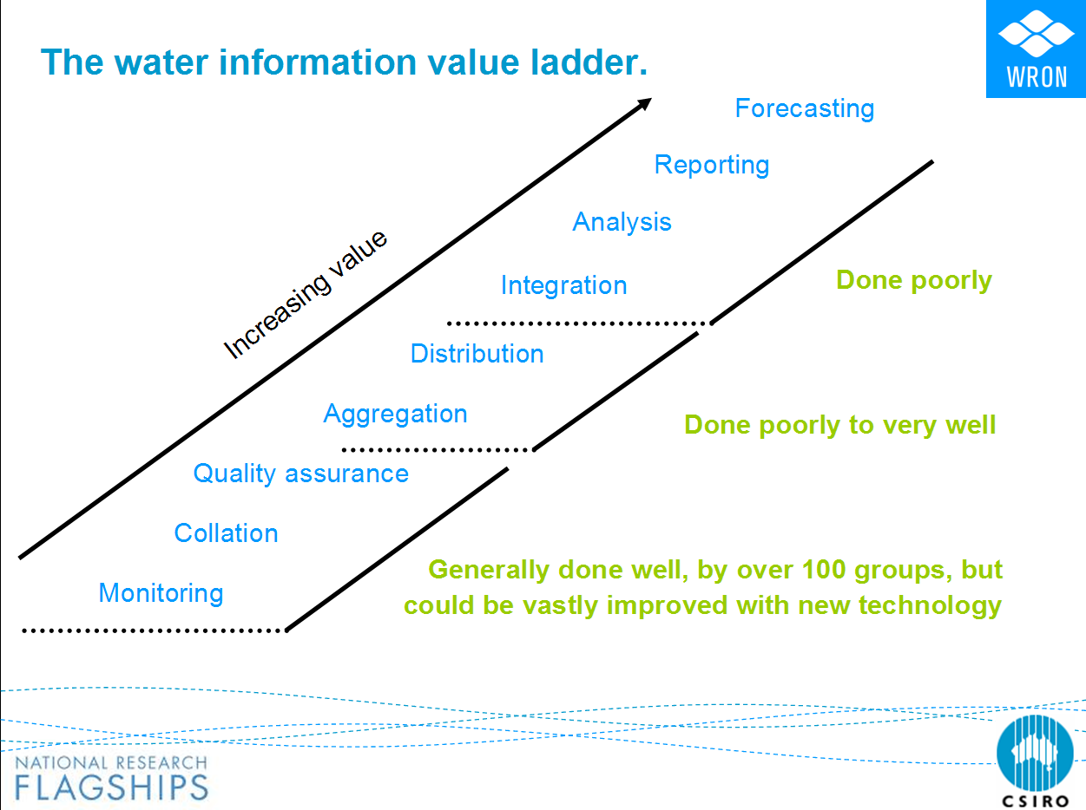
Arc Hydro River
From Robert Vertessy, CSIRO, Australia

Slide 11
Outline
Context within Arc Hydro River
Motivation
Environmental Flows
Flow
Biota
Habitat

Slide 12
Instream Flows
Dr. Thom Hardy, Texas State University
Instream Flows is the art and science of collecting data in systems we cannot adequately sample using methods developed by committees of technically unqualified participants for organisms we know very little about in order to form concepts about processes we do not fully understand that we represent as mathematical abstractions that we cannot precisely analyze to determine their responses to indeterminate stresses we cannot accurately predict now let alone in the future all in such a way that society at large is given no reason to suspect the extent of our ignorance.

Slide 13
Environmental Flows definition
Brisbane Declaration 2007
“The quantity, timing, and quality of water flows required to sustain freshwater and estuarine ecosystems and the human livelihoods and well-being that depend on these ecosystems”

Slide 14
Texas Legislative Background
Freshwater inflow needs for bays & estuaries (1980s)
Senate Bill 1: water resource planning & management (1997)
Senate Bill 2: the science bill (2001)
  Instream flow data collection and evaluation program
  Methodologies to determine flow conditions in Texas rivers and streams necessary to support a sound ecological environment
Senate Bill 3: the implementation bill (2007)
  The who, when, and how of eflow implementation in Texas
  TCEQ must adopt the recommended standards by June 2011
Notes:
NOTES:

Slide 15
Outline
Context within Arc Hydro River
Motivation
Environmental Flows
Flow
Biota
Habitat

Slide 16
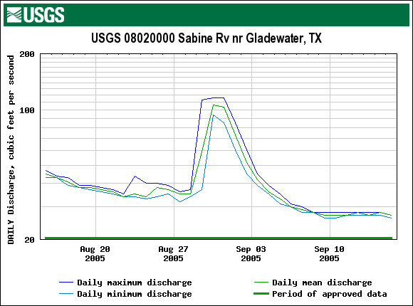
the natural flow regime
Rate of Change
Magnitude
Duration
Timing
Not depicted: frequency

Slide 17
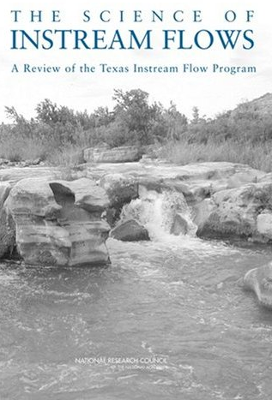
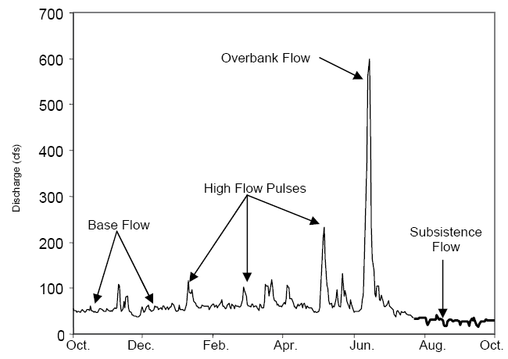
flow components
(NRC 2005)

Slide 18
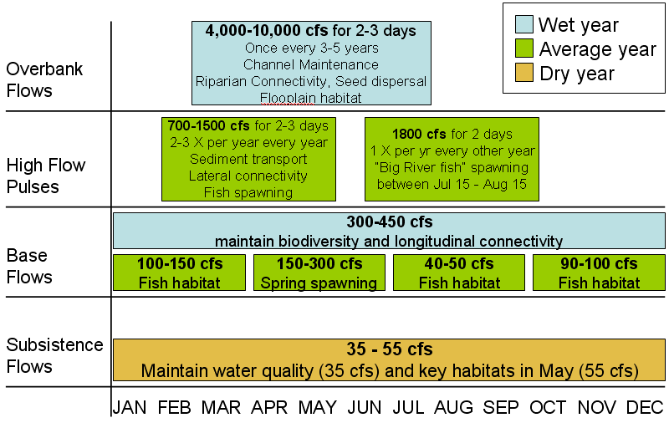
SB2 instream flow prescription

Slide 19
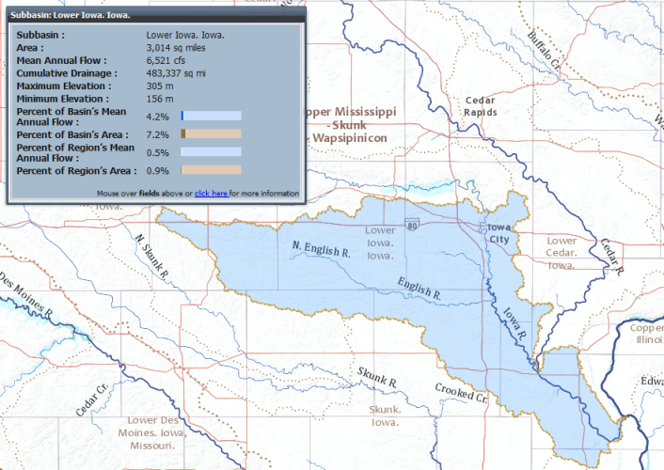
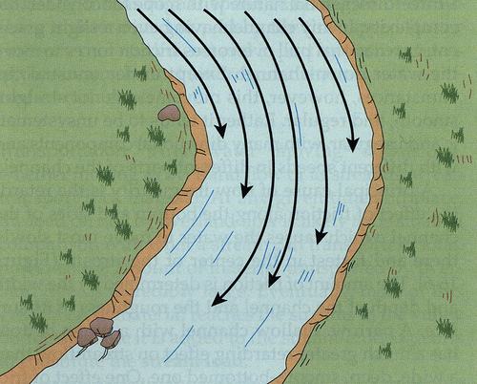
Current Treatment of Streamflow
NHDPlus attributes
ESRI Community Hydro Base Map
USGS Streamstats
The Nature Conservancy’s Indicators of Hydrologic Alteration (IHA)
USGS Hydrologic Assessment Tool (HAT)

Slide 20
Outline
Context within Arc Hydro River
Motivation
Environmental Flows
Flow
Biota
Habitat

Slide 21
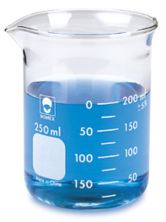

The Water Environment
Distinct types of water data, each with its own character
  Physical data describe the movement of water and its properties
  Chemical data describe the constituents moving with, in, and through the water
  Biological data describe the organisms inhabiting the water environment.
Surveys
Sensors
Continuous
Longitudinal
Studies
Samples
Discrete
Lateral
phys/ chem
biol
vs.

Slide 22
The Data Cube
S = f {x,y,z,t,v}
Time, T
“When”
t
A data value
D
s
“Where”
Space, S
V_{i}
“What”
Variables, V

Slide 23
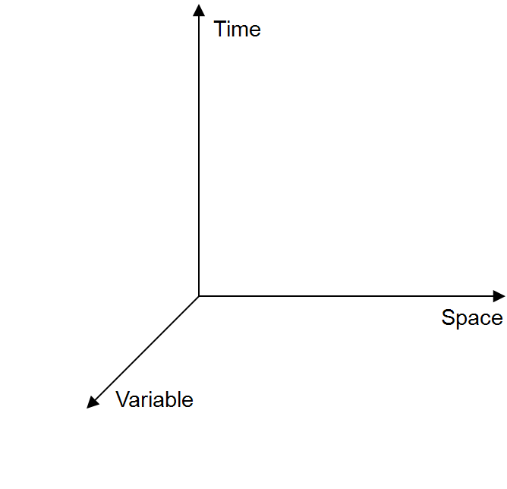
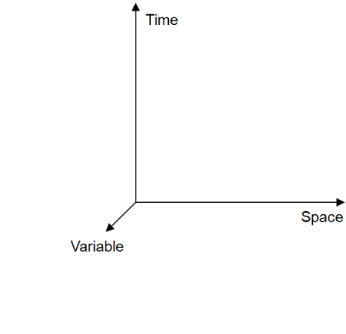
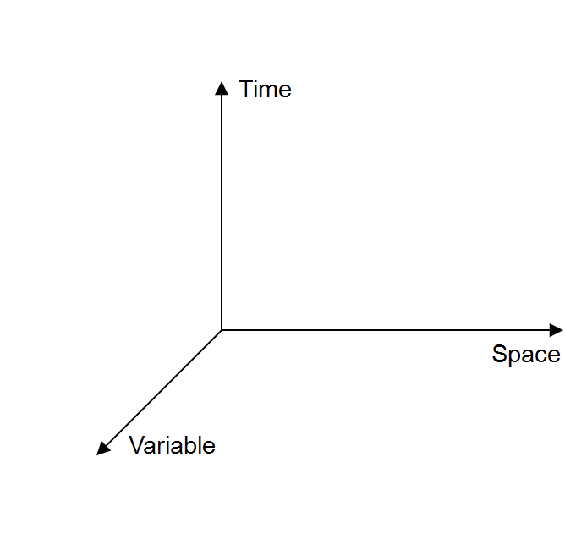
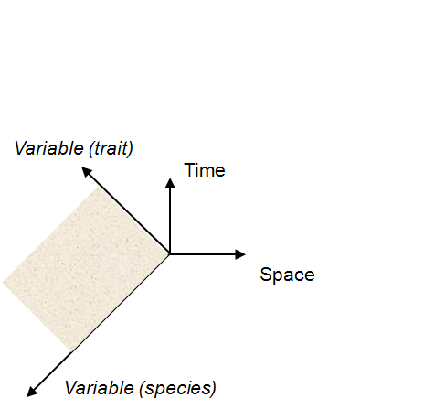
S = f {x,y,z,t,v}
taxonomy
1a. generic data cube
1b. physical
phenotype
Measurements, traits, and characteristics, such as length, mass, sex, or count.
1c. chemical
1d. biological

Slide 24
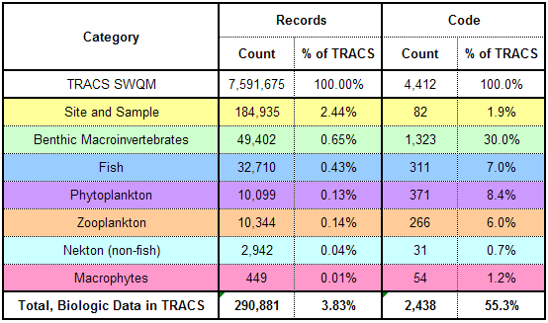
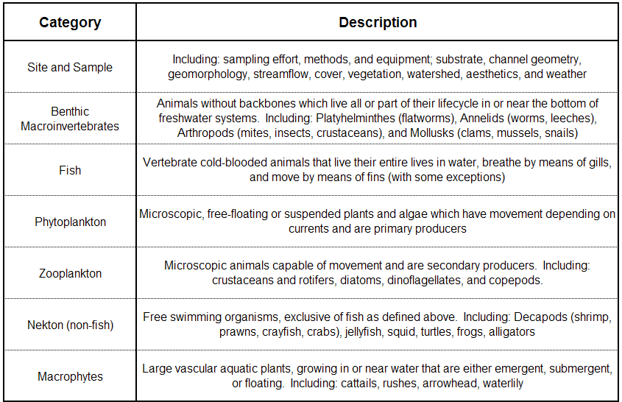
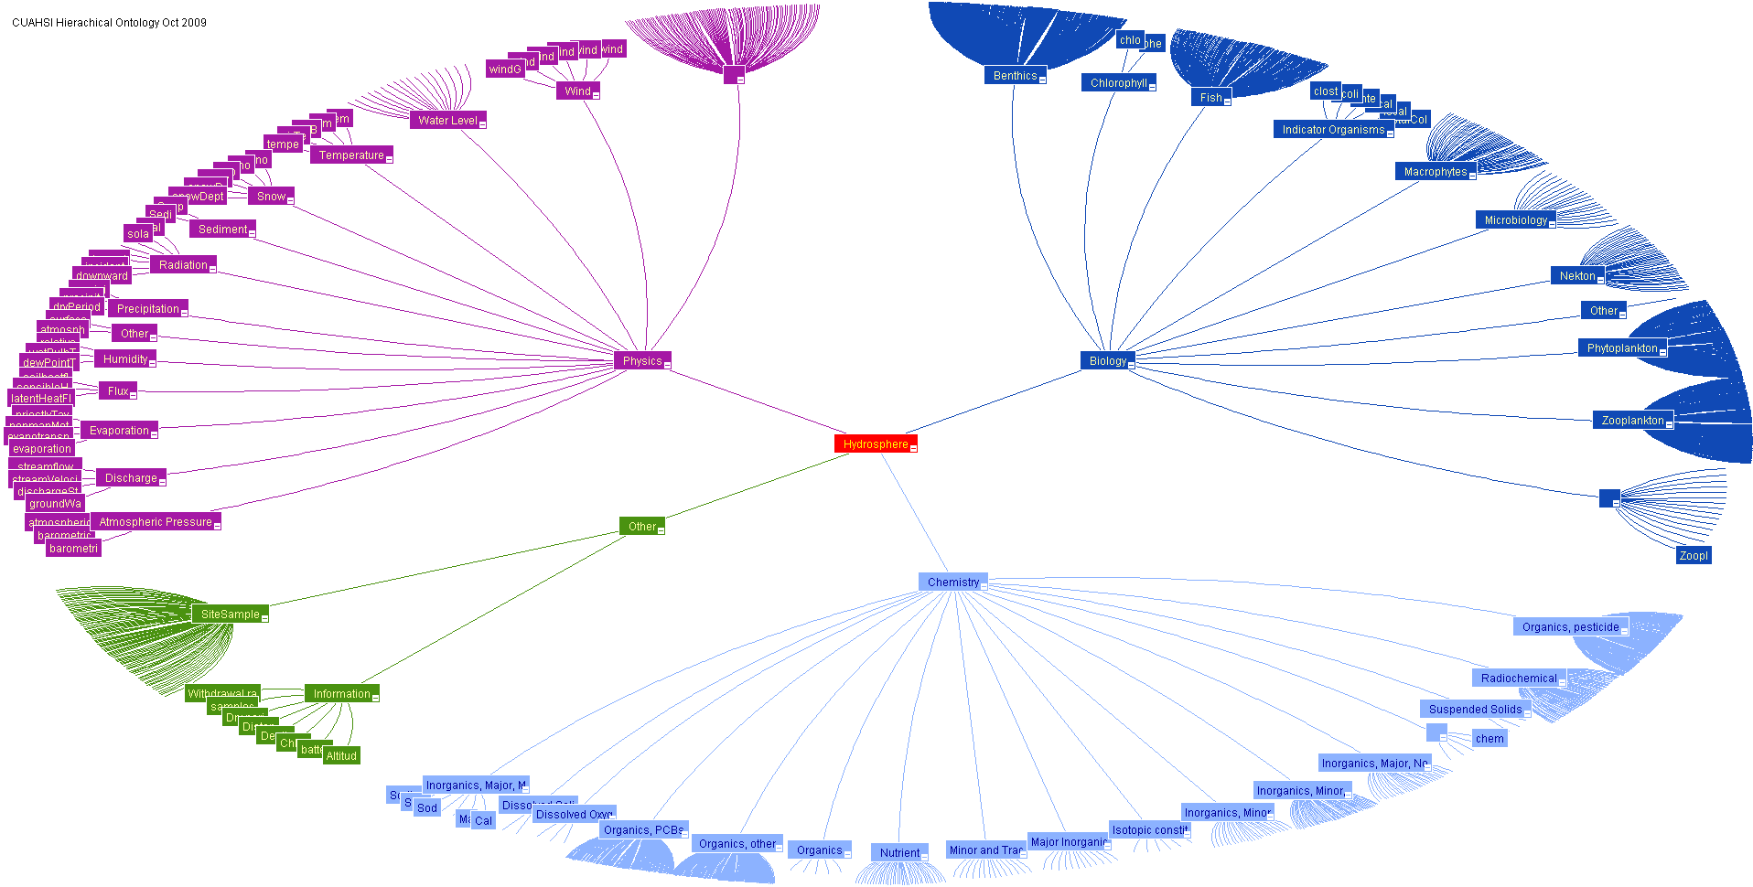
Ontologies & Semantic Mediation
eg: ‘reservoir inflow’ vs. ‘discharge’
http://test.hydroseek.net/ontology/CUAHSIOntologyMay2009.html

Slide 25
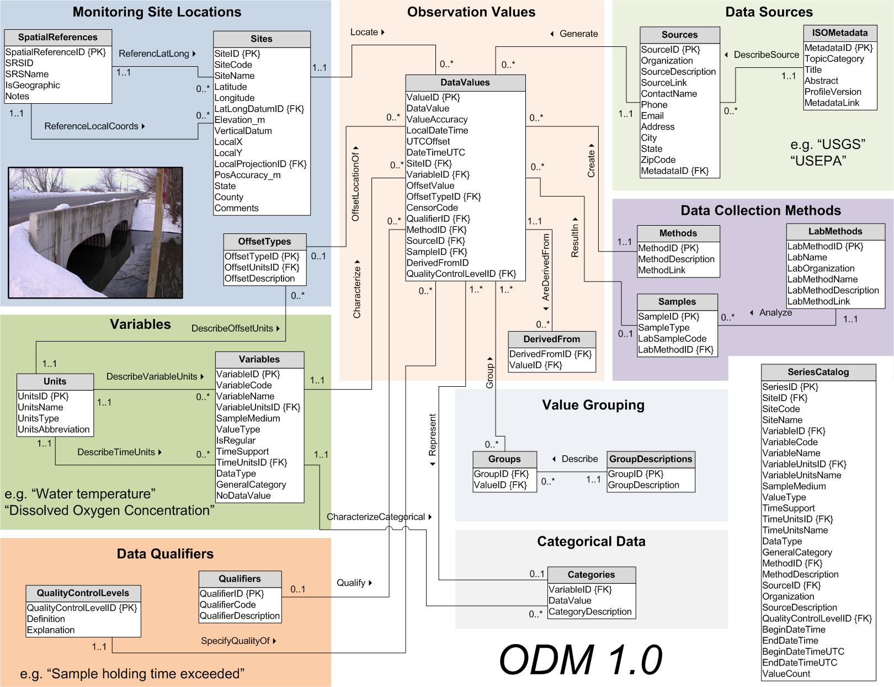
Horsburgh et al (2008)

Slide 26
BioODM
v.1.2
Eric S. Hersh, UT-CRWR
9/25/2009
Size
Organism
Weight
Units
(has traits, ID)
Group
Taxonomy
(characteristics, statistics)
Sample
Method
Site
Habitat
(specific location)
(substrate,
cover,
hydraulics,
characteristics)
Source
Document
(provenance, contact info)
Domain
(link to pdf, geography)
(general location)
Datum

Slide 27
The hydroinformatics maturity ladder
NODC, NCAR EOL
Marine Biol.
Aquatic Biol.
FishBase, NTL, FBIS, private/internal
Ecol. Info
NSF- NEON, LTER, NCEAS; NatureServe, GBIF
Decreasing maturity
(Digital Libraries)
1990s; moderate commercial & open source; widespread investigation
HIS
Conceptualized in 2000s by CUAHSI, an NSF-sponsored university partnership
GIS
Maintains a mature commercial market. ESRI revenue of ~$800 million/year

Slide 28
data centers
metadata standards
Long-term Ecological Research sites (LTER)
National Center for Ecological Analysis and Synthesis (NCEAS)
National Ecological Observation Network (NEON) - sensors
USGS National Biological Information Infrastructure (NBII)
Ecological Markup Language (EML) – data discovery/ flexible, vs. WaterML – data discovery and integration/ structured
data models/ databases
catalogs
NatureServe Biotics4 PDM
North Temperate Lakes LTER
NOAA NW Fisheries Science Center Aquatic Resources Framework
TetraTech EDAS
NZ NIWA Freshwater Biodata Information System
Ontario Ministry of Natural Resources Flowing Water Information System
Global Biodiversity Information Facility (GBIF)
FishBase – 33 million hits/mo

Slide 29
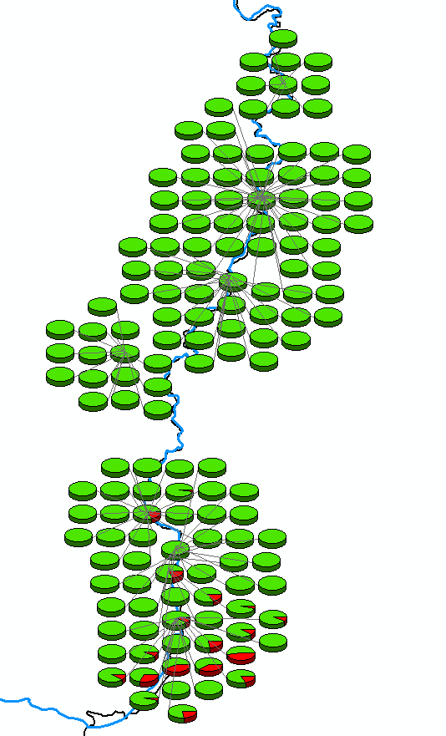
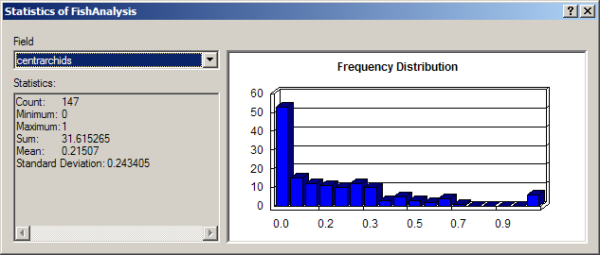

-Sabine River: 165 samples collected at 8 study reaches over 8 days in 2006; 147 samples yielded fish, averaging 40 fish per sample
-5,811 fish were observed, representing 58 species
-Across all sites, 889 Centrarchids (sunfish, bass, and crappies) were observed with a relative abundance of 22% ± 24%
-The only non-native observed was the inland silverside (Menidia beryllina). 192 total, ranging from 0-90% of the sample population with a mean of 3% ± 12%
Distribution: Originally found in coastal waters and upstream in coastal streams along the Atlantic and Gulf coasts; widely introduced into freshwater impoundments (Hubbs et al. 1991)
http://www.bio.txstate.edu/~tbonner/txfishes/menidia%20beryllina.htm

Slide 30
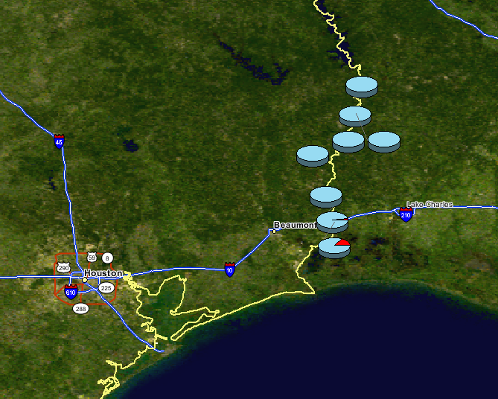

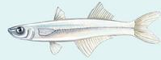
Inland Silverside
Menidia beryllina
Non-native species distribution

Slide 31
Outline
Context within Arc Hydro River
Motivation
Environmental Flows
Flow
Biota
Habitat

Slide 32
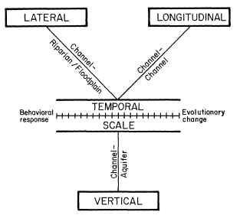
The 4-D Nature of Lotic Ecosystems
Ward, JNABS, 1989

Slide 33
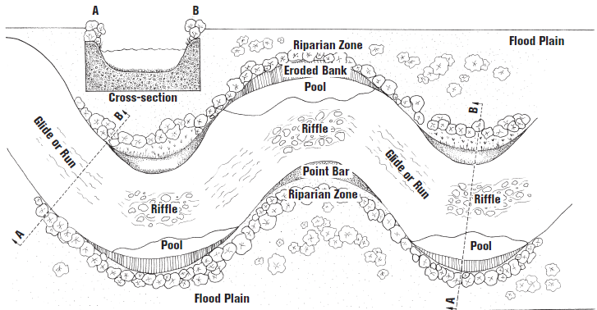
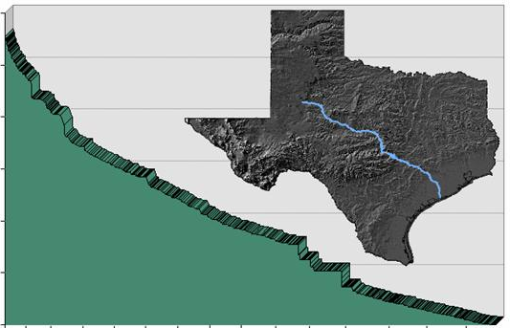
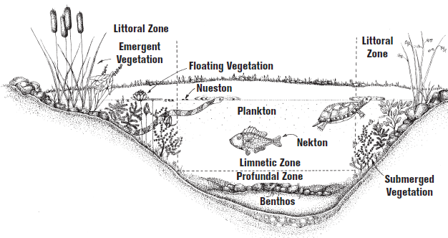

Slide 34
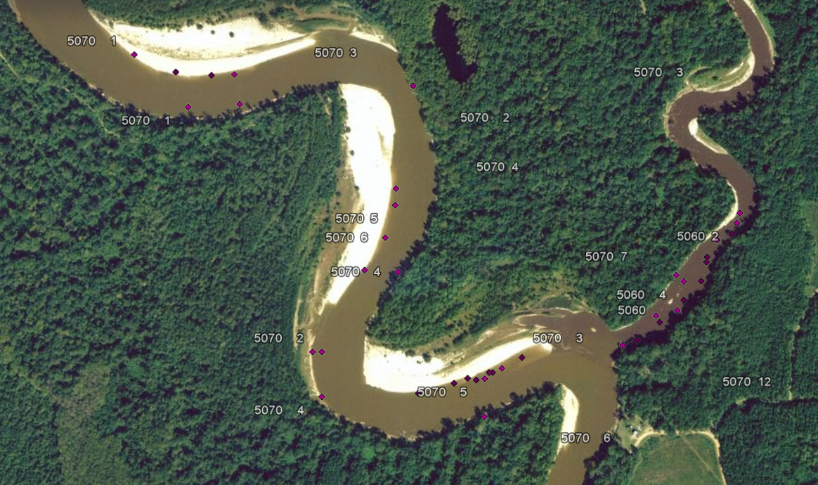
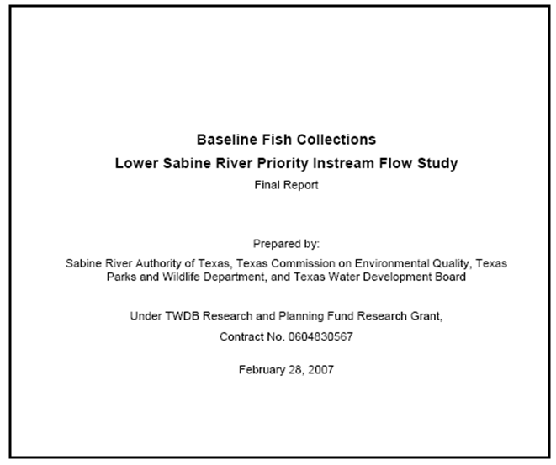
KML map links to both the data and the document

Slide 35
Fluvial coordinates
Rectangular coordinates (x,y,z)
Fluvial coordinates:
s | Relative linear-referenced stream address (analogous to River Mile)
n | Width offset at cross-section (from bank, thalweg, etc)
z | Depth offset (from water surface, channel bed, etc)
Dynamic wrt hydrology, geomorphology, but additional value derived
  e.g.: was a DO sample taken near the surface? In the water column? At the sediment-water interface? In the pore space?

Slide 36
Habitat Complexities
3-D channel representation
  ArcScene?
Morphometry and geomorphology
  Time-enabled feature class in ArcGIS 10?
Sediment, substrate, vegetation, cover
  Observations and/or spatial data? Both/neither?
What is a river?
  Ephemeral, intermittent, canals? NHDPlus as guidance?
GW-SW interaction, hyporheic zone
  Interaction/ exchange with Arc Hydro Groundwater?

Slide 37
Concluding Thoughts
with regards to river ecology…
Arc Hydro River could provide a physical template for the riverine and riparian environment which would enable the storage and sharing of observations of the lotic ecosystem and thus would support analyses of flow-biota-habitat linkages

Slide 38
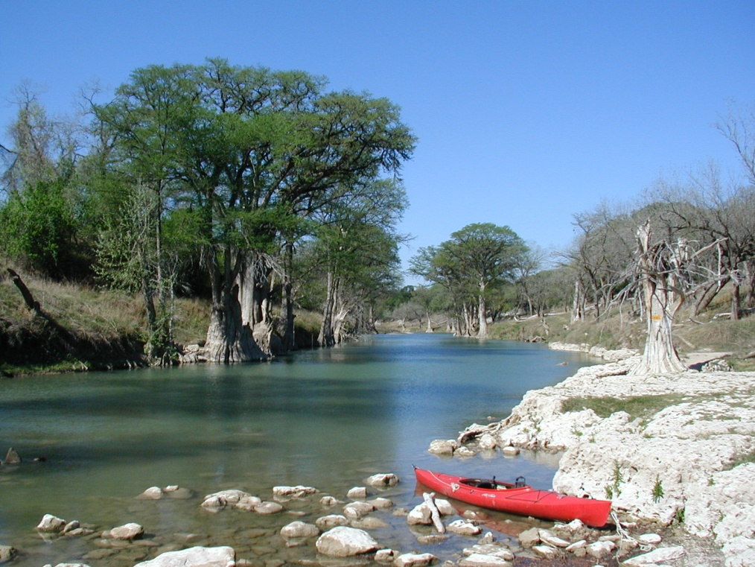
thanks.

