Slide 1



Creating a Statewide Inventory of Low Water Crossings and High Water Marks for Texas
Melinda Luna, PE, CFM
Dec 2| Floodplain Mapping Services

Slide 2
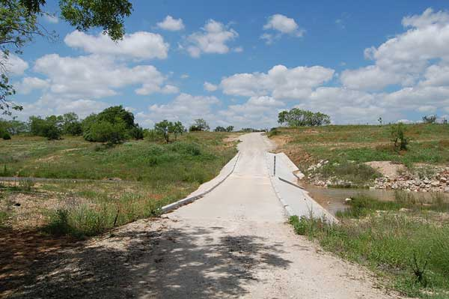
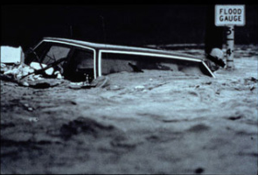
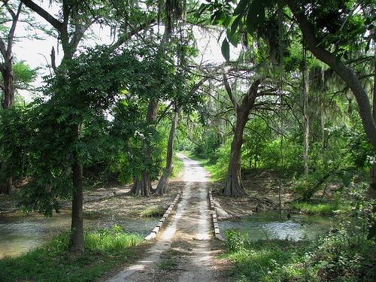
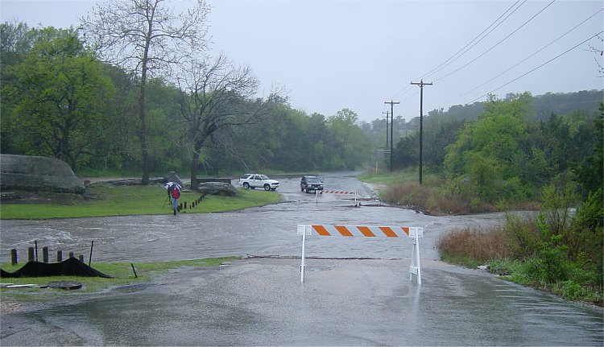
What is a low water crossing?

Slide 3
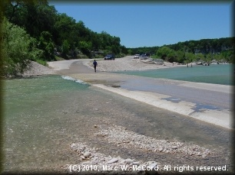
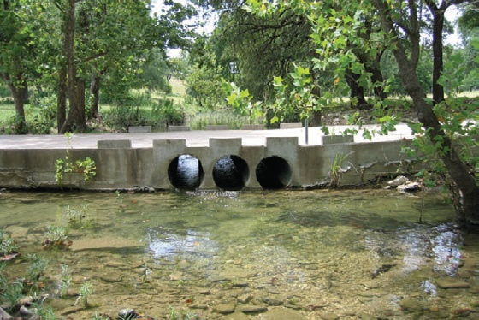
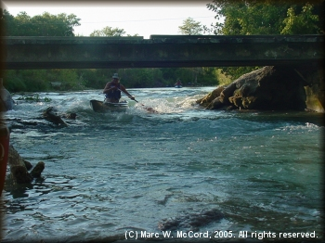
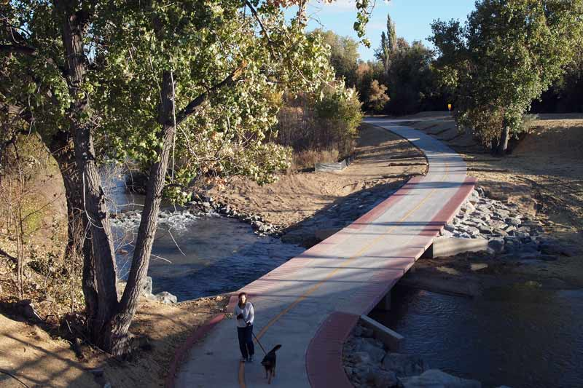
Types of low water crossings
Unvented Ford
Vented Ford
Bridge Class
Overtopped at 10 year
Pedestrian

Slide 4

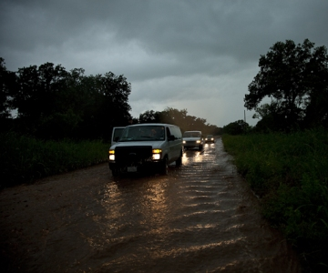

Why are low water crossings dangerous?

Slide 5
How were the low water crossings gathered?

Slide 6
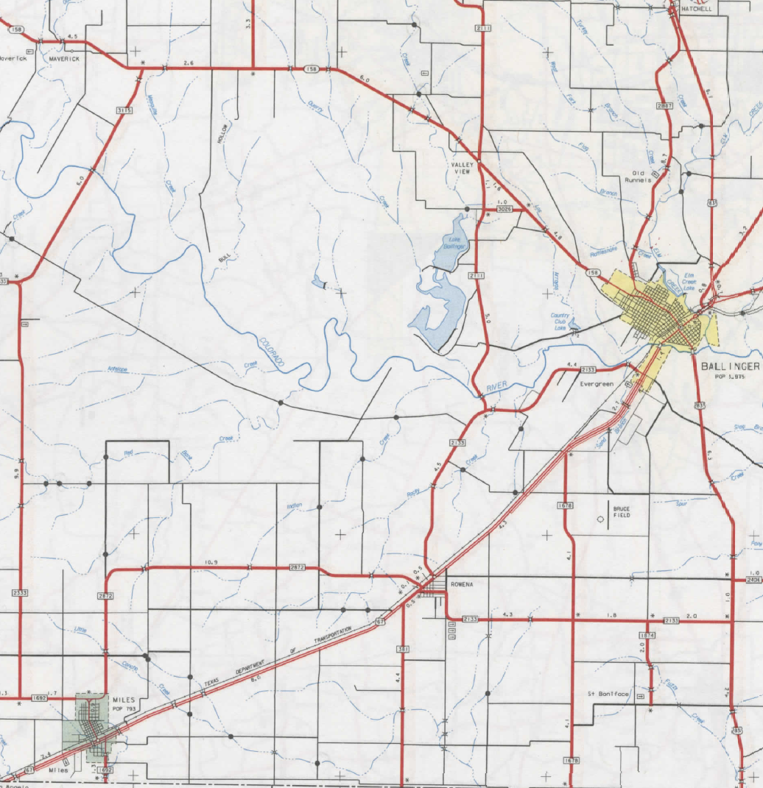
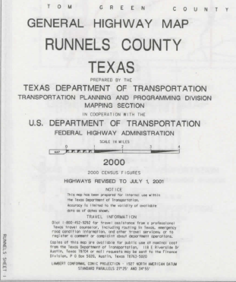
How were the low water crossings gathered?
Low Water Crossings

Slide 7

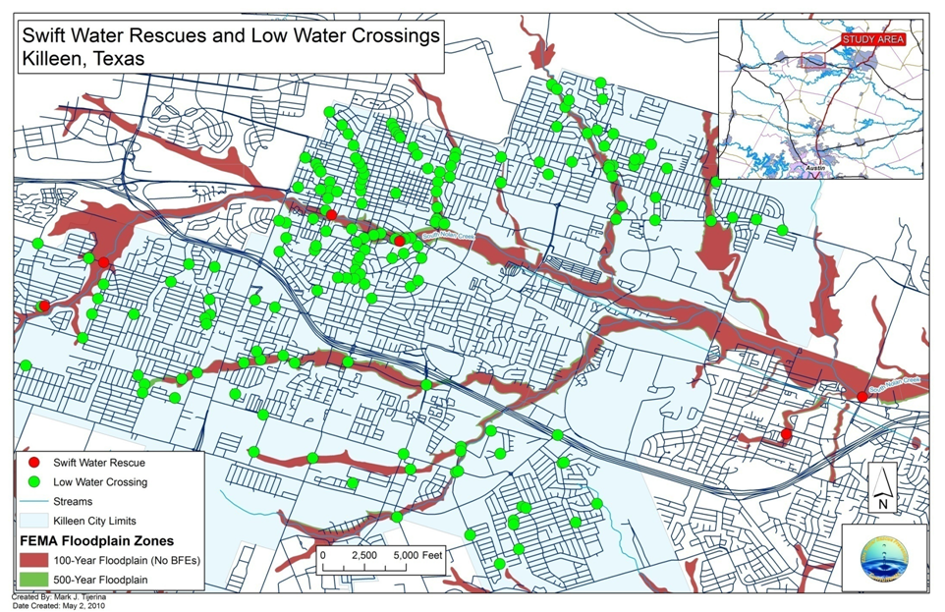
How were the low water crossings gathered?

Slide 8
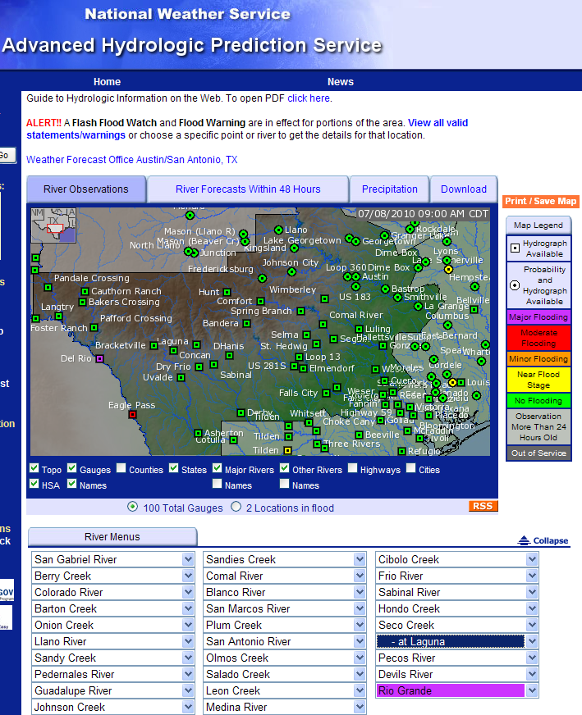
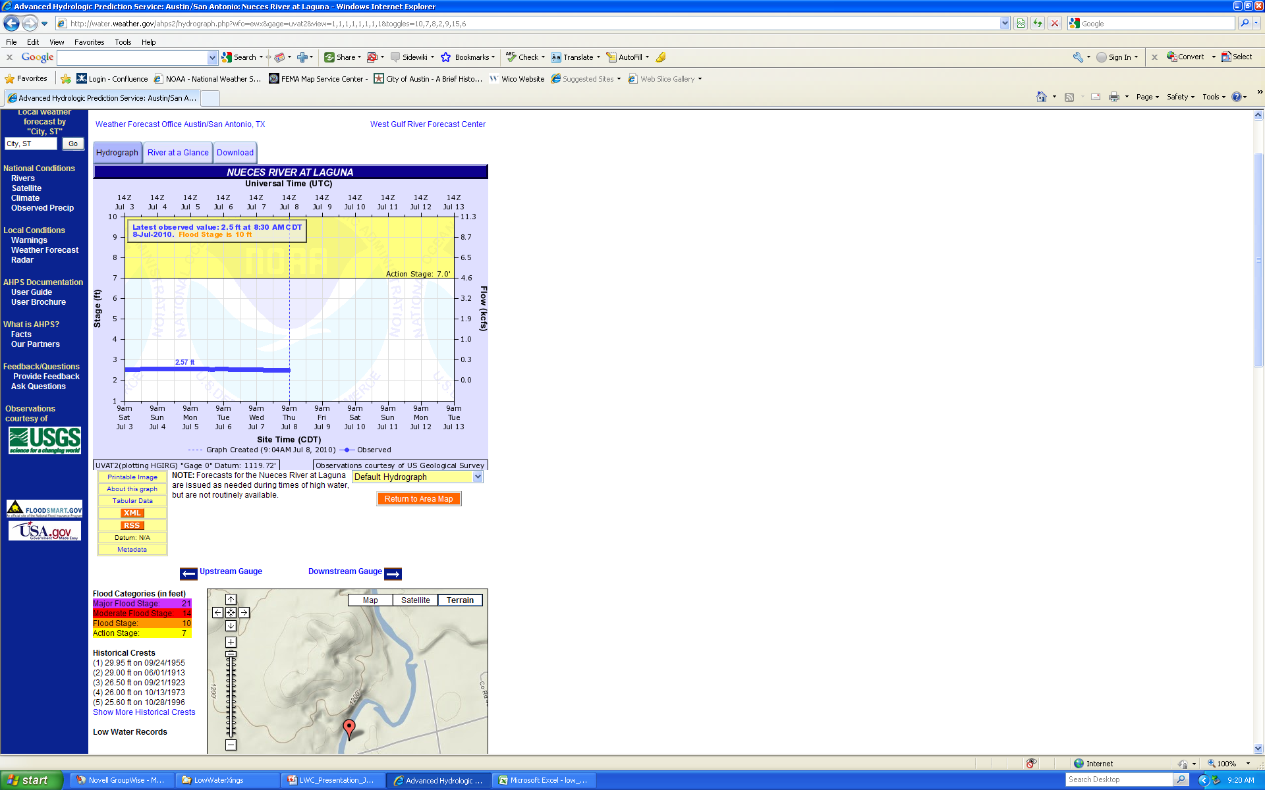
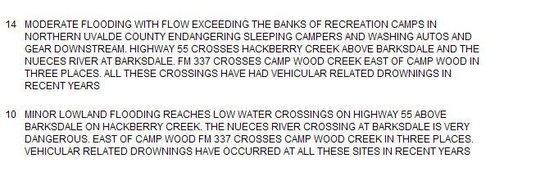
How were the low water crossings gathered?

Slide 9
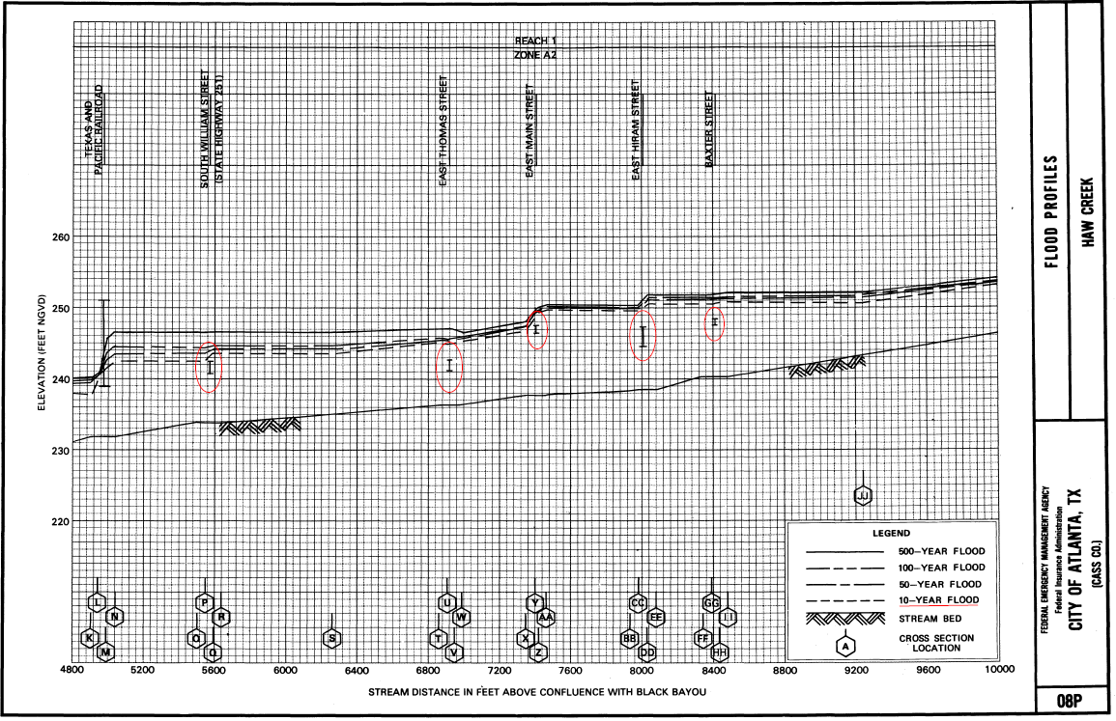
How were the low water crossings gathered?

Slide 10
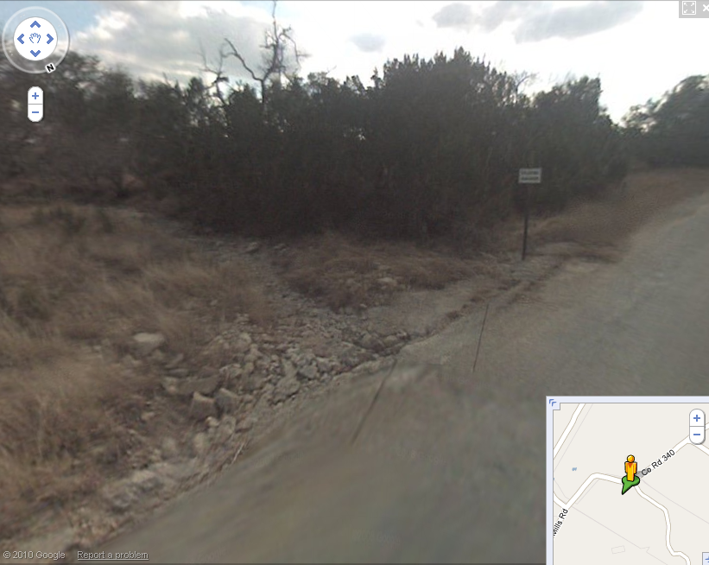

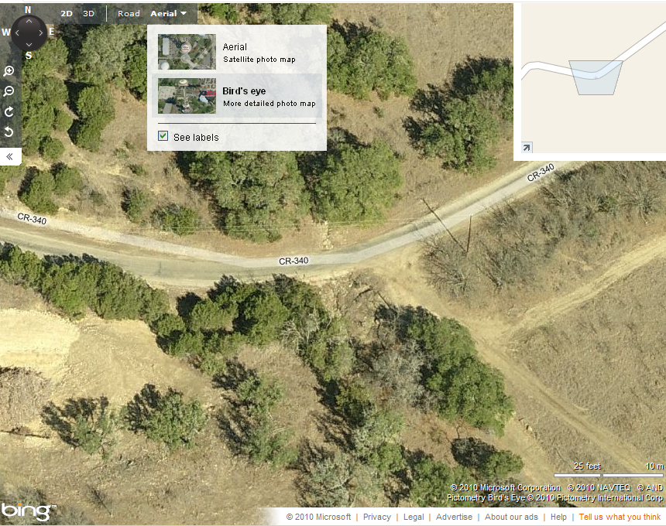
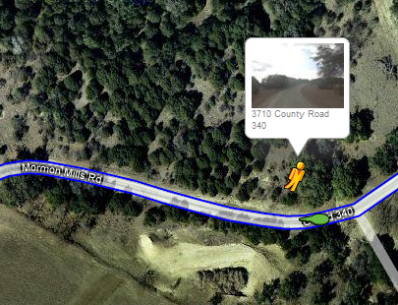
How were the low water crossings gathered?
Google Maps, Street View, Bing Maps, Birds Eye Photos

Slide 11
Data Fields included in Inventory
FIPS code
County Name
Street or Road carried
Waterway
Source of identification - Tx DOT county maps, IFF study, FIS, already Collected by county
LWX Type – Bridge class, pedestrian crossing, vented ford, or unvented ford.
Owner - state, city, county, etc.
Owner ID - National Bridge inventory (NBI) number or the ID used by the owner.
Detour length
Over Topping Type - Tidal or Riverine

Slide 12
Low Water Crossings in Texas

Slide 13
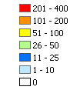
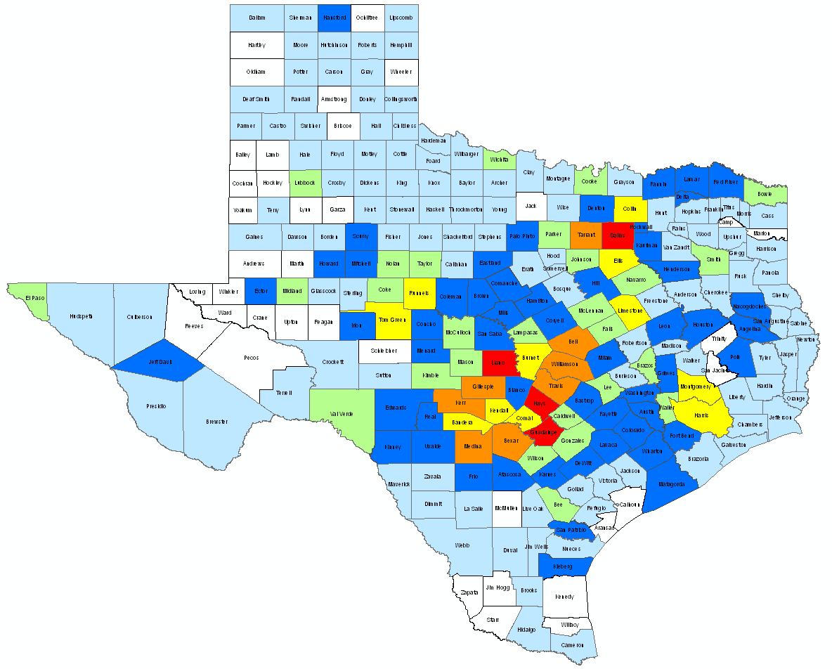
Low Water Crossings in Texas
None Identified
As of : 10-18-2010

Slide 14
Low Water Crossing Statistics
25 on average per county
218Counties contain one or more
5,423 Statewide

Slide 15
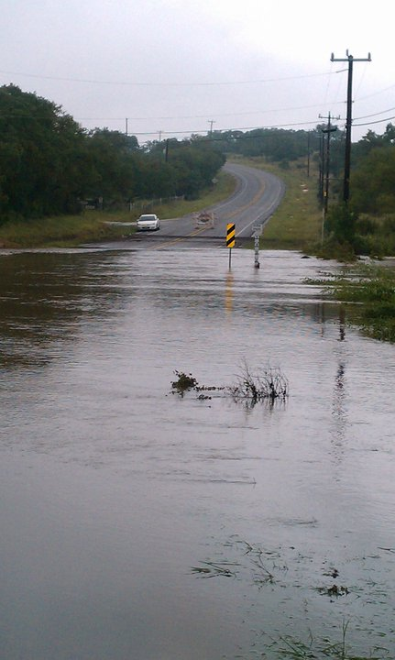
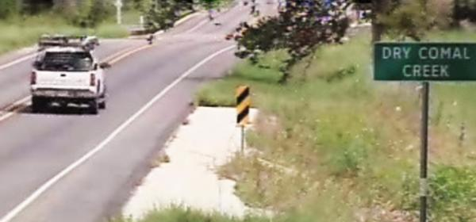
Potential Future Work
Additional Information added
Photographs of low water crossings
Collaboration with other agencies

Slide 16
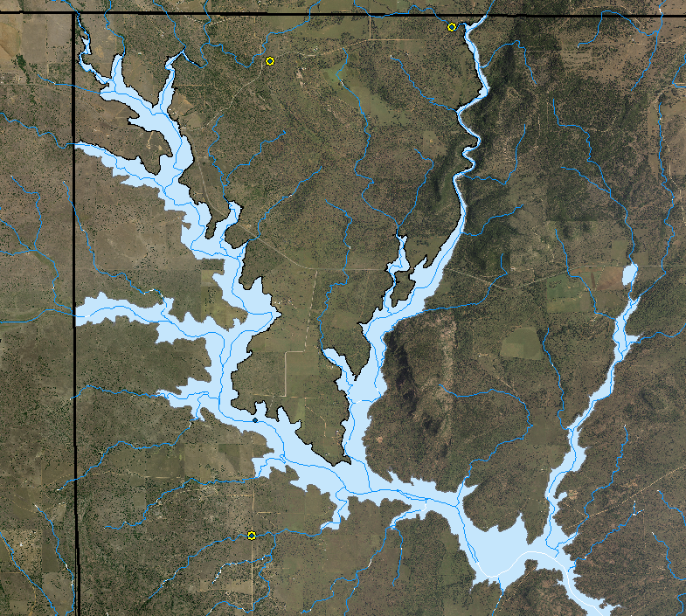
How can this data be used?
Indicator of Floodplain mapping needs
Locations of Hazards and Risk General Public
Hazard Mitigation plans
Research
Credit for CRS
FEMA’s Discovery
National Weather Service Forecasts

Slide 17

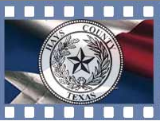


Thank you to:

Slide 18
High Water Mark Inventory

Slide 19
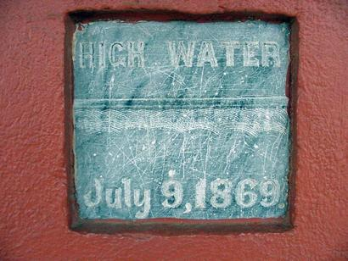
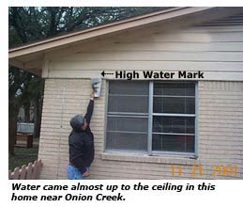
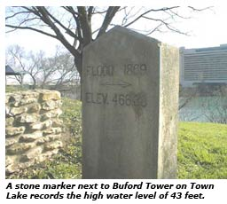
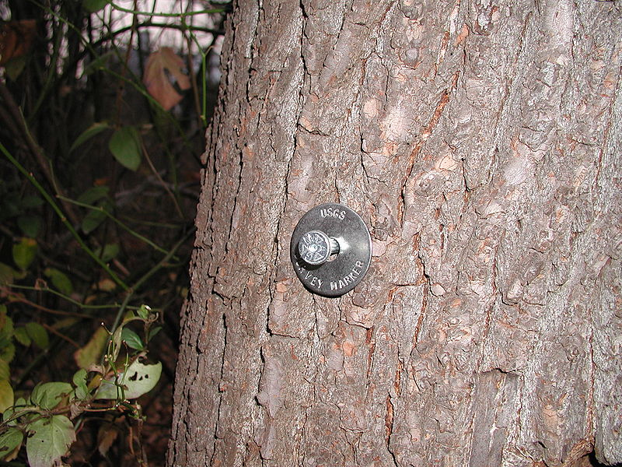
What is a high water mark?
Notes:
a mark indicating the highest level reached by a body of water. They can be represented by a sign on a wall in a building or on a bridge; a Surveyed Monument…this one is the Corps of Engineers’ and is from the 1869 flood; Well marked line on a home or fence; a surveyed point…this one is from the USGS. If you have ever made it downtown to the BBQ place Iron Works then you will see they have one in their restaurant.

Slide 20
How were the high water marks gathered?
Notes:
Here is the break down for the majority of the data we have collected to date. 70% of the HWM in our database has come from the Corp of Engineers, 20% from the National Weather Service and 10% from TxDOT.

Slide 21
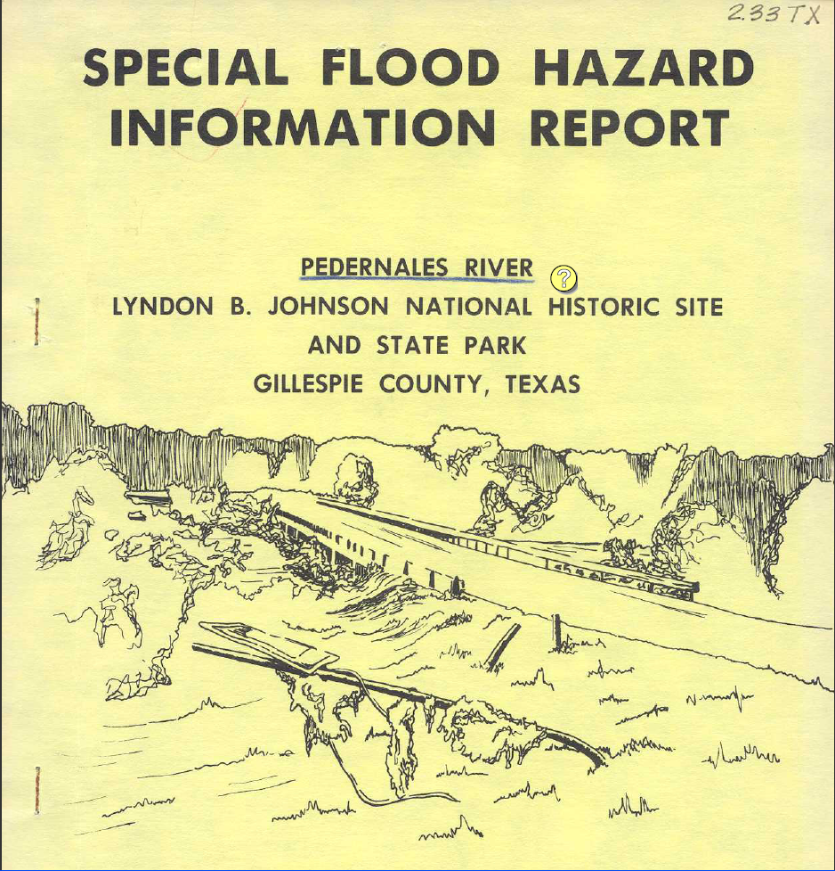
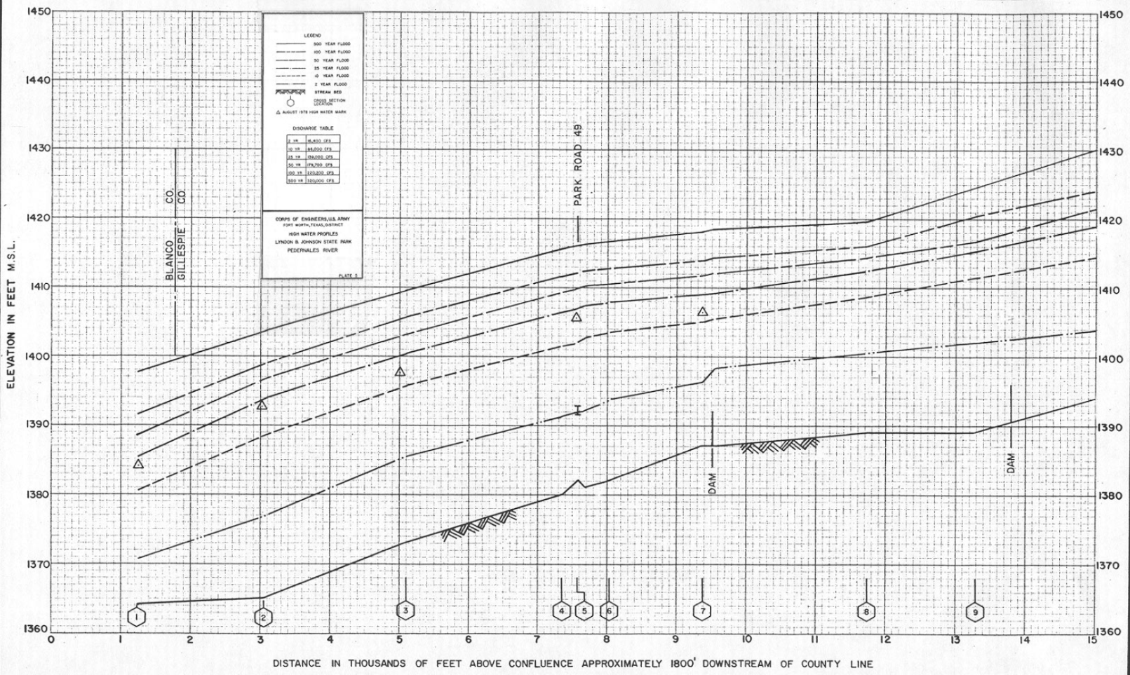
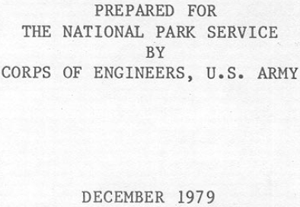
How were the high water marks gathered?
High Water Marks
Notes:
Special Flood Hazard Information Reports prepared by the Corp of Engineers in the 1970s.

Slide 22
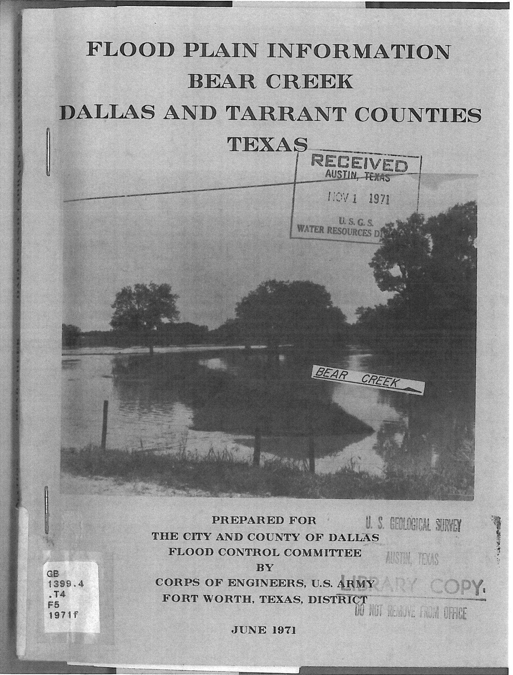
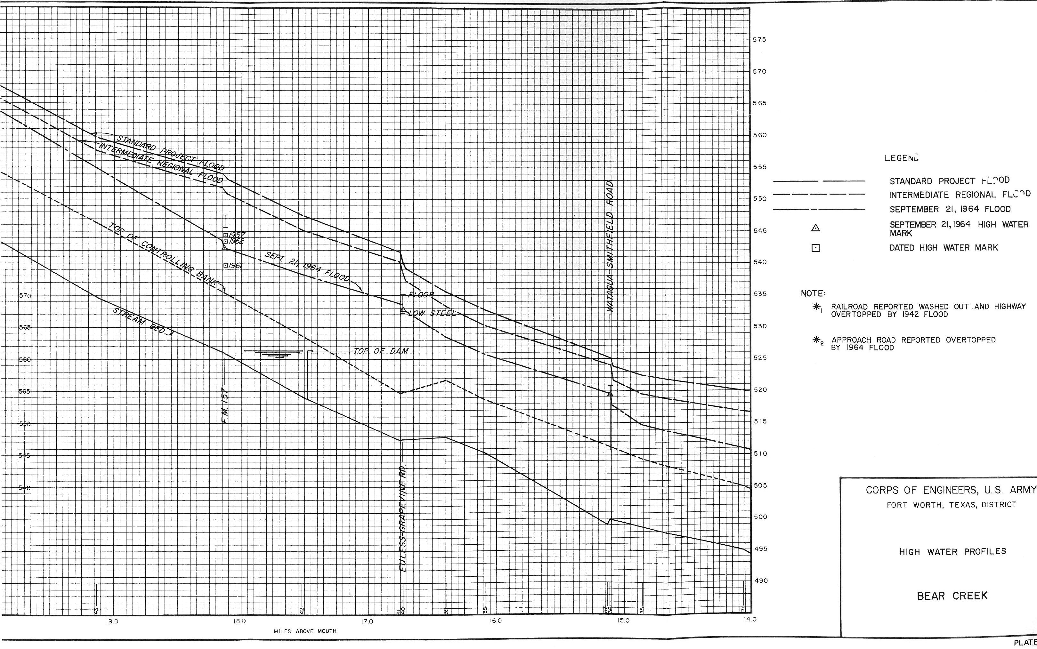
How were the high water marks gathered?
High Water Marks
Notes:
Flood Plain Information Reports prepared by the Corps of Engineers in the late 60s and early 70s.

Slide 23
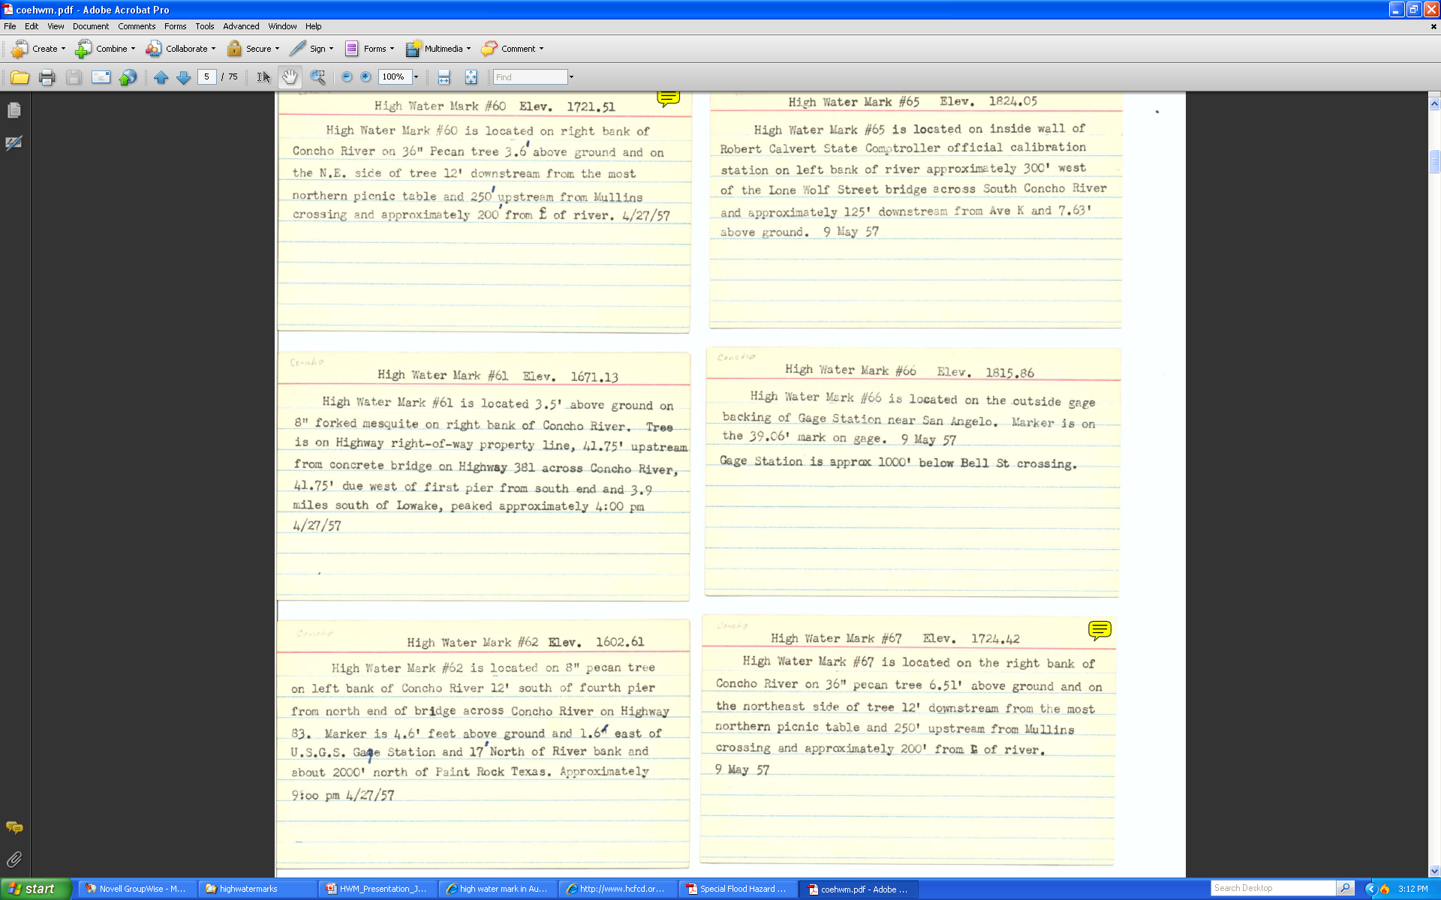

How were the high water marks gathered?
Notes:
Field notes on high water marks from the Corp of Engineers.

Slide 24
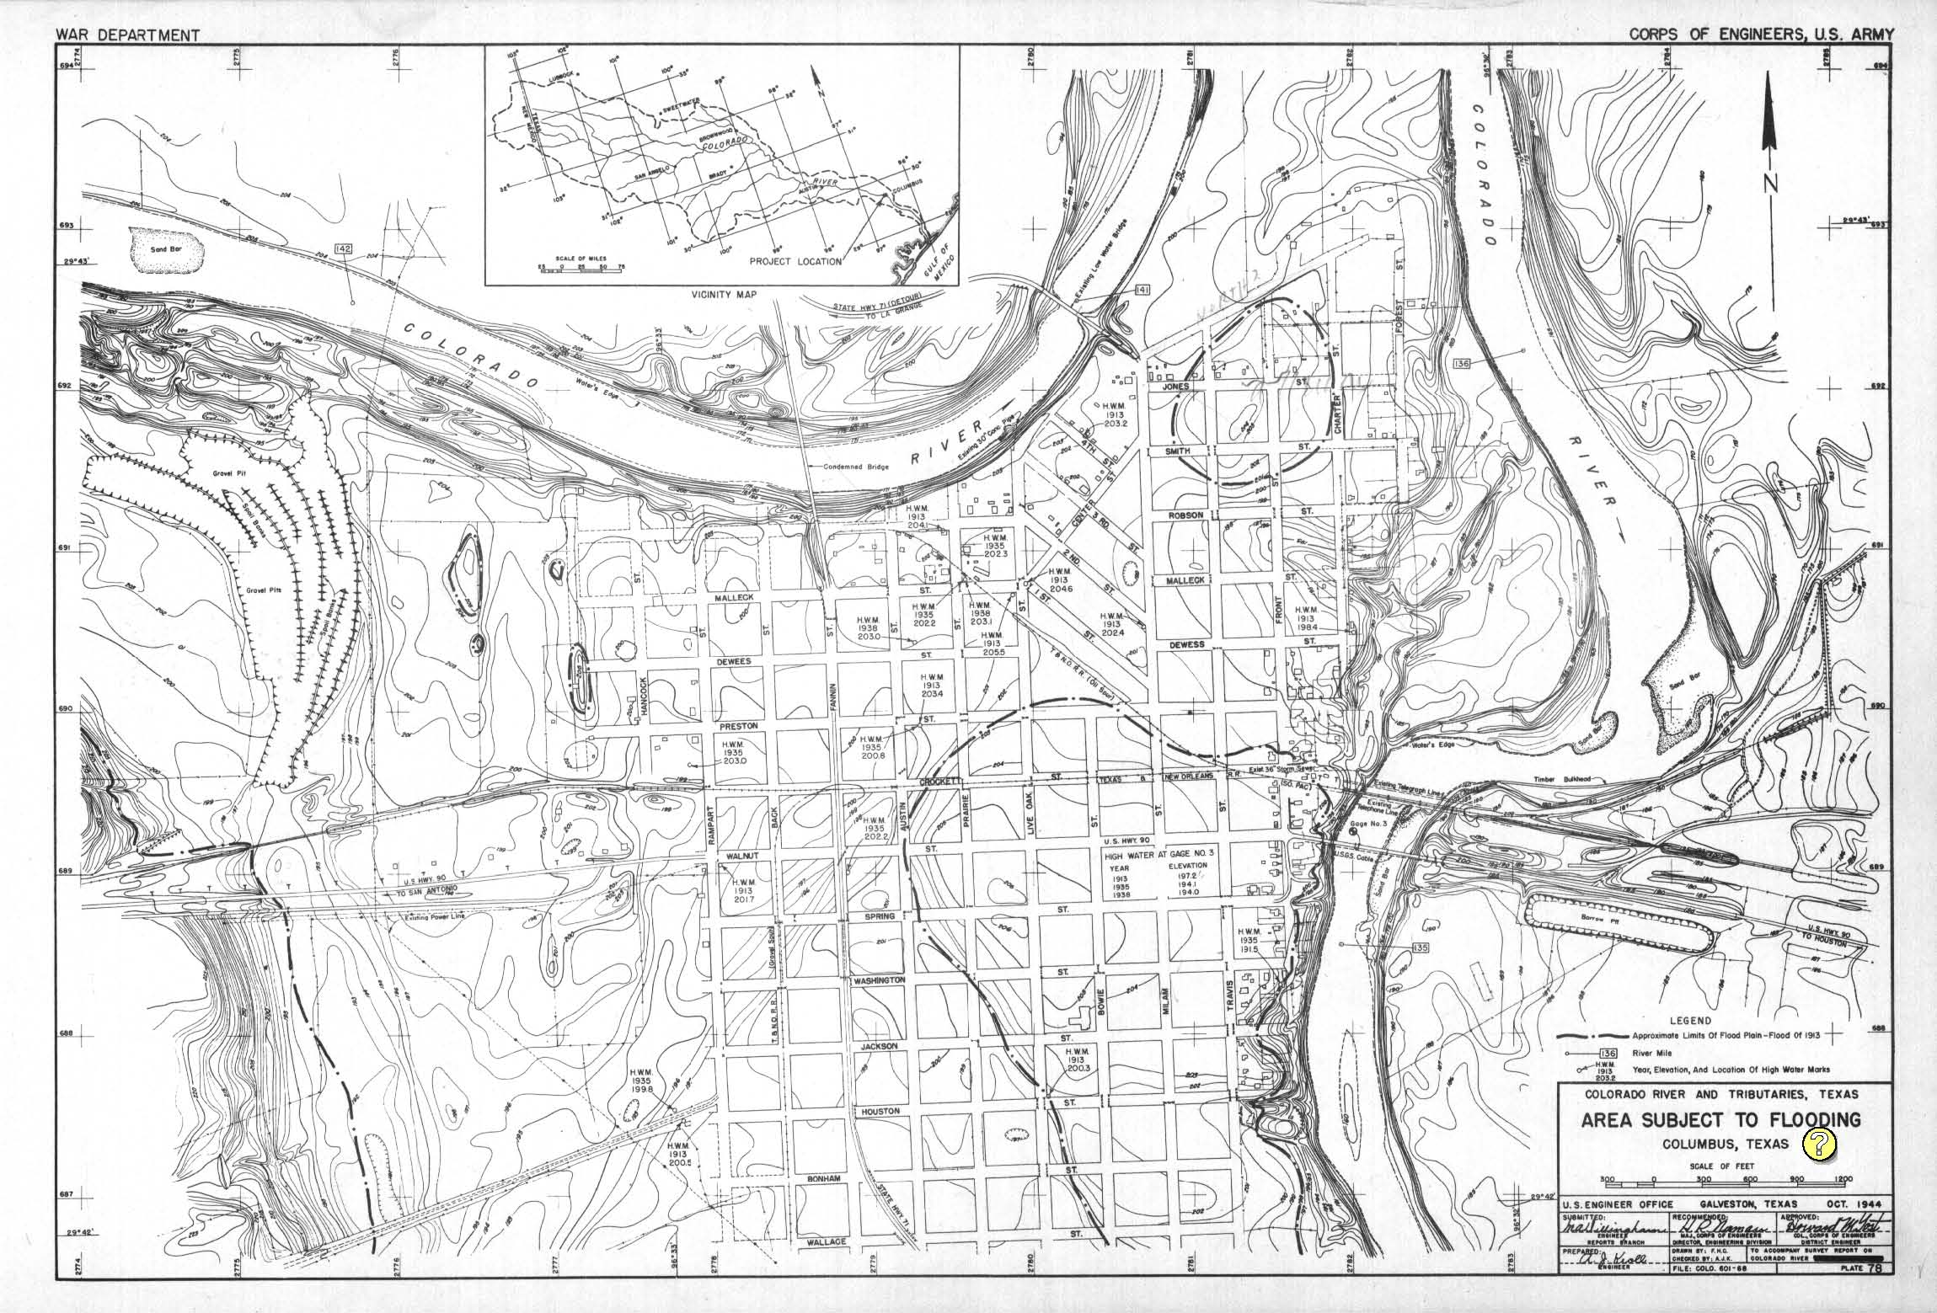
How were the high water marks gathered?
High Water Mark
Notes:
Area Subject to Flooding Maps created by the Corp of Engineers War Department. All of these reports are a tremendous resource. For these maps, I geo-reference the image in GIS and plot the points. One of these plates can have up to 30 or more high water marks.

Slide 25
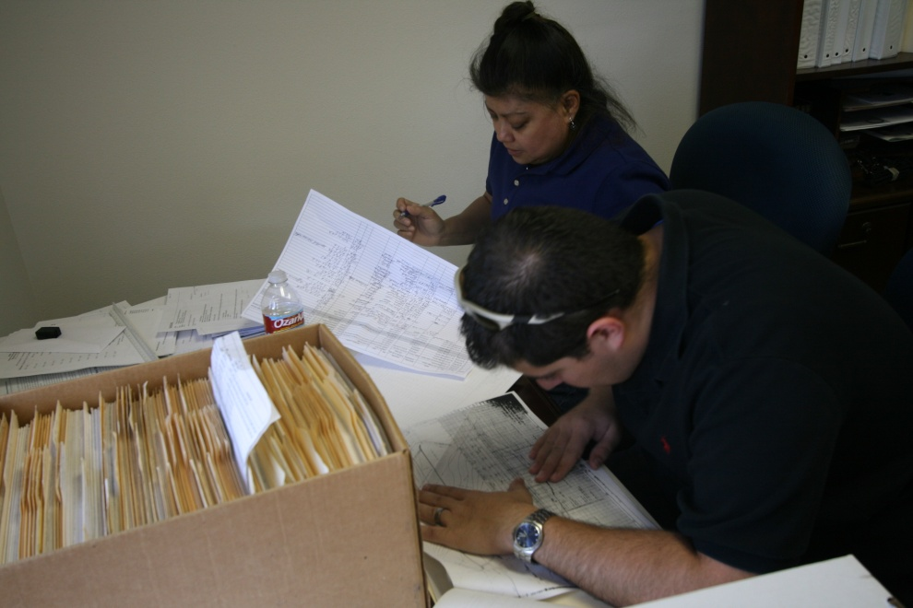
How were the high water marks gathered?
Bridge layout of Leon River Bridge from TxDOT
Notes:
Collecting high water marks from TXDOT bridge layout files.

Slide 26
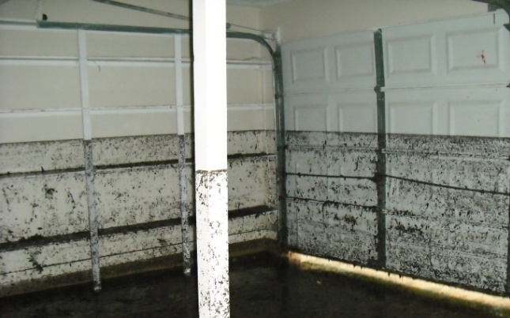
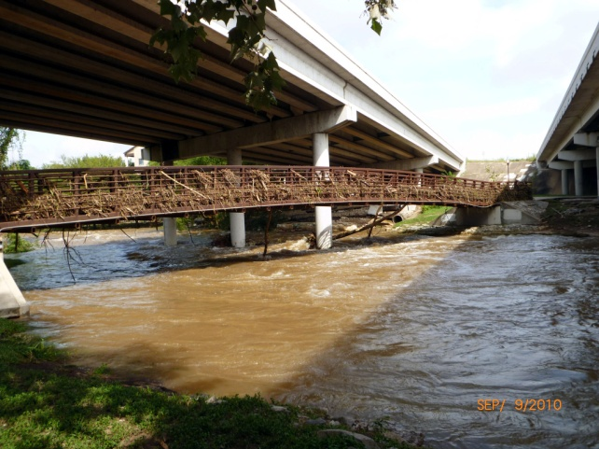
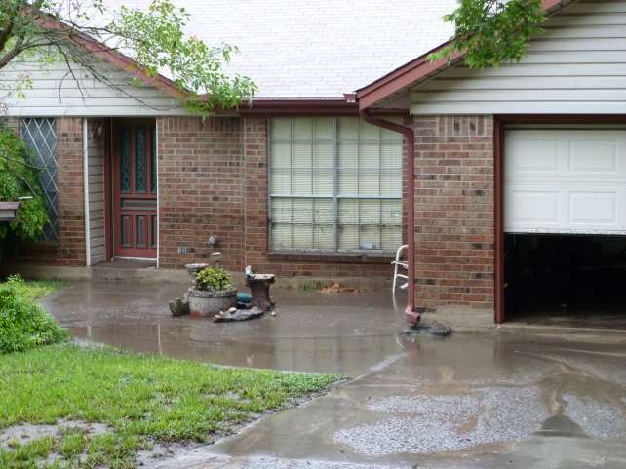
High Water Mark Inventory
Fields collected:
Source of Highwater Mark
Date, Time, Year of Highwater Mark
Road name
County
County FIPS code
Flooding Source
Elevation of Highwater mark
Qualifier for Highwater mark
Comments
Latitude
Longitude
Photos Courtesy:
City of Round Rock
– Sept. 2010

Slide 27
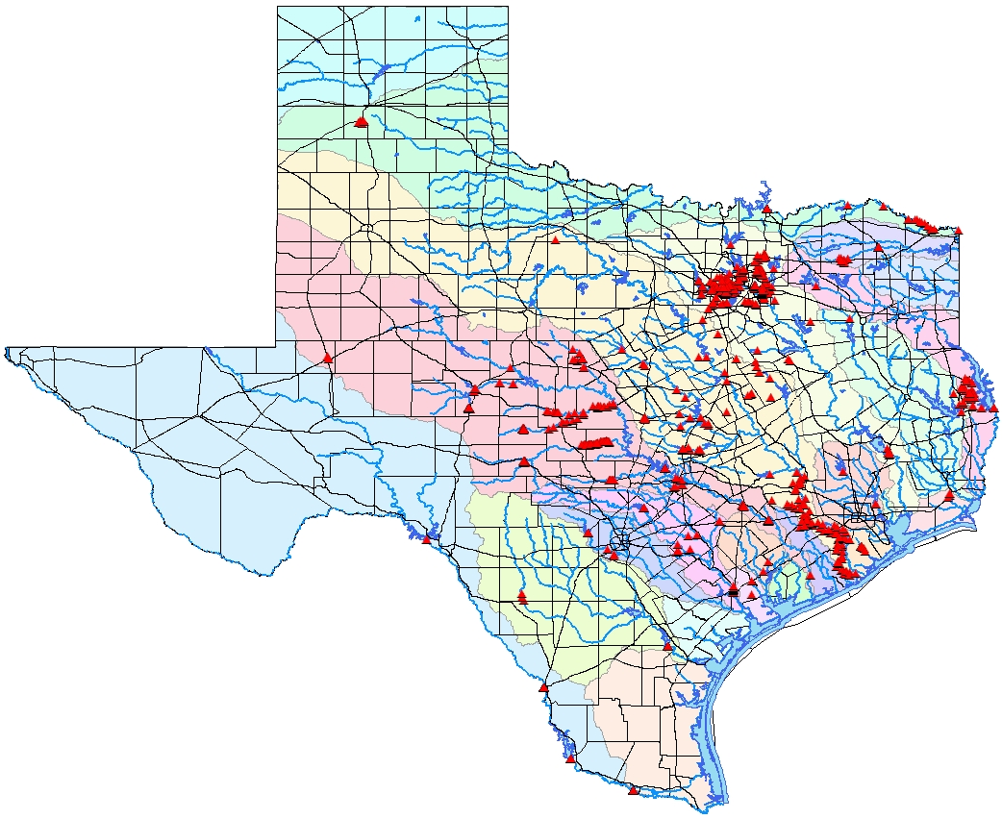
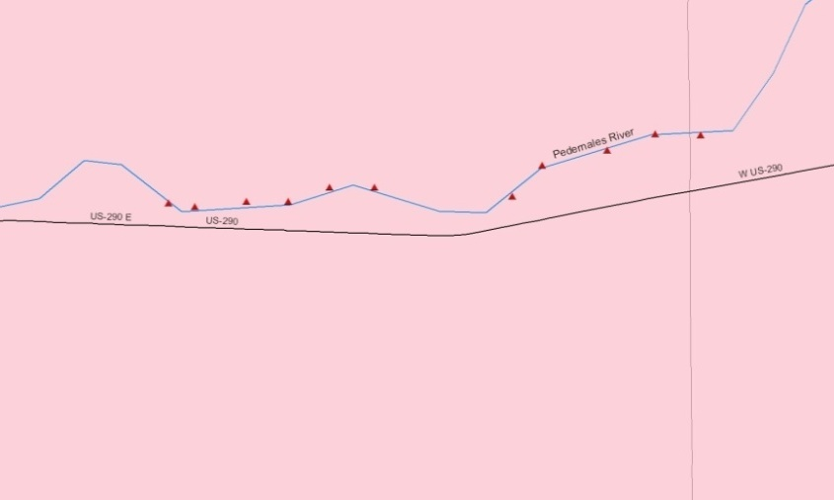
High Water Marks in Texas
Legend
#
*
Highwater_marks
MajHwys
As of : 10-20-2010
Major Rivers
Major Lakes
River Basins
Brazos River Basin
Brazos-Colorado Coastal Basin
Canadian River Basin
Colorado River Basin
Colorado-Lavaca Coastal Basin
Cypress Creek Basin
Guadalupe River Basin
Lavaca River Basin
Lavaca-Guadalupe Coastal Basin
Neches River Basin
Neches-Trinity Coastal Basin
Nueces River Basin
Nueces-Rio Grande Coastal Basin
Red River Basin
Rio Grande River Basin
Pedernales River in Colorado River Basin
Sabine River Basin
San Antonio River Basin
San Antonio-Nueces Coastal Basin
San Jacinto River Basin
San Jacinto-Brazos Coastal Basin
Sulphur River Basin
Trinity River Basin
Trinity-San Jacinto Coastal Basin

Slide 28
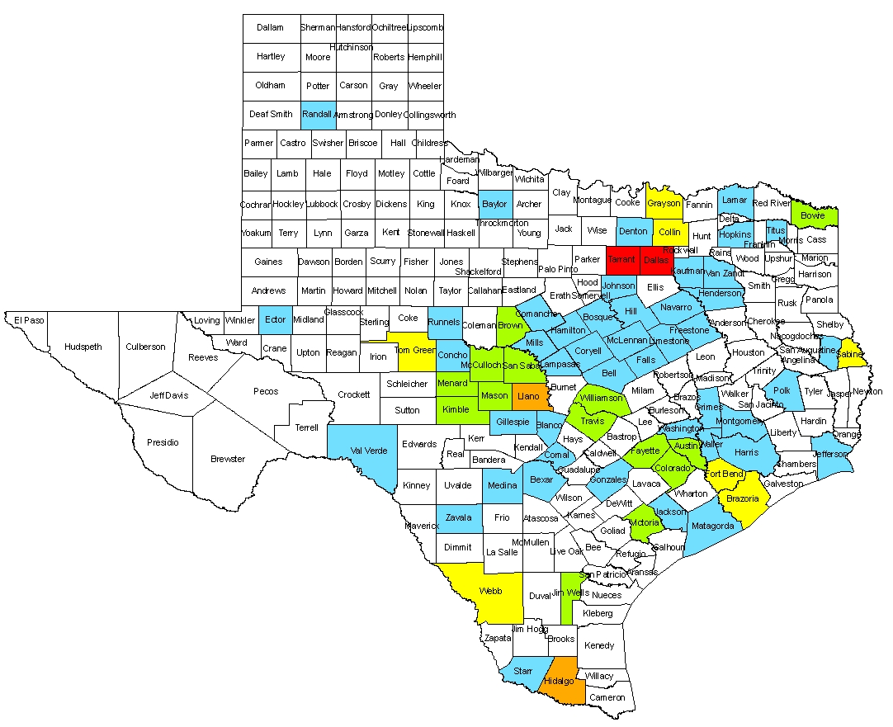
High Water Marks in Texas
101 - 200
51 - 100
26 - 50
11 - 25
1- 10
None Identified
As of : 10-20-2010

Slide 29
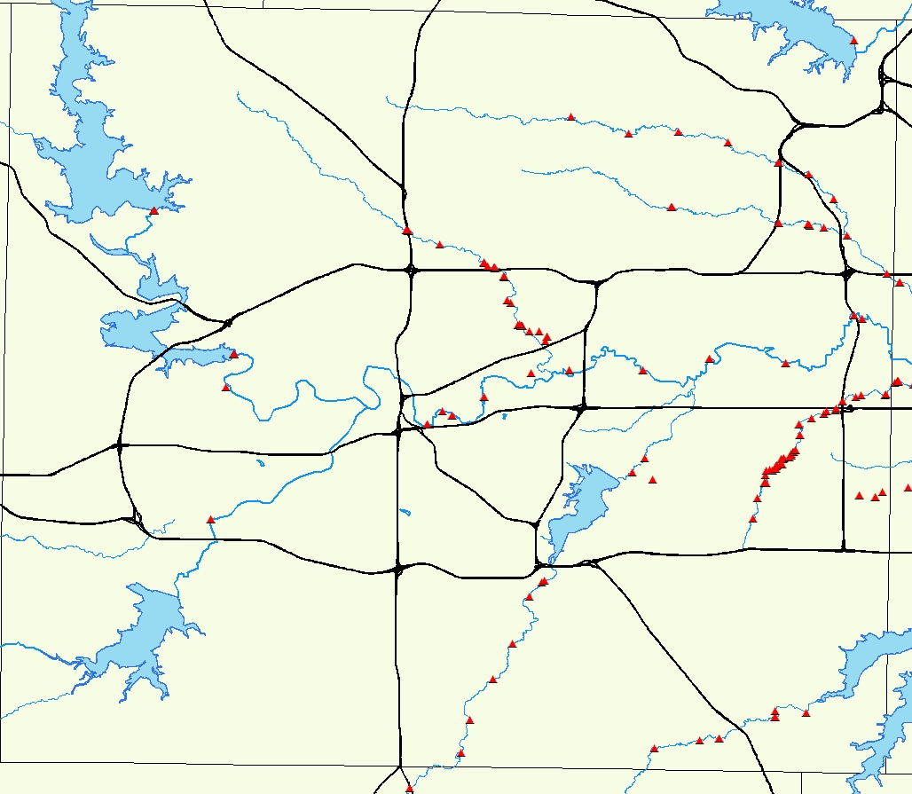
County with the largest inventory of HWM
Tarrant County, 240

Slide 30
High Water Mark Statistics
16 HWM on average per county
71 Counties contain one or more HWM
1400 HWM statewide
1938 is the flood with the most HWM
Trinity River is the watershed with most HWM
Tarrant is the county with the most HWM
Notes:
110 HWM along the Rio Grande
134 HWMs from 1938
Trinity River has 364 HWMs and the Colorado River comes in second with 330
Tarrant County has 170 HWM as you saw from the previous slide.

Slide 31
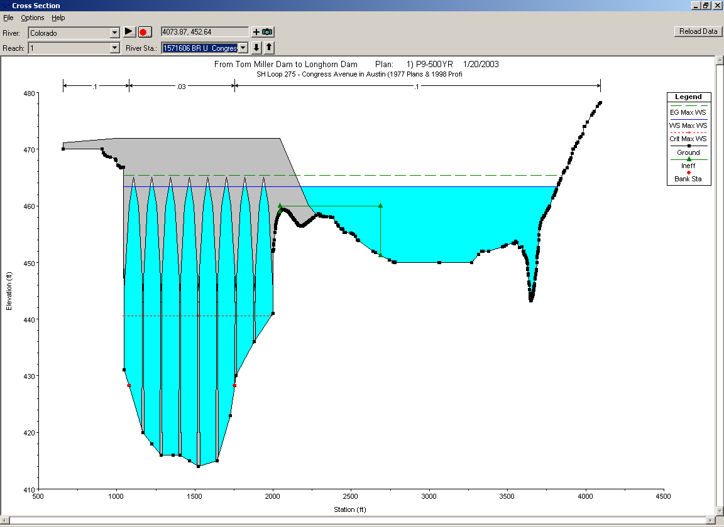
How can HWM’s help in Floodplain Mapping?
Calibration of Hydraulic models
Outreach – Understanding flooding
Research projects
Uses outside floodplain mapping
Recreate Historic Flood Events
FEMA’s Discovery
Notes:
Outreach – NOAA’s HWM signs
Uses outside Floodplain Mapping – Emergency Action Plants
Inundation Mapping – Colorado River
Recreate Historic flood events – as you all will see later today in Jude Kasten’s and Kevin Dobb’s presentation on Reconstructing the Texas Flood of 1938.

Slide 32






Thank you to:

Slide 33
Thank you
Floodplain Mapping Services Main Number 512-463-8337
Texas Natural Resources Information Systems,
a part of the Texas Water Development Board
Melinda Luna, PE, CFM , Team Lead
512-463-9625
Melinda.luna@twdb.state.tx.us
Meggan Georgas, CFM
512-463-1786
Meggan.Georgas@twdb.state.tx.us

