Slide 1
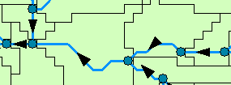
Geospatial Data Layers for Arc Hydro River
Center for Research in Water Resources
University of Texas at Austin
01 Dec 2010
Arc Hydro River Meeting
Clark Siler
Notes:
Originally presented as dissertation proposal defense titled: “Hydrologic Geospatial Data Models: A Network-Catchment Approach”

Slide 2
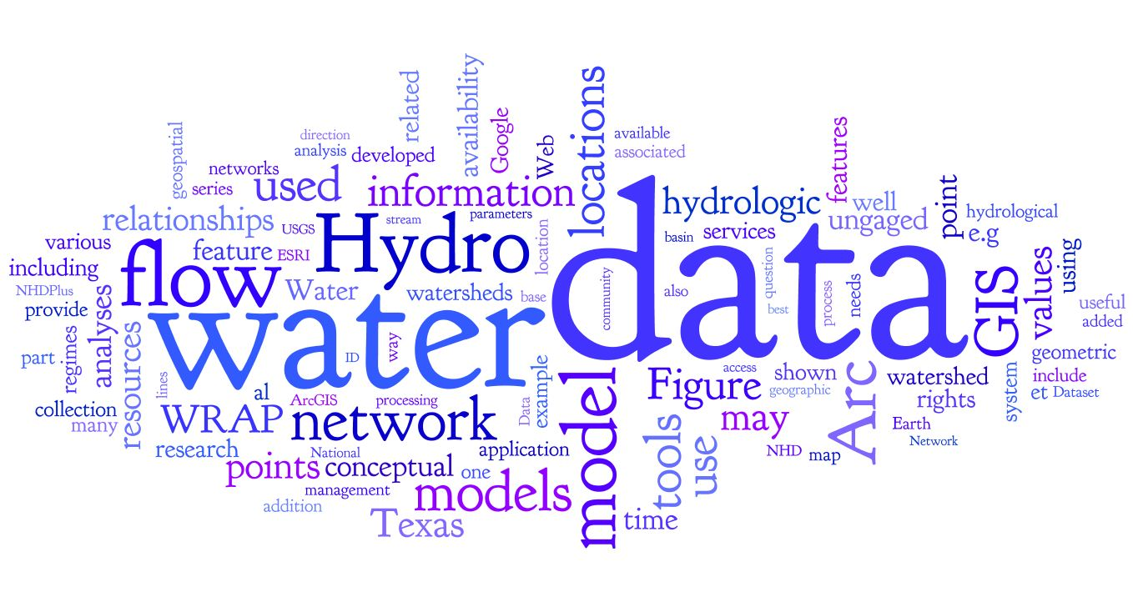
Outline
Review
Vision
Research Questions
  Q1: History
  Q2: Future
  Q3: Network Applications
  Summary
Indicators of Completion

Slide 3
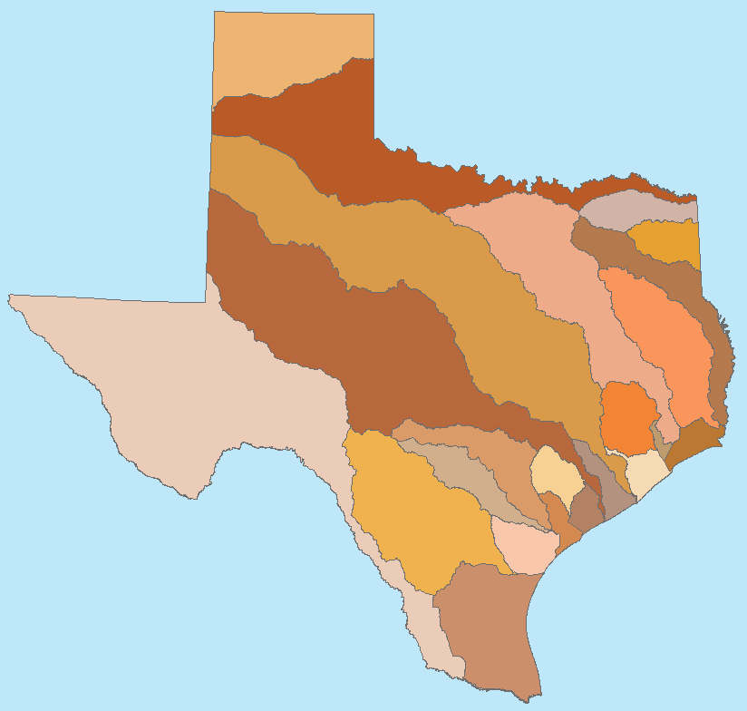
Review – Texas’ Senate Bills
Senate Bill 1 (1997)
  Established Texas’ official WAM
Senate Bill 2 (2001)
  Instream flows
  “…establish and continuously maintain an instream flow data collection and evaluation program….”
Senate Bill 3 (2007)
  Environmental Flows Allocation Process
  How much water do rivers and bays need to stay healthy?
Notes:
http://www.texaswatermatters.org/flows.htm
BBEST - Bay/Basin Expert Science Team
BBASC - Bay/Basin Stakeholder Committee
EFAG - Environmental Flows Advisory Group
SAC -Science Advisory Committee

Slide 4
Review – WRAP & WAM
WRAP – Water Rights Analysis Package
  Suite of programs to digitally manage water rights in Texas
  Developed by Dr. Ralph Wurbs of the Texas Water Resources Institute at Texas A&M
  23 basins, 10,000 locations, 50 years
Texas’ official Water Availability Model
  Response to drought of 1996 (SB1)
  Includes WRAP model & input datasets
Notes:
Availability
Public domain software package (WRAP)
Input data available from TCEQ
WRAP models have been built for all
23 river and coastal basins in Texas
Applications
Simulates surface water withdrawals at about 10,000 issued water permit locations in Texas
Uses monthly time steps and ~50 year planning period
Used in analyzing new water rights or amending existing rights

Slide 5


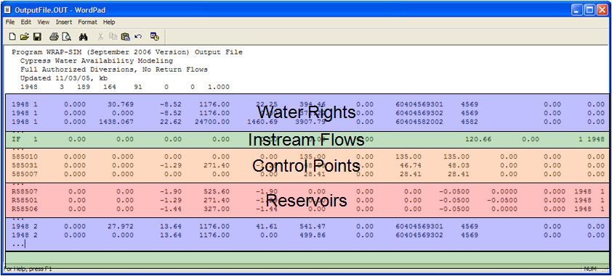
Review – WRAP
WRAP as a Hydrologic Geospatial Model
WRAP
Input Files
Model
Output
Sensitive to Change
Notes:
Output from WRAP is sensitive to changes in that it is an ASCII file where even an additional character in the output structure changes how data can be extracted.

Slide 6
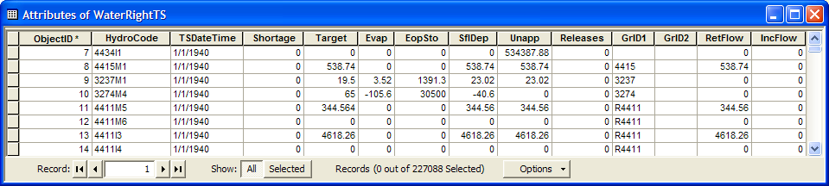
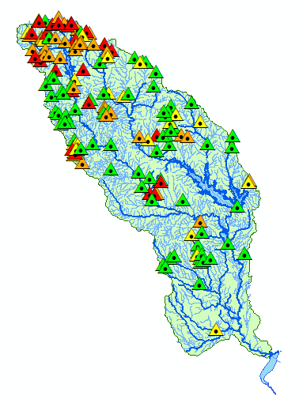
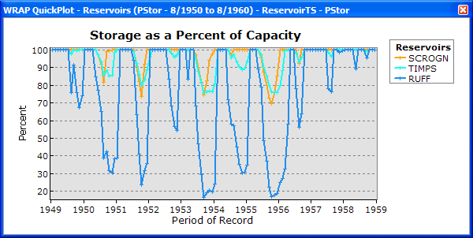
Review – WRAP Display
Each space-time point is unique
and is associated with a set of variables
Space
Time
A set of variables…
Graphs
Time
Maps
Space
Hard-coded
Notes:
The WRAP Display Tool was specifically written to “sit on top” of the WRAP output. The tool is hard-coded to extract the data from the ASCII file and place it in a collection of geodatabase tables (one each for water rights, instream flows, control points, and reservoirs). The result is a tool that works, but it is hard-coded so that if there is even a slight change to the output structure, the tool would need to be re-written to accommodate the change.

Slide 7
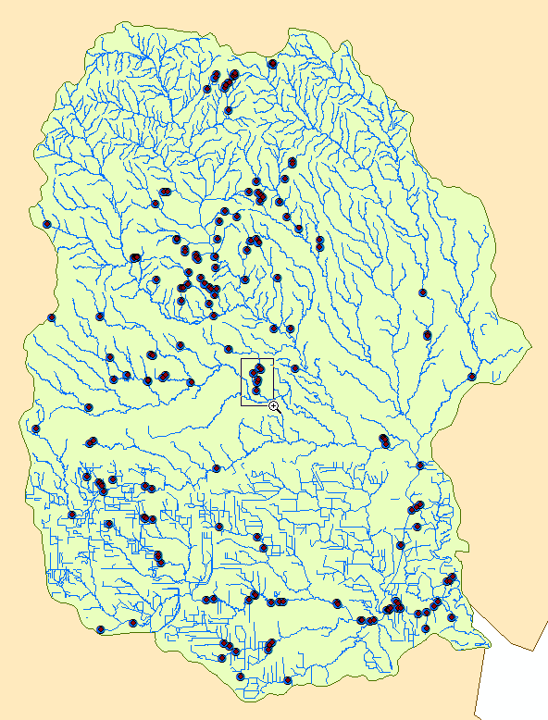
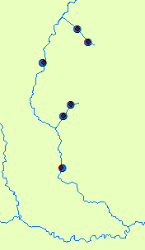
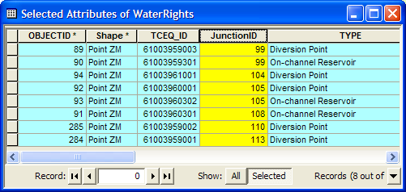
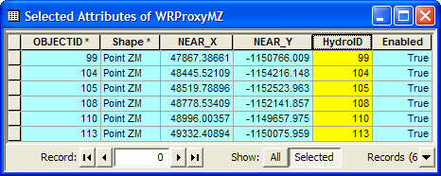
Review – WRAP Network Tools
Spatially-aware tools on a network
Layers related, but network
was modified manually
Notes:
The WRAP Network Tools use official databases and GIS networks of the TCEQ to aid in spatially-aware analyses. This tool enabled the creation of notice lists via a visually-based GIS tool, instead of needing to look at and make sense of a collection of tables. The problem was that the resulting GIS layers were related to both databases of water right holders’ information and a geometric network (in GIS) but that setting up an analysis environment (i.e. getting the data ready) required the geometric network to be “broken” at locations where water rights or control points were represented on the stream. The result was a duplicate network that looked the same, but had more line segments (resulting in segments being broken at points). This duplication requires an organization to maintain and update multiple networks—one for these analyses, and one for other analyses.

Slide 8


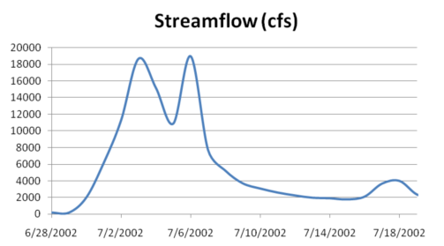




Review – Flow Regimes
IHA
Data and analyses
singly-contained for
easy sharing
MBFIT
Not connected to GIS
Notes:
This work was able to successfully combine the wonders of web data extraction (e.g. daily flow values from the USGS) with multiple models, all housed within a single Excel workbook. The user enters the gage number and time period of interest; the tool gathers the data via CUAHSI web services; the user can then inspect the data and manipulate input data for two models (IHA and MBFIT), run the models* within Excel (* the tool runs images of the models using VBA), view the models’ output, and select which model to use for further analysis with HEFR; HEFR is run via an Excel Add-In, which uses the user-selected data and records what input parameters were used. The overall result of this workbook is that instead of needing to make sense of data and choices made, as evidenced by a wide variety of data, tools, and note-keeping, this workbook retains the data and all decisions that were made and input that was chosen, resulting in a fully-transferrable and replacatable start-to-finish view of analyses.
The main drawback was a lack of connectivity to GIS.
NOTE:
-IHA is the Nature Conservancy’s model, Indicators of Hydrologic Alteration <http://www.nature.org/initiatives/freshwater/conservationtools/art17004.html>
-MBFIT is a modified version of the US Bureau of Reclamations BFI Tool (created by Joe Trungale); it stands for Modified Base Flow Index with Threshold.

Slide 9
Review – Barriers & Goal
Three Barriers Encountered
  Adaptable geospatial model
    WRAP Display
  Underlying network for analyses
    WRAP Network Tools
  Web inclusion and sharing of analyses
    Flow Regimes Work
Goal: Build a simpler, more sustainable system

Slide 10
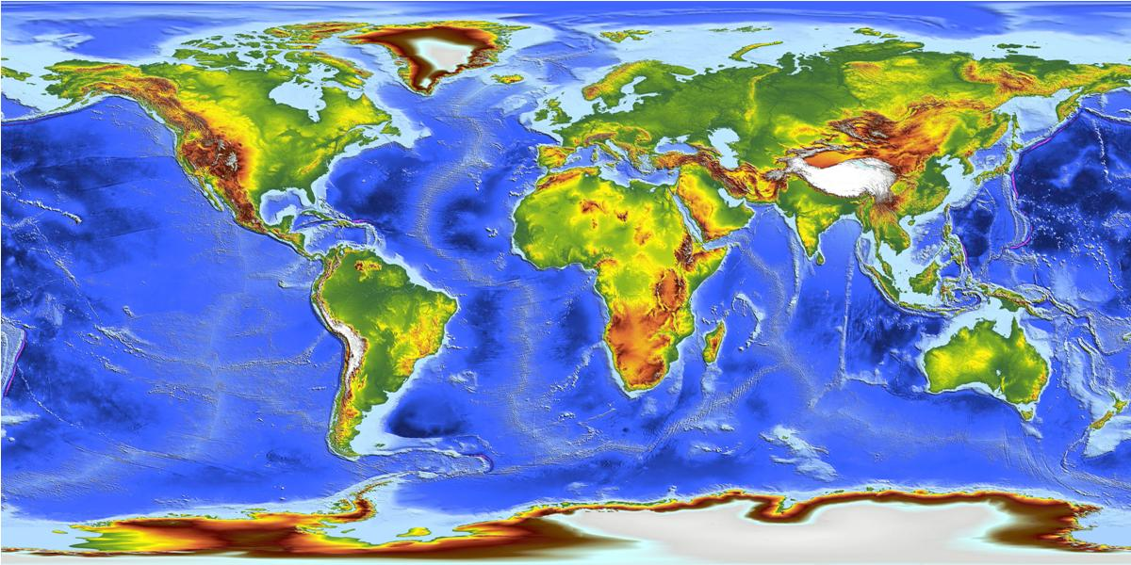
Review – DEMs & Catchments
Much of hydrologic analysis stems from raster data: DEMs
Cell-based systems have been supplemented by vector data: Points, Lines, Polygons
The fundamental unit in hydro analyses can be seen as the catchment, a vector unit
Catchments piece together much like traditional cell-based units
Fundamental flaw in information model: Loops
Notes:
DEM Image Source: http://earth.eo.esa.int/cgi-bin/satimgsql.pl?show_url=753&startframe=0

Slide 11
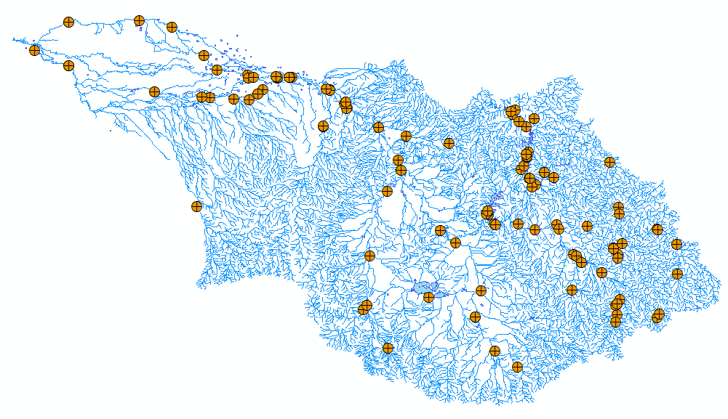
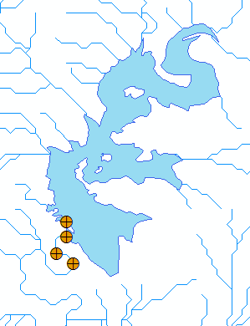

Vision – Display Layer
Display Layer – Hydro Base Map Example
The Hydrography or “blue line” component of a topographic map
Arc Hydro Feature Classes
Notes:
DEM Image Source: http://earth.eo.esa.int/cgi-bin/satimgsql.pl?show_url=753&startframe=0

Slide 12
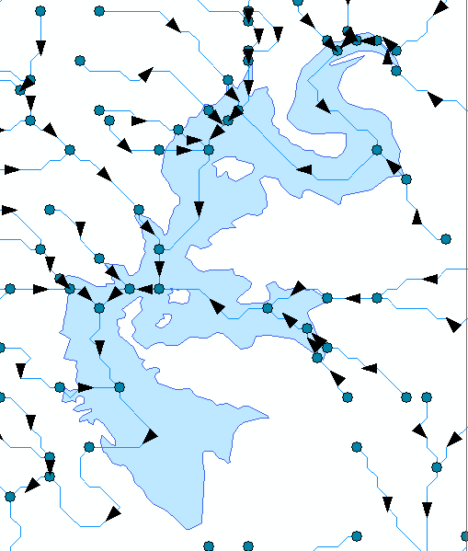
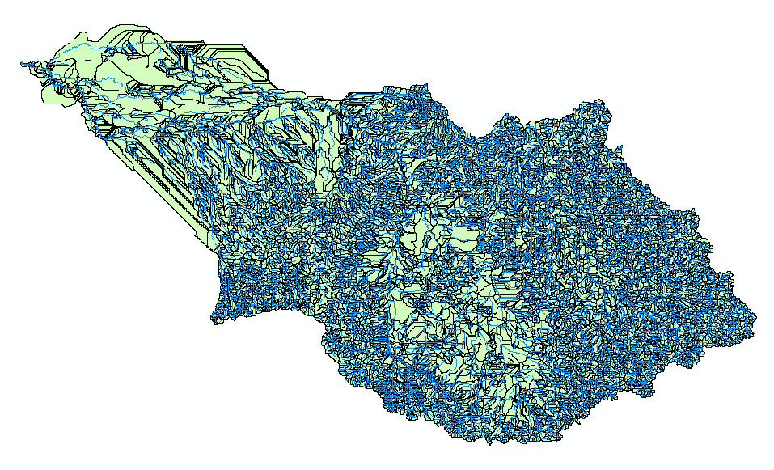

Vision – Analysis Layer
Analysis Layer – Hydro Base Map Example
A geometric network with a
local catchment for each network edge
Arc Hydro Feature Classes
Notes:
DEM Image Source: http://earth.eo.esa.int/cgi-bin/satimgsql.pl?show_url=753&startframe=0

Slide 13
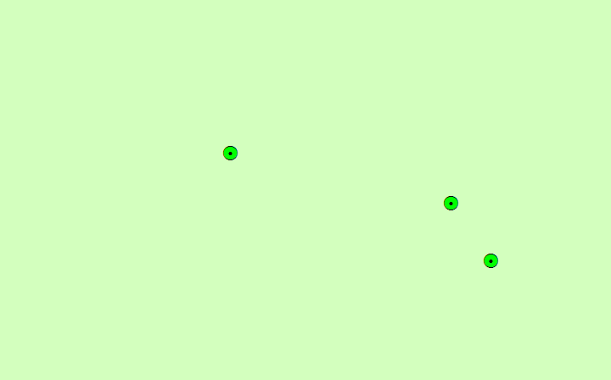
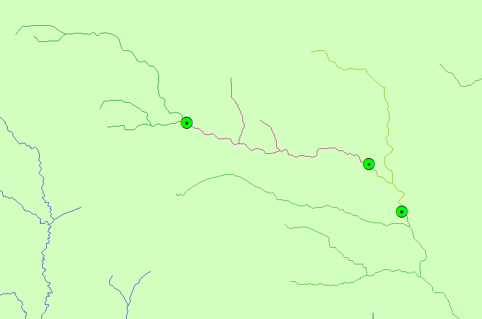
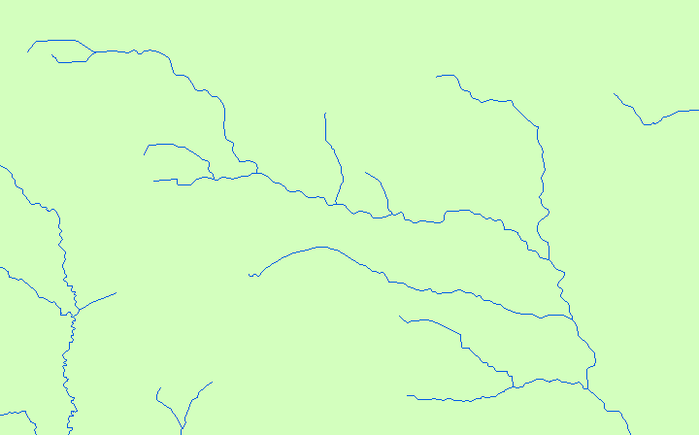
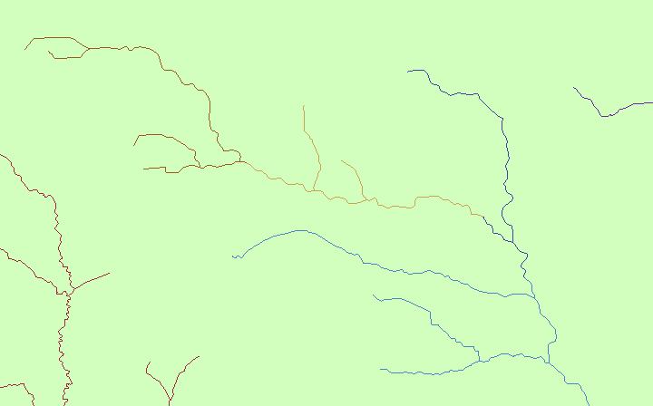
Vision
We want a general analysis layer: TCEQ Example
WAM Event Layer
Network
Underlying Network, Event Layers
TMDL Event Layer

Slide 14
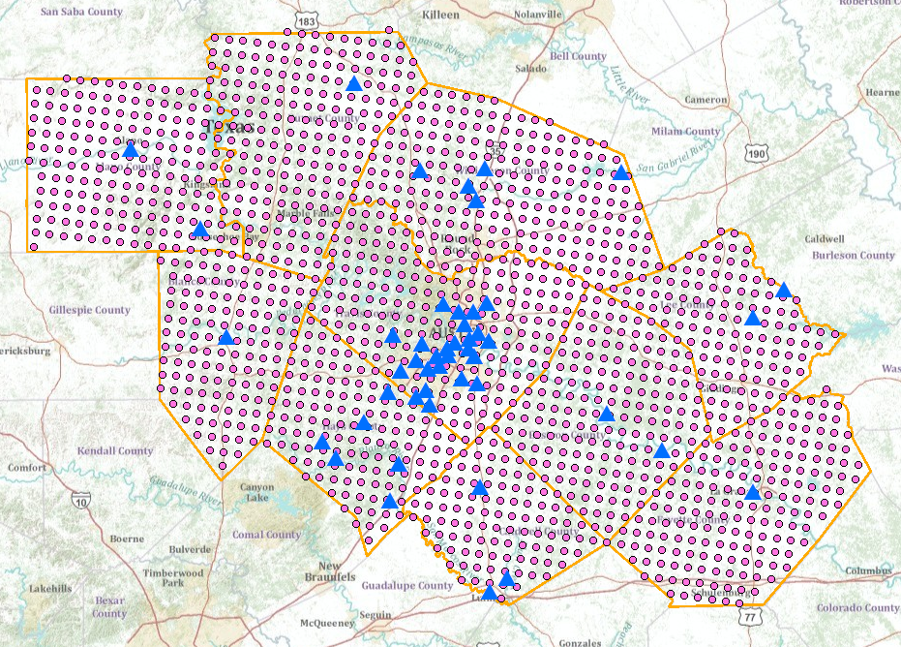
Review – Vision
Observation Data is Becoming Available Online
Mapping Services Can Connect Space and Time
  Example: Nexrad Rainfall and USGS Gages
  http://129.116.104.176/ArcGIS/rest/services/capcogaustin/capcog/MapServer
Can this be done
for anywhere in the
world?

Slide 15
Research Questions
Q1: What has been learned from the various hydrologic geospatial data models in the past ten years and how can this knowledge best be applied in future hydrologic applications?
Q2: What geospatial model can best handle the predicted future of hydrologic data?
Q3:How can estimated flow values and flow regimes be represented on geometric networks?

Slide 16
Research Questions
Q1: What has been learned from the various hydrologic geospatial data models in the past ten years and how can this knowledge best be applied in future hydrologic applications?
Q2: What geospatial model can best handle the predicted future of hydrologic data?
Q3:How can estimated flow values and flow regimes be represented on geometric networks?
Notes:
Data sources and models are many, but a single, universally-applicable model does not exist. In what ways can knowledge of status quo models affect the future?

Slide 17
Q1: History
Hydrologic Geospatial Data Models Review
  Arc Hydro
  WRAP Hydro
  NED and NHD
  CUAHSI
  Australian Geofabric
  Base Maps
  USGS Water Census

Slide 18
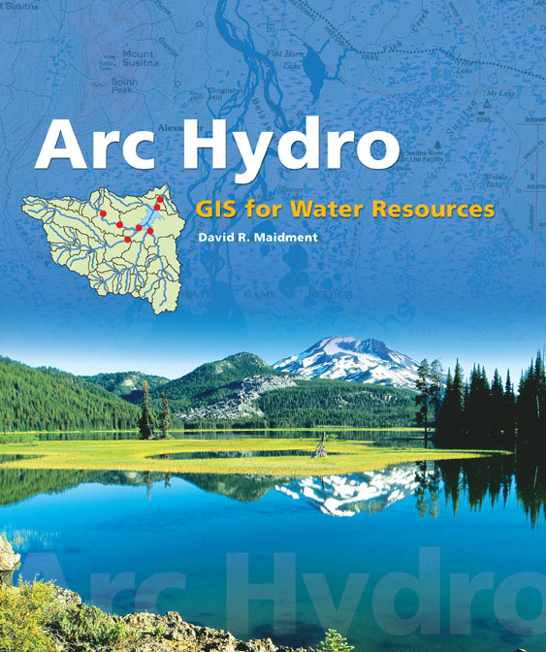


Geospatial Model Review: Arc Hydro
1.
Geospatial and temporal ArcGIS data model
Employs geodatabase schema
Over 100 GIS tools
Framework for hydrologic simulation models
Notes:
Geospatial and temporal data model for water applications
Employs geodatabase schema (connects geospatial and temporal data to support hydrologic analyses)
Used to store both geospatial data as well as time series data (through the use of specialized Arc Hydro geodatabases)
Related GIS tools are available for ArcGIS use

Slide 19
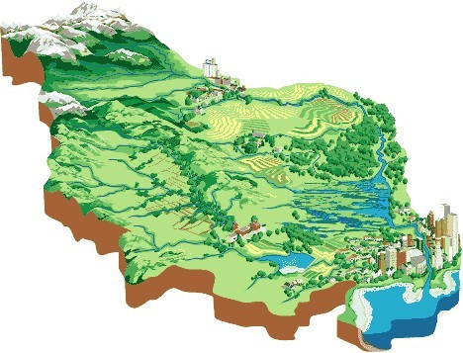
Geospatial Model Review: WRAP Hydro
2.
Arc Hydro for WRAP
Data model and tools for Texas’ WAM
Notes:
Part of response to severe drought in Texas, Senate Bill 1 (1997) established an official state water availability model: WRAP
A data model that includes tools and processes for producing and collecting watershed parameters and water rights connectivity data as geospatial input for Texas’ official water availability model
Think: applied Arc Hydro
2003
Image source: http://www4.agr.gc.ca/resources/prod/img/pfra/water/watersheds.jpg

Slide 20
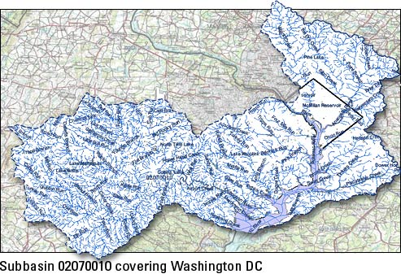
Geospatial Model Review: NED & NHD (USGS & EPA)
3.
National Elevation Dataset (USGS) – seamless raster elevation data (30 m)
National Hydrography Dataset – feature-based representations of common surface water features
NHDPlus – combines benefits of NED, NHD, WBD, and NLCD (30 m); includes geometric network
NHD 24K – higher-resolution
Notes:
Models
SPARROW (SPAtially Referenced Regressions On Watershed Attributes), StreamStats, and WATERS (Watershed Assessment, Tracking & Environmental ResultS) Web Services
National Elevation Dataset (USGS) – seamless raster elevation data (30 m)
National Hydrography Dataset – feature-based representations of common surface water features
NHDPlus – combines benefits of NED, NHD, WBD, and NLCD (30 m); includes geometric network
NHD 24K – higher-resolution

Slide 21
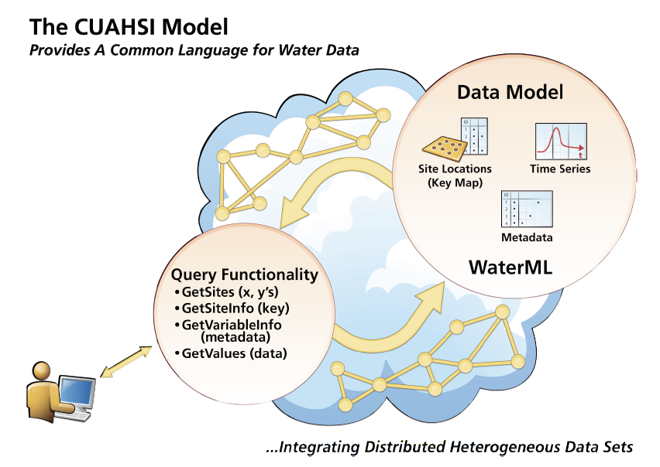

Geospatial Model Review: CUAHSI
4.
Notes:
Consortium of Universities for the Advancement of Hydrologic Science, Inc.
Developing infrastructure and services to further hydrologic science and education:
WaterOneFlow – Web service retrieves water data based on user-supplied parameters
WaterML – Based on ODM and XML, WaterML defines all that is used and needful for the WaterOneFlow services to function.

Slide 22

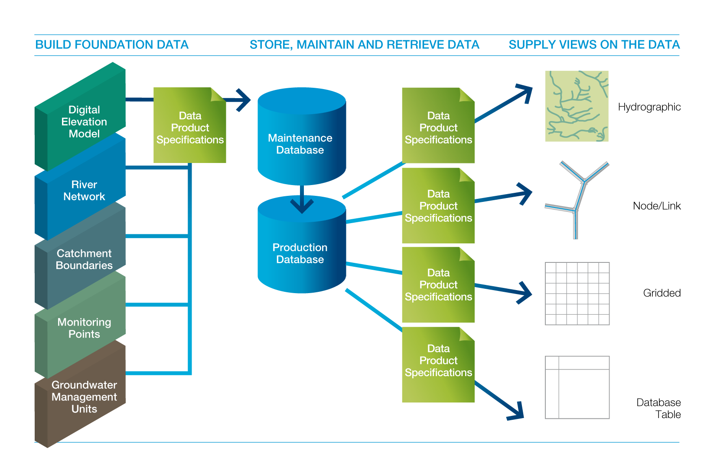
Geospatial Model Review: Australian Geofabric
5.
AWRIS
Notes:
Australian Bureau of Meteorology’s system to house all of the water information in the country (water availability, water use, and water quality)
This data is stored in the Australian Water Resources Information System (AWRIS), spatially enabled by the geospatial fabric (Geofabric)—GIS features linking key features
Goal: reveal the overall water balance—how water is stored, transported, and used throughout the country

Slide 23

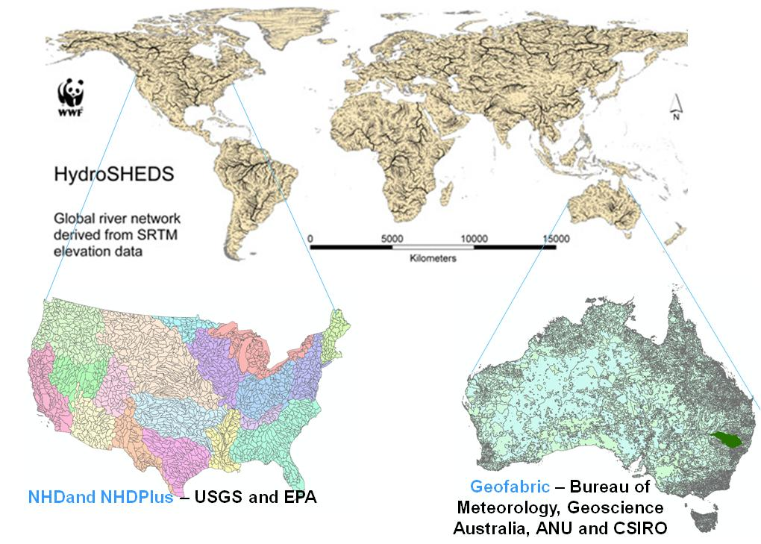

Geospatial Model Review: Base Maps
6.
Hydro Base Map
ArcGIS Online
Notes:
Images and information stitched together in background
ESRI provides a collection of base maps online (ArcGIS Online) that are interactable in GIS
Hydro Base Maps are next the step, showing all things hydro in a map’s background (acting as a view into the water landscape)

Slide 24
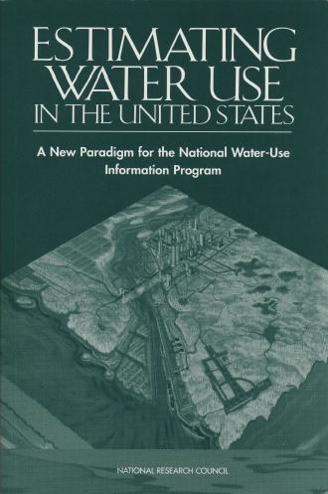
Geospatial Model Review: USGS Water Census
7.
Seamless Water Data
  Spans jurisdictional and political boundaries
  Water availability and water use trend data
Notes:
Similar to Australia’s Geofabric, minus the information system aspect
Provide seamless water data spanning jurisdictional and political boundaries, providing for more unified analyses
Water availability and water use trend data over recent decades
Focus on the nation’s 21 water-resources regions

Slide 25
Research Questions
Q1: What has been learned from the various hydrologic geospatial data models in the past ten years and how can this knowledge best be applied in future hydrologic applications?
Q2: What geospatial model can best handle the predicted future of hydrologic data?
Q3:How can estimated flow values and flow regimes be represented on geometric networks?
Notes:
Hydrologic applications have traditionally been machine-based (they exist as part of a GIS application or tool). With the movement toward online resources (with similar functions and non-local storage) the network construction and maintenance processes may need to be reevaluated to determine how best to incorporate advances in Web services.

Slide 26
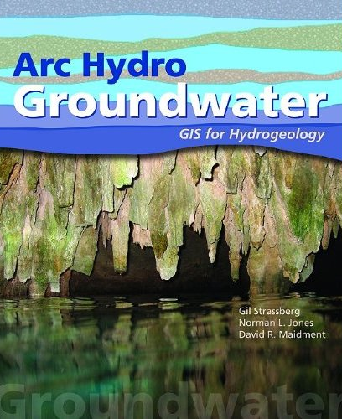

Q2: Future
Watersheds
Groundwater
Future…
Two Global Models
Notes:
watersheds and groundwater (two global models)

Slide 27
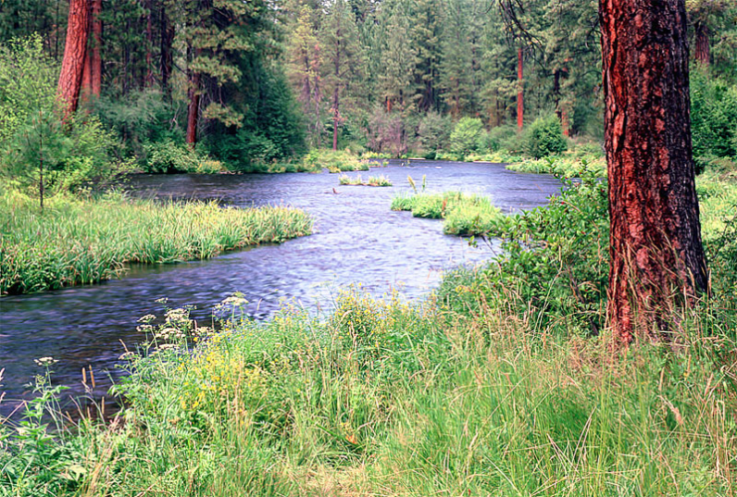
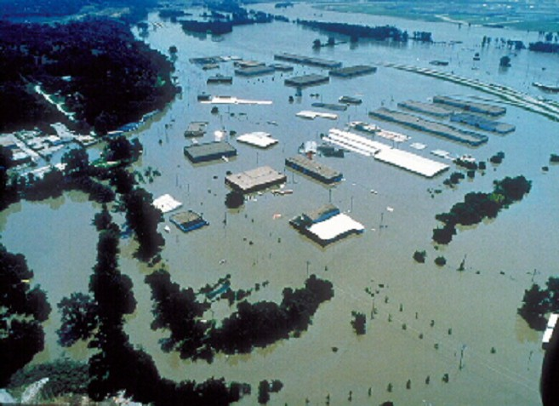
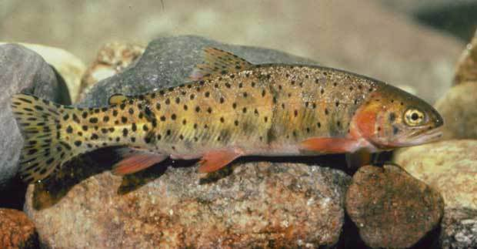
Q2: Arc Hydro River
GIS for River Modeling and Morphology
River Network
Channel Shape
Geography
Aquatic Biology
Flooding
Applications
Notes:
My research will provide an intellectual backbone or framework for the River Network aspect of Arc Hydro River.

Slide 28
Research Questions
Q1: What has been learned from the various hydrologic geospatial data models in the past ten years and how can this knowledge best be applied in future hydrologic applications?
Q2: What geospatial model can best handle the predicted future of hydrologic data?
Q3:How can estimated flow values and flow regimes be represented on geometric networks?
Notes:
Estimating flow at ungaged locations is as old as hydrology itself. The “information revolution” lends to bridging the gap between established methods and new data access by linking estimations—both values (flows) and information products (flow regimes) to networks.
The advancements provided by a new hydrologic geospatial model for the future provide framework for storing estimated values and information products on a network

Slide 29
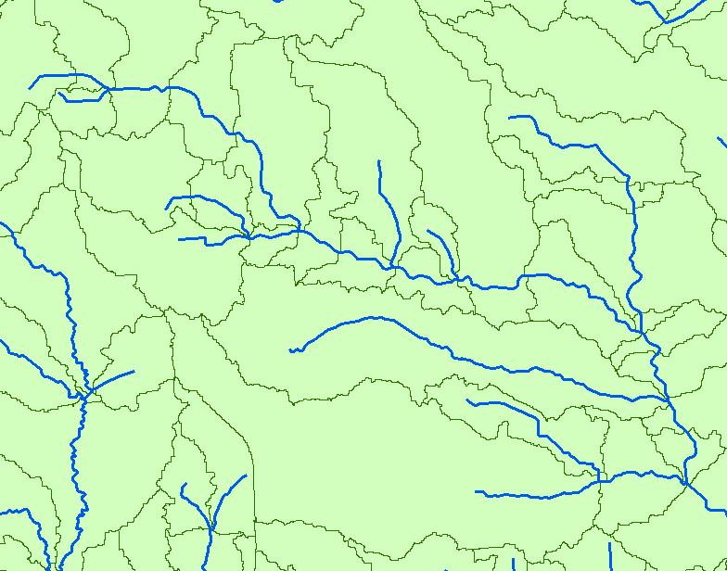
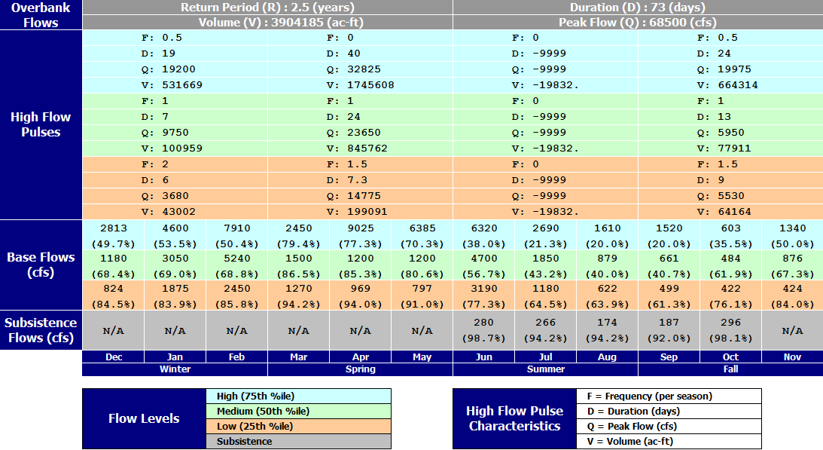
Q3: Network Applications
Notes:
The vision is to incorporate networks in the analyses of both flow data and information products (such as flow regimes). Can these both be represented on a network? Can the value provided by the network be included in analyses (e.g. the tracking of flow values over a network, as opposed to looking at flow values at discrete points along a network)?

Slide 30
Research Questions
Q1: What has been learned from the various hydrologic geospatial data models in the past ten years and how can this knowledge best be applied in future hydrologic applications?
Q2: What geospatial model can best handle the predicted future of hydrologic data?
Q3:How can estimated flow values and flow regimes be represented on geometric networks?

Slide 31
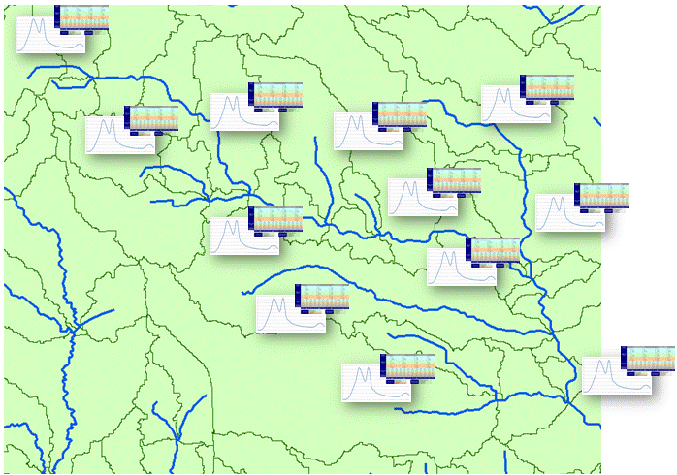
Summary
We need a simpler, more sustainable hydrologic conceptual model
  Allow analysis layer to “live” under display layers
  Synthesize with wealth of online observations data
  Intellectual backbone of Arc Hydro River
Model should accommodate time series and information products for individual catchments in a network

Slide 32
Indicators of Completion
“How can we tell when it’s done?”
  When a time series exists on a network that represents flow values and/or flow regimes, being based on a geospatial model that incorporates best principles and practices from the past.

