Slide 1
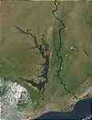
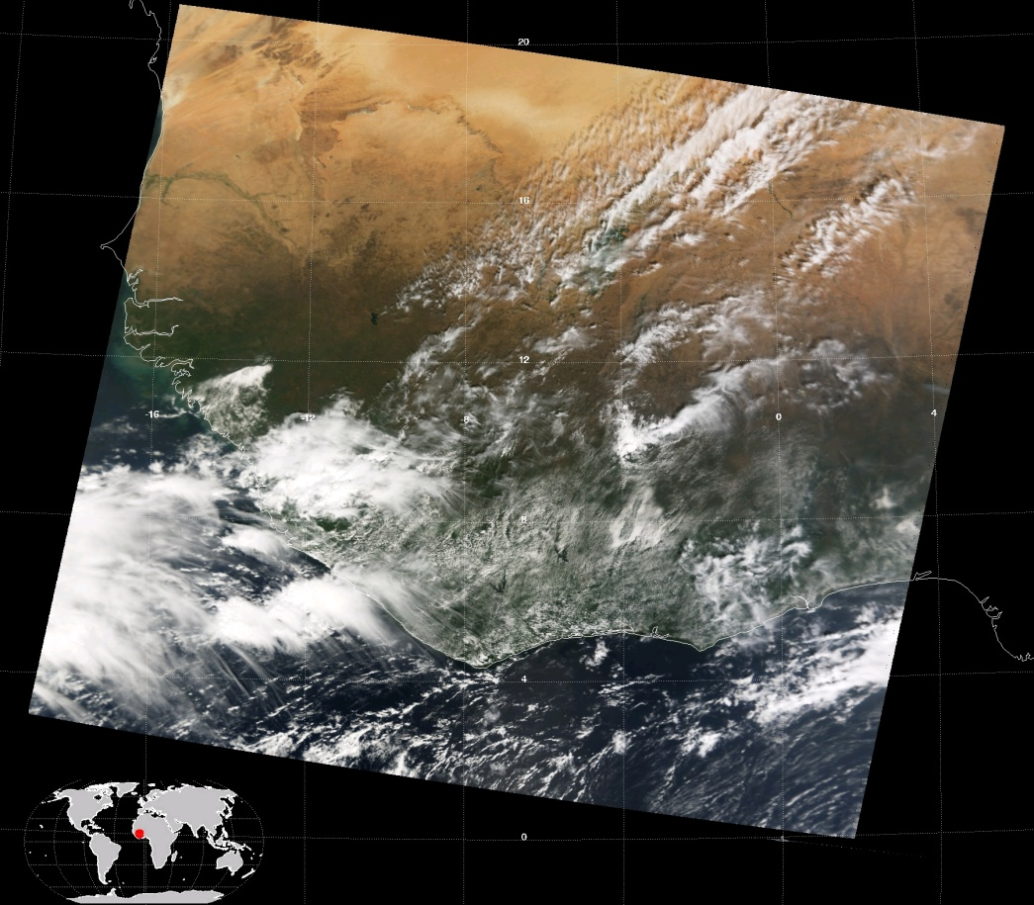
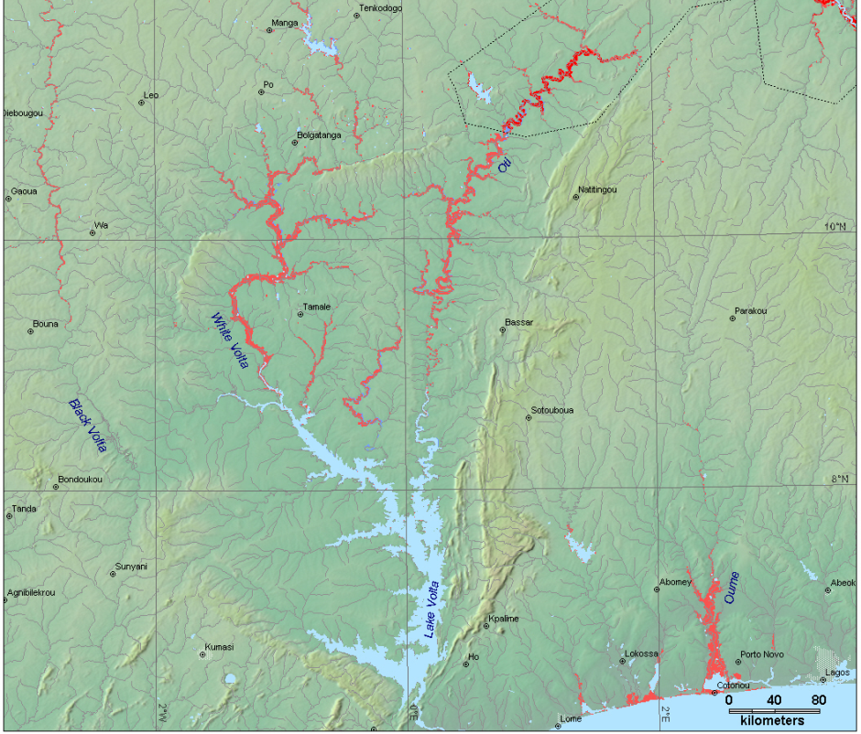
Ghana Precipitation Patterns
http://www.dartmouth.edu/~floods/2007159.html
http://modis-atmos.gsfc.nasa.gov/IMAGES/index.html
Katherine Alfredo

Slide 2
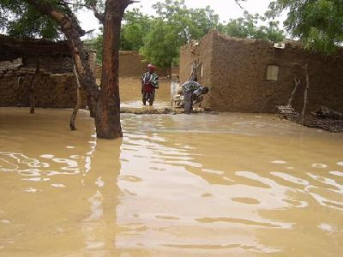
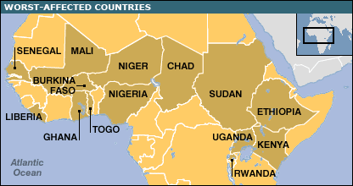
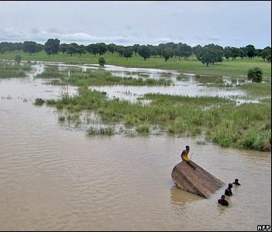
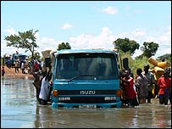
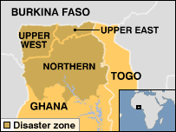
Northern Ghana has only one rainy season:
  April through October
Farming communities
Disasters: Both Floods and Drought
  Floods: 1999 and 2007
  Droughts: 1982-1983, 2004
Aide Relief rarely reaches Northern regions of Ghana
Floods exacerbated by Diebougou Dam in Burkina Faso
“Some villages and communities have now been totally wiped off the map of Ghana” George Azi Amoo,Ghana's national disaster management co-ordinator. BBC world news Sept2007
http://news.bbc.co.uk
Overview
Notes:
Rainy Season: April-Oct
Farming communities in North: Depend on consistent rain patterns
Floods: 1999 and 2007
Drought 1982-1983, 2004
Diebougou Dam in Burkina Faso: Releases water and floods north…occurred in both 1999 and 2007

Slide 3
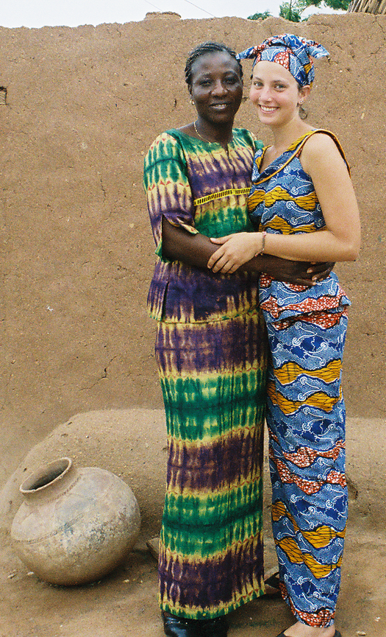
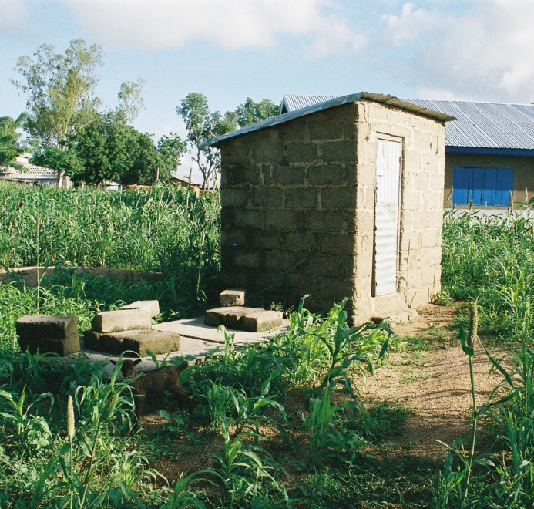
Stayed in Bongo Ghana the summer of 2005
Interested in how GIS could help manage water along the Volta River
My Graduate Research based on water quality issues in Northern Ghana
My Personal Interest
Notes:
I stayed in Bongo, Ghana in 2005 for almost 3 months---learned about fluoride contamination problem…current graduate work
Interested in how GIS could help this region both with water quality (another project) and for this project, if it could help prevent the flooding of the northern region. Weather mapping and topography to help farmers and the Volta River Basin that spans at least Burkina Faso, Ghana and Togo, to better manage water daily and especially in times of flooding and drought.

Slide 4
Streams and Political Boundaries:
Bongo
http://biogeo.berkeley.edu/bgm/gdata.php
http://iscm.org
Data Search
Notes:
Finding data is HARD!
The political boundaries I was able to download from a Berkeley site
Bongo borders Burkina Faso. Interesting here, when look at both images:
Poverty is in North….especially north of the lake. Notice how the streams are vacant around the lake, had to create a new network of streams that connected all the tributaries to a centerline through the lake.

Slide 5
Digital Elevation Map
Not Correct…
GTOPO 30: http://edc.usgs.gov/products/elevation/gtopo30/gtopo30.html
Data Search
Notes:
For the DEM I downloaded it from the GTOPO site managed by USGS. Unfortunately, my grid of data appeared corrupt, but with some tweaking of the header files, I was able to get a working DEM, clip it down, and then burn my streams in.

Slide 6
Precipitation Data
Global Precipitation Climatology Center: http://www.dwd.de/
Data Search
Notes:
Precipitation data was available that covers the entire earth in ½ degree grids.

Slide 7
CellID: 48047
In Northern Ghana:
  One rainy season: April to October
  Average annual rainfall in North: 1000mm
Annual Rainfalls
1980: 919mm
1983: 748mm
1999: 1246mm
Understanding the Precipitation
Notes:
Looking at the precipitation data, I wanted to see, on an annual basis, what constituted a normal, drought and flood year.

Slide 8
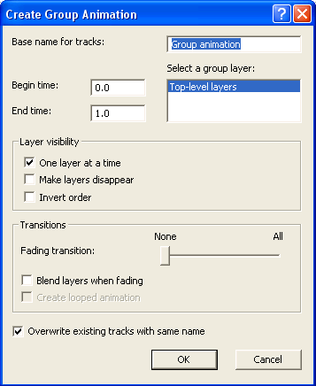
Interpolate to Raster
Inverse Distance Weighted
Create a Raster for each month
Creating Animations

Slide 9
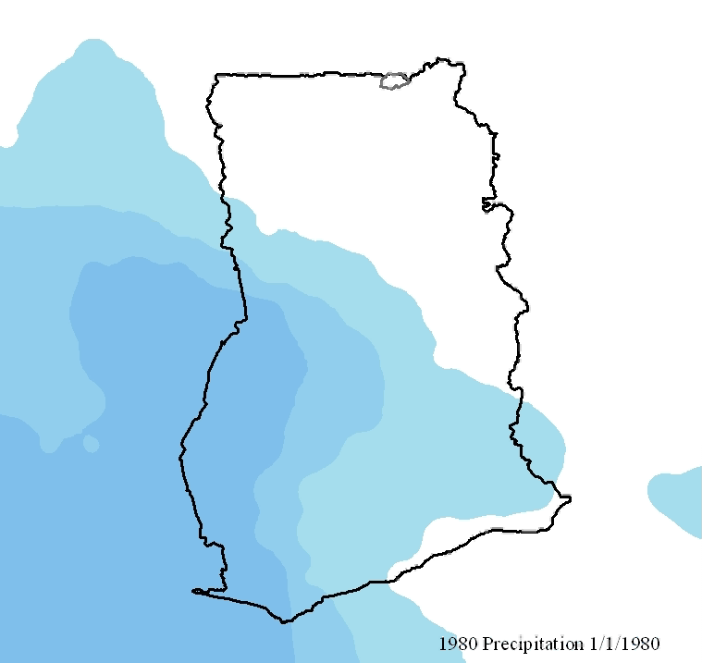
1980: Normal Precipitation Year
VIDEO

Slide 10
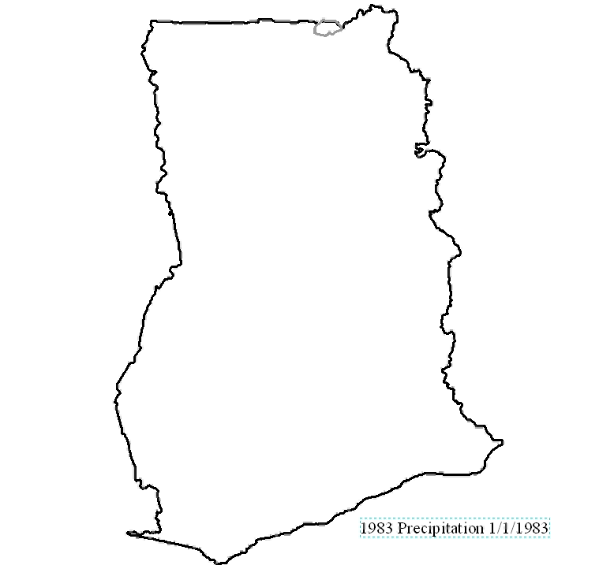
1983: Drought Year
VIDEO

Slide 11
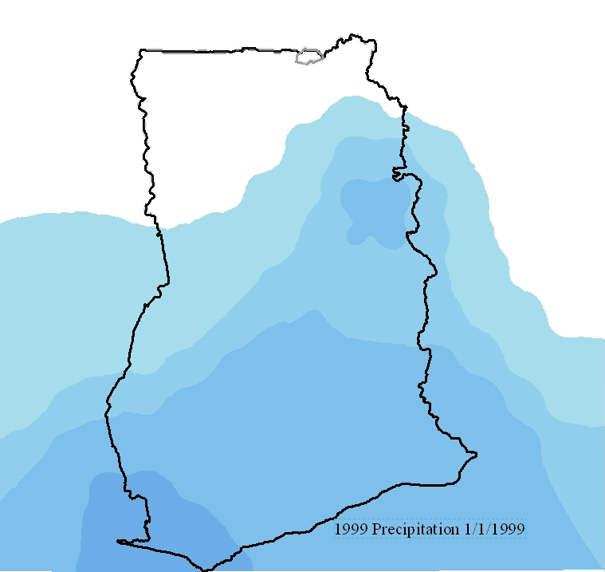
1999: Flood Year
VIDEO

Slide 12
Precipitation in June
1983: Drought Year
1980: Average Year
1999: Flood Year

Slide 13
Precipitation in July
1983: Drought Year
1980: Average Year
1999: Flood Year

Slide 14
Precipitation in August
1983: Drought Year
1980: Average Year
1999: Flood Year

Slide 15
Precipitation in September
1983: Drought Year
1980: Average Year
1999: Flood Year

Slide 16
Precipitation in October
1983: Drought Year
1980: Average Year
1999: Flood Year

Slide 17
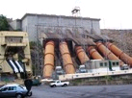
Hope for the Future
Finding Data is hard! Hydroseek for Africa(?)
Daily Precipitation Data.
Need to study the Volta River Basin.
Flooding and Water Quality.
Volta River Authority and GIS.
Aide Relief and GIS.

Slide 18
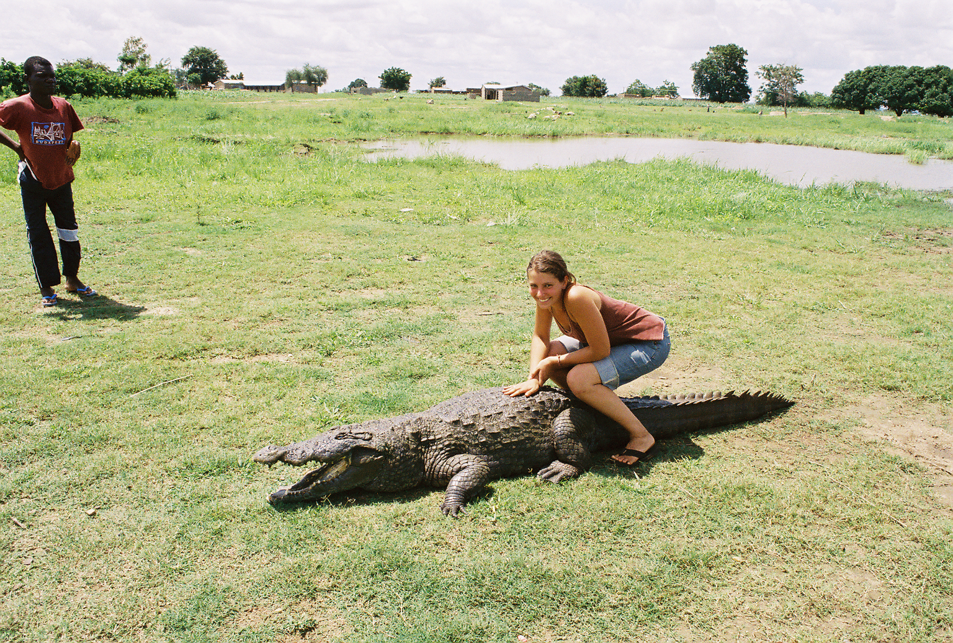
Any Questions?

