Slide 1
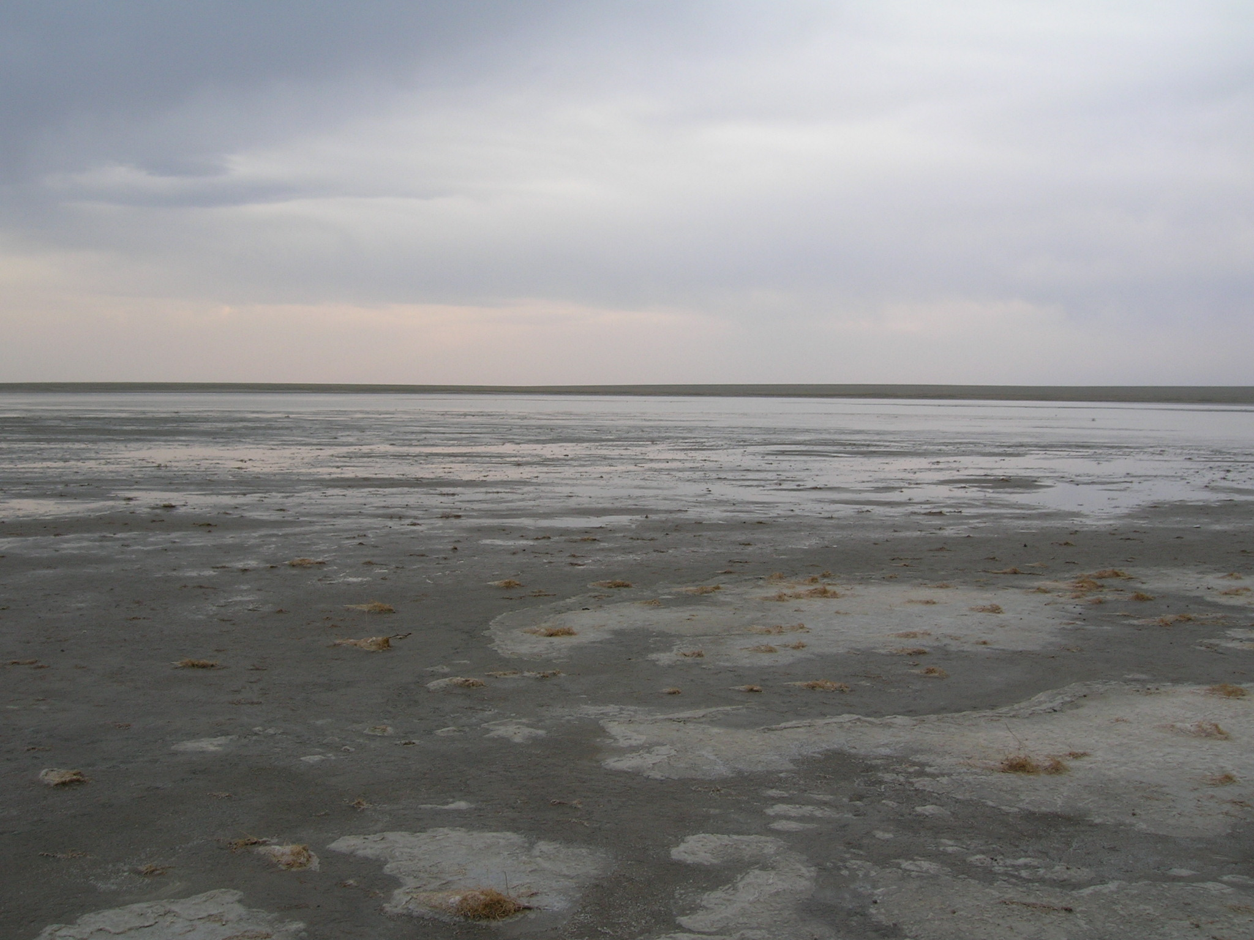
Hydrogeology of Mongolian Soda Lakes
Ben Linhoff
Notes:
Hi, my name is Ben Linhoff. My talk today is on the hydrogeology of soda lakes in eastern Mongolia. For my masters research, I’ve worked to answer a variety of questions related to the hydrology and biogeochemistry of these lakes. Today, I’d like to tell you about how I was able to use GIS to interpret a critical piece of my data set.

Slide 2
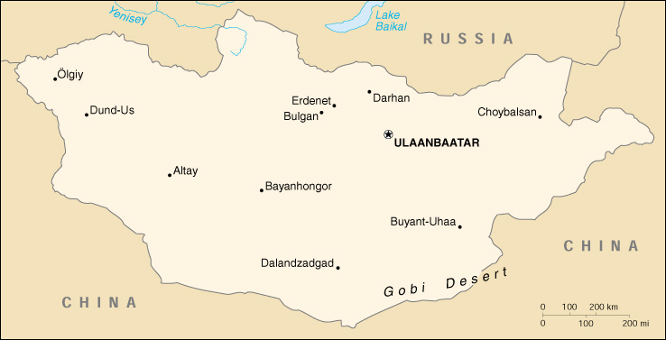
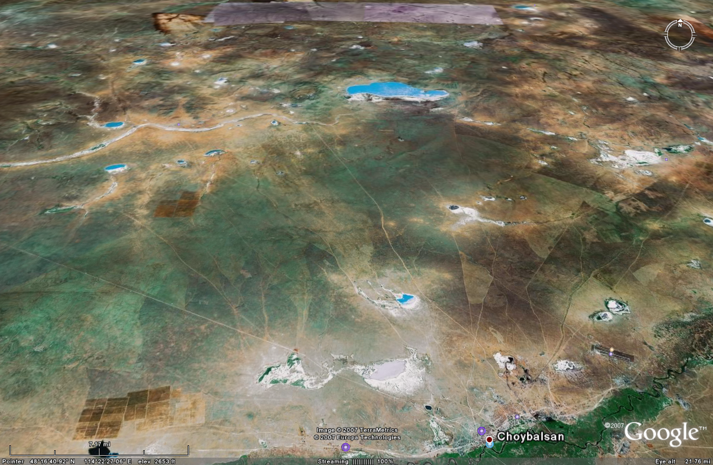
Notes:
For about a year of my masters degree I was living in Mongolia as a Fulbright Fellow

Slide 3
Lakes
Notes:
Closed basin lakes

Slide 4
Wells
Notes:
Note the proximatey of the wells to the lakes which is important because you are looking at the relationship b/t lakes and wells

Slide 5
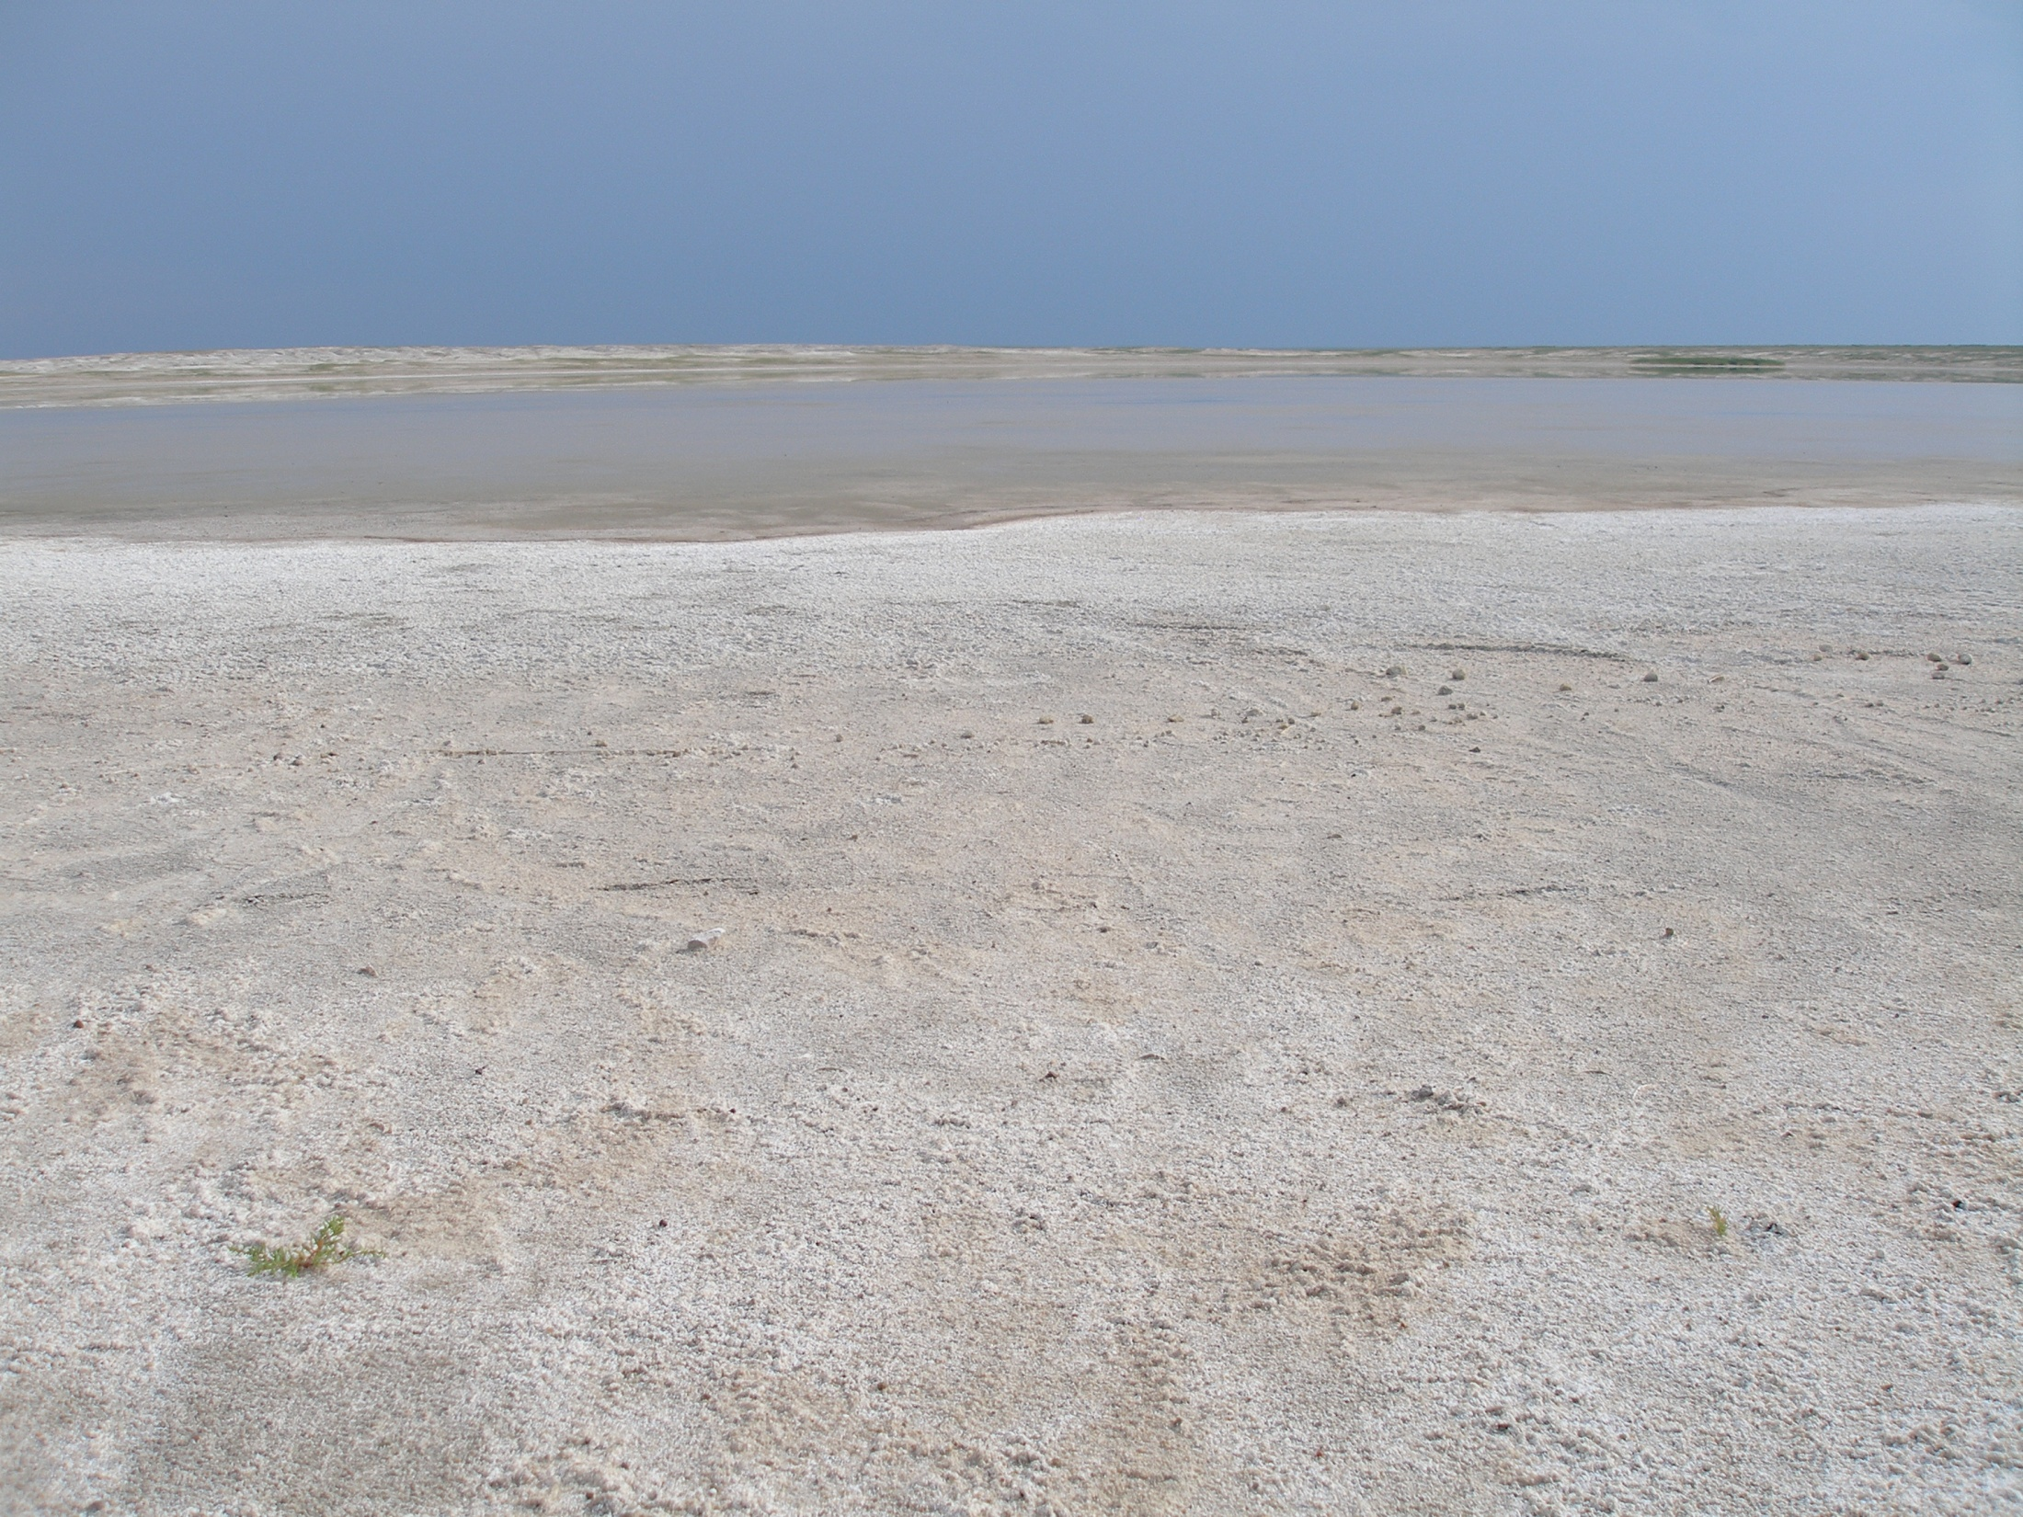
Observation and Questions
Strontium isotopes vary substantially between sampling locations.
  What is the cause of the variation?
  What are the implications of the variation?

Slide 6

Strontium isotope basics
^{87/86}Sr in water typically varies as a function of water/rock interactions.
^{87/86}Sr obtain the signature of the rock controlling water chemistry.
^{87/86}Sr can vary substantially in rain water (I have no rain water samples…).

Slide 7
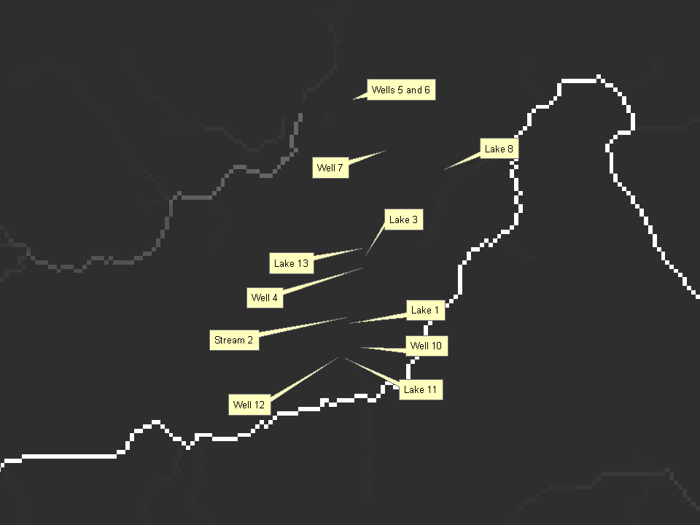
Flow accumulation layer
Defines number of cells which
flow into each downstream cell.
8

Slide 8
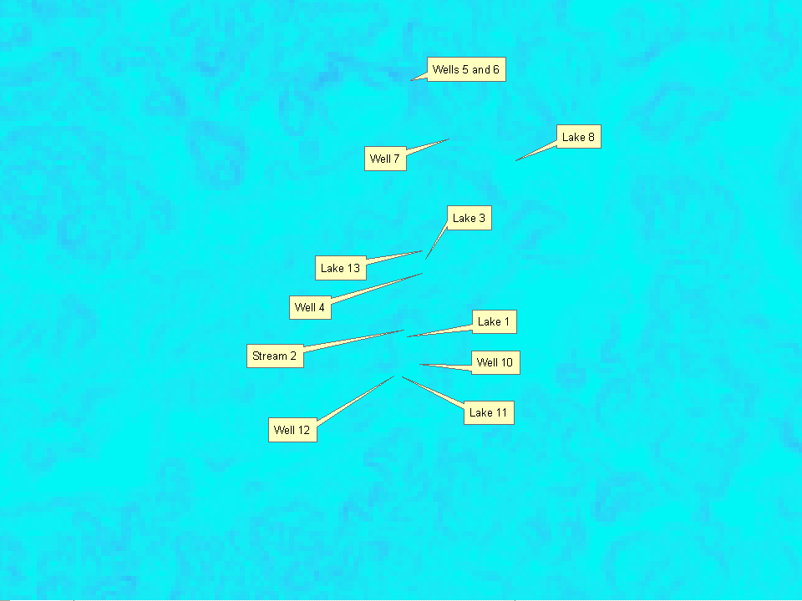
Slope Layer
Maximum change between
cell and its 8 neighbors

Slide 9
Wetness Index
_{= ln ( FA / tan (slope) )}
Notes:
How much water is likely to pass through each cell

Slide 10
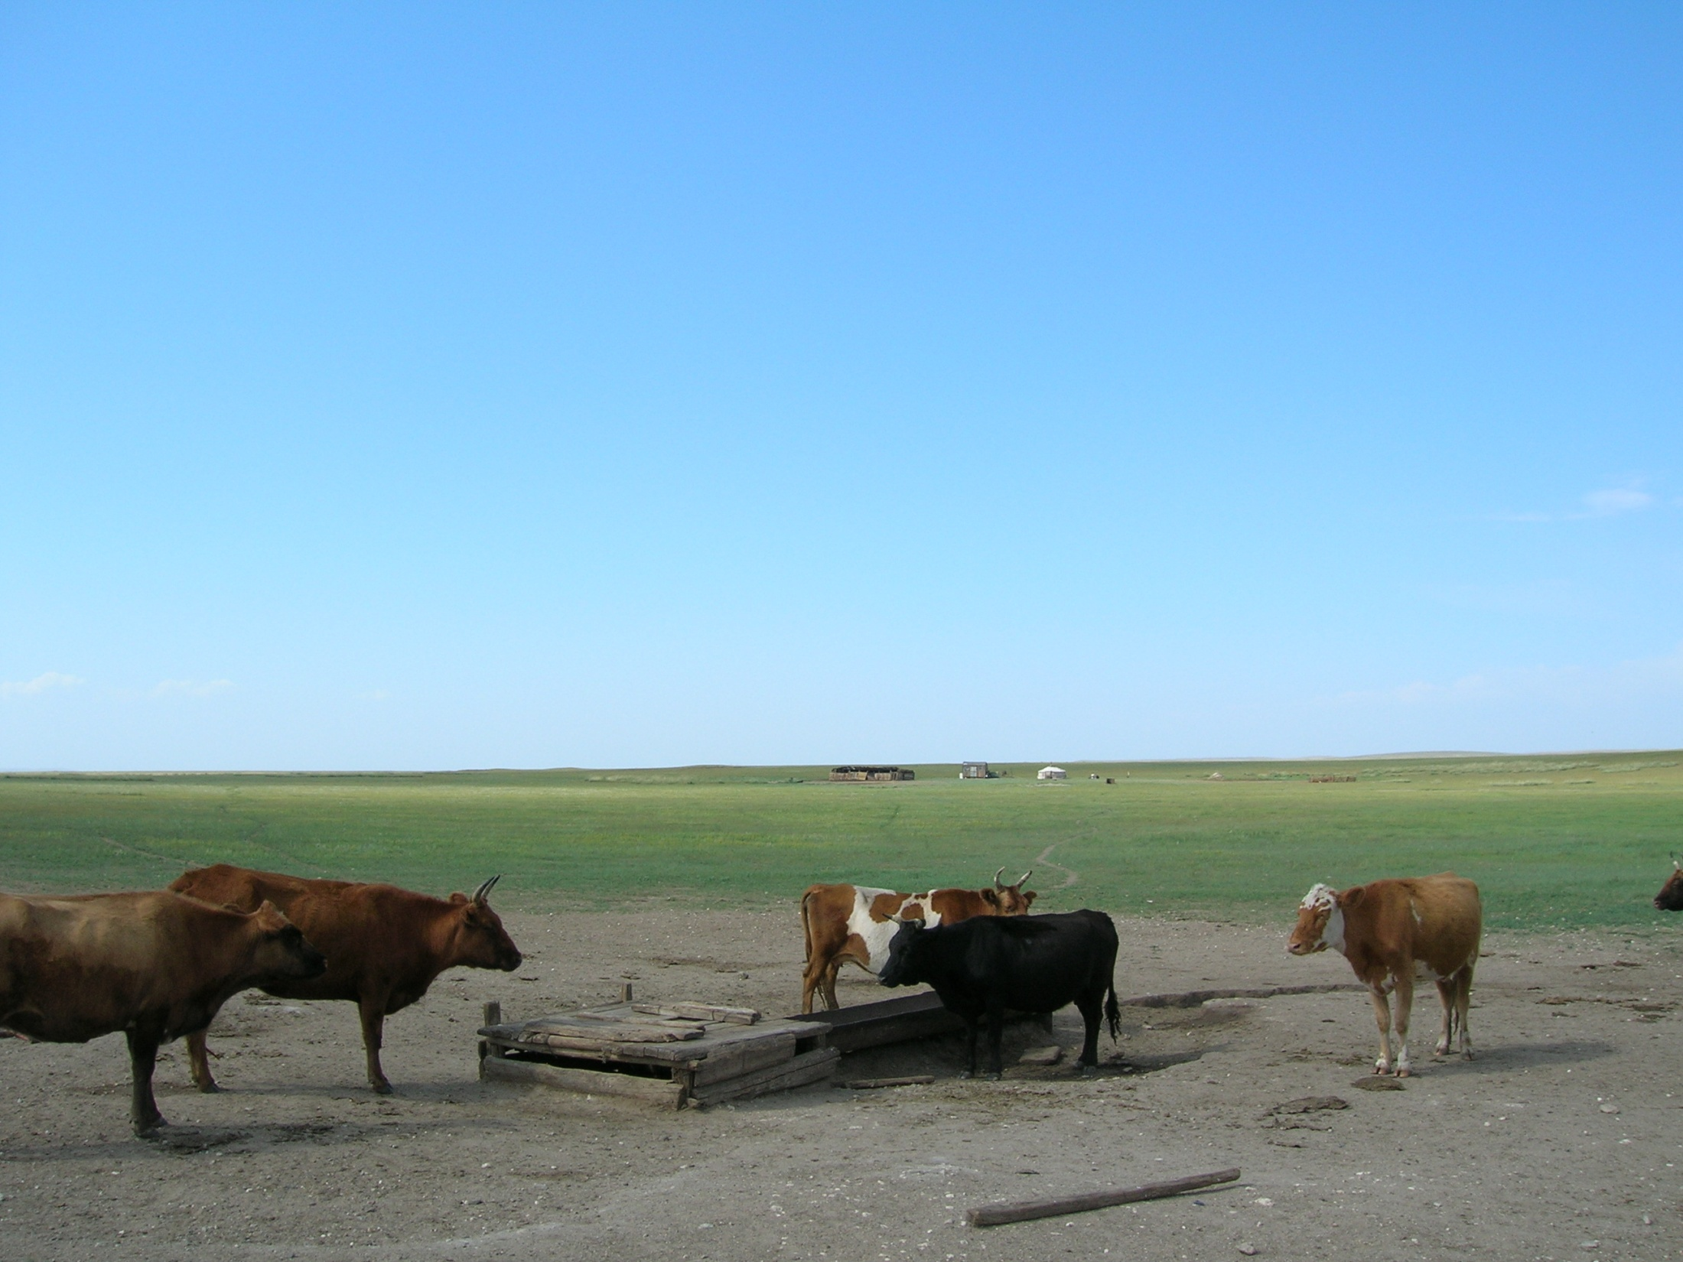
Wells
Expected
Loess

Slide 11
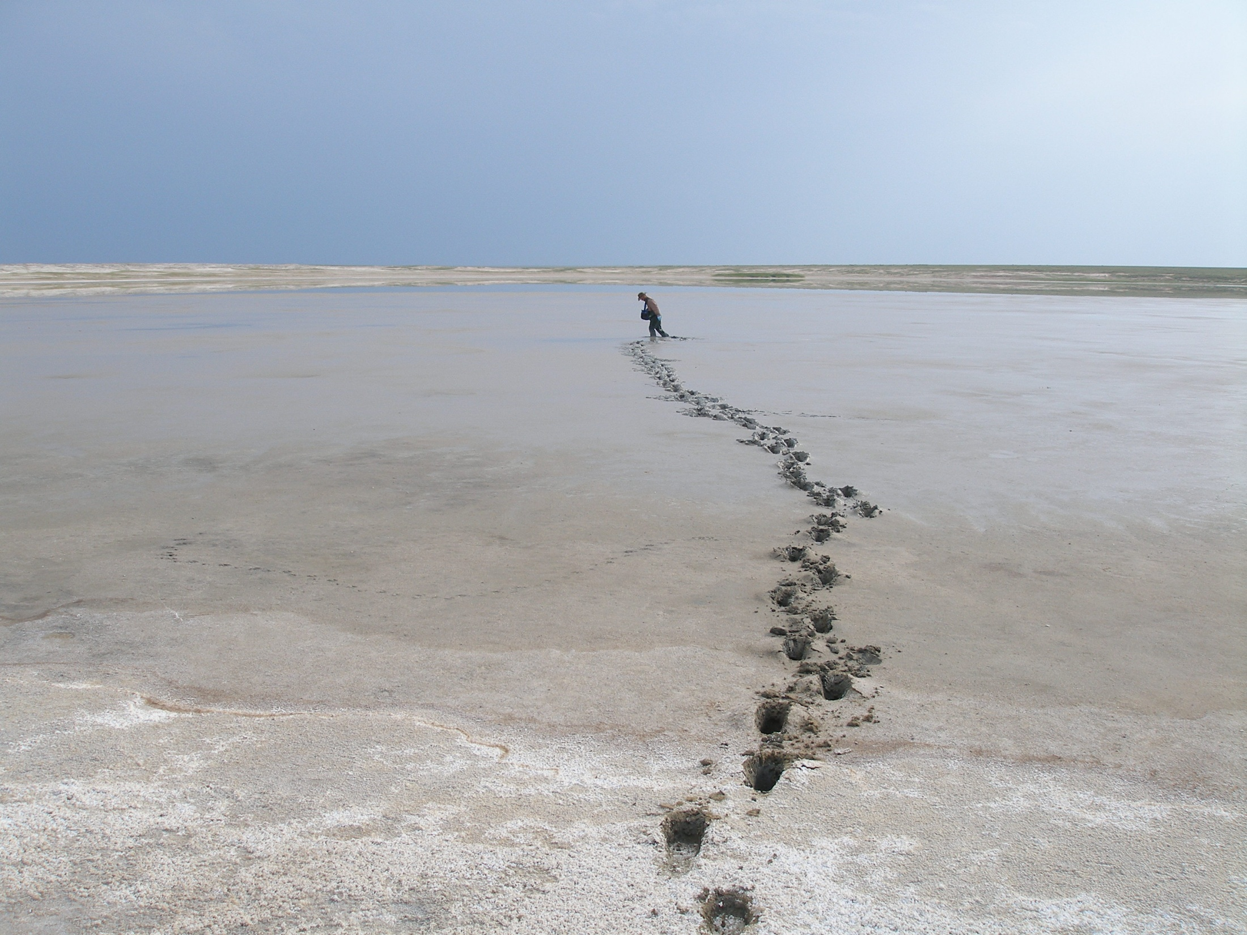
Lakes
Notes:
Smaller lakes

Slide 12
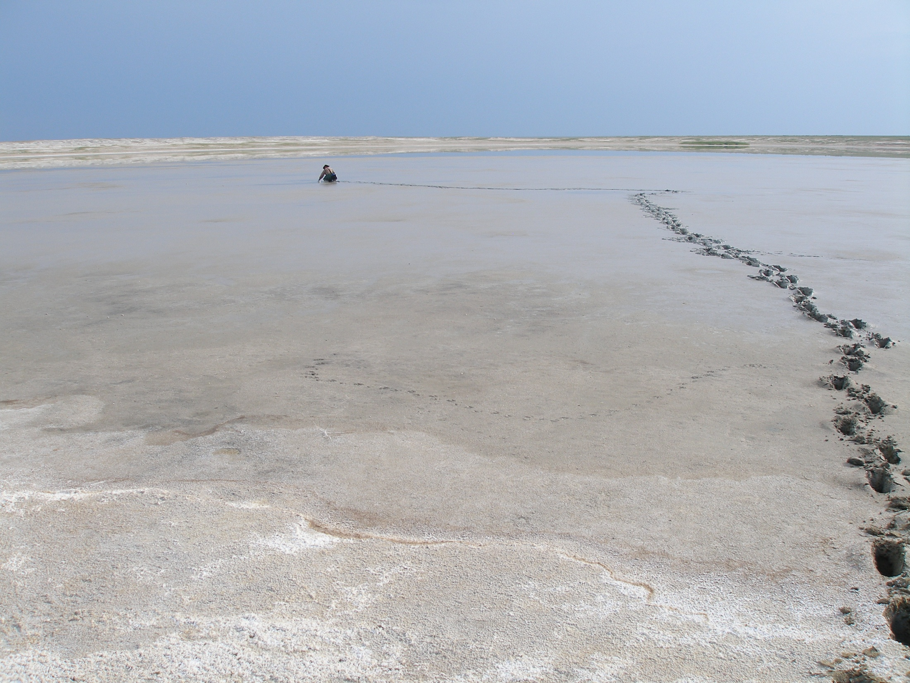
Soda Lakes
HCO₃ pH
Notes:
Smaller lakes

Slide 13
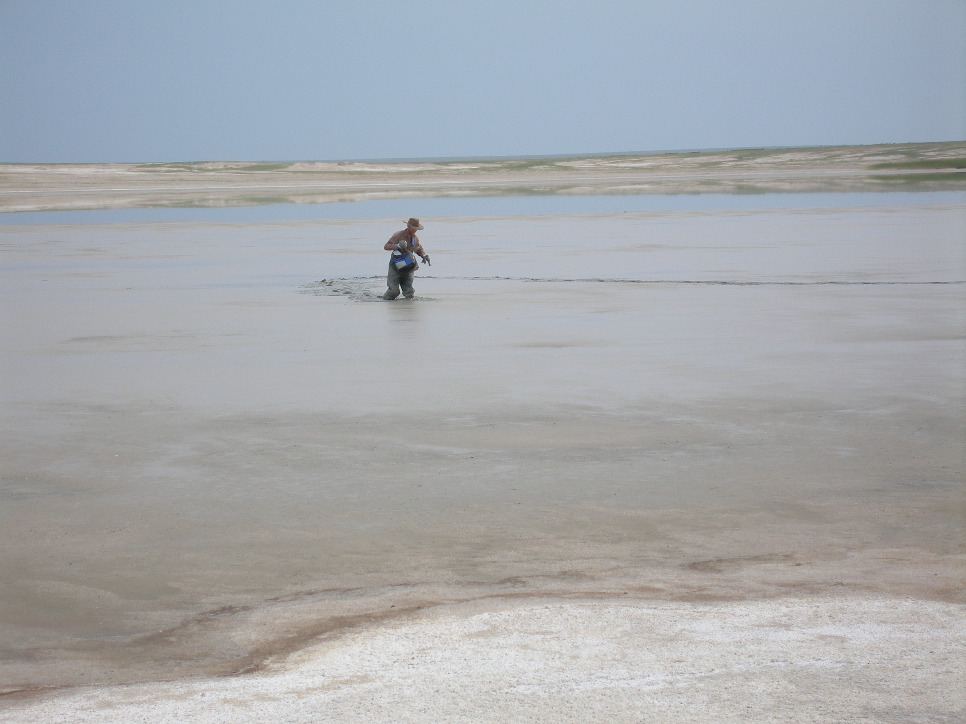
Lakes
weathering

Slide 14
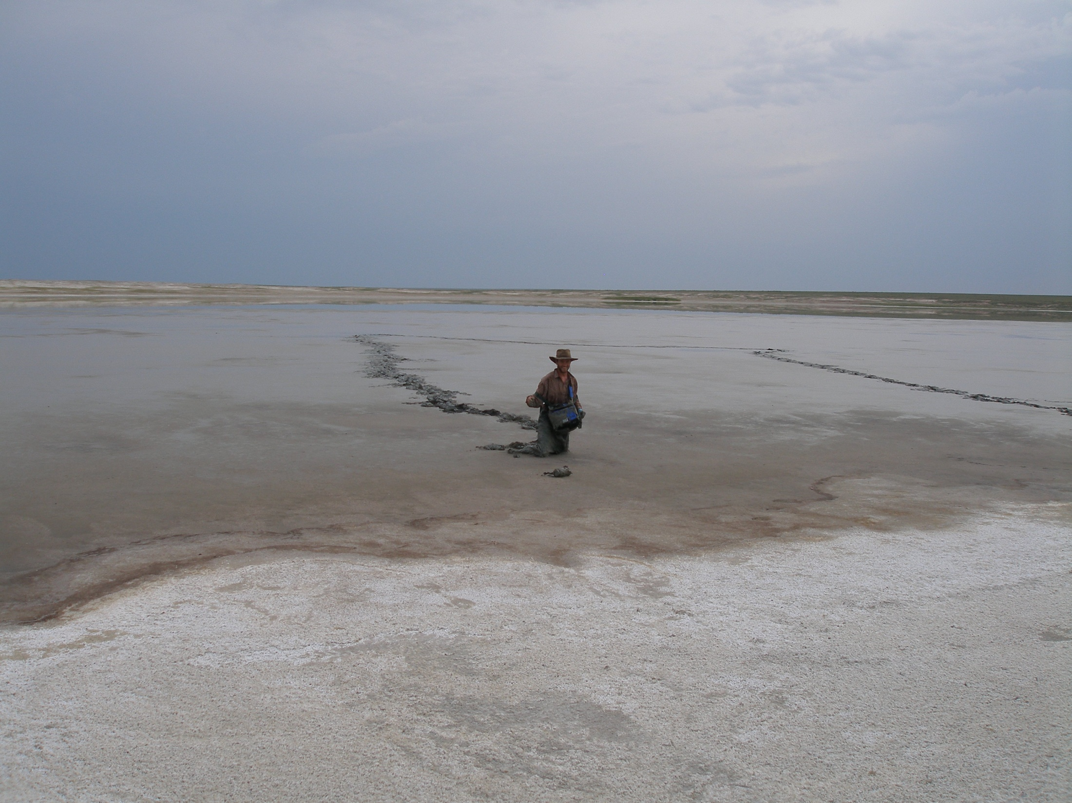
Lakes ^{87/86}Sr Variation
^{87/86}Sr controlled by water rock
interactions
^{87/86}Sr in lakes a function of weathering and
average ^{87/86}Sr groundwater input

Slide 15
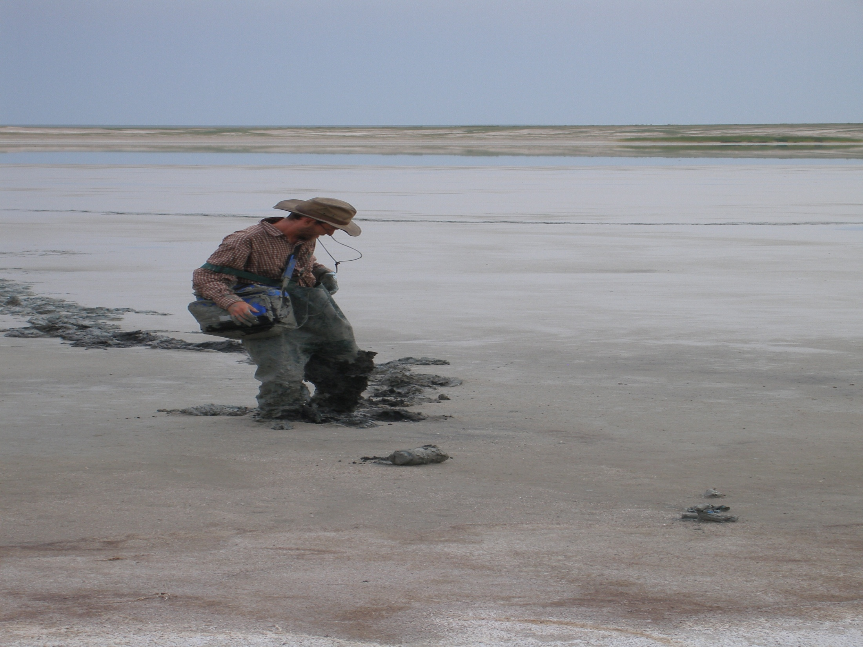
Implications
Wetness Index is a great tool to predict extent of groundwater/rock interactions.
Wetness Index and flow accumulation layers are a function of the catchment area of a closed basin lake.

Slide 16
Conclusions
Chemistry of well and lake water is controlled by loess
Wetness Index predicts ^{87/86}Sr variation at my field site

Slide 17
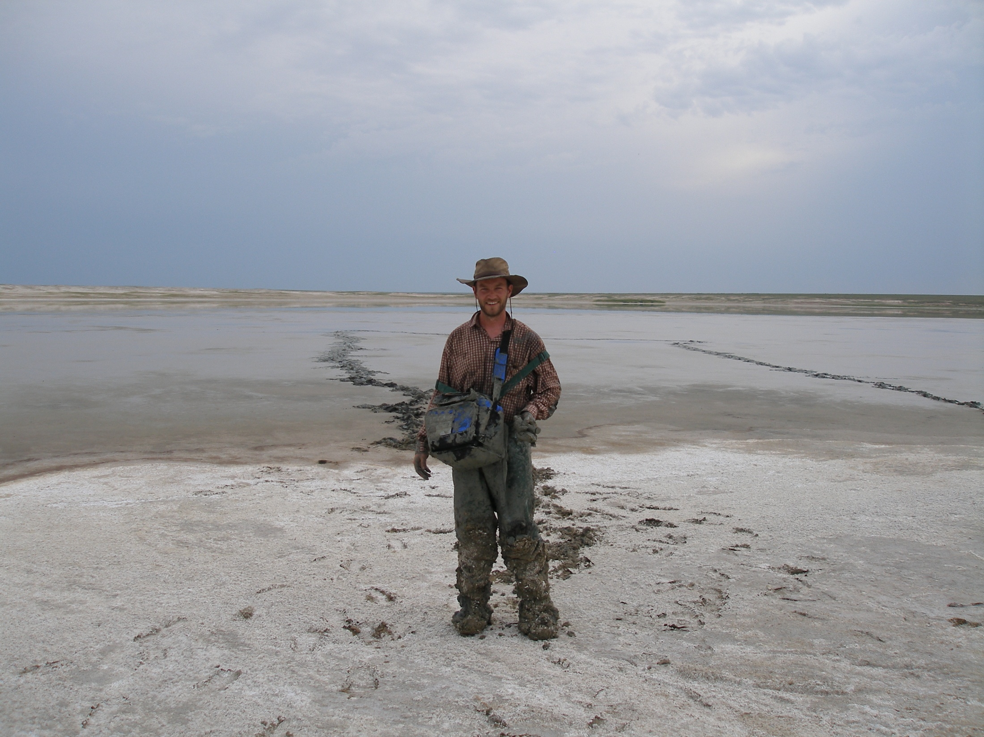
Questions?

