Slide 1
Effects of Urbanization on the Water Resources of Atlanta
Kate Marney

Slide 2
Outline
Background
Objectives
Methods
Results
Conclusions

Slide 3
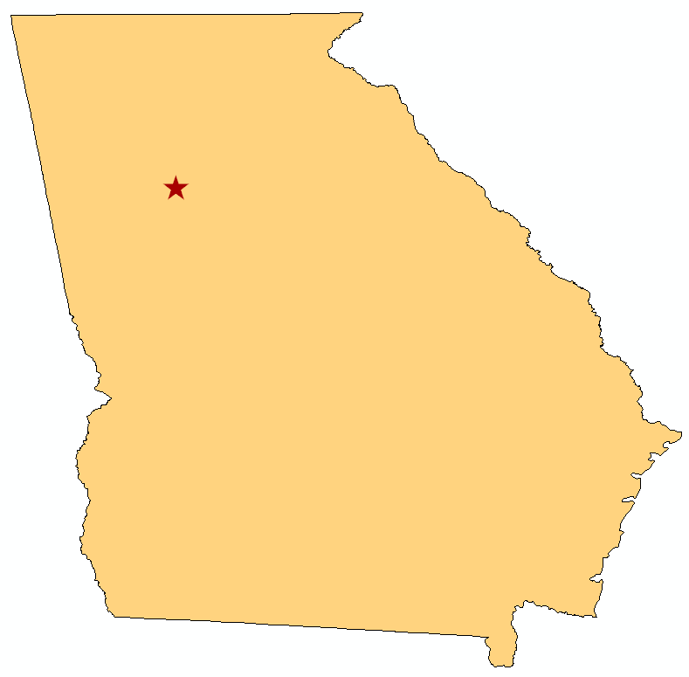
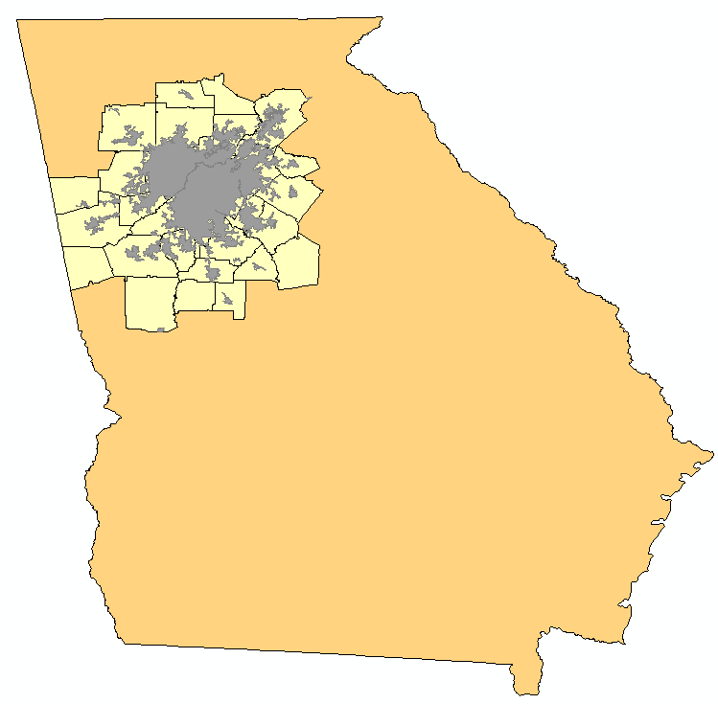
Background
Atlanta
  Capital of Georgia
  “Poster Child for Sprawl”
  25% growth since 2006
Atlanta
Atlanta
Georgia
Georgia
Notes:
Atlanta metro area gained over 1 million people between 2000 and 2006
Known by many as the “poster child for sprawl”
Chose this assuming population increase correlates with development and an increase in impervious surface coverage.

Slide 4
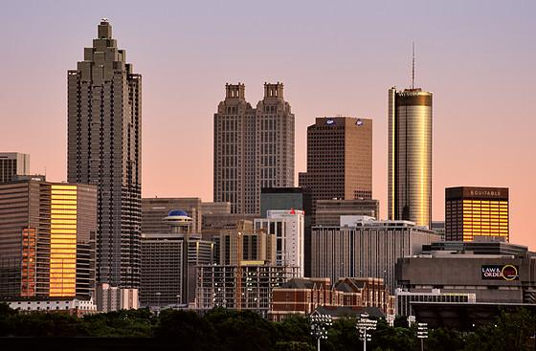
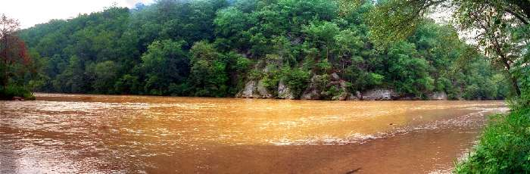
Objective
Understand some of the effects of urban sprawl
Correlate urbanization with:
  Streamflow
  Water temperature
  Contaminant levels
Photo: Atlanta Skyline, Wikipedia.org
Photo: Chattahoochee River in Atlanta (alternate title: Chattaewwchee), Georgia.org

Slide 5
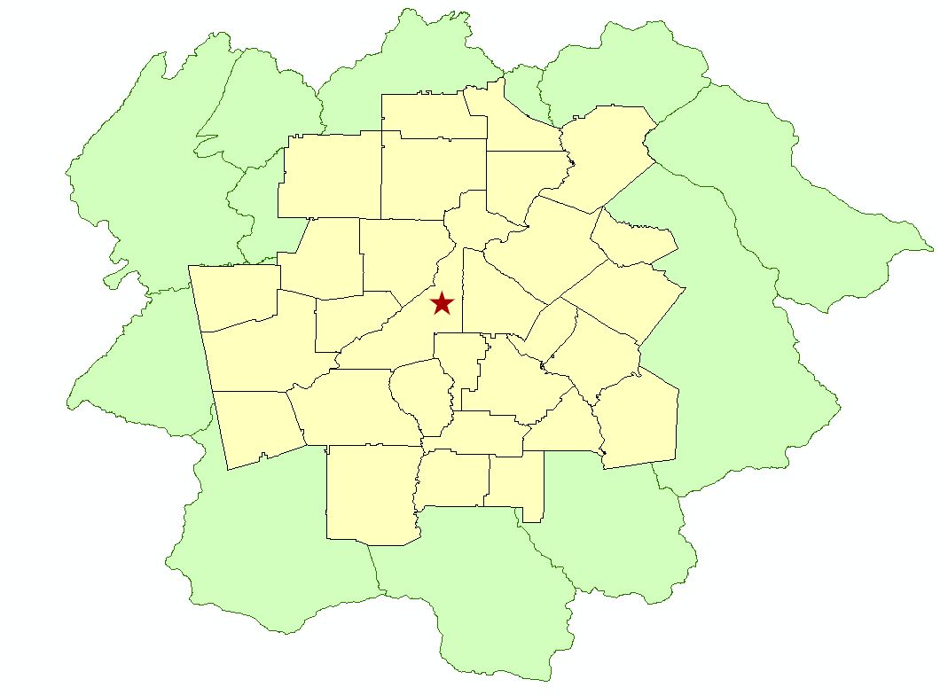
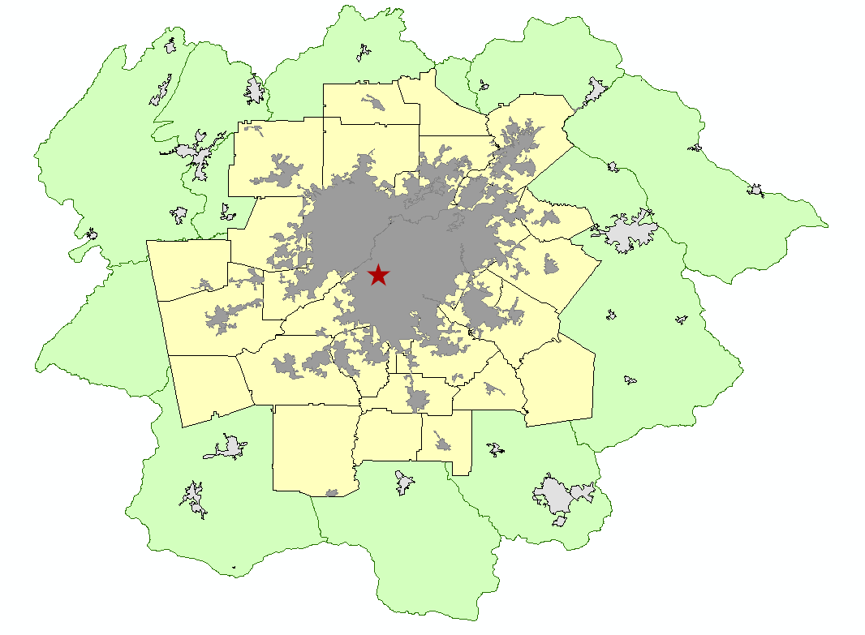
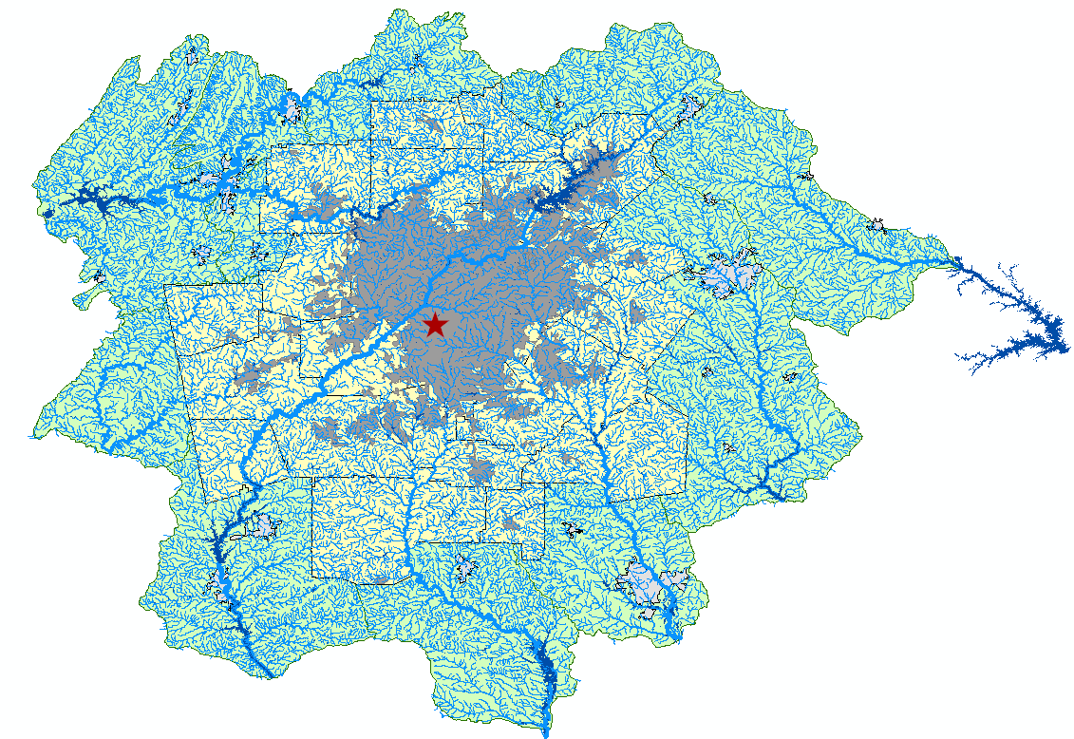
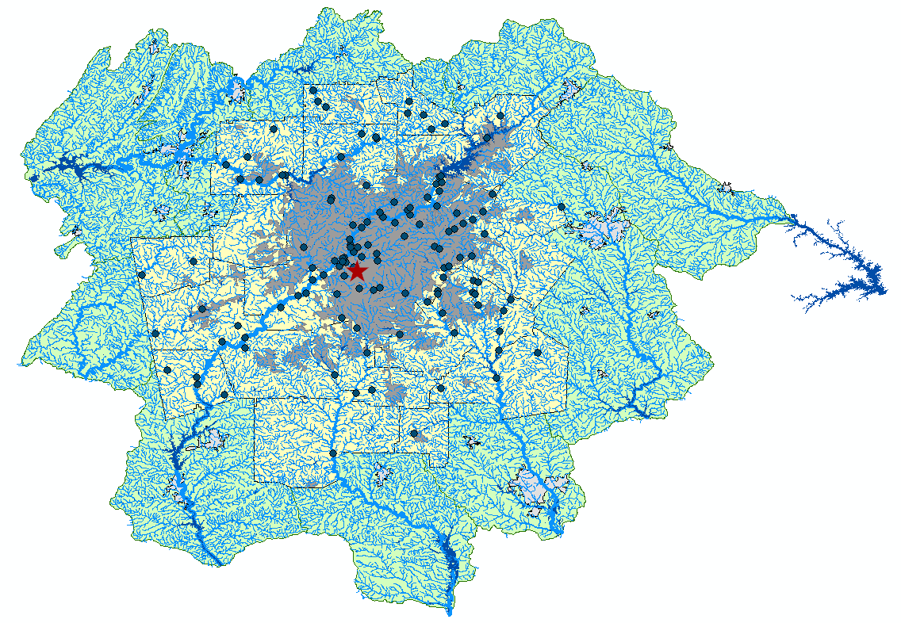
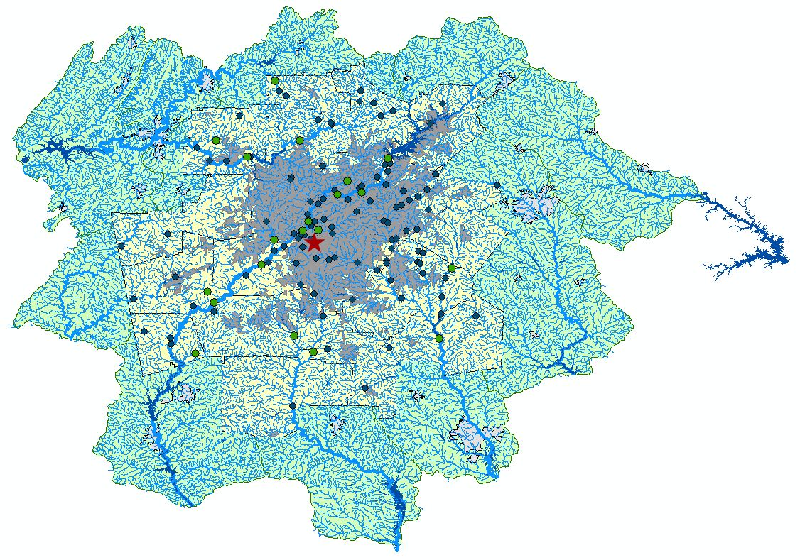
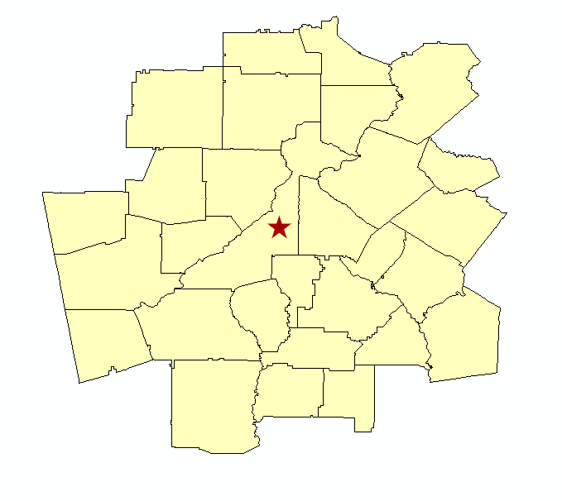
ArcMap Data

Slide 6
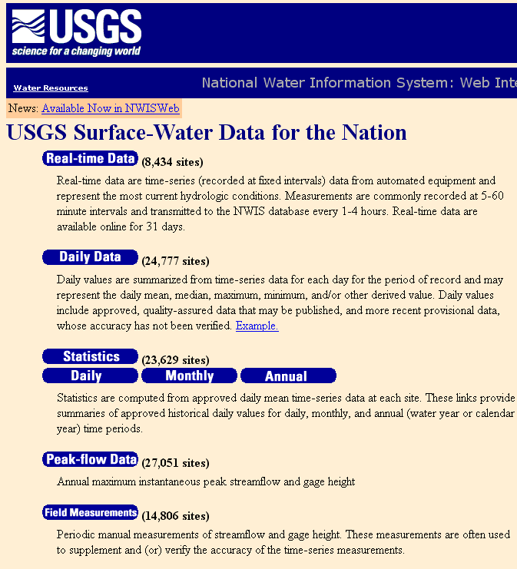
Streamflow Analysis
Peak flow data from USGS
Graph results
  5 sites out of 20 increasing
  5 show evidence of channelization or regulation
Notes:
Other data points affected by regulation or channelization to a lesser, but apparent degree, or saw greater variation in peak flows.

Slide 7
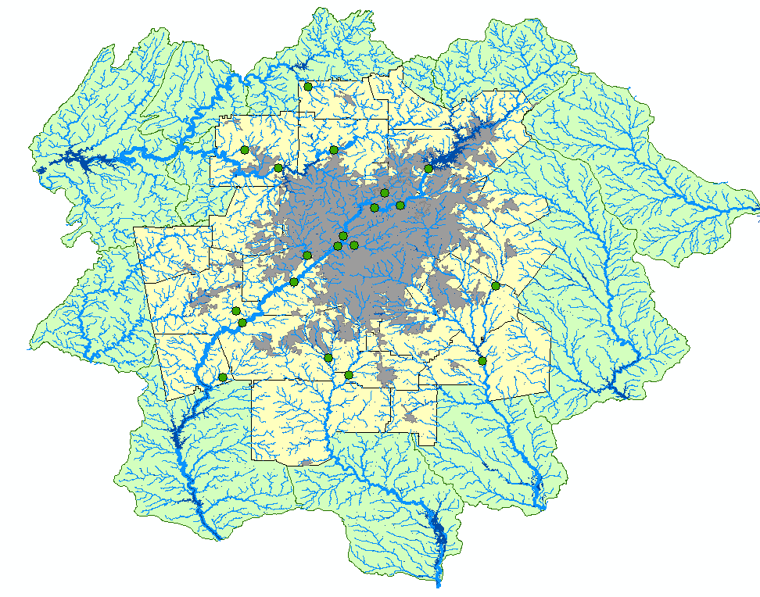
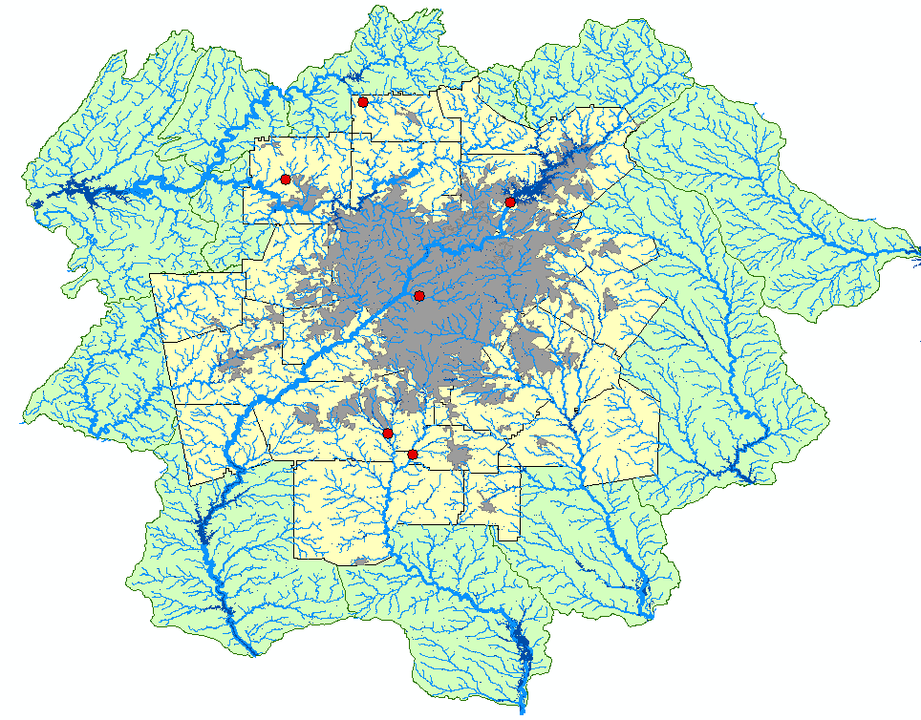

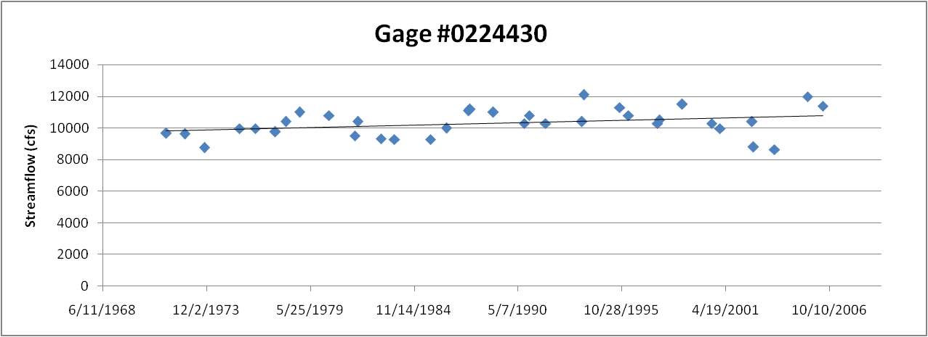
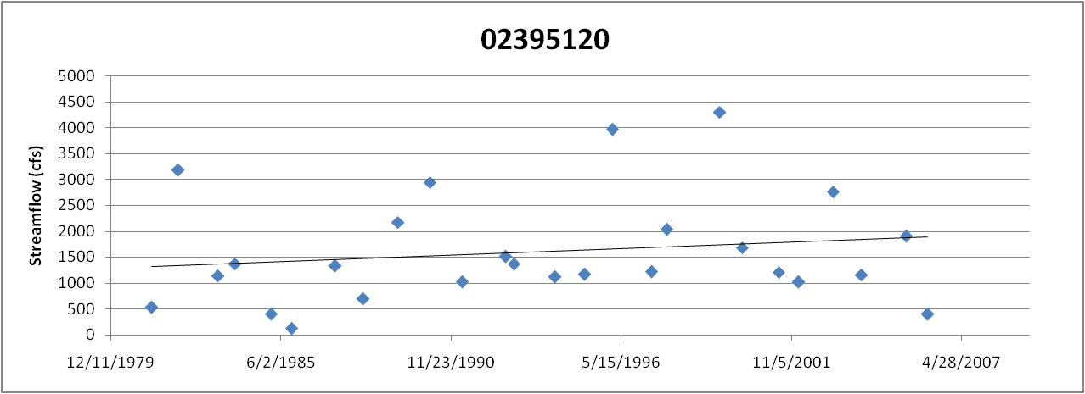
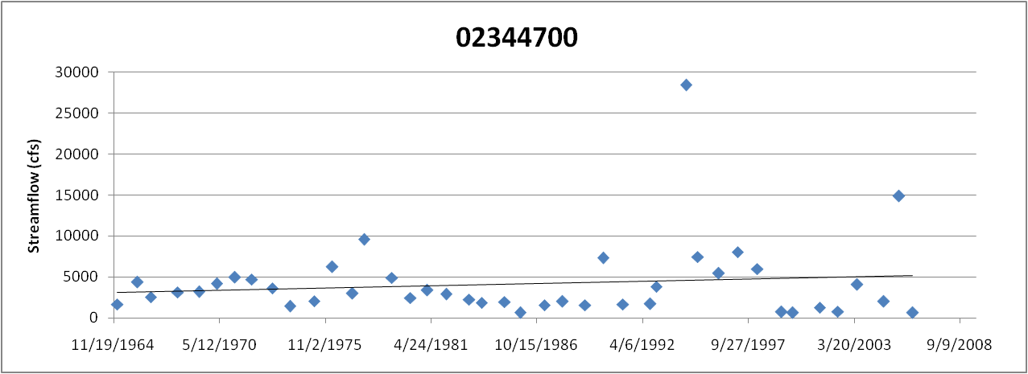
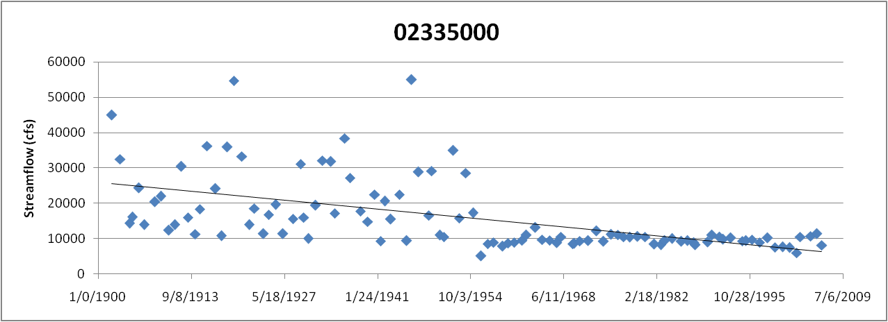
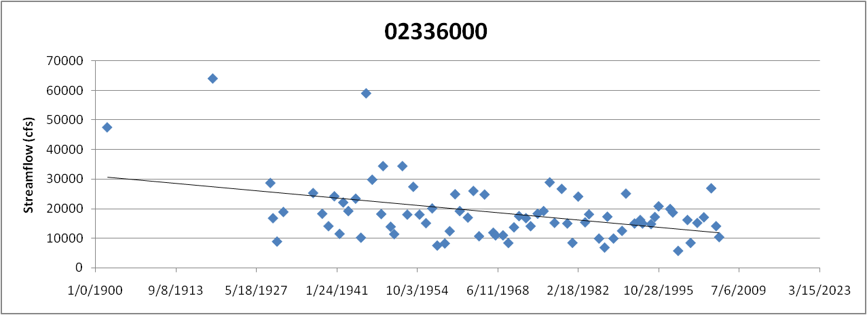
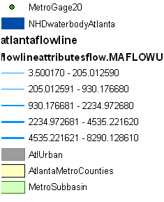
Streamflow Results

Slide 8
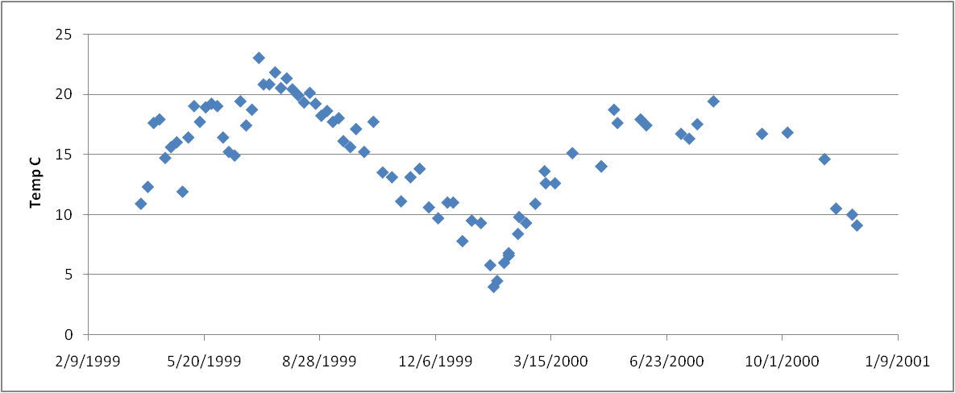
Temperature Analysis
US EPS STORET Data
89 Locations in Metro Area
Name | Station | State | HUC | Generated | HUC | Station | Station | Station | Horizontal | Visit | Zone | Activity
Environmental | Protection | 13012001 | CARROLL | 3150108 | 33.4892 | -85.3043 | 1 | 2/7/2001 | 8:10:00 | Water | 6.2 | deg
Environmental | Protection | 13014101 | CARROLL | 3150108 | 33.5488 | -85.0948 | 1 | 9/18/2001 | 8:30:00 | Water | 19 | deg
Environmental | Protection | 13014101 | CARROLL | 3150108 | 33.5488 | -85.0948 | 1 | 1/10/2001 | 10:35:00 | Water | 2.6 | deg
Environmental | Protection | 4112151 | ROCKDALE | 3070103 | 33.5797 | -84.0642 | 1 | 9/7/1999 | 9:55:00 | Water | 22 | deg
Environmental | Protection | 4181001 | GWINNETT | 3070103 | 33.9139 | -84.0986 | 1 | 5/6/1999 | 10:10:00 | Water | 18.5 | deg
Environmental | Protection | 4181001 | GWINNETT | 3070103 | 33.9139 | -84.0986 | 1 | 2/12/1999 | 13:10:00 | Water | 14 | deg
Environmental | Protection | 4112401 | HENRY | 3070103 | 33.5694 | -84.2331 | 1 | 12/8/1999 | 8:20:00 | Water | 8 | deg
Environmental | Protection | 4310001 | NEWTON | 3070103 | 33.4494 | -83.8283 | 1 | 2/11/2003 | 7:20:00 | Water | 7.1 | deg
Environmental | Protection | 3036401 | WALTON | 3070101 | 33.8067 | -83.6636 | 1 | 1/5/1999 | 11:10:00 | Field | deg | C
Environmental | Protection | 4140001 | HENRY | 3070103 | 33.4532 | -83.9286 | 1 | 8/3/1999 | 8:20:00 | Water | 27 | deg
Environmental | Protection | 4207501 | GWINNETT | 3070103 | 33.7781 | -84.0381 | 1 | 11/3/1999 | 12:45:00 | Water | 12.6 | deg
Environmental | Protection | 13012001 | CARROLL | 3150108 | 33.4892 | -85.3043 | 1 | 8/7/2001 | 7:20:00 | Water | 23.9 | deg
Environmental | Protection | 4140001 | HENRY | 3070103 | 33.4532 | -83.9286 | 1 | 9/7/1999 | 8:30:00 | Water | 24 | deg
Environmental | Protection | 4112151 | ROCKDALE | 3070103 | 33.5797 | -84.0642 | 1 | 6/8/1999 | 9:40:00 | Water | 21 | deg
Environmental | Protection | 4207501 | GWINNETT | 3070103 | 33.7781 | -84.0381 | 1 | 4/6/1999 | 12:00:00 | Water | 17.3 | deg
Environmental | Protection | 4112201 | HENRY | 3070103 | 33.525 | -84.0447 | 1 | 10/5/1999 | 9:35:00 | Water | 19.5 | deg

Slide 9
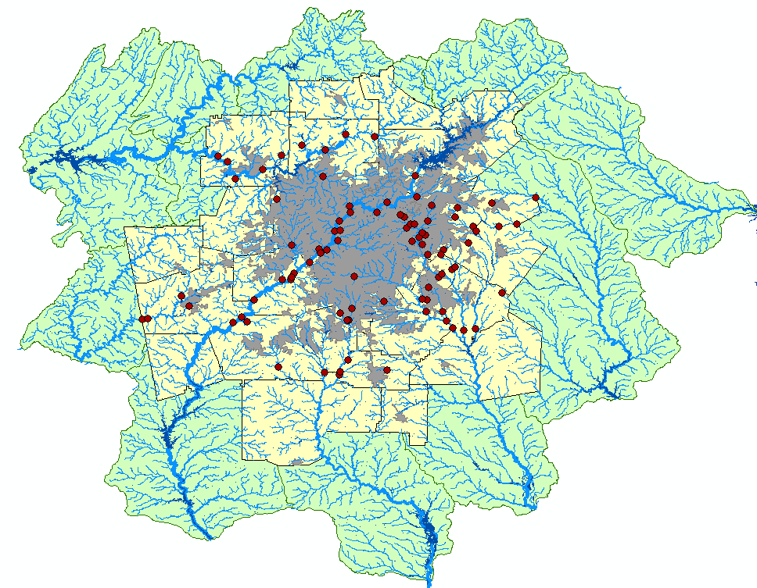
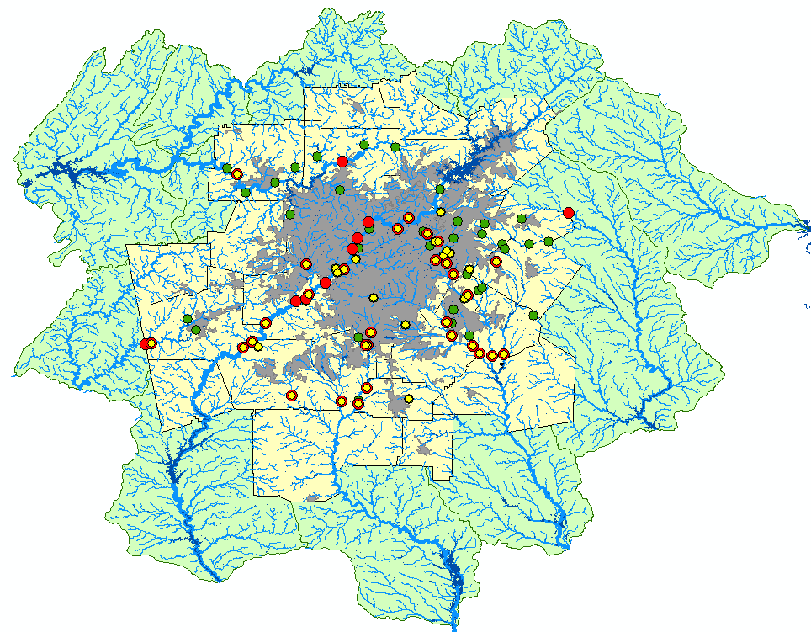
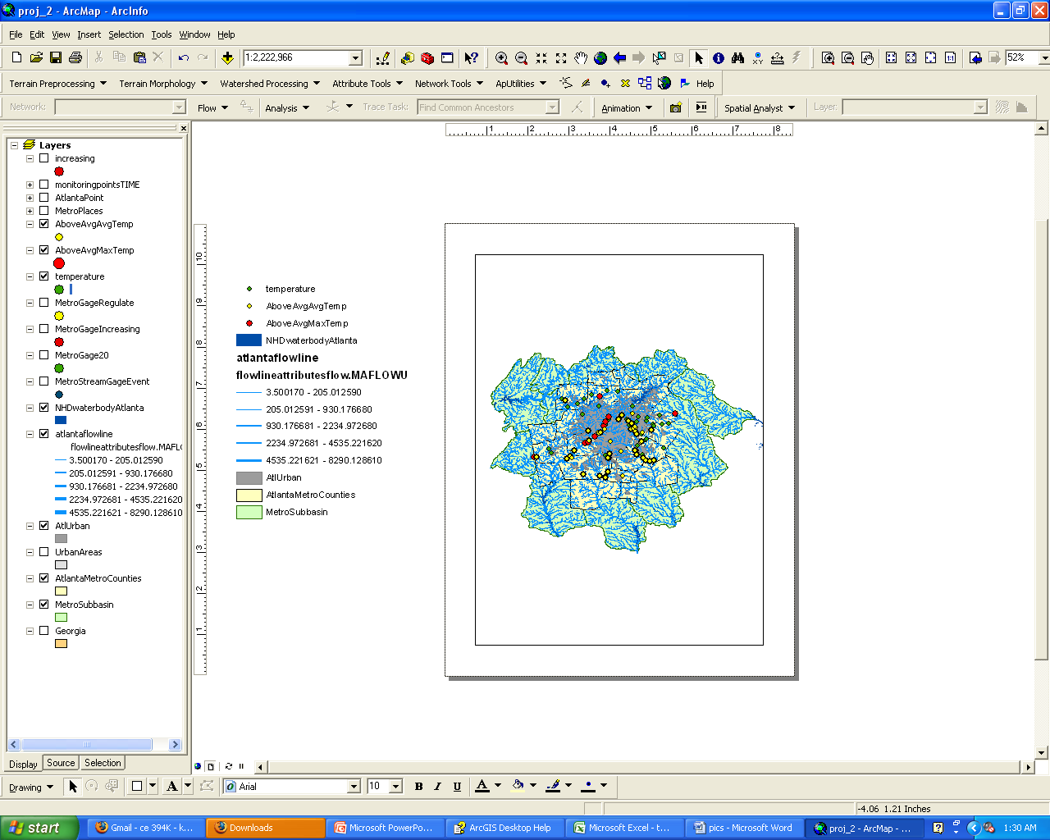
Temperature Results
Lowest Average (9.49)
Lowest Max Temp (11.8)
Highest Average (19.41)
Highest Max Temp (31)

Slide 10
Temperature Results

Slide 11
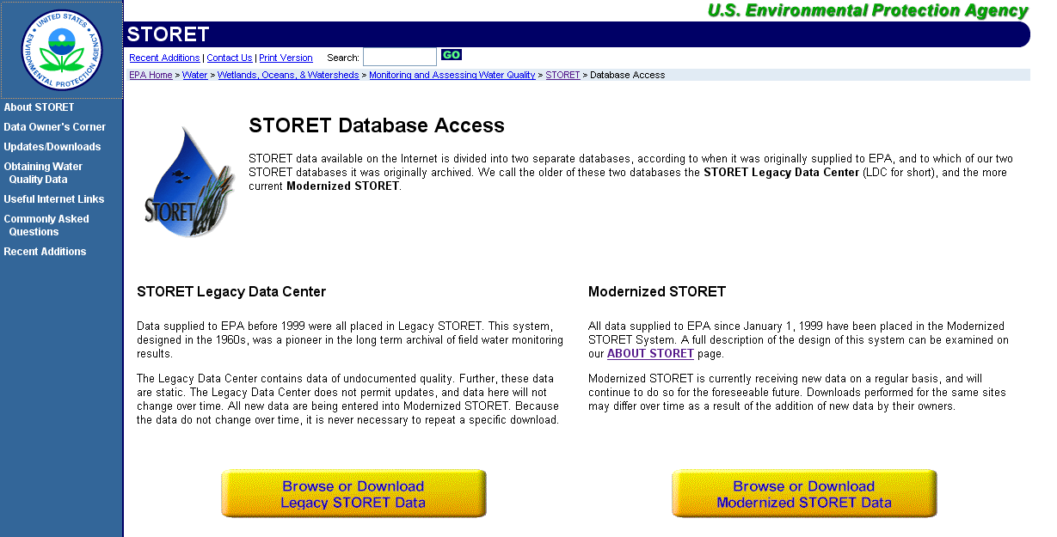
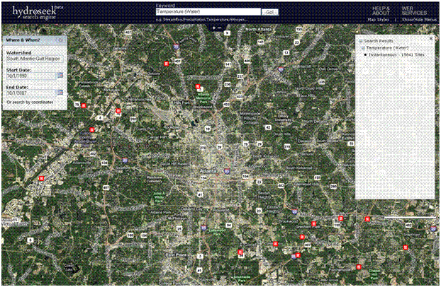
Contaminant Levels
Nitrogen, Phosphorus, Bacteria
Data not readily available for long time periods
Data Sources:

Slide 12
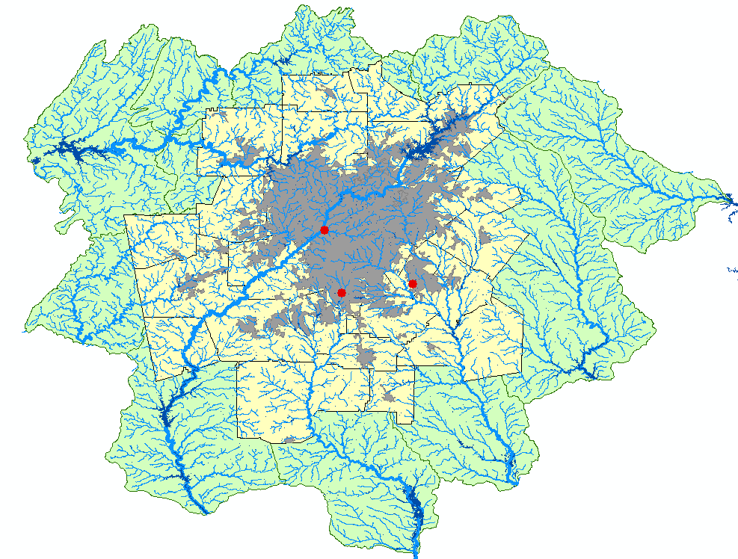
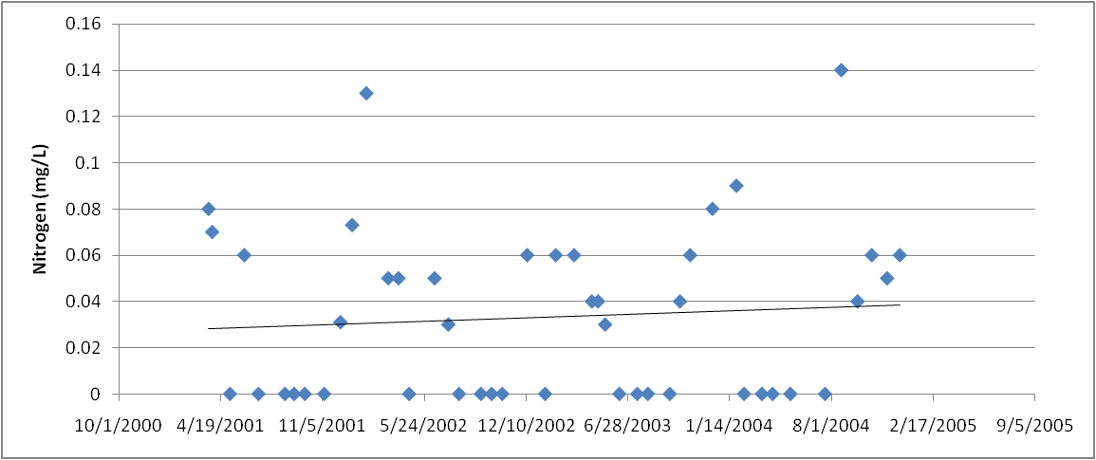
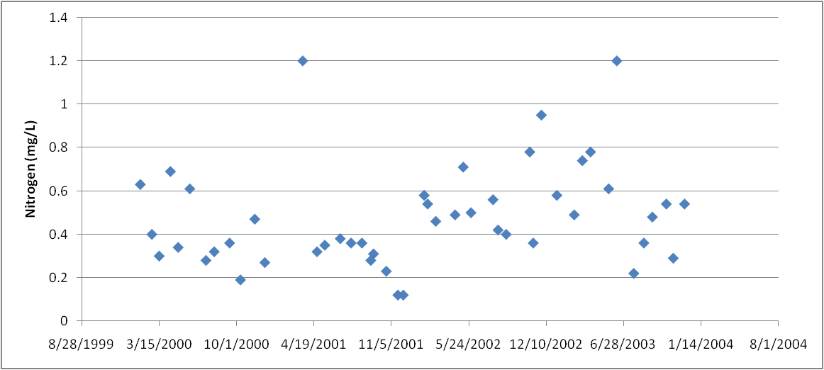
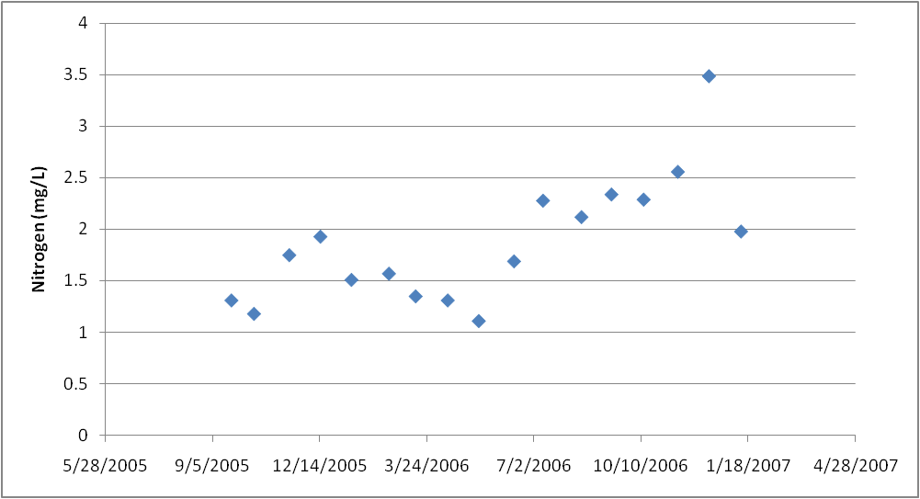
Contaminant Results

Slide 13
Conclusions
Urbanization has a marked, detrimental effect on water resources
Streamflow, temperature, and contaminant levels are likely to increase as urbanization occurs
Understanding the effects and their magnitudes can aid in mitigation efforts

Slide 14
Questions

