Slide 1
Peru and The Rimac River
The Effects of Climate Change

Slide 2
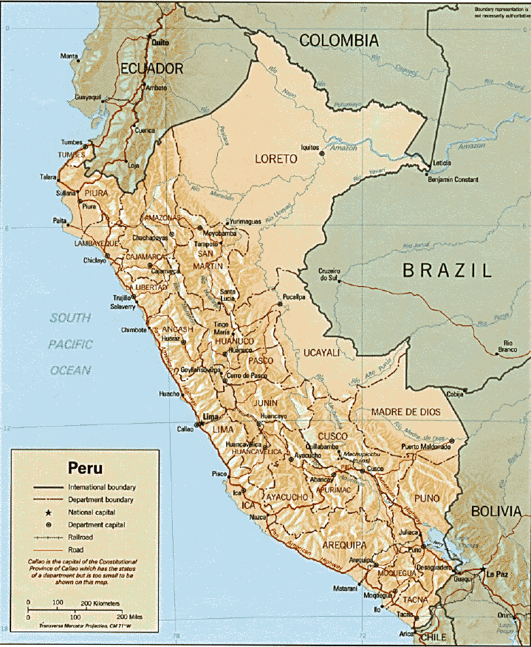
Peru – The Land of the Incas
“Peru is the third riskiest country to climate hazards after Honduras and Bangladesh”
~ Tyndall Centre on Climate Change, UK
West Coast Shortage
70% of Population
2% of Natural Resources

Slide 3
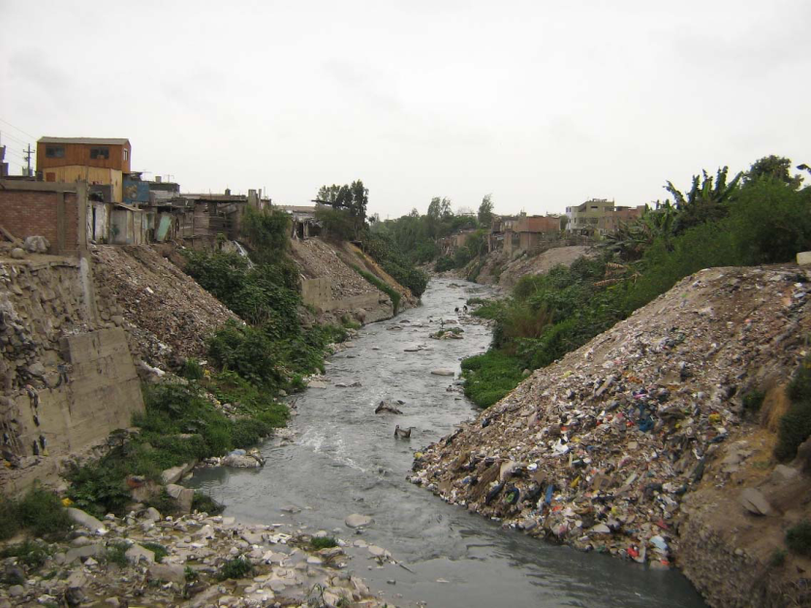
Rimac River – Why?
Most important source of potable water for Lima and Callao metropolitan area
Provides 71.8% of Lima’s Drinking Water
One of the most heavily polluted and uncared for rivers in all of Peru
Area: 3191 km²
Length: 160 km

Slide 4
Rimac River - Goals
Analyze Historic Precipitation Trends in Rimac River Basin
Annual, Wet Period, Dry Period
Analyze Future Precipitation Trends in Rimac River Basin
Annual, Wet Period, Dry Period
Predict Future Discharge in Rimac River
Study Effects of Climate Change

Slide 5
Rimac River - Goals
Analyze Historic Precipitation Trends in Rimac River Basin
Annual, Wet Period, Dry Period
Analyze Future Precipitation Trends in Rimac River Basin
Annual, Wet Period, Dry Period
Predict Future Discharge in Rimac River
Study Effects of Climate Change

Slide 6
Rimac River – Delineate Watershed

Slide 7
Rimac Basin - SENAMHI

Slide 8
Rimac Basin – Precipitation Gauges

Slide 9
Rimac Basin – Data Acquisition
Year | Nana | Santa Eulalia | Autisha | Carampoma | Milloc | Casapalca | Matucana | San Jose De Parac | Rio Blanco | Chosica
63/64
64/65
65/66
66/67
67/68
68/69
69/70
70/71
71/72
72/73
73/74
74/75
75/76
76/77
77/78
78/79
79/80
80/81
81/82
82/83
83/84
84/85
85/86
86/87
87/88
88/89
89/90
90/91
91/92
92/93
93/94
94/95
95/96
96/97
97/98
98/99
99/2000
2000/01
2001/02
2002/03
2003/04
2004/05

Slide 10
Rimac Basin – Gauge Interpolation

Slide 11
Rimac Basin – Average Annual Precipitation

Slide 12
Rimac Basin – Average Wet Period Precipitation

Slide 13
Rimac Basin – Average Dry Period Precipitation

Slide 14
Rimac River - Goals
Analyze Historic Precipitation Trends in Rimac River Basin
Annual, Wet Period, Dry Period
Analyze Future Precipitation Trends in Rimac River Basin
Annual, Wet Period, Dry Period
Predict Future Discharge in Rimac River
Study Effects of Climate Change

Slide 15
Intergovernmental Panel on Climate Change (IPCC)
Distributes multiple Climate Change Outputs/Predictions based on General Circulation Models (GCMs)
Dataset
Scenario
Variable

Slide 16
IPCC – Data Selection
Goddard Institute for Space Studies, NASA
Monthly 30 Year Climatologies
Scenario 1PTO2X
CO2 concentrations increased by 1% each year until doubled then held constant
Precipitation Flux
Resolution: 4 degrees lat by 5 degrees long

Slide 17
GISS_1PTO2X_PrecipitationFlux

Slide 18
Rimac Basin: Precipitation Trends

Slide 19
Rimac Basin: Monthly Trends

Slide 20
Rimac Basin: Future Trends

Slide 21
Rimac River - Goals
Analyze Historic Precipitation Trends in Rimac River Basin
Annual, Wet Period, Dry Period
Analyze Future Precipitation Trends in Rimac River Basin
Annual, Wet Period, Dry Period
Predict Future Discharge in Rimac River
Study Effects of Climate Change

Slide 22
Rimac Basin - Precipitation

Slide 23
Rimac Basin - Discharge

Slide 24
Rimac Basin - Correlation

Slide 25
Rimac Basin - Correlation

Slide 26
Rimac Basin - Correlation

Slide 27
Rimac River: Discharge Trends

Slide 28
Future Work
Compare other Climate Change Scenarios
CO2 concentrations increase until quadrupled then held constant

Slide 29
No Mas….
Questions??

