Slide 1
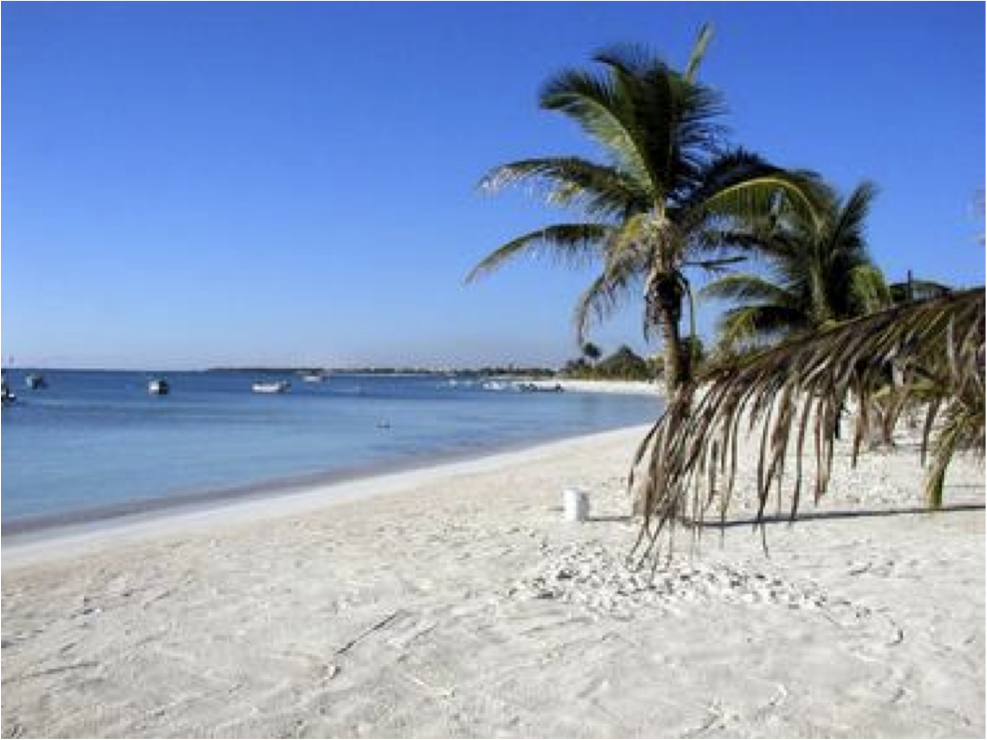
Nutrient Dynamics along the Caribbean Coast of the Yucatan Peninsula, Mexico: Monitoring for Potential Impacts of Development
Sarah Wallace
CE 394K
December 2, 2008

Slide 2
Outline
Introduction
Questions
Study sites
Methods
Results
Conclusions (or further questions!)

Slide 3
Introduction
Water quality parameters directly influence ecology
Rapid development along coastlines increases nutrient runoff
Eutrophication: overabundance of nutrients→ leads to rapid increase in primary production

Slide 4
Questions
Do the coastal water bodies of the Greater Akumal area show eutrophic conditions?
Can nutrient levels be linked to the increased development in the area?

Slide 5
How can we determine the source of nutrients?
ΔN¹⁵: measurement comparing N¹⁵:N¹⁴ in a sample
  Both isotopes found in nature
  Wastewater tends to have a heavy (high) N¹⁵ signal

Slide 6
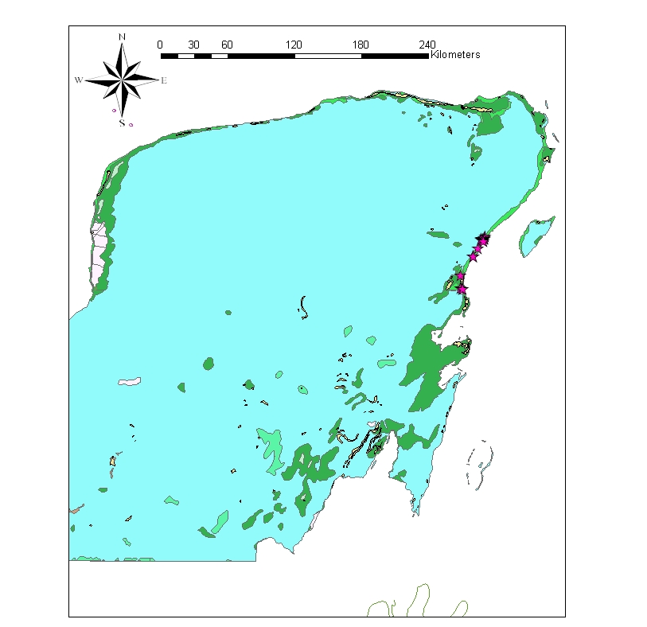
Study Sites

Slide 7
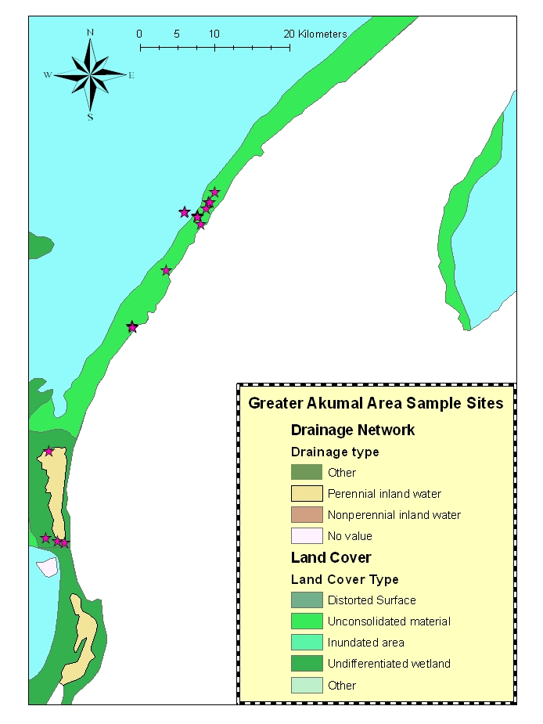
Study Sites

Slide 8
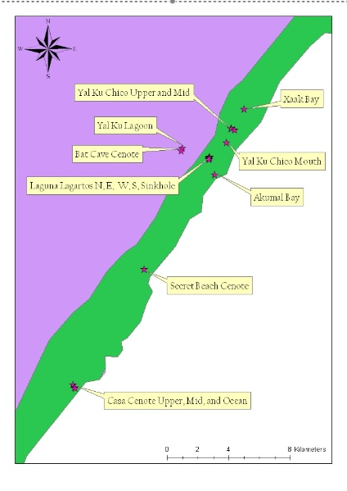
Study Sites

Slide 9
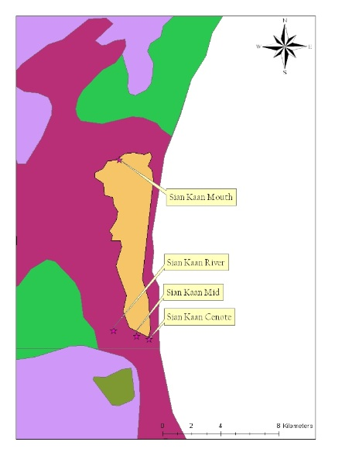
Study Sites

Slide 10
Methods
Data gathered over two years: May-June 2005 and 2007
Sonde data: Temperature, salinity, DO, pH
Water samples: NO₃
Tissue samples: Drift algal and seagrass ΔN¹⁵

Slide 11
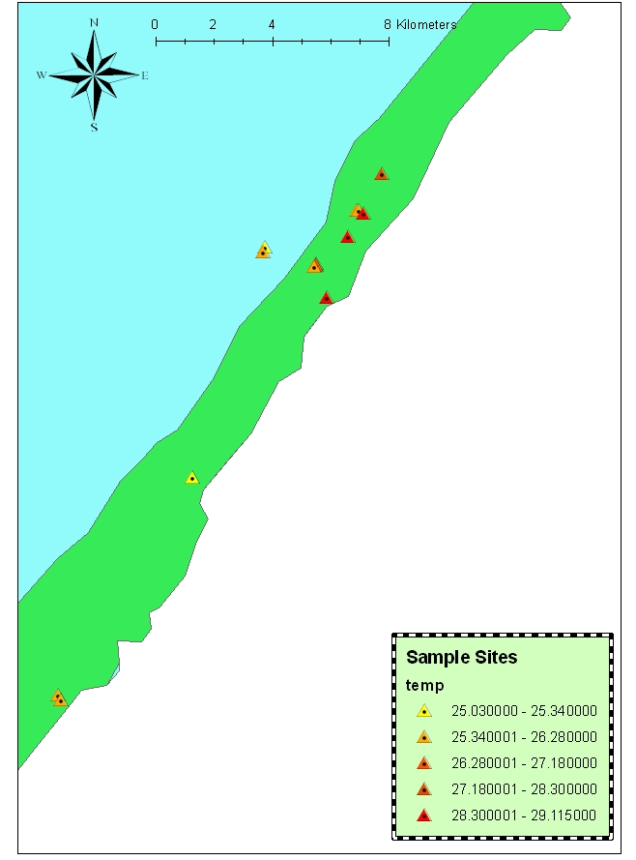
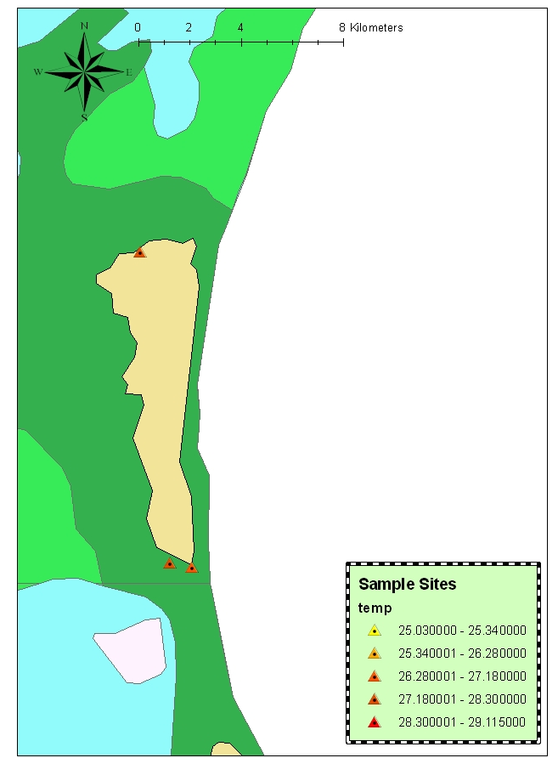
Results

Slide 12
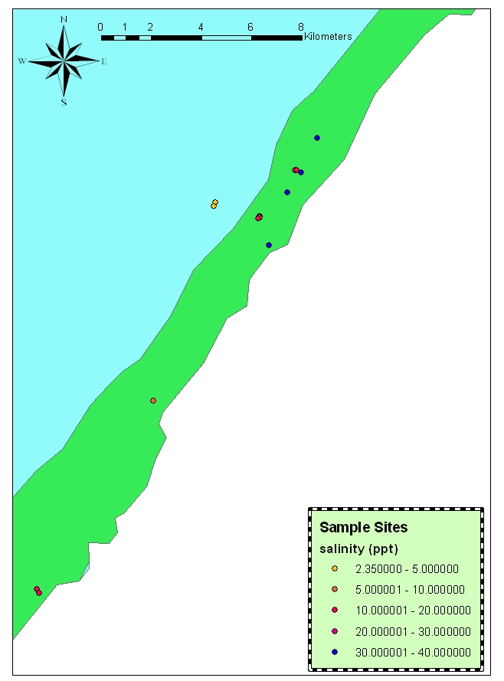
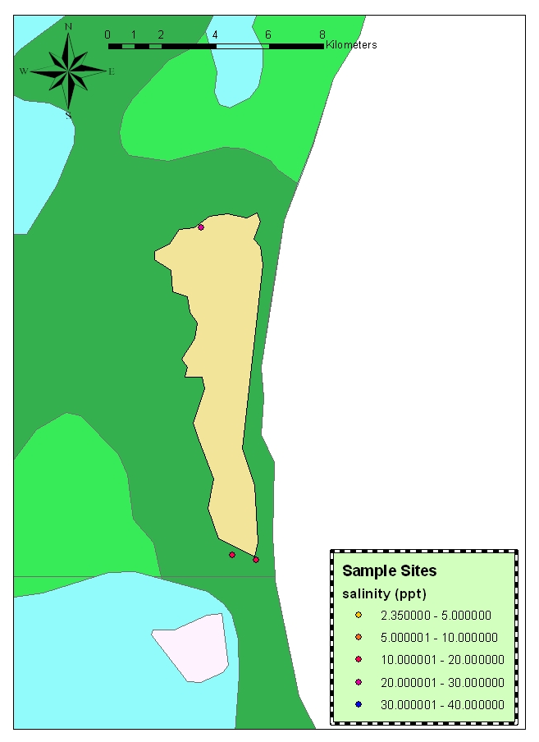
Results

Slide 13
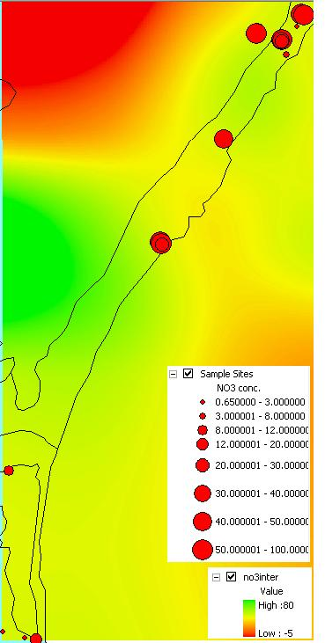
Results

Slide 14
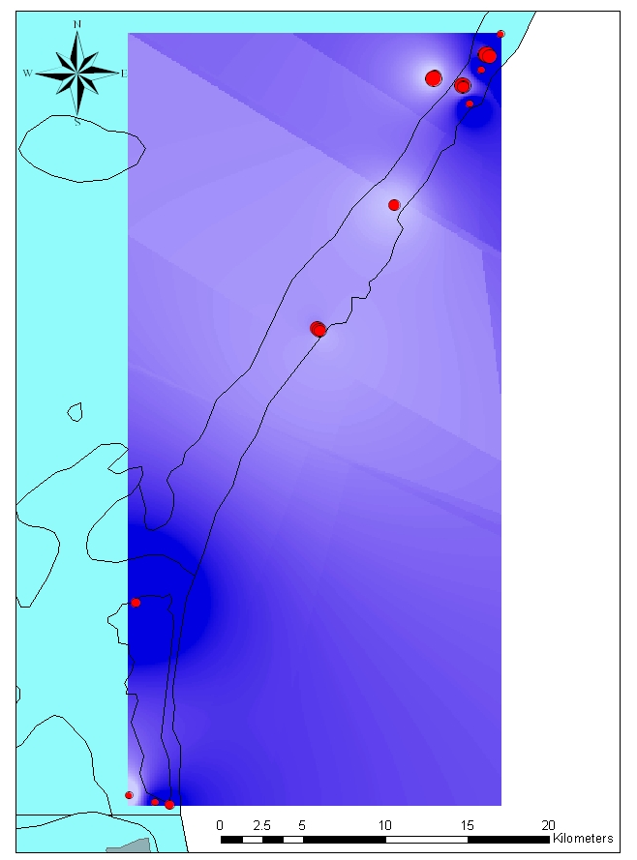
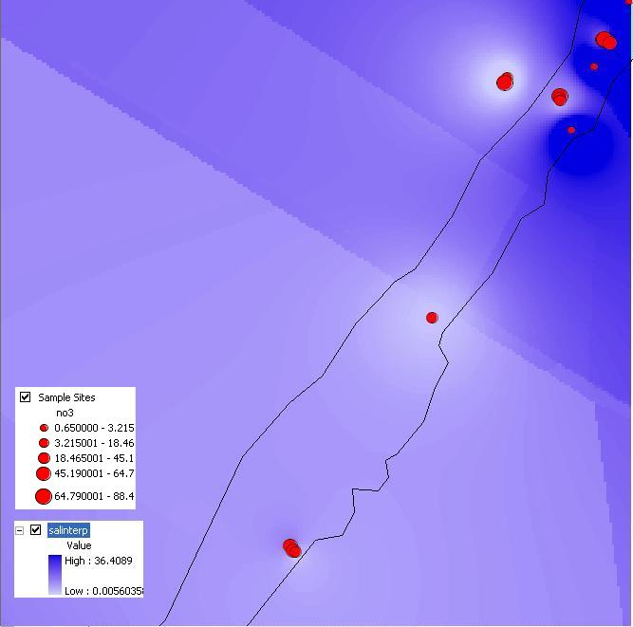

Slide 15
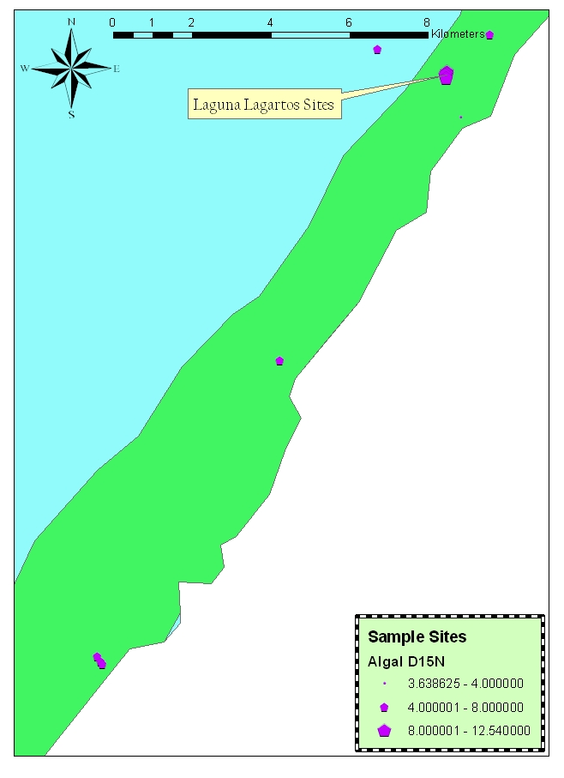
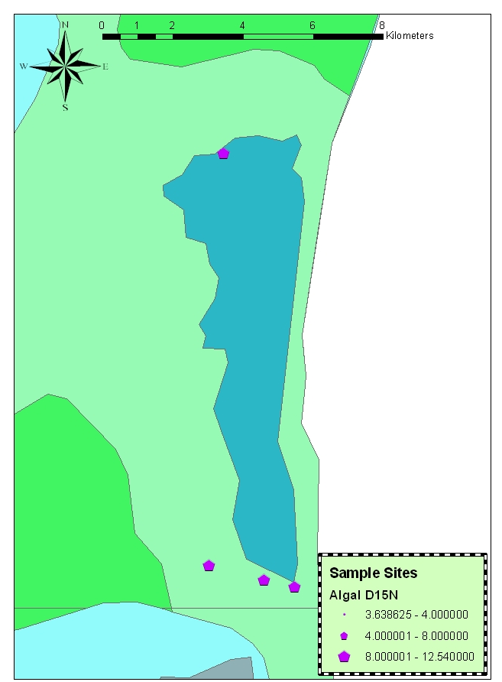

Slide 16
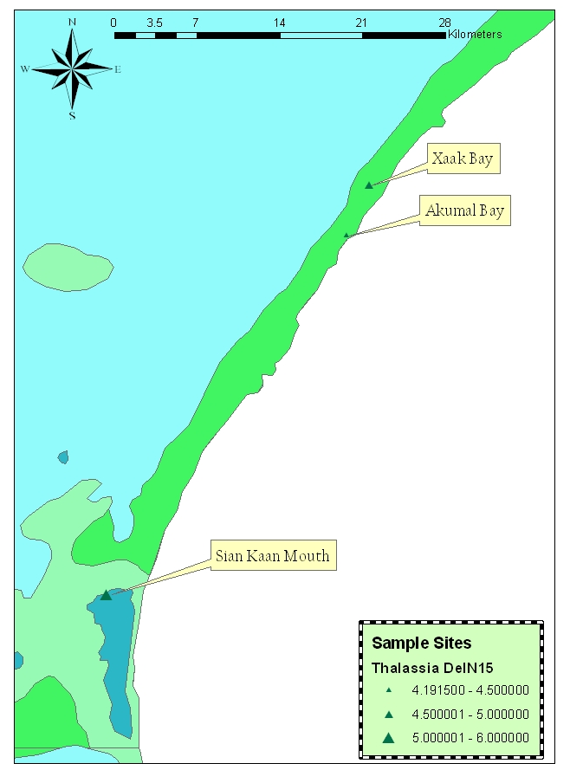

Slide 17
Discussion
Difference in nutrient values between Northern and Southern sites
Nutrient levels appear linked to freshwater input
HOWEVER, high algal ΔN¹⁵ across GAA
  Groundwater connectivity
  Naturally N¹⁵ sediments

Slide 18
Improvements/ Future work
More data!
Integration of phosphorus/ammonium data
Investigate nutrient pulses
Transect study to trace “plumes”
Trophic interactions!

Slide 19
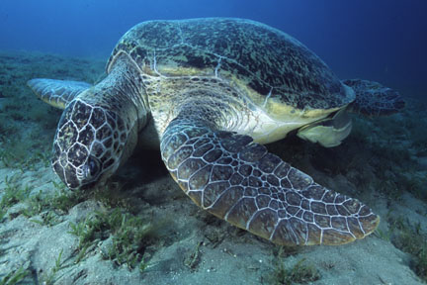
Thank You!
http://www.oceanrealmimages.com/gallery/main.php?g2_view=core.DownloadItem&g2_itemId=161&g2_serialNumber=5

