Slide 1
“Water derives its value from the fact that there is never enough of it”
Examining water quantity and quality in Delhi, India
Nishtha Mehta

Slide 2
Introduction
Background
Sources of Water
Quantity and Quality
Pollution
Disease Burden
Conclusions and Next Steps

Slide 3
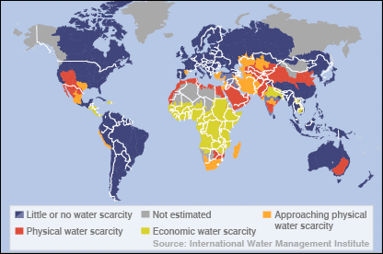
World Water Access
Notes:
Water stress means the proportion of the water intake to the inventory of water resources
According to the UNHABITAT, more than 1 billion people across the globe live in ‘slums’. Approximately 98% of these are in developing countries. UNHABITAT defines these slums as “areas that combine, to various extents, characteristics such as inadequate access to safe water, and other infrastructure, poor structural quality of housing, overcrowding, and insecure residential status” Going by this definition there are approximate 1 billion people across the world that do not have access to adequate water supply. In Delhi alone this number is between 6-8 million people.

Slide 4
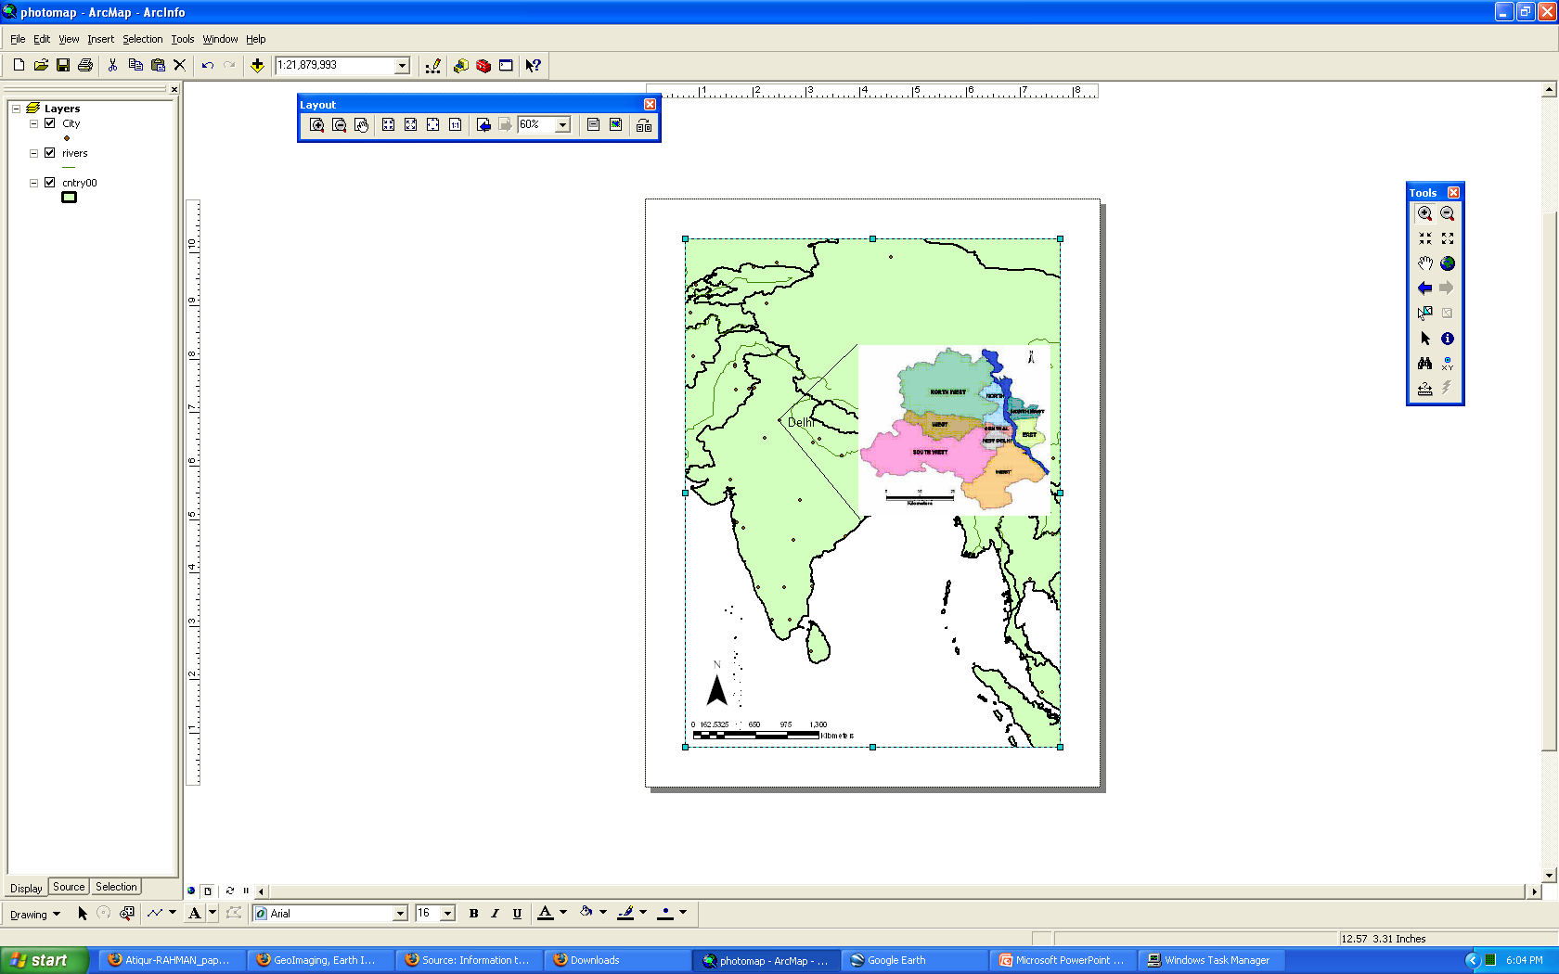
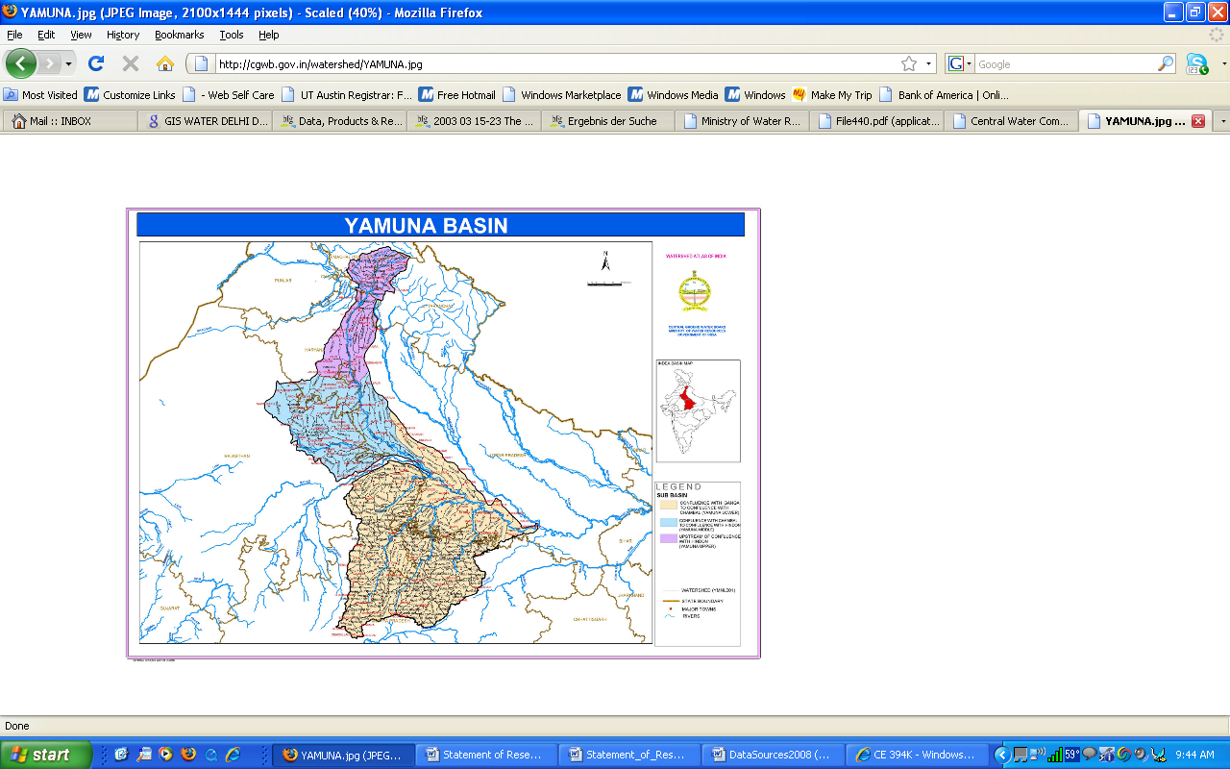

Delhi, India
Delhi
Notes:
Delhi has total area of 1486 sq kms out of which fully developed urban areas is 525 sq kms. With about 17 million inhabitants, the city is bursting at its seams. Delhi receives a total average rainfall of around 600 mm per year, of which 80 % is received in three months ( July – September). Average density of delhi is 9,294 persons per sqkm. In slums this goes upto 300,000 persons per sq km. Average income within these slums is 2$ a day. Poor people end up paying a lot more for water – Davis (2006) found that in Bombay, the poor pay 4000% more for potable water than those with piped connections.

Slide 5
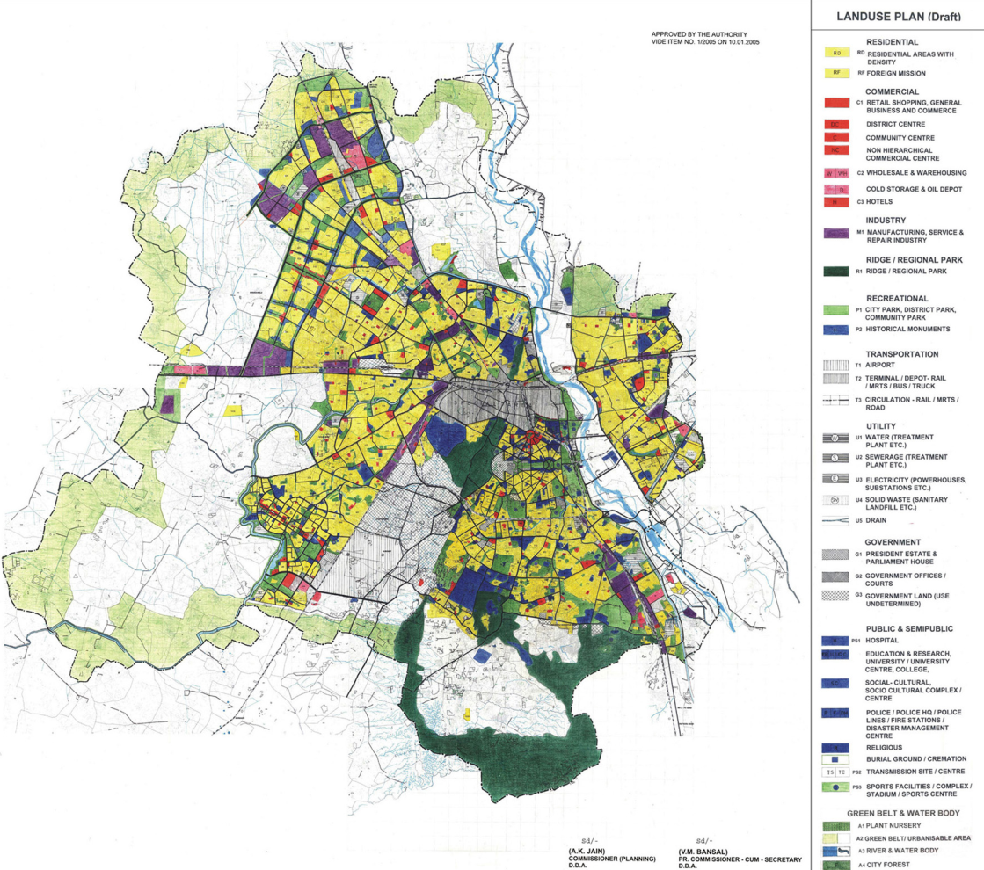
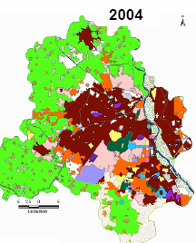

Delhi – Change in Land Use
Notes:
As Delhi population is increasing the land use is expected the shift a bit. What you see here is that the high density residential is moving away from the center of the city to the outskirts. This includes a lot of the slums that existed in the center are being forced out towards the periphery of the city. The periphery does not have piped infrastructure to supply water, of even enough water supply to serve the shifting and incoming population.

Slide 6
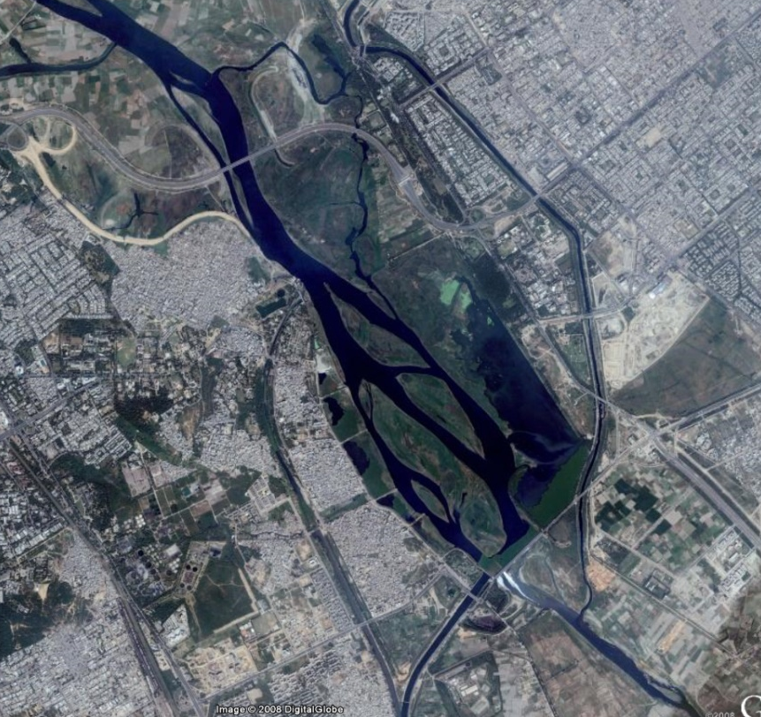
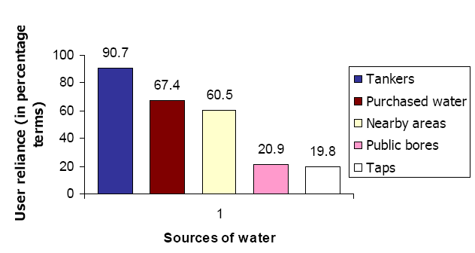
Sources of Water
Yamuna
Notes:
Situated on the banks of the river Yamuna, the city is mainly supplied by surface water from the Yamuna, Ravi beas water ( Bhakra storage) and the Ganga water. The water availability from surface water sources, viz. Yamuna, Ganga and Bhakra systems is approximately 1150 MCM ( million cubic metre), and of this 40 % is available from Yamuna river. Total groundwater availability is of the order of 290 MCM per year. Ranney wells and tubewells. This source, Delhi's ground-water level has gone down by about eight meters in the last 20 years at the rate of about a foot a year.
- According to the DJB office, 10-12 residents can ask for a tanker free of cost. Most residents say that their allotted tanker arrives once
in two or three days. But in 2007 DJB’s limit has been reached, so no more applications for tankers are being accepted. The number of people depending on nearby sources of water has increased.

Slide 7
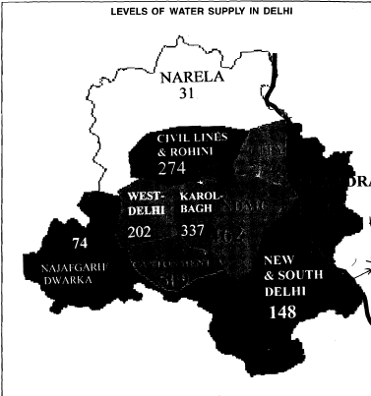
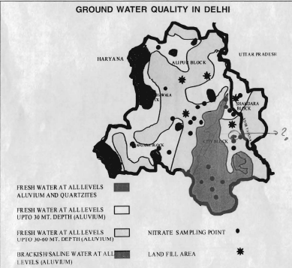
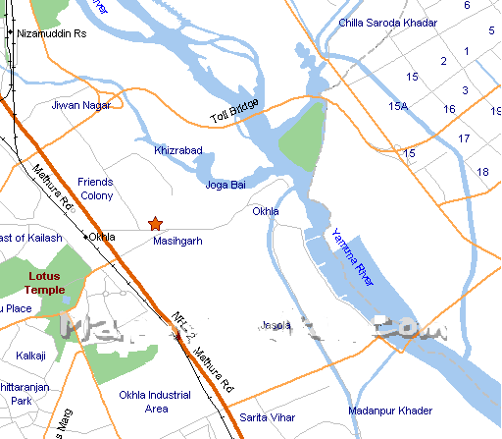
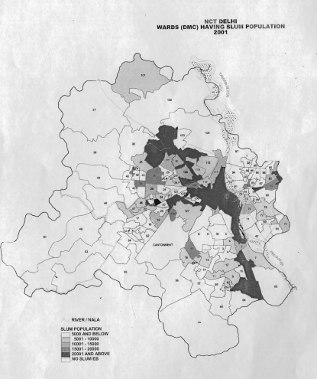
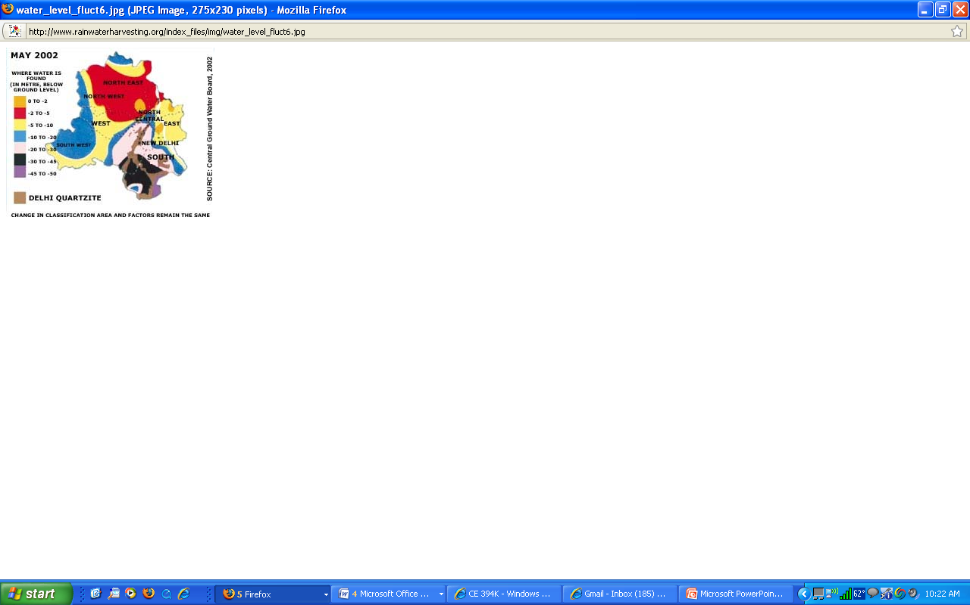
Water Quality and Quantity
Notes:
the ground water levels in Delhi are declining. The water quality is questionable. In most of the Delhi Jal Board Area (60% of the city) the water quality is either brackish at all levels or the fresh water is at 40m. In terms of the zones of decline too, the south Delhi rate is approximately 12-m per year.
the worst case scenario is the South of the city. because there is no existing water treatment plant in the South of the Delhi. neighborhood and Zehra and Whittington have found that slums located near waste water treatment plants have better access to potable water. The closest Ranney Wells are all located on the other side of the river making access difficult.
It's estimated that one hand pump serves an average of 125 households (approximately750 people). Most pumps are already dry or in disrepair.

Slide 8
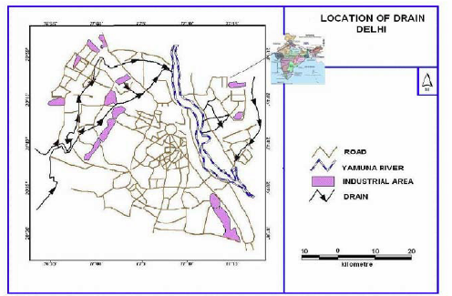
Water Pollution
Notes:
The river Yamuna covers a 22 km stretch between Wazirabad and Okhla barrage in Delhi which is only 2% of its catchments area, but Delhi contributes about 80% of the river’s total pollution load. Nineteen major drains of Delhi dispose untreated municipal wastewater, approximately 2,871 million litres per day into the Yamuna of which approximately 300 million litres per day are from the industrial sector. Out of this at least 200 million liters of untreated muck being dumped in it everyday by Delhi's sewerage system that is why it is one of the most polluted rivers in the world (Malik, 2000). The Najafgarh drain alone contributed more than 80% of the waste water entering into the river Yamuna.
However, you also have to remember that approximately 60% of water supply is from Yamuma and most of the people living in slums do not have access to treated piped water. This is one of the reasons why the water borne disease rate in Delhi is extremely high.

Slide 9
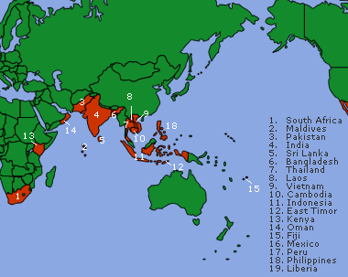
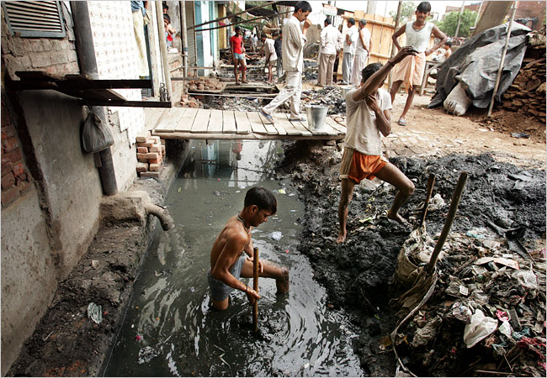
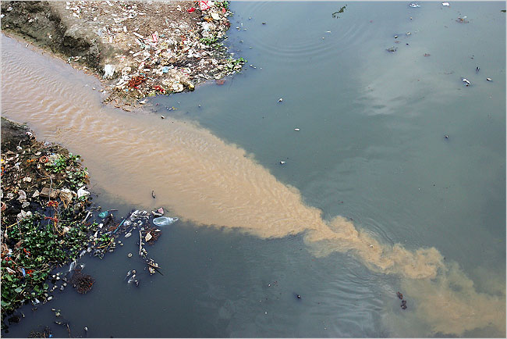
Water Borne Diseases
Notes:
- In June of 2004, approximately 1000 cases cholera were reported in Delhi. This figure is more than three times the number of cases (207) reported for the same period in 2003. Typhoid cases also increased from 56,000 to 106,000 from 2004 to 2007. Diarrhea is endemic and is responsible for at least 15% of below 5 death in India. (This implies that all water borne diseases when examined together affect a significant percentage of the Delhi population. This disease burden is borne disproportionately by the slum residents due to the lack of means to clean water and adequate water-storage facilities (Lal, et al., 1996).

Slide 10
Conclusions and Next Steps
Water access in Delhi, specifically in slums is limited. There are no piped connections and people mostly rely on storing, stealing and buying.
The ground water is not considered safe to drink.
There is a wide gap between water related policies, and water use on the ground
KEY NEXT STEP – Maybe create some GIS Maps for the city!
Notes:
The World Bank and Asian Dev Bank and UN have been promoting privatization. That has not been successful in three pilot programs in India. The reason for that is its been economically motivated. The language used is “willingness to pay” “consumers” “economic good”. “ability to pay” “coping mechanisms” and “human right” are words that are not being explored much and hence not being reflected in policies. I am hoping that this research will address this gap.

