Slide 1
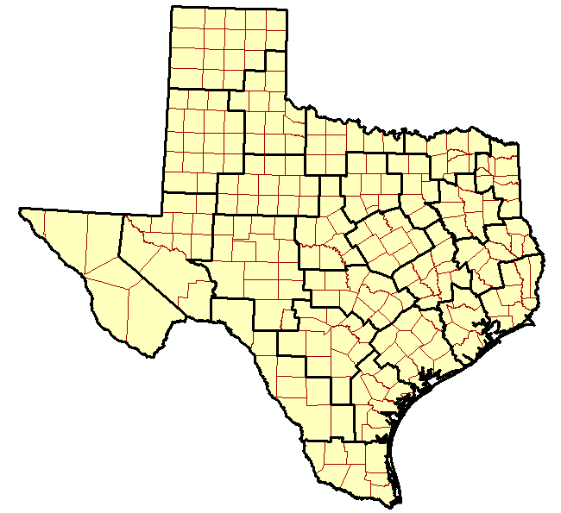
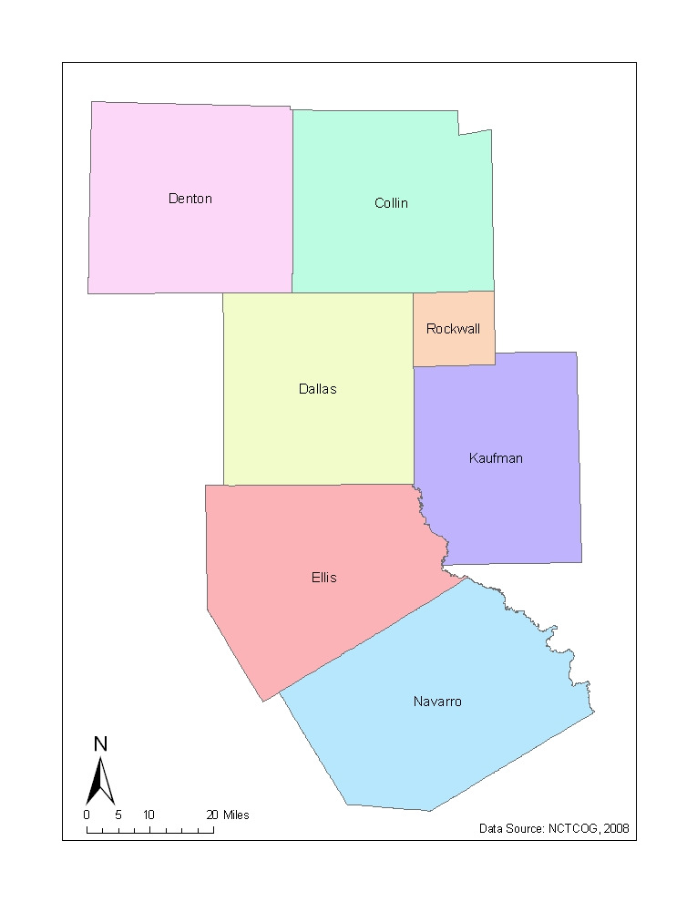
Creating a GIS Based Traffic Control Planning Tool for the Dallas District
Andrew Karl
Dr. Maidment
CE 394K.3
GIS in Water Resources
Term Project
Due: 12/4/08

Slide 2
Dallas – Fort Worth area is 5th most congested region in the country
Commuters lose an average of 58 hours per year stuck in traffic
Total hours lost in the region will be over 150 million this year
Counteract traffic congestion with proper maintenance and construction of new infrastructure

Slide 3
Problem:
Maintenance and upgrades to roadway infrastructure involves lane closures
Detours cost commuters time and money
These user costs are often unaccounted for in traffic management plans
The importance of considering these user costs has driven the need for an aggregate database combining information on roadway properties, capacity, and demand
Solution:
Use data from 3 existing databases:
Census Road Data: gives roadway geographic information for each county
Pavement Management Information System (PMIS) + Texas Reference Markers (TRM)
a. PMIS contains physical roadway characteristics (# of lanes, lane width, shoulder width) which are used to calculate a roadway’s capacity
b. TRM is a statewide linear referencing database which ties PMIS data to geographical locations
Dallas – Fort Worth Regional Travel Model (DFWRTM): provides estimated traffic volumes on roadway links in the Dallas region
MORE PROBLEMS:
No common identifier among the 3 databases
Different coordinate systems were used

Slide 5
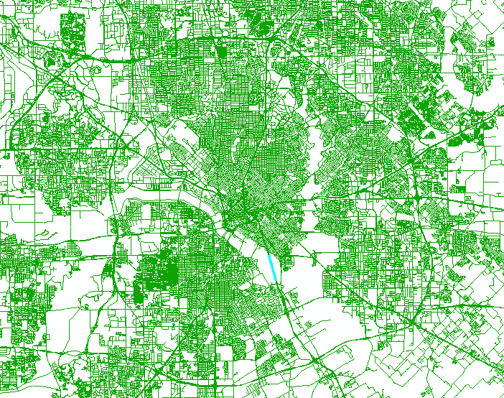
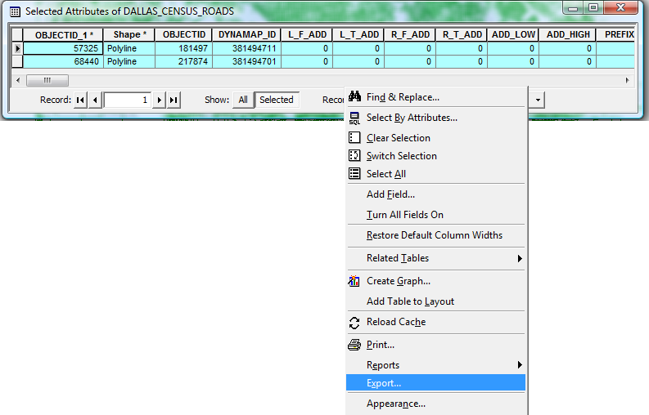
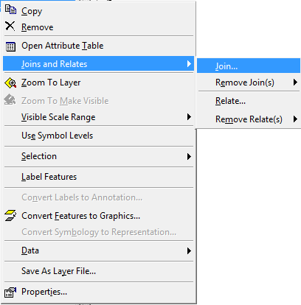
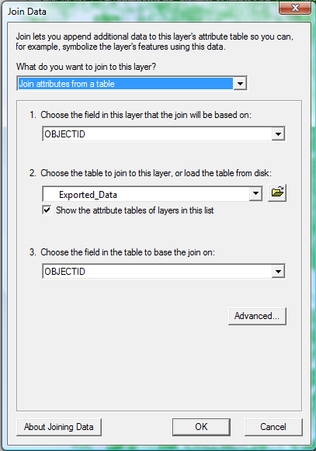
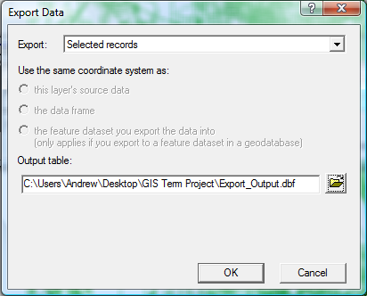
1. Create PMIS Labels for Census Road Layer
VBA Program
IH0045L
IH0045R

Slide 6
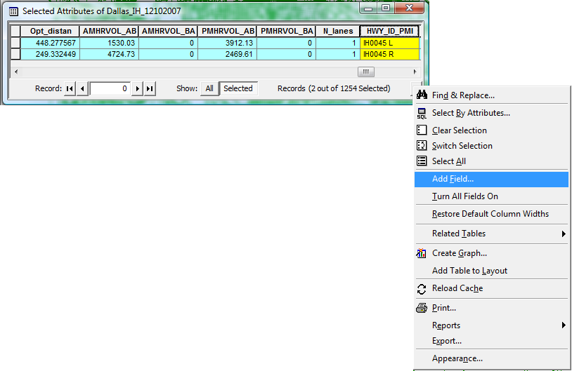
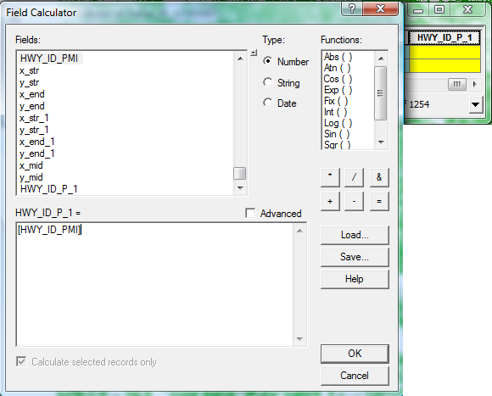
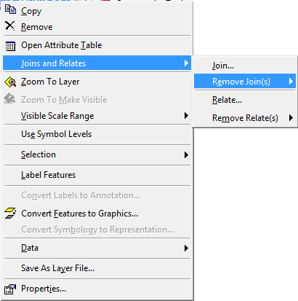
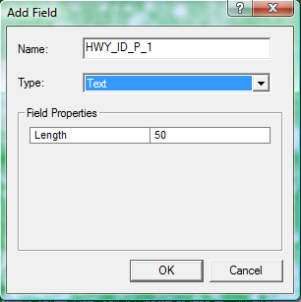
1. Create PMIS Labels for Census Road Layer

Slide 7
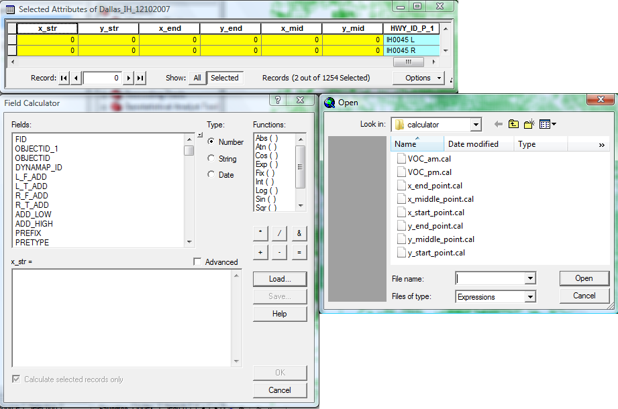
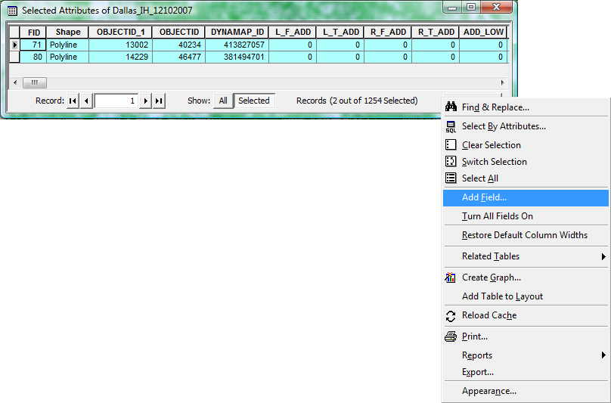
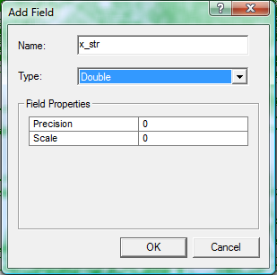
2. Add X & Y Coordinates of Start, Mid, and End Points for Census Roads

Slide 8
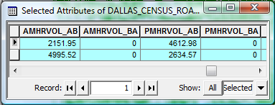
3. Create PMIS Labels for the Demand Layer
Add Demand shapefile to ArcMap and repeat similar to Step 1
4. Add X & Y Coordinates of Mid-Points of Demand Layers
Repeat similar to Step 2
5. Merge the Demand and Census Road Layers
Export both attribute tables (Demand and Census Road) to EXCEL
VBA program is run to merge the layers
Criteria for matching:
1. Uniform Identifier
2. Match the closest links based upon start, mid, end points

Slide 9
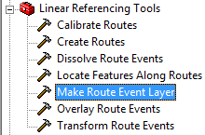
6. Calculate Capacity Using PMIS Data
Query necessary data from ACCESS, import to EXCEL, perform calculations
Freeway Capacity: SF_{i} = MSF_{i}(N)(f_{w})(f_{HV})(f_{p})
2-Lane Highway Capacity: V = v_{p}(PHF)(f_{g})(f_{HV})
7. Create Route Event Layer of Capacity Data
Select roadway segments from Census Road shapefile
Create new layer consisting of only that roadway
Use Linear Referencing Tools Make Route Event Layer

Slide 10
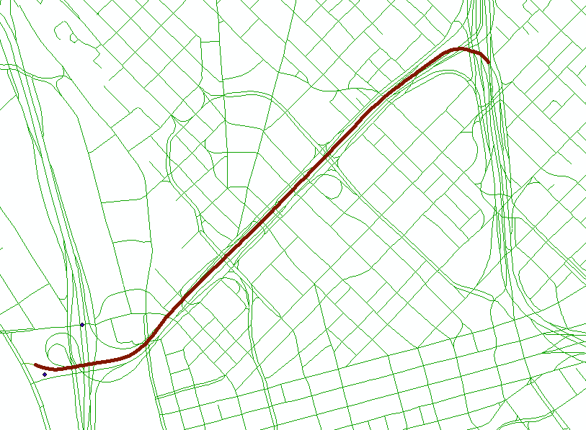
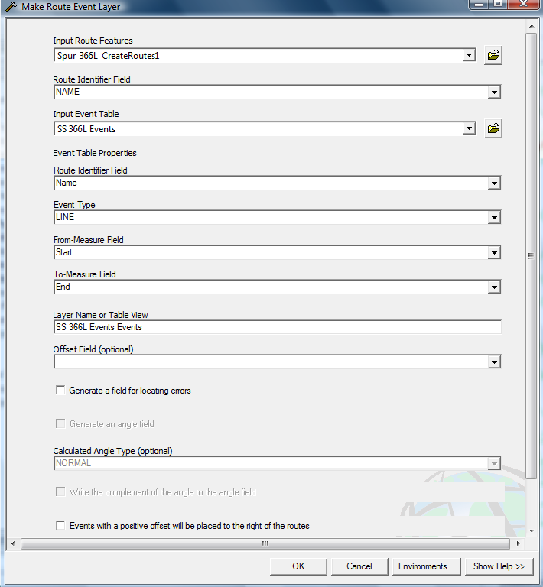
7. Create Route Event Layer of Capacity Data

Slide 11
8. Merge the Capacity (Route Event) Layer with the Census Road Layer
Accomplished similar to previous merging procedures

Slide 12
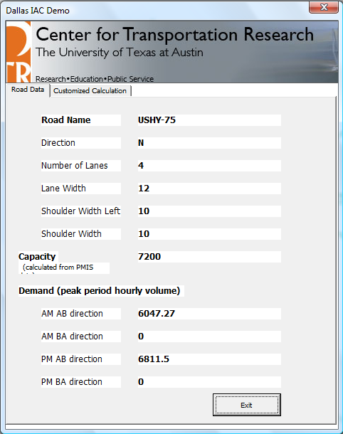
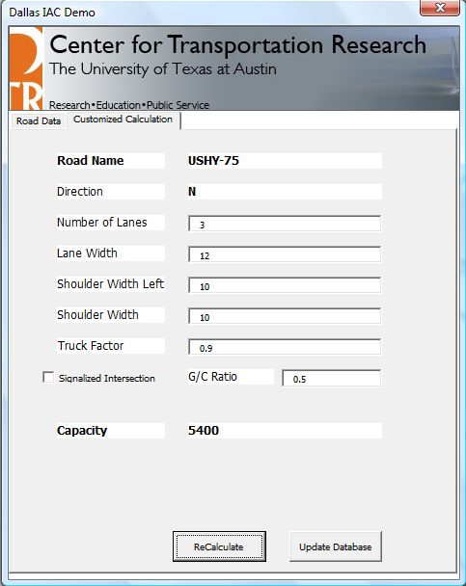
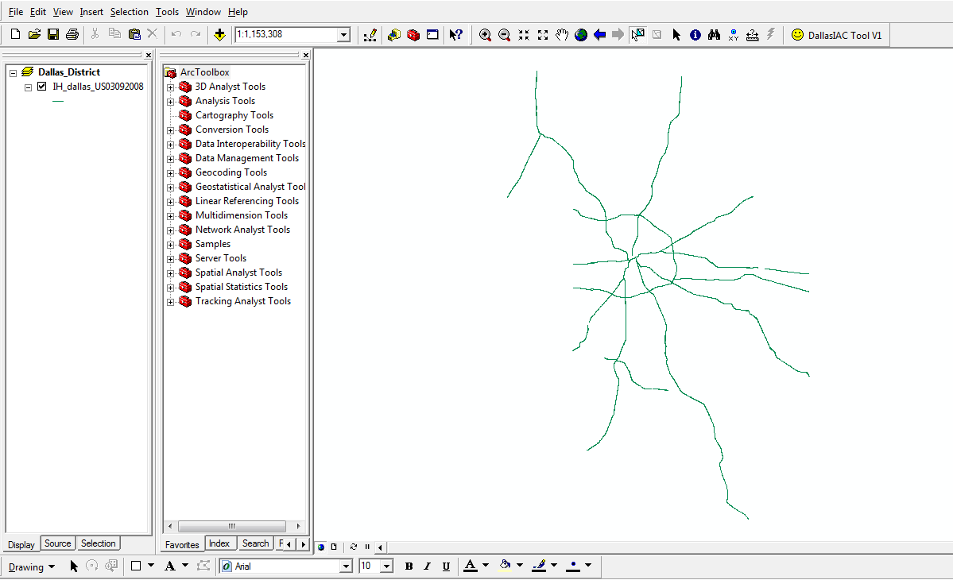
Current GIS Model

Slide 13
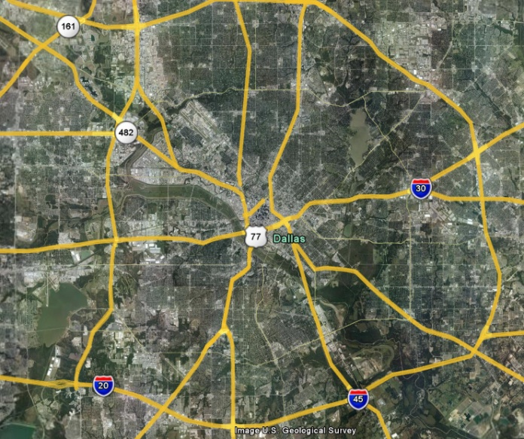
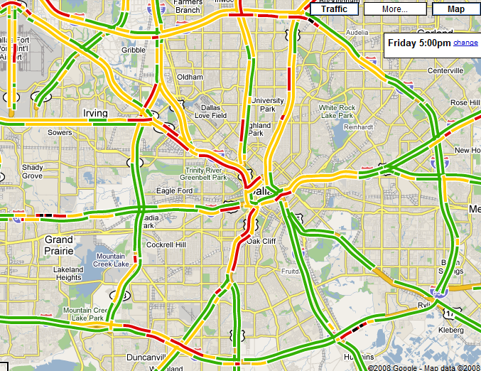
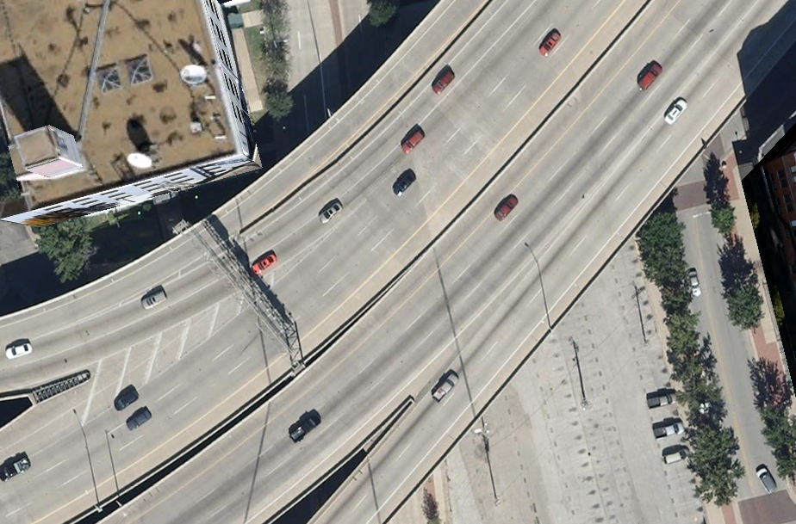
Other Neat Features

Slide 14
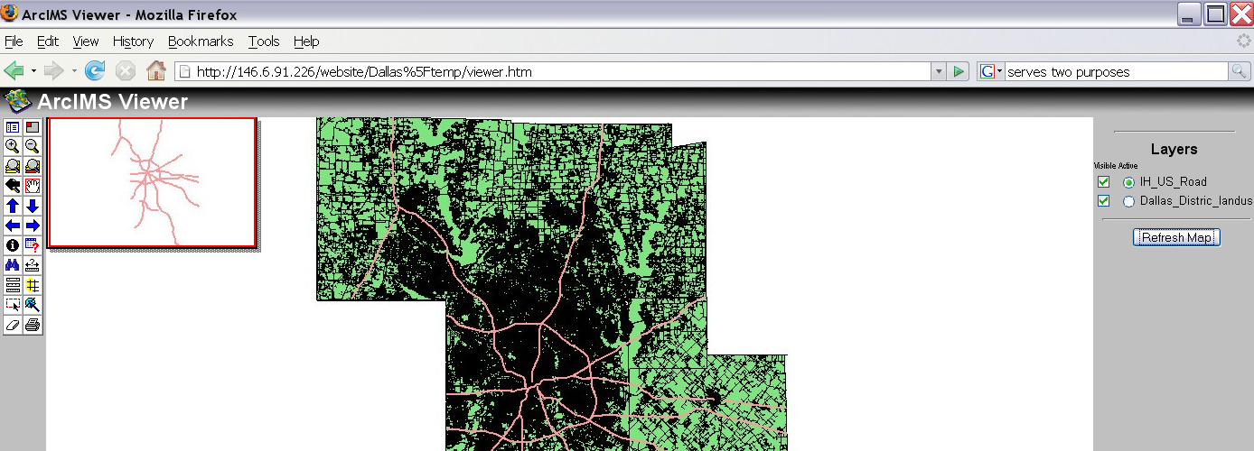
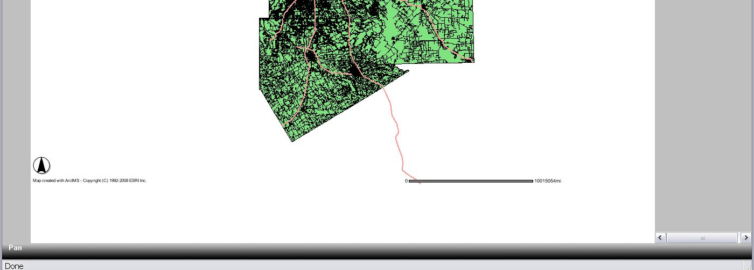

Slide 15
Future Work
Phase 1:
Currently working on adding frontage roads and arterial streets into the GIS model
Phase 2:
Will provide the model with simulation ability which will generate further information for enhancing traffic flow
Phase 3:
Involves transforming the static model into a dynamic model, thus providing more realistic estimates of traffic flow in the region

