Slide 1
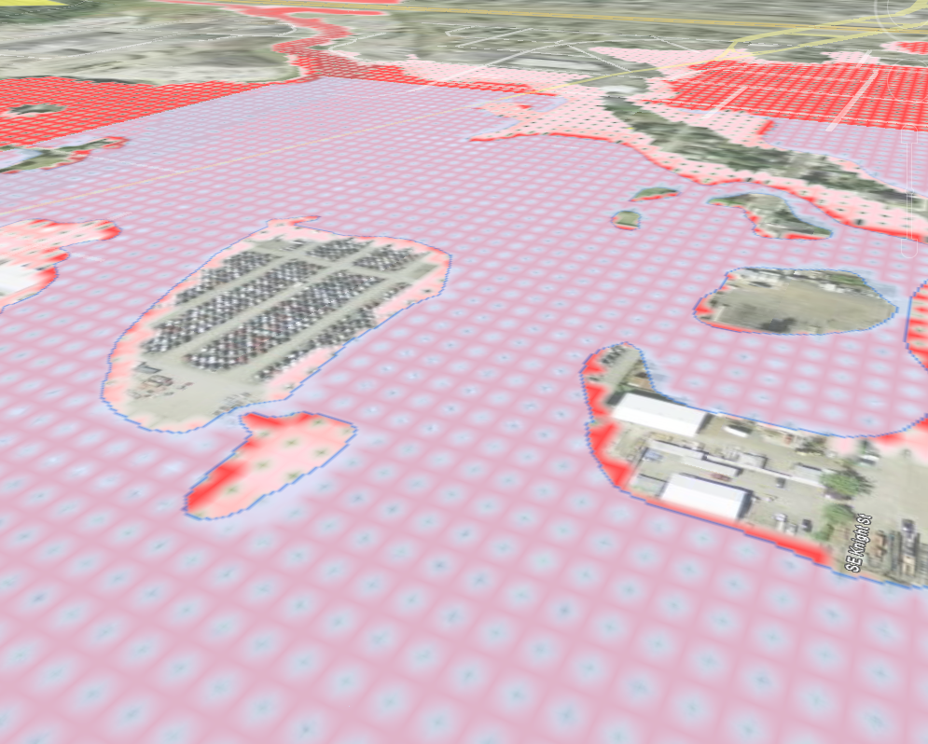
Impacts of Flooding in the Johnson Creek Watershed
Laura Read
December 4, 2008

Slide 2
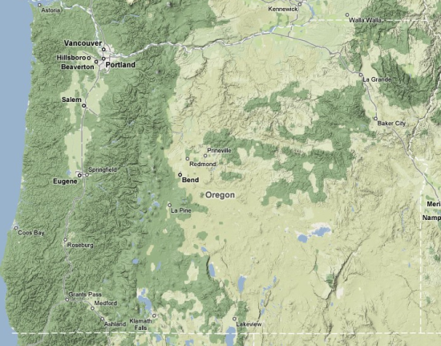
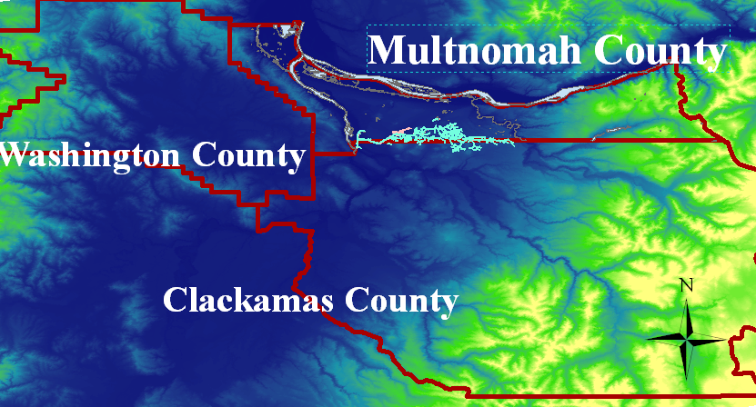
Study Region

Slide 3
Project Questions and Goals
Demographic description of Johnson Creek’s residents and land value
Land use and changes
How flooding may play a role in shaping the land usage in Johnson Creek

Slide 4
Multnomah County, Johnson Creek Watershed
170,000 residents on 52 mi² of land
WPA’s renovations altered stream without improving flood conditions
Urbanization increased flood prone area

Slide 5
Johnson Creek Watershed

Slide 6
Flood Facts
Portland awarded $2.5 million from FEMA’s Pre-Disaster Mitigation Grant Program
East Lents: Flooded 39 times in the past 60 years
Floodplain
Floodway

Slide 7
Taxlots and Identification
A visual property information database
Collaboration between City Bureaus

Slide 8
Taxlot Attributes
Sample Attribute Table
Zoomed In

Slide 10
Property Values

Slide 12
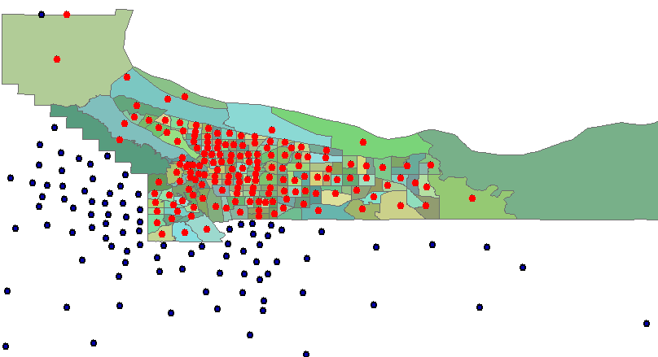
Census Analysis
Census data for each tract

Slide 13
Land Cover in 1992, Multnomah Co.

Slide 14
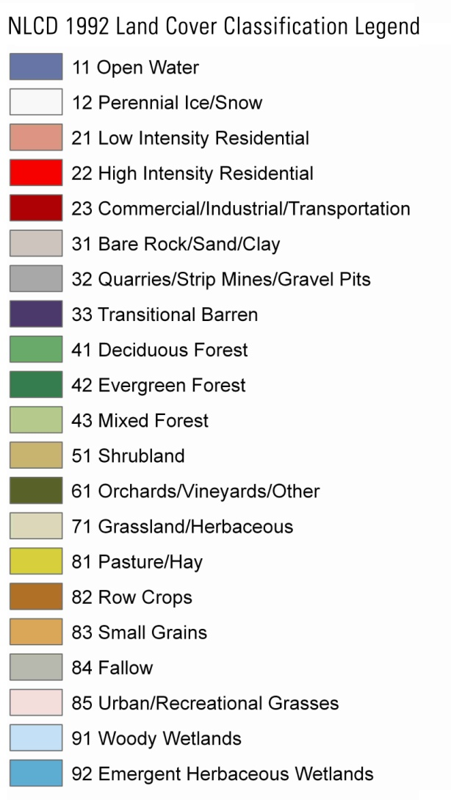
Land Cover in 2001, Multnomah Co.

Slide 15
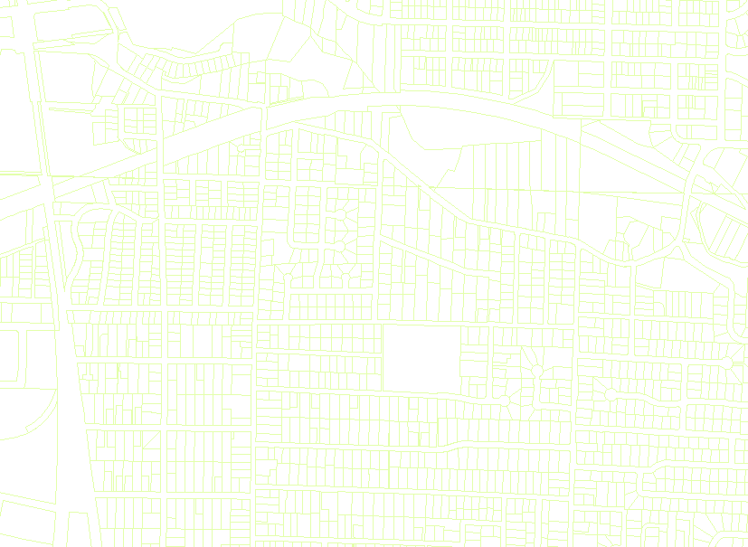
Finishing Touches
Created maps of demographic distributions: population, average house value, age, poverty, unemployment
Analyzed Land Cover and Usage for percentages
Still need to compare Multnomah Co. data to Johnson Creek

Slide 16
Data Sources
City of Portland: taxlots, streets, streams
U.S. Census Bureau TigerLine and PUMA files
USGS Seamless for 1 arc second DEM and Land Cover Data (NLCD)
Google Earth

