Slide 1
Desalination and Long-Haul Transfer as a Drinking Water Supply
Ashlynn Stillwell December 4, 2008 CE394K: GIS for Water Resources
http://www.webberenergygroup.com

Slide 2
Outline
Background on Desalination
Purpose of Project
Assumptions
Case Study Map
Results and Discussion
Implications
Questions

Slide 3
Background on Desalination
Treats brackish water or seawater to potable quality
Types of desalination
Multi-effect distillation
Multi-stage flash
Reverse osmosis
Source: Lawler & Benjamin

Slide 4
Purpose of Project
Dallas-Fort Worth Metroplex is growing
Metro statistical area: 5.6 million people (2003)
Dallas water use: 238 gal/person/day
Fort Worth water use: 177 gal/person/day
Population increases 2% annually, on average
Depleted water supplies
Looking toward alternative supplies

Slide 5
Assumptions
20 MGD desalination facility
Sufficient for 100,000 people at current DFW water use
Real estate available
No financial consideration – energy only
Pipe friction factors based on laminar flow

Slide 6
Desalination and Long-Haul Transfer Map
Straight Pipeline from Houston to Dallas-Fort Worth

Slide 7
DEM and Cumulative Elevation Changes
Straight Pipeline from Houston to Dallas-Fort Worth
Cumulative elevation change: 700 m (2,300 ft)
Pipeline length: 413 km (257 mi)

Slide 8
Desalination and Long-Haul Transfer Map
Right-of-Way Pipeline from Houston to Dallas-Fort Worth

Slide 9
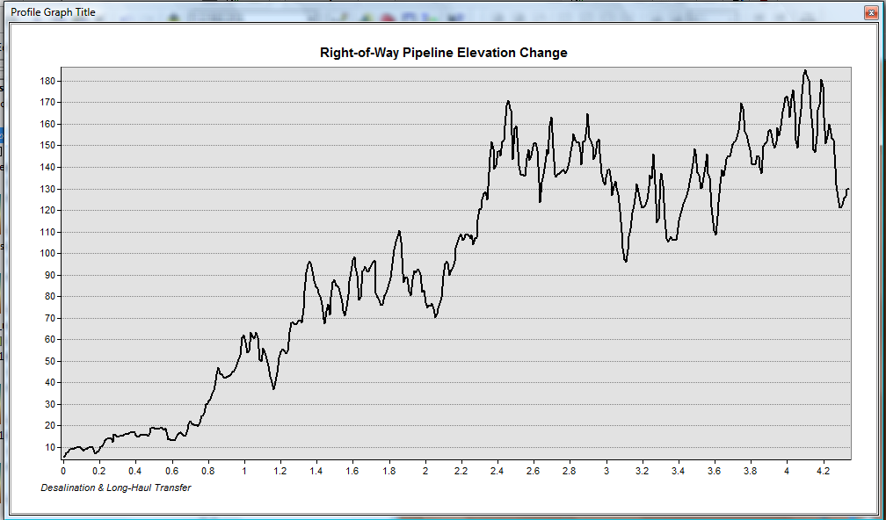
DEM and Cumulative Elevation Changes
Right-of-Way Pipeline from Houston to Dallas-Fort Worth
Cumulative elevation change: 745 m (2,400 ft)
Pipeline length: 486 km (302 mi)

Slide 10
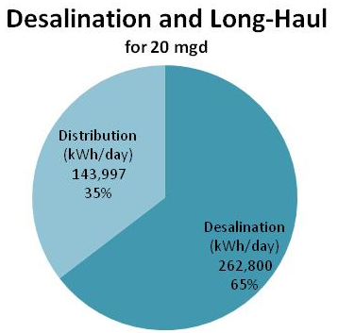
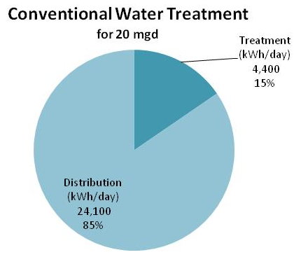
Energy Requirements for Desalination and Long-Haul Transfer
Total: 407,000 kWh/day
Total: 28,500 kWh/day

Slide 11
Air Emissions from Energy Production
407,000 kWh/day
Electricity generated by coal:
933,000 lbs CO₂
2,700 lbs SO₂
2,000 lbs NO_{x}
Electricity generated by natural gas:
466,000 lbs CO₂
407 lbs SO₂
12 lbs NO_{x}

Slide 12
Implications for Energy and Water Policy
Desalination scenario requires 14 times more energy than standard water treatment
Additional environmental concerns over disposal of concentrate
“Alternative” water supply – Conservation
Water Conservation Implementation Task Force recommends 140 gal/person/day
Saving water saves energy

Slide 13
Questions?

Slide 14
END
Ashlynn Stillwell Graduate Research Assistant Cockrell School of Engineering Department of Environmental & Water Resources Engineering Lyndon B. Johnson School of Public Affairs
University of Texas at Austin
ashlynn.holman@mail.utexas.edu
http://www.webberenergygroup.com

