Slide 1
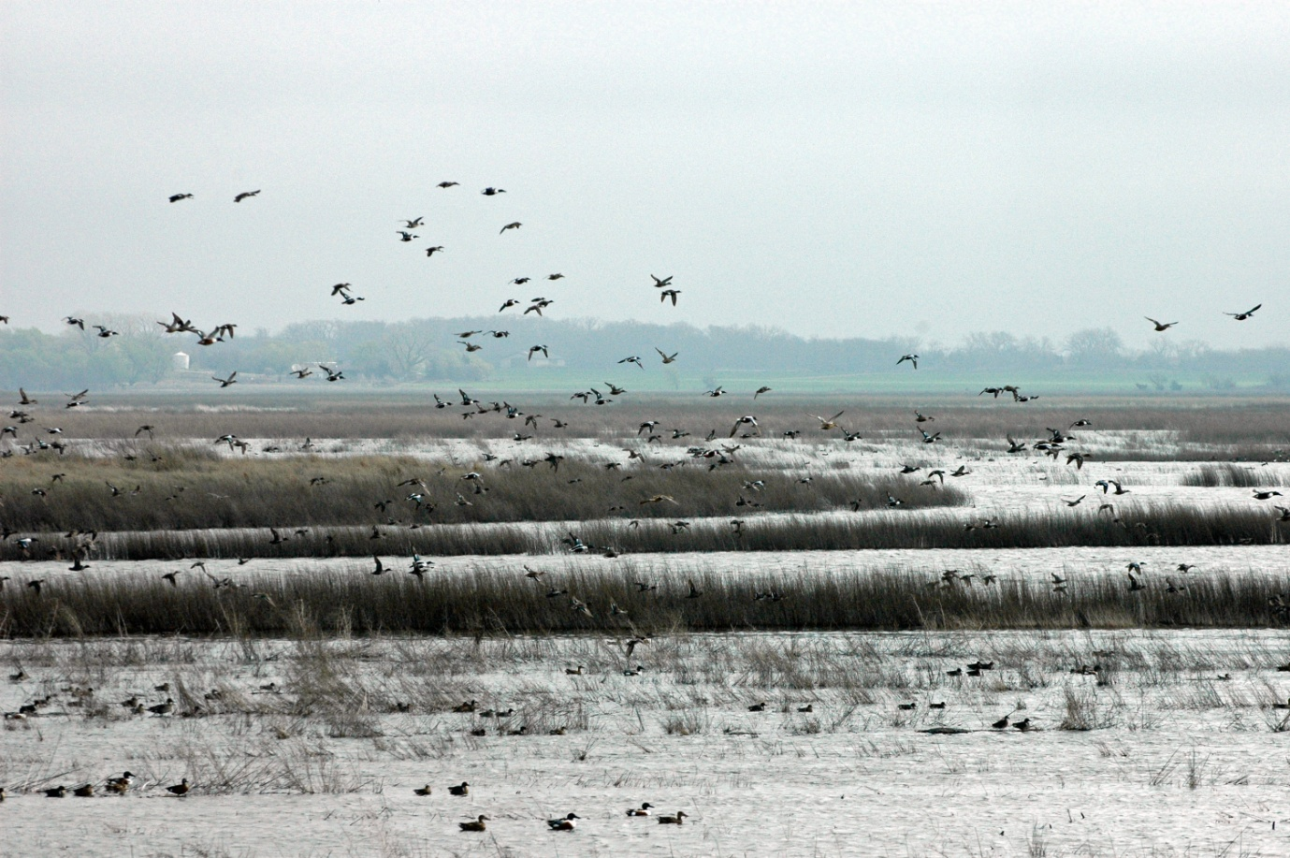
Texas Coastal Wetlands
Linking Water & Land
By: James McDonald

Slide 2
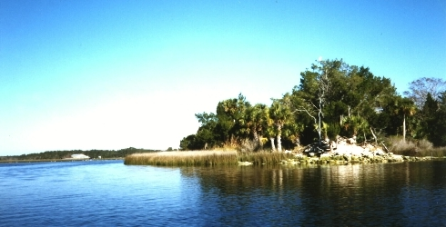
Background
5 Million people reside on or near the Texas Gulf Coast
Project Objectives:
  Are wetlands disappearing?
  At what rate?
  How will this affect us?

Slide 3
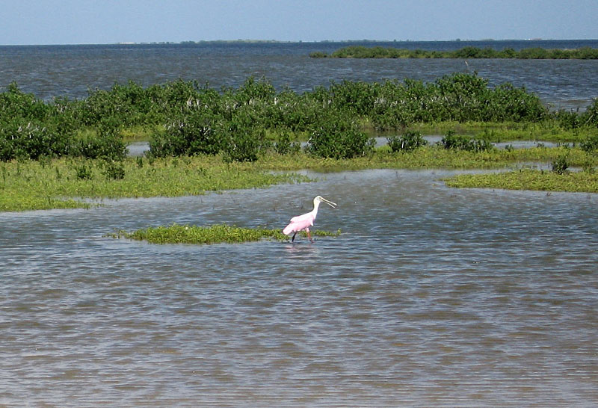
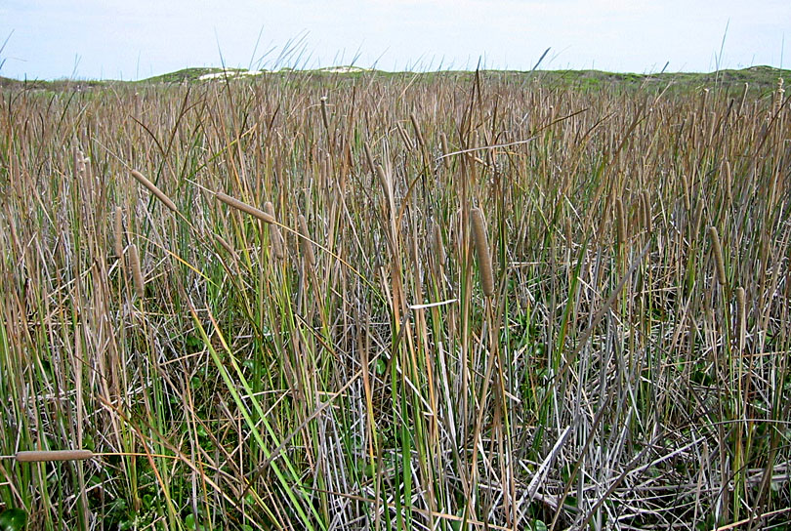
Wetland Functions & Importance
Habitats
Hydrologic & Hydraulic
Water Quality

Slide 4
Project Analysis
Galveston Bay and surrounding area
Data sets (1956, 1989) – USGS
Habitat classification – wetland type

Slide 5
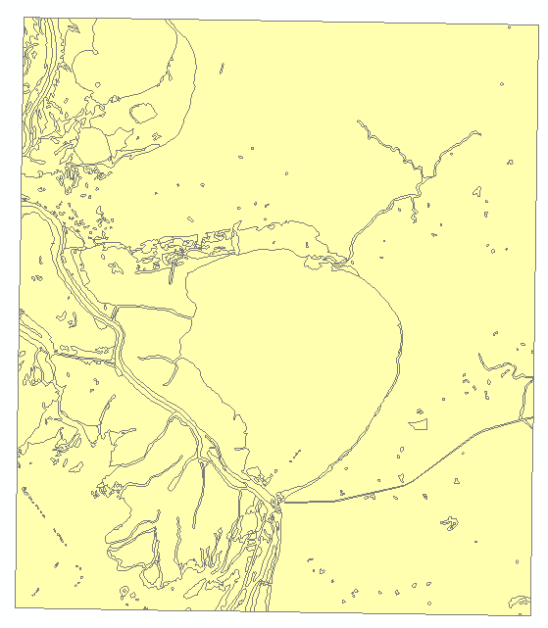
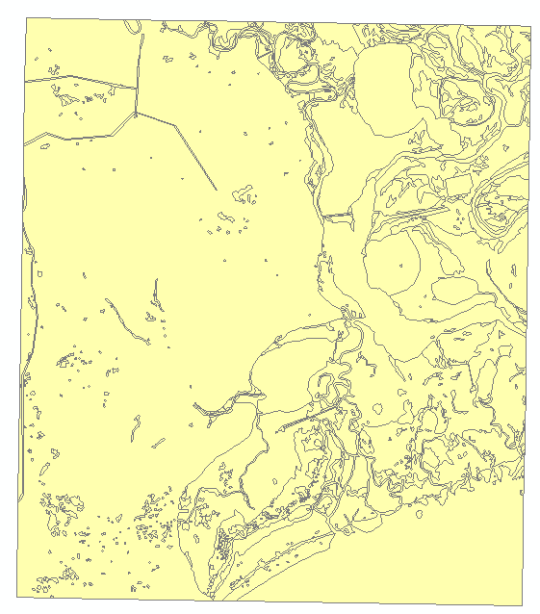
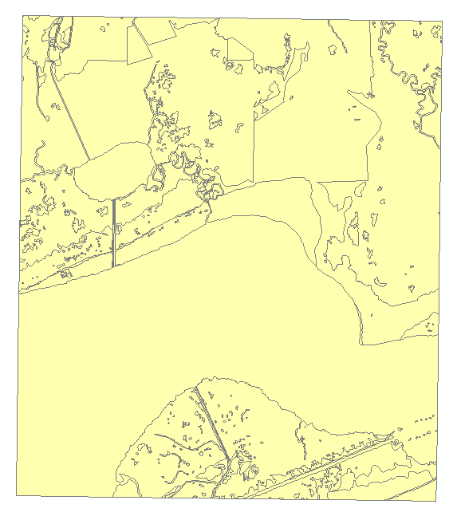
Data Source
Data was obtained from the USGS
  Includes 31 quadrangle maps at 1:24,000 scale, developed by the National Wetlands Inventory (NWI)

Slide 7
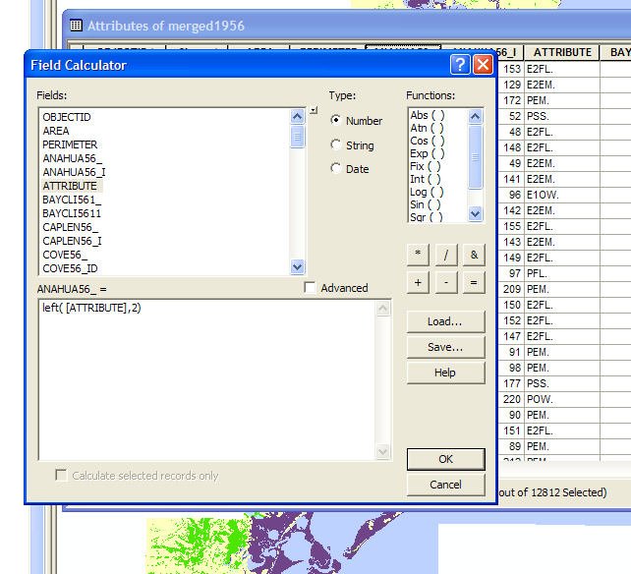
Organization by Field Calculator

Slide 8
Merged Data

Slide 9
1956
Palustrine Wetlands
Estuarine/Marine Wetlands

Slide 10
1989
Palustrine Wetlands
Estuarine/Marine Wetlands

Slide 11
1956
Palustrine Wetlands
Estuarine/Marine Wetlands

Slide 12
1989
Palustrine Wetlands
Estuarine/Marine Wetlands

Slide 13
1956
1989

Slide 14
Wetland Loss
 | Area (km²)
 | 1956 | 1989 | Difference
Marine Wetland | 10 | 9 | -1
Freshwater Emergent Wetland | 193 | 90 | -103
Freshwater Forested Wetland | 11 | 23 | 12
Freshwater Shrub Wetland | 14 | 8 | -6
Estuarine Wetland | 542 | 513 | -29
Rivers | 13 | 12
Lakes | 48 | 87
Freshwater Pond | 6 | 16
Deep Water | 1498 | 1539
Upland | 1990 | 2021
Total Wetlands | 770 km² | 643 km²
Loss of 16%

Slide 15
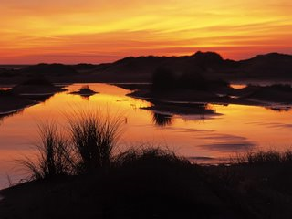
Conclusions
Wetlands are diminishing
Galveston Bay reduction rate = 3.8 km²/year
Palustrine (freshwater) wetlands have seen more severe adverse affect
  Particularly at river deltas

Slide 16
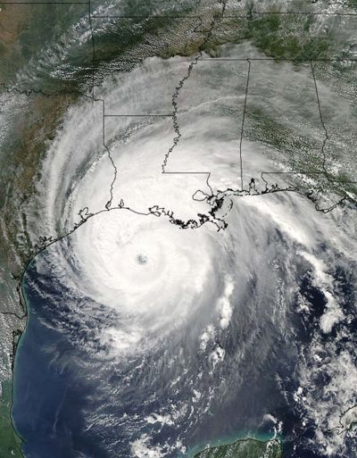
Consequences
Loss of habitat, ecologic integrity
Vulnerability:
  Storm surge: 1 km of wetlands reduces surge by 7 cm
  Flooding: 1 km² of wetlands can store 250-350 gallons of water

Slide 17
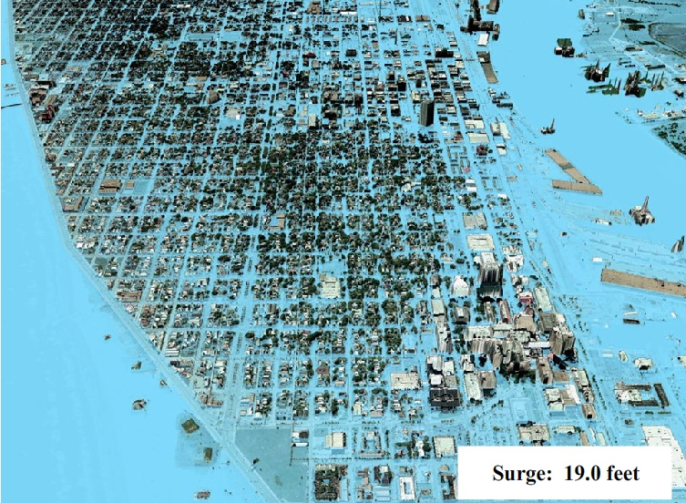
Future Work
Flood inundation area with reduced storm surge
1977 data set – trend for future loss
Determining wetland loss using remote sensing
  Center of Space Research (UT)

Slide 18
I hope this flood of information has saturated your thirst for wetlands.
Questions?

