Slide 1
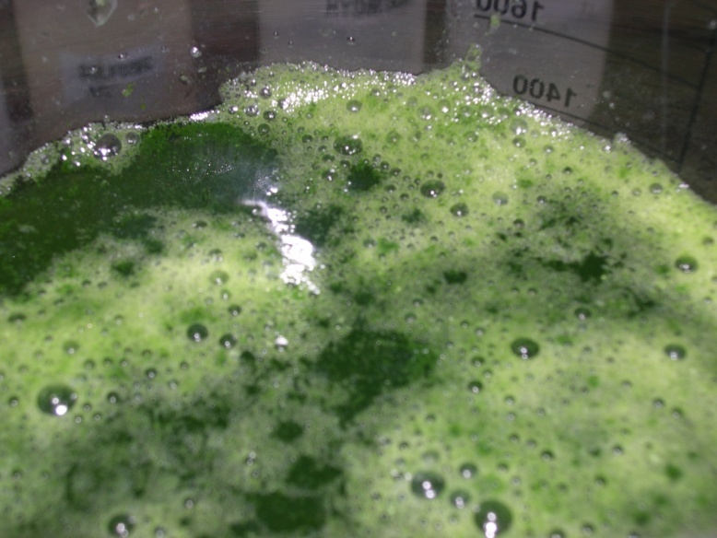

Resources for Algae Production in Texas
Allison Osborne

Slide 2
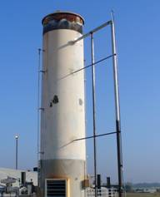
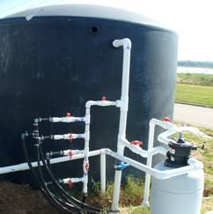
Algae is an Emerging Fuel Resource
Highest productivity for biodiesel: 5,000-15,000 gallons/acre-year.
Immature industry, algae oil production has struggled to cost-effectively scale up.
Couple freely-available sources of water and carbon dioxide for cost-effective algae production.
Source of images: Sunrise Ridge Algae, Inc.

Slide 3
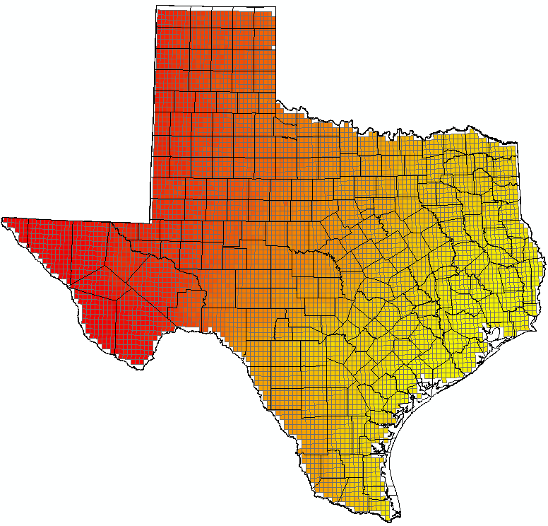
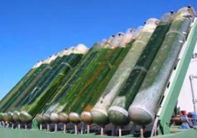
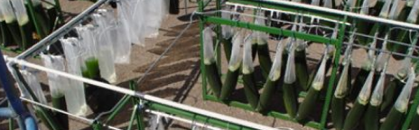
Texas Climate and Land
Availability of a suitable climate and sunlight resources in Texas.
Algae can be grown in ponds, shrimp/fish farms, photobioreactors on private land, or closed, vertical reactors on intensively used
urban land.
Source of images: Greenfuel Technologies, Corp.

Slide 4
GIS Research
Where do wastewater and carbon dioxide resources co-exist in Texas to permit cost-effective algae production?
Given annual sunlight conditions, what volume of algae, and algae oil, can be produced from those resources?
What limitations does land use set?
Equations:
  Yield (based on available sunlight)= 3.1536* Insolation* Solar energy capture efficiency/energy content of dry biomass
  Yield (based on water and CO₂) calculated according to photosynthesis equation: 6(CO₂) + 6(H₂O) + light -> C₆H₁₂O₆ + 6(O₂)

Slide 5
Wastewater and CO₂ Sources in Texas

Slide 6
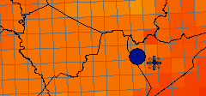
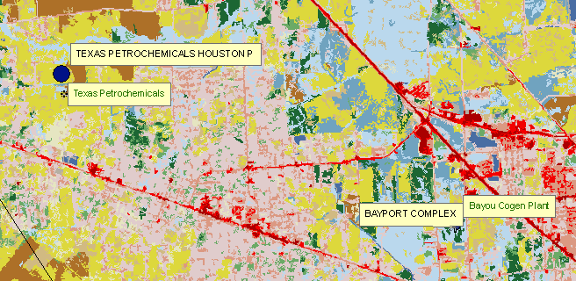
2 Facilities with Water and CO₂ within 0.5 Miles
Sunlight
Land Use
Name | Flow Rate (MGD) | CO₂ (tons) | Sunlight (wh/m²/d) | Land Use
Texas Petrochemicals Houston | 6.5 | 933,161 | 4,088 | Hay/Pasture
Bayport Complex | 0.072 | 1,629,460 | 4,208 | Woody Wetlands

Slide 7
Calculated Algae Potential at 2 Sites
Location Name | Biomass Yield (tons/ha) | CO₂ Limited Yield (tons) | Water Limited Yield (tons) | Maximum Oil Yield (barrels)
Texas Petrochemicals Houston | 1.408 | 399,421 | 51,791 | 65,671
Bayport Complex | 1.449 | 697,458 | 574 | 727
Total |  |  |  | 66,398
Accounts for approximately 0.007% of annual crude oil consumption in Texas.

Slide 8
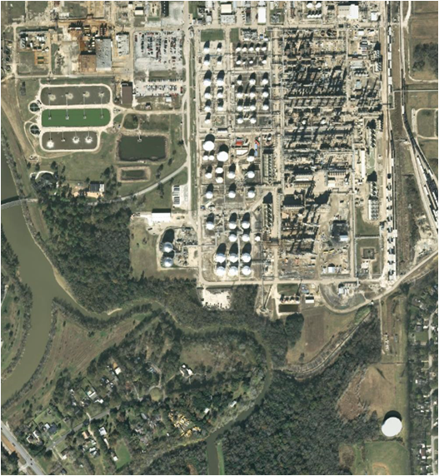
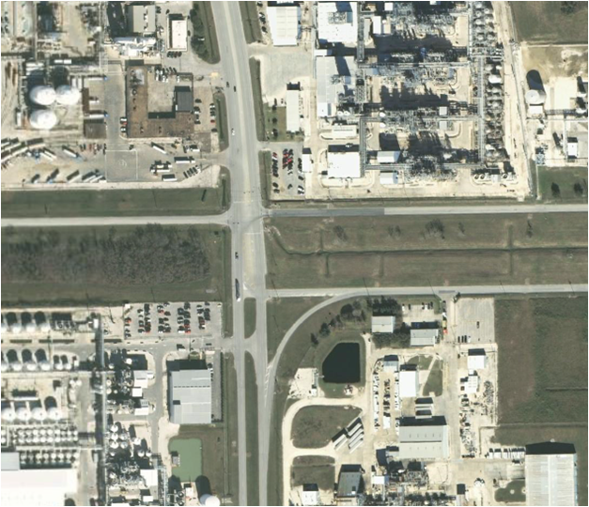
Bioreactor Types
Texas Petrochemicals
Bayport Complex
Location Name | Land Required (ha) | Reactor Type
Texas Petrochemicals Houston | 36,785 | Mixed
Bayport Complex | 396 | Vertical Photobioreactors

Slide 9
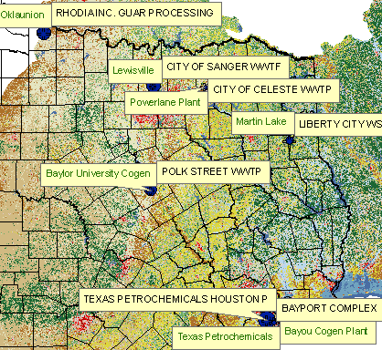
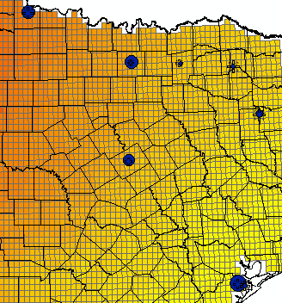
8 Facilities with Water and CO₂ within 1.0 Miles
Land Use
Sunlight
Name | Flow Rate (MGD) | CO₂ (tons) | Sunlight (Wh/m²/d) | Land Use
Liberty City WSC WWTP | 0.18 | 21,593,119 | 4,366 | Developed, Low Intensity
Rhodia, Inc. Guar Processing | 1.3 | 4,829,977 | 5,032 | Herbaceous
Polk Street WWTP | 0.4 | 27,533 | 4,730 | Developed, Open Space
Texas Petrochemicals Houston | 6.5 | 933,161 | 4,088 | Hay/Pasture
City of Sanger WWTF | 0.98 | 0 | 4,884 | Developed, Low Intensity
City of Winfield WWTP | 0.084 | 17,491,542 | 4,458 | Shrub/Scrub
Bayport Complex | 0.072 | 1,629,460 | 4,208 | Woody Wetlands
City of Celeste WWTP | 0.0948 | 39,661 | 4,554 | Developed, Open Space

Slide 10
Calculated Algae Potential at 8 Sites
Name | Sunlight Yield (tons/ha) | CO₂ Limited Yield (tons) | Water Limited Yield (tons) | Oil Yield (barrels)
Liberty City WSC WWTP | 1.5 | 9,242,509 | 1,434 | 1,819
Rhodia, Inc. Guar Processing | 1.7 | 2,067,377 | 10,358 | 13,134
Polk Street WWTP | 1.6 | 11,785 | 3,187 | 4,041
Texas Petrochemicals Houston | 1.4 | 399,421 | 51,791 | 65,671
City of Sanger WWTF | 1.7 | 0 | 7,808 | 0
City of Winfield WWTP | 1.5 | 7,486,910 | 669 | 849
Bayport Complex | 1.4 | 697,458 | 574 | 727
City of Celeste WWTP | 1.6 | 16,976 | 755 | 958
Total |  |  |  | 87,199
Accounts for approximately 0.01% of annual crude oil consumption in Texas.
With 50% recycle, production rises to 2.2 billion barrels (0.2% of consumption in Texas)

Slide 11
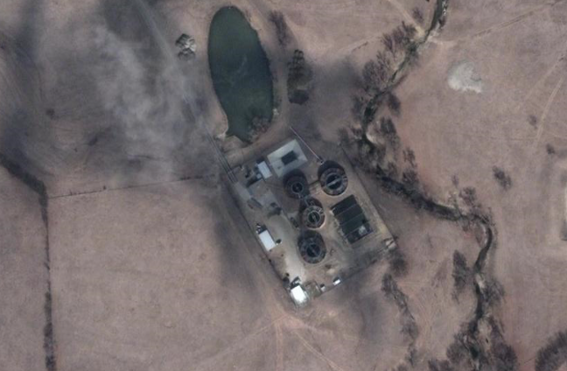
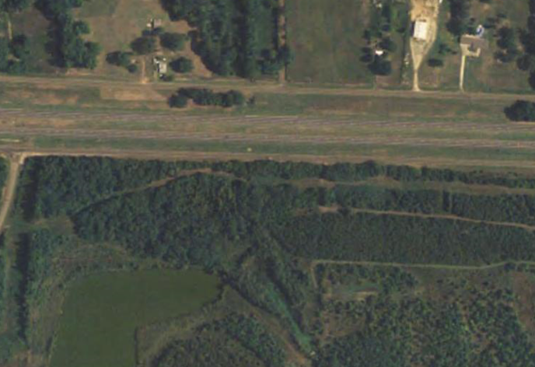
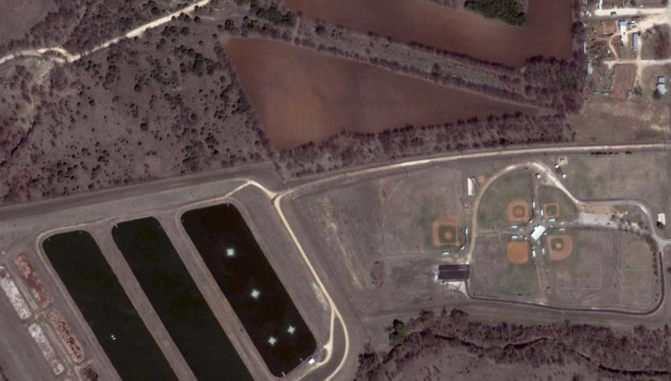
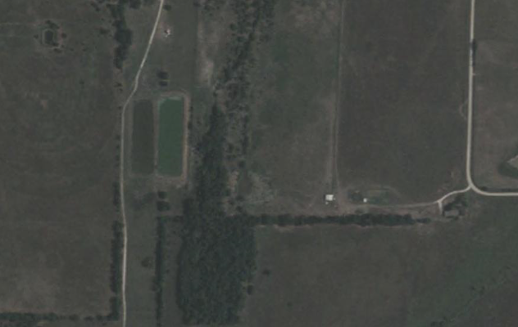
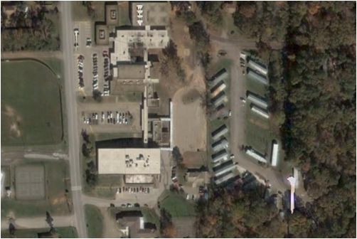
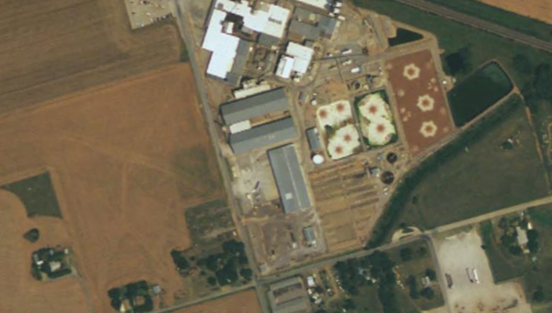
Bioreactor Types
City of Sanger
City of Winfield
Polk Street
Name | Land Required (ha) | Bioreactor Type
Liberty City WSC WWTP | 954 | Horizontal/Ponds
Rhodia, Inc. Guar Processing | 5,977 | Horizontal/Ponds
Polk Street WWTP | 1,956 | Horizontal/Ponds
Texas Petrochemicals Houston | 36,785 | Mixed
City of Sanger WWTF | 4,642 | Horizontal/Ponds
City of Winfield WWTP | 436 | Horizontal/Ponds
Bayport Complex | 396 | Vertical Photobioreactors
City of Celeste WWTP | 482 | Horizontal/Ponds
City of Celeste
Liberty City
Rhodia

Slide 12
Conclusions
Overall, algae oil may provide limited contribution to total Texas oil consumption unless significant water recycle is implemented.
Limited growth potential at some of the identified facilities.
Consider options for transporting wastewater/carbon dioxide to increase production potential.

Slide 13
Questions?

