Slide 1
Effects of Dam-Induced Daily River Stage Fluctuations on a Large Gravel Bar
Blair Stanley
November 18, 2008

Slide 2
Outline
Introduction
Objective
Methods
Progress to Date
Preliminary Results and Conclusions
To Do

Slide 3
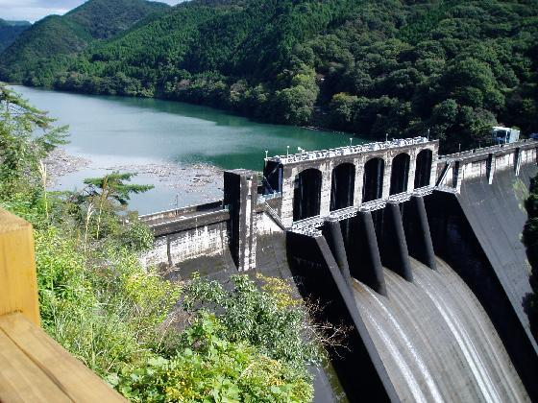
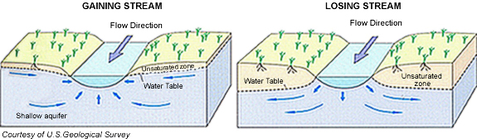
Introduction
Dams alter hydrogeology
    Storage of water, sediment, and nutrients
      Ecosystems (biogeochemistry)
      Contaminants (dilution or intensification)
    Change Channel hydraulics

Slide 4
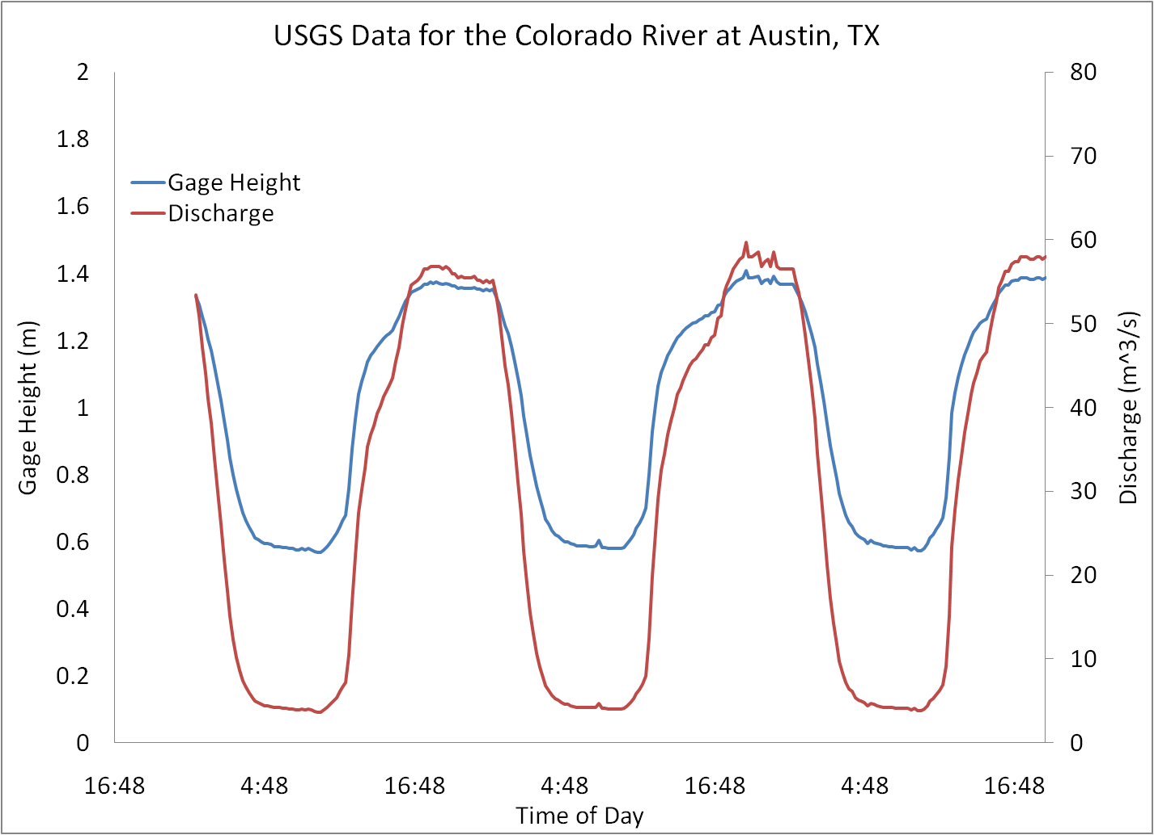
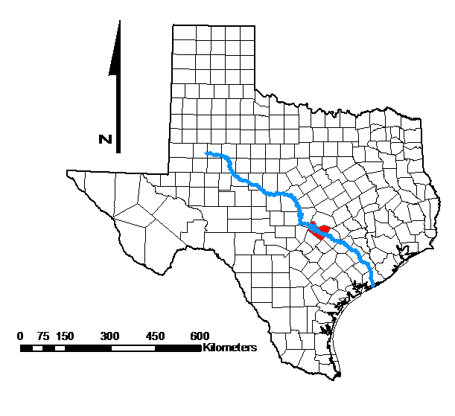
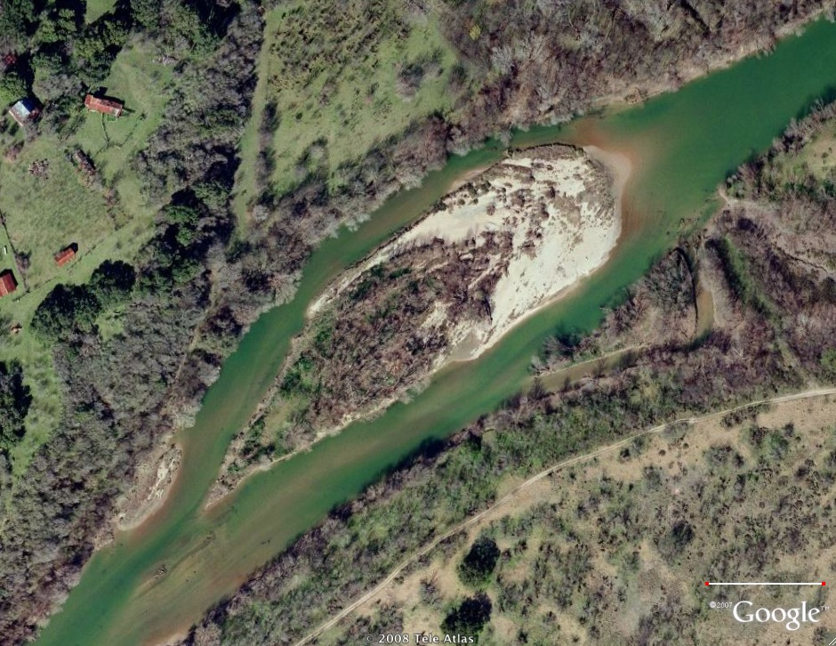
Introduction: Study Site
Hornsby Bend Island
  Colorado River southeast of Austin, Texas
  Large gravel bar with riparian forest
  Severely modified hydrograph

Slide 5
Objective
How have dams affected the discharge within the Colorado River near Hornsby Bend Island?
How do regulated stage fluctuations affect flow patterns within Hornsby Bend Island?
Main Objective:
  Analyze groundwater dynamics
    Capture fluctuations in the water table
  Couple groundwater and surface water data with ArcGIS

Slide 6
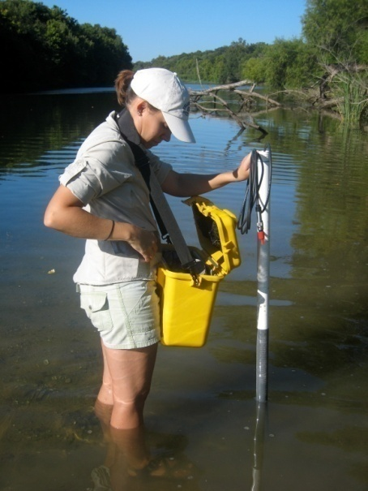
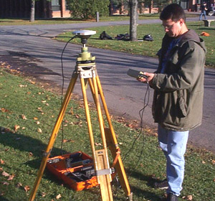
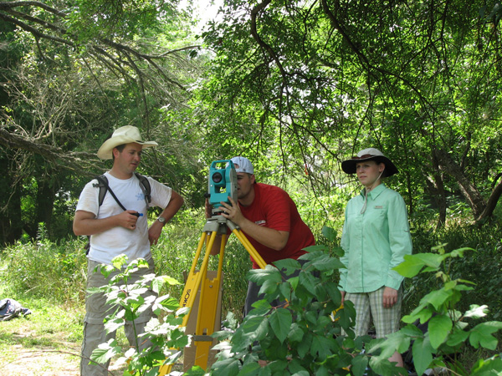
Methods
Monitor discharge values from the USGS
Monitor head distributions from probes on island
Locate piezometers using:
  Differential Global Positioning System
  Total Station Surveyor
Upload groundwater and surface water data to ArcGIS
  Contour water table elevations using data interpolation
http://www.nysgis.state.ny.us/outreach/gist/images07/base_1.jpg

Slide 7
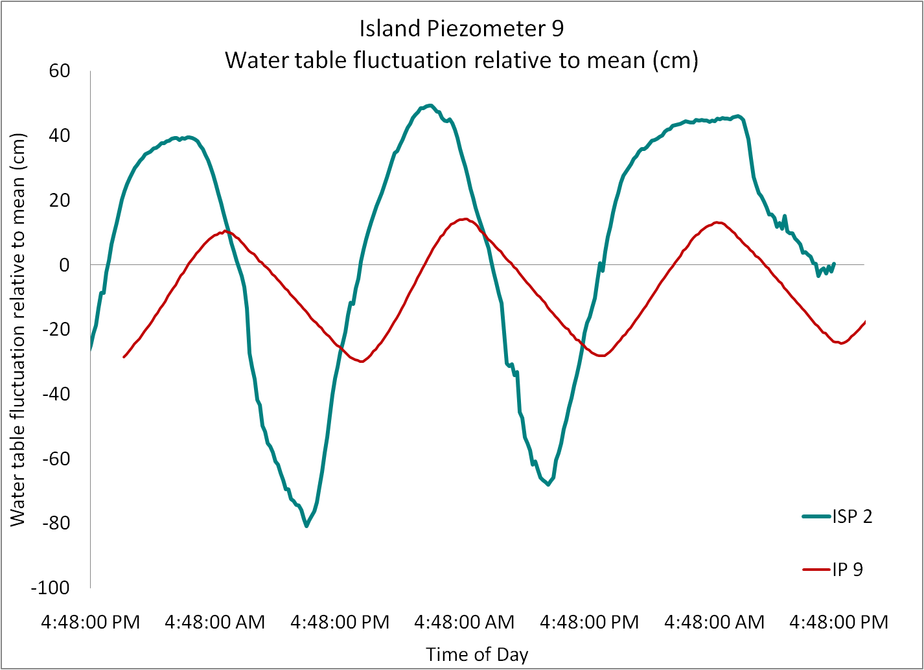
Progress to Date
USGS data collected and uploaded
  National Water Information System
Pressure-transducer data collected and being analyzed
Piezometer locations obtained and being uploaded

Slide 8
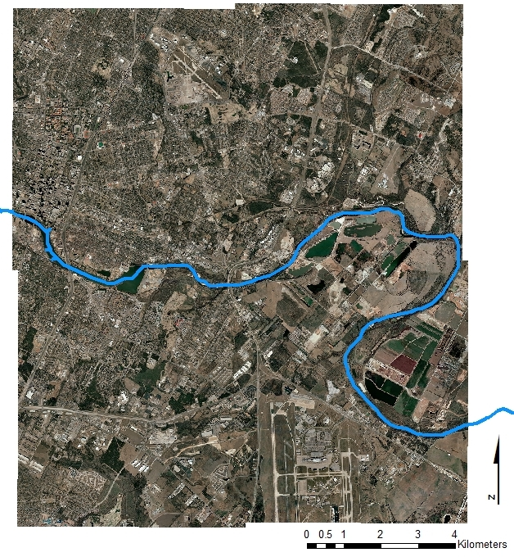
Progress to Date
  Capitol Area Council of Governments
  Orthoimagery downloaded and uploaded
  Hydrography data downloaded and uploaded

Slide 9
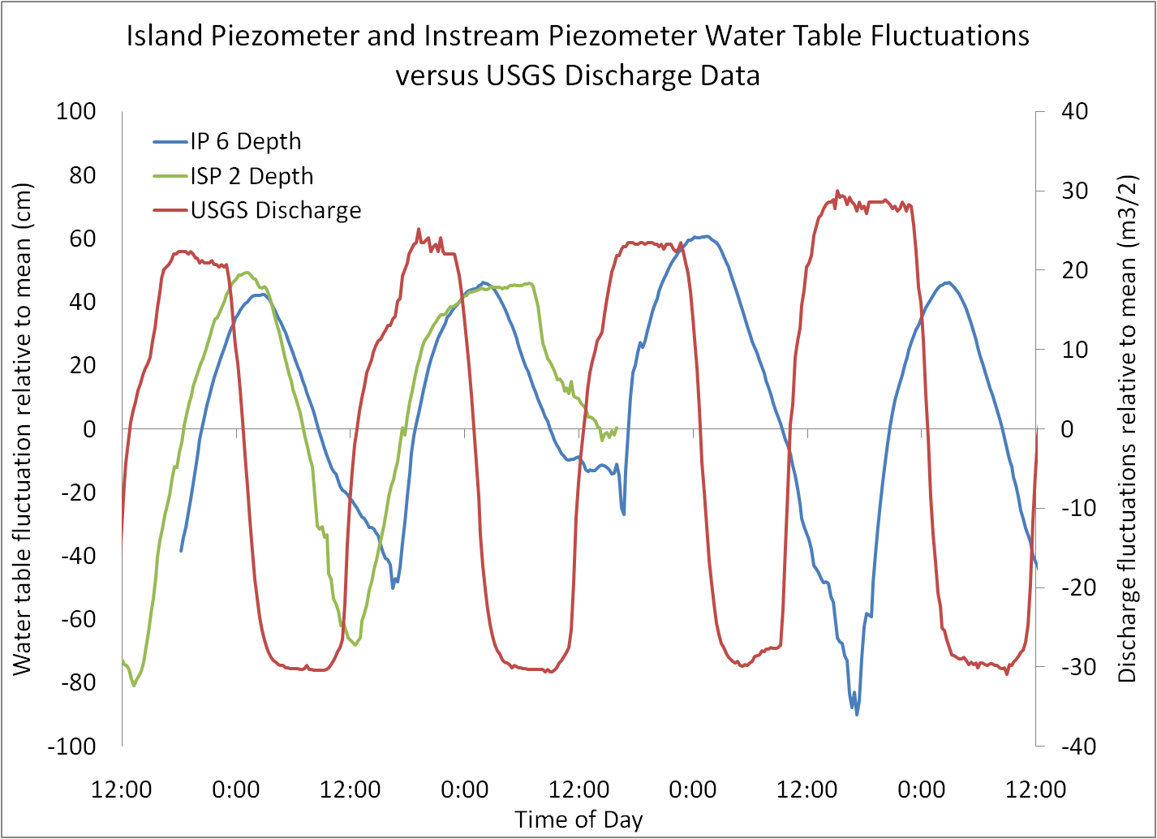
Preliminary Results & Conclusions
Groundwater fluctuations mimic surface water fluctuations

Slide 10
To Do
Process water table elevation data with time
Upload data into ArcGIS
Create water table maps
Incorporate temperature data (if time permits)

Slide 11
Questions?

