Slide 1
Land Use and Land Cover Change in the San Antonio and Guadalupe River Basins
Rachel Mills
Department of Marine Science
November 20, 2008

Slide 2
Objectives
Identify San Antonio and Guadalupe River Basins
Analyze Discharge and Stream Flow Data
Analyze Land Use/Land Cover Data
Analyze Observations vs. Discharge

Slide 3
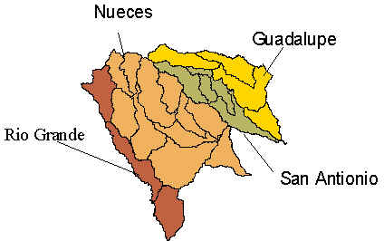
San Antonio and Guadalupe River Basin
Length =230 mi
Avg Disch = 1200 cfs
Basin Area = 2023 mi^2
Length = 240 mi
Avg Disch = 400 cfs
Basin Area = 934 mi^2

Slide 4
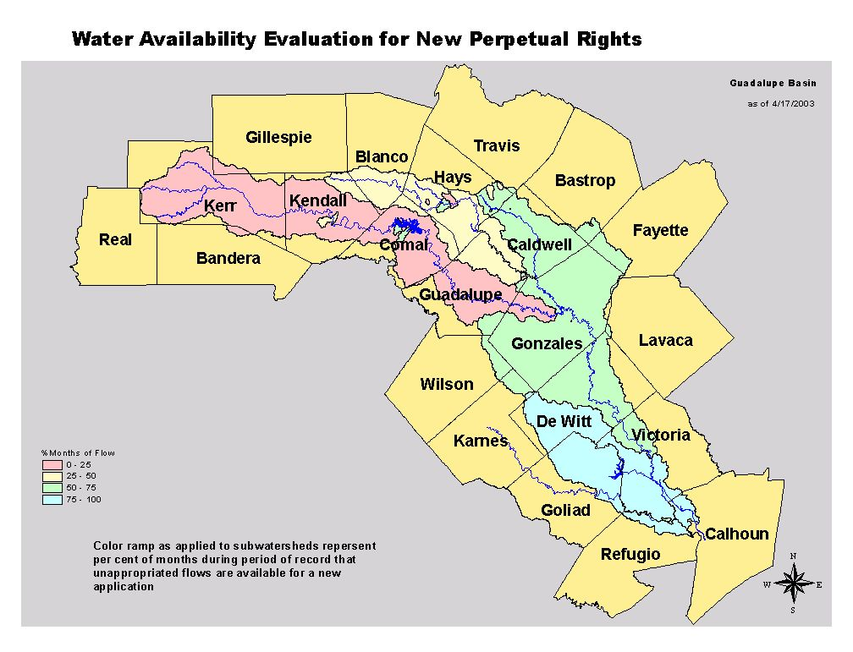
Guadalupe Basin

Slide 5
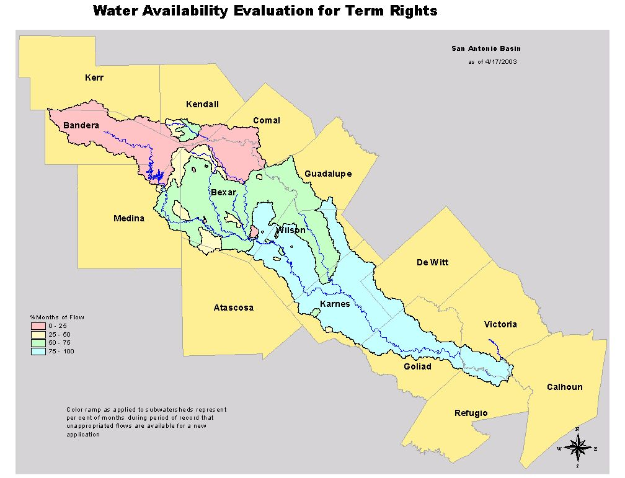
San Antonio Basin

Slide 6
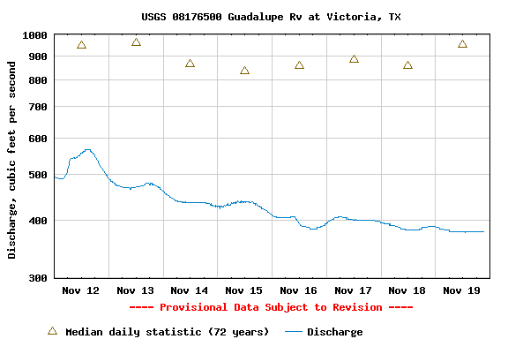
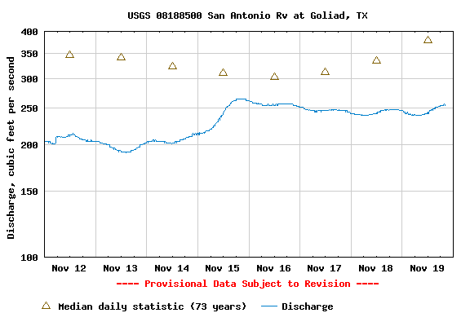
Weekly River Discharge
Guadalupe River
San Antonio River

Slide 7
Annual Discharge

Slide 8
Annual Discharge

Slide 9
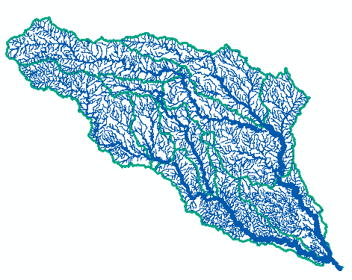
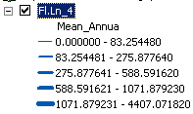
Streamflow

Slide 10
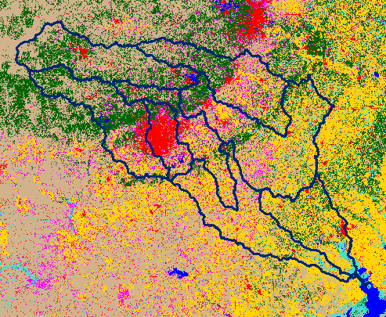
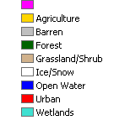
Land Use

Slide 11
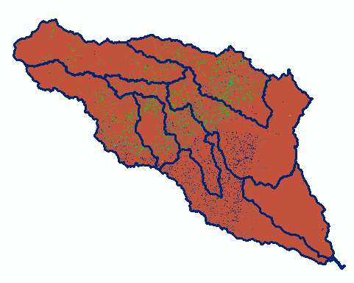
Land Cover Change

Slide 12
Land Cover Change
Category | 1992 | 2001
Open water | 183865 | 204403
Urban | 2322486 | 2568680
Barren | 37931 | 52851
Forest | 7819649 | 6933025
Grassland/Shrub | 10828073 | 11292678
Agriculture | 7296467 | 7300536
Wetlands | 826000 | 962298
% Land Cover Change = 6.445

Slide 13
Still to come…
Storm events and Land Use Land Cover Change
*To be finished
Calculate number of Observations for levels of Discharge (High and low flow events)
*To be finished

Slide 14
Questions??
Thank you!

