Slide 1
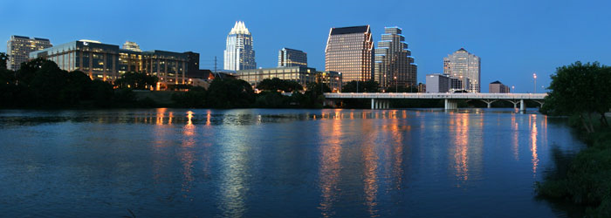
Impact of Urbanization
In the City of Austin
Bryan Barnett

Slide 2
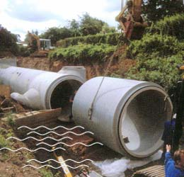
Overview
Atrophic Effects on the Hydrologic Cycle
Potential Effects on the Surface
  Excessive Run-off
  High transport of pollutants
Potential Effects Underground
  Leaks allow infiltration
  Storm water can penetrate the earth much more quickly

Slide 3
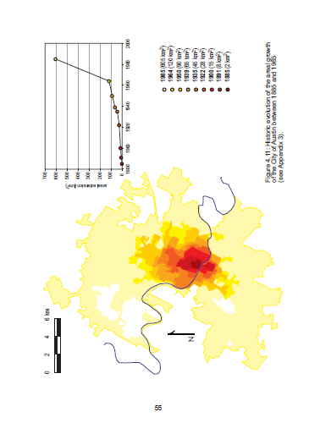
Goals of My Project
Utilize Available Land Use Datasets, USGS Data
Use a variety of catchment processes to identify correlations between rate of catchment urbanization, surface discharge and well level
Identifying trends will fortify the theory of Antropic recharge enhancement
Based on Thesis “Urban effects on groundwater recharge in Austin, Texas,” by Beatriz Garcia-Fresca Grocin, 2004

Slide 4
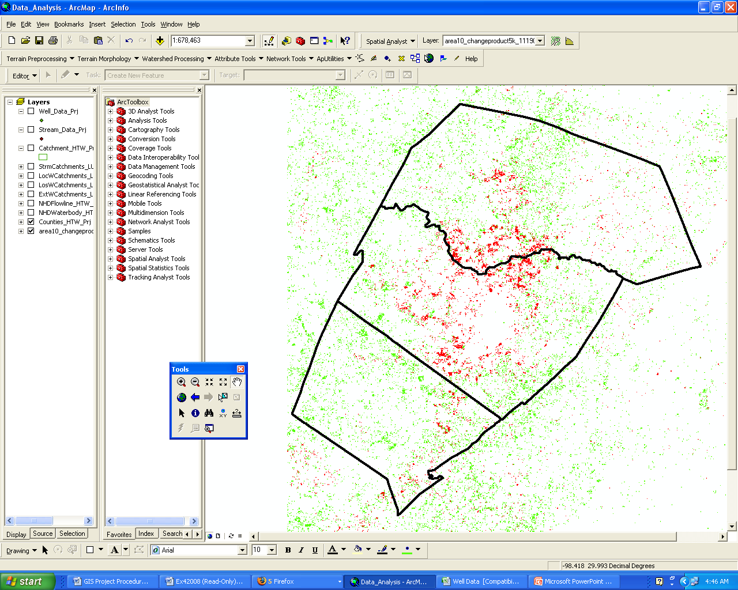
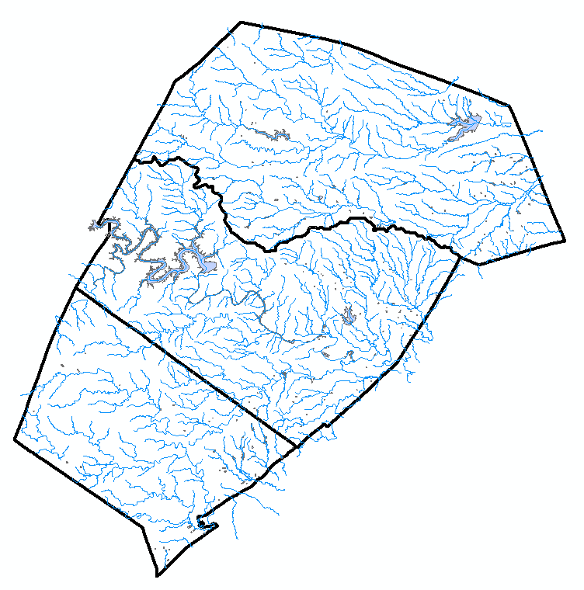
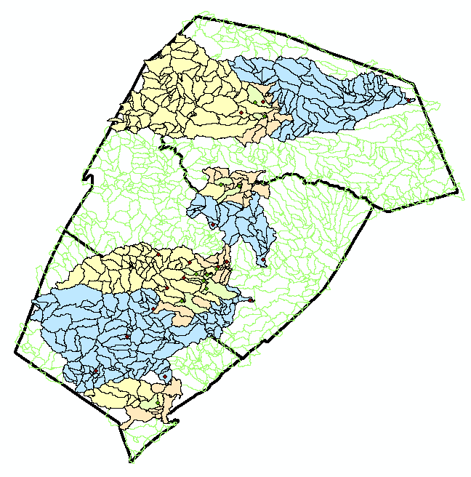
Methodology
Utilized USGS Station Data, Land Use Comparisons, NOAA Precipitation Records and NHDPlus Catchment and Stream Datasets
http://www.mrlc.gov/faq.php#changeproduct
NHDPlus Products From http://www.horizon-systems.com/nhdplus

Slide 5
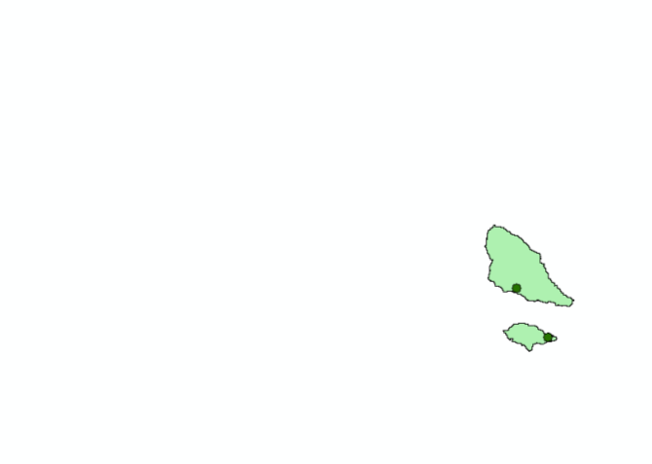
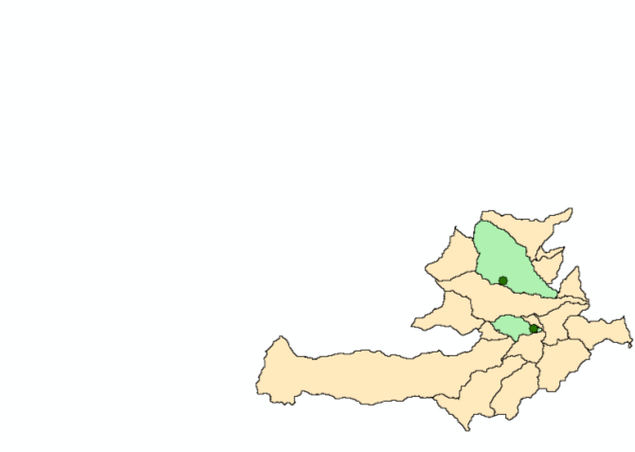
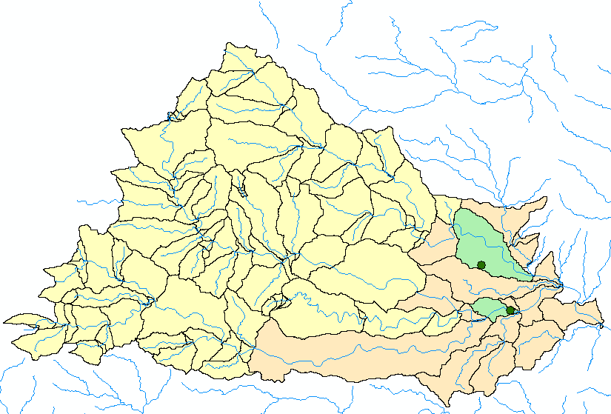
Methodology Continued…
Used Stream Networking to Delineate Surface Flow Catchment Areas of USGS Stream Gauges
Well Data was compared to three different catchment regimes: Local, Extended Local and Losing Stream
Local: Surrounding Catchment
Extended: .03 Degrees Away
Losing Stream: Typical Watershed

Slide 6
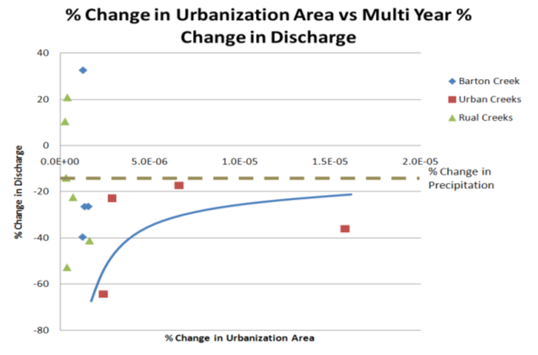
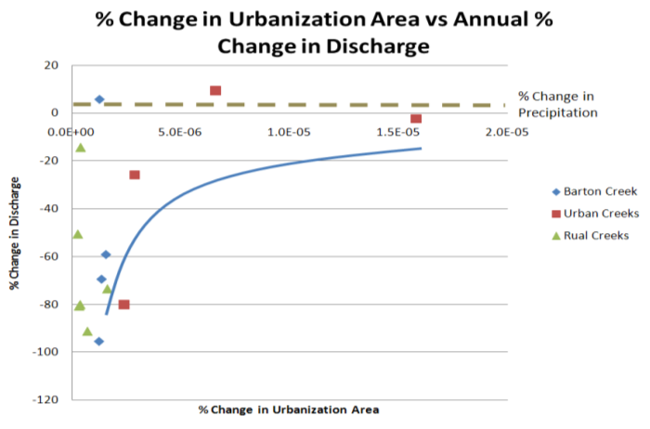
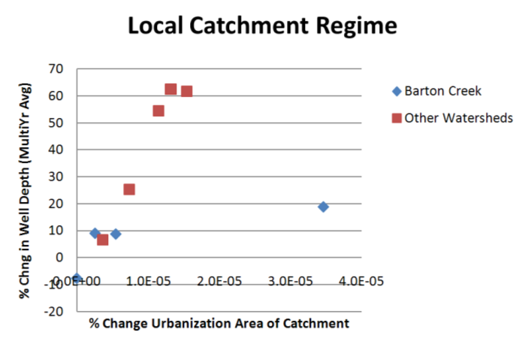
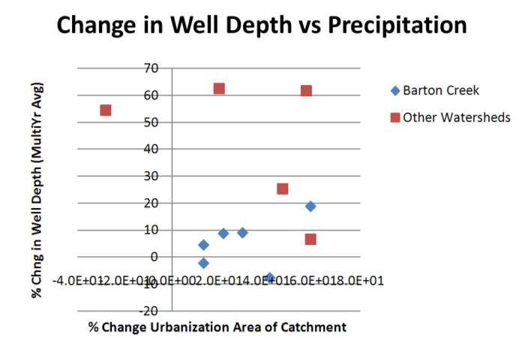
Results- Annual and Multi Year Averaging
Surface Data- Surface Percent Seemed to Trend to Precipitation %
Well Data- Strongest Correlation Found in Local Catchment Regime

Slide 7
Challenges…
Scarcity of Data- Never enough gages!
Ignorance of Powerful Statistical Tools
Understanding the complexities of Dataset Manipulation and Representation

Slide 8
Conclusion
ArcGIS combined with USGS Data is a powerful toolset for investigating local hydrogeology
With even better data, this research could have significant implications for city planning or environmental regulation
Land Use is just one component of anthropogenic effects on the hydrologic cycle.
Keeping your personal geodatabase organized and clean is difficult but IMPORTANT!

Slide 9

Questions

Slide 10
Appendix- How to get % Urban
Create Stream Networks, Other Catchment Polygons
Create Catchment Rasters (Value = 1), parse out data
Convert Parsed Land Use Rasters to Polygons
Use Spatial Analyst Tools/Zonal/Tabulate Area
  Requires Text String Identifiers
Append resultant table to Catchment Polygons
Relate USGS Datasets to Catchments, with Land Use Areas appended
Export to Excel for graphing and analysis

