Slide 1
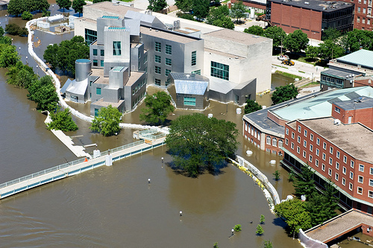
Iowa Flooding
Mark Hughes
November 25, 2008
University of Iowa News Service

Slide 2
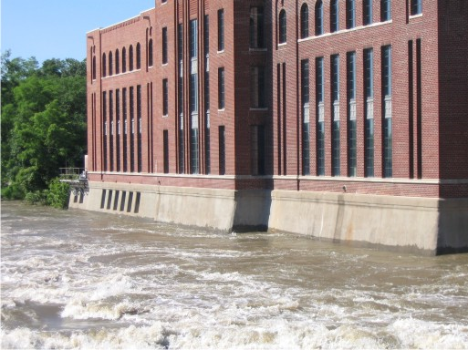
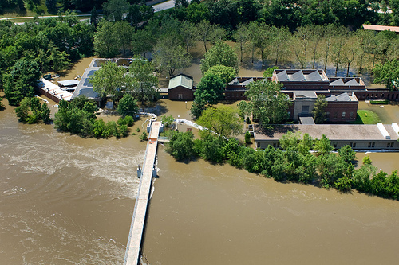
Background
Two “500 year” events
Major damage to the University of Iowa and surrounding area
University of Iowa News Service

Slide 3
Where In Iowa?
Iowa State University GIS Facility

Slide 4
Flood Elevations
Iowa River USGS Gauging Station at Iowa City, IA
1993 Maximum Elevation = 645.17 ft NGVD 29
2008 Maximum Elevation = 648.29 ft NGVD 29

Slide 5
Calculated Flooding Map
Map Area Flooded in 1993 and 2008

Slide 6
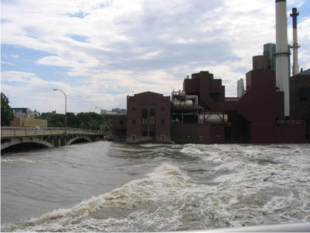
How accurate is this map?
Trying to get actual flood data map from the University of Iowa
Dam before gauging station

Slide 7
Compare To Flood Maps
Map Based on Water Elevation at Iowa City
Actual Iowa City Flood Map

Slide 8
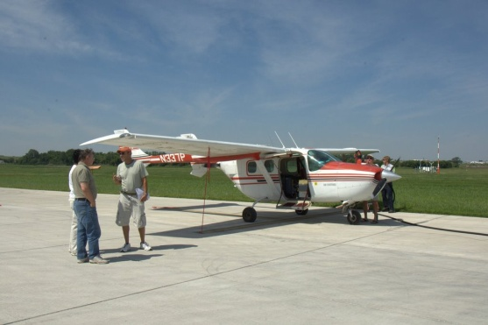
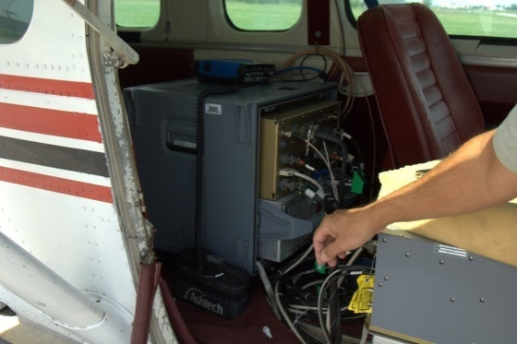
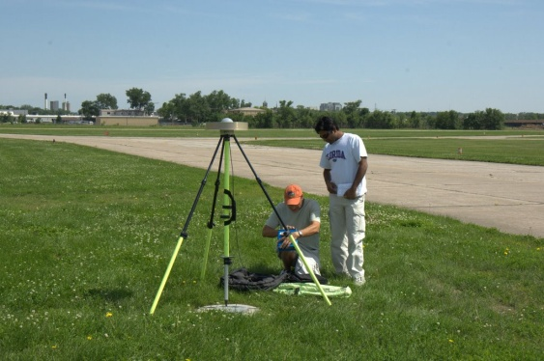
The National Center for Airborne Laser Mapping

Slide 9
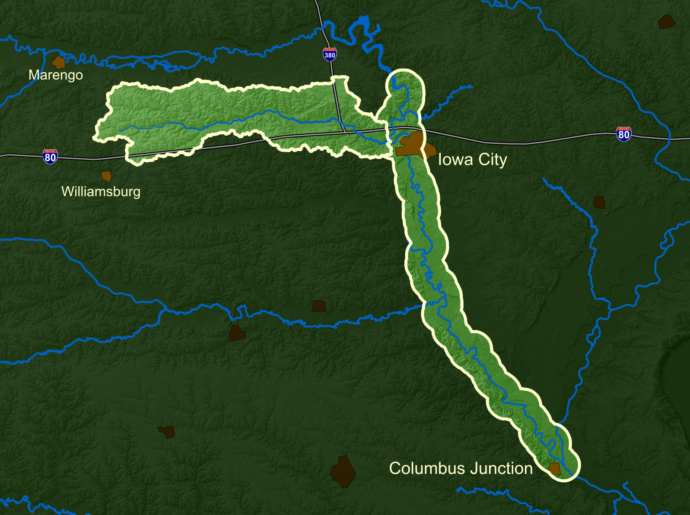
NCALM Mapped

Slide 10
2008 Precipitation and Pool Elevation
Spill Way Height

Slide 11
Pool Elevation and Discharge

Slide 12
To Do
Get real flood data
Calculate volumes of storage and discharge
Further look into dam operation requirements

Slide 13
Questions ??

