Slide 1
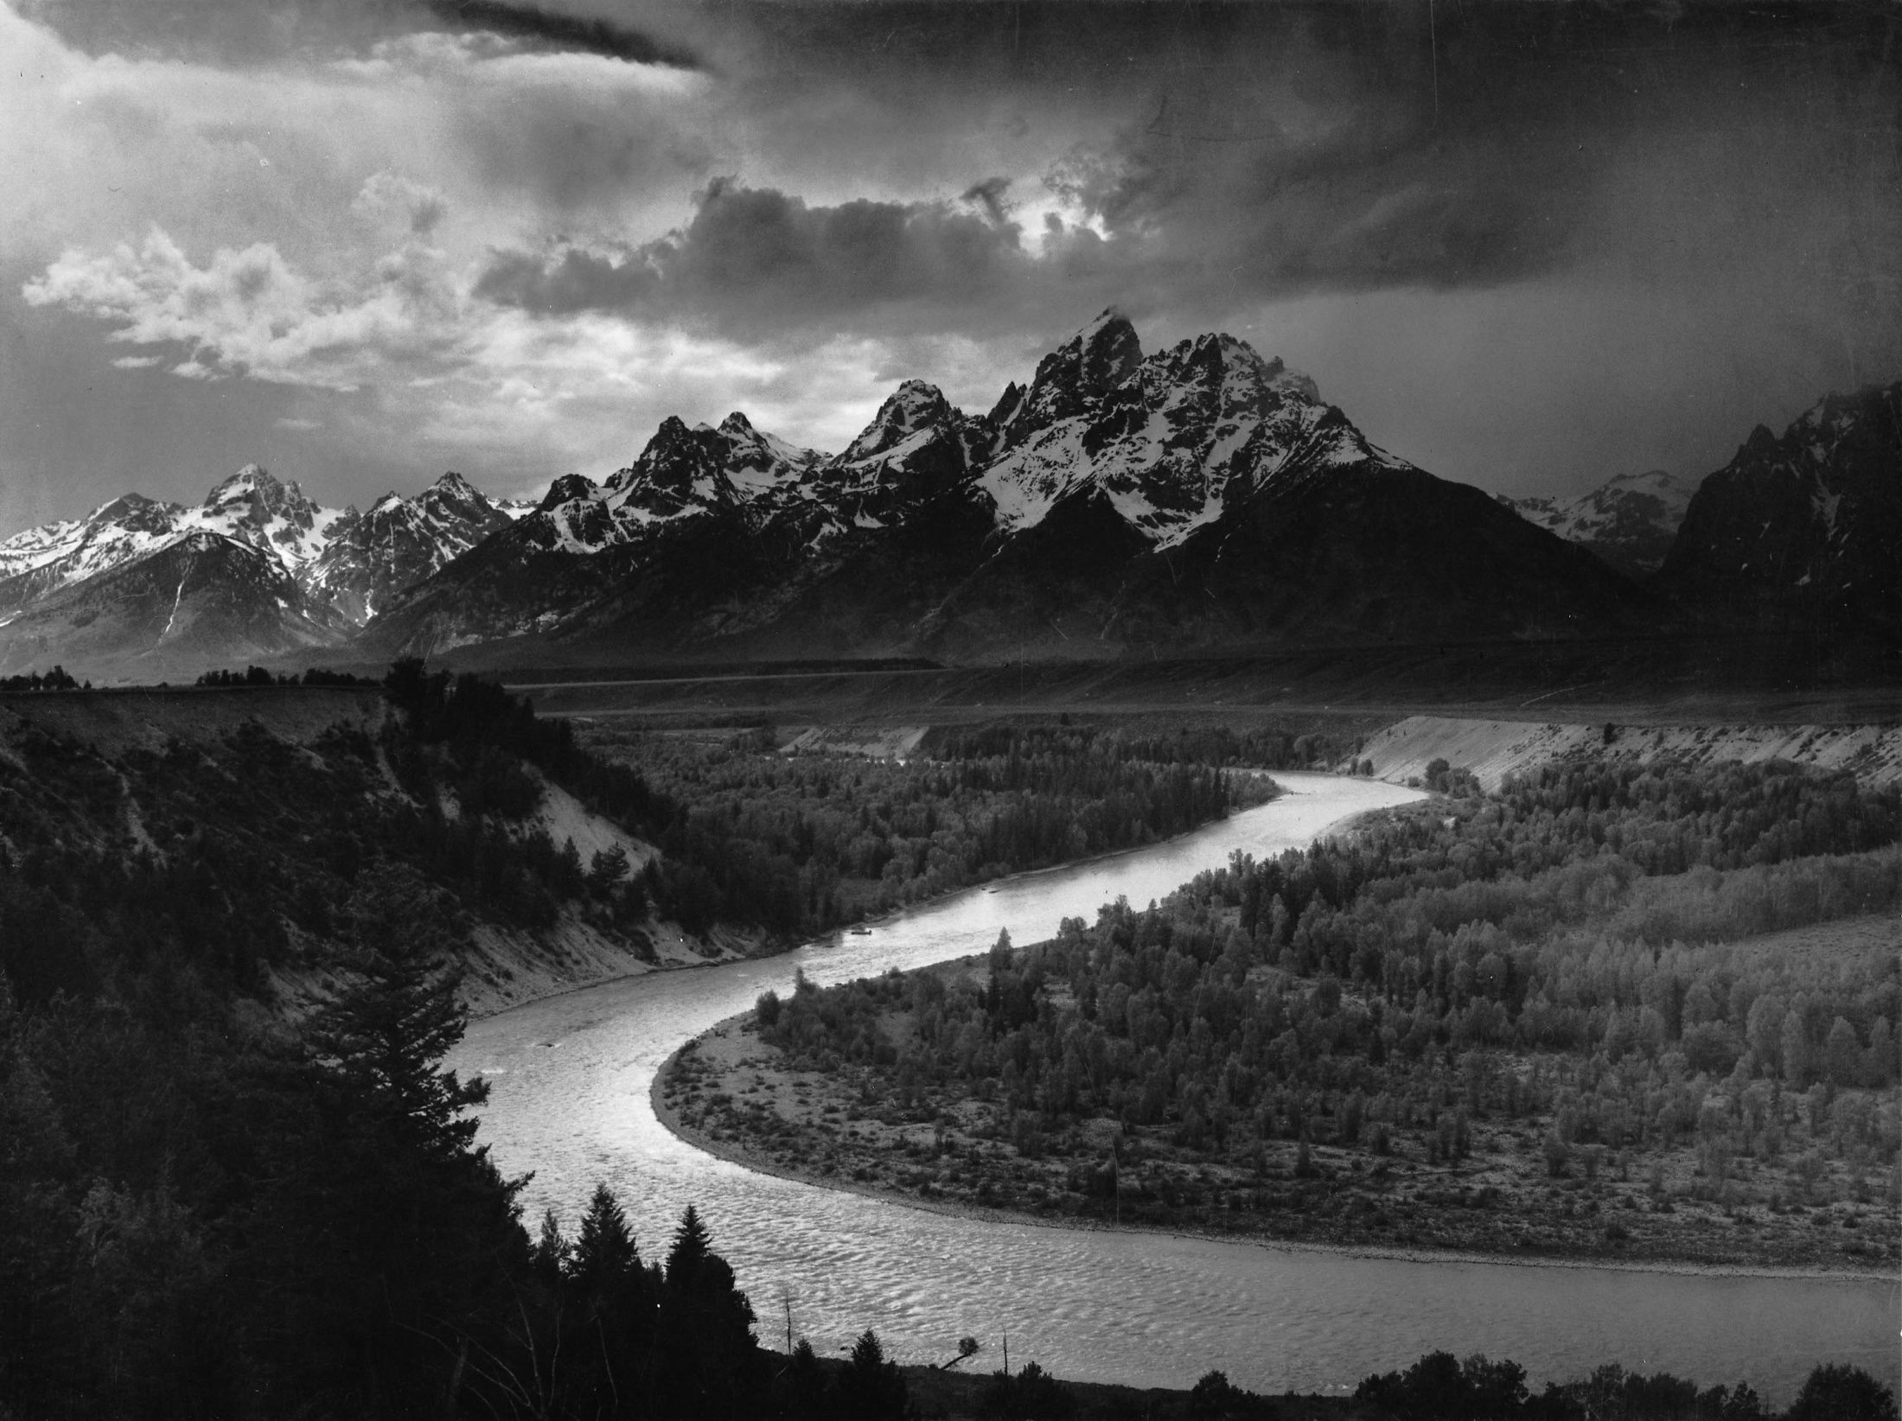
Pacific Northwest Salmon Migration and the Relationship with Hydroelectric Dams
Matt Jordan
CE 394 GIS and Water Resources

Slide 2
introduction
objective
methods
results
conclusions

Slide 3
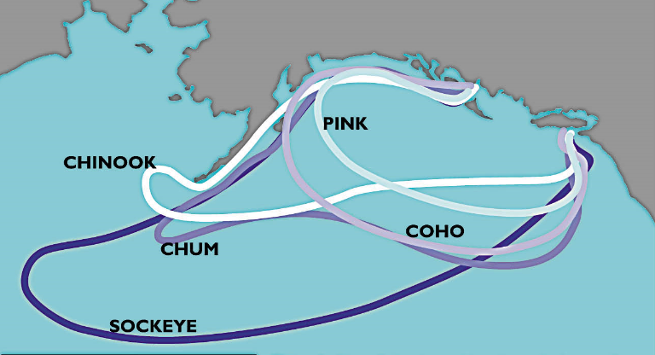
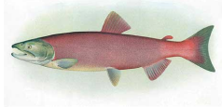
introduction – pacific northwest salmon
Types of salmonoid species :
  Chinook
  Coho
  Sockeye
Salmon Run
  2500 km every 3 months
http://www.bcsalmon.ca/Resources/wildsalmon/pages/BC%20salmon%20migration%20chart.htm
http://www.fs.fed.us/r10/tongass/districts/mendenhall/fishcam/images/sockeye_female.jpg

Slide 4
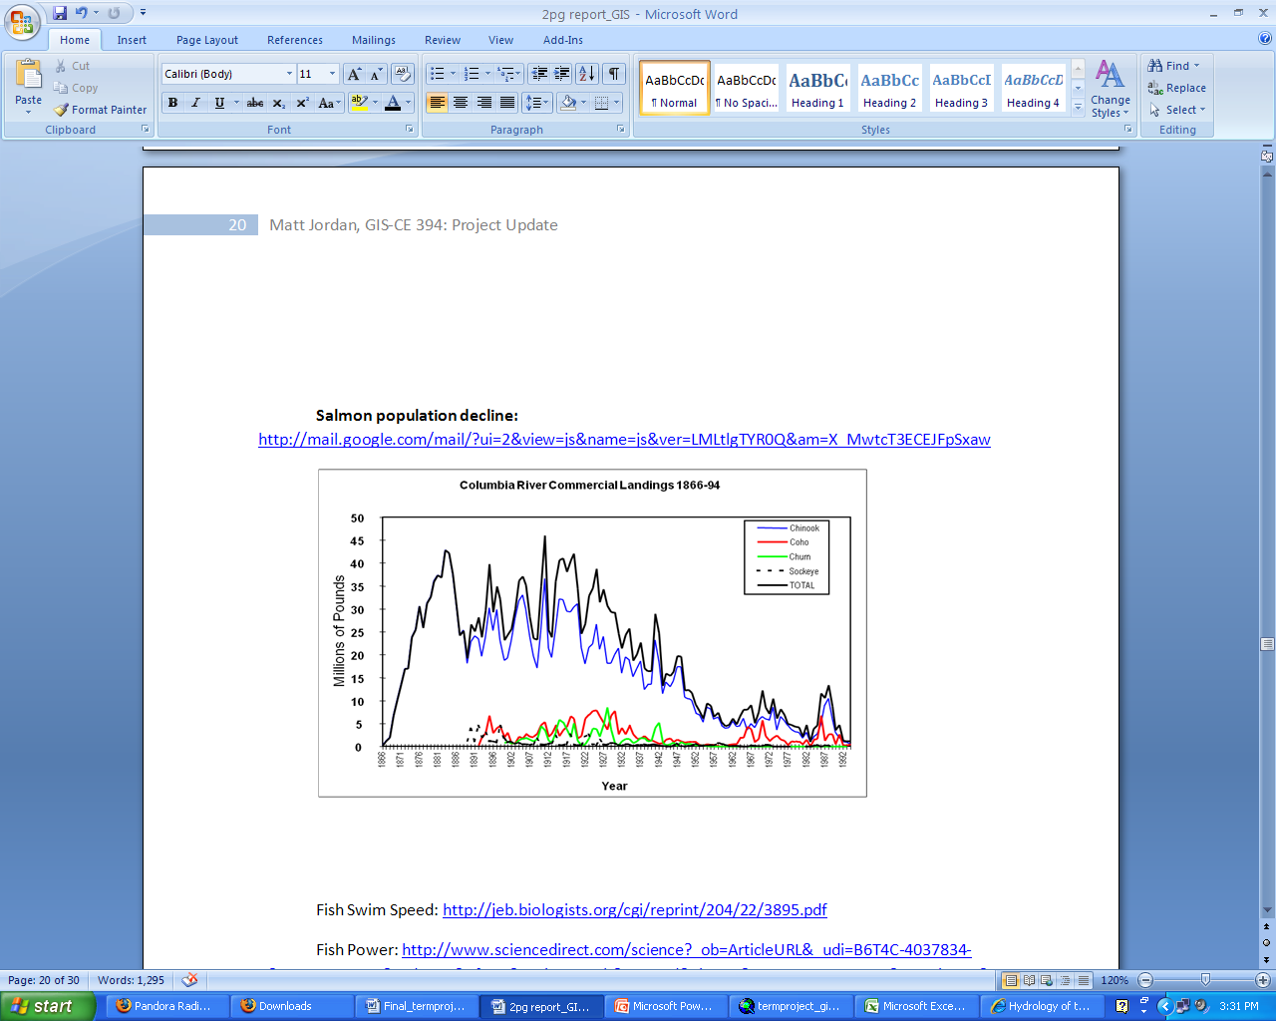
objective – understanding dams salmon
dramatic declines in fish populations
  contributing factors:
    dam construction
    increased logging, climate change, agriculture, over fishing
    Bonneville Dam
    Federal Dam Complex- Lower Snake River
http://mail.google.com/mail/?ui=2&view=js&name=js&ver=LMLtlgTYR0Q&am=X_MwtcT3ECEJFpSxaw

Slide 5
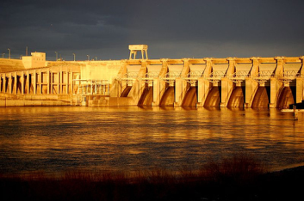
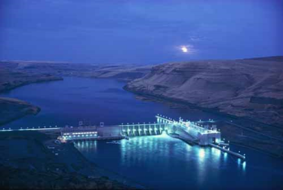
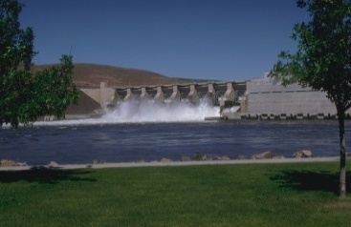
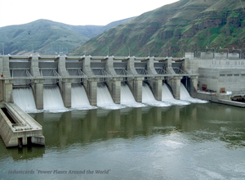
objective – understanding
dams salmon
Four federal dams on the lower Snake River effect salmon migration
Salmon species are endangered and/or threatened under the Endangered Species Act (ESA)
ice harbor
Lower monumental
little goose
lower granite

Slide 6
methodology – data collection
  NHD Plus
    base map and flowline attributes
  National Inventory of Dams (NID)
    dam locations and attributes
  NOAA National Marine Fisheries Service
    critical habitat for endangered species

Slide 7
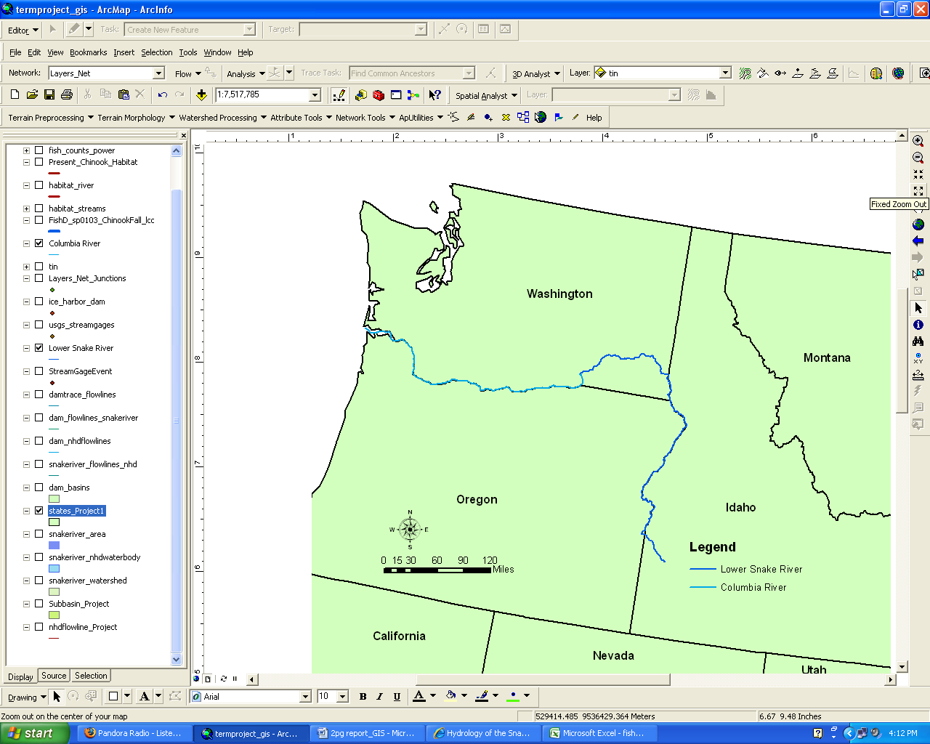


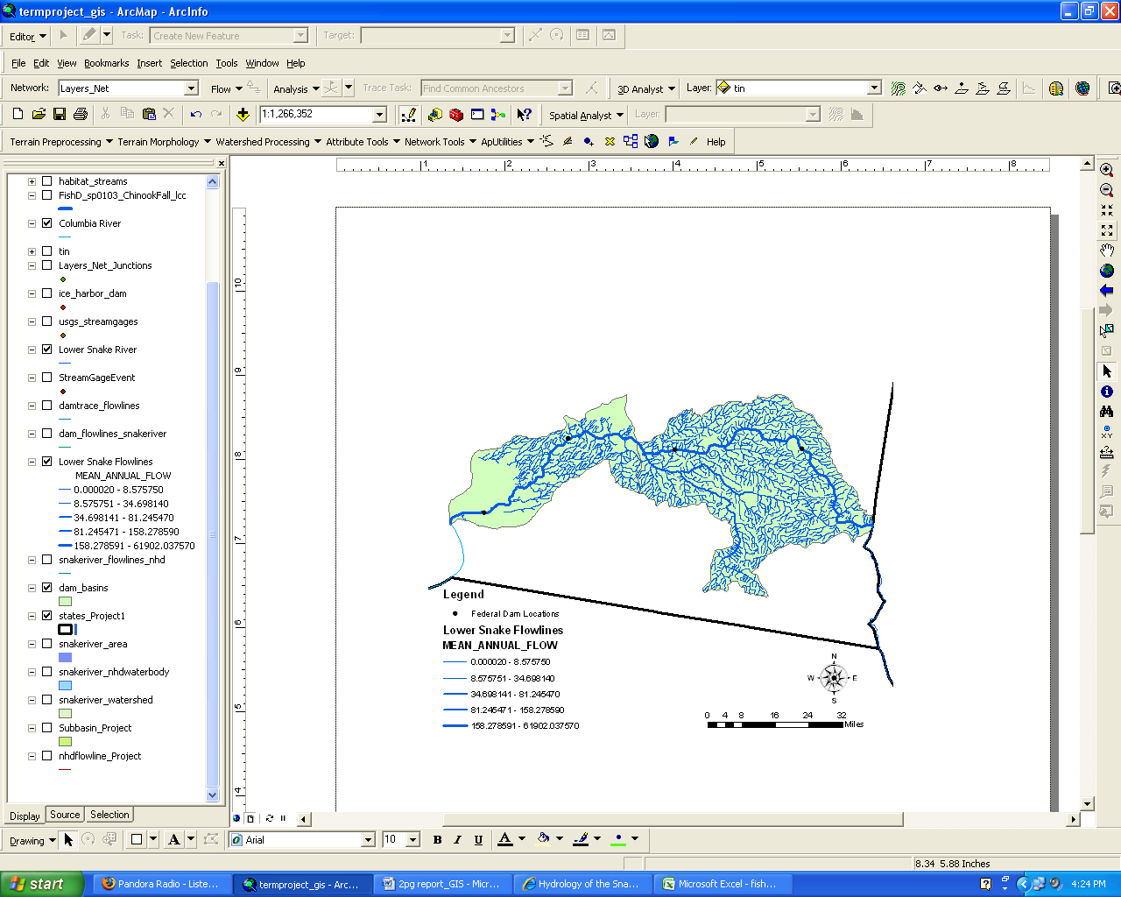

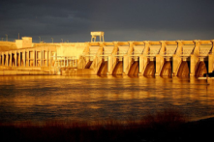
methodology – map building
Lower Monumental
Little Goose
Lower Granite
Ice Harbor

Slide 8
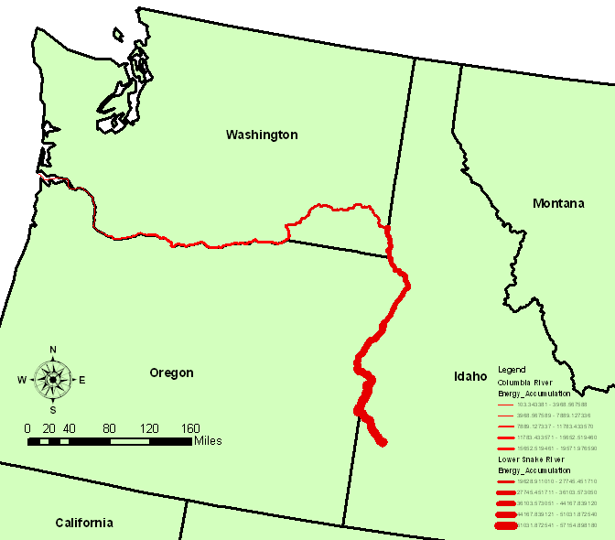
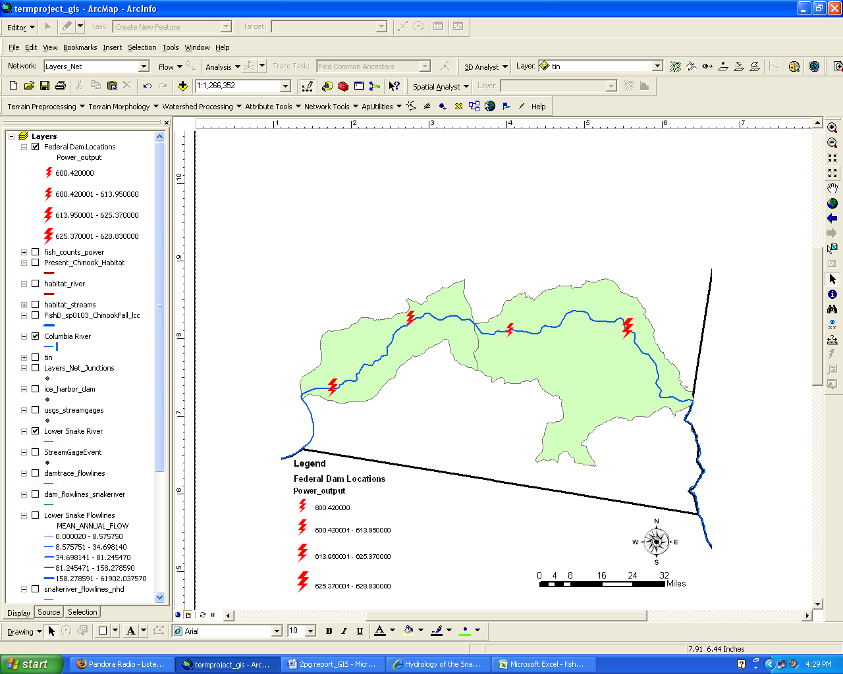
results – two worlds of energy
SALMON
  Salmon travel 1100 km, in 36 days, consuming their own body mass.
  Exerts an average of 2 Watts for the duration of the journey .
HYDROELECTRIC DAMS
  Turbines in the dams utilize the potential and kinetic energy of the river system to produce power.
  On average: 600 MW
``
Energy calculation includes: elevation change (potential) + drag of fish in the river (kinetic) + velocity of fish (kinetic)
Energy calculation includes: elevation change (potential) + flow of river

Slide 9
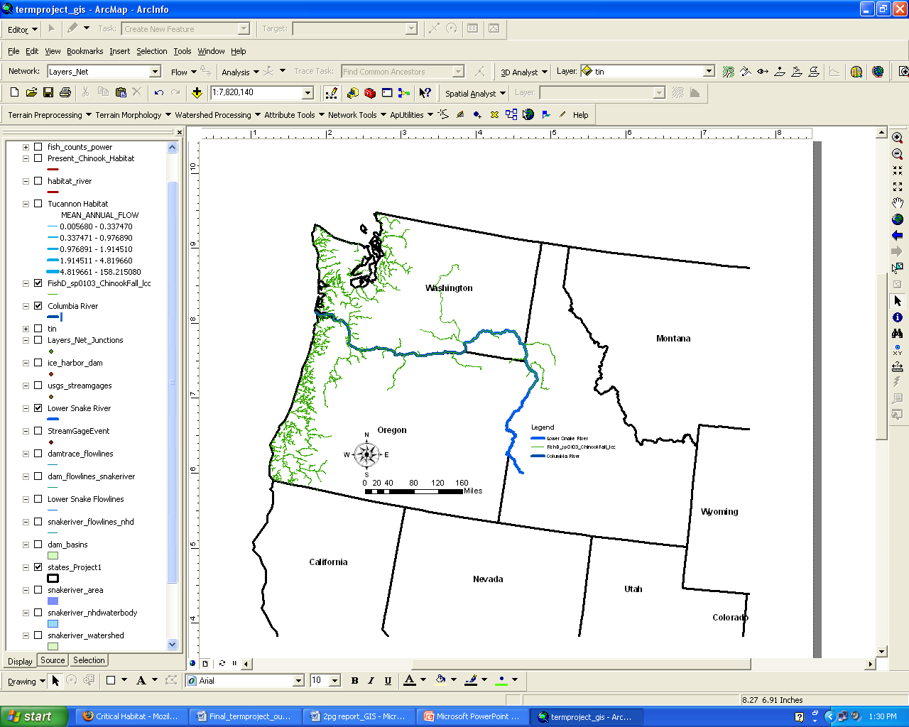
results – critical habitat (NOAA)
Critical habitat as designated by the Federal Government under the Endangered Species Act (ESA)
Contrasting:
  engineered system (Federal Dam Complex)
  natural system (Tucannon River)

Slide 10
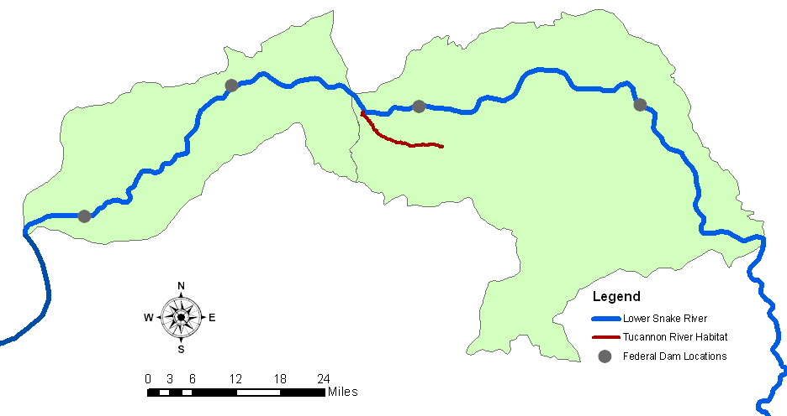
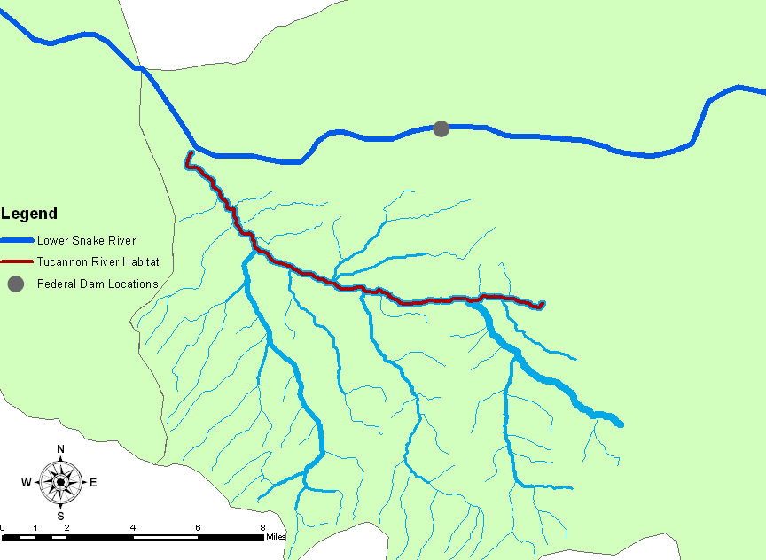
results – flow profile(natural)
  The Tucannon River is classified as critical habitat but does not house any hydroelectric dams
  Drops in the flow profile are the result of inflows from tributaries and rivers

Slide 11
results – hypsometric (natural)
  The hypsometric profile displays a gradual change in the channel elevation
Approximate Slope = 1%

Slide 12
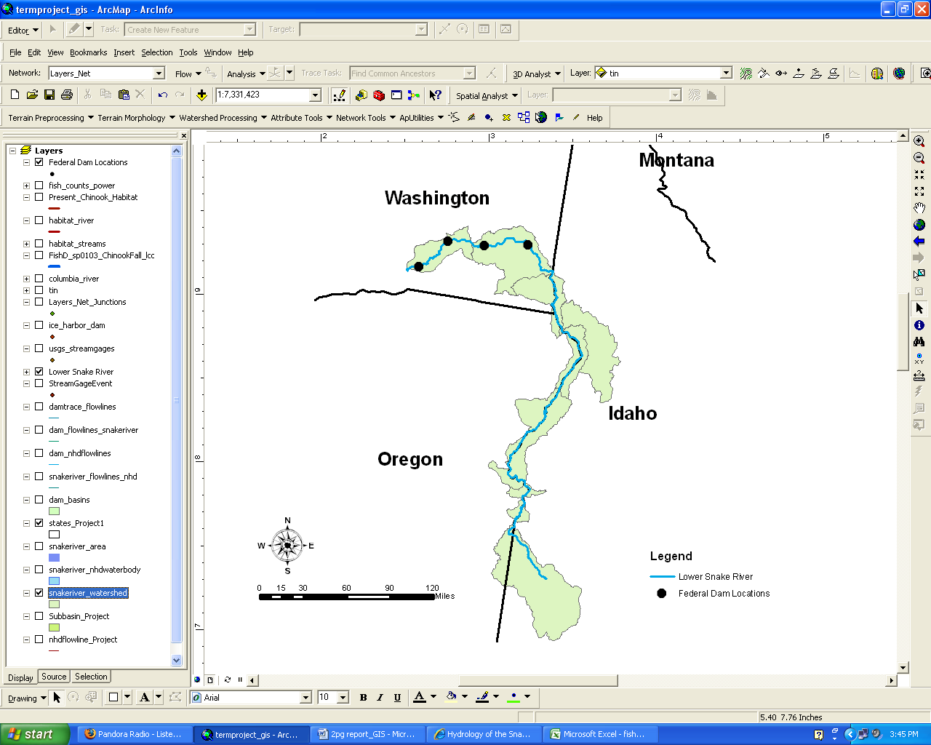
results – flow profile (eng.)
  The Snake River is classified as critical habitat and maintains 7 megawatt hydroelectric dams
  Flow profile indicates there are large rivers feeding the system
  Tucannon
  Clearwater River
  Grand Ronde
  Salmon River

Slide 13
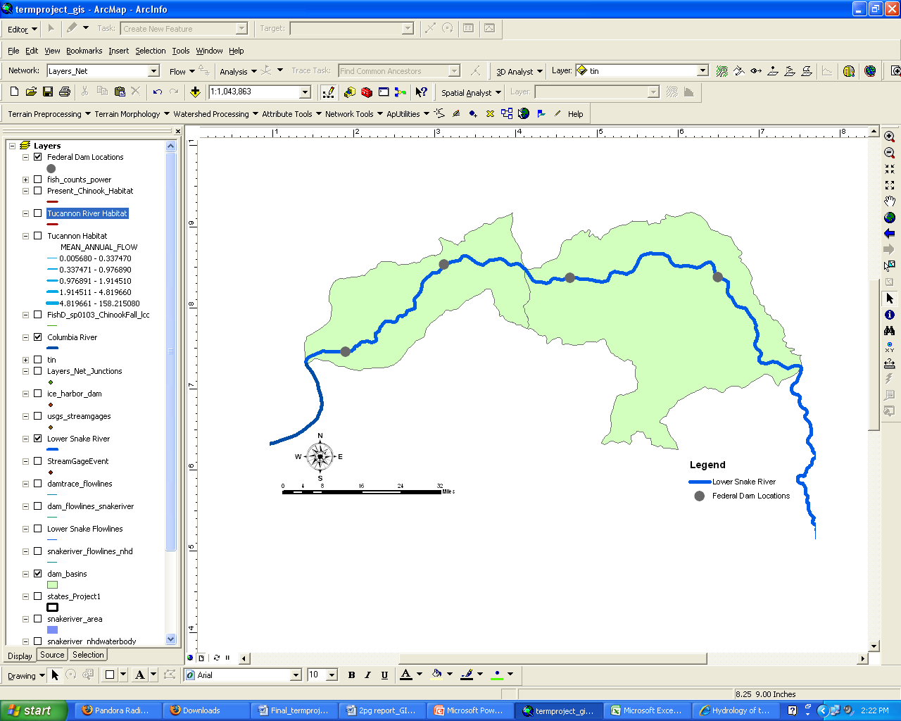
results – hypsometric (eng.)
  Two megawatt hydroelectric complexes.
L. Granite
Little Goose
L. Monumental
Ice Harbor
  Hell’s Canyon Complex
  Federal Dam complex (lower Snake River)

Slide 14
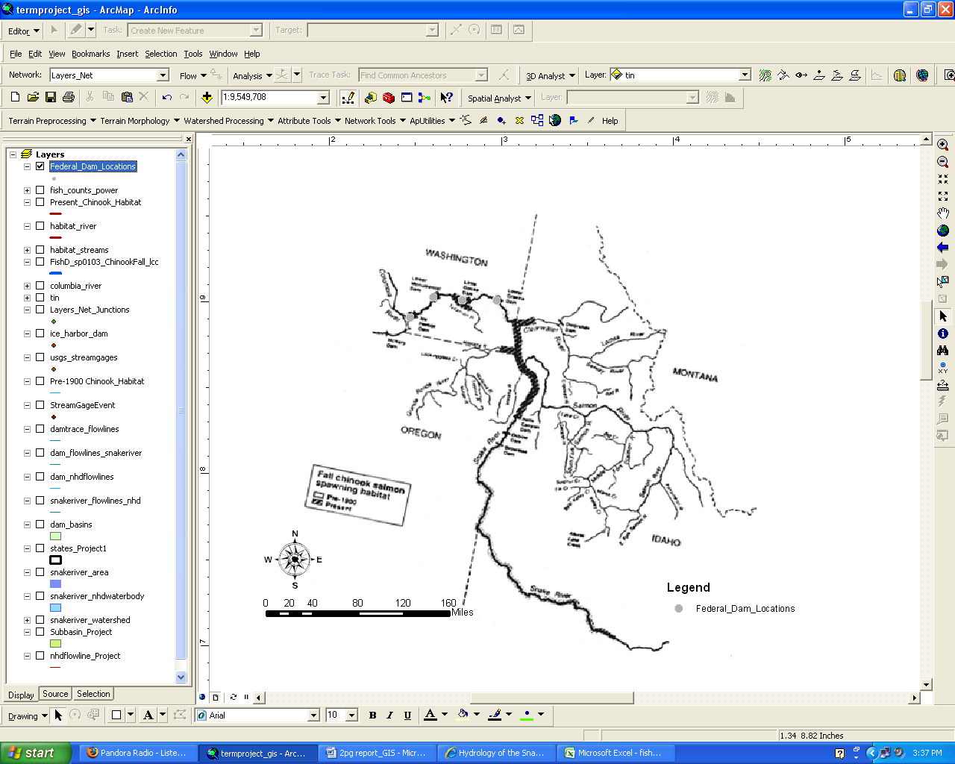
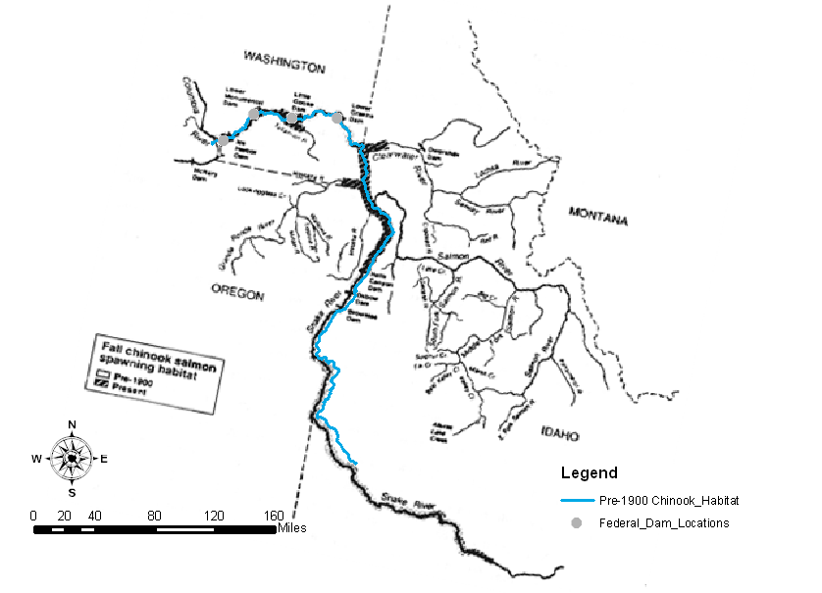
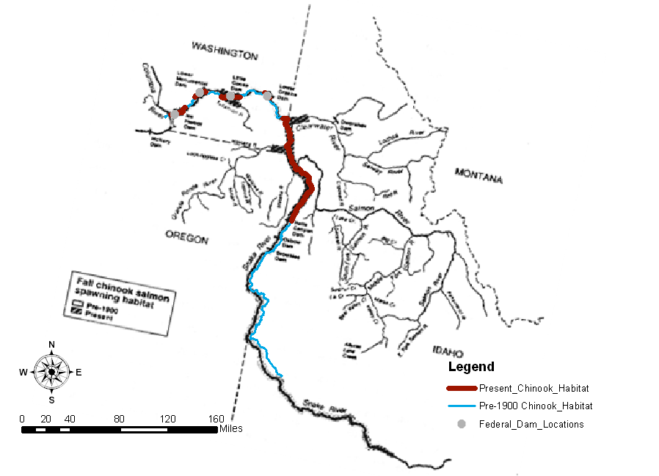
results – chinook habitat loss
BPA designation of chinook habitat in the lower snake river
change since 1900
Chinook habitat pre-1900 on the lower snake river
Approximately 714 km
present chinook habitat on the lower Snake River
60% loss of habitat

Slide 15
conclusion –
the dams significantly alter the hydrology of the river system
the presence of dams on the Snake River likely contributes to the destruction of endangered salmon habitat

Slide 16
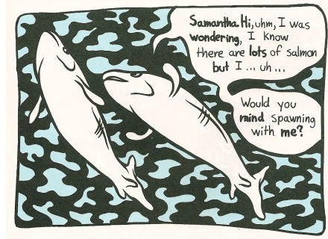
questions – ?
http://madinkbeard.com/blog/wp-content/images/salmon2.jpg

