Slide 1
WISKI and ArcGIS in
Hydrological Data Analysis
Jingqi Dong 12/1/2009
University of Texas at Austin

Slide 2
Contents
Introduction to WISKI
Study Area
Methods
  Several functions in WISKI
Results
  Spatial Information by ArcGIS
  Temporal Information by WISKI
Future extensions

Slide 3
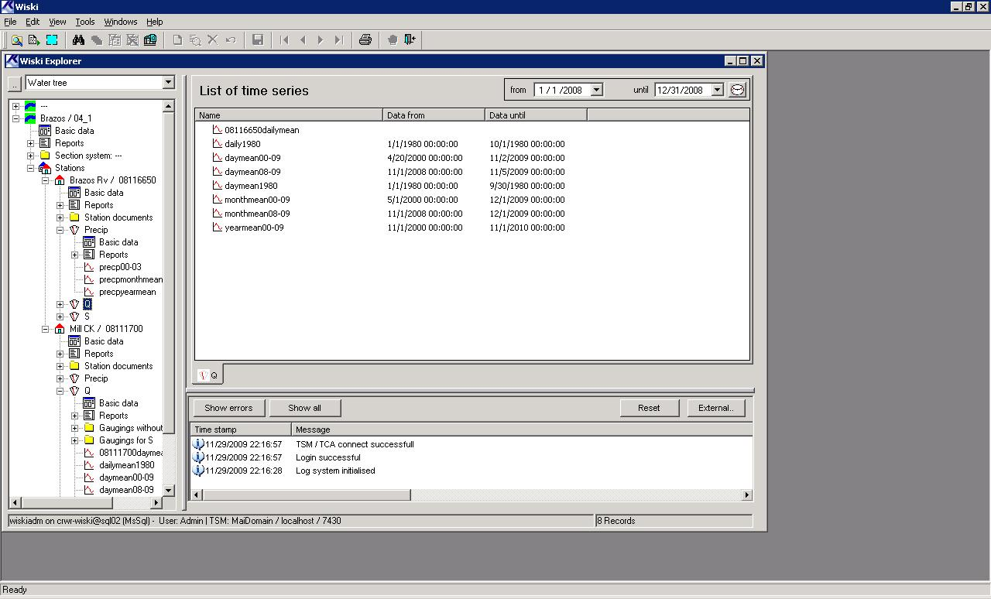
Introduction to WISKI
Time Series Management in Hydrology
Water body
Stations
Time series
Parameters

Slide 4
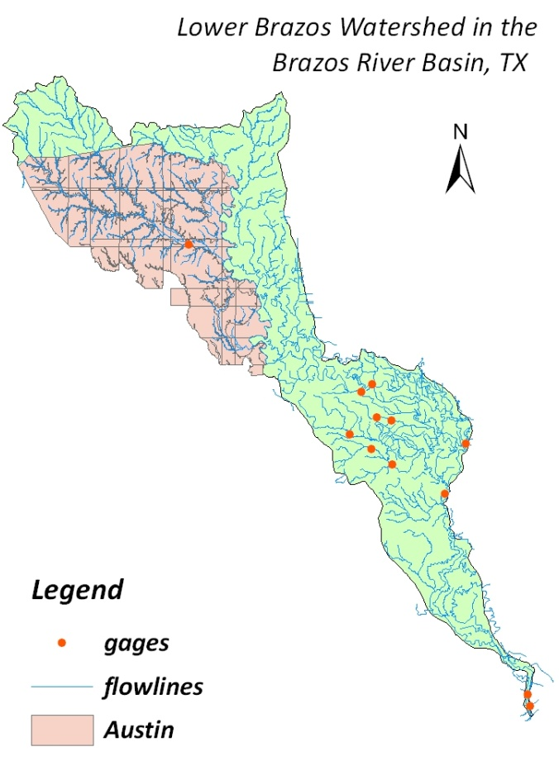
Study Area
Lower Brazos Watershed
(Left picture from: Brazos River Authority)
Mill Ck nr Bellville, TX
Brazos Rv nr Rosharon, TX

Slide 5
Work to do
Derive time series from original data;
Estimate base flow through regression analysis;
Compare discharge’s changes in the two stations.

Slide 6
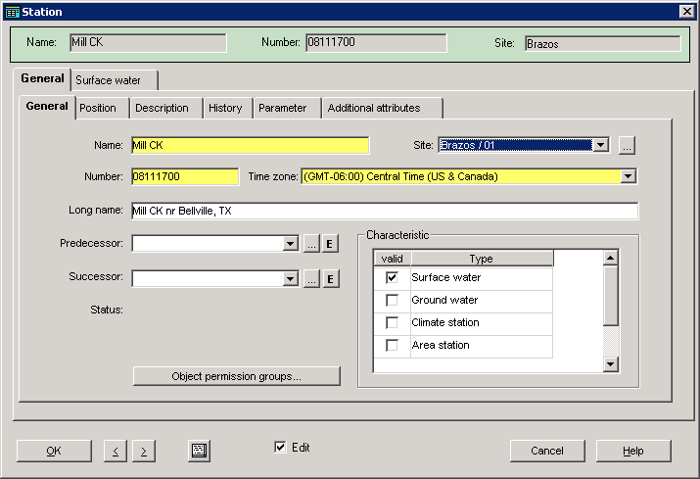
Basic Methods in WISKI
Step1. Systemize Research Area

Slide 7
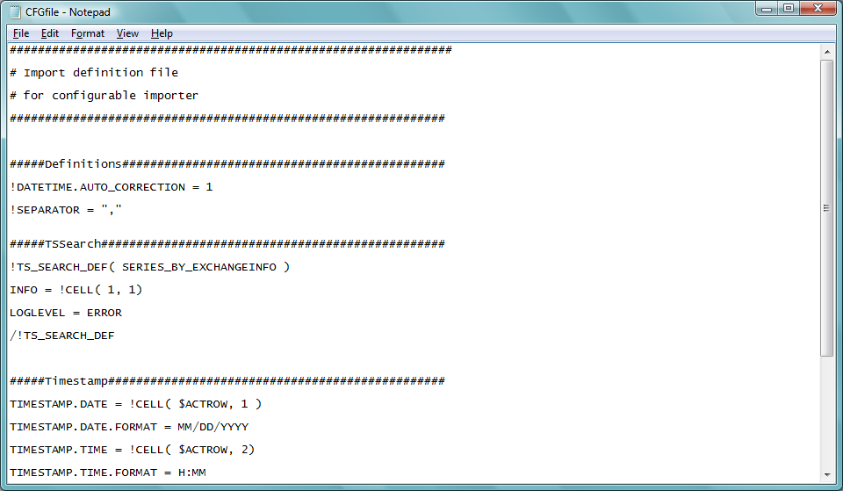
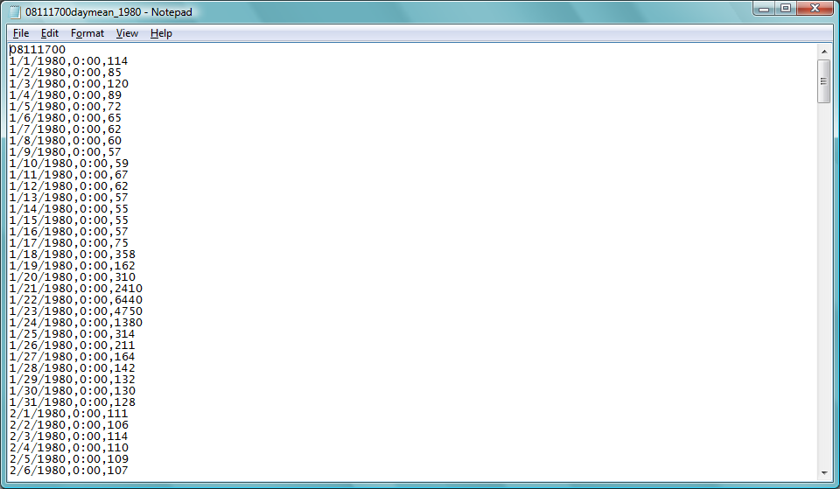
Basic Methods in WISKI
Step2. Import Original TS data

Slide 8
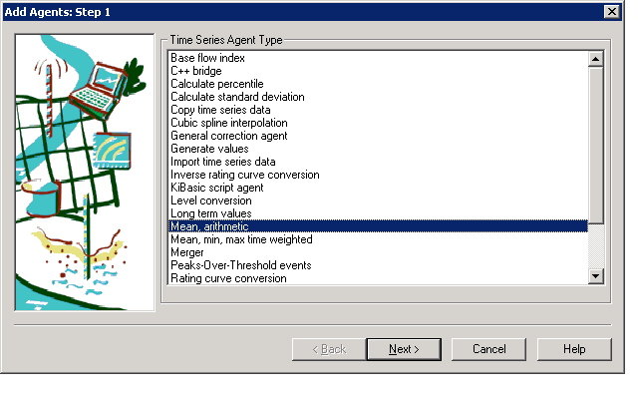
Basic Methods in WISKI
Step3. Calculate Production Time Series

Slide 9
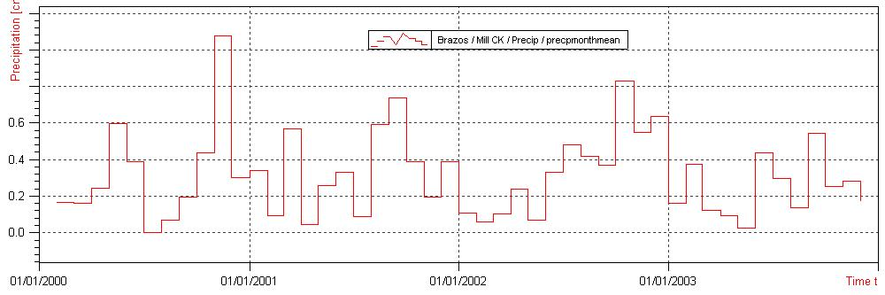
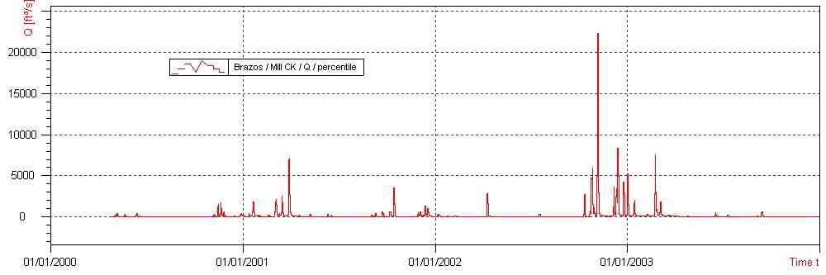
Basic Methods in WISKI
Some example results:

Slide 10
Basic Methods in WISKI
Other functions:
  Regression Analysis in the graph;
  Integration;
  Formula
Calculations
Agents
Analysis tools
Formula

Slide 11
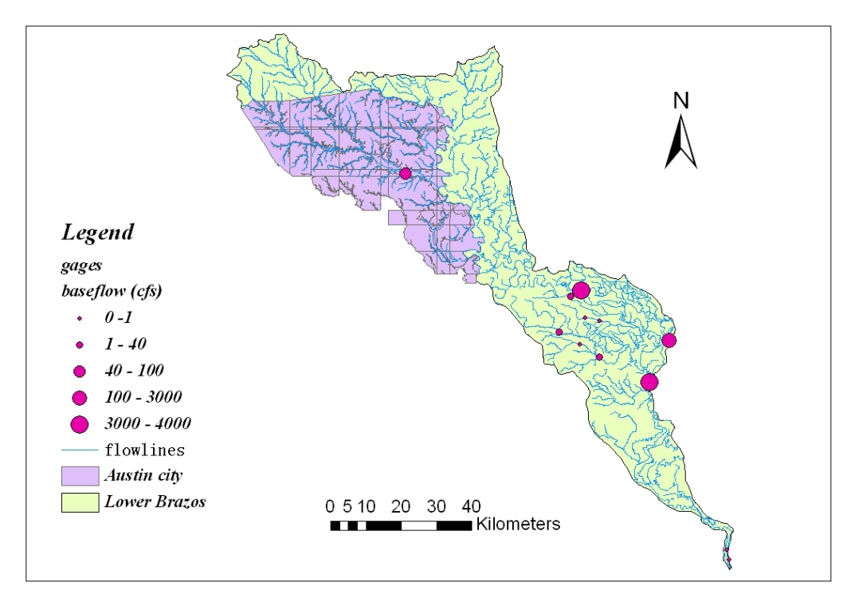
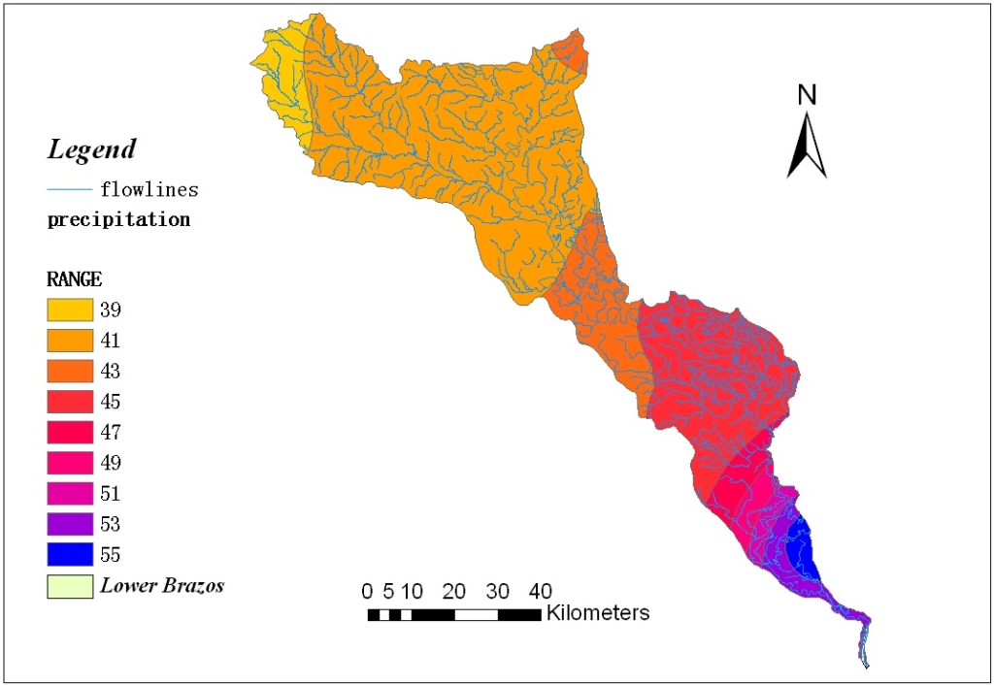
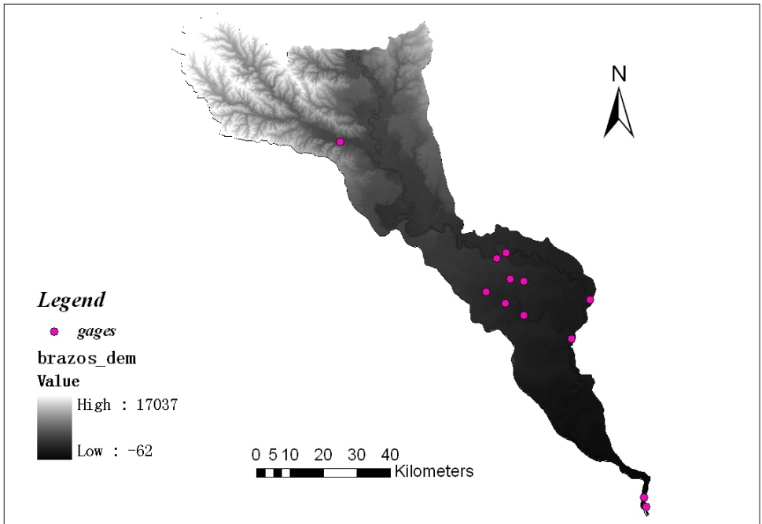
Results – Spatial Information
Mill Ck nr Bellville, TX
Brazos Rv nr Rosharon, TX
Station name | Drainage Area (Mile²) | BF (cfs) | Precp (inch) | DEM
Mill Ck nr Bellville, TX | 376 | 40.9 | 39~41 | 3977
Brazos Rv nr Rosharon, TX | 35,773 | 3970 | 43~45 | 373

Slide 12
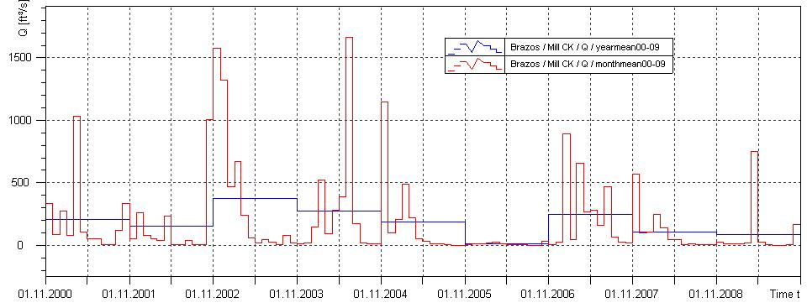
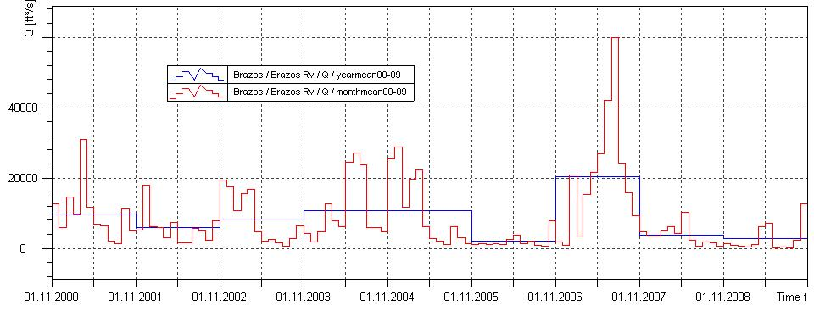
Results – Temporal Information
Discharge at
Mill Ck
Discharge at
Brazos Rv

Slide 13
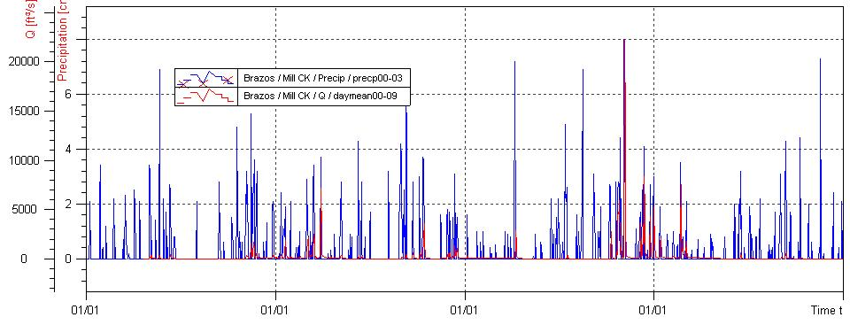
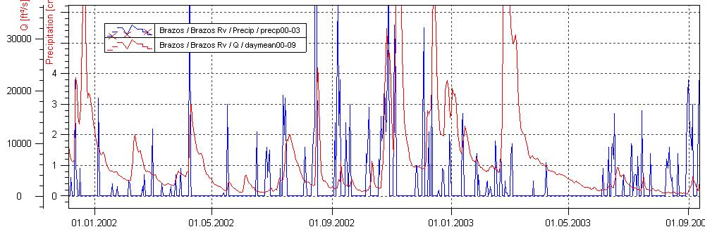
Results – Temporal Information
Regression Analysis between precp/discharge
Precipitation
Mill Ck
Discharge
Brazos Rv

Slide 14
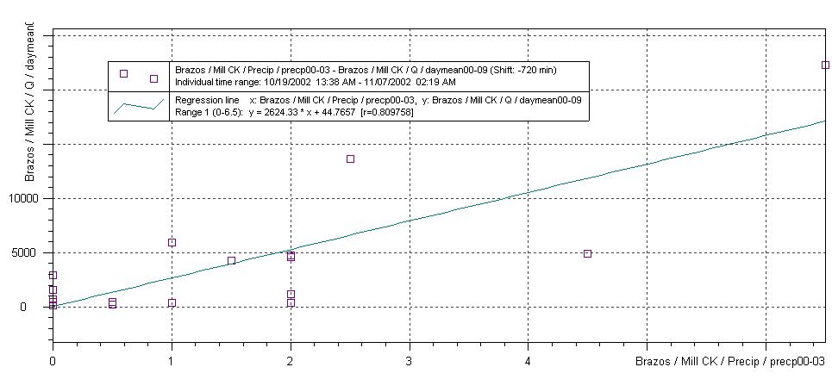
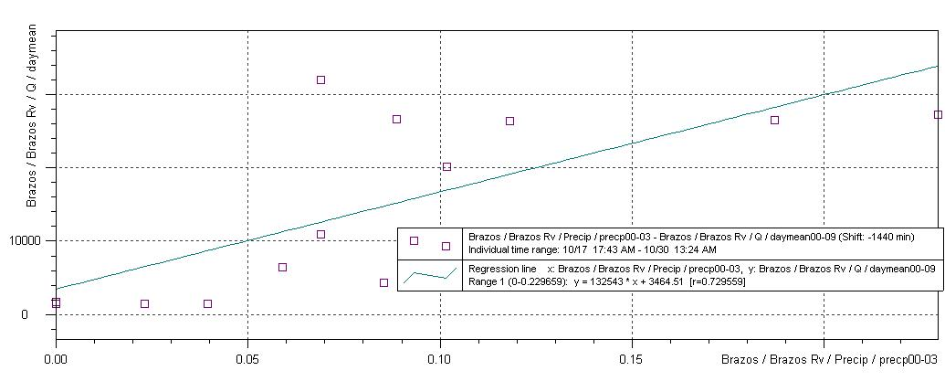
Results – Temporal Information
;
Mill Ck
Brazos Rv

Slide 15
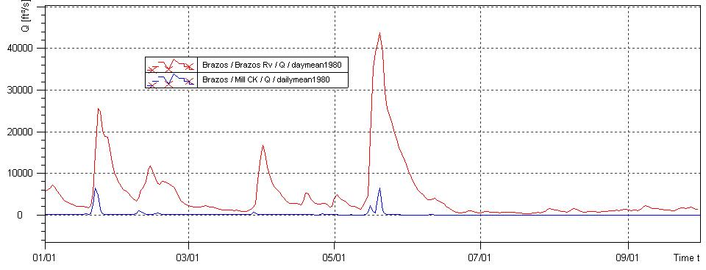
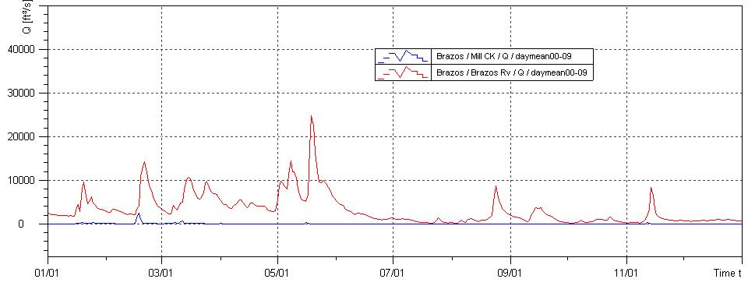
Results – Temporal Information
Discharge Changing
Mill Ck
1980
Brazos Rv
2008

Slide 16
Results – Temporal Information
Changing percentage
Why?
Why?
a). Higher elevation; lower base flow;
b). City area; artificial influences; reduce base flow.

Slide 17
Future extensions
Explore for more algorithms in WISKI
Explore adding map/ArcGIS files into WISKI

Slide 18

Thank you!

