Slide 1
Rainwater Catchment
Travis County
By: Laura Hurd
December 1, 2009

Slide 2
Overview
unpredictable nature of Central Texas weather
rain catchment devices
land use in Travis County
  codes and map
average annual precipitation
2000 Census data
water use per person

Slide 3
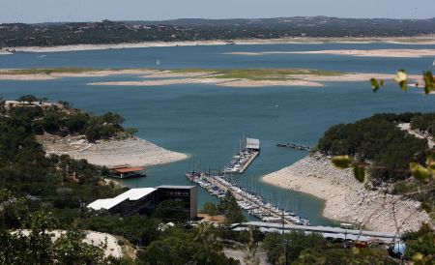
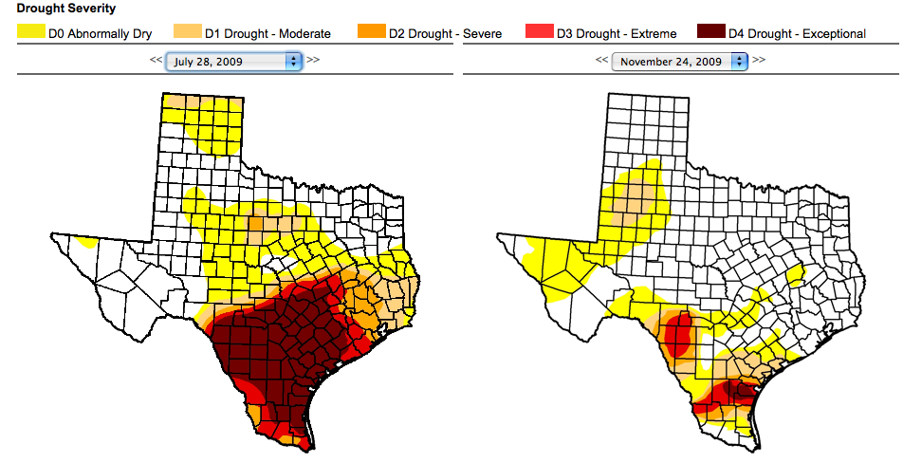
Drought

Slide 4
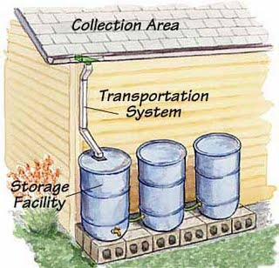
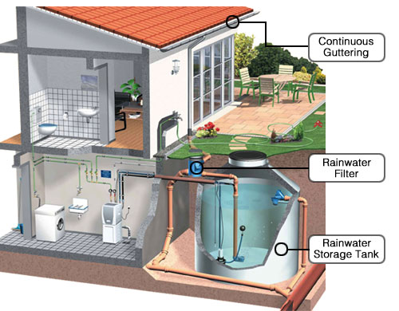
Rain Catchment Devices
http://renewableenergycreations.com/Products.html
http://saveearth-savehumanity.blogspot.com/2009/03/water-table-level-in-chennai-raised-by.html

Slide 5
Land Use Code
Value | Definition
100 | Single Family - one dwelling in a single building on one lot. May be attached to another unit, as long as there are separate parcels. Includes manufactured, non-mobile homes.
113 | Mobile Homes - one or many dwellings in single buildings, designed to be mobile.
150 | Duplexes - two dwellings within a single building and on one lot, other than a mobile home.
160 | Large-lot Single Family - one dwelling in one buidling on a parcel 10 acres or greater, usually used as a farm, that can possibly be redeveloped for another use
210 | Three/Fourplex - Three or four dwellings within individual buildings on one lot.
220 | Apartment/Condo - more than 5 dwellings within individual buildings on one lot.
230 | Group Quarters - one dwelling containing non-family occupants on one lot and providing. Occupants share services.
240 | Retirement Housing - one dwelling containing non-family occupants on one lot and providing services to retirees
(ftp://ftp.ci.austin.tx.us/GIS-Data/Regional/landuse/landuse_2003.htm#what)

Slide 6
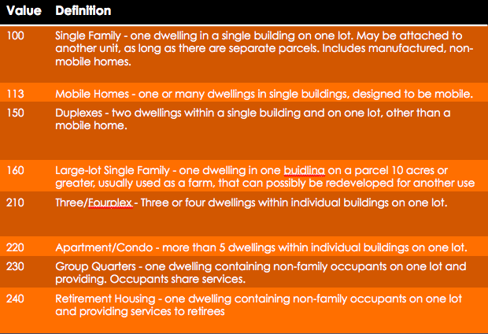
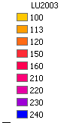
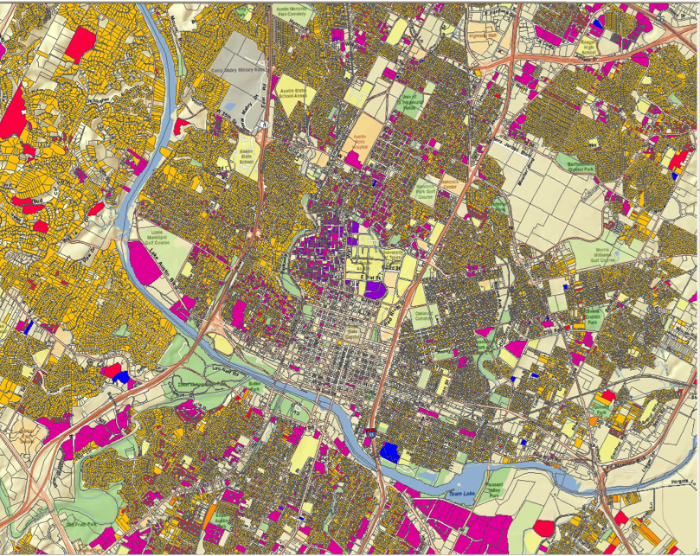
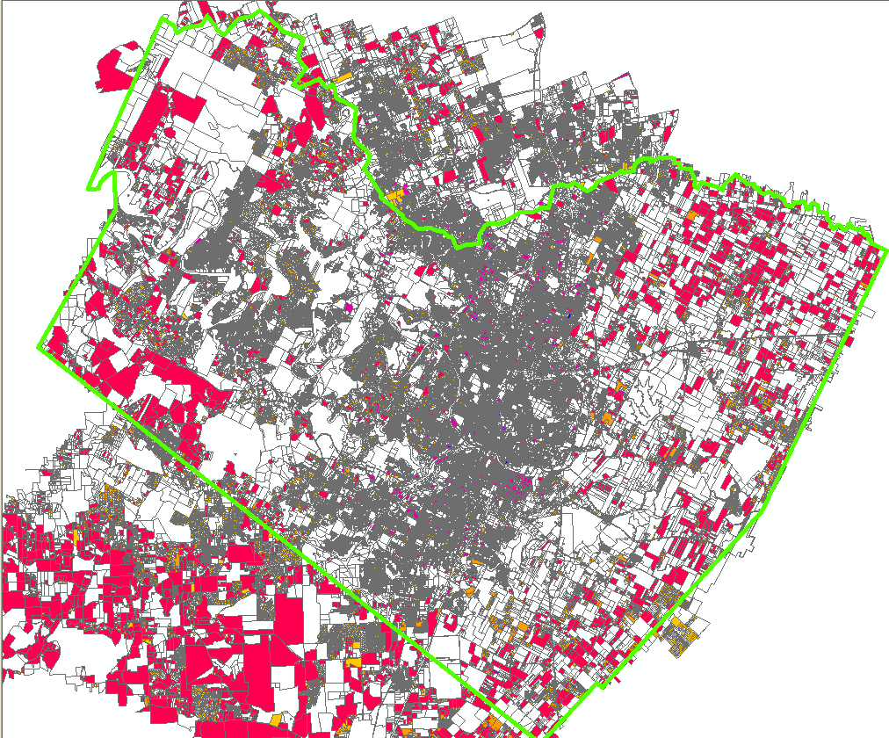
Land Use Map

Slide 7
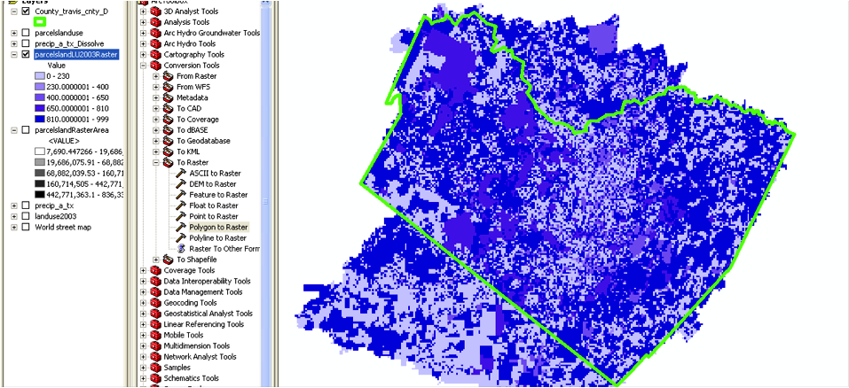
Land Use Code Raster

Slide 8
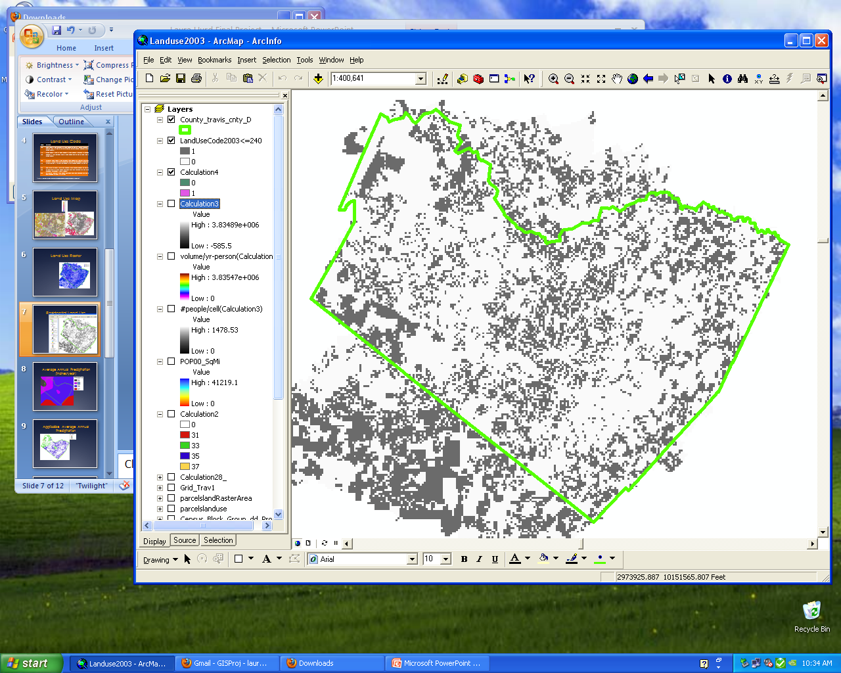
Residential Land Use Raster Calculation
All residential areas are in grey

Slide 9
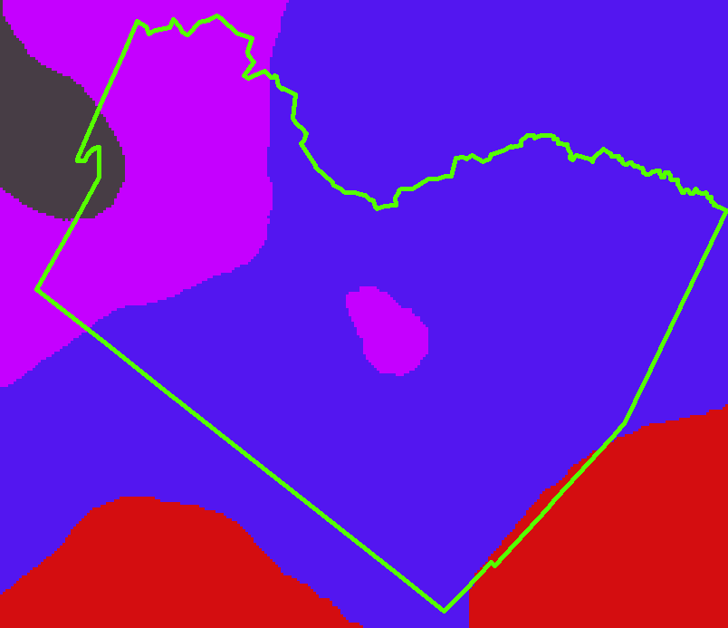
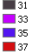
Average Annual Precipitation (inches/year)

Slide 10
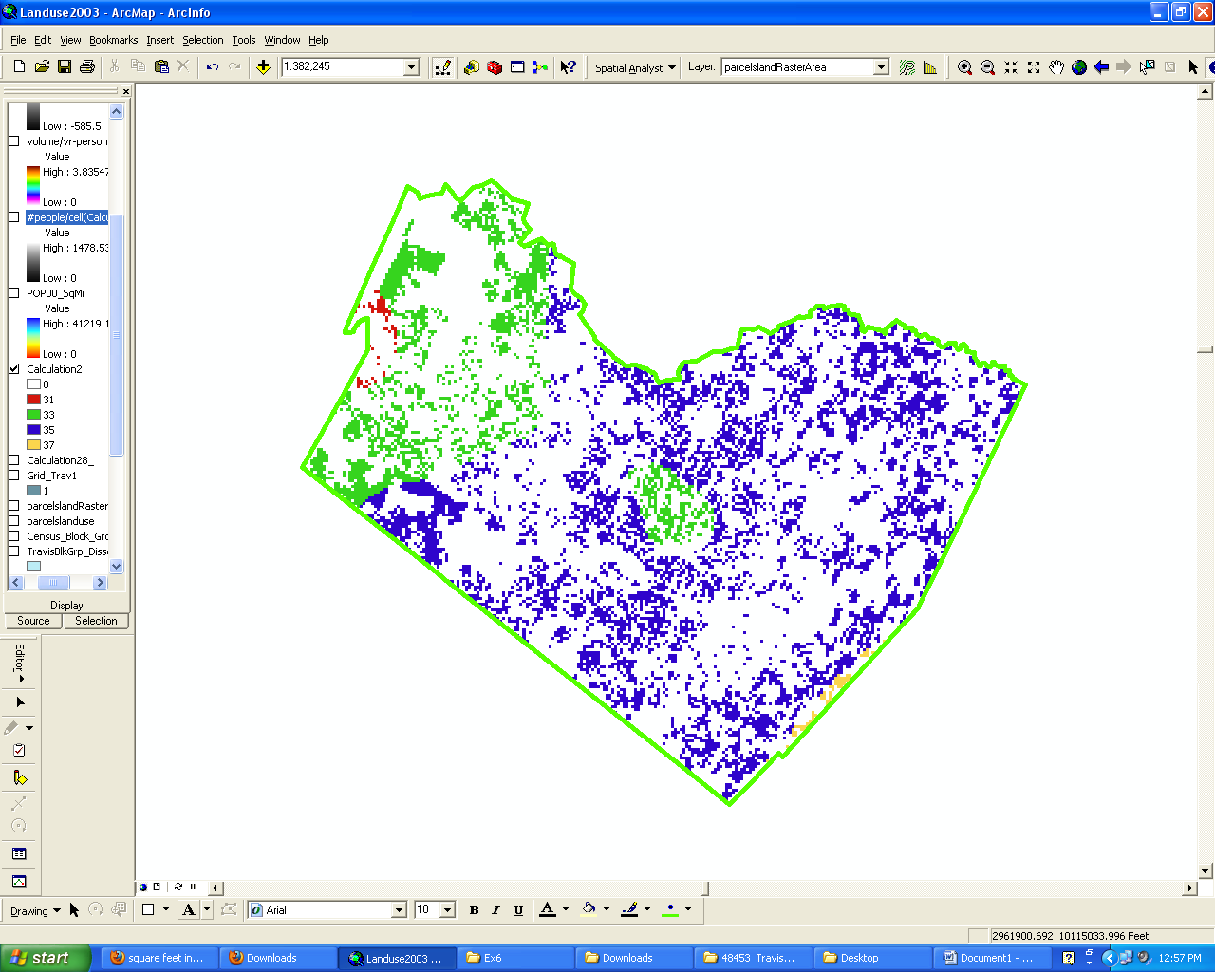
Average Annual Precipitation for Residential Areas

Slide 11
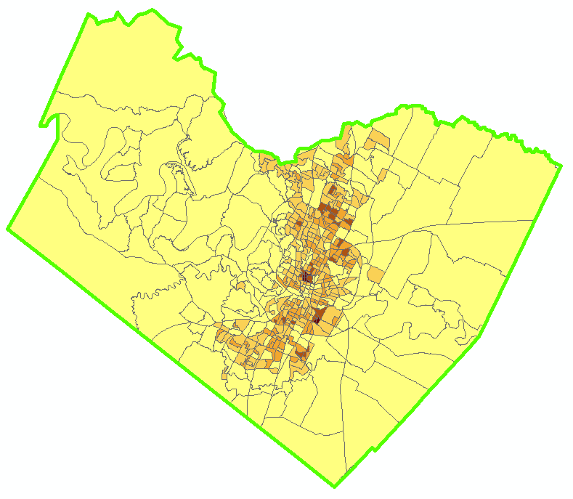
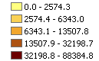
2000 Census # of people per square mile

Slide 12
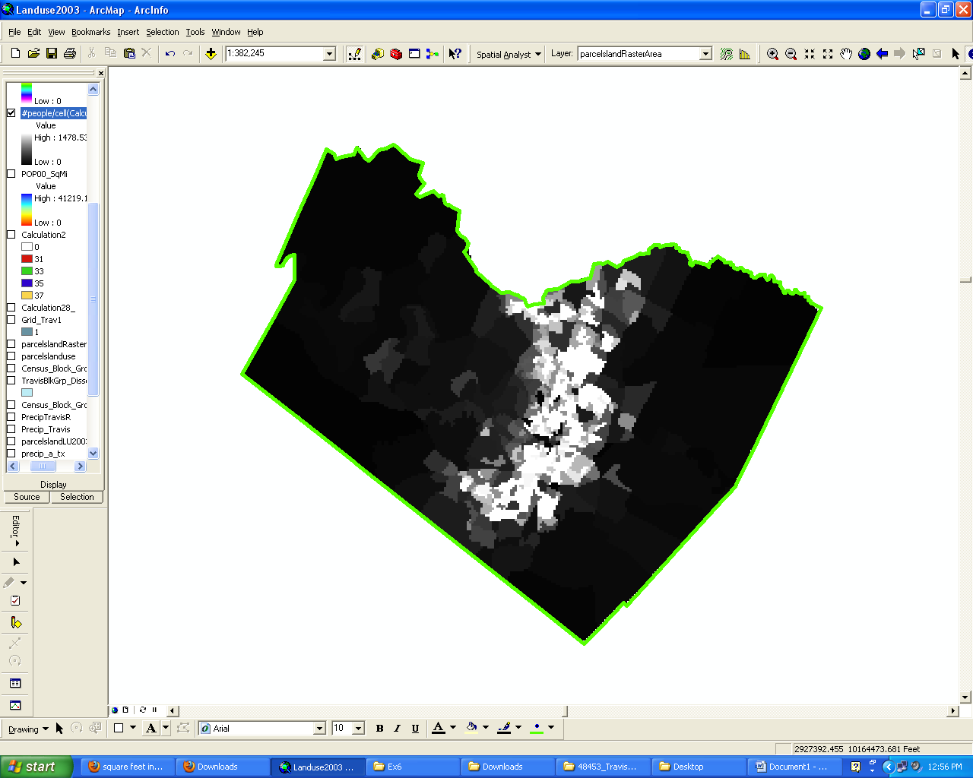
Number of people per cell

Slide 13
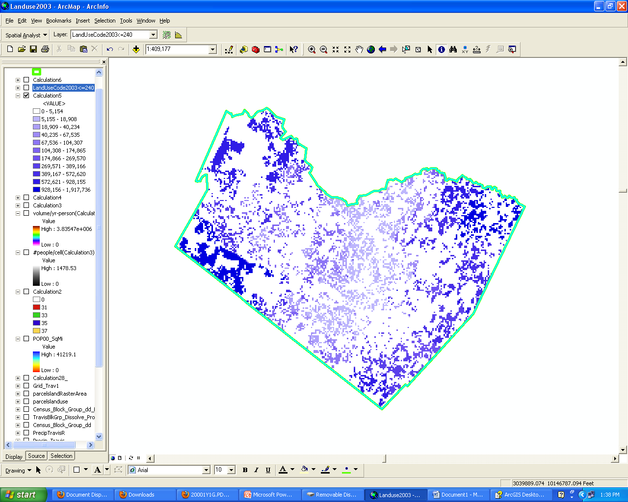
Raster Calculation: Volume (ft^3) of water per year per person

Slide 14
Water Usage
On average100 gallons of water is used per day per person (Nalco Handbook) which is about 5,000 cubic feet of water per person per year

Slide 15
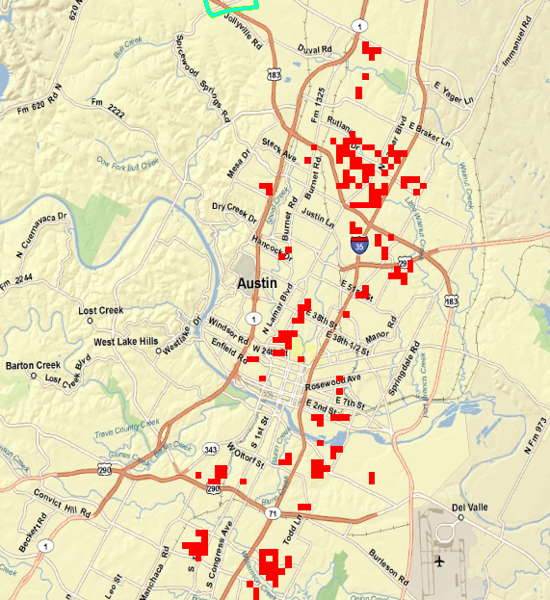
Conclusion
red cells are residential
areas with < 5000 cubic feet/year-person of rainwater volume
These red blocks are areas where rainwater catchment is not worth pursuing for all water needs.
Red areas consist primarily of high density housing areas (e.g. dorms, apartments)

Slide 16
Questions?

