Slide 1
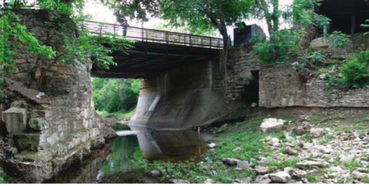
The Potential Benefits of Greenroofs in Waller Creek Watershed
Katherine Jashinski
GIS in Water Resources
December 1, 2009

Slide 2
Benefits of Greenroofs
Reduce sewage system loads by assimilating large amounts of rainwater
Absorb air pollution, airborne particulates, and store carbon
Insulate a building from extreme temperatures
Reduce urban heat island effects
Protect underlying roof material by eliminating exposure to the sun’s ultraviolet (UV) radiation and extreme daily temperature fluctuations

Slide 3
Waller Creek Watershed
One of the most densely developed streams in the city, >50% impervious cover
5.63 sq. miles in area
Drains to Colorado River at Ladybird Lake

Slide 4
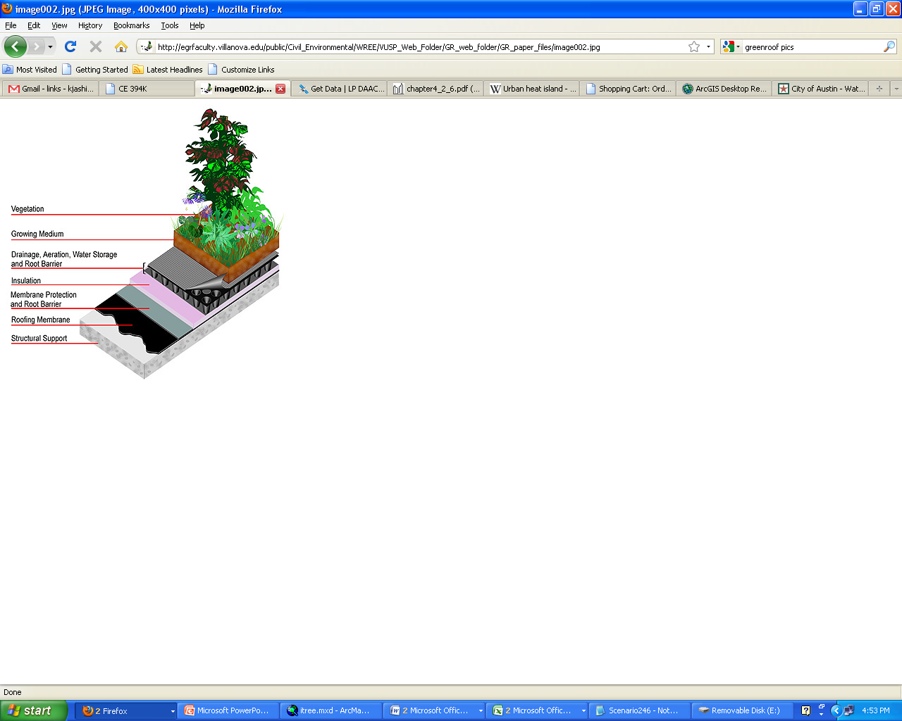
Study Assumptions
Roofs are at least one story above grade
All roofs are flat
100% of the total roof area is available for conversion to greenroofs
Extensive greenroofs

Slide 5
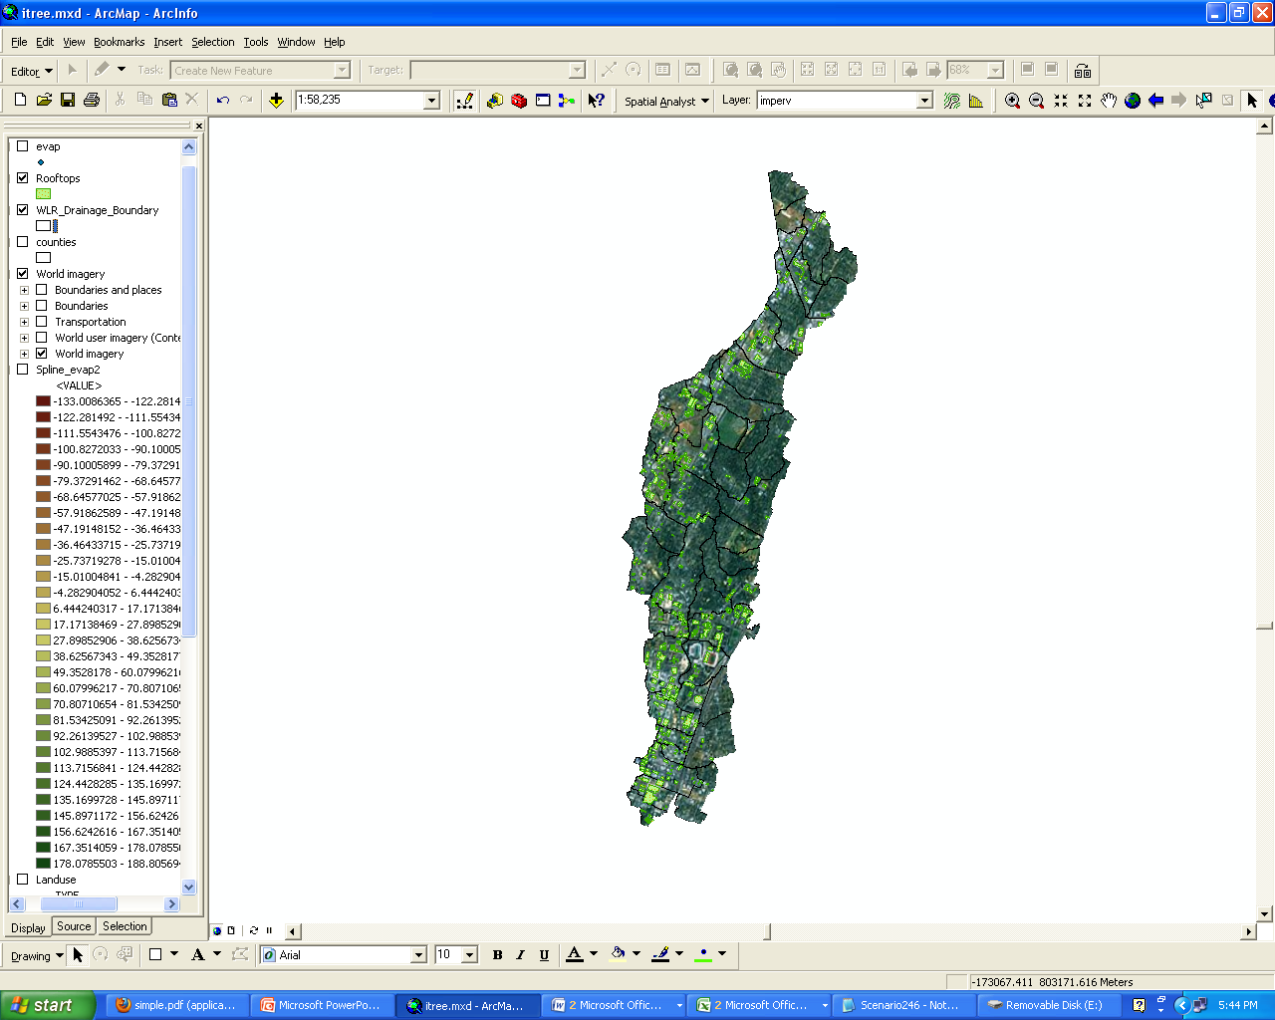
~0.34 sq. miles of the watershed or 6% is viable roof space for conversion to greenroofs

Slide 6
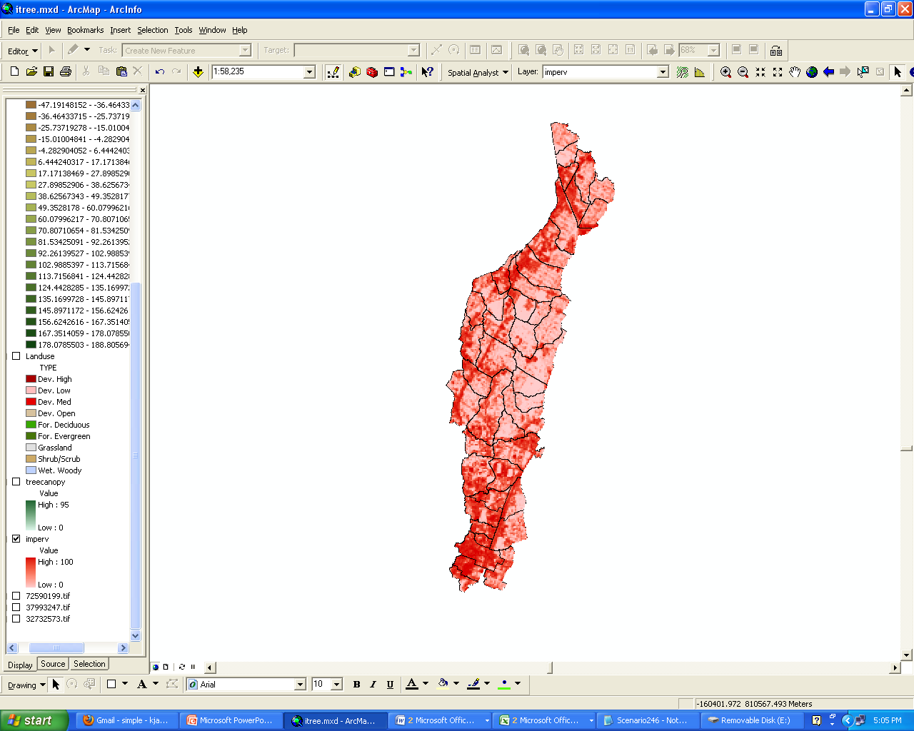
Modeling Runoff
Simple Method: R = P * Pj * Rv
Where: R = Annual runoff (inches)
P = Annual rainfall (42.87 inches in 2001)
Pj = Fraction of annual rainfall events that produce runoff (usually 0.9)
Rv = Runoff coefficient
Rv=0.05+0.9Ia
Ia = Impervious fraction (36.63%)

Slide 7
Benefits of Reduced Stormwater
Reduced stormwater load of 203.8 million gallons for the year
Three types of the stormwater benefits are estimated
stormwater best management practice savings due to the application of green roofs (BMP)
pollutant reduction (P)
reduction of receiving stream erosion (E)
BMP | $8/sq ft of greenroof | $75,338,588
Pollutant Reduction | P=05.*$1,414,133/sq mile green roof | $238,847
Erosion Reduction | E=$1,309,239*sq mile green roof | $442,261

Slide 8
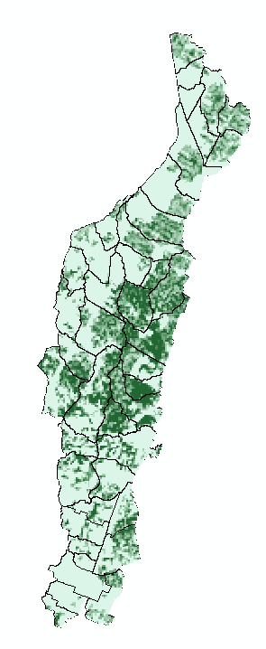

Pollution Removal
i-Tree (UFORE) using clipped rasters from Arc GIS
Removal
CO
NO2
O3
SO2
PM10
Impervious
Tree Canopy
Land Use

Slide 9
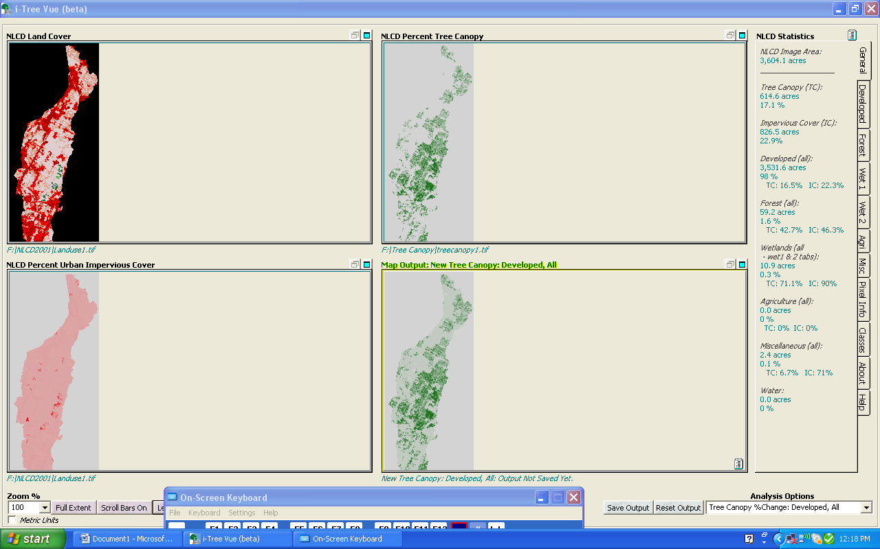
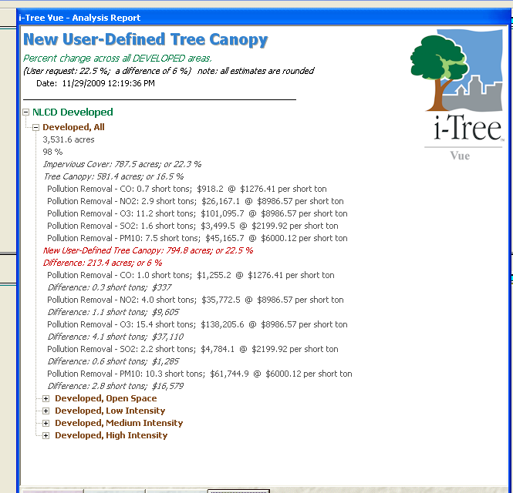

Slide 10
Benefits of Removed Pollution
Pollutant | CO | SO2 | O3 | NO2 | PM10
Reduction (tons) | 0.1 | 0.2 | 1.4 | 0.4 | 0.9
Savings | $113.1 | $431.1 | $12,452.6 | $3,223.2 | $5,563.3
Total Savings = $21,783

Slide 11
Direct Energy Savings
Savings Category | Amount of saving per sq. ft. of green roof area | $ saved per sq. ft. of green roof area
Direct Energy Savings | 0.385 kWh/sq ft. annually | $168,470
CO2 Mitigation | 2454.2 tons | $22,264
-4.64 cents/kWh
-Assuming fossil fuel
energy production

Slide 12
Benefit Summary
Pollutant Reduction | $238,847
Erosion Reduction | $442,261
Removed Pollution | $21,783.00
Direct Energy Savings | $168,470
CO2 Mitigation | $22,264
Total | $893,625
*cost of greenroofs $75,338,588

Slide 13
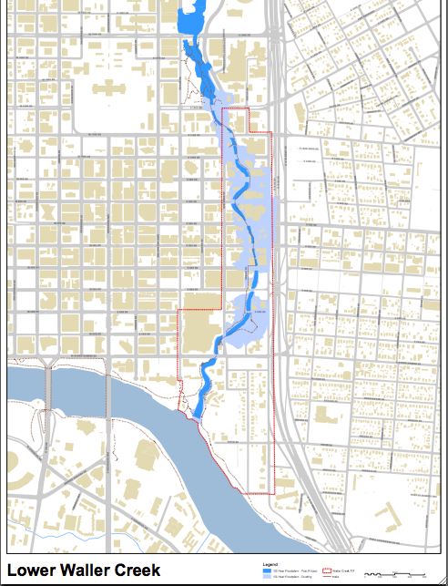
Waller Creek Tunnel Project
$127 million dollars
expected to reduce the size of the 100-year floodplain of the lower Waller Creek watershed by an estimated 28 acres
allow denser development in a very desirable area of downtown
a pump station at Waterloo Park will maintain constant water flow in the creek during the dry season to improve water quality

Slide 14
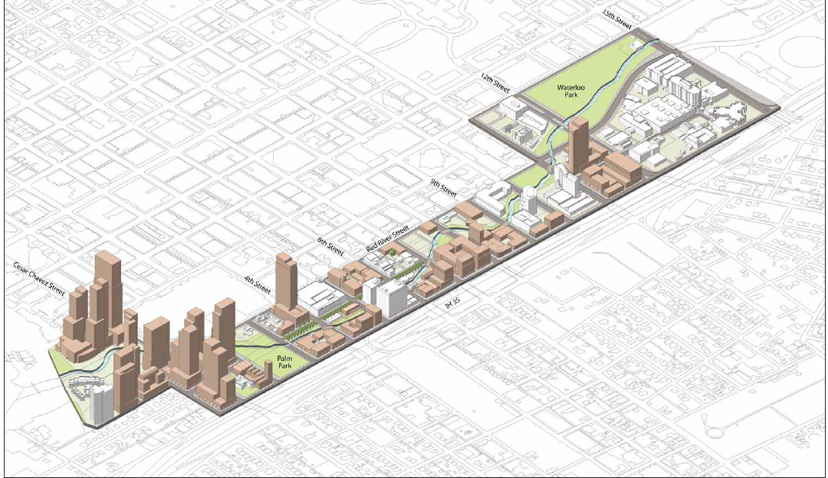
Waller Creek District Master Plan

Slide 15
Conclusions
Many benefits to greenroofs both monetary and environmental
The City of Austin has an opportunity with new development to implement a large area of greenroofs
Other benefits that could be quantified and modeled to make greenroofs a more viable BMP

