Slide 1
Flood Alarm and Community Protection Systems
Term Project : GIS in Water Resources
Chan-Hoo Jeon
EWRE, CAEE
University of Texas at Austin

Slide 2
Contents
Introduction
Methodology
A Case Study for Waller Creek in Ausin
  Flood Alarm System
  Community Protection System
Conclusion

Slide 3
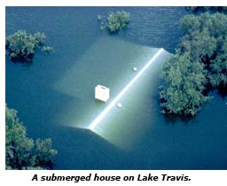
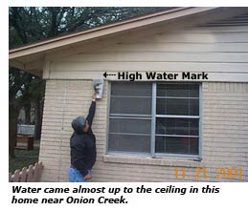
Flood History in Austin
Introduction
December 20, 1991
November 15, 2001
200 homes were completely under water
860 buildings had flood damage

Slide 4
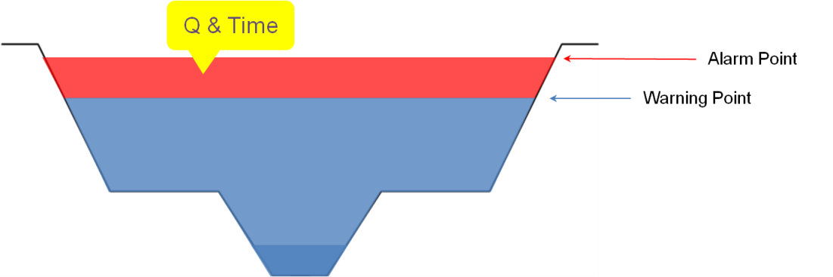
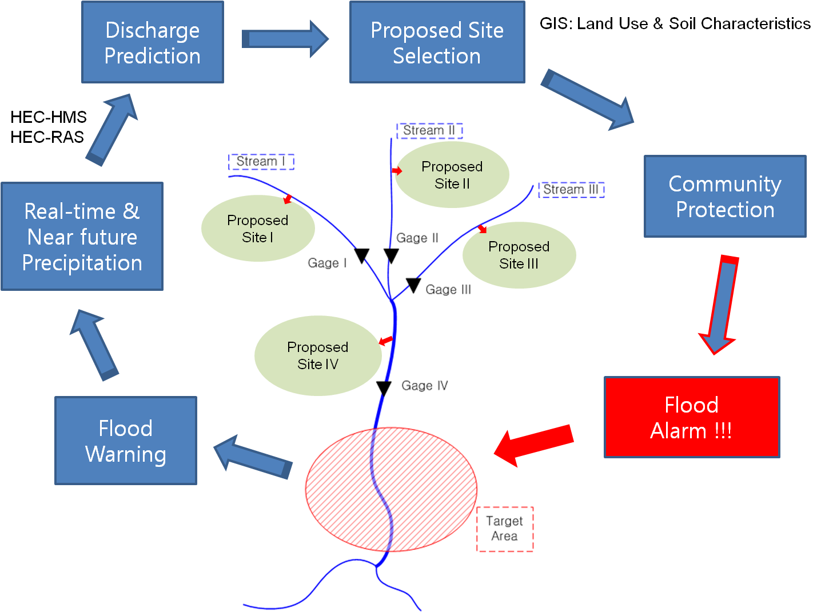
Methodology

Slide 5
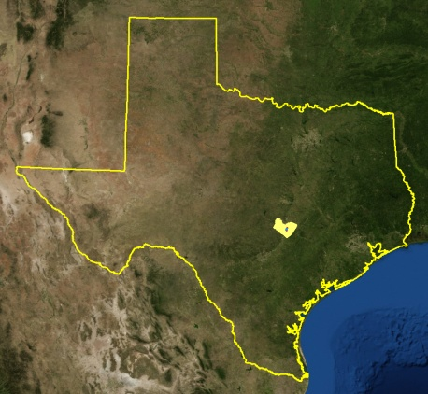
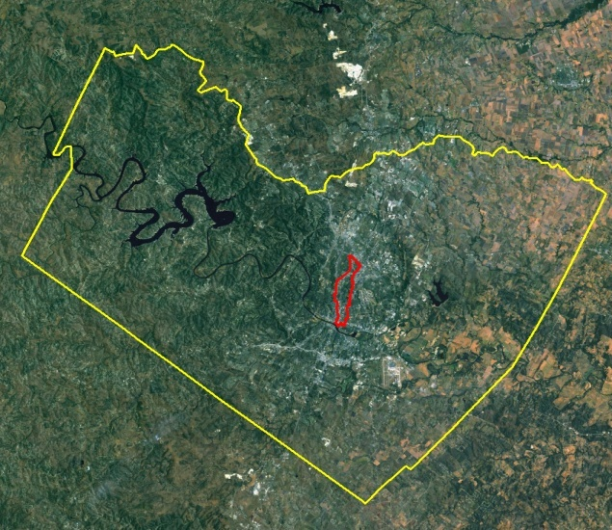
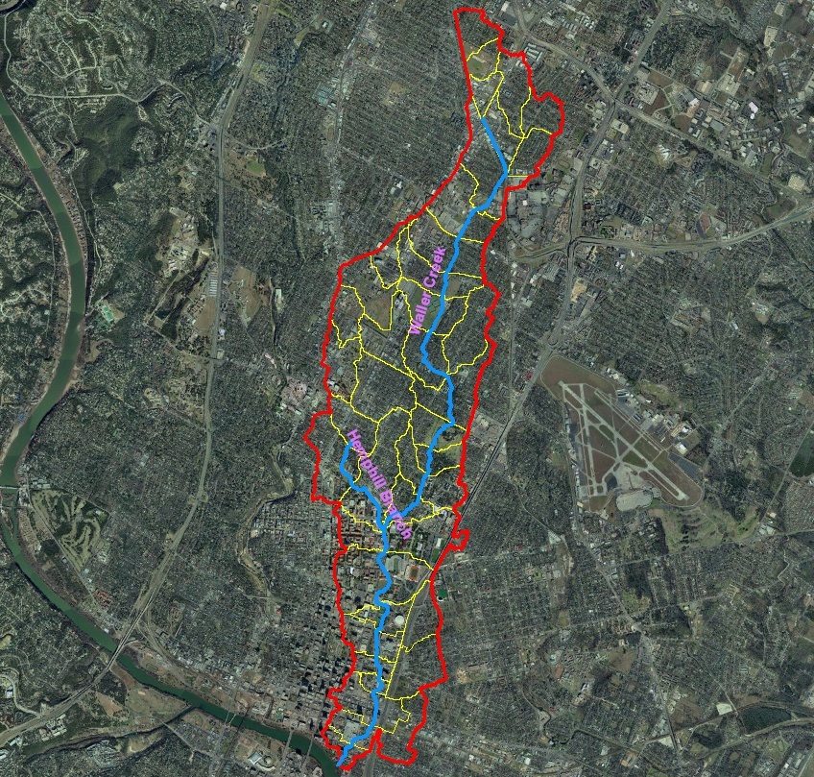
Waller Creek
Waller Creek
Waller Creek & Hemphill Branch
Texas
Travis County

Slide 6
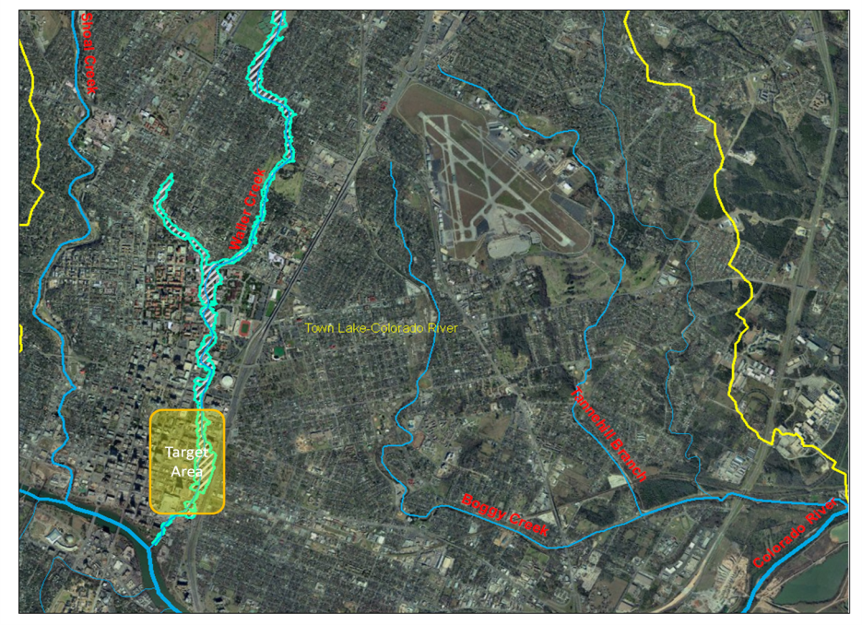
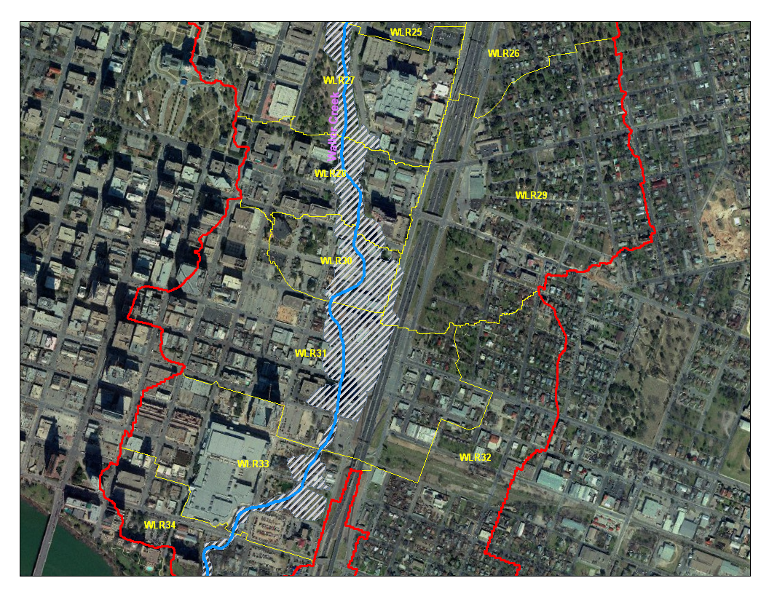
Target Area in this Project
Target Area
Inundation map of 100 yr flood in the target area
Target area to be protected

Slide 7
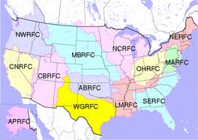
Precipitation Data from NEXRAD
Flood Alarm System
Network of 13 RFCs
Texas
WGRFC
24 Radars (radius = 230 km)
West Gulf River Forecast Center (WGRFC)

Slide 8
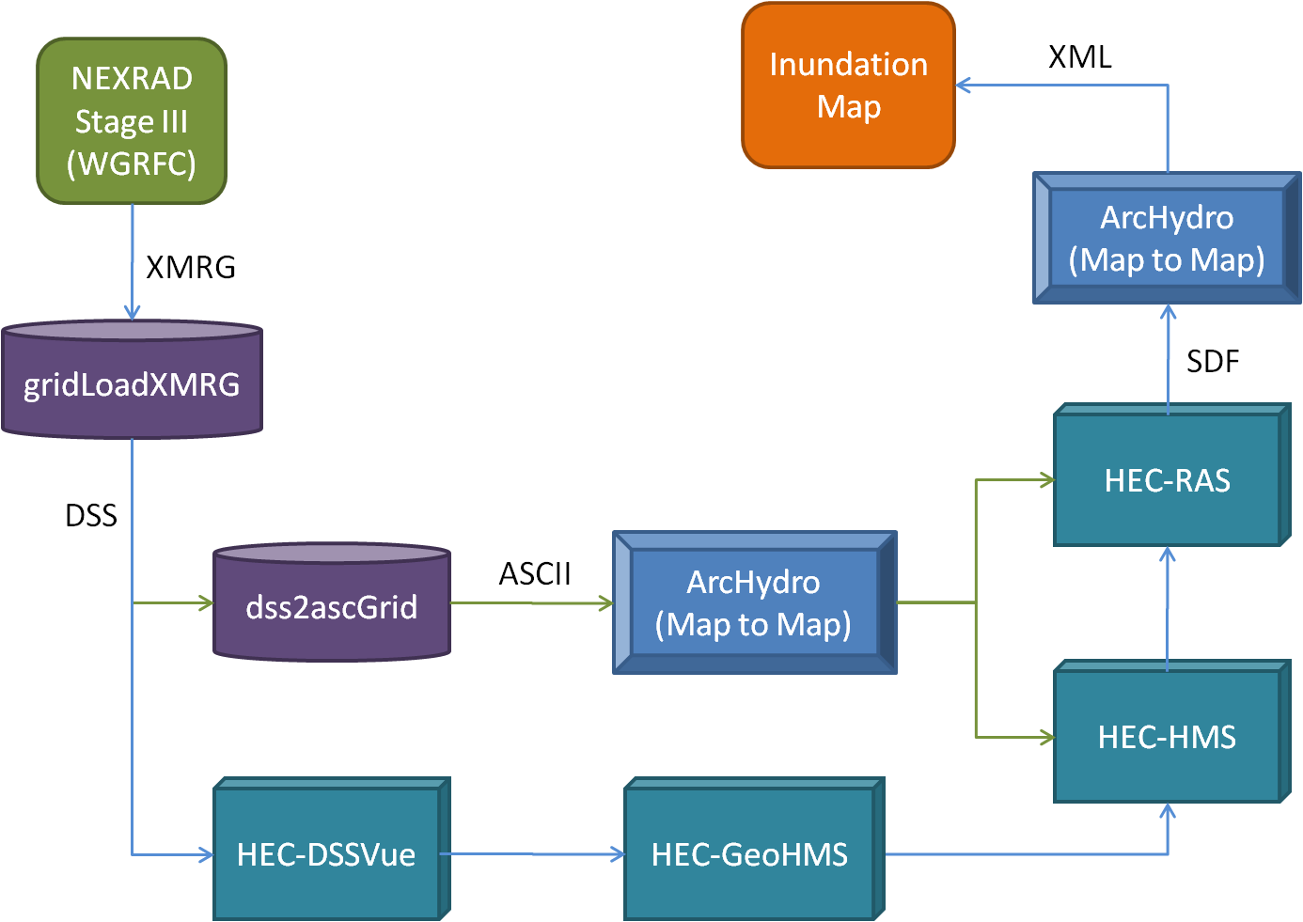
NEXRAD Data(XMRG) into Inundation Polygon (XML)
Flood Alarm System

Slide 9
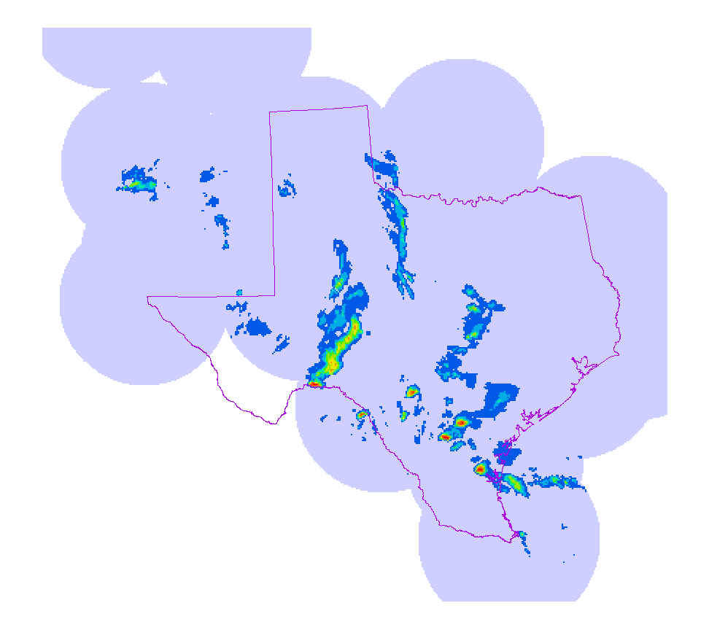
NEXRAD Data (11.15.2001 ~ 11.16.2001)
Flood Alarm System

Slide 10
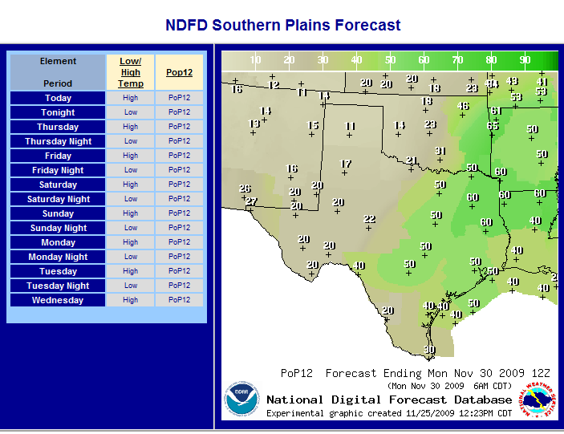
Probability of Precipitation from NDFD
Flood Alarm System
Web view
ArcGIS view
NDFD (National Digital Forecast Database)
Probability of precipitation, Temperature, wind, and so on
NDFD → Shape and FLT files for ArcGIS

Slide 11
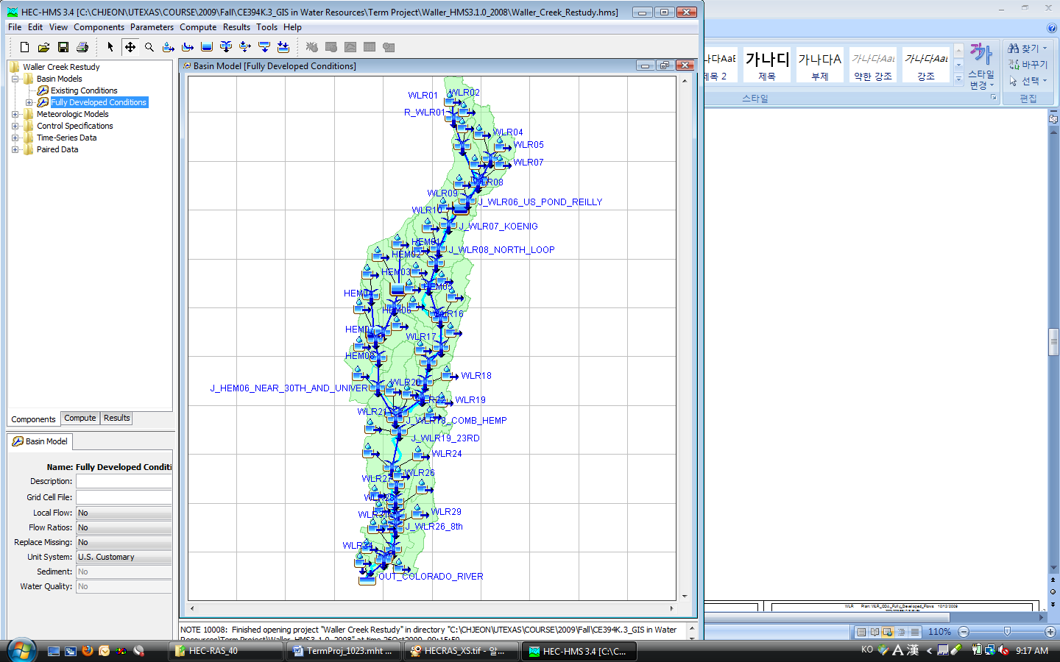
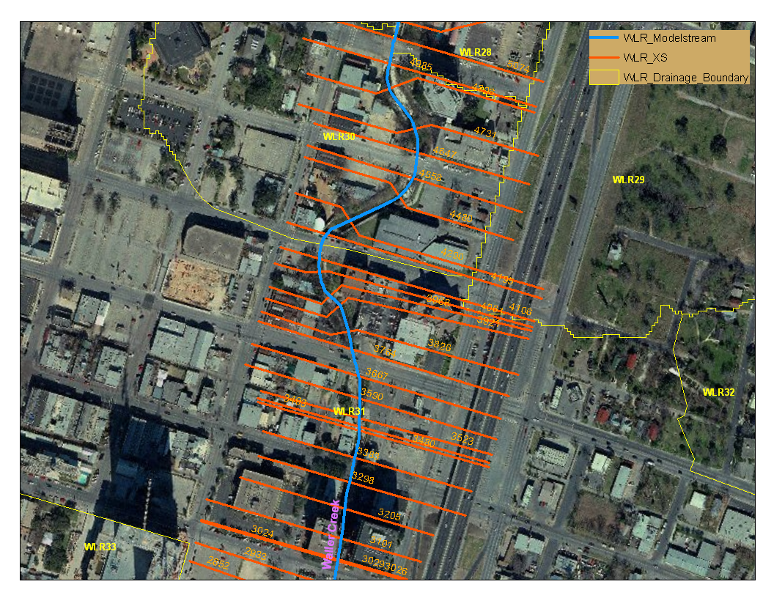
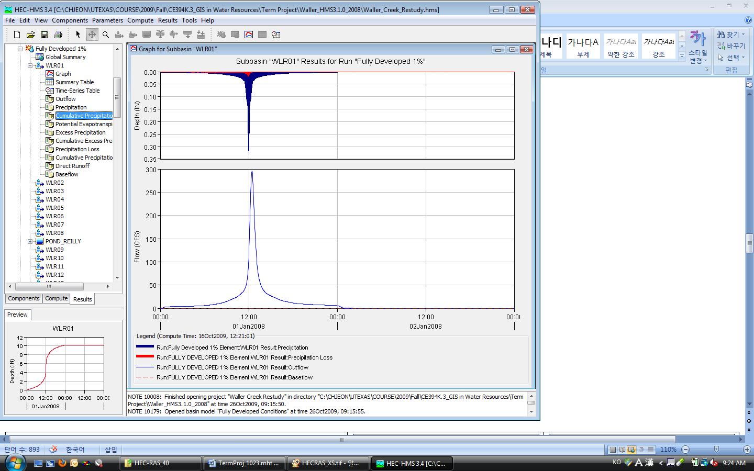
HEC-HMS & HEC-RAS
Flood Alarm System
HEC-HMS : Precipitation Data → Runoff
HEC-RAS : River Flow → Change of water surface level

Slide 12
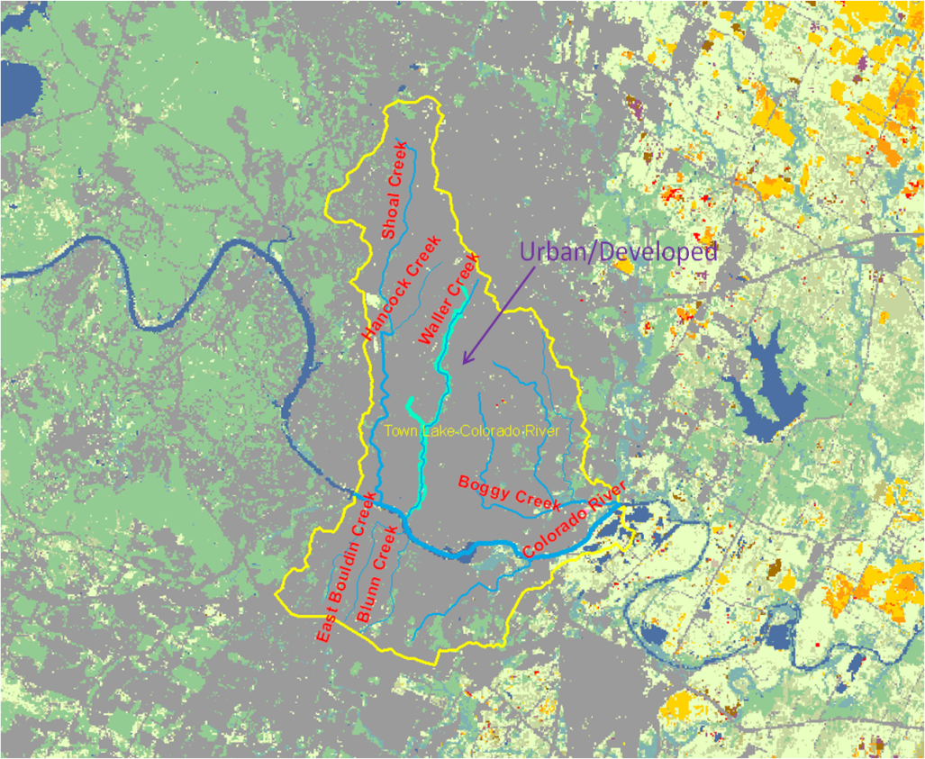
Land Use in Waller Creek
Community Protection System
Almost all area in the watershed (HUC-12) is ‘Urban/Developed’

Slide 13
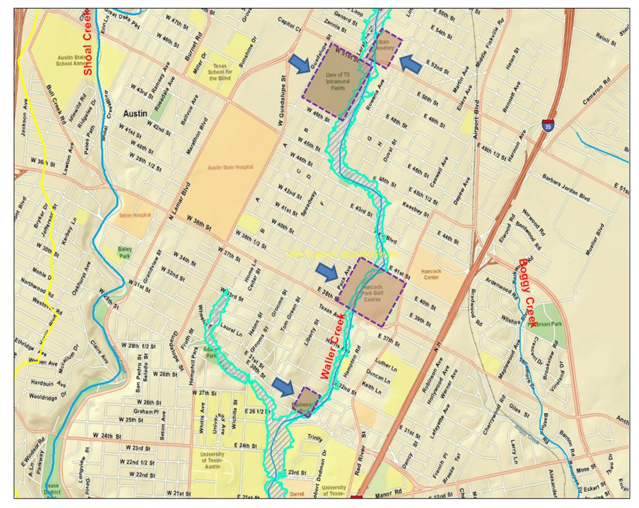
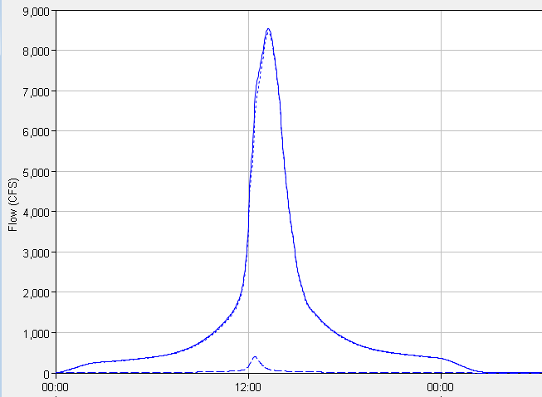
Alternative I. Underground Facilities
Community Protection System
overflow
Hancock Park Golf Course
Intramural Field
State Cemetery
Commerce Park
Eastwood Park
Waterloo Park
capacity

Slide 14
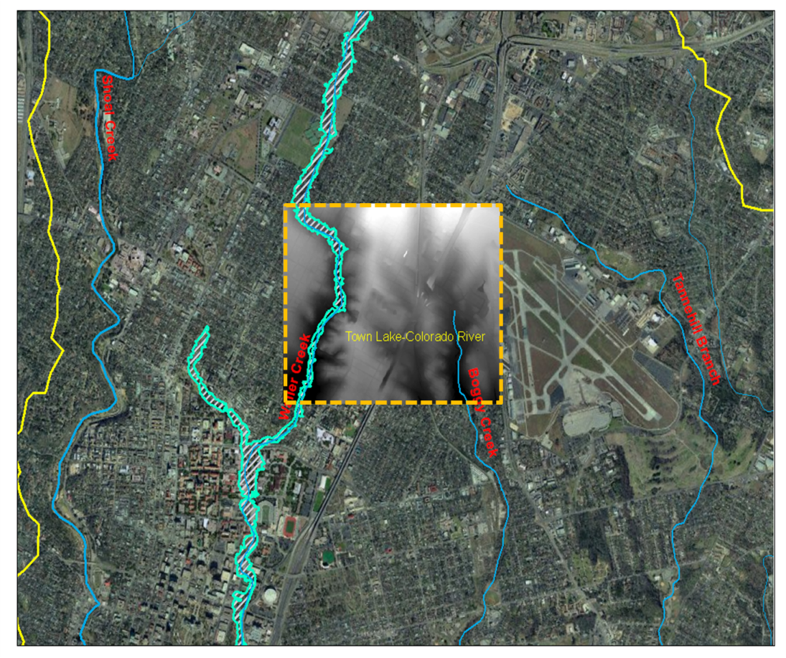
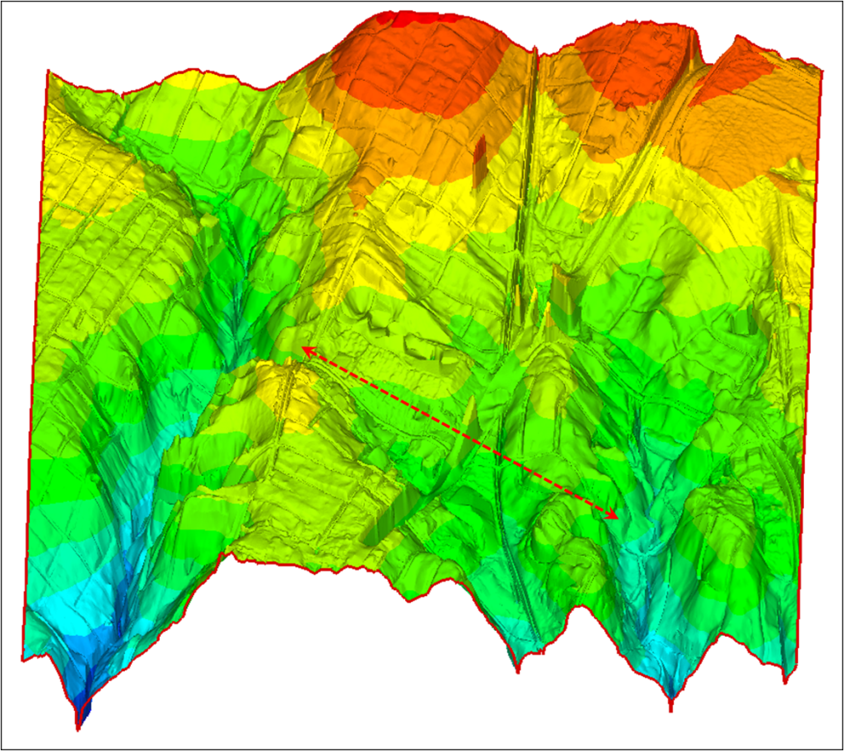
Alternative II. Connection to Boggy Creek
Community Protection System
Distance : 4,100ft ≈0.78mile
Use existing drainage pipe lines along the road

Slide 15
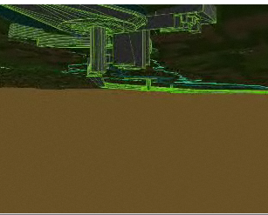
Waller Creek Tunnel Project
Community Protection System
City of Austin
Waterloo Park to Lady Bird Lake
D = 22 ~ 26 ft
Approx. $127 million
Jan. 2010 ~ Jul. 2014
Reduce the size of the 100 yr floodplain
Improve water quality
Fostering a creek side atmosphere suitable

Slide 16
Waller Creek Tunnel Project
Community Protection System
Current and expected 100 year flood plain
The community will be protected from the 100 year flood by this tunnel.

Slide 17
Conclusion
Conclusion
The object of this project is to protect the community from a flood.
It can be possible to calculate rainfall during the flood period by using NEXRAD data.
Real-time and near future data can be obtained from NDFD.
The Waller Creek tunnel is expected to protect the downstream area of Waller Creek from a flood.

Slide 18
Any Questions?

