Slide 1

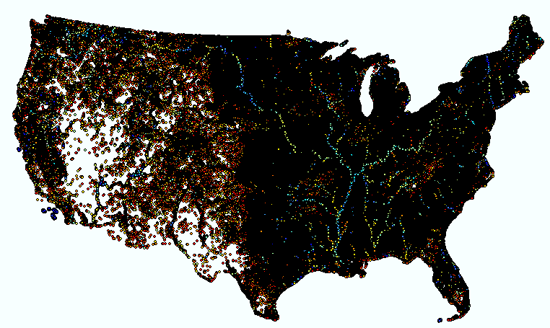
U.S. River Width by Brian Kiel
~30m ~300m ~3000m
1

Slide 2
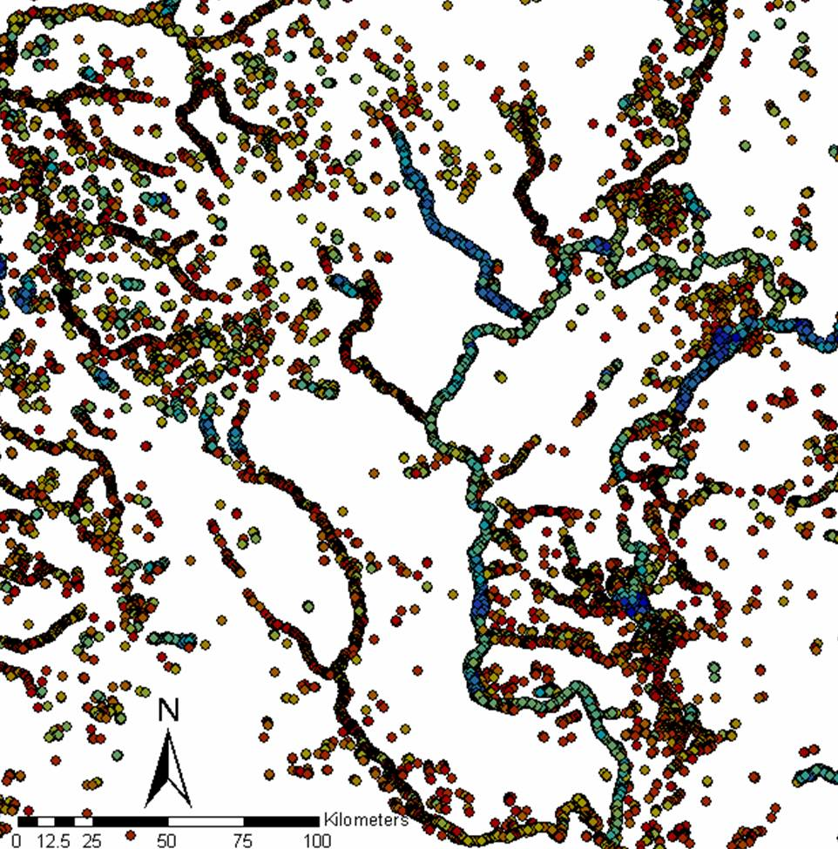
(Width, zoomed in)
~30m ~300m ~3000m
2

Slide 3
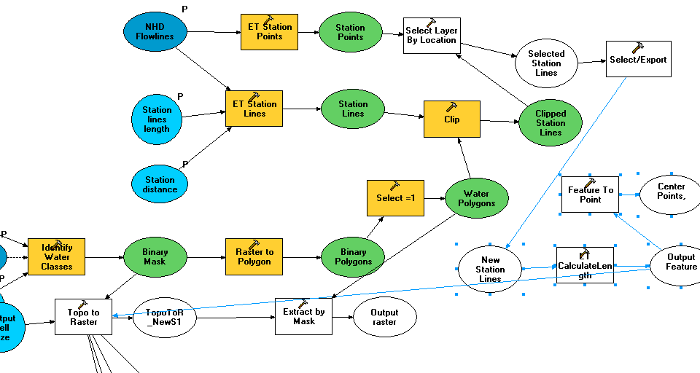
Wrong method:
Hard to use flowlines/centerlines!

Slide 4
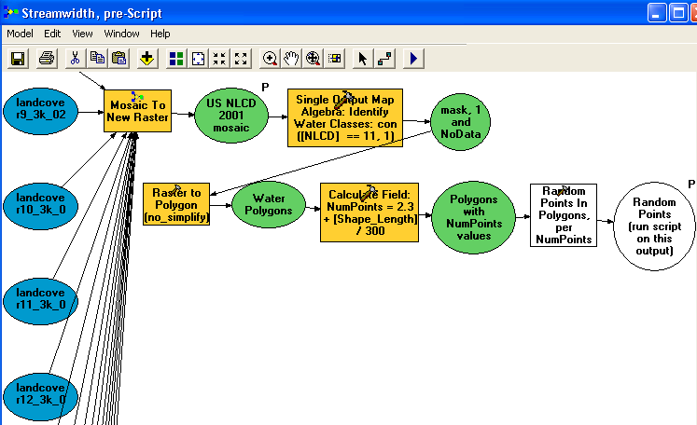
Best ArcMap Procedure
Following execution of this model, run script located at http://arcscripts.esri.com/details.asp?dbid=14264

Slide 5
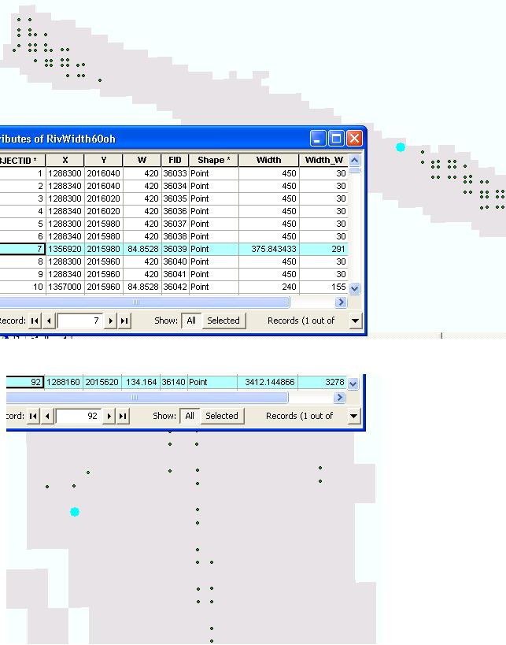
Differences between This Method and Pavelsky's RivWidth
Pavelsky RivWidth code for ENVI/IDL
  Problems
    Runtime: 2 days for one reservoir
    Reliance on inaccurate centerlines
    Requires adjustment of parameters locally
My Arc method
  Runtime: 2 days for entire US
  No reliance on centerlines
  No true analytic parameters requiring adjustment
  Width at a point is the length of the shortest “perpendicular” line passing through
Notes:
Two screenshots of RivWdith 84.8528 error points: points are selected in blue; corresponding values selected blue in attribute table; W = RivWidth value, Width = BrianWidth value. Note that the apparent reason RivWidth failed at these locations is because erroneous centerline points are present. Despite these points not being located on a true centerline, BrianWidth gives an accurate measurment of width. Relying on "centerlines" to calculate widths is impractical, because creating accurate centerlines is so difficult. There's simply no easy way to create a network of accurate river centerlines! For instance, you're asking a computer program to differentiate between a branching river (where you'd want a branching centerline) and a cove or wide backwater area along a river (where you wouldn't want a branching centerline).

Slide 6
Input Data Parameters
Polygons
  Eliminated polygons of < 4 pixels and the largest polygons such as the Great Lakes.
  Did not eliminate lakes/reservoirs.
Points
  3 measurement points in smallest polygons, while point spacing in large polygons is hundreds of m.
  Increase the density of width measurements simply by increasing the number of input points.

Slide 7
U.S. River Width
~30m ~300m ~3000m
7

Slide 8
Analysis
By observation, widths more accurate than those generated by RivWidth
Can analyze data by river or region
  Ohio River: mean width 598 m, max. 8702
  San Marcos Basin: mean width 96 m, max. 1080 (reservoir)

Slide 9
Further Work; Publication
Definition of river width (Dietrich?)
Invert Whipple/Howard (?) equation or apply Manning’s Equation to solve for discharge.
Compare widths with those calculated from discharge using Whipple/Howard (?) equation.
Quantitatively analyze stream scaling laws
Apply width method to foreign countries
Could interpolate points (within polygons) to raster product
9

