Slide 1
University of Texas at Austin
GIS in Water Resources
Large Scale River Network Routing Using RAPID
Ahmad Tavakoly
December 01 2009

Slide 2
Why Continental Scale?
Dynamics of the Earth System
Control of Earth's Climate
Human Development and Economic Activity
Plant and Animal Life

Slide 3
The intimate relation
Climate Dynamics
Geophysics
Global Ecology
Global Hydrology

Slide 4
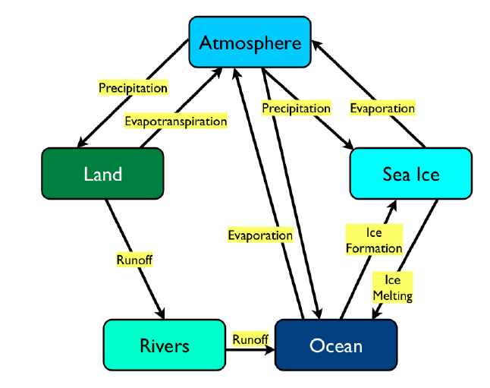
Hydrological Cycle
Ref. Larson et al, 2007

Slide 5
Land Surface Models
Atmosphere
Bottom Boundary Condition
Land
Water Inflow
Rivers

Slide 6
River Network Model
RAPID developed by Cedric David,2009
Links with LSMs
Computes Flow and Volume Using Muskingum Method
Using NHDPlus

Slide 7
RAPID Model Application
Average Length:
3.00 Km
Total River Reaches:
5175 Reaches
Average Catchment:
5.11 km²

Slide 8
RAPID Model Application
Average Length:
3.00 Km
Total River Reaches:
74615 Reaches

Slide 9
Results
01 January 2004 – 31 December 2007

Slide 10
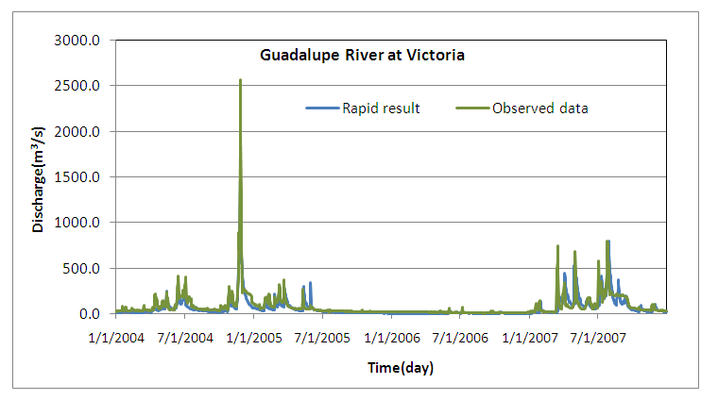
Results
Guadalupe River

Slide 11
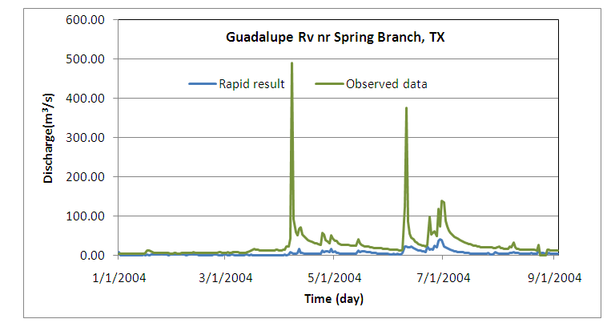
Results
Guadalupe River

Slide 12
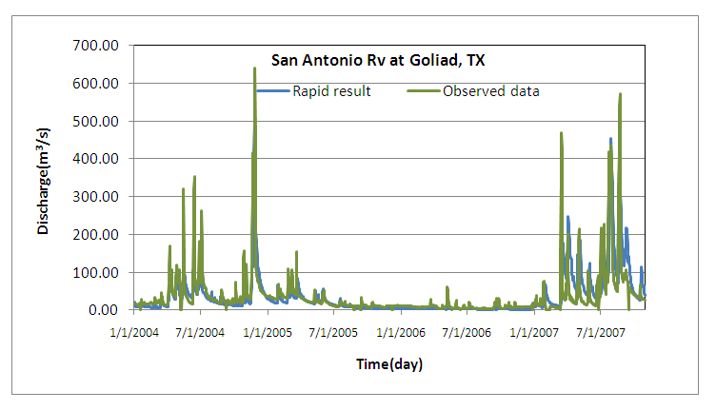
Results
San Antonio River

Slide 13
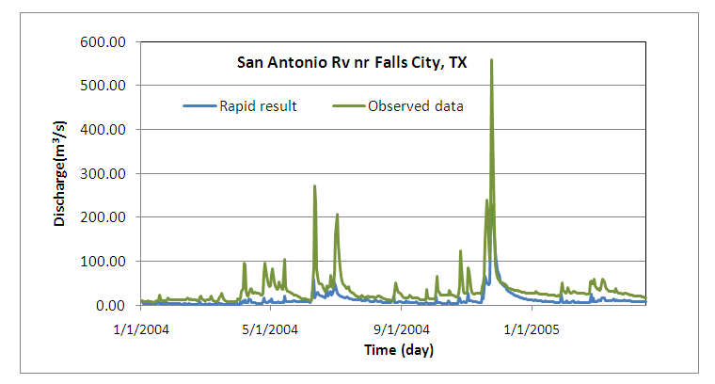
Results
San Antonio River

Slide 14
Results
San Antonio and Guadalupe Basins
20 April 2004

Slide 15
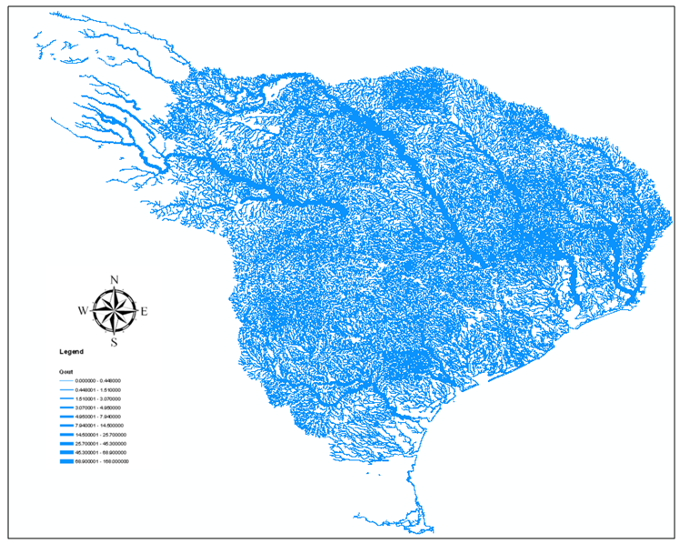
Results
Region 12
20 April 2004

Slide 16

Results
Scalability of parallel computation
Lone star

Slide 17
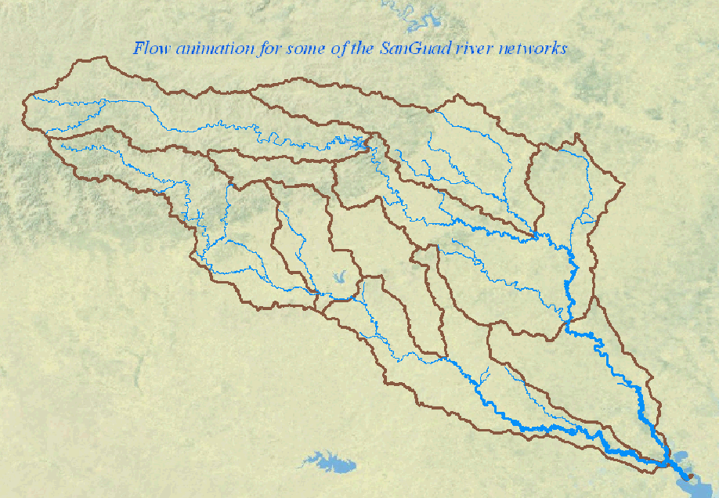

Slide 18
Conclusion
RAPID Results are very Satisfactory.
RAPID shows scalability for the simulation considered.

Slide 19

Question?

Slide 20
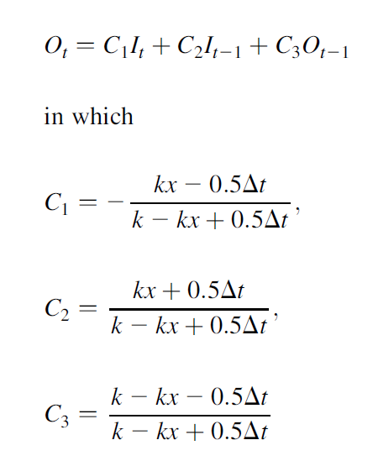
well-known Muskingum flood routing equation

Slide 21
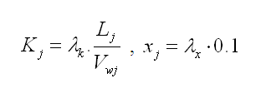
Input Data for RAPID
Run off from LSMs
V_{wj} = wave celerity
Optimize

