Slide 1

ODM For
Texas Water Development Board’s
Ground Water Database
By
Harish Sangireddy

Slide 2
What is CUAHSI?
Data Discovery
HIS Central Dash
CUAHSI Water Data Services
Data Access
Water ML Web Services
HydroExcel
Data Publication
HIS Server
HydroGet
And many More
ODM Databases
ODM Tools
Master CV registry
CUAHSI Water Web services
Source: http://his.cuahsi.org/

Slide 3
What is ODM?
ODM is a Relational Database which matches data by using references to data elements through common characteristics found within the data set. Usually by defining a primary and foreign key reference.
ODM stores hydrological variables in space and time. The hydrological variables could be stream flow, water quality, ground water levels and precipitation.
The schema of the observations data model looks complicated and huge. But it is very simple and well thought of generic data model.
OBSERVATIONS DATA MODEL

Slide 4
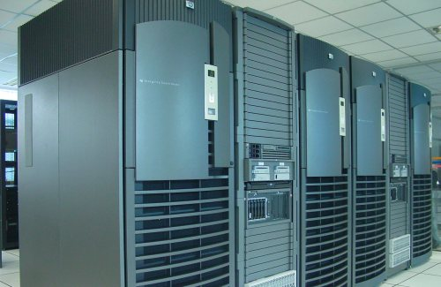
So what Does ODM for Ground Water Database Mean!!!
To represent data in a form compliant with the CUAHSI observations data model.
Create Views in the Database
TWDB Ground Water Database

Slide 5
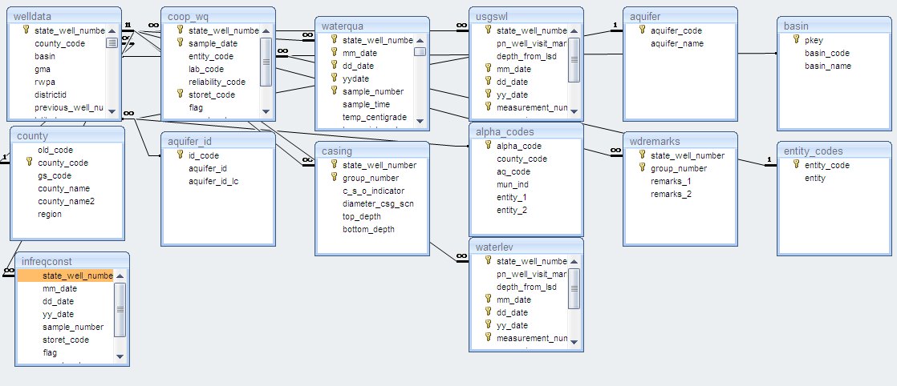
Tables of Texas Ground Water Database

Slide 6

What is a database View?
A Database View is a subset of the database sorted and displayed in a particular way . For example, in an equipment database, perhaps you only wish to display the Weapons stored in the database. To do that you would create a Weapons view.
For each view, you can control which columns are displayed, what order they are displayed in, how wide each column is, how the data is sorted, and what types of records to display

Slide 7
Methodology
To represent the TWDB database in ODM format, I divided the task into steps
  Mapping the TWDB database tables into ODM, which means that we would like to identify which tables in TWDB database would be able to give us the information required to put into ODM schema.
  Create Views by making the TWDB tables as our base tables. So that the views would be in a format that would be similar to ODM schema.

Slide 8

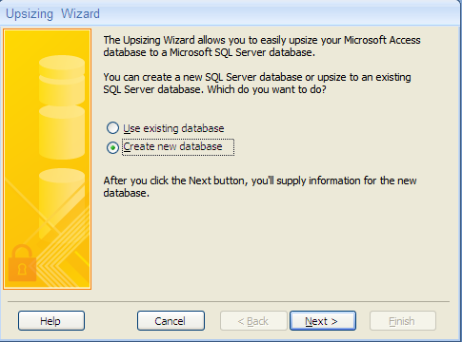
Import Database
In order to work with the database I used SQL Server 2005 as graphical management tool.
I imported the database from MS Access into SQL Server 2005 by using the upsizing process provided by MS Access to connect to SQL Server 2005 and to import MS Access databases into SQL Server 2005.

Slide 9
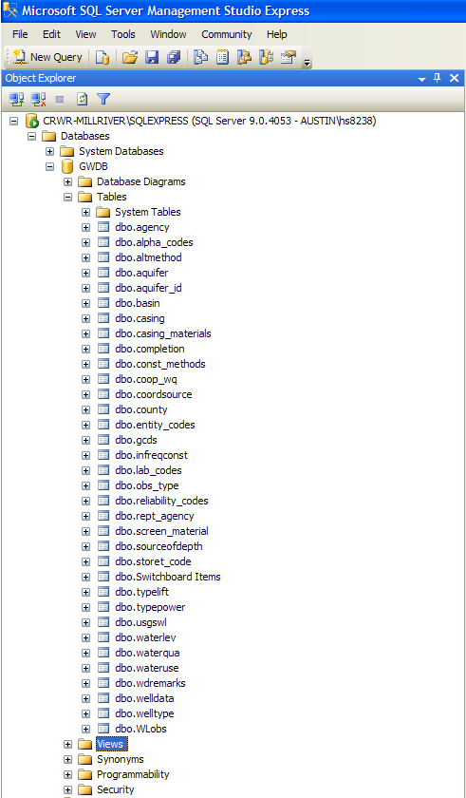
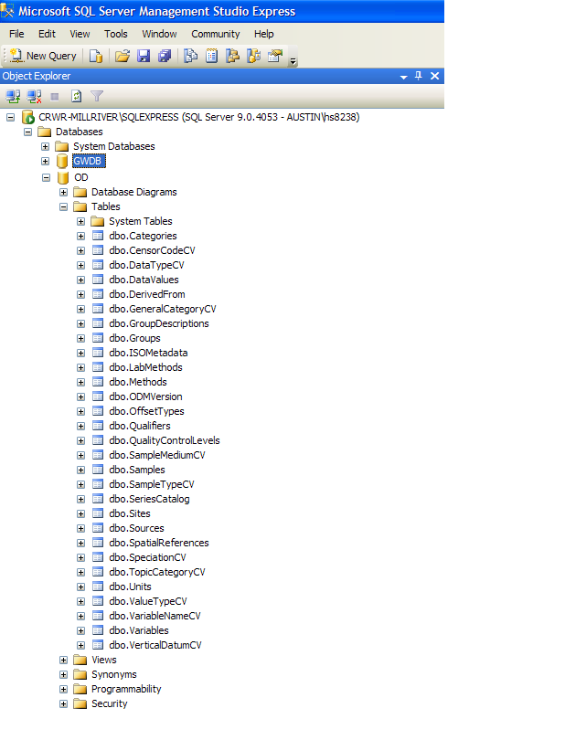
TWDB database and ODM blank schema in SQL Server 2005

Slide 10
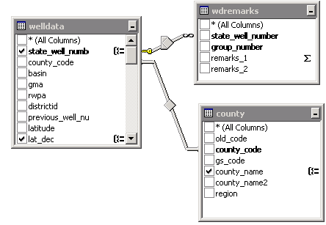
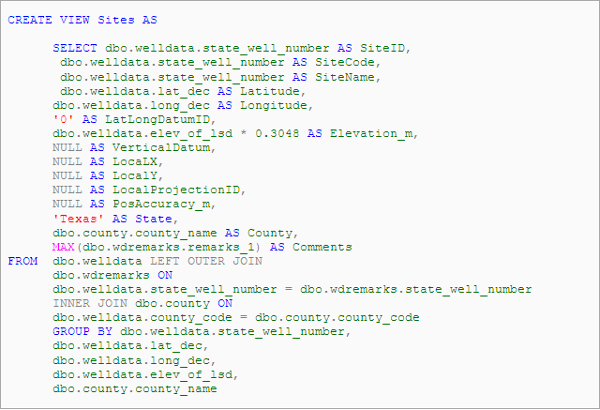
Mapping of Tables

Slide 11
Various Tables and Views
Base table:
Storet_Code
View:
Units
Base Table:
Entity_code
View:
OffsetTypes
Base Table:
Agency
View:
Sources
Base Table:
Reliability_Codes
View:
Methods
Base Table:
Lab_Codes
View:
LabMethods
Base Table:
Watequa
View:
Variables

Slide 12
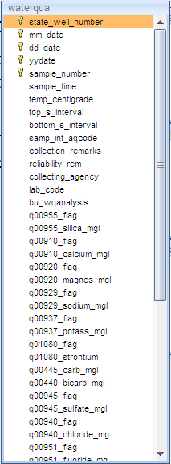
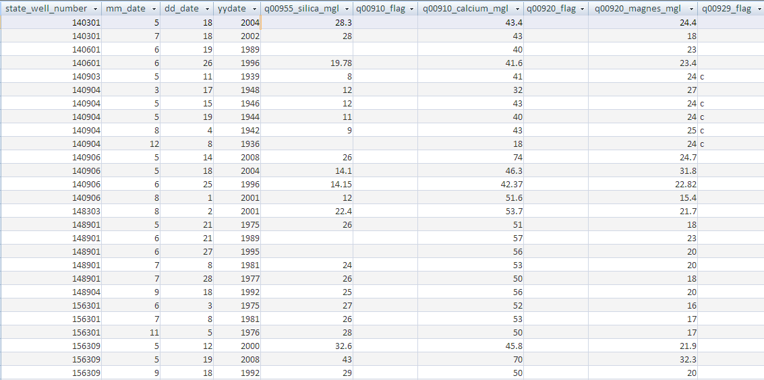
DataValues

Slide 13
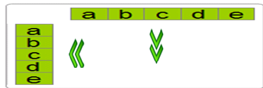
So how does this all matter?
What happens in ODM is that each of these data variables value is stored in a different row.
So if we have 17 data values in the gwdb.waterqua all measured on a single day at a particular site, then we would have 17 columns holding this data for us, in a single row in TWDB
And if we want to store these data values in ODM schema, then we had to transpose these columns into rows in the views that we would build on the waterqua base table.

Slide 14
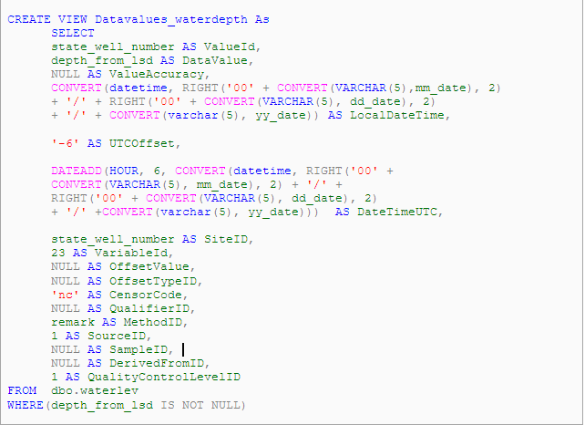
Solution
Hence I came up with the idea to build the views for datavalues for each variable and then Union all the datavalues so that we have all datavalues transposed into the ODM structure.
Thus individual views were built for each variable and then the final datavalue view was a union of all the views.

Slide 15
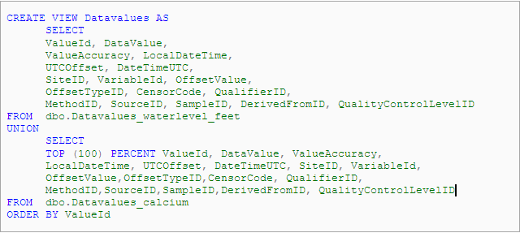
Union of DataValues

Slide 16
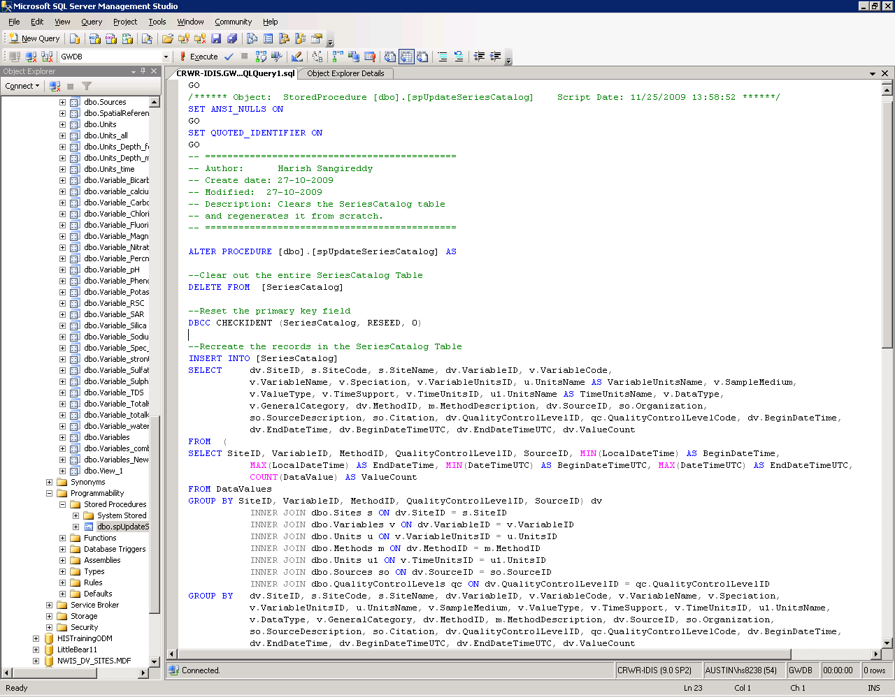
Procedure for SeriesCatalog

Slide 17
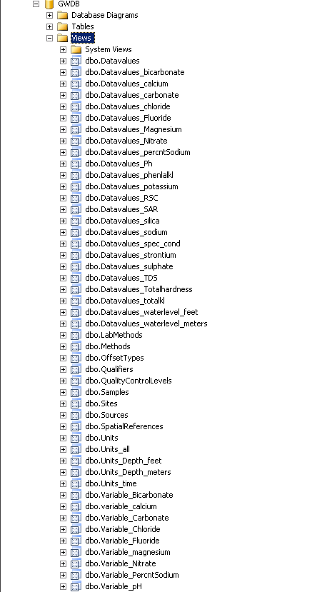
The List of Database Views

Slide 18
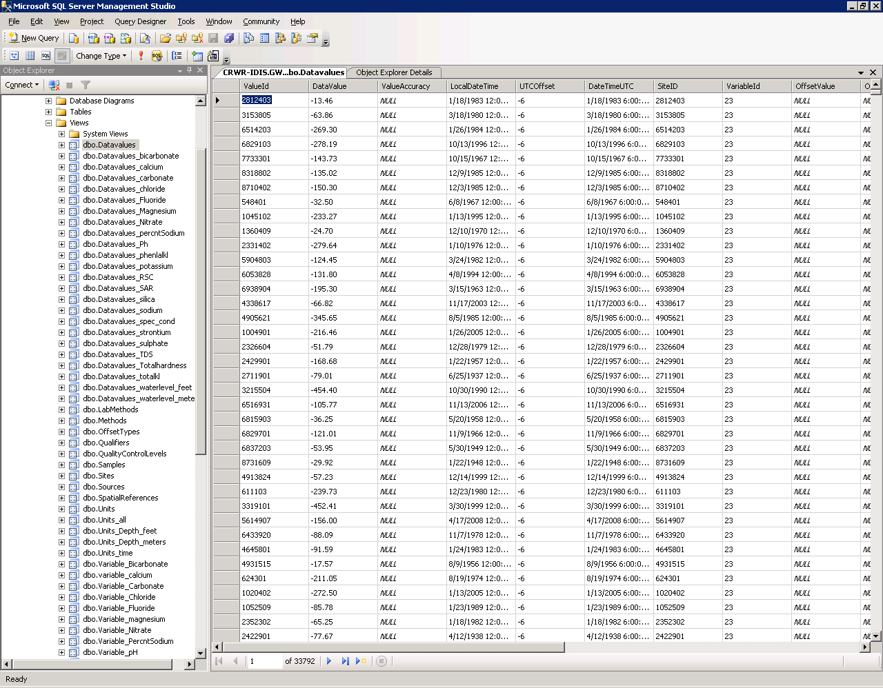
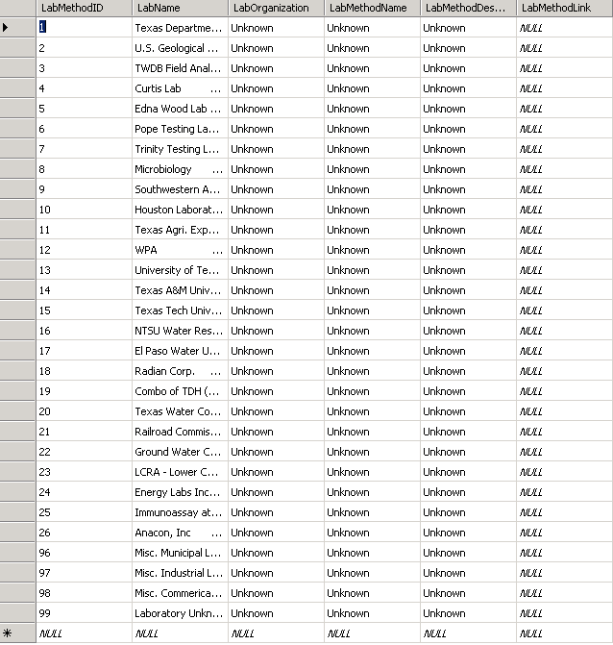
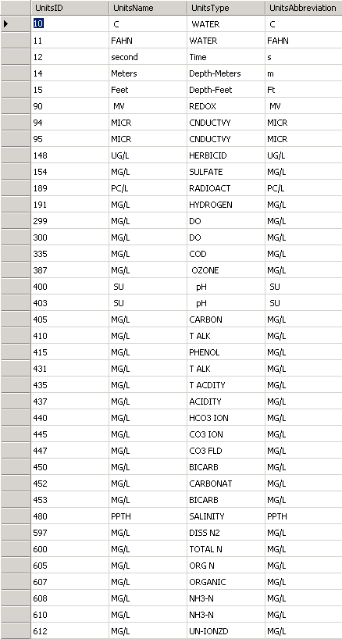
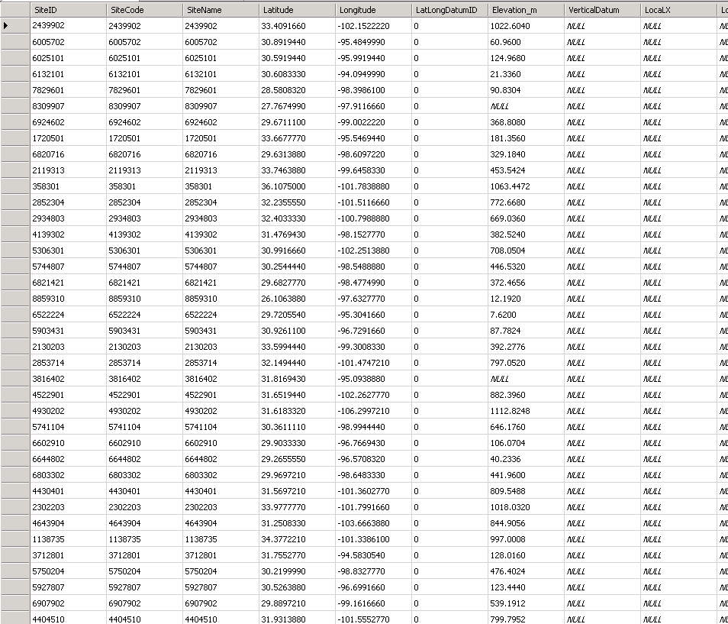
Results of the Views in the database

Slide 19
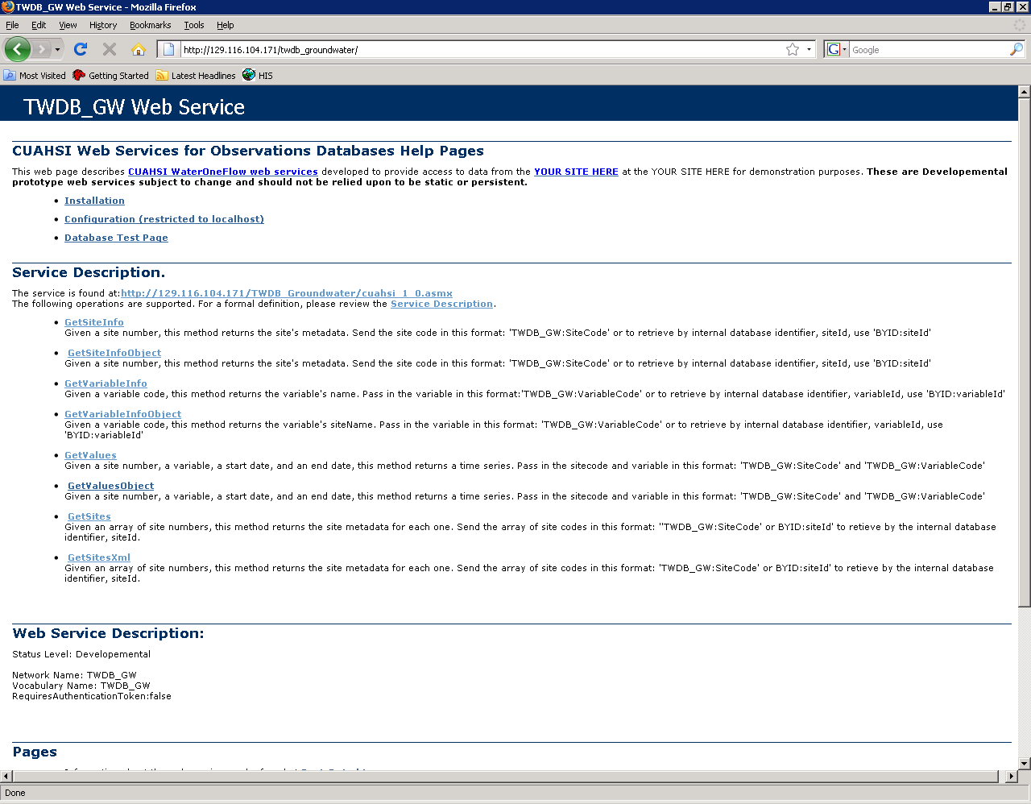
WaterOneFlow Webservices for our Database

Slide 20
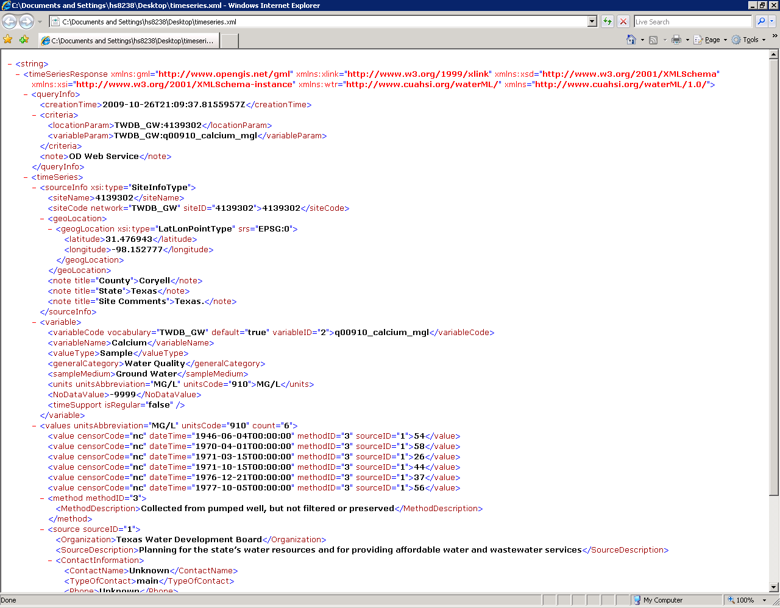
Time Series XML generated from WaterOneFlow Webservices

Slide 21
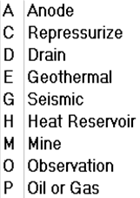
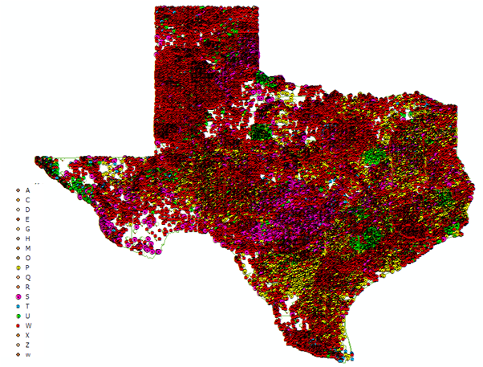


Different Type of wells across Texas

Slide 22
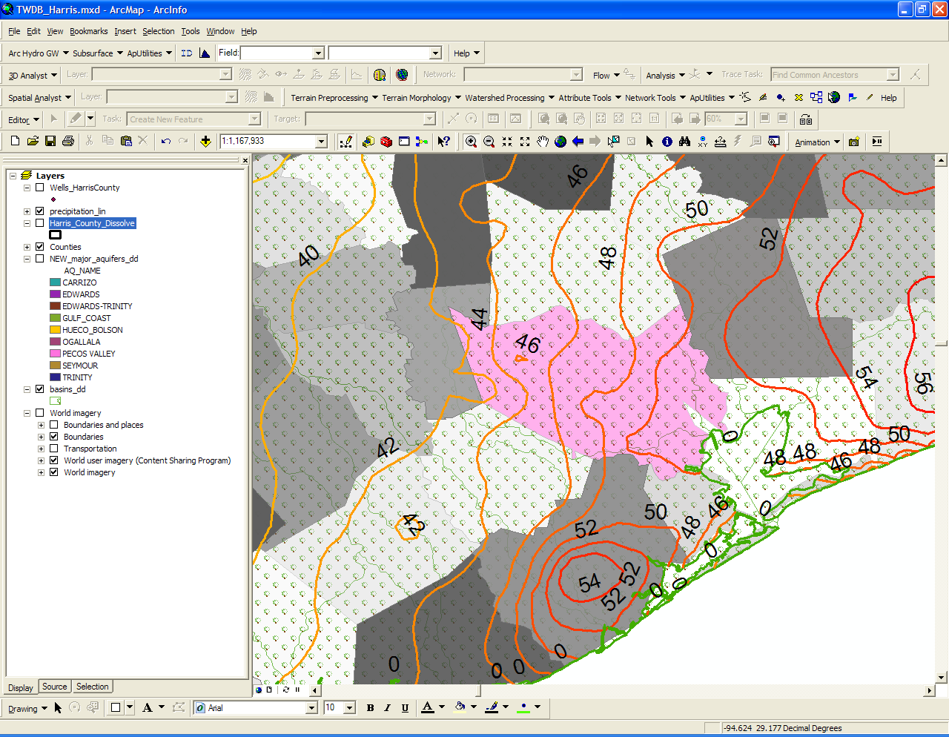
Harris County(the most populated county in Texas)

Slide 23
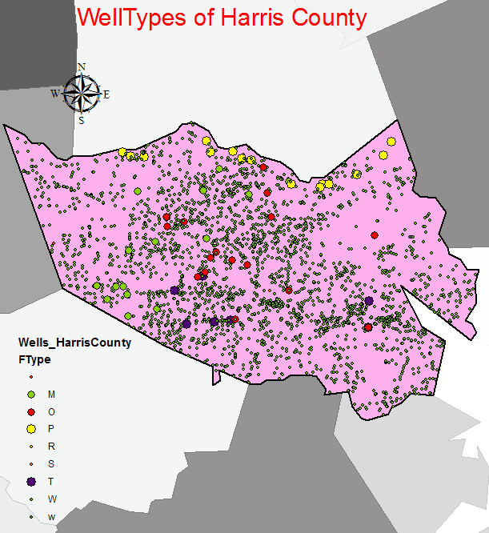
So I next plotted the different type of wells in the Harris County.
Water withdrawing wells were the most abundant type of wells distributed all over the county, which is not surprising, as this part f the area mostly depends on ground water, for any kind of water use.

Slide 24
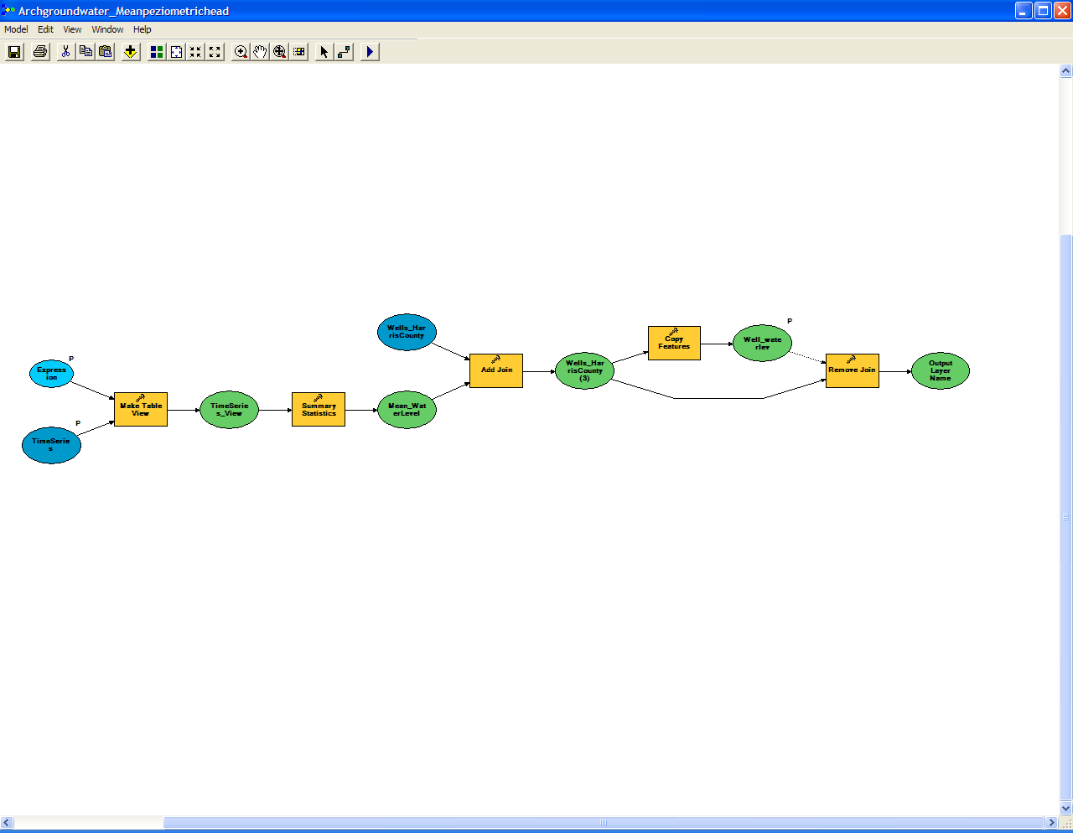
Generic Ground Water Model

Slide 25
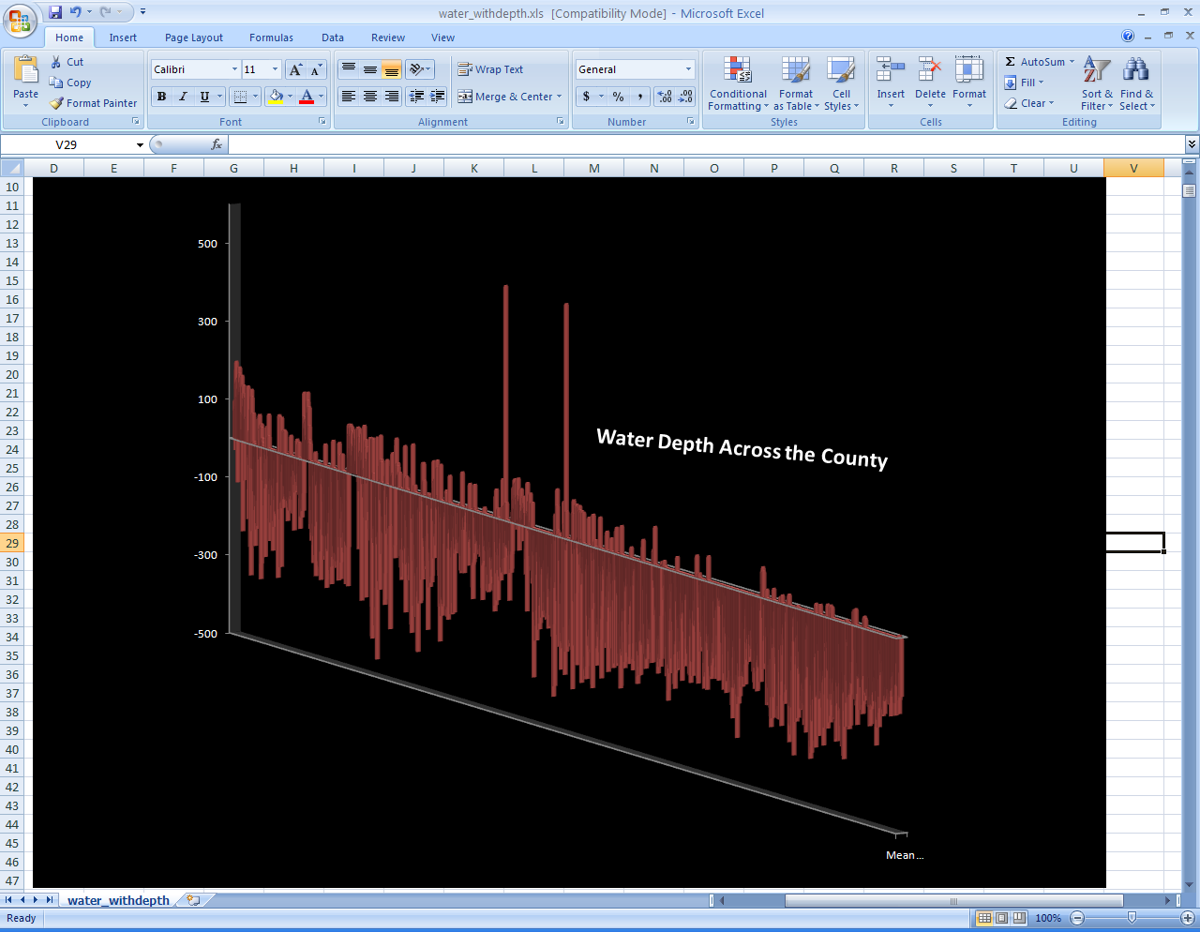
The water level was plotted for each of the wells, and the water level was observed to be below the datum for most of the wells with some exceptions where the water level was above the datum specified.

Slide 26
Conclusion
WaterOneFlow Webservices works perfectly on views.
HydroExcel also works for the views and is able to fetch data from the webservices for TWDB, hosting the database views.
The performance of the views was a matter of concern, but it was seen that the views perform far better than what we had expected.

Slide 27

!QUESTIONS!

