Slide 1
ThemeViewer
An Online Viewer for Geospatial Space-Time Themes
James Seppi
GISWR2009
University of Texas

Slide 2
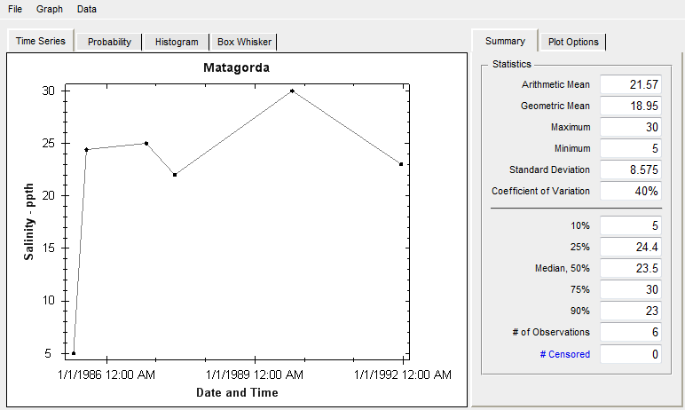
Background
At CRWR we use the ODM Time Series Analyst (TSA) for viewing and downloading time series data
However, the TSA requires a single ODM database, which are organized by provider (TCEQ, TCOON, TPWD, etc.)
  What if we want to aggregate data for a specific variable across a variety of providers?

Slide 3
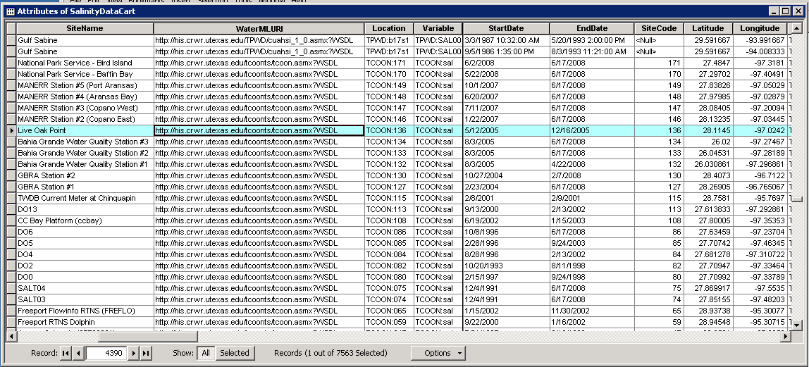
Themes
We can define a Theme for the variable of interest
    Idea and design from Dr. Tim Whiteaker
    Represented by a feature class called a Thematic Dataset Catalog
  A Thematic Dataset Catalog contains:
      Geospatial information – i.e., the measurement sites for the variable of interest
      All the information required to call a WaterOneFlow webservice to get the time series data
        WSDL URL, Location (site code), Variable
        Other relevant information
        Start and end date, value count, etc.

Slide 4
Objectives
Explore the ArcGIS Server Javascript API
Learn more about using webservices, particularly WaterOneFlow
Create a rich web application to view Themes
  Useful
  Reusable
  Intuitive

Slide 5
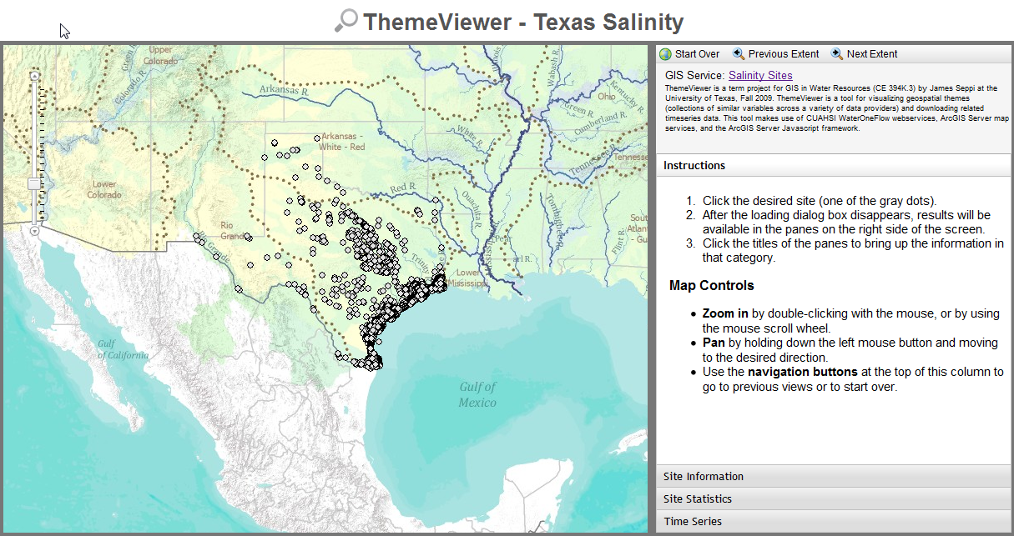
Introducing…

Slide 6
Technologies
ArcGIS Server Map Services
ArcGIS Server API for Javascript
http://resources.esri.com/arcgisserver/apis/javascript/arcgis/index.cfm?fa=home
Dojo Javascript Toolkit, including Dijit and DojoX
http://www.dojotoolkit.org/
PHP, including PHP_Soap extension
~500 lines of Javascript, 250 lines of PHP, 200 lines of HTML and CSS
Notes:
Lines of code are obviously a bad estimate

Slide 7
Features
Search by site name, site code, etc.
Quickly see site information and representative time series statistics
View a plot of the time series for any site
Download time series data for a specific site
Code is easily reused, so making a page for a new Theme only requires setting a few parameters

Slide 8
Demo
http://data.crwr.utexas.edu/ThemeViewer/

Slide 9
Conclusions & Future Work
Takeaway: Standardized, documented services can be combined to create useful mash-up applications.
Future Enhancements:
  Create a “site basket”, so multiple sites can be selected and quickly compared
  Better statistical methods (ie., take nondetects into account); add a cumulative frequency plot
  Transform XML values file into more easily used CSV file
  Automatically build ThemeViewer pages from a listing of published themes

