Slide 1
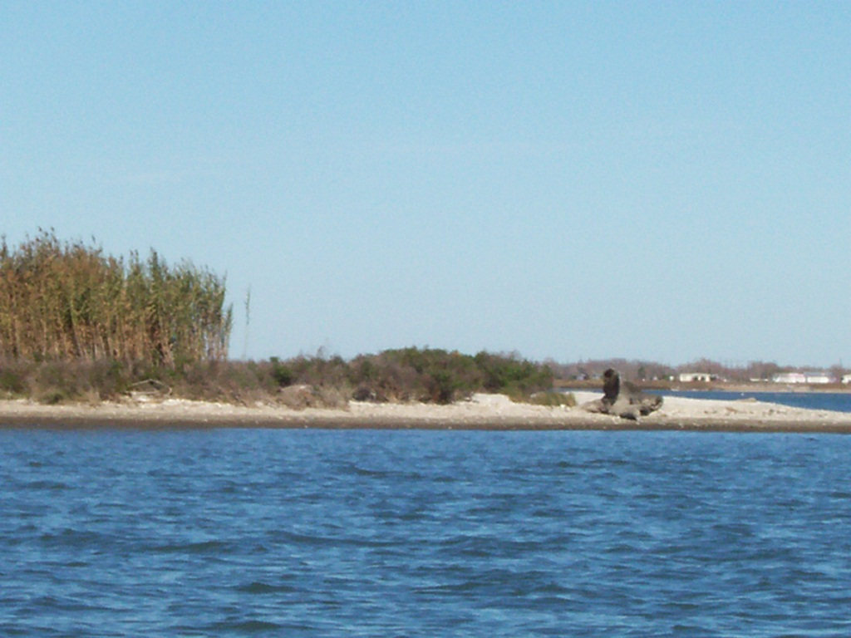
Freshwater inflow and salinity in San Antonio Bay
By Karen A. Bishop

Slide 2
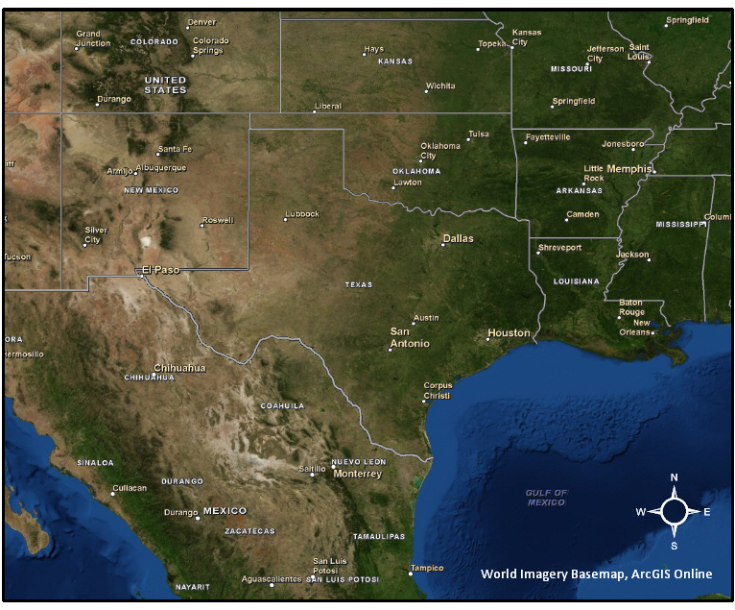
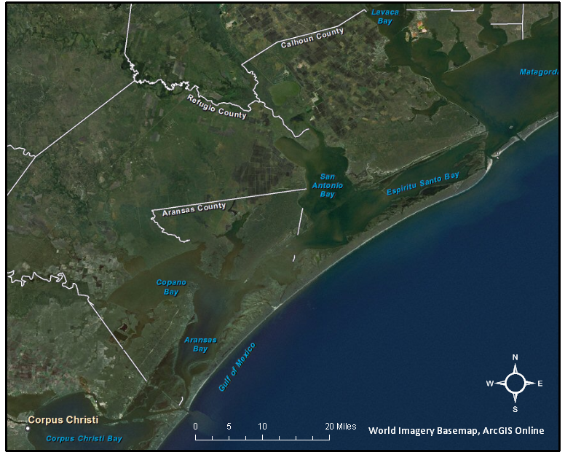
San Antonio Bay
Resource management
Ecosystem processes

Slide 3
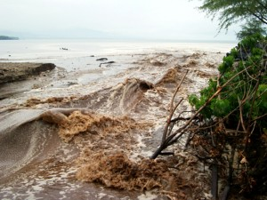
Freshwater Inundation Events
Cause changes in:
Salinity
Nutrients
Organisms
Ecosystem structure
http://www.bigislandchronicle.com/?tag=the-kohala-center

Slide 4
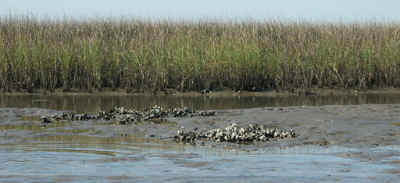
Oysters
Stationary
Filter feeders
High tolerance for changes in environment
http://grandbaynerr.org/images/oysterbed.jpg

Slide 5
*Oysters as Indicators*
Plankton take up nutrients
Oyster tissues take up isotope ratios when plankton consumed
¹³C isotope = salinity
¹⁵N isotope = source of nutrients

Slide 6
Past Questions and Research…
Summer study questions:
  Does ¹³C represent salinity? Yes
  Nutrient loading high or low? High
  Do isotope values vary by location? Yes

Slide 7
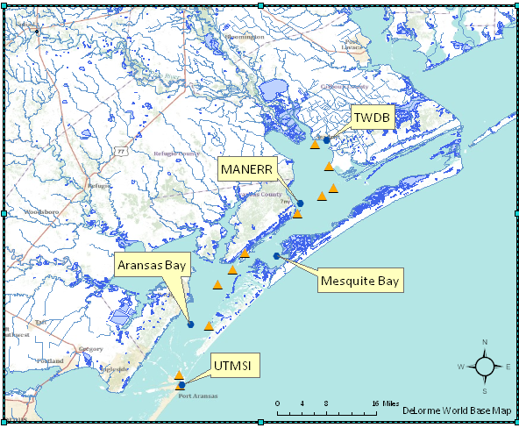
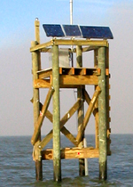
Plotting the data points

Slide 8
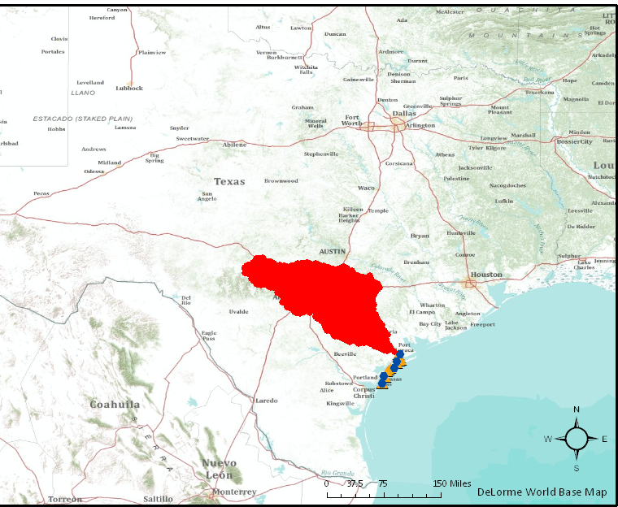
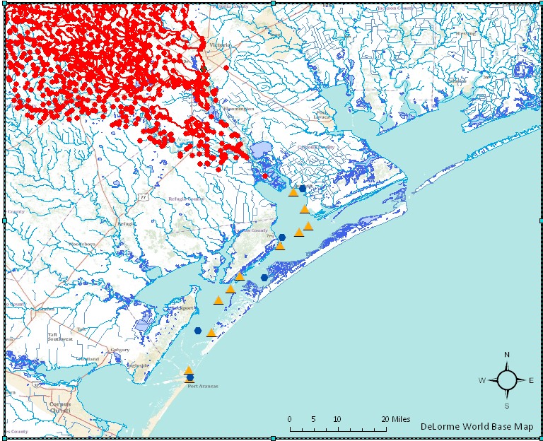
Traces of flow paths

Slide 9
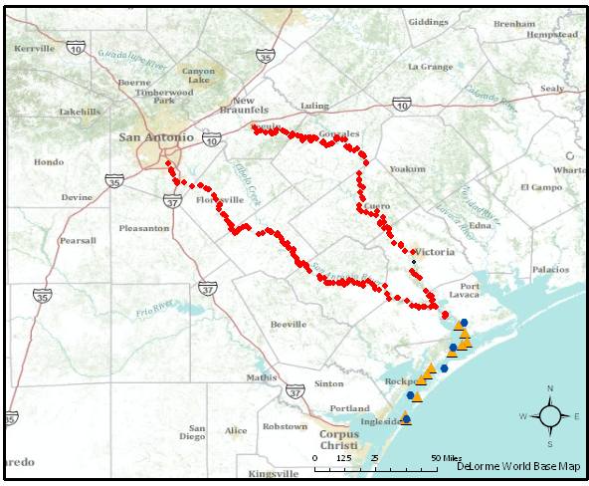
Traces of flow paths
Plot USGS Gage Points

Slide 10
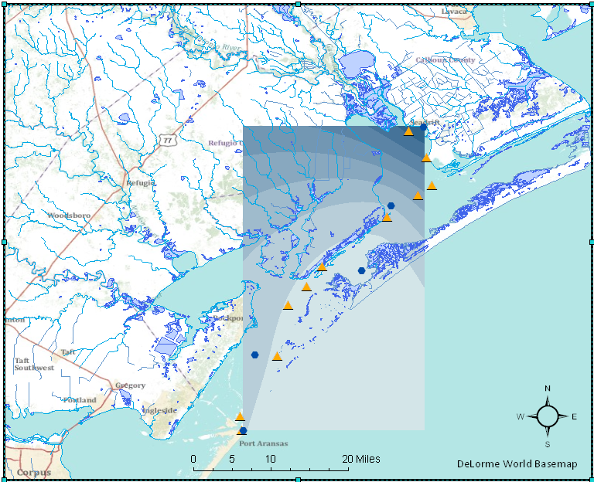
Salinity Gradient

Slide 11
What’s next…
Complete a salinity time series
Add ¹³C values to Oyster bed points
Show relationship of salinity to ¹³C values over time
*Model inflow and nutrient loads.
Prediction model for storm events or long term changes?

