Slide 1
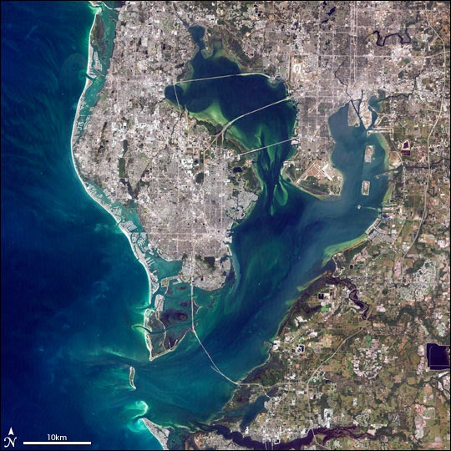
Nutrient Loading in Tampa Bay
Elena Chavarría Gordienko
http://earthobservatory.nasa.gov/IOTD/view.php?id=4745

Slide 2
Gulf of Mexico
http://www.geo365.no/sfiles/34/61/2/picture/gulfofmexico_lav.jpg
Notes:
Eleventh largest body of water in the world
US coastline: 2700 km, water from 33 major rivers
Hypoxia (dead zone) an important problem, especially from Texas to Louisiana
Florida region: Frequent red-tide algal blooms, that kills fish. Affects people near coast, respiratory issues.
Algal blooms are linked to nutrient loadings, and high water temperatures.
Goal: see if there is a connection between nutrient loading, DO in water, and water temperature.
Future work: relate land use to nutrient loadings. Predict where algae could be a problem based on the many factors.

Slide 3
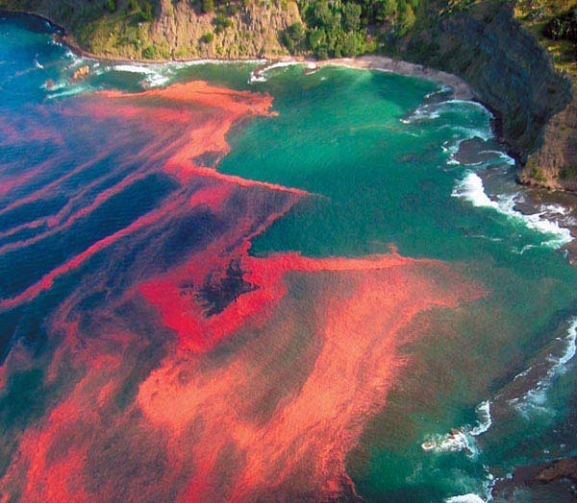
Algal Blooms
Water Temperature
Nutrient Loading
Phosphates
Nitrates
pH
Dissolved Oxygen
https://www.e-education.psu.edu/files/earth540/image/Lesson7/redtideBuckner_serc_carleton_edu.jpg
Notes:
Alagae grows best at pH 7.5-8.4

Slide 4
Tampa Bay Wathershed
Notes:
HUC 8 Tampa Bay: Green and Blue (ocean water, the bay itself)
Other watersheds: contribute to some the measurements made on Tampa Bay based on USGS studies.

Slide 5
Water Temperature

Slide 6
pH
Notes:
Added for completion, but not really important, since algae grow better at pHs 7.5-8.4.

Slide 7
Nitrate Loading

Slide 8
Phosphate Loading

Slide 9
Dissolved Oxygen

Slide 10
Questions?

Slide 11
References
USGS Florida Science Centers
USGS Gulf of Mexico Integrated Science
Tampa Bay Study
National Coastal Data Development Center
NHDPlus
Natural Resources Conservation Center
Watershed Boundary Data Set

