Slide 1
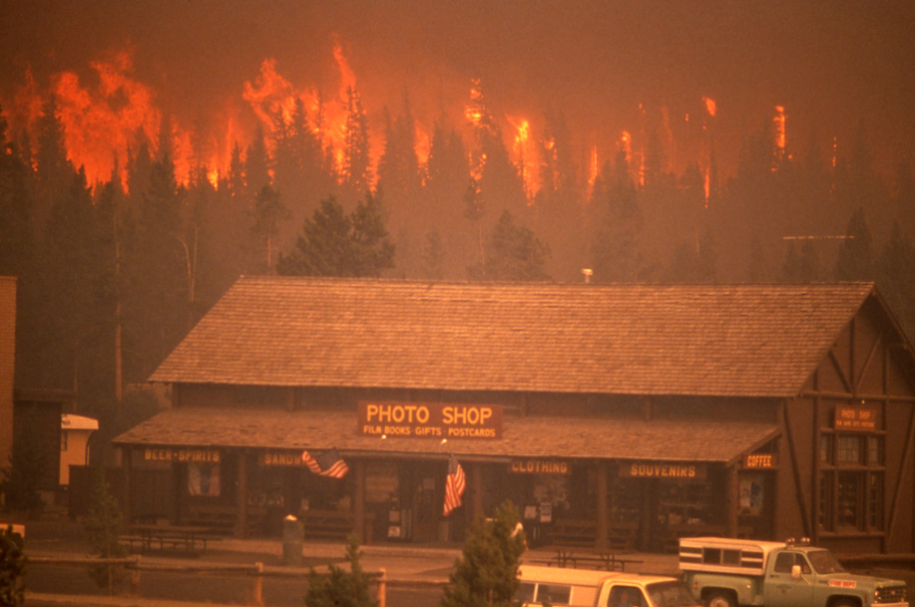
Yellowstone Fires and Their Hydrologic Effects
Patrick Sejkora
November 17, 2009
GIS in Water Resources

Slide 2
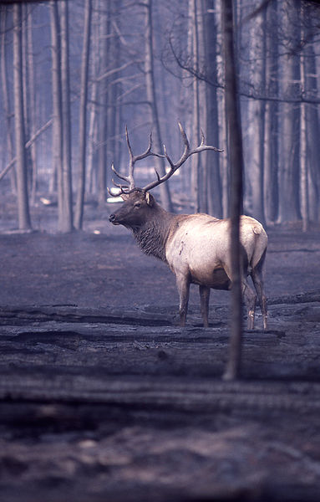
Yellowstone National Park 1988 Fires
1988 driest summer on record
7 major fires burned June-September 1988
3,215 km² (36% of park) burned
  485 km² on August 20 alone!
Fires extinguished in September by rain/snow

Slide 3

Objectives
Did fires augment surface water runoff regimes in Yellowstone?
Hypothesis: Evapotranspiration and infiltration rates decrease in burned areas₁, increasing runoff
Evaluate using runoff ratio:
Is runoff ratio post-fires higher than pre-fires?
1. Robichaud 2000

Slide 4
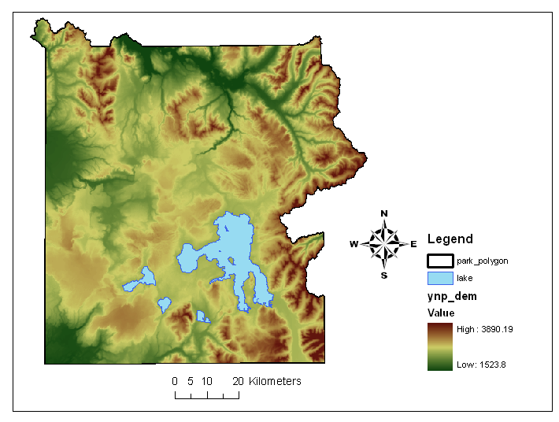
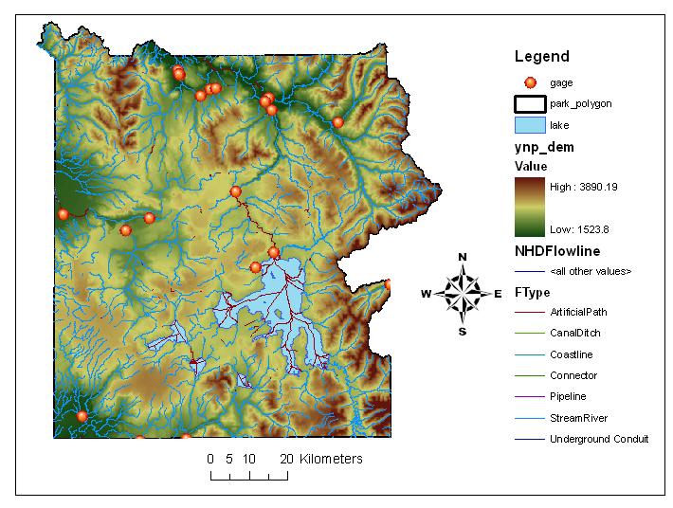
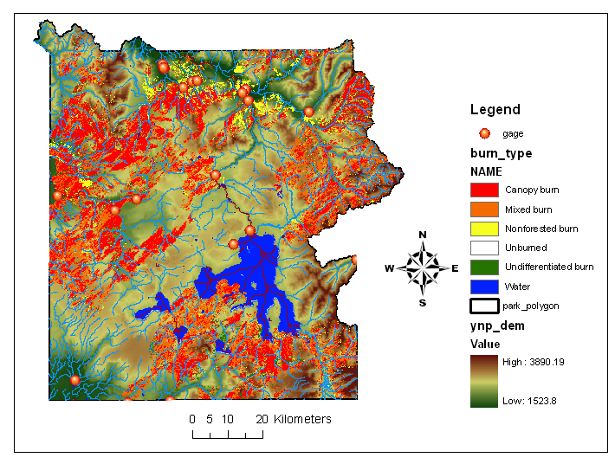
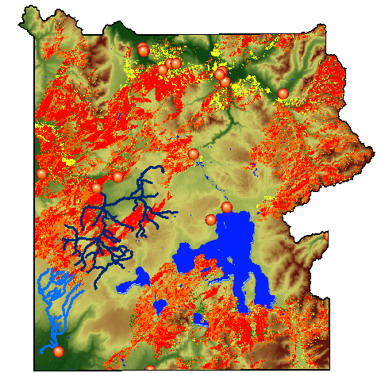
GIS DATA
Firehole River
Park outline and Digital Elevation Map (DEM)
NHD Flowlines and USGS Gage Sites
Burn Type Raster
Compare runoff ratios between heavily burned and unaffected (control) watersheds
  Before Fire
  After Fire
Boundary Creek

Slide 5
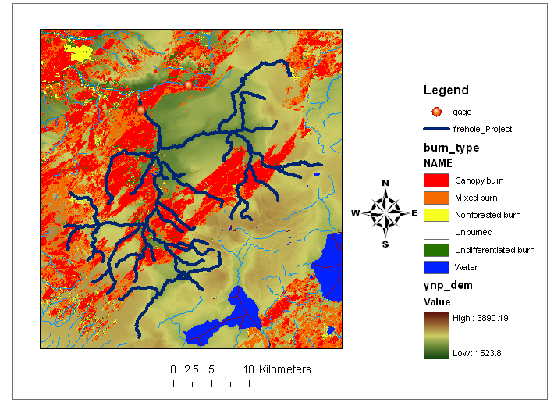
Firehole River
(burned/ experimental watershed)
Baseflow 7.37 m³/s
724 km² watershed (obtained with ArcHydro Terrain Preprocessing)
288 km NHD flowline
Drainage Density of 0.40/km
4th order stream at gage

Slide 6
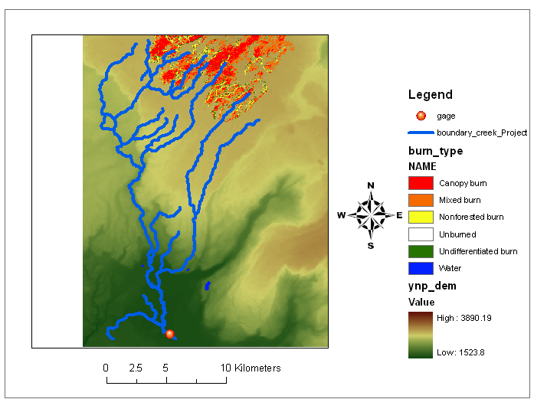
Boundary Creek
(unburned/ control watershed)
Baseflow 1.94 m³/s
224 km² watershed
151 km NHD flowline
Drainage Density of 0.68/km
3rd order stream at gage

Slide 7
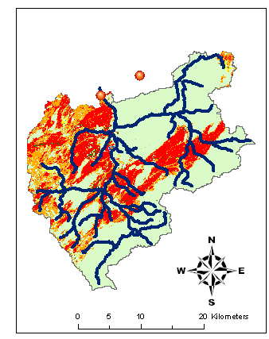
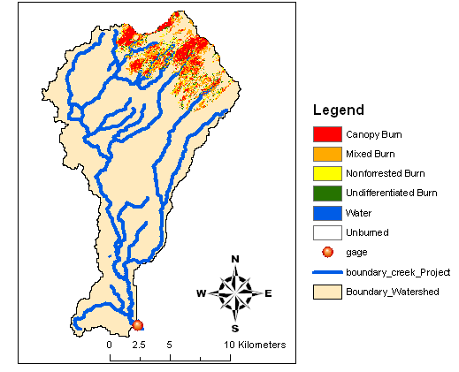
Firehole River
Boundary Creek

Slide 8
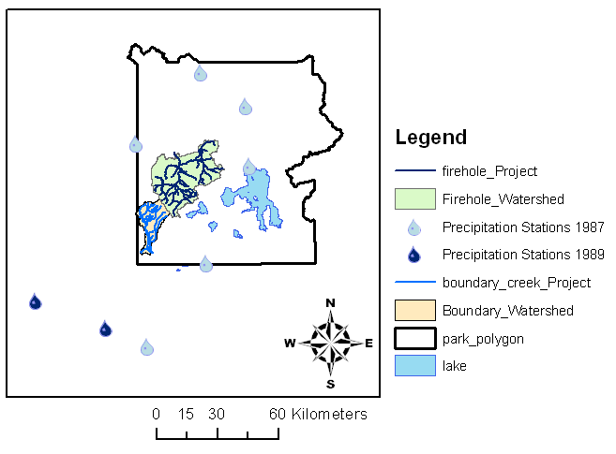
Precipitation Data
Find similar precipitation events before and after 1988 fires
Obtain data from National Climactic Data Center
Interpolate rainfall across park via Spline

Slide 9
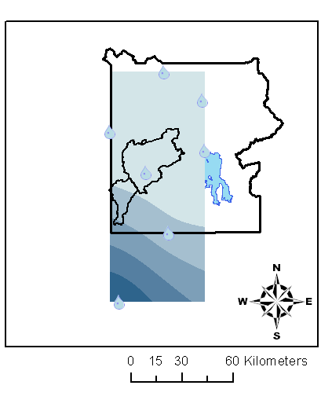
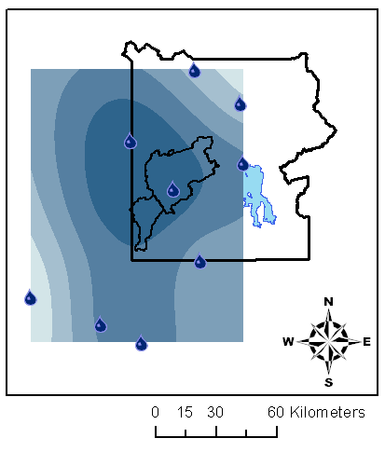
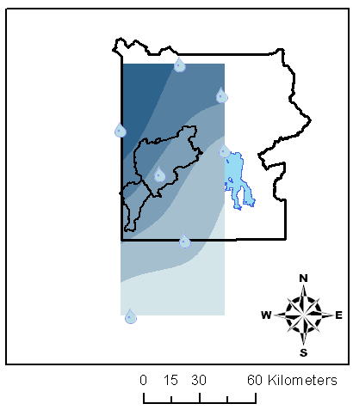
Pre-1988 Precipitation Event
July 10, 1987
Average Precipitation Across Watersheds
September 18, 1989
0.5 cm
Spline raster can be used to estimate rainfall across watersheds
  Zonal Statistics Tool in Spatial Analyst
0.6 cm
1.6 cm
1.6 cm
July 11, 1987
1.7 cm
1.6 cm

Slide 10
Storm Event Flow Conditions
Firehole River
Boundary Creek
Pre-Fire
Post-Fire

Slide 11

Runoff Ratios
Runoff Ratio Example Calculation (Boundary Creek 9/18/1989)
Firehole River
Pre-Fire RR = 1.1%
Post Fire RR = 0.9%
Boundary Creek
Pre-Fire RR = 1.1%
Post Fire RR = 0.9%
These Runoff Ratios aren’t very different!

Slide 12
Conclusions
Runoff Ratios before and after fire are indistinguishable in burned watershed
An event’s runoff ratio same for both watershed
Suggests other factors besides landcover may influence runoff regimes
  Antecedent dry period, storm intensity, etc.?

Slide 13
Future Work
Evaluate other storm events using same methodology
  NEXRAD precipitation data for recent events
Similar effects for snow melt?

Slide 14
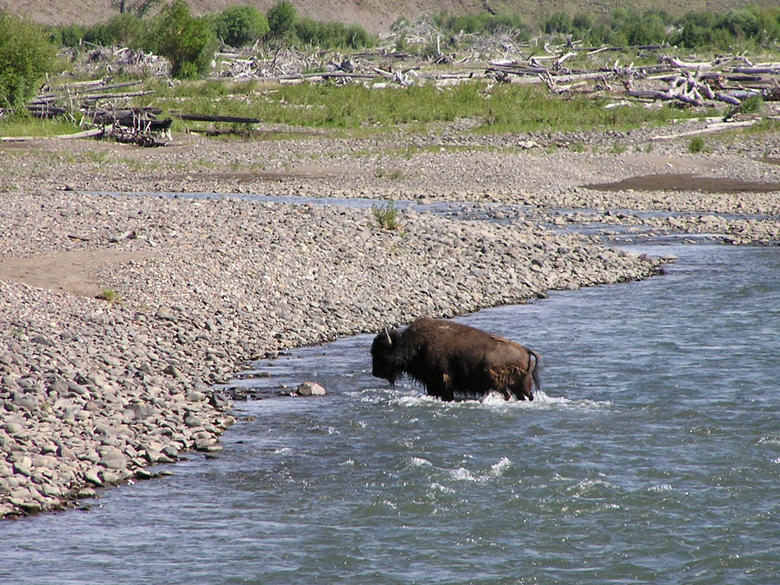
Questions?

Slide 15
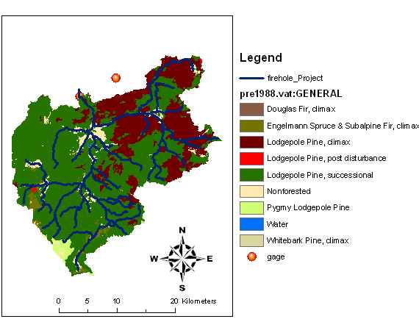
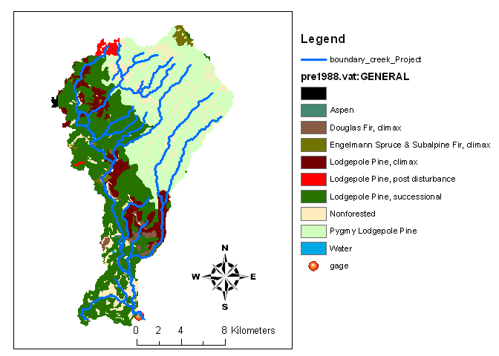
Firehole River
Boundary Creek

Slide 16
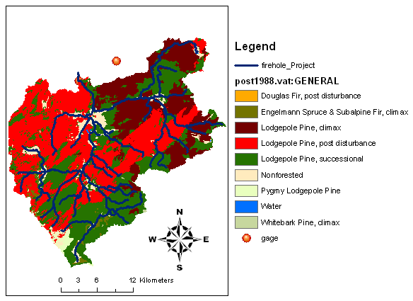
Firehole River
Boundary Creek

