Slide 1
River Flow and Salinity in Nueces Bay, Texas
Joseph Stachelek

Slide 2
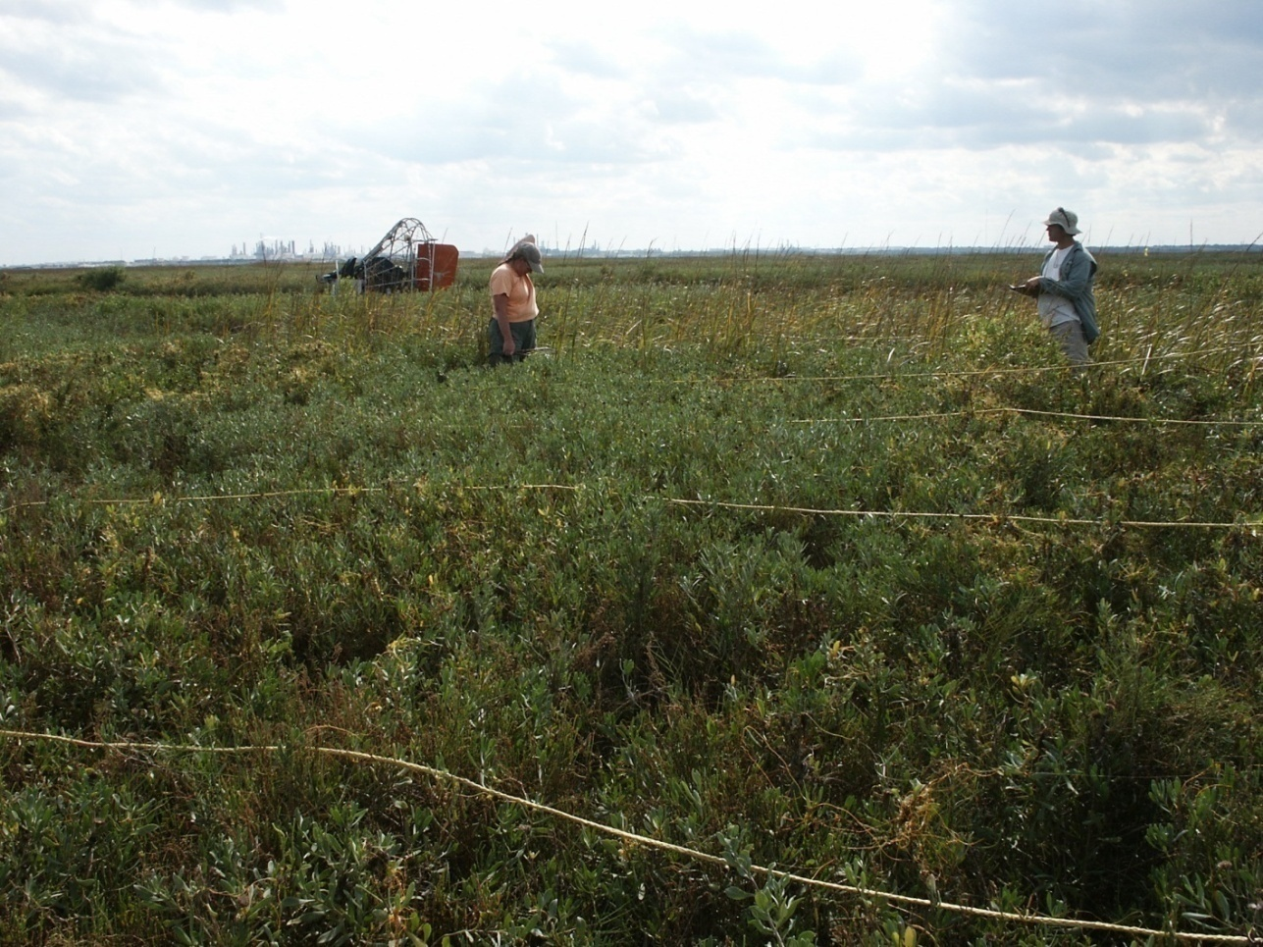
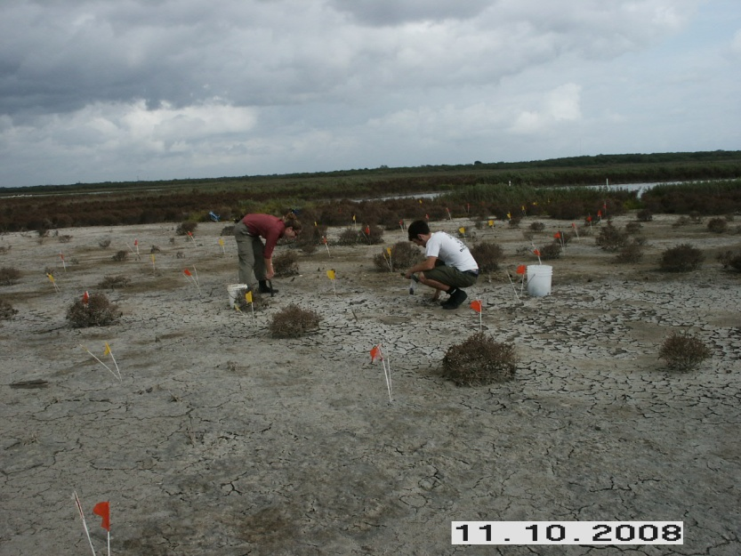
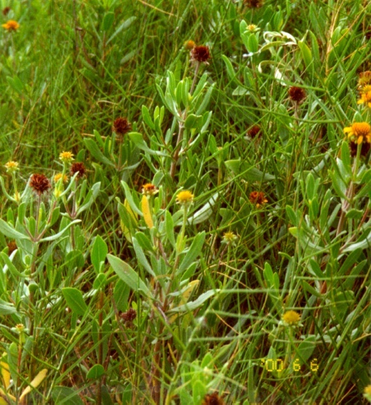
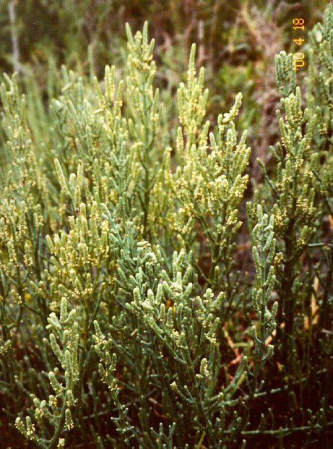
What determines the failure of vegetation recovery in these hypersaline soils?

Slide 3
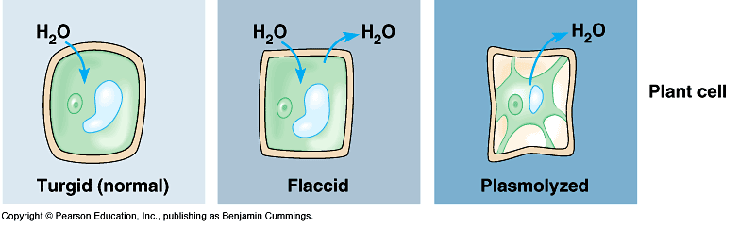
Multiple Stressors
Drought
Salinity
Nutrient

Slide 4
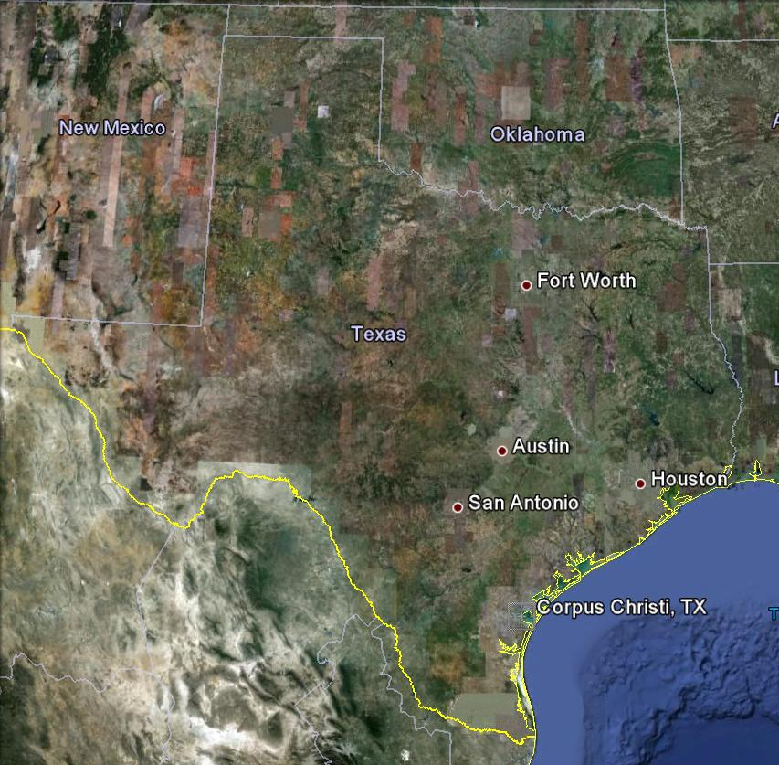
Nueces Bay

Slide 5
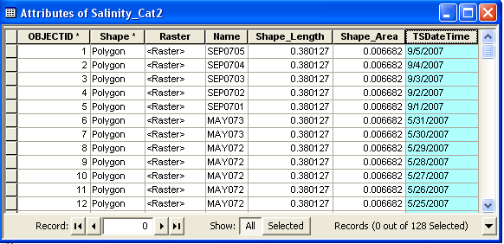
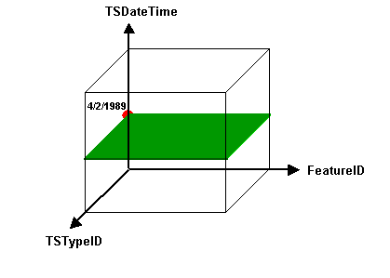
Methods
Basemaps
MonitoringPoints
  Daily Salinity Values (5 Sites)
Raster Catalog

Slide 6
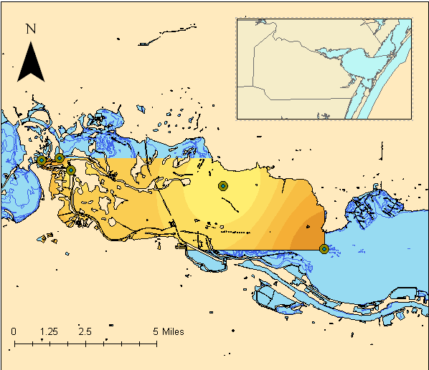

Slide 7
Nueces River Discharge
Fall 2002 Flooding
Fall 2007 Flooding
What is more desirable, frequent moderate inflow events or rare flood stage events?
Notes:
Monthly precipitation (grey bars) and potential evapotranspiration (lines) and difference between PPT and PET (black bars).

Slide 8
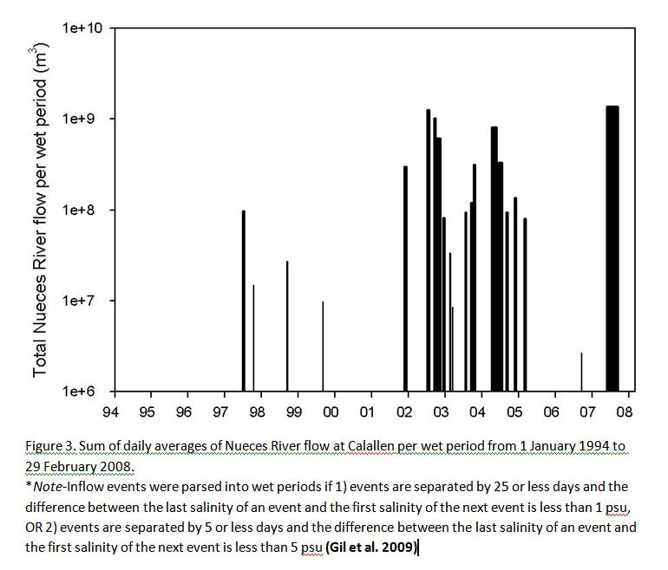

Slide 9
May – September 2007
http://vimeo.com/moogaloop.swf?clip_id=7655559
Raster Animation

Slide 10
Future Work
Extend 2007 Raster Time Series
Complete the 2003 Raster Time Series
Add more sites from offline datasets

