Slide 1
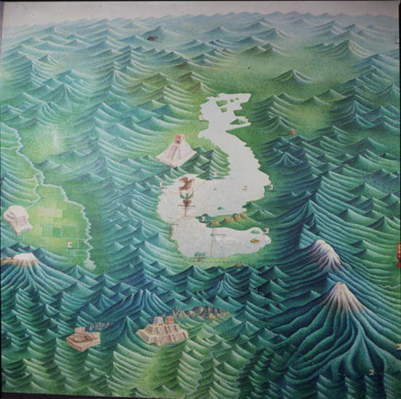
Hydrologic Balance in the Mexico Valley
Fernando Almada Calvo

Slide 2
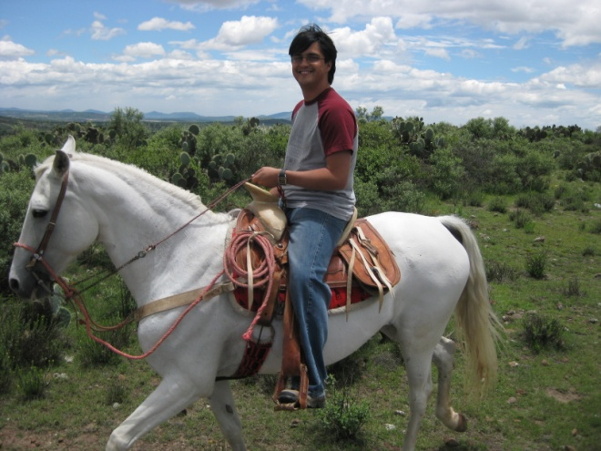
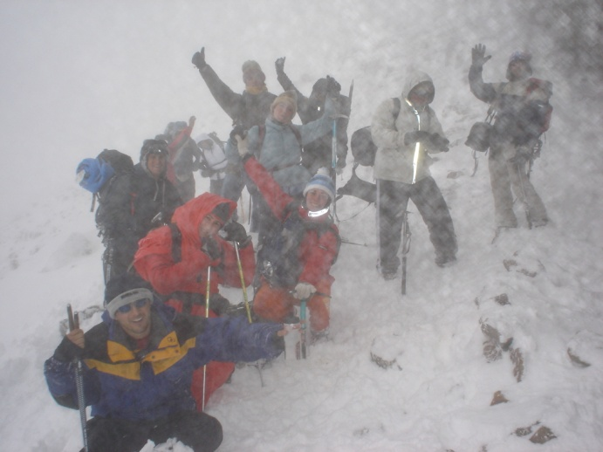
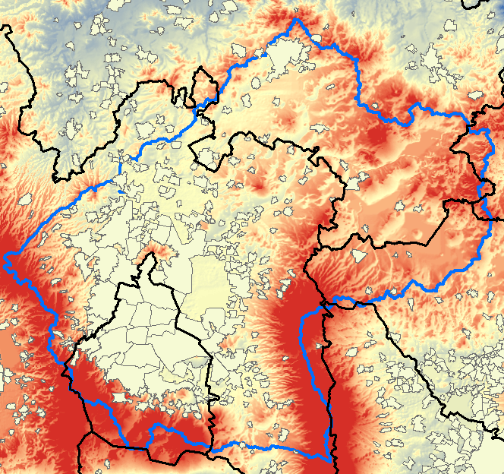
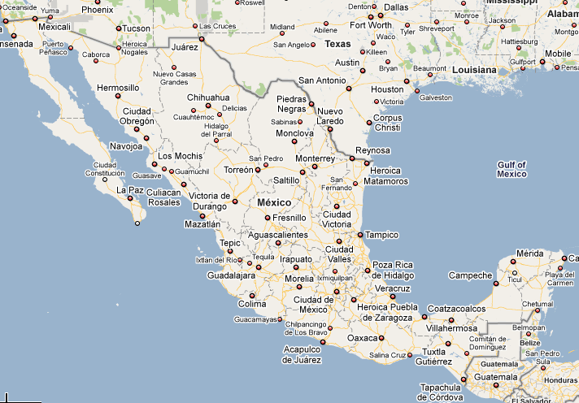
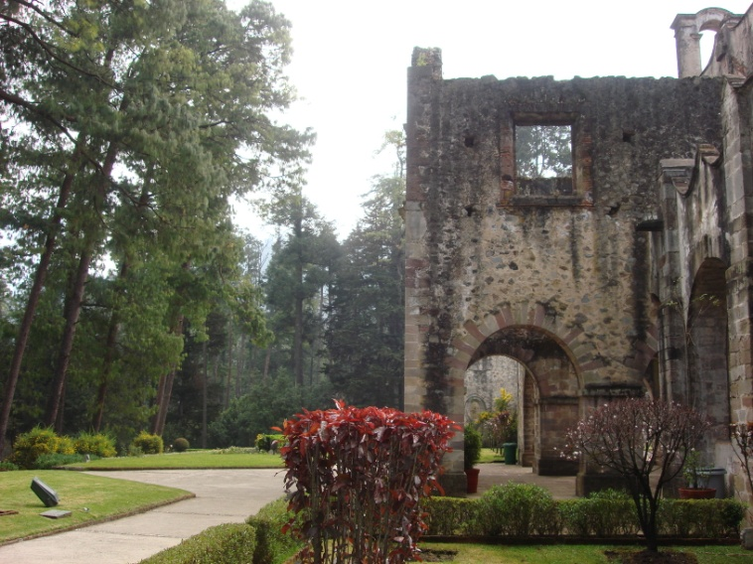
What and where is the Mexico Valley? (Also called Anahuac: Nahuatl for Close to water )
Closed hydrologic system, situated in Central Mexico.
Mexico City and Pachuca
Area: 9,611km² (1.5 times the area of Delaware)
City of Pachuca
Popocatepetl
(5384 m/17664 ft)
Mexico City

Slide 3
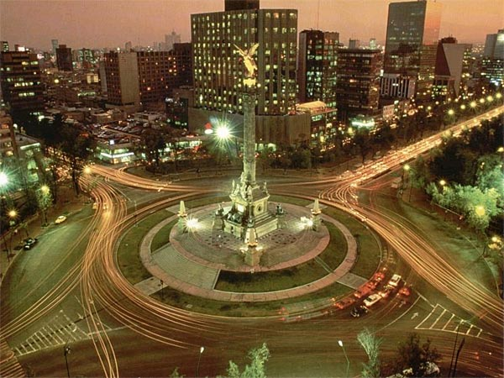
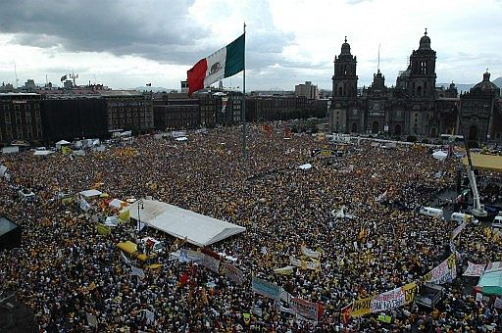
Why is this important?
Less that 1% of territory.
19 million people live in the Valley (20%)
1/3 of Mexico’s GNP is concentrated there
Density: Averaged in valley:~2,000 hab/km²
NYC :~9,000 hab/km²
Mexico City:~5,000 hab/km²

Slide 4
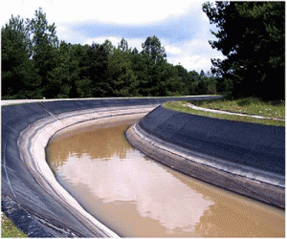
Objectives
Perform a hydrologic mass balance on the Mexico Valley
Estimate the power needed to pump water from the Cutzamala System to the Mexico Valley.
Mexico Valley
Inflows
Outflows

Slide 5
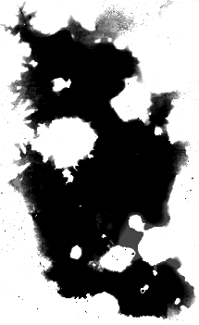
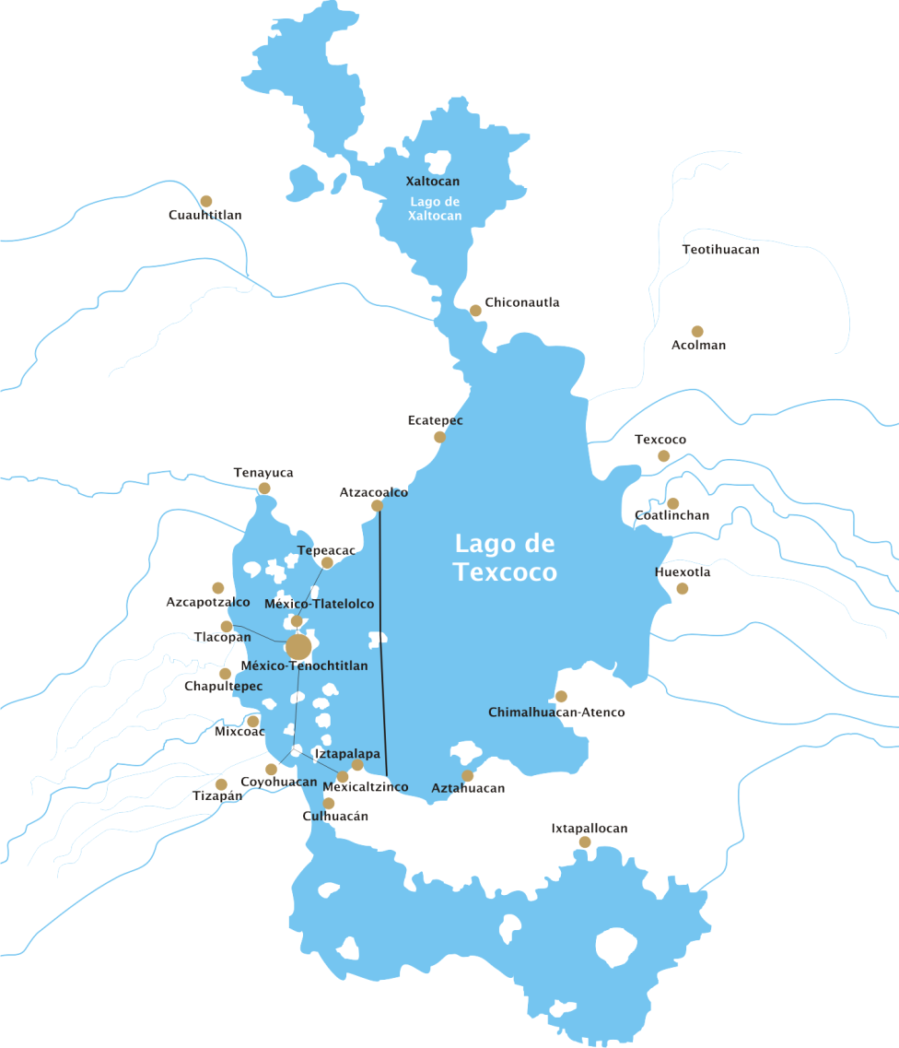
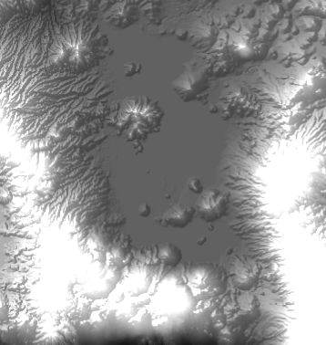

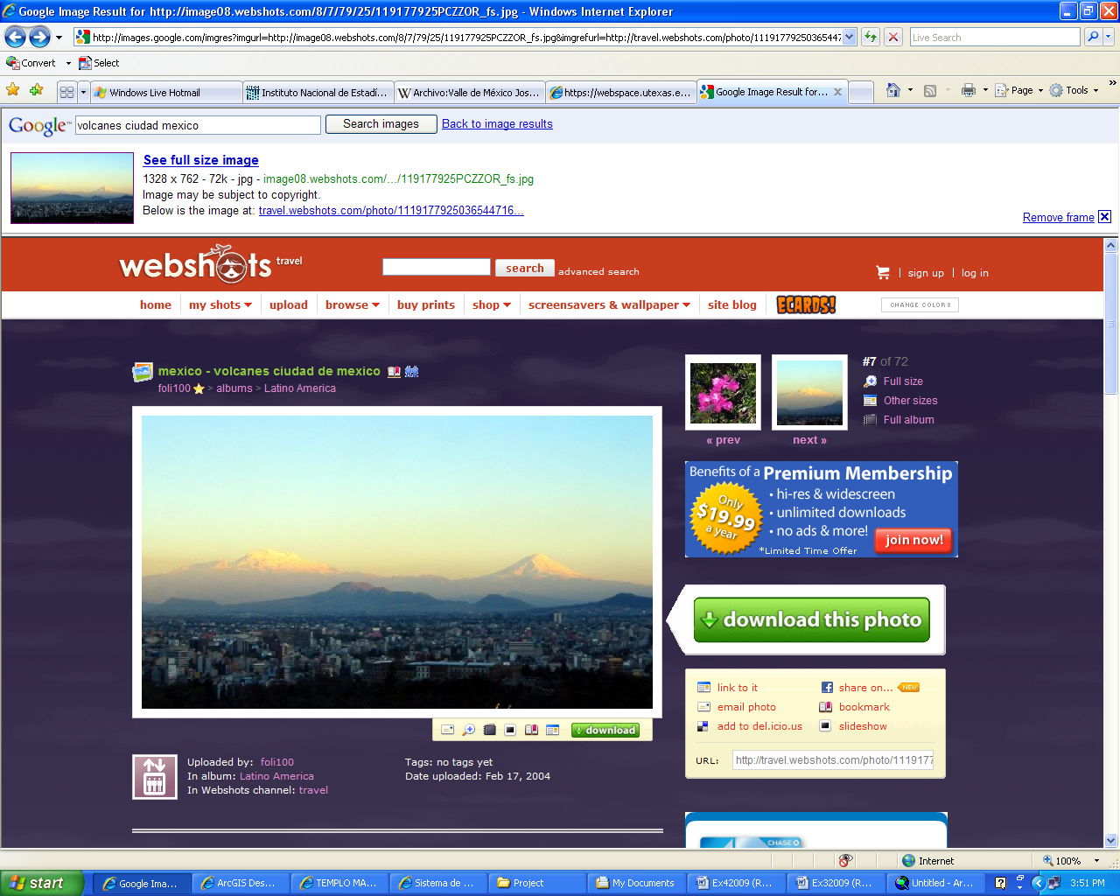
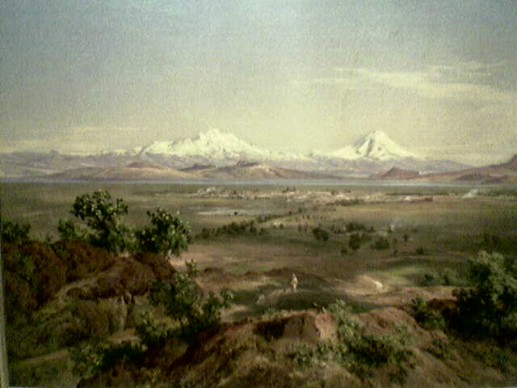
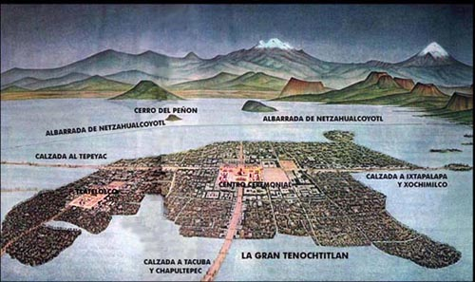
Filled
Raw
=
-

Slide 6
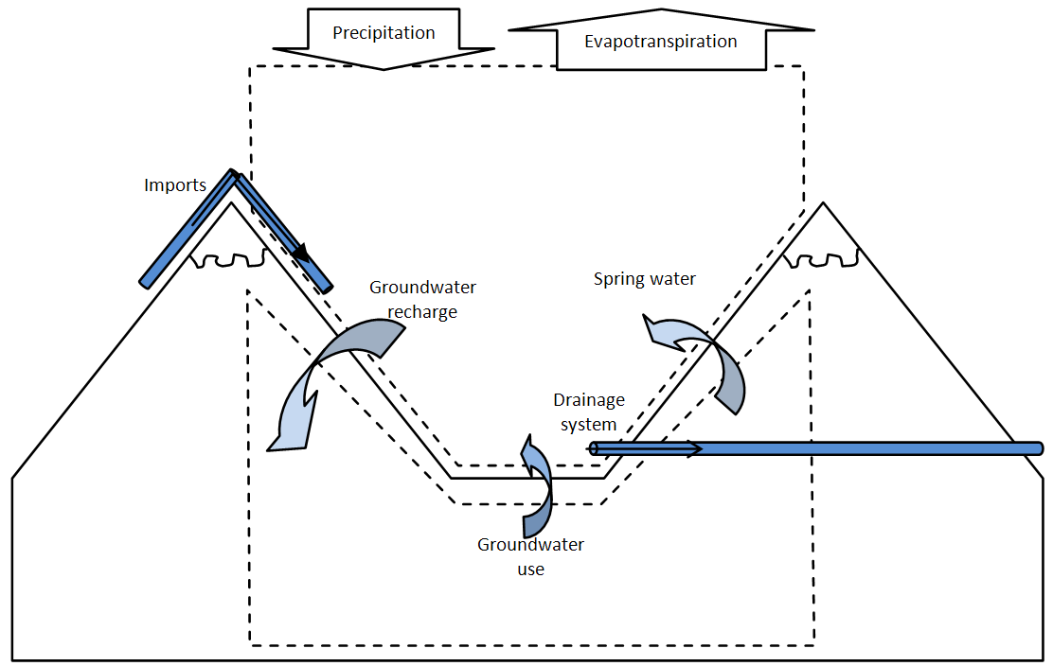
Balance diagram
Surface water or in engineered systems
Groundwater

Slide 7



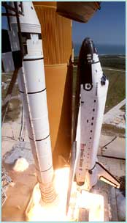
Data acquisition
National Institute of Geography and Statistics (INEGI)
  River shapefiles
  Water bodies
National Water Commission (CNA)
  Water use and consumption
  Water flow in drainage system
Water technology Institute (IMTA)
  Daily precipitation data (1978-1998)
  Evapotranspiration
Shuttle Radar Topography Mission
  DEM

Slide 8
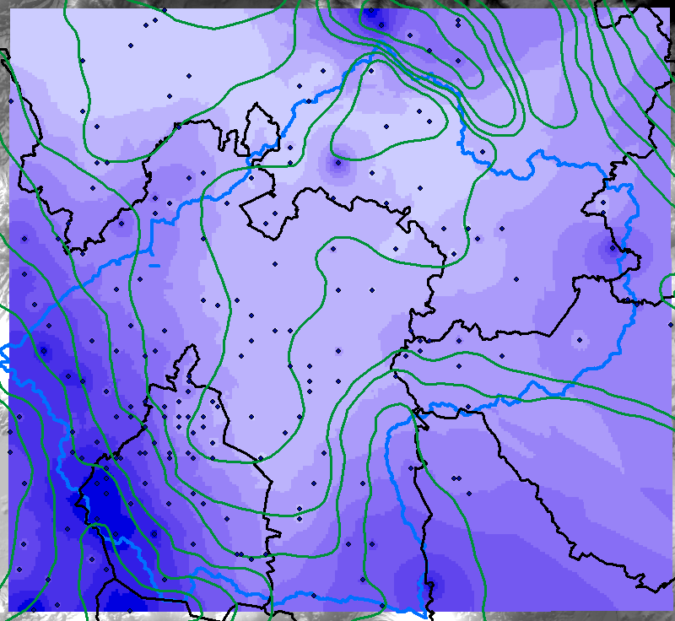
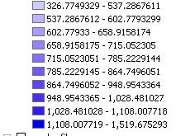
Precipitation
(mm/year)
Precipitation:
6,347 Mm³/year

Slide 9
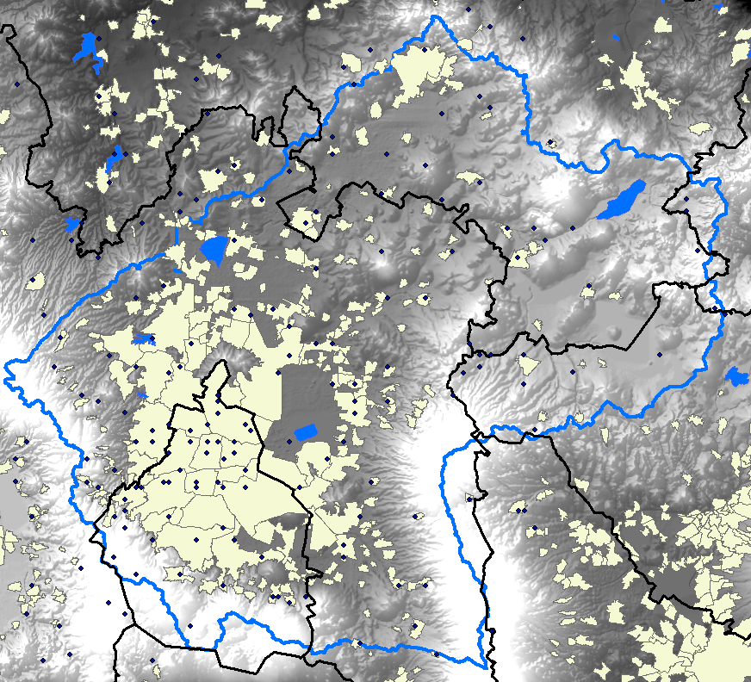
Pan Evaporation and
Evapotranspiration (mm/year)
Name of waterbody | Area km2
Tecocomulco Lagoon | 26.19048
Zumpango Lagoon | 18.15263
Texcoco Lake | 9.104374
Guadalupe Reservoir | 4.532924
Marin reservoir | 0.881915
Evapotranspiration: 5,001 Mm³/year
(Contreras et al)

Slide 10
Balance diagram
(Unknown or illegal use?)
Evapotranspiration
5,002 Mm³/year
Evaporation from water bodies
~100Mm³/year
Unknown Losses
~67Mm³/year
Outflow from the valley
1,861 Mm³/year
(CNA)
698
Runoff ratio 0.11
Superficial Water bodies
539
329
1532
(IMTA)
Precipitation
6,347 Mm³/year
210
(IMTA)
1692
Use
2,449 Mm3/year
(IMTA)
647
Groundwater
DV=-992 Mm³/year
1639
(IMTA)
Losses during use
917 Mm3/year
(IMTA)
Imports
600 Mm3/year
(CNA)

Slide 11
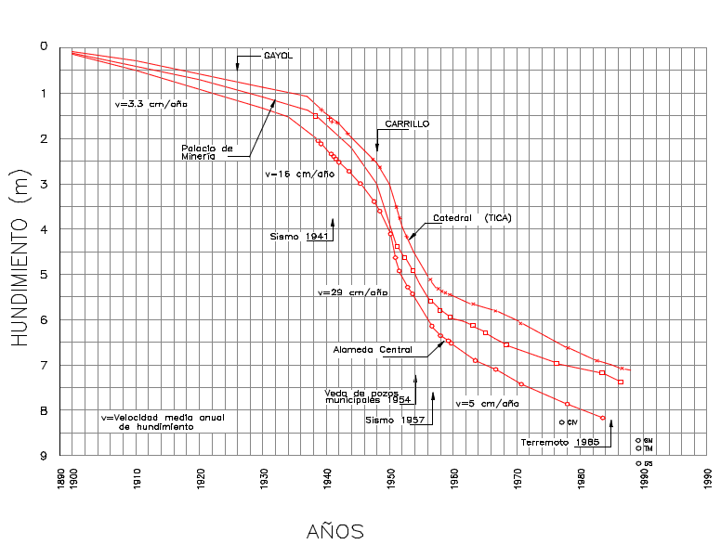
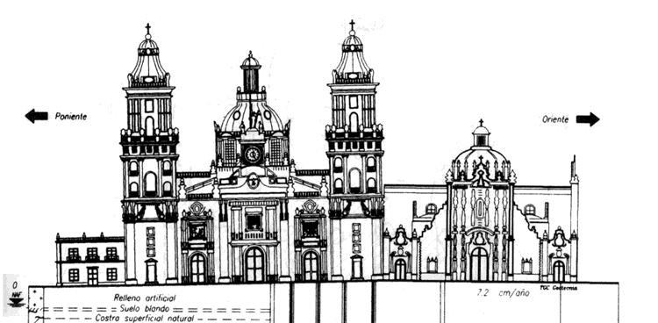

Slide 12
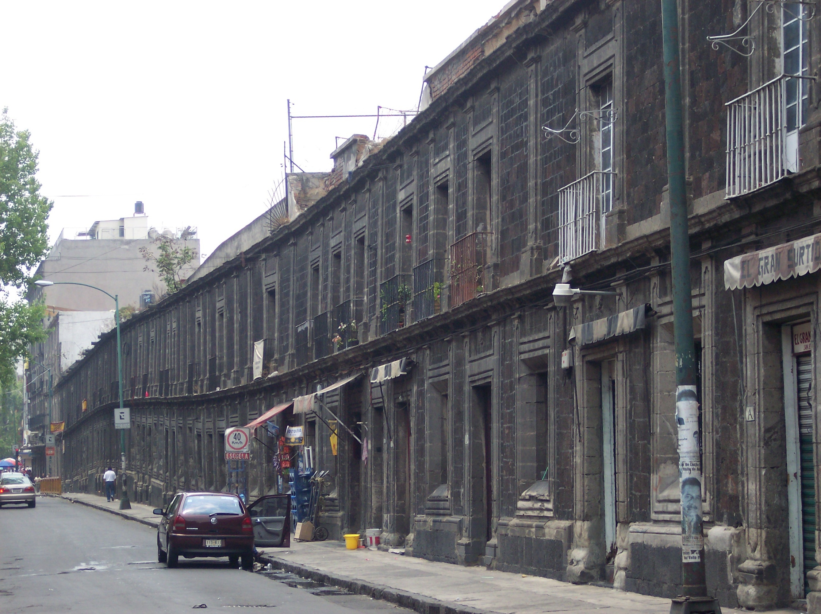

Slide 13
Work to do
Locate in map reservoirs and canals of Cutzamala system.
Calculate the energy required for pumping 19m³/sec of water to the Mexico Valley.
Write Report

Slide 14
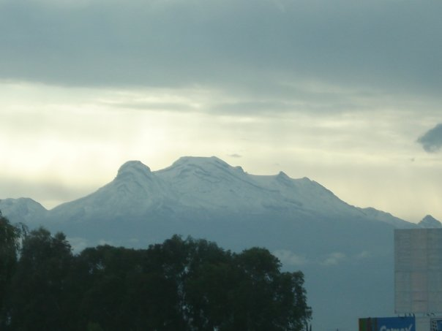
Questions?

