Slide 1
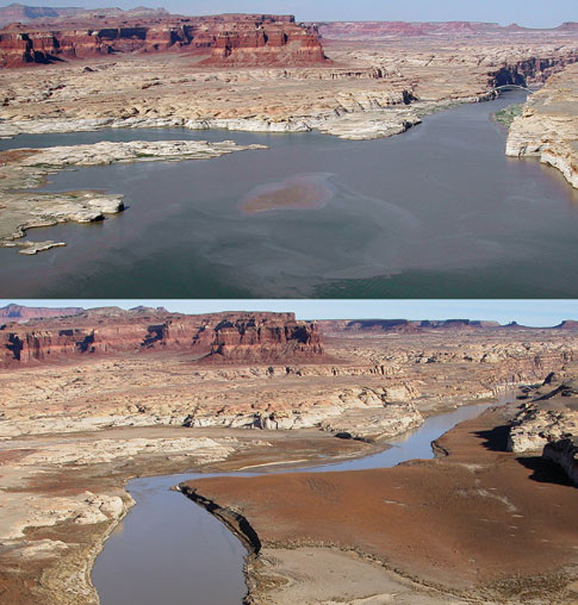
Drought in Upper Colorado Basin
Solaleh Khezri, GIS in Water Resources, University of Texas, Fall 2009

Slide 2
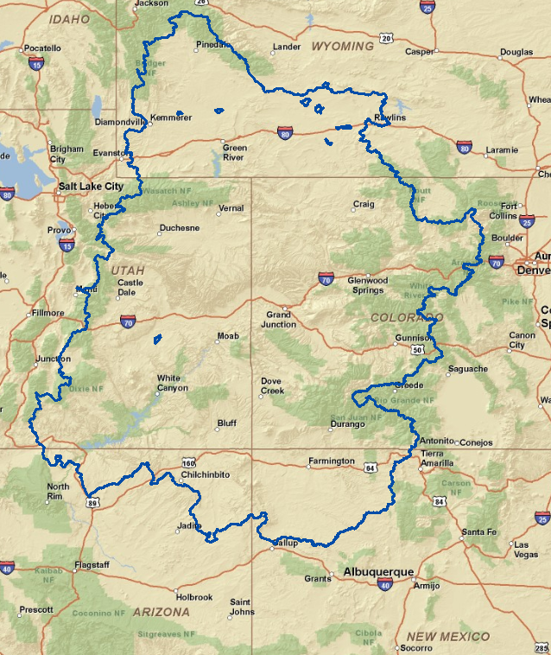
Upper Colorado River Basin

Slide 3
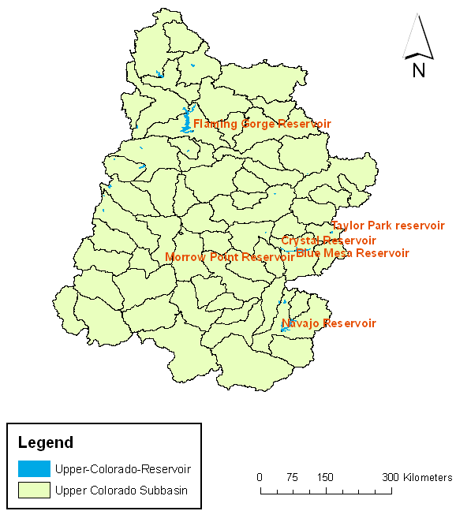
Upper Colorado Basin Reservoirs

Slide 4
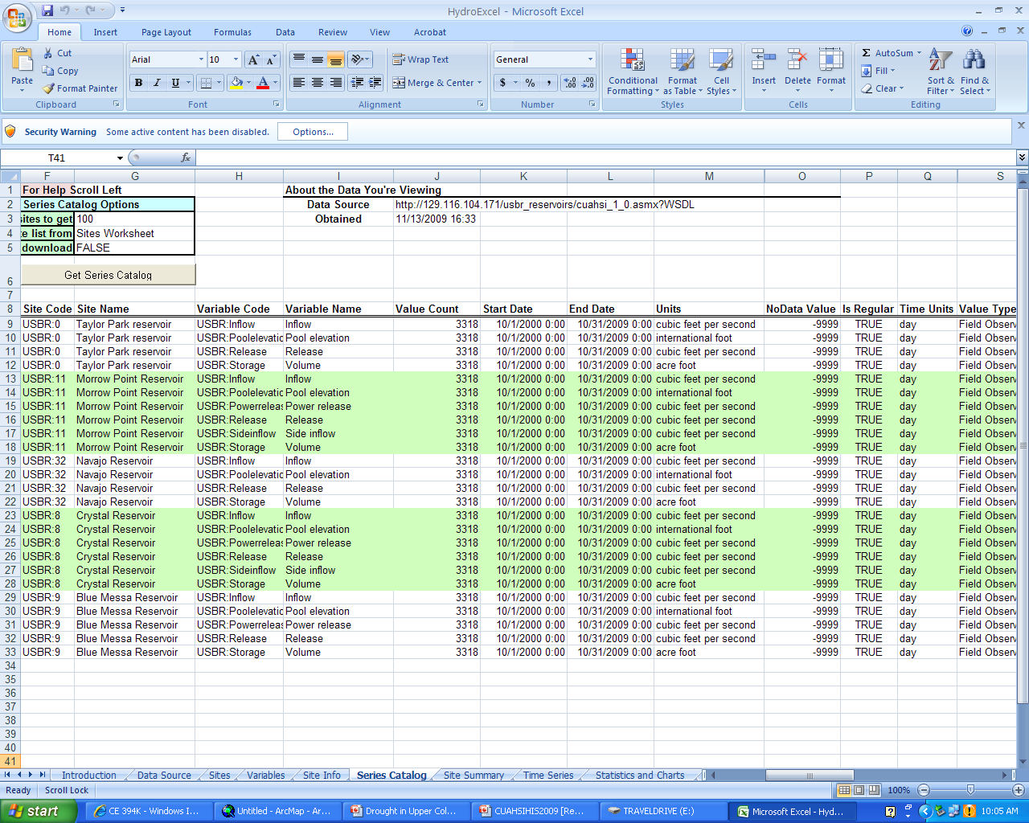
Hydro Excel

Slide 5
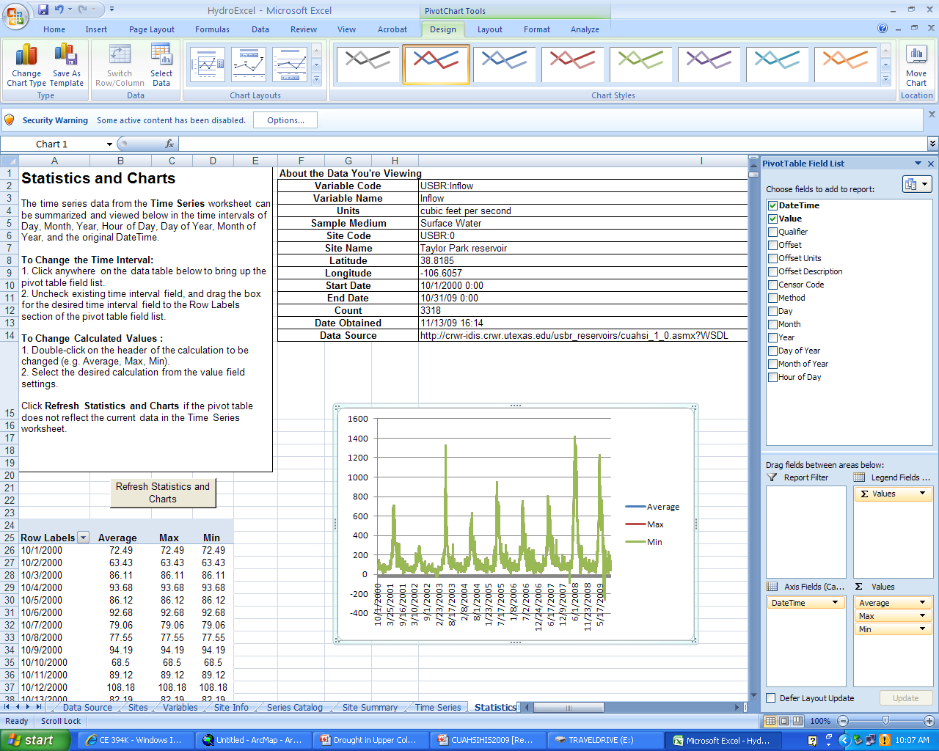
Generation of Graphs in Hydro Excel

Slide 6
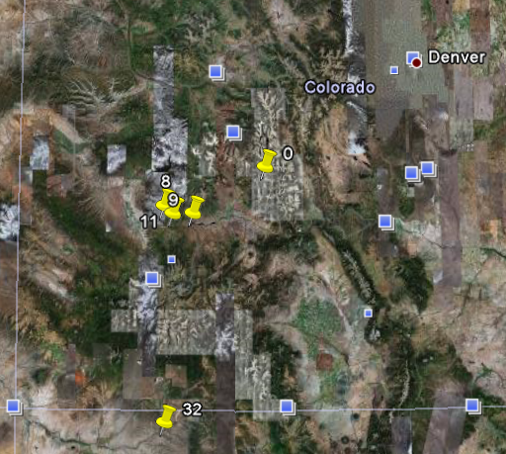

Slide 7
Drought Indices
Palmer Drought Severity Index :Indicator of soil moisture
Surface Water Supply Index: based on snowpack, streamflow, precipitation, and reservoir storage.
Drought Monitor: Combination of indices, including the PDSI, Soil Moisture Model, Standardized Precipitation Index (SPI), USGS weekly streamflow percentiles, etc.

Slide 8
Reservoirs Monthly Inflow Index-2002

Slide 9












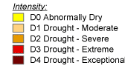
Monthly Inflow Index Maps-2002
February
January
March
May
June
July
August
September
October
November
December
April

Slide 10
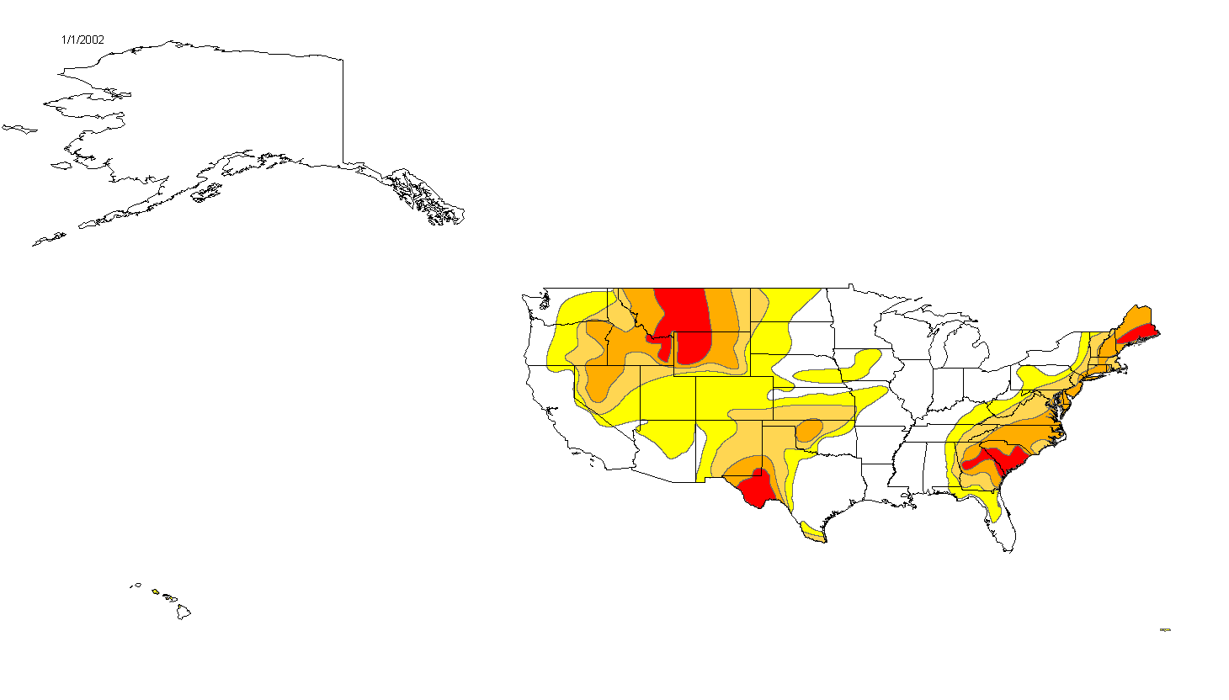
Monthly Drought Monitor-2002

Slide 11
What to do next?
Calculate Inflow Index for 8 years
Create Inflow Index maps

