Slide 1
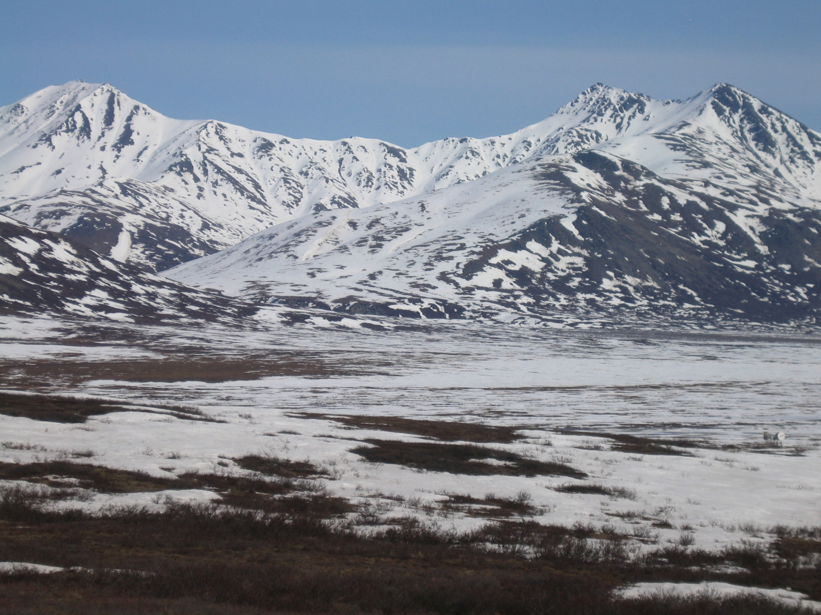
Watershed and Stream Network Delineation on Alaska’s North Slope

Slide 2
Arctic Climate Change
IPCC AR4 Projections (2007)
  Increased temperature
    Winter larger
    Summer smaller
  Increased precipitation
    Winter larger
    Summer smaller
Changes in Arctic Hydrology

Slide 3
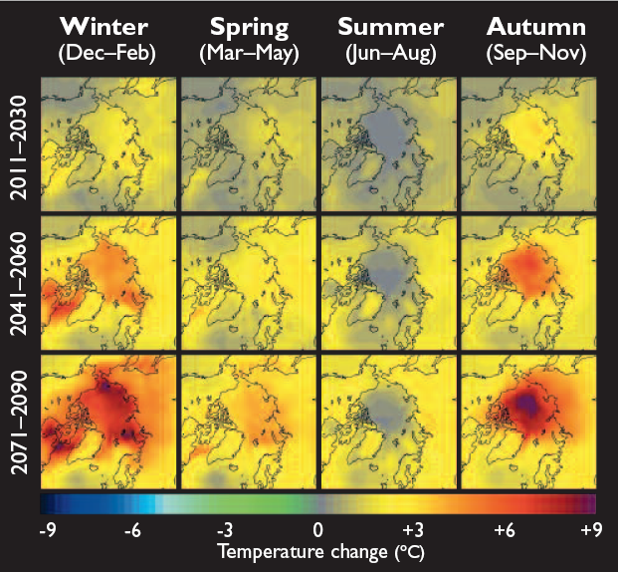
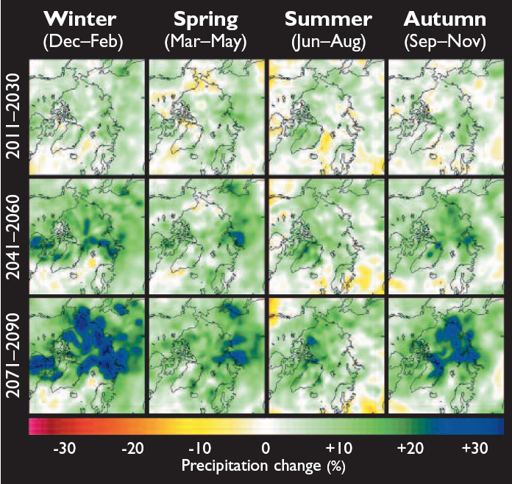
Climate Change

Slide 4
Climate Change

Slide 5
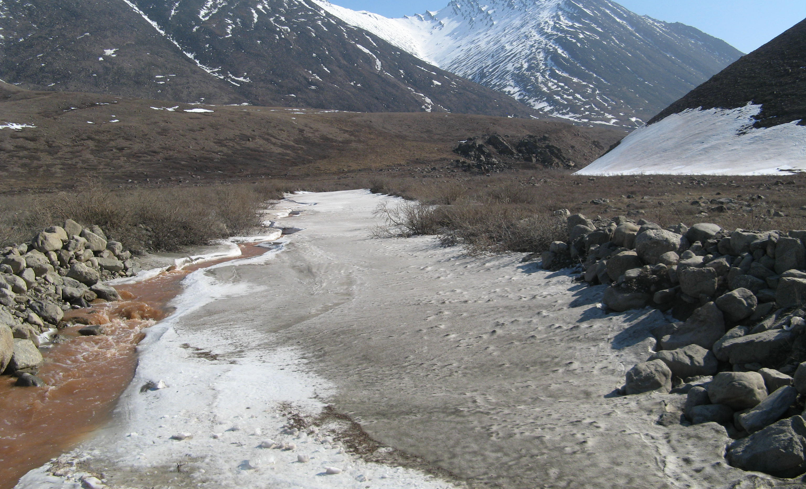
Arctic Streams
5/21/2009

Slide 6
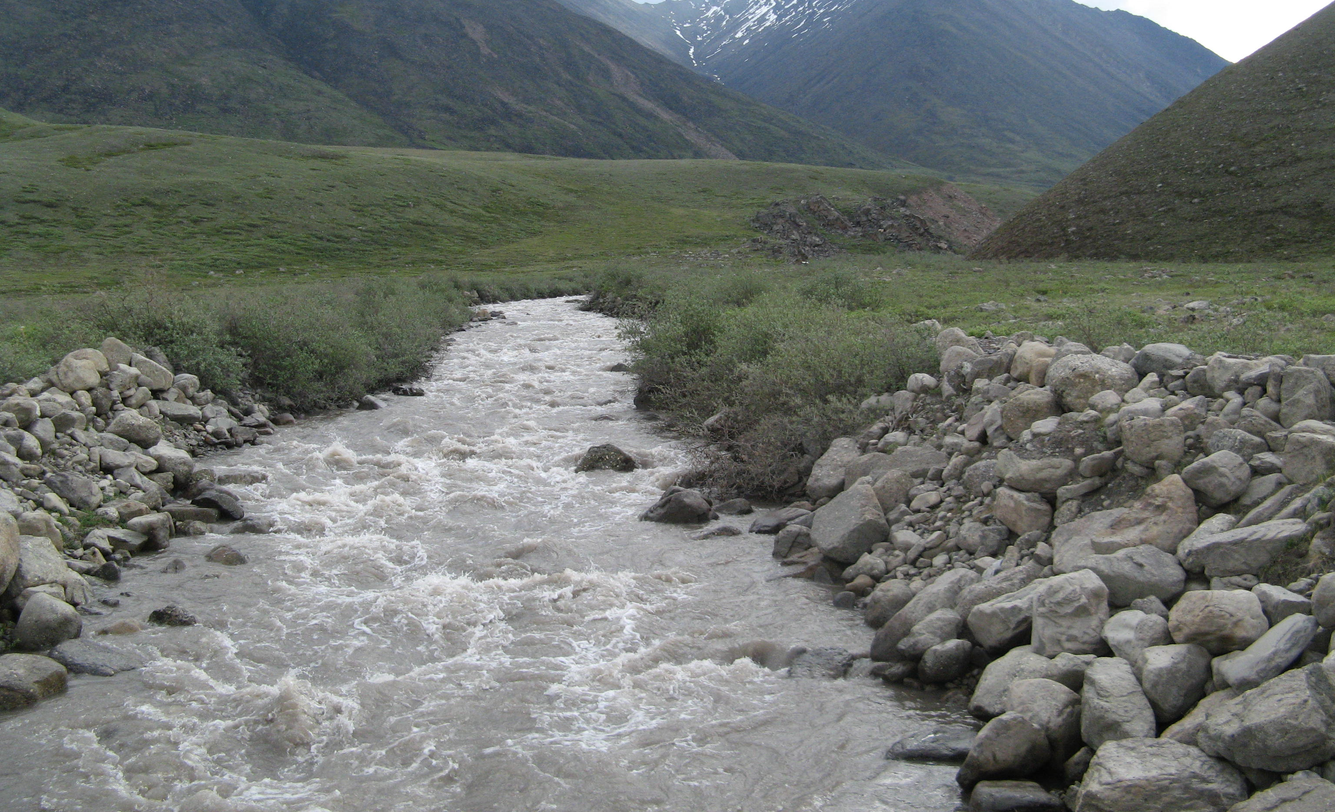
Arctic Streams
6/18/2009

Slide 7
Arctic Streams
High amounts of organic matter
  Carbon and Nitrogen
Sites of Biogeochemical transformations
  Organic matter conduits
  System loss pathways
How will they be affected ???

Slide 8
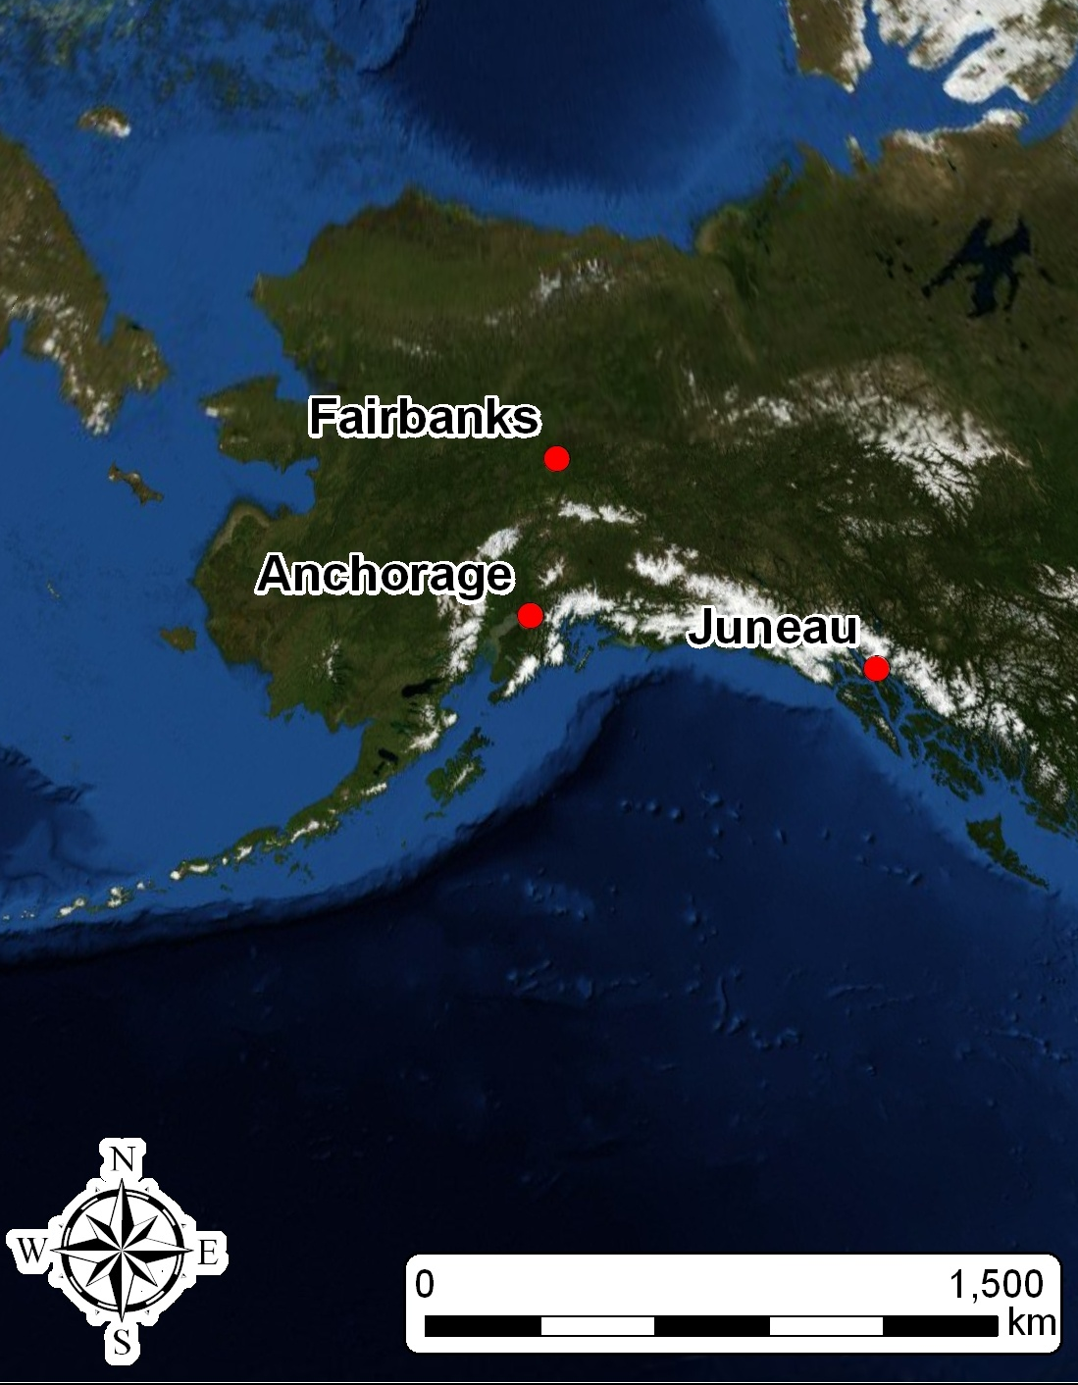
Study Area

Slide 9
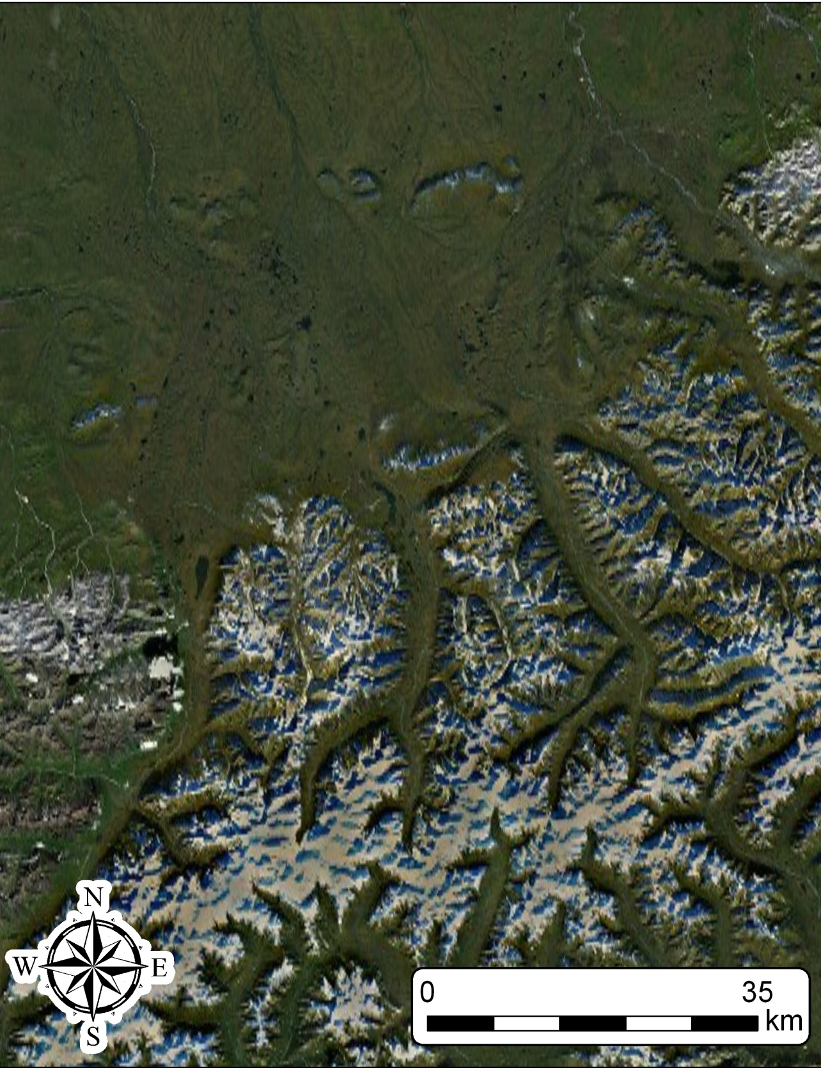
Study Area

Slide 10
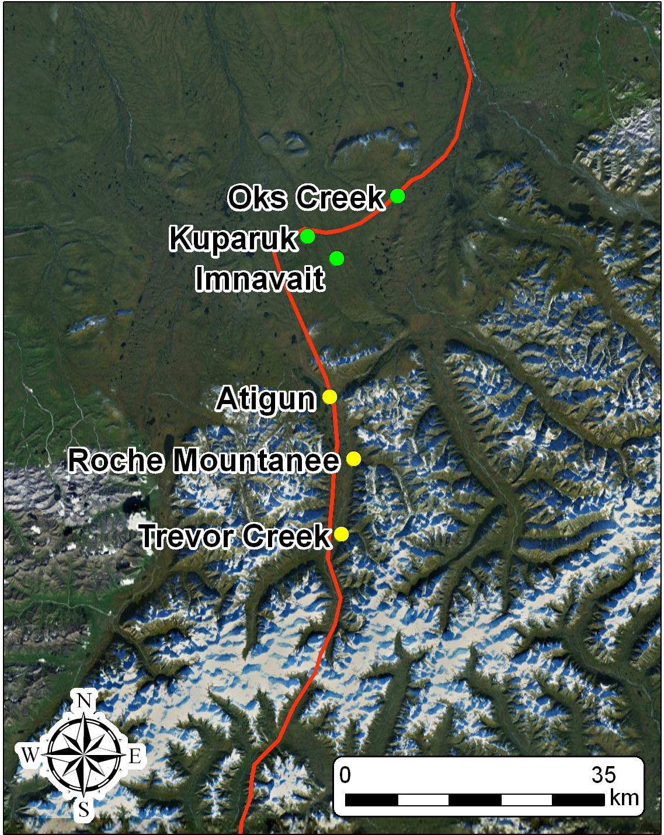
Study Area
Sampling Sites
  3 Mountain
  3 Tundra
  Watershed area ?

Slide 11
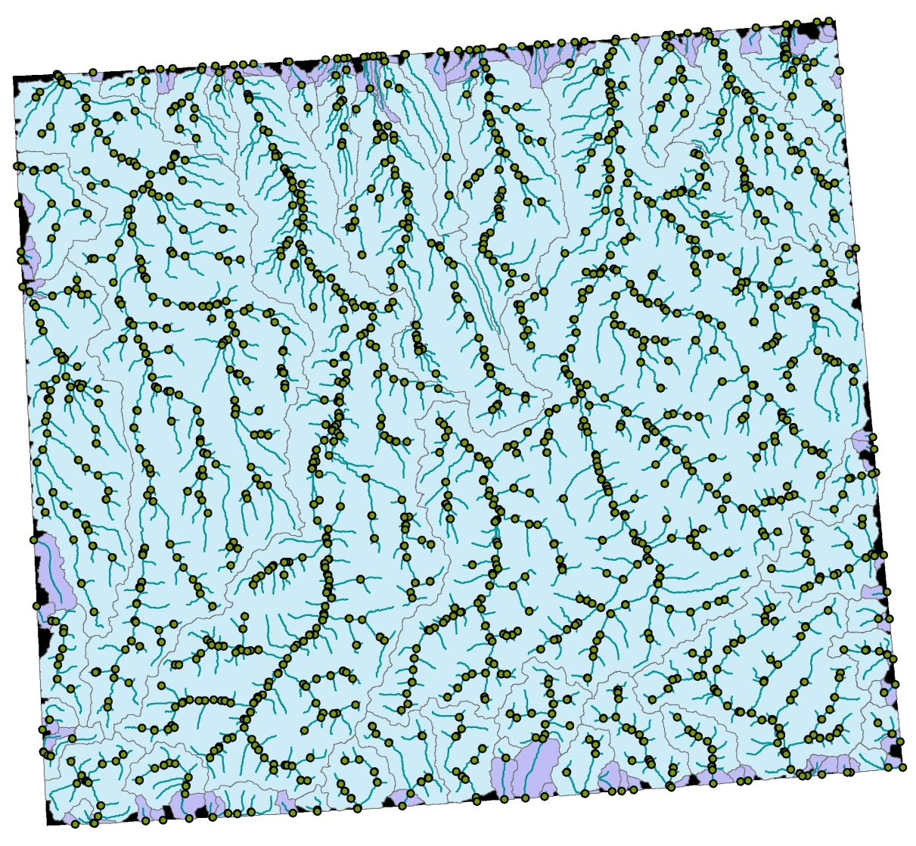
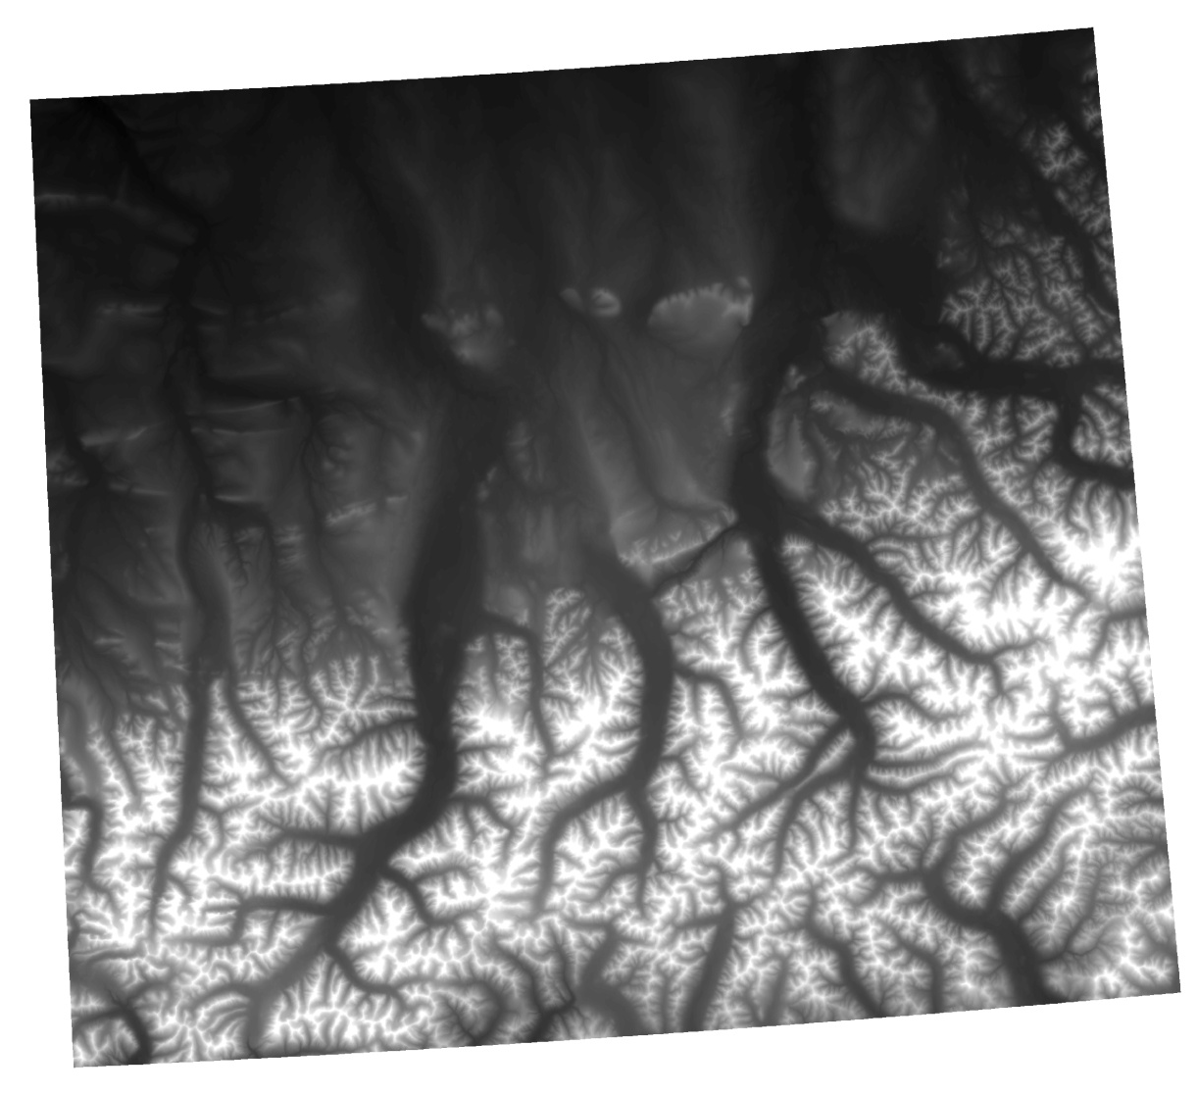
Methods

Slide 12
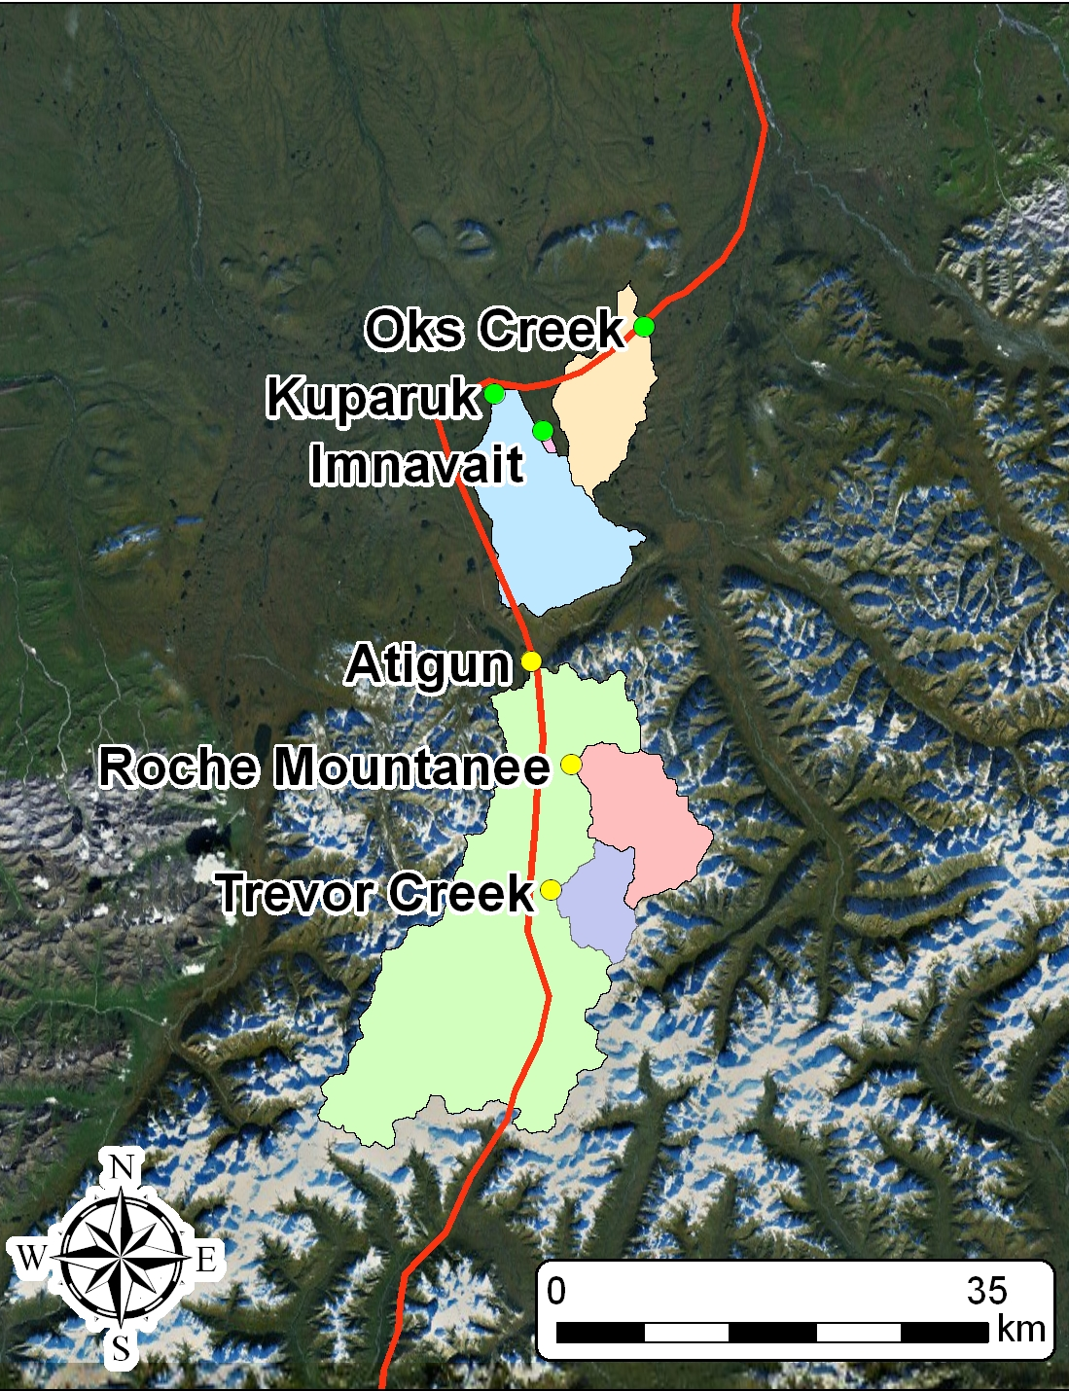
Study Area
Sampling Sites
  3 Mountain
  3 Tundra
  Watershed area ?

Slide 13
Watershed Areas

Slide 14
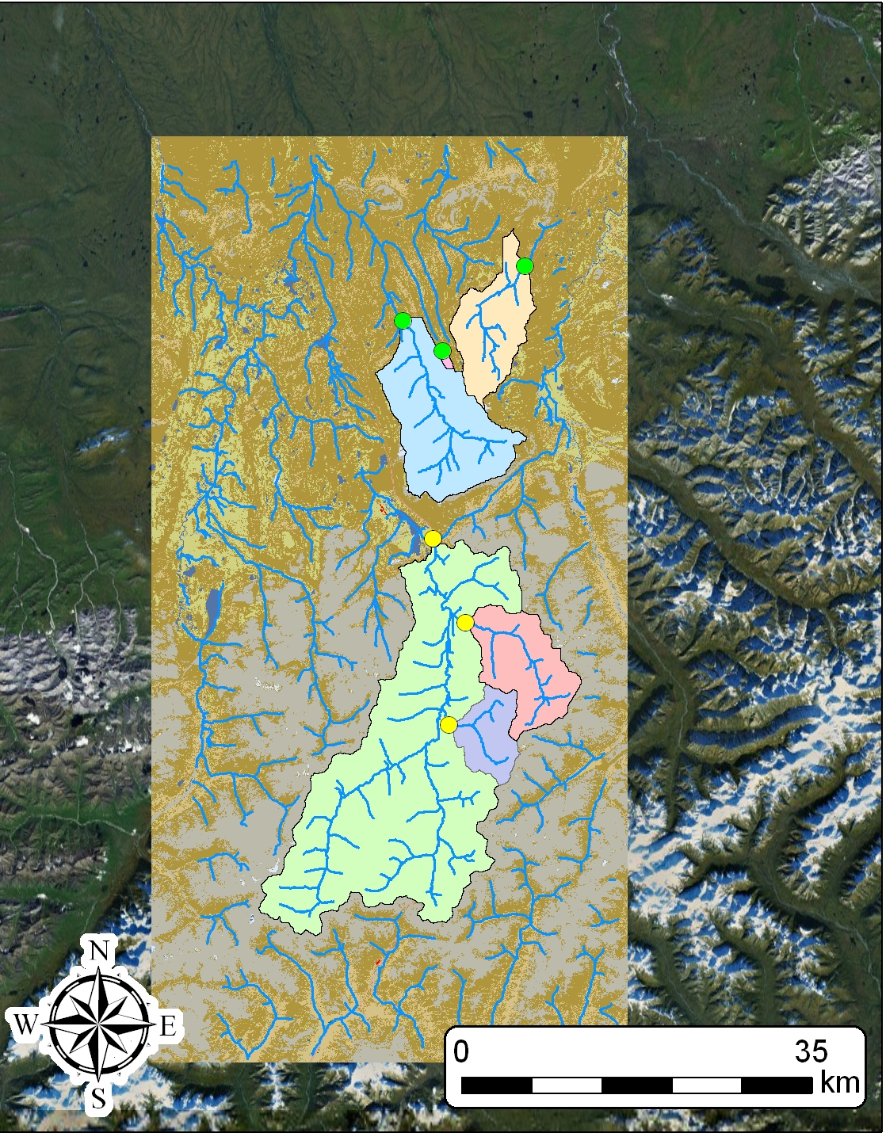
Further Work…
land cover type ?
drainage density ?

Slide 15
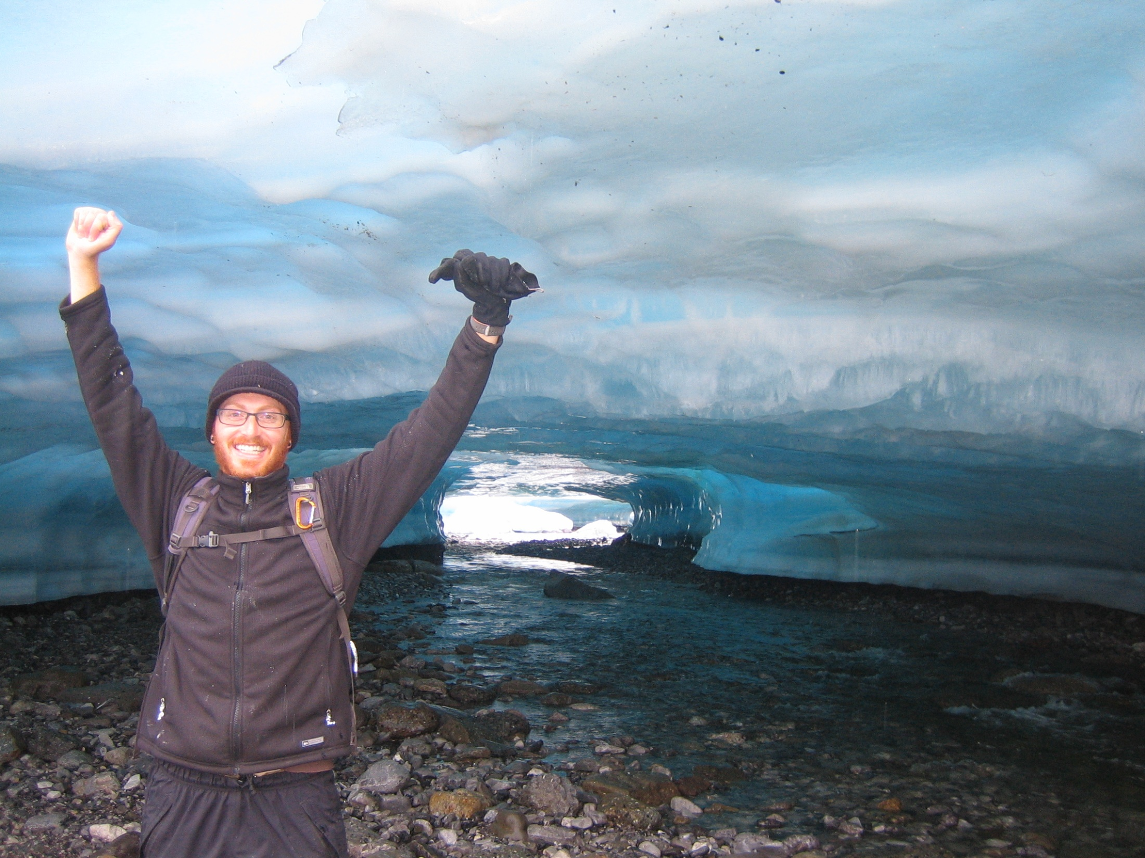
Questions ???

