Slide 1
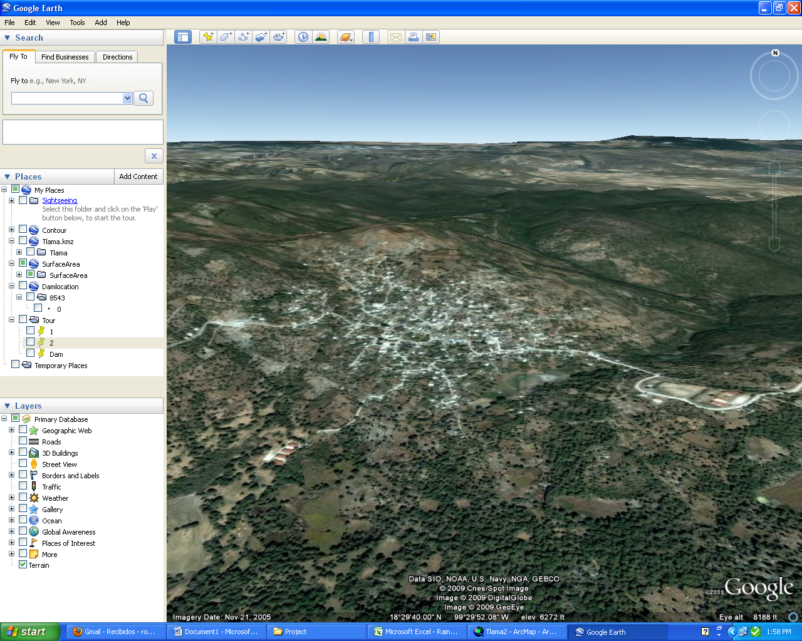
CE 394K: GIS in Water Resources Small Dam in Village of Tlamacazapa, Mexico Robin Lynch

Slide 2
Tlamacazapa, Guerrero
Remote mountain village
Wells contaminated with: Arsenic, Lead, and Fecal Runoff
Severe 6 month dry season
Limited piped water (~2 hours/week)

Slide 3
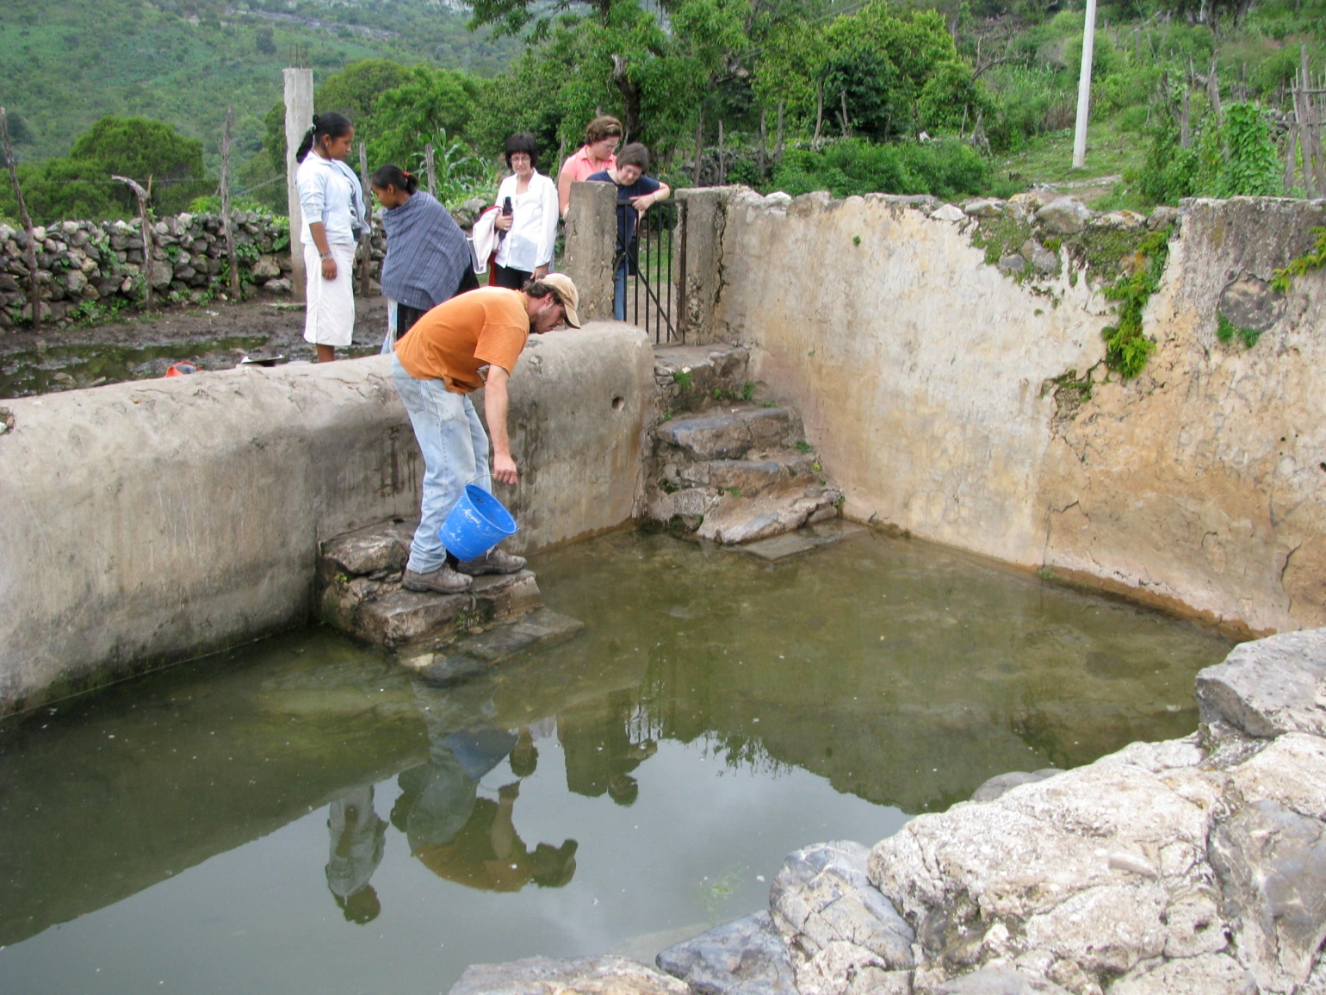
Wet Season
“Agua de Shrek”

Slide 4
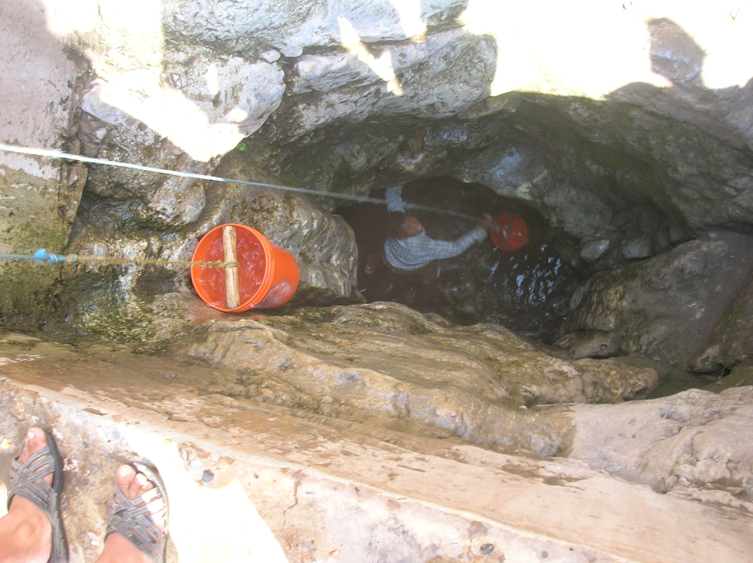
Dry Season (Same well)

Slide 5
Goal of Project
Create a dam to meet water needs
Delineate stream network
Determine best location for dam
Delineate watershed
Size the dam using Sequent Peak Method

Slide 6
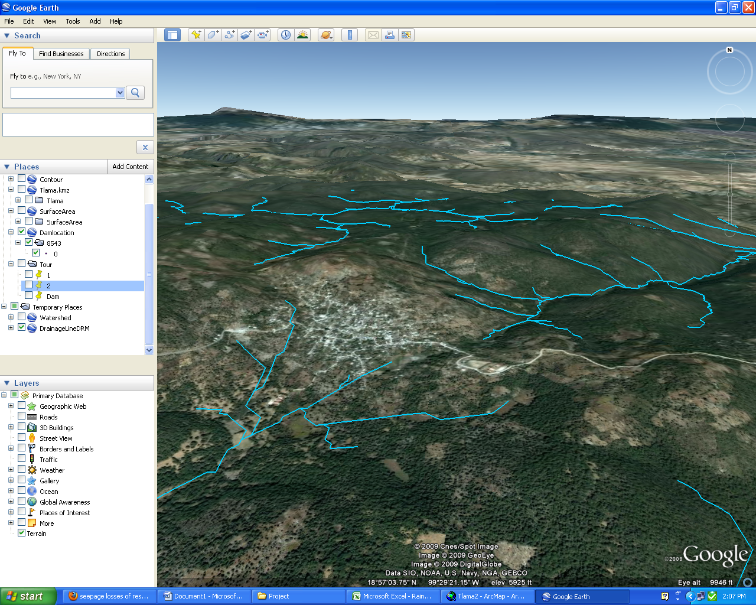
Stream Delineation
Too far from road, difficult to maintain
Perfect!
Drains from village runoff, too polluted

Slide 7
Watershed delineation
Drainage Area = 7689600 m²
Dam

Slide 8
Average Rainfall (2003-2007)

Slide 9
Flow Calculation
Runoff ratio, w = 0.2
Drainage Area, DA = 7689600 m²
Q = P*DA*w
Calculated per month

Slide 10
Water Demand
Calculate volume for 3 scenarios
Assume population of 6000 people
Water Use Per Day:
Current | 15 | L/c/day
Minimum | 40 | L/c/day
Optimum | 100 | L/c/day
Monthly Volume
Current | 2700 | m³/month
Minimum | 7200 | m³/month
Optimum | 18000 | m³/month
~2.5 flushes
~7 flushes
~17 flushes

Slide 11
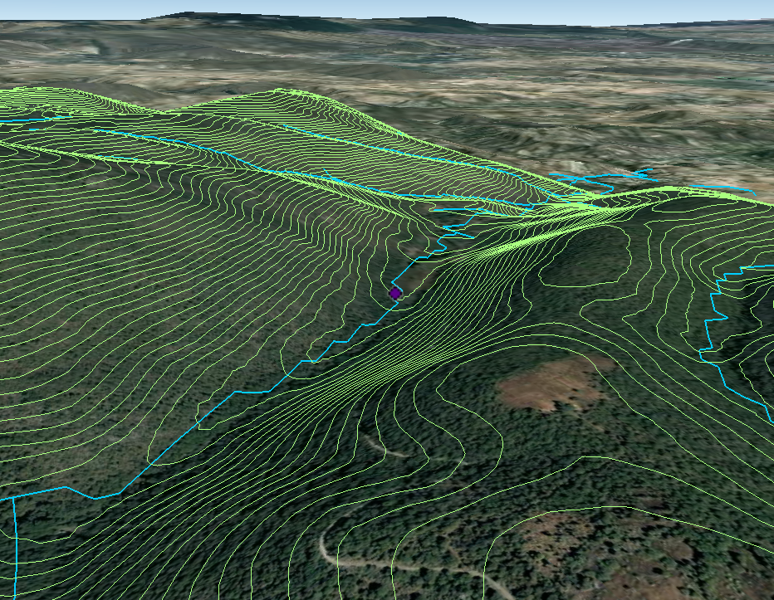
Dam Location

Slide 12
Dam Sizing

Slide 13
Sequent Peak Method
Water Demand
Evaporation Losses
Inflow
 |  |  | (m³/month)
t | Rt | e | Lt | Qt | Kt-1 | Kt
 |  | mm/mo
May | 18000 | 60 | 71.63157 | 128840.8 | 0 | 0
June | 18000 | 60 | 71.63157 | 342015 | 0 | 0
July | 18000 | 60 | 71.63157 | 282202.2 | 0 | 0
August | 18000 | 60 | 71.63157 | 325743.8 | 0 | 0
September | 18000 | 60 | 71.63157 | 290137.8 | 0 | 0
October | 18000 | 60 | 71.63157 | 135146.3 | 0 | 0
November | 18000 | 93 | 111.0289 | 30020.2 | 0 | 0
December | 18000 | 93 | 111.0289 | 0 | 0 | 18111.03
January | 18000 | 93 | 556.4386 | 799.7184 | 18111.03 | 35867.75
February | 18000 | 93 | 879.081 | 12610.94 | 35867.75 | 42135.89
March | 18000 | 93 | 966.0064 | 13121.53 | 42135.89 | 47980.36
April | 18000 | 93 | 1034.379 | 12278.75 | 47980.36 | 54735.99
Minimum Capacity (m³)

Slide 14
Dam Sizing
 | m³/month | Kt (m³) | Height (m)
Current | 2700 | 4899 | 3.5
Minimum | 7200 | 14016 | 5.5
Optimum | 18000 | 54736 | 10.5

Slide 15
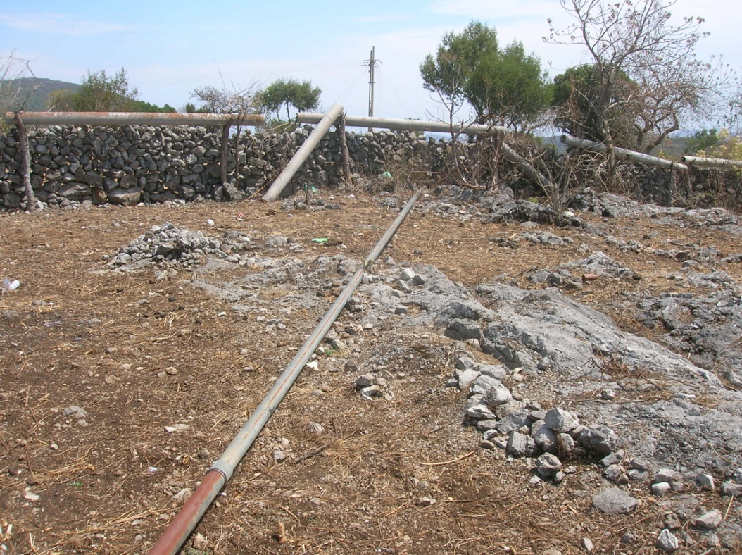
Next Steps/Pitfalls
Geological survey
Community Participation
Clear organizational structure
Affordable pricing

Slide 16
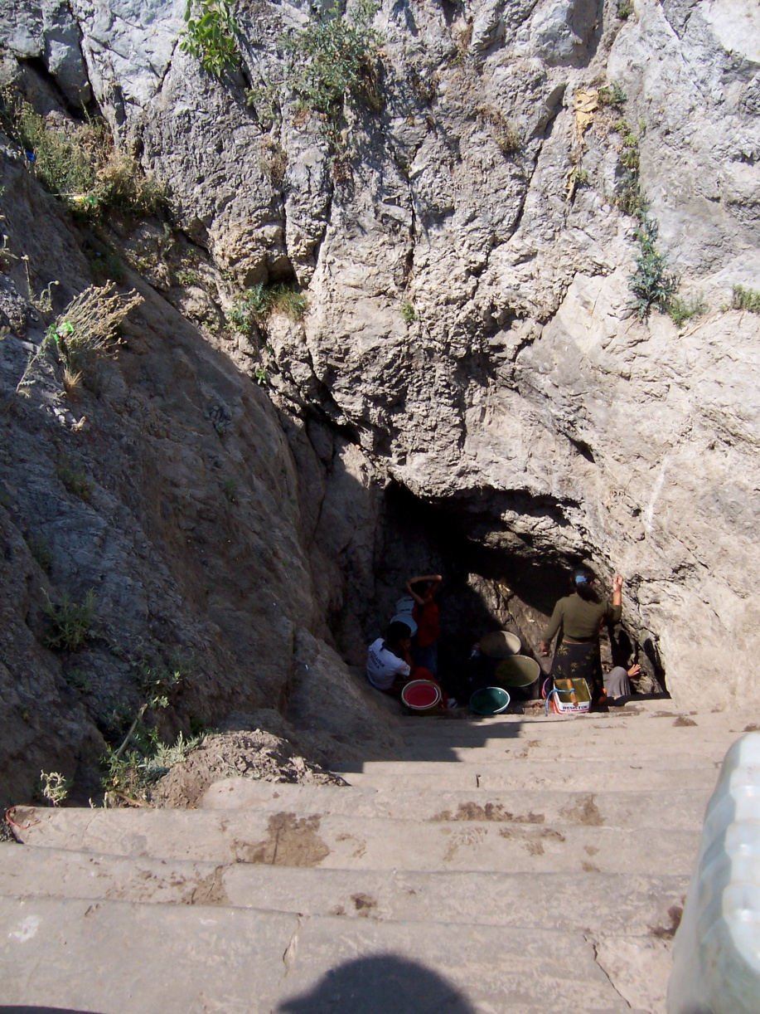
Questions?

