Slide 1
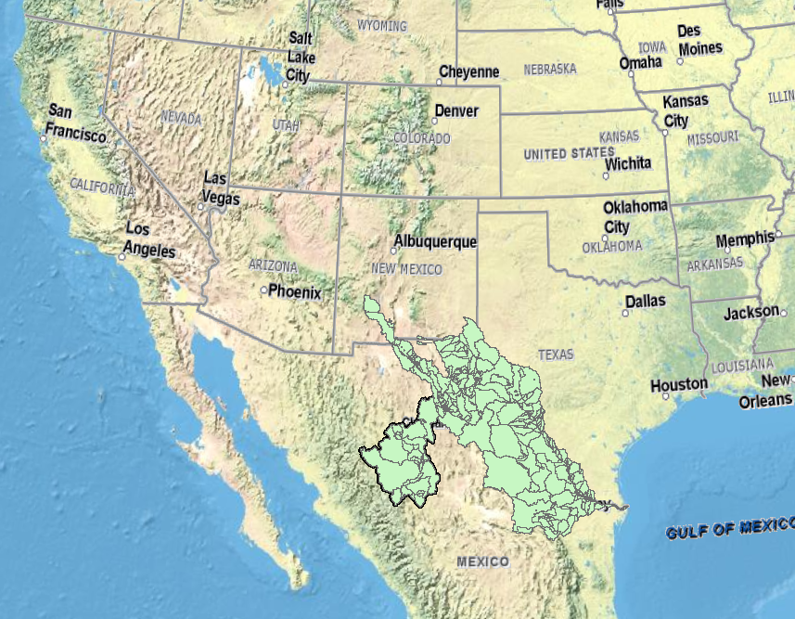
Application of GIS in
Analysis of Temporal and Spatial Variation of Surface Air Temperature in the Rio Conchos Basin in Mexico
Marcelo Somos

Slide 2
Introduction
The warming of the climate system has become a reality by taking into account the observations of increases in global average air and ocean temperatures, widespread melting of snow and ice, and rising global mean sea level, etc.
This phenomenon is affecting the temporal and spatial distribution of the temperature.

Slide 3
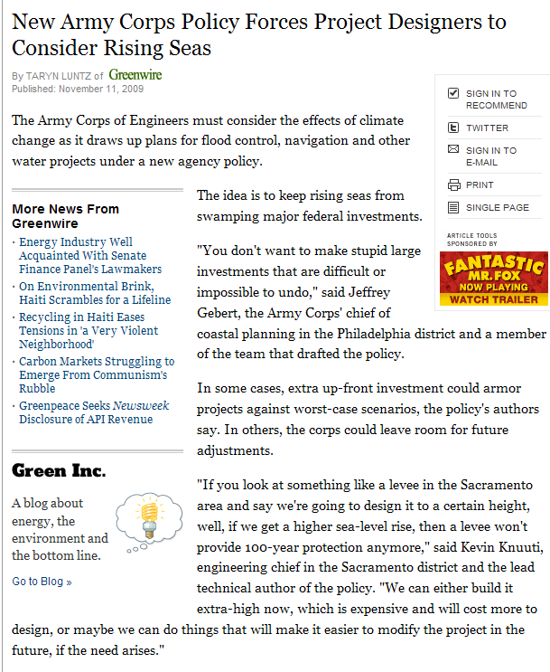
Global Warming
http://www.nytimes.com/gwire/2009/11/11/11greenwire-new-army-corps-policy-forces-project-designers-7288.html

Slide 4
Many processes are affected by the temperature
Biological processes
Glacial melting
Flora and Fauna development
Water quality (Dissolved oxygen)
Etc.

Slide 5
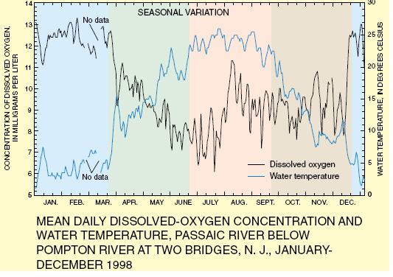
Water Quality Example
http://ga.water.usgs.gov/edu/dissolvedoxygen.html

Slide 6
Objectives
Extract the monthly values of temperature estimated by a GCM in the Conchos River Basin during three different periods (2010 to 2019, 2020 to 2029 and finally 2040 to 2049)

Slide 7
Objectives
Use the tool model builder in order to automate the process of extraction of data from the NetCDF file
Analyze the behavior of the surface air temperature for the next 40 years in the Conchos Basin

Slide 8
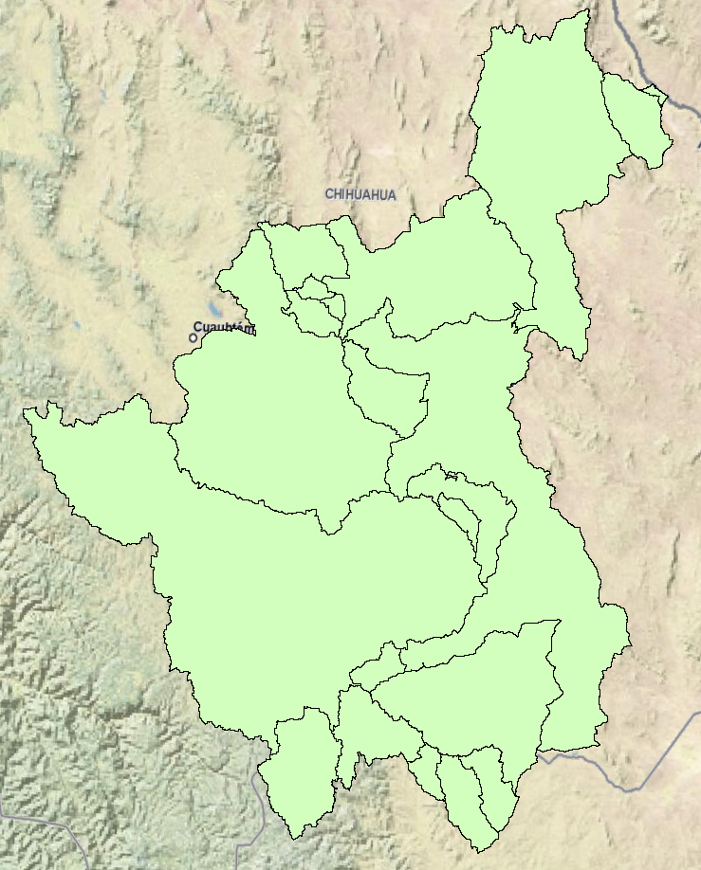
Study Area
This project is focused on the Conchos river. It has a drainage area of 67,862 km2.
Geographically, it is located within the coordinates 26° 03’ and 30° latitude north, and 104° to 107° West

Slide 9
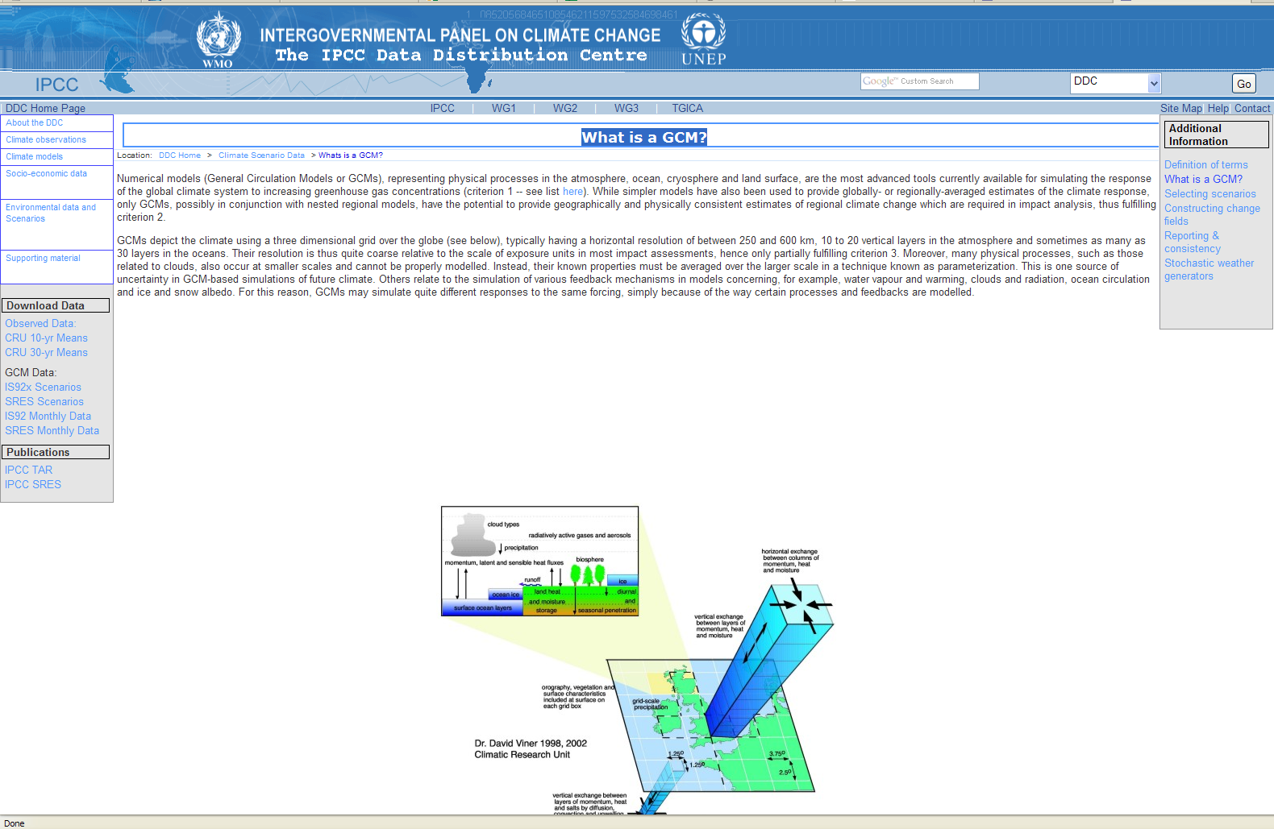
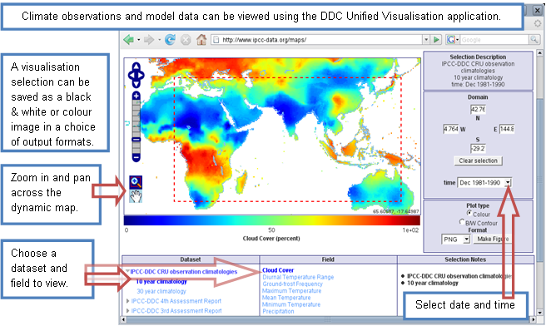
Main Source of Data: IPCC
Typically having a horizontal resolution of between 250 and 600 km

Slide 10
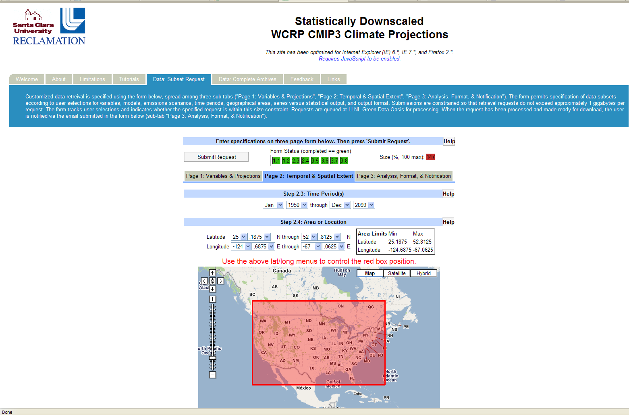
Santa Clara University
Horizontal resolution of 15 by 15 km

Slide 11
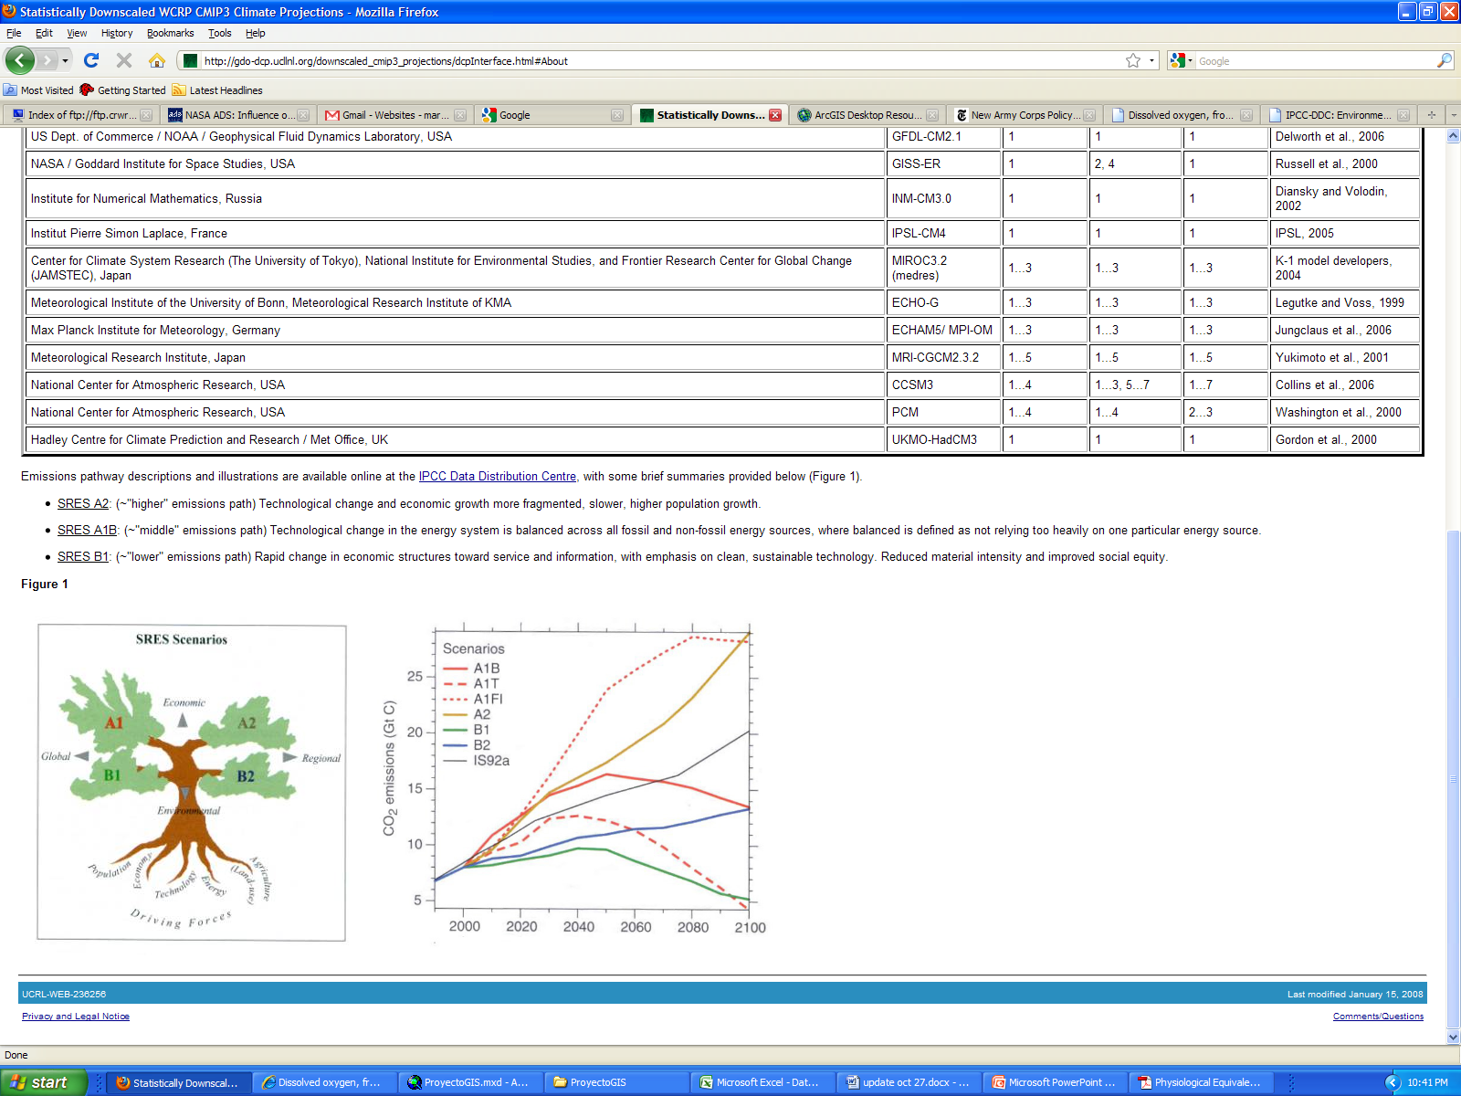
Scenarios
SRES A2: (~"higher" emissions path) Technological change and economic growth more fragmented, slower, higher population growth (In this project the Hadley United Kingdom is used)
http://gdo-dcp.ucllnl.org/downscaled_cmip3_projections/dcpInterface.html#About

Slide 12
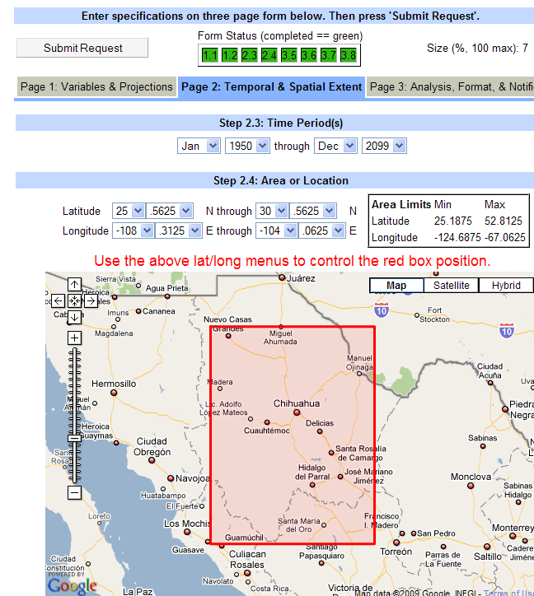
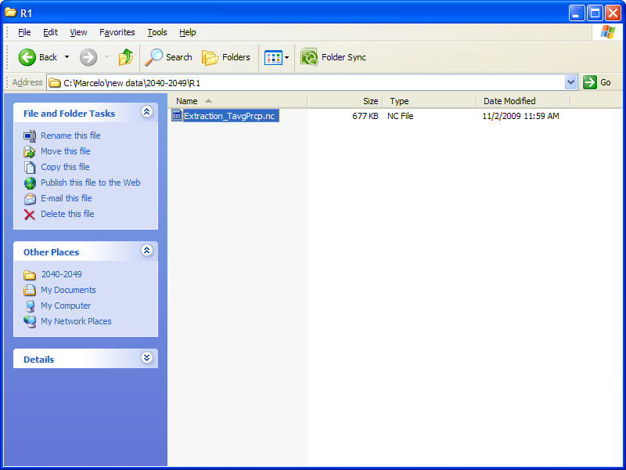
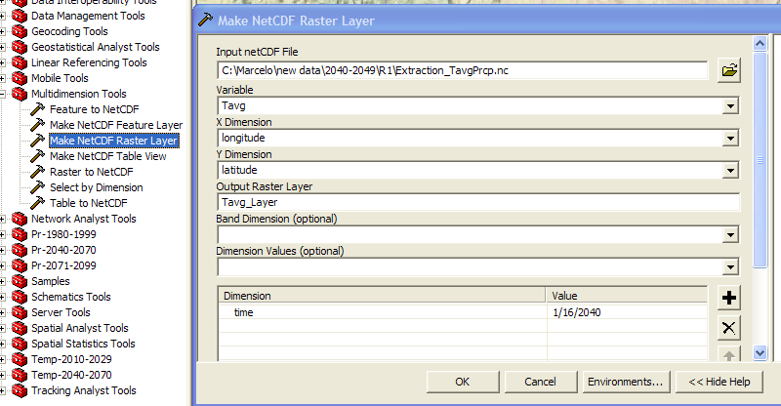
Methodology

Slide 13
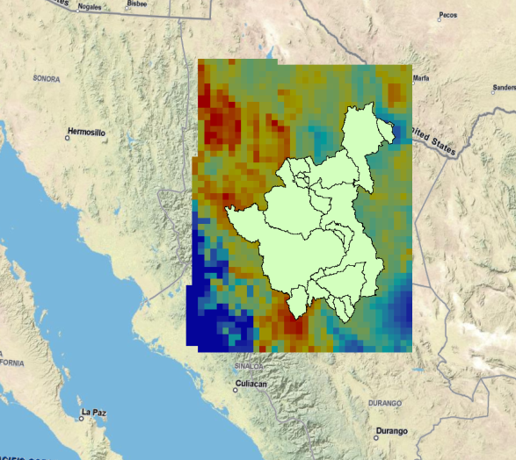
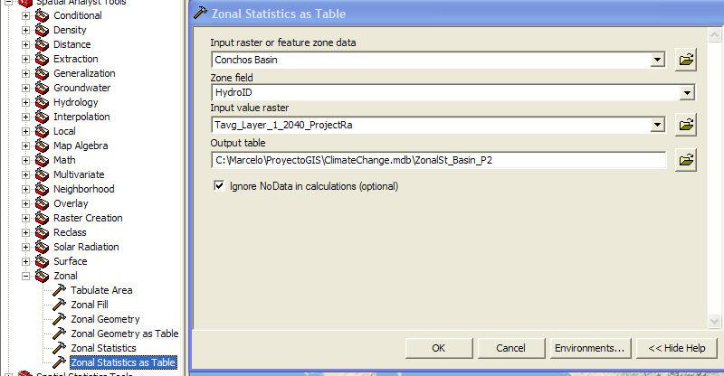
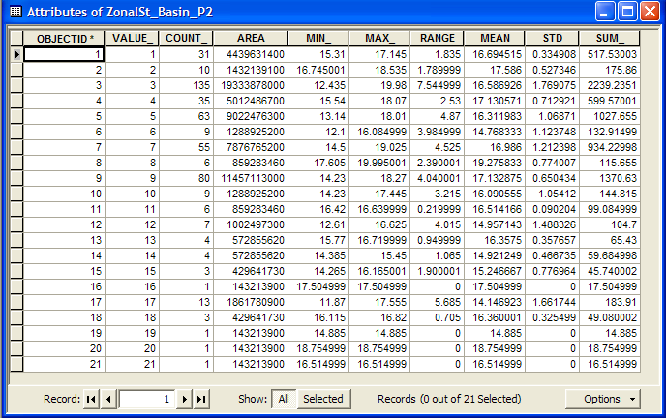
Methodology
5 processes per month in 12x30=360 months. That means 1800 processes.

Slide 14
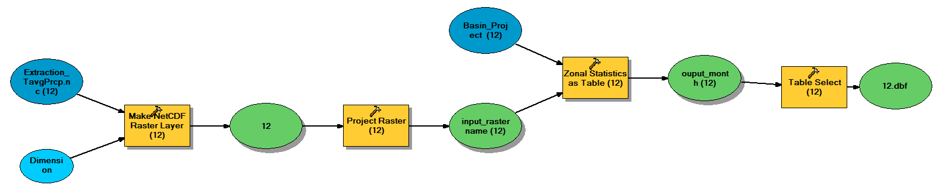
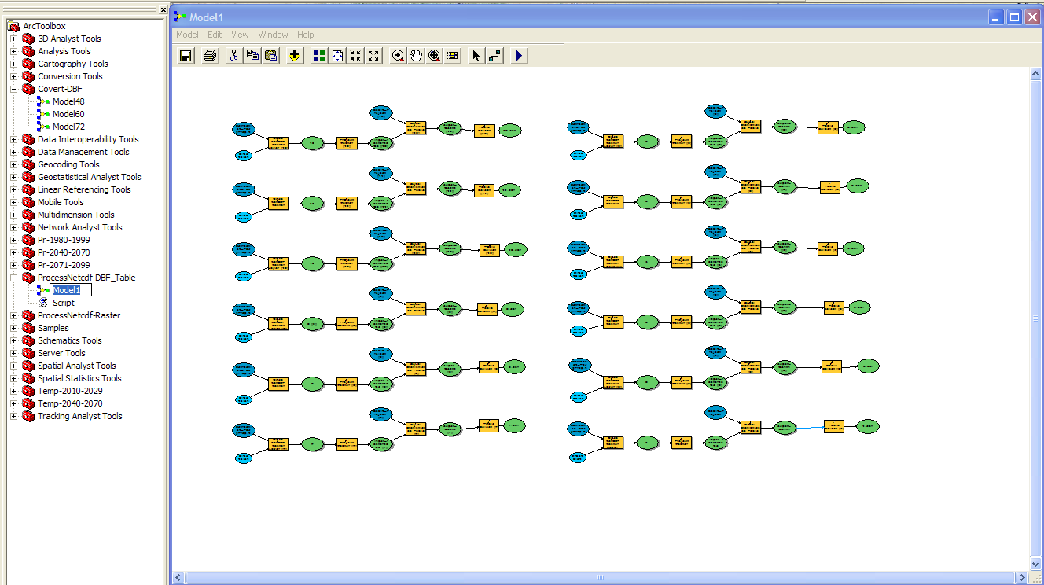
Model builder
Now 30 Processes

Slide 15
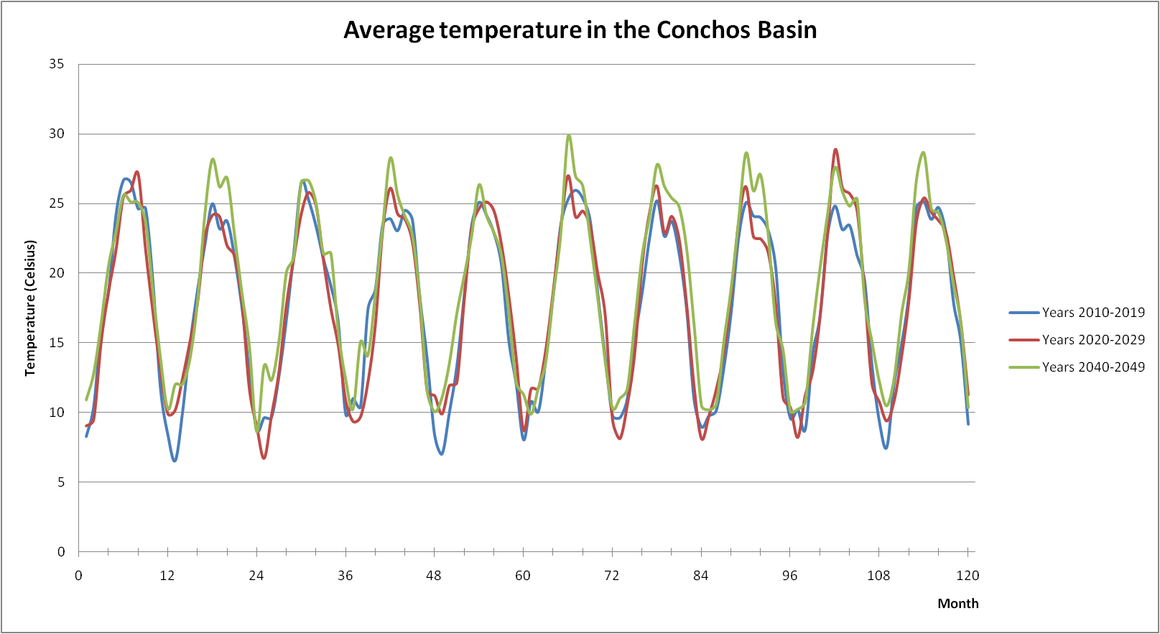
Results

Slide 16
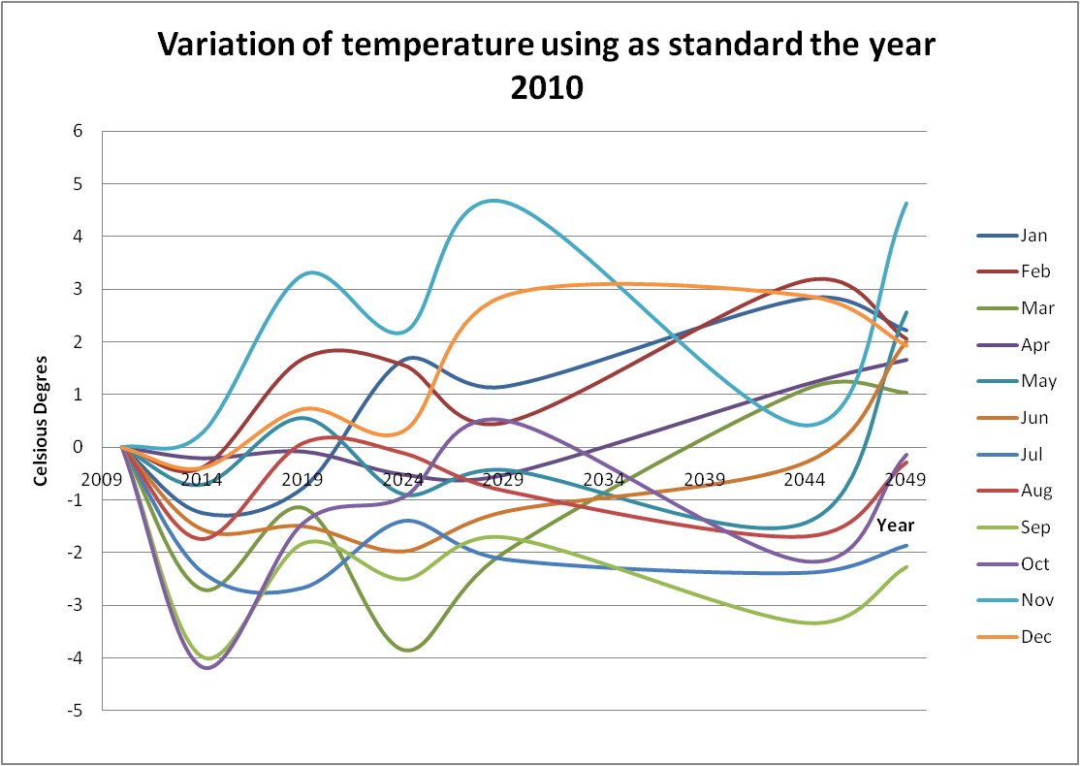
Temporal Variation
The temperature will increase between November and June
The temperature will decrease between July and October.

Slide 17
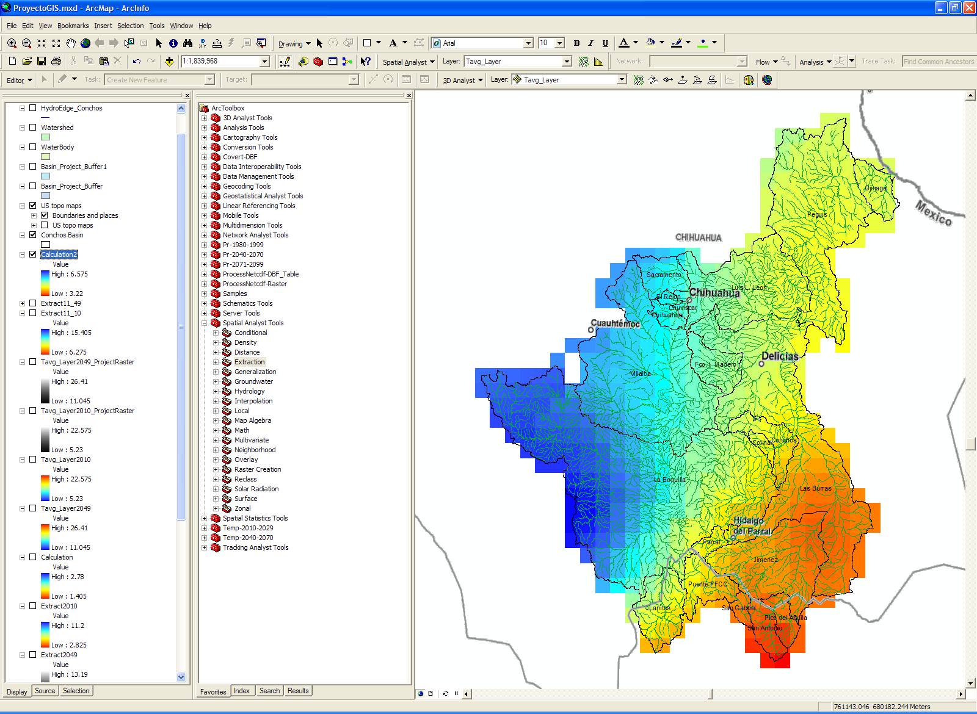
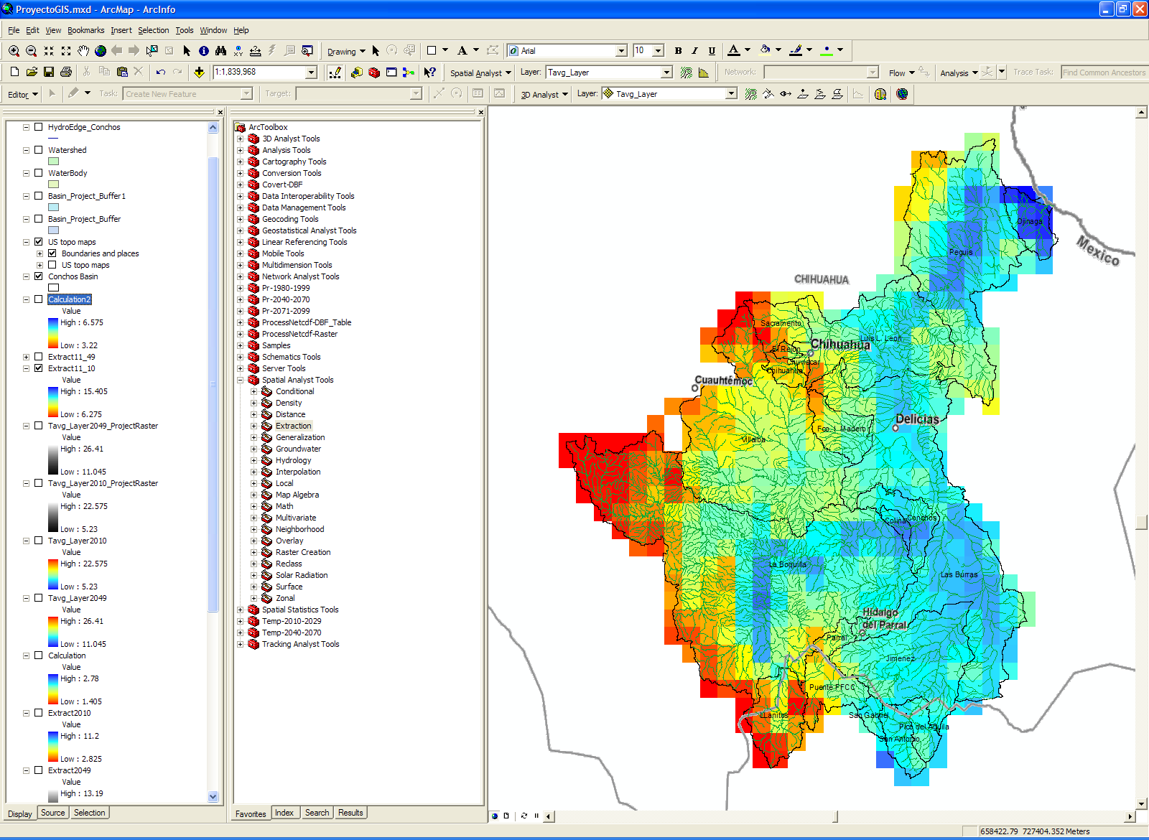
Spatial Variation
Variation of temperature between November 2010 and November 2049
November 2010

Slide 18
Question?

