Slide 1


Applied GIS On Kuwait’s water
GIS in Water Resources
Fall 09
University of Texas Austin
Duaij AlRukaibi

Slide 2
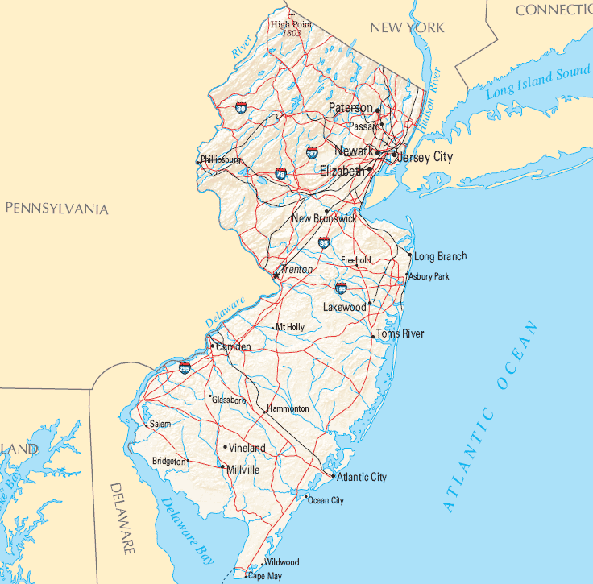

Background:
Kuwait is located in Asia in middle east , between latitudes 28°30' and 30°05' north and longitudes 46°30' and 48°30' east, with total area of 17820 Km².It is slightly smaller than New Jersey.
In Kuwait, one of the GCC countries, natural resources of fresh water are very limited. Kuwait is situated in an arid coastal region characterized by high temperatures, low humidity, sparse precipitation rates, and high evaporation and evapotranspiration rates with no rivers or lakes
Let’s go to KUWAIT now

Slide 3
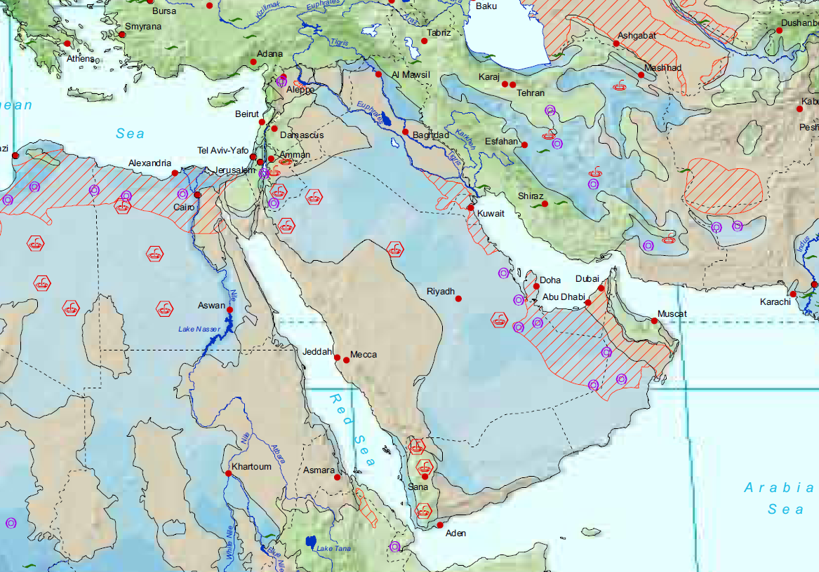
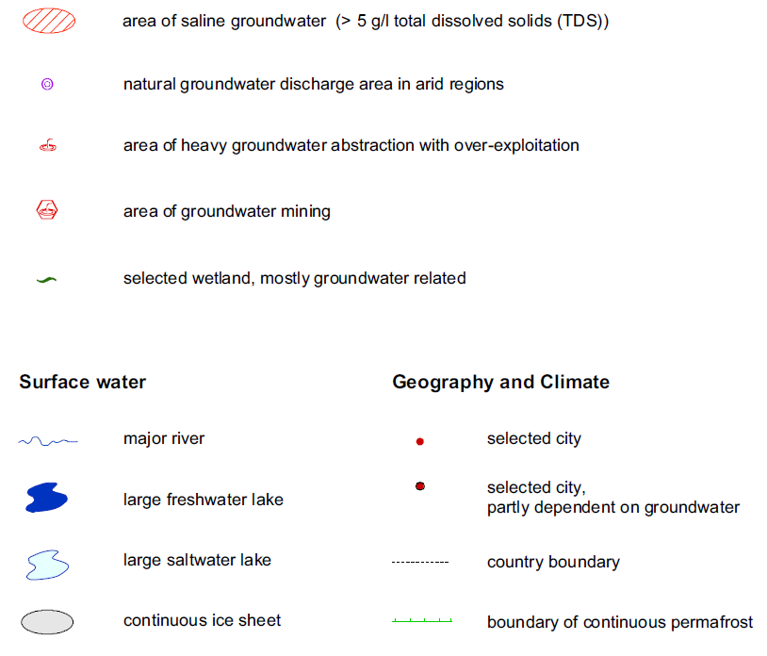
Groundwater Resources
Fresh water
Brackish ‘saline’

Slide 4
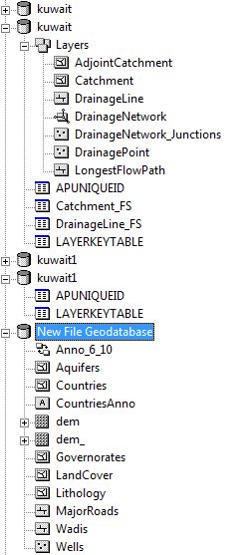
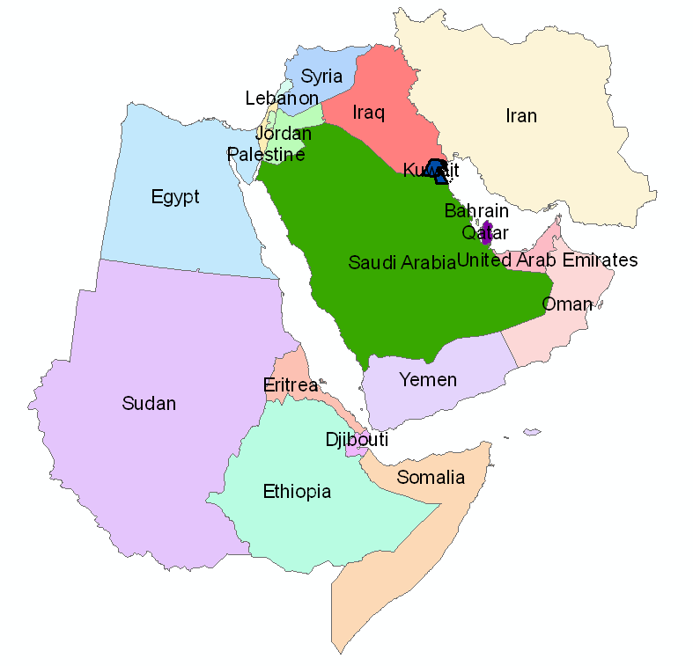
Applied GIS on KUWAIT map

Slide 5
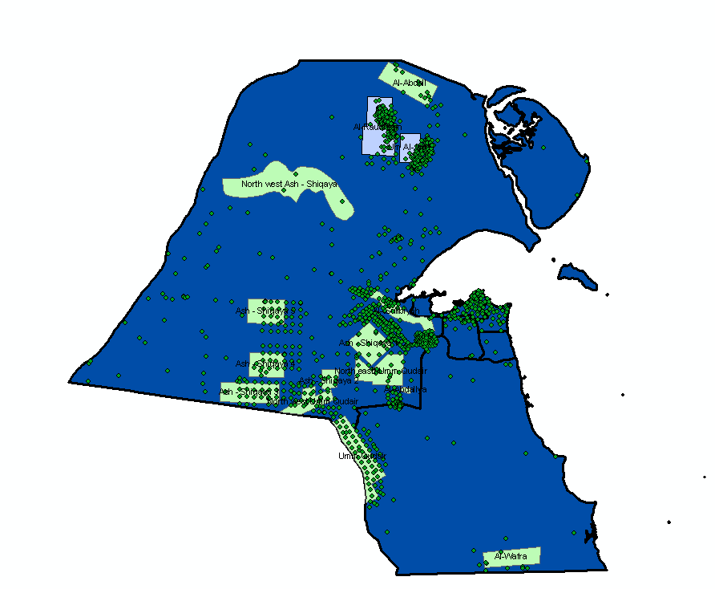
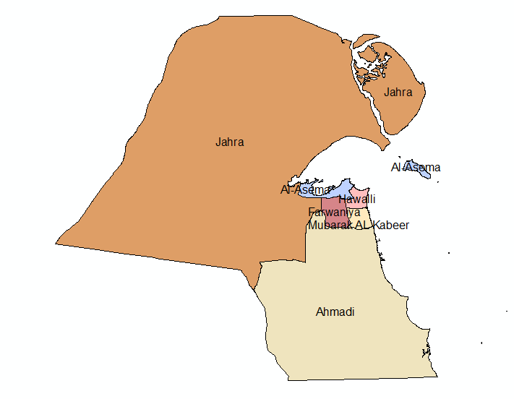
GIS Of Kuwait
map of Kuwait

Slide 6
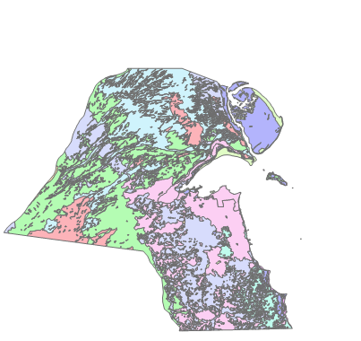
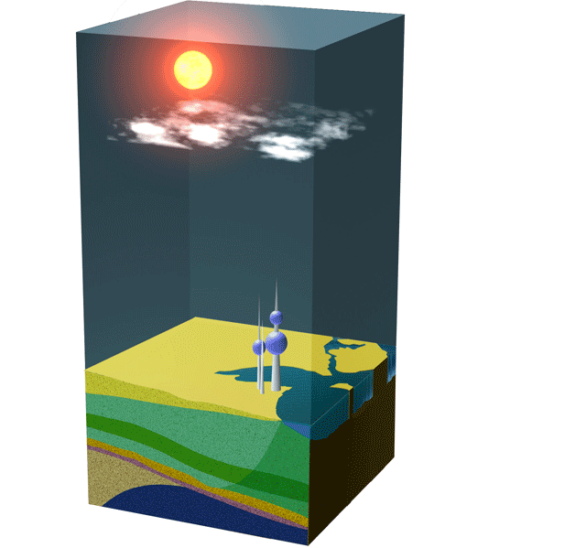
GIS Of Kuwait
geologic layer

Slide 7
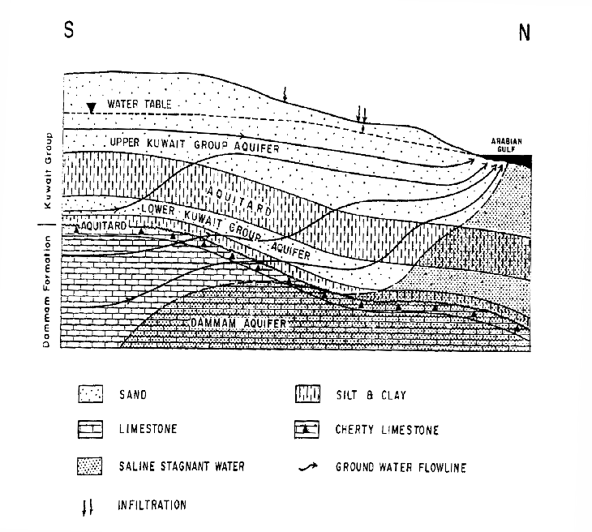
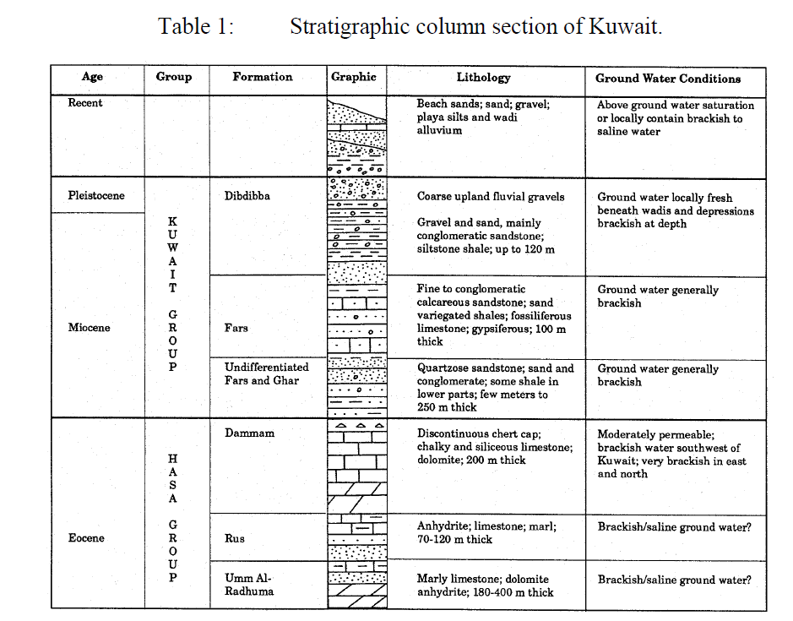
GIS Of Kuwait

Slide 8
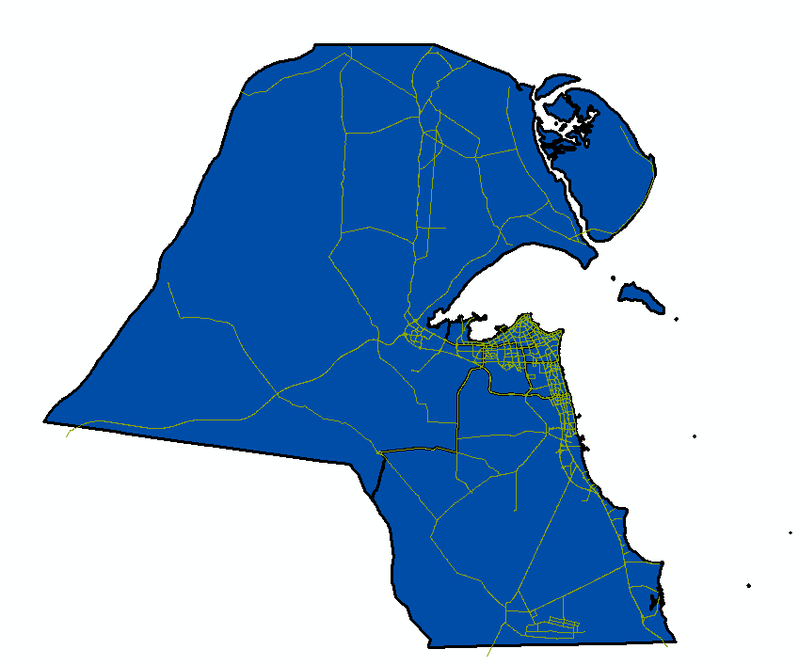
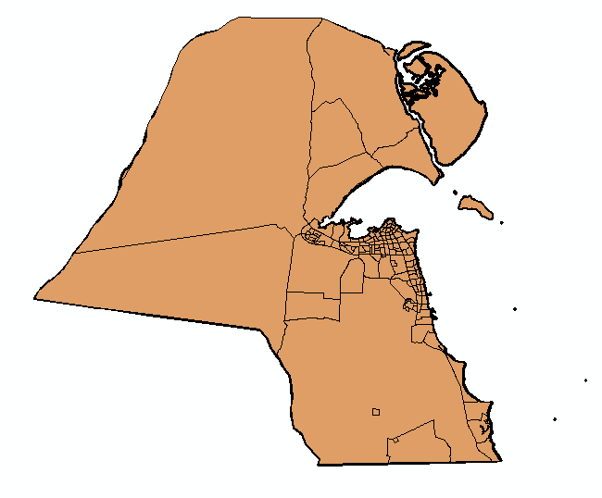
GIS Of Kuwait
Civilization areas
Major roads

Slide 9

Source of map:
Projected Coordinate System: KUDAMS_KTM
Projection: Transverse_Mercator
False Easting: 500000.00000000
False Northing: 0.00000000
Central Meridian: 48.00000000
Scale Factor: 0.99960000
Latitude_Of_Origin: 0.00000000
Linear Unit: Meter
Geographic Coordinate System: GCS_KUDAMS
Datum: D_Kuwait_Utility
Prime Meridian: Greenwich
Angular Unit: Degree

Slide 10
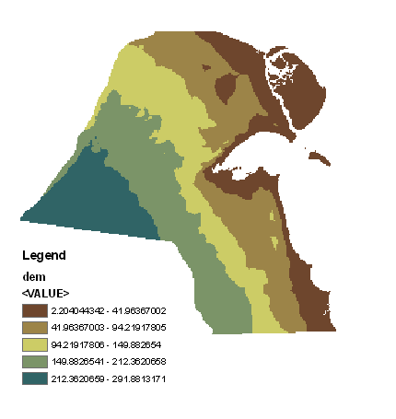
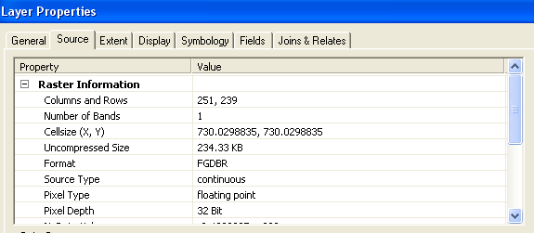
DEM LAYER

Slide 11
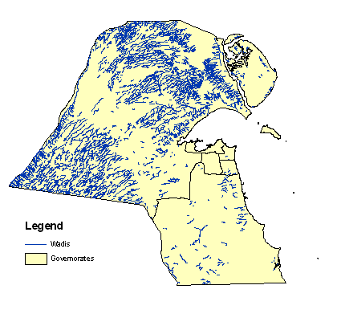
Wadis layer
Wadi : is the Arabic term traditionally referring to a valley; in some cases it may refer to a dry riverbed that contains water only during times of heavy rain

Slide 12
By using Arc Hydro Tools
Fill sinks
Flow Direction
Flow accumulation
Stream Definition
Stream Segmentation
Catchment Grid Delineation
Catchment polygon processing
Drainage line processing
Adjoint catchment processing
Drainage point processing

Slide 13
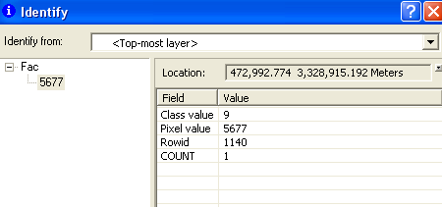
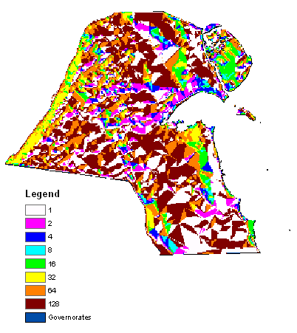
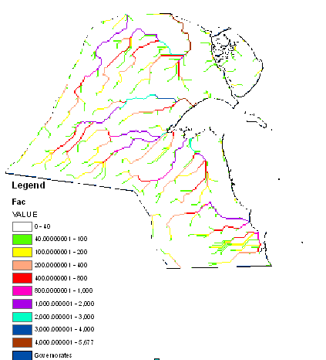
Flow Direction and accumulation

Slide 14
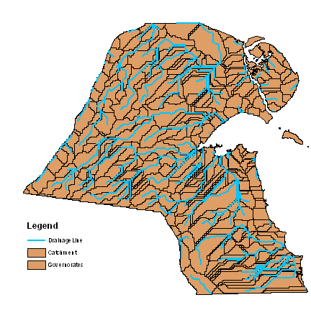
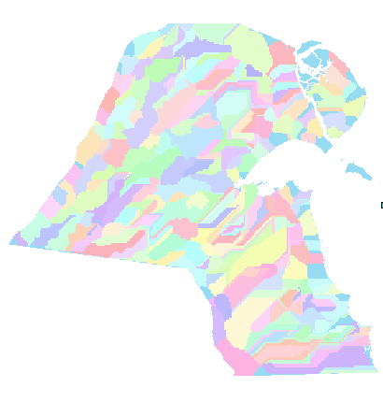
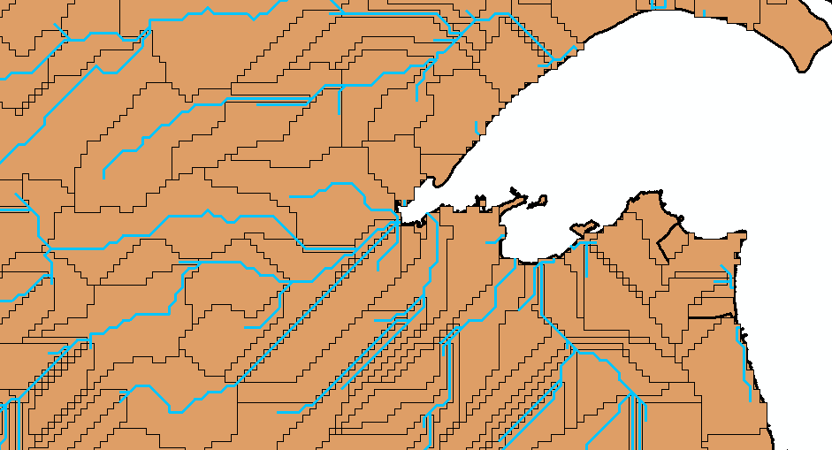
Drainage lines passing through cat.

Slide 15
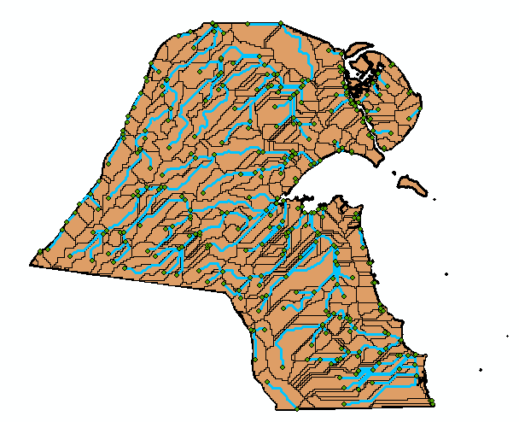
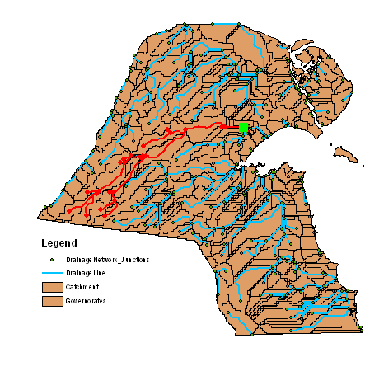
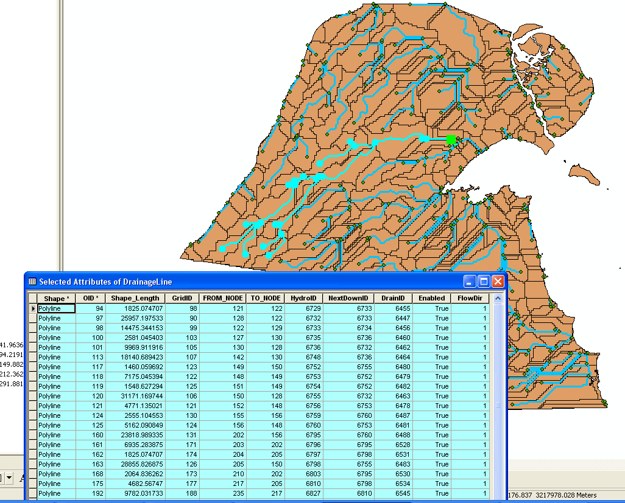
Geometric network

Slide 16
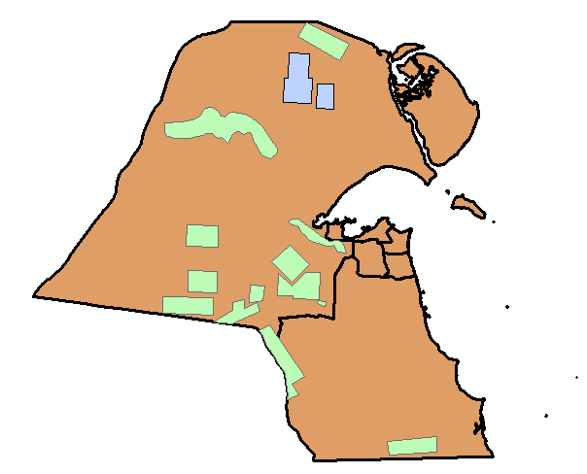
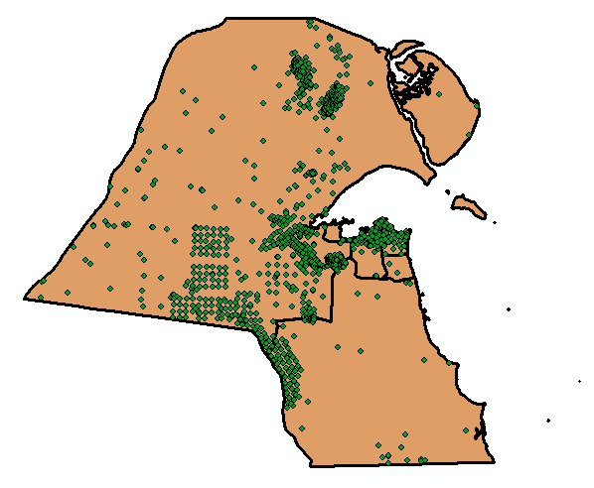
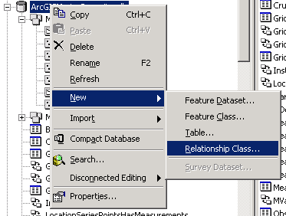
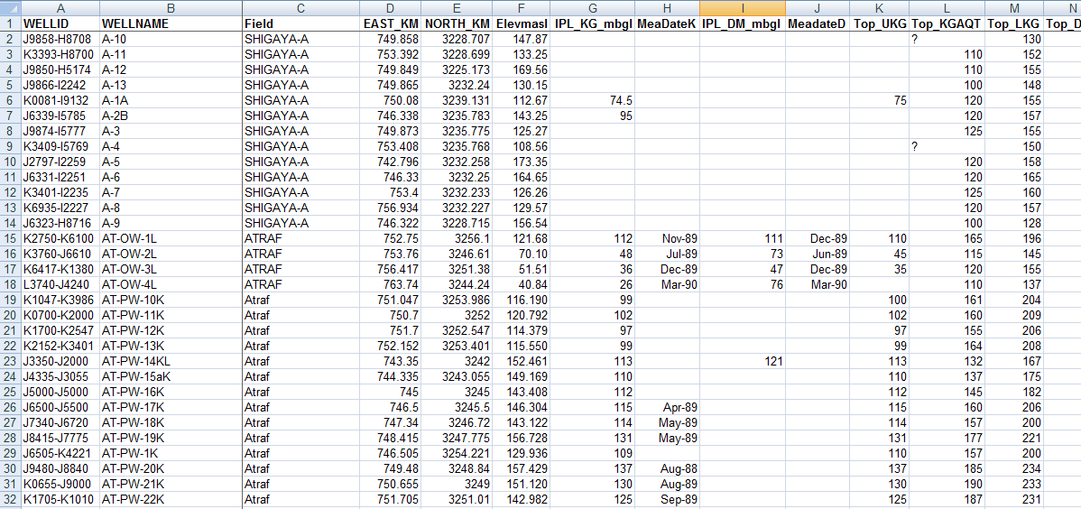
relationship class:

Slide 17
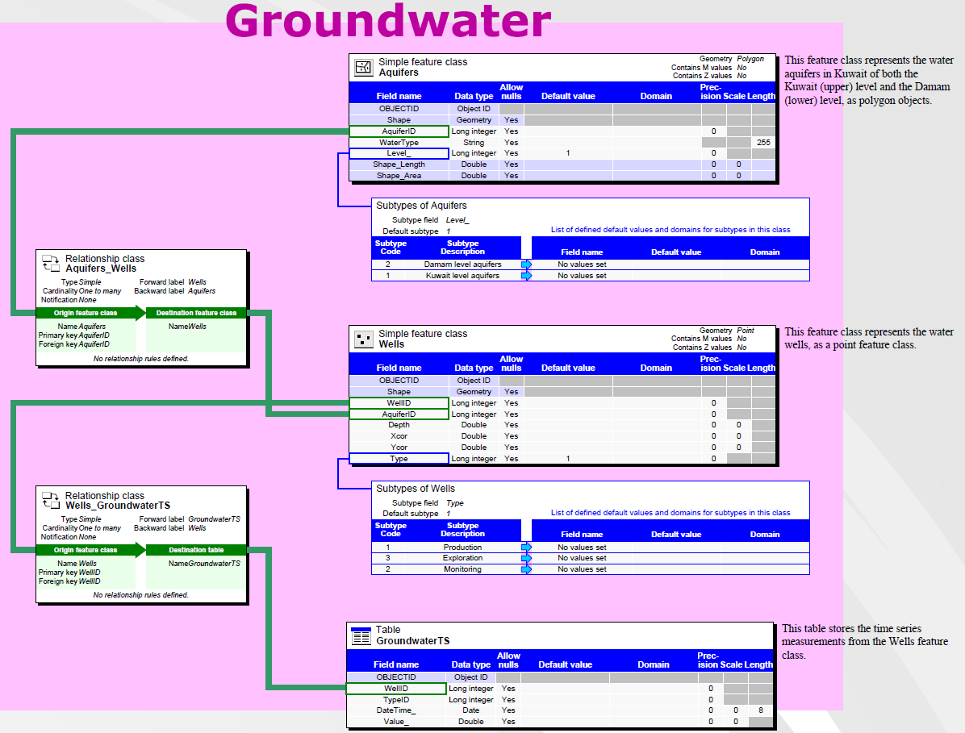
Arc Hydro Of Kuwait

Slide 18
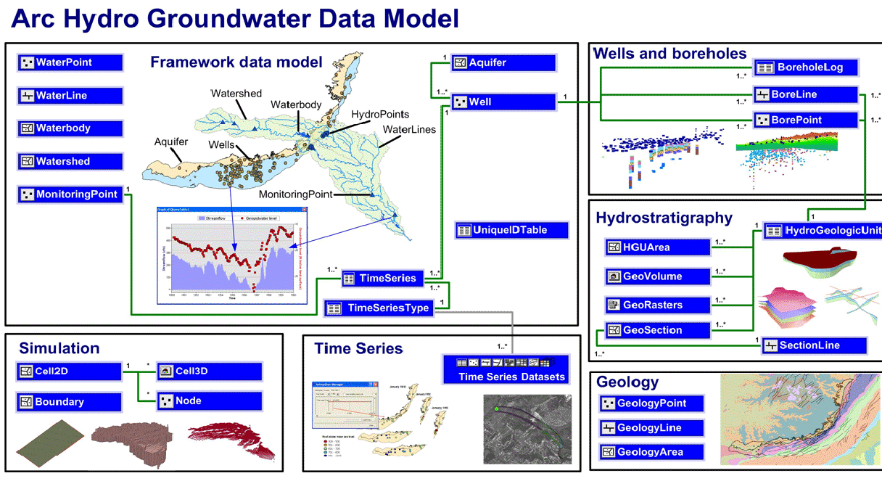
Future work
Add more boreholes log Tables with Time series tables and add data for precipitation in Kuwait
→ then using ARC Hydro groundwater tool to see the layer by 2D and 3D

Slide 19
Future work
Hopefully after end GIS in Water Resources class
Making Arc Hydro Of Kuwait “with helping from Prof. Maidment

Slide 20

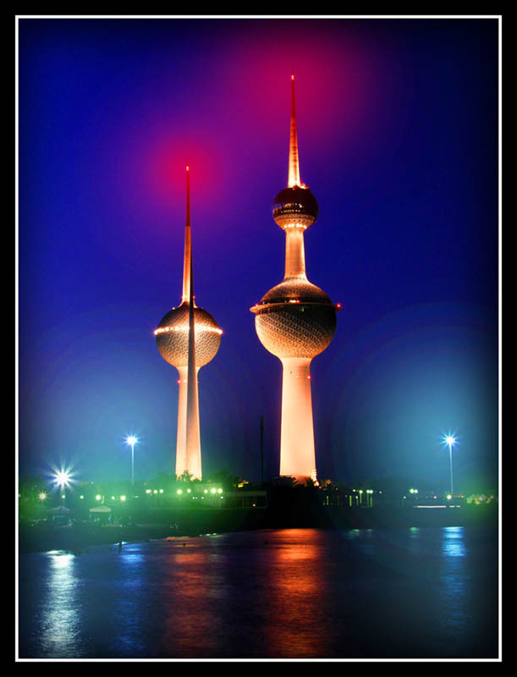
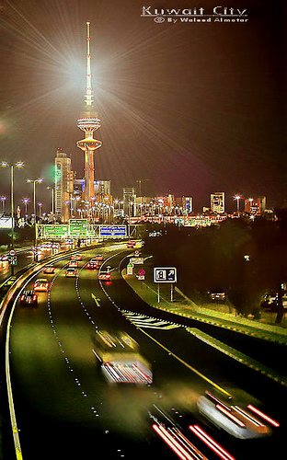
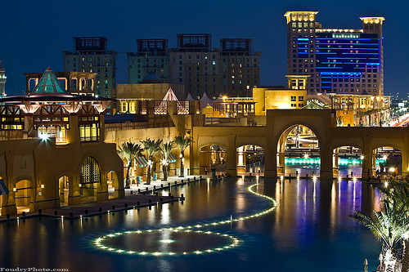
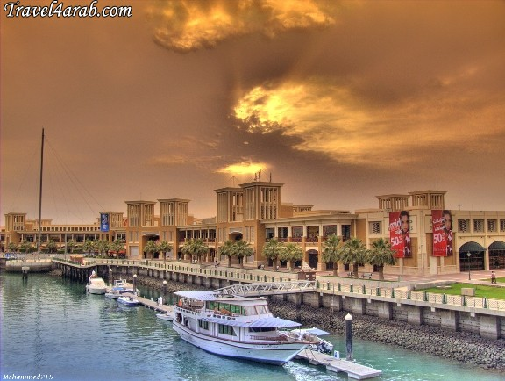
Questions ??????

