Slide 1
Evolution of Texas climate
Richard Casteel
Jackson School of Geosciences
11-24-09

Slide 2
Outline
  Modern day Texas climate
Climate change - varying resolutions
  Geologic indicators
  Soil indicators
  Fossils and isotopes
  Tree ring data
Current research
Notes:
Why is there a need to discuss this? → the data is scattered and there needs to be a summation of it in order for people to gain a clear and concise understanding of past climate. So what I am about to show you is part of a grant I have been working on for the past two semesters. Part of it is coring trees to get a high resolution drought history and part of it is combining all of the known data sources into a single paper to more succinctly describe central Texas climate.

Slide 3
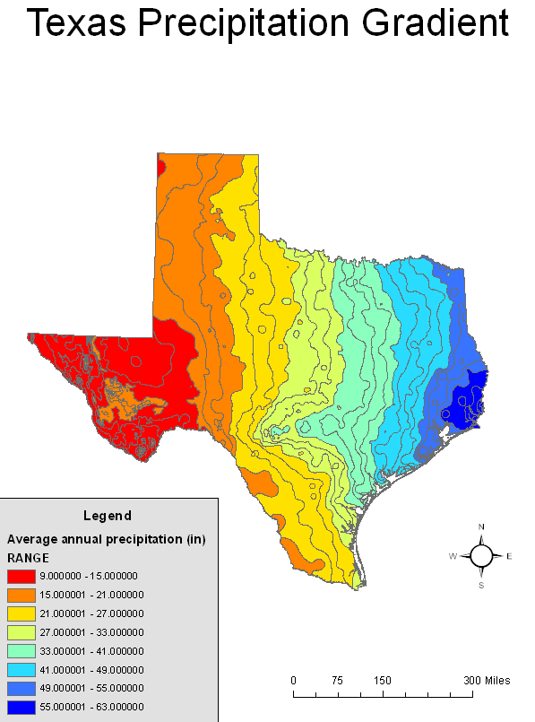
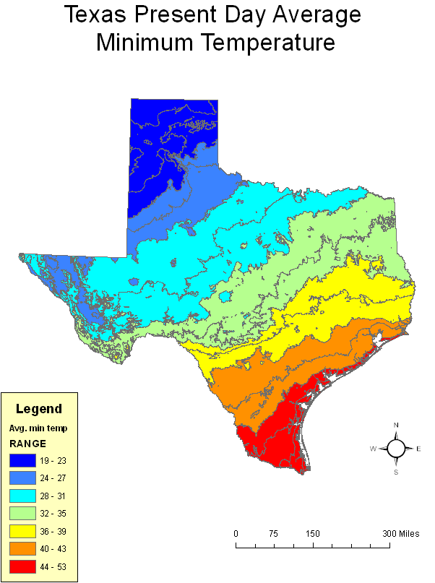
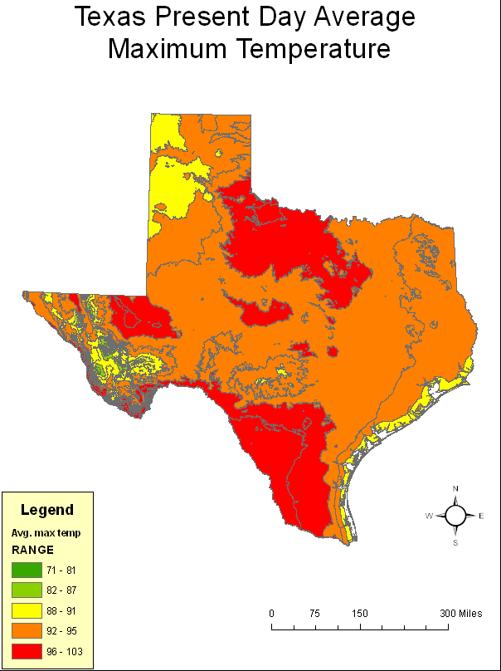
Modern Texas climate
Hot, dry summers
Mild, dry winters
Wet springs/falls
High rate of PET
Hot spot for
climate change?
Notes:
Bullet points for climate details?
One thing you probably have already noticed is that Texas is hot in the summer. These maximum temps usually occur in July and August
But there are also nice, mild winters where we live and it gets colder as you move north. This is most likely due to the polar jet stream in the north and the warm gulf of mexico air in the coastal regions
Another aspect of Texas climate is the precipitation gradient as you move from west to east.
This is also evident in a shift in vegetation and animal life which is important to paleoclimate as fossils can give an indication of what was living in an area at a certain time.
But what we also see are periods of drier times and wetter times.

Slide 4
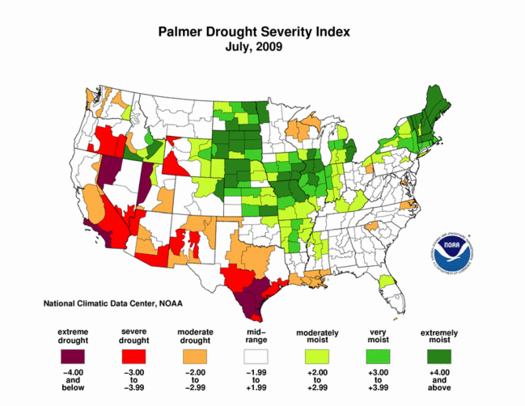
Geologic map of Texas
Notes:
Explain the drought index very simply → it is a determination of soil moisture and thus drought conditions based on temperature and precipitation. It takes into consideration the previous months when configuring the June drought severity.

Slide 5
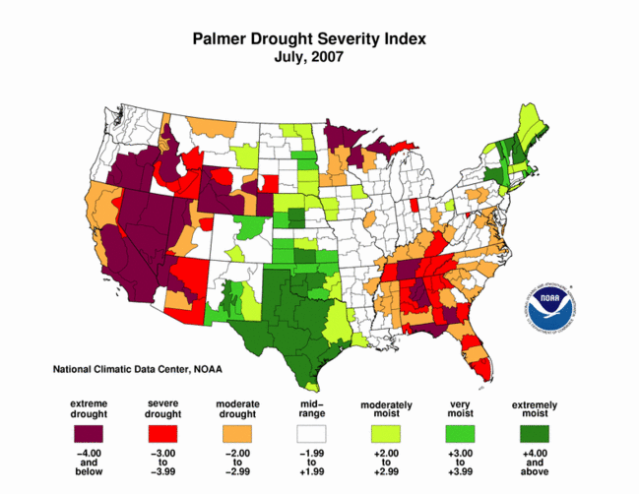
Notes:
So there appears to be some variability
One of the goals of paleoclimate work is to use the modern day variability as an analogue to understand the past. Answer questions such as are there cycles? It can also help determine the mechanisms for climate change. It can also help to improve climate models.
So lets look at some different sources of paleoclimate data and how varying resolutions can answer different questions.
We are going to work towards detecting this high resolution variability but first let’s look at low resolution data.

Slide 6
Geologic Map of Texas
Notes:
The limestone was deposited between 144 to 65 million years ago during the last great marine transgression → which basically translates to a rise in sea level but this does little to tell us about the climate at the time of deposition.

Slide 7
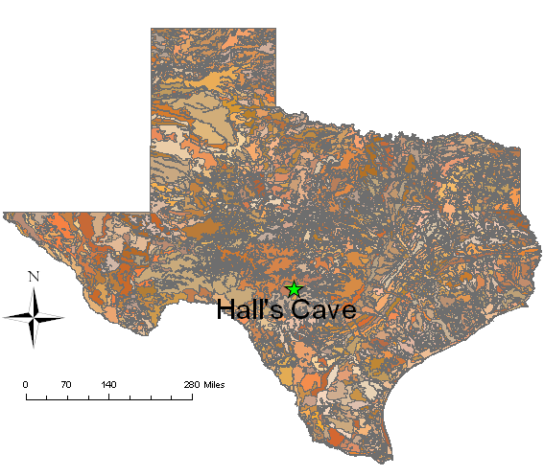
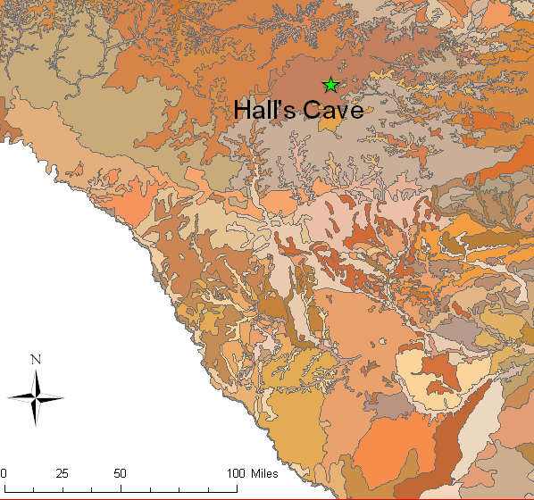
Soil map of Texas
Dominated by:
  Thin, rocky soils
Thicker in past
  Upland soils
  Cave deposits
Notes:
If we look at a modern day soil map of texas you can seethat there are varying soil types from around the state, yet the predominate soil structure is one of discontinuous, thin soils on the Edwards Plateau. So some good questions are why are the soils thin, were they thicker in the past, can we find any paleoclimate proxies to help with these questions?
It is inferred that the soils were thicker in the past as there was a glacial maximum about 20,000 years ago. But increased aridity, seasonality, and intensity of precipitation drove the loss of soil.
If this is the case then…

Slide 8
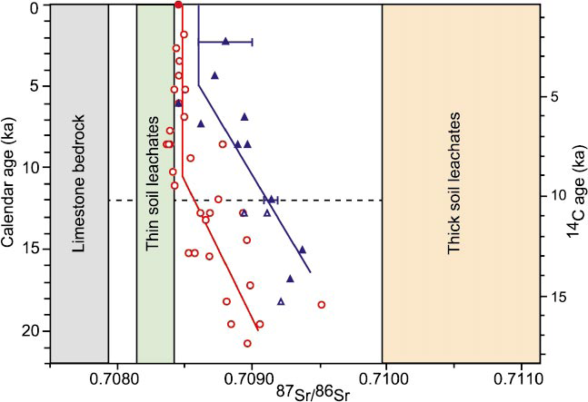
Soil degradation - Sr isotopes
Carbon dated soil deposits Hall’s Cave
Gopher/vole
tooth enamel
  Diet
Hackberry seed
fossils
  Root position
(Cooke et al, 2003)
Notes:
The study was conducted on the Edwards Plateau at Hall’s Cave. The loss of thicker soils coincides with the ending of the LGM. This makes sense as warmer weather can change the abundance of plant life and an increase in extreme weather events can aid in erosion of soils. As you can see the loss of soil appears to be fairly linear. Yet, this data is fairly low resolution and does not indicate any oscillations in climate.
This is still fairly low resolution data and does not indicate very specific climate data. It is good, however, in that it highlights the change from cooler, wetter conditions to dry, warmer conditions. Now I am going to show you higher resolution data taken from isotopes, fossils, and magnetic susceptibility
It looks like climate is changing but can we get higher resolution than this?

Slide 9
Paleoclimate inferred from fossils and isotopes
Last glacial maximum
Notes:
So what I did was compile many papers into a more useable format and this is a depiction of the climate changes throughout central Texas.
-what is the number of sites?
-what is the number of papers?
I am still working on this data and would like a more quantifiable way to combine the many sources of data into an easily readable format.
The ages are constrained by carbon 14 dating.
The general trend of the data is an increase in temperatures and a decrease in precipitation. There are also some higher resolution oscillations in temperature as the data becomes more resolute. Due to brevity I will focus on three distinct times. The first is…

Slide 10
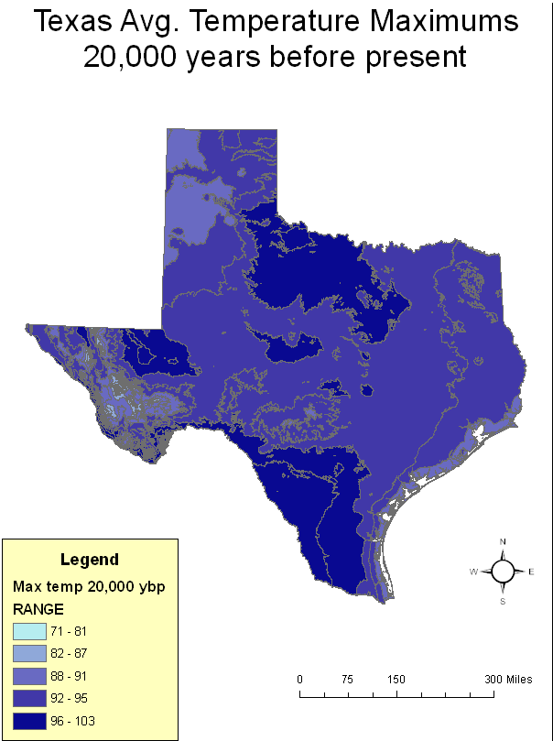
24-14 ka.
Cooler and wetter
  Faunal evidence
  Pollen data
  Alluvium δ ¹³C values
  of -21‰
    C3 plant abundance
62 - 72
73 - 78
79 - 82
83 - 86
87 - 94
Notes:
During this time 24-14 thousand years ago it was cooler by an average of up to 5 degrees in the summer as depicted in this GIS map. The faunal evidence includes….
Pollen data indicates…

Slide 11
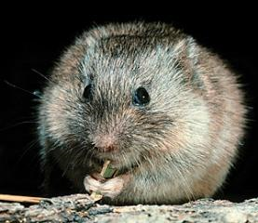
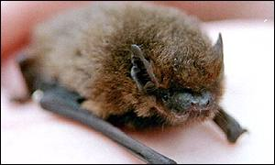
6-2 ka.
Warm/
dry period
Notes:
This is a time period when we see the disappearance of the pipistrelle bat and the woodland vole; absence or minimum of wet weather shrew and the abundance of a dry weather shrew; Systematic variations in species across Texas suggest that the west to east precipitation gradient similar to modern conditions was present at this time;
This is the warmest and driest of the Holocene which is the last 10,000 years before present
Not many people live to be 1000 years anymore so we need proxies that can help us predict climate on a human lifetime scale as this can be important for water planning and resources needed to sustain human life and keep a reasonable standard of living for populations in water stressed areas. So therefore we turn to a very high resolution proxy → tree rings

Slide 12
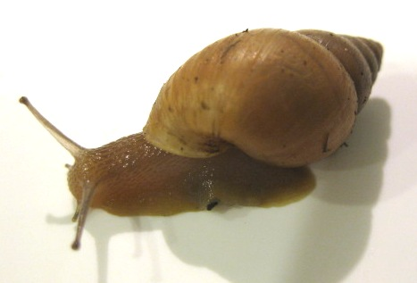
6-2 ka.
δ ¹³C values
  Snail shells (Goodfriend and Ellis, 2000)
  Alluvium and soil (Nordt et al, 1994)
  More positive values =
  higher abundance C4 plants
Notes:
Know details.
Note that the layers are dated using carbon 14 methods.
It is real informative to have climate proxies that vary on thousand to hundred year scales but higher resolution data would be preferable. Thus we turn to tree rings.

Slide 13
1698-1980
Post oak chronology
Annual resolution
Calibrated with
modern record
(Stahle and Cleaveland, 1998)

Slide 14
June PDSI derived from tree rings
Notes:
One thing to notice are the oscillations between wet periods and dry periods. Of most concern are the dry periods and there is a trend for prolonged periods of drought to occur on a 90 to 100 cycle; at least within the past 300+ years.

Slide 15
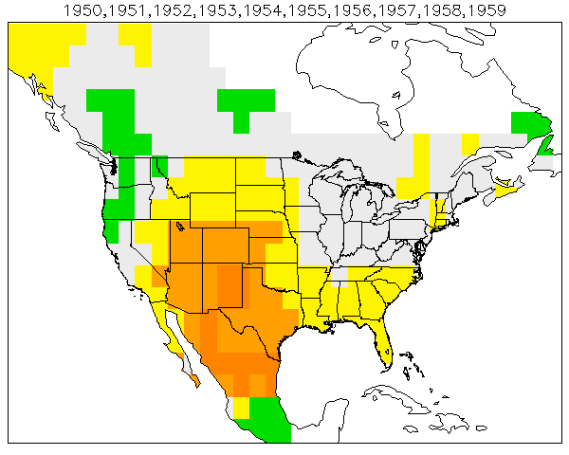

Drought of the 1950s
http://www.ncdc.noaa.gov/paleo/pdsidata.html

Slide 16
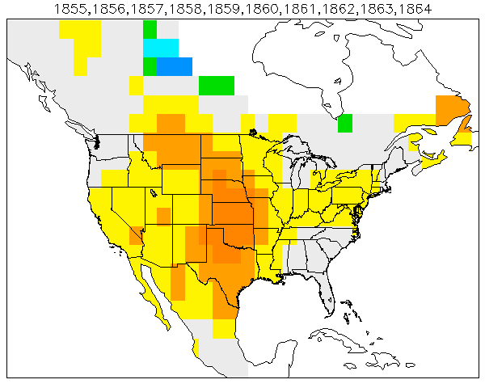
Drought of the late 1850s-1860s
http://www.ncdc.noaa.gov/paleo/pdsidata.html

Slide 17
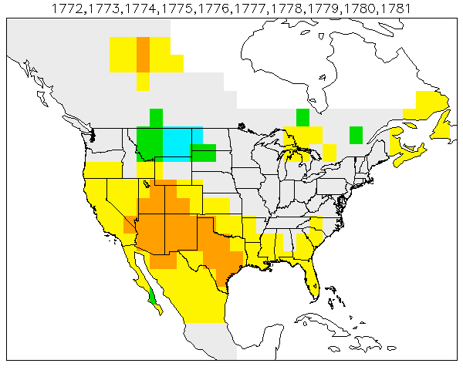
Drought of the 1770s
http://www.ncdc.noaa.gov/paleo/pdsidata.html
Notes:
Well, are there longer cycles, are there more severe droughts that we should be concerned with?

Slide 18
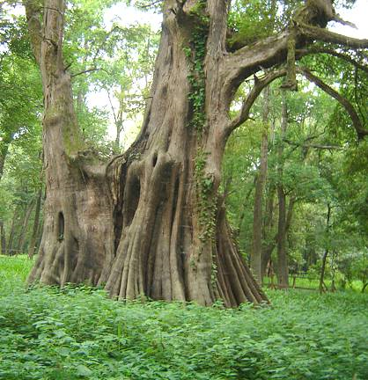
Current research
Extend the high resolution climate record
  Past drought for water
  planning
  Bald cypress trees
  Preliminary results
  http://www.news8austin.com/content/your_news/default.asp?ArID=255153

Slide 19
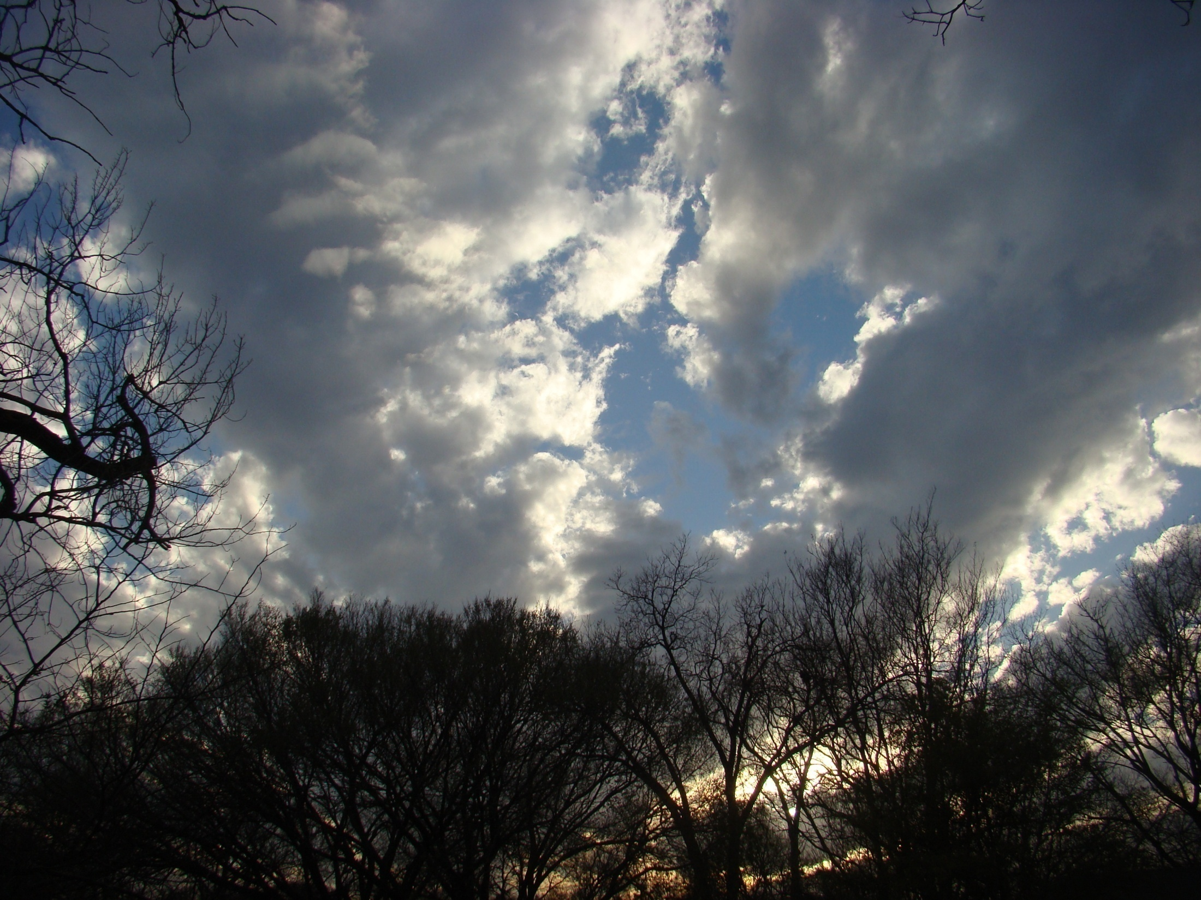
QUESTIONS?

