Slide 1
Vulnerability map of the Edwards Aquifer
Rami Harfouch
November 2009, Austin

Slide 2
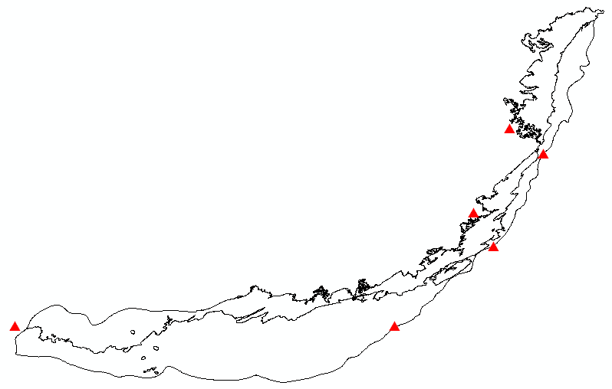
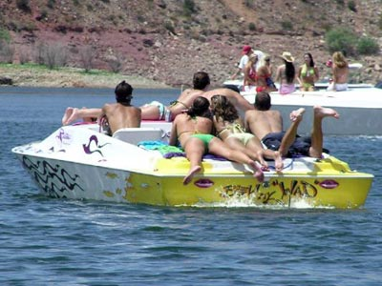
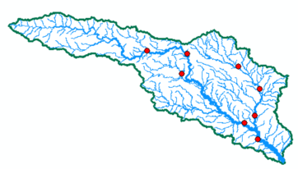
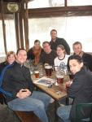
The Edwards Aquifer
Lake Travis
Gauging station at Blanco River at Wimberley
Alamo Village
Hugo Boss Outlet in San Marcos
Crown and Anchor

Slide 3
Kyle Seale Parkway in northwest Bexar county in 2008

Slide 4
D R A S T I C
Depth of Water
Conductivity of the Aquifer
Soil
Topography
Aquifer Media
Recharge of the Aquifer
Vadose Zone
V = D . λ_{D} + R . λ_{R} + A . λ_{A} + S . λ_{S} + T . λ_{T} + I . λ_{I} + C . λ_{c}
D R A S T I C
λ : 5 4 3 2 1 5 3

Slide 5
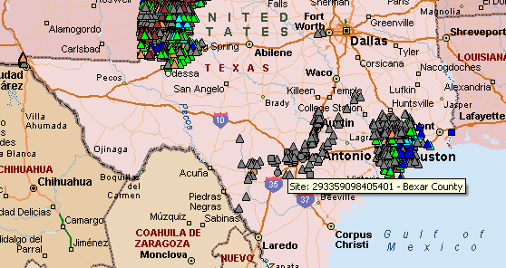
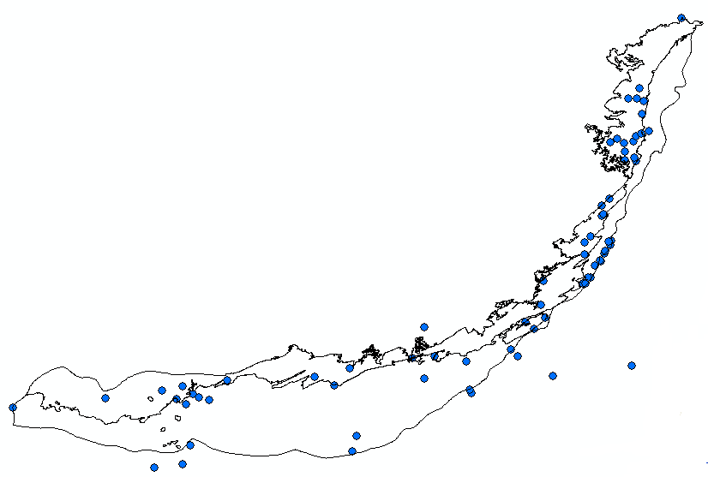
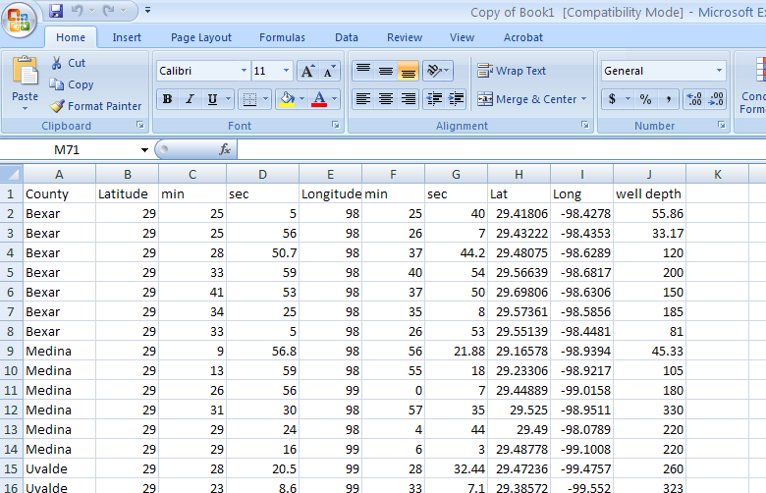
Depth of Water
USGS Wells Data

Slide 6
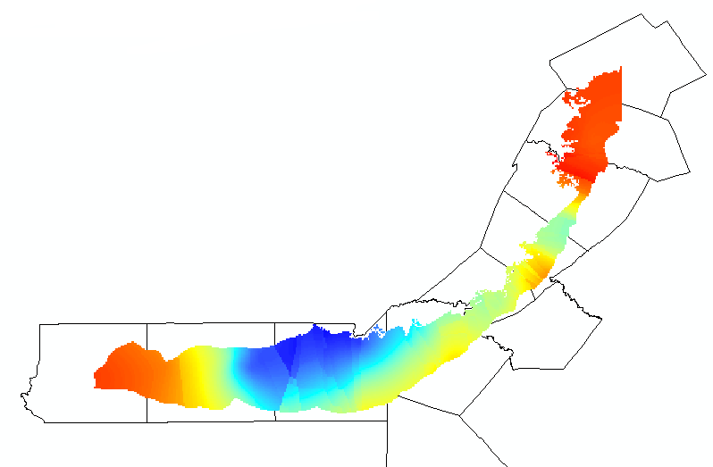
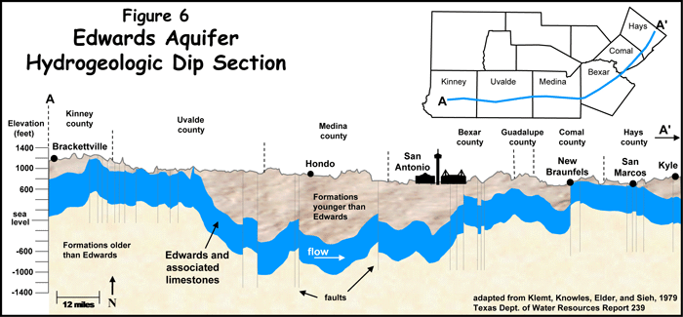
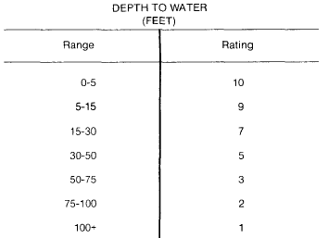
Depth of Water (m)
High : 70
Low : 12
Drastic rating
1
2
3
5

Slide 7
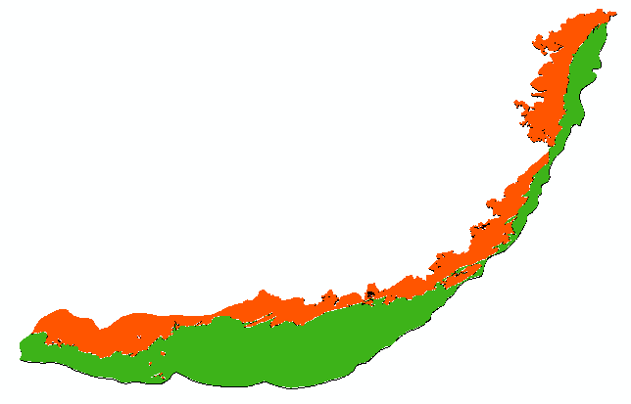
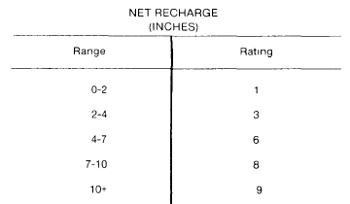
Recharge of the Aquifer
TWDB data
3 Recharge zones: Outcrop (2 in/yr), downdip (< 2in/yr), holes (>10 in/yr)
Drastic Rating
1
3
9

Slide 8
Aquifer Type
Assuming that the Edwards is exclusively a limestone aquifer
Drastic rating
8

Slide 9
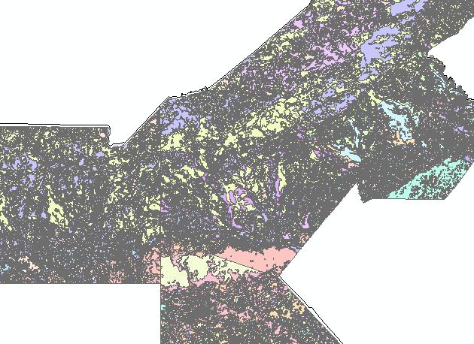
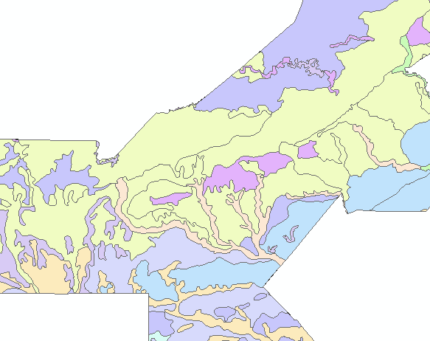
Soil Type
STATSGO
SSURGO
Set of spatial and tabular data linked through a dynamic database

Slide 10
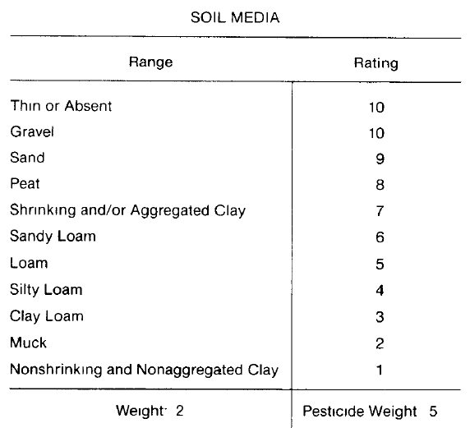
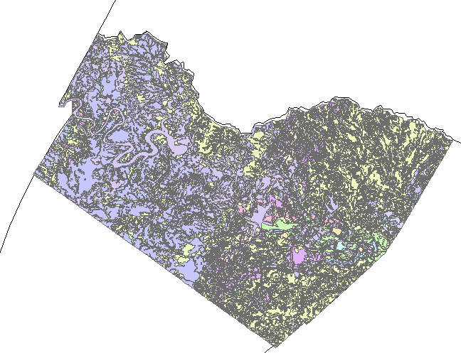
Soil Type
TRAVIS COUNTY
Bedrock
SOIL TYPE
Clay
(Aller et al.)
Clay loam
Fine sand
Fine sandy loam
Loam
Loamy fine sand
Loamy sand
Sandy clay
Sandy loam
Silty clay
Silty clay loam
Silty loam
Very fine sandy loam

Slide 11
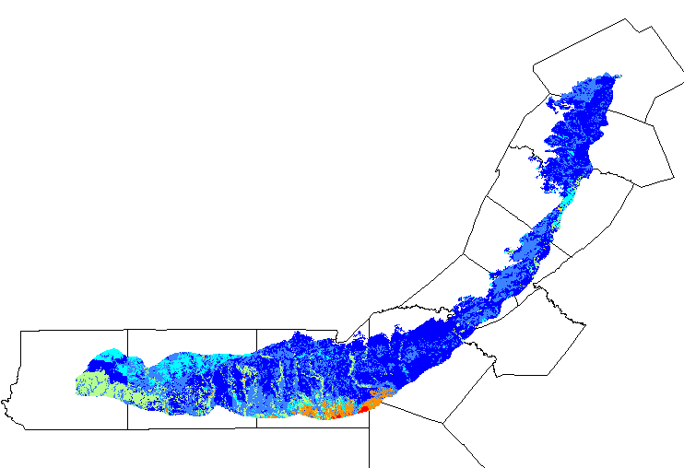
Soil Type
DRASTIC rating
1
3
4
5
6
7
9

Slide 12
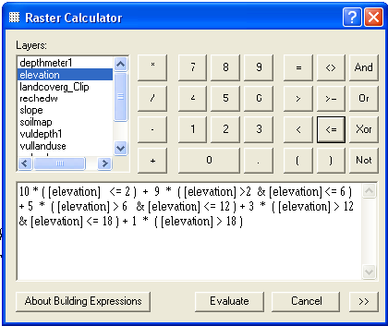
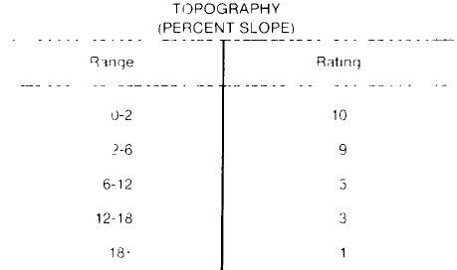
Topography/Slope
NED → Flow direction (% drop) → Slope map

Slide 13
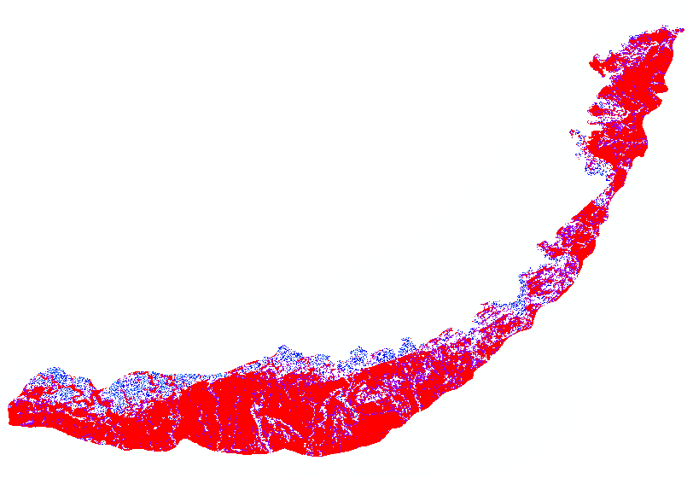
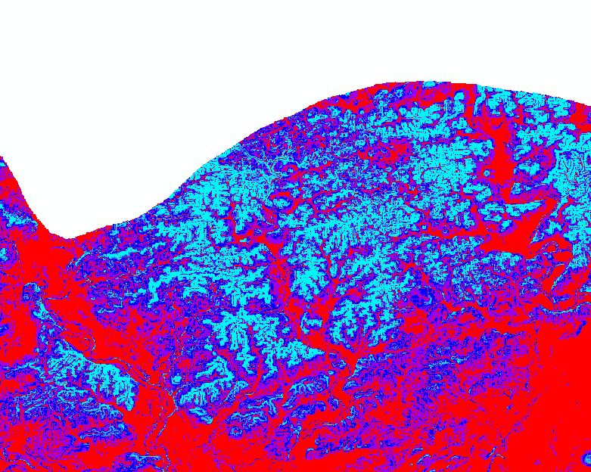
Topography/Slope
DRASTIC rating
1
3
5
9
10

Slide 14
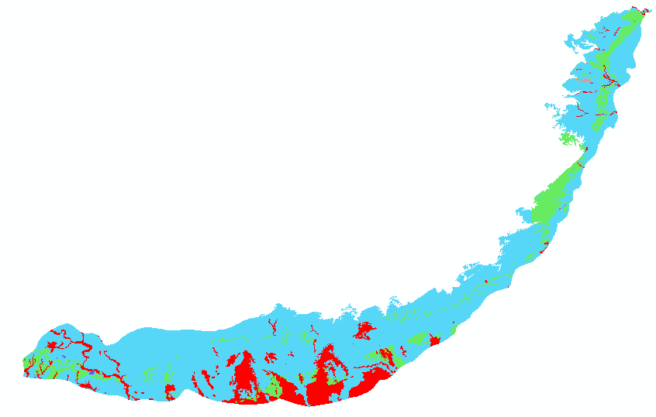
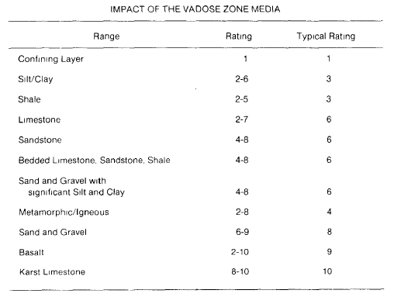
Vadose Zone
Vadose Zone = Geologic Map
DRASTIC rating
1
3
4
6
8

Slide 15
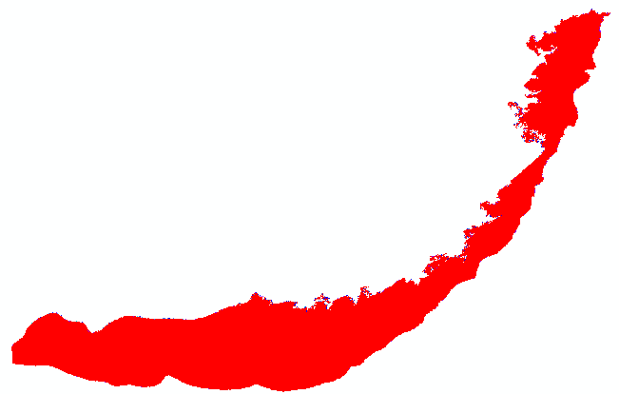
Conductivity of the Aquifer
Since we assumed that Limestone is the only aquifer media
K >> 25 m/day
Drastic Rating
10

Slide 16
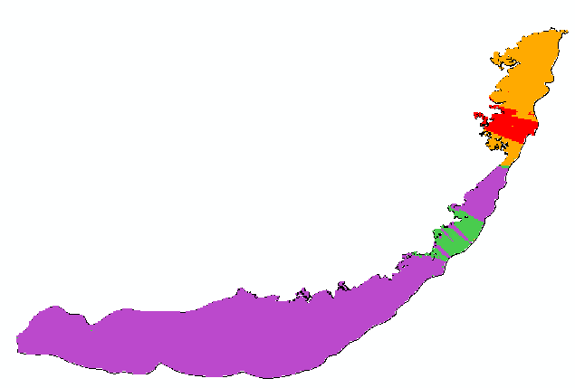
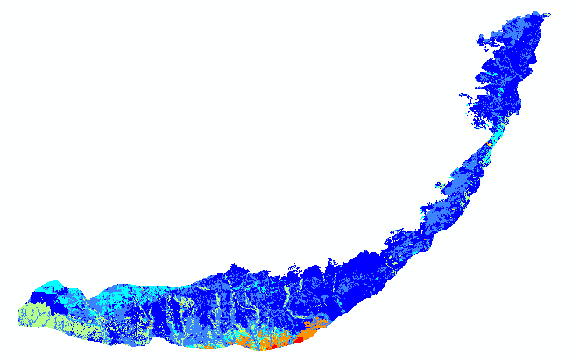
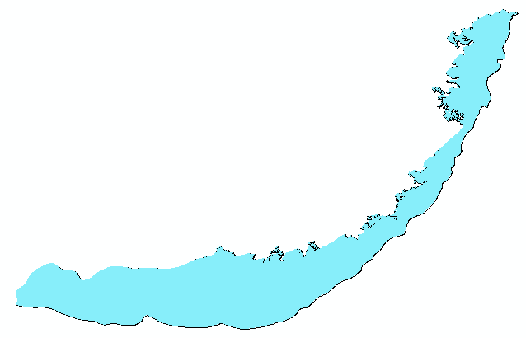
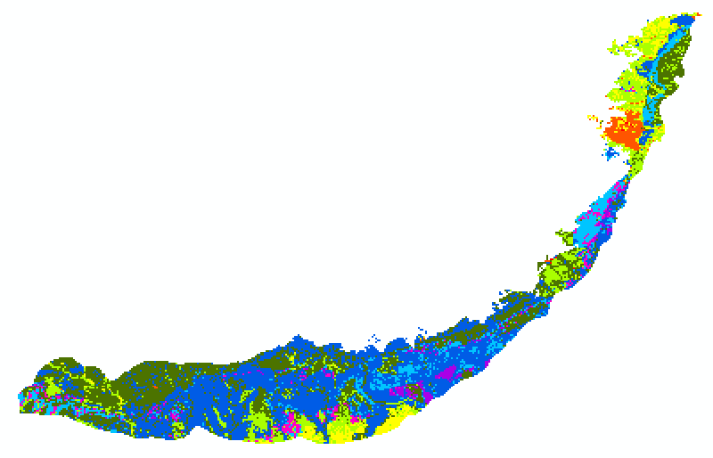
Depth of Water
Recharge
Soil
Aquifer Media
Vadose Zone
Conductivity
Topography
Vulnerability map of the Edwards Aquifer

Slide 17
Vulnerability map of the Edwards Aquifer Aquifer
(least vulnerable aquifers) 65 < DRASTIC INDEX < 225 ( most vulnerable)
DRASTIC INDEX
84 - 90
90 - 978
97 - 104
104 – 111
111 - 118
118 - 125
125 - 132
132 - 139
139 - 146

Slide 18
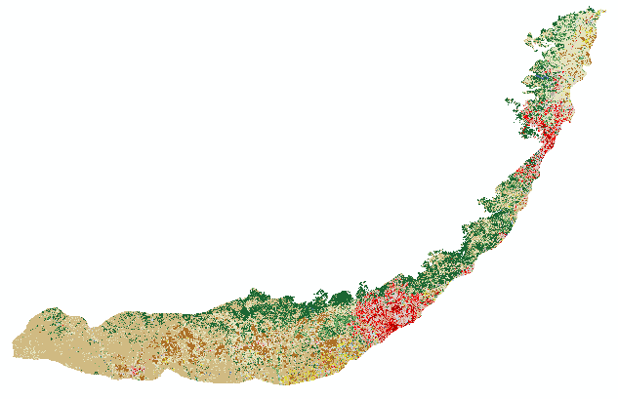
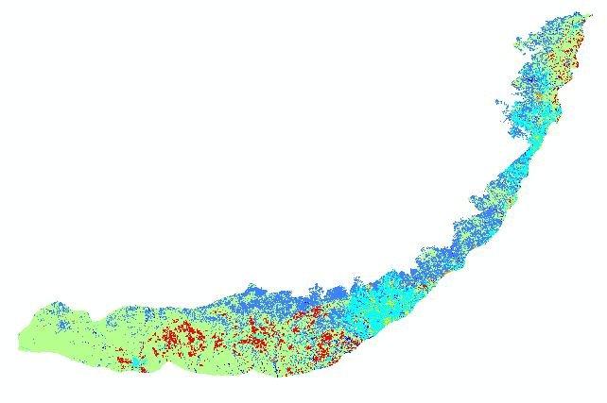
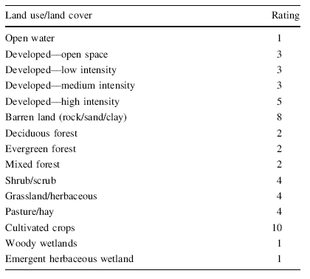
Land use
Land Use/ Land Cover
Barren Land
Cultivated Crops
Deciduous Forest
Developed, High Intensity
Developed, Low Intensity
Developed, Medium Intensity
Developed, Open Space
Emergent Herbaceuous Wetlands
Evergreen Forest
Hay/Pasture
Herbaceuous
Mixed Forest
Open Water
Shrub/Scrub
Woody Wetlands
DRASTIC rating
1
2
3
4
5
8
10
(Gomezdelcampo, 2007)

Slide 19
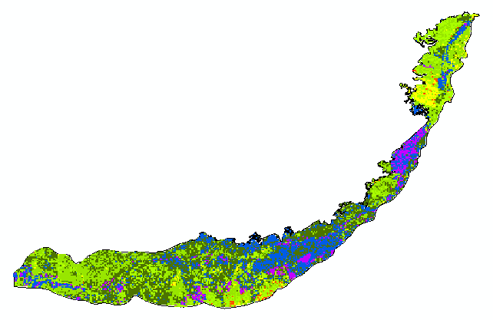
Vulnerability map + Land use = Aquifer pollution risk map
Risk Index
92 - 100
100- 108
108 - 116
1168 - 124
124 - 133
133 - 141
141 - 149
149 - 157
157 - 166

Slide 20
75-80% of the Edwards recharge water comes from the rivers in the outcrop region!!
Availability of the DRASTIC raw data online…for the USA
Possibility to build models and automate the procedures

Slide 21
Questions?

