Slide 1
Landscape Restoration Tool
Using ArcMap
Chris Kelley
CE 394K Term Project, Fall 2009

Slide 2
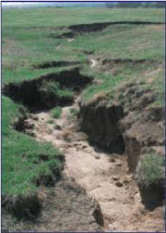
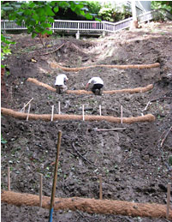
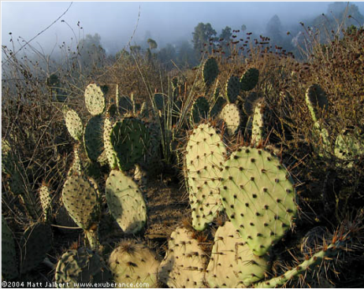
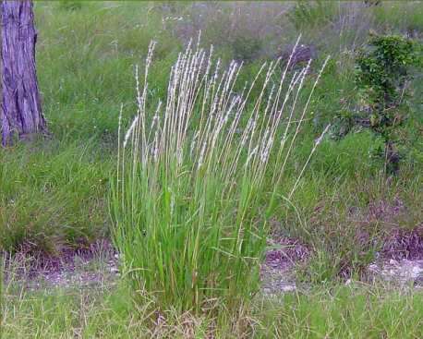
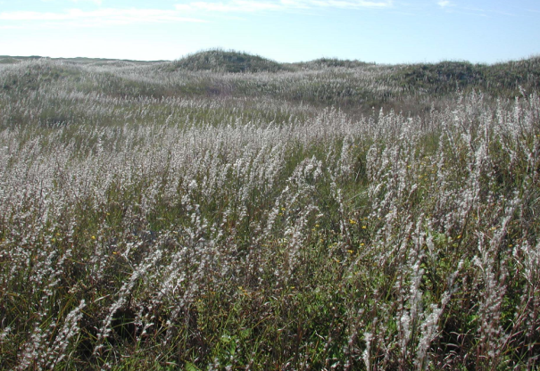
Landscape Restoration: Basic Process

Slide 3
Landscape Restoration Tool Using ArcMap
Programs and Ideas Developed While Taking Preliminary Stabs at Designing a
Chris Kelley
CE 394K Term Project, Fall 2009

Slide 4
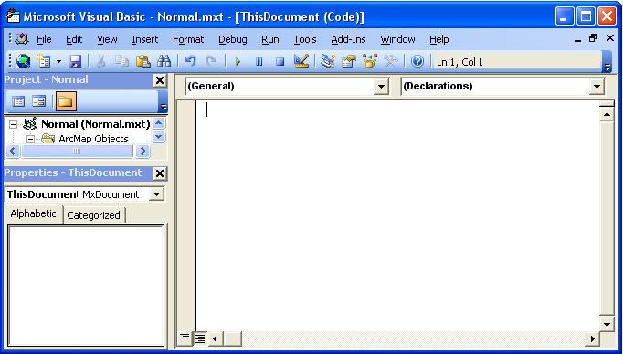
Learn VBA with ArcMap
Visual Basic for Applications (VBA)
In ArcMap (or MS Office) just hit <F11>
ArcObjects

Slide 5


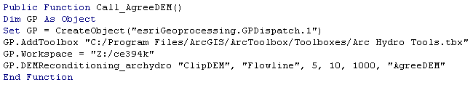
Learning ArcObjects through ArcHydro
Step 1: “hello world!”
Step 2: Call the AgreeDEM function

Slide 6
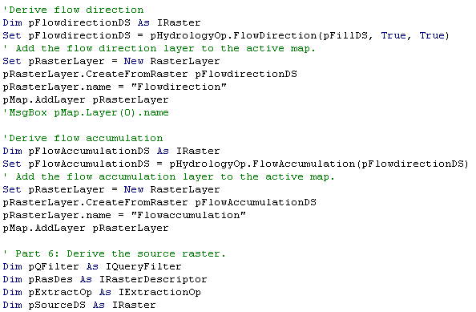
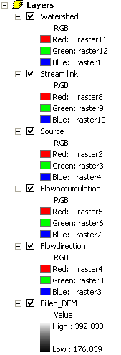
Step 3: Replicate basic dendritic processing*:
VBA is easy and samples abound…
*see Chang, 2007

Slide 7
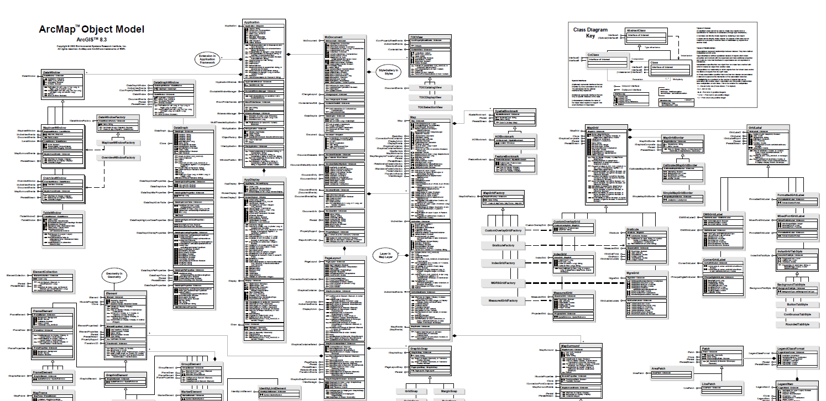
…but ArcObjects gets complicated

Slide 8
Warning: VBA deprecated in ArcMap
Why did they do this?!
Bet you feel silly, Chris.

Slide 9
Encapsulation and its Discontents
ESRI wants to separate code from program instances
Compare with data and metadata
What about simulations?

Slide 10
Simulation vs. Sampling
z = f(x, y, t)
z(100m, 100m, 11/23/9) = 12.6
Adapted from Maidment, 2009

Slide 11
Issue One – Continuous versus Discrete
Simulation: continuous and uncertain
Sampling: highly discrete and certain
Sensing: granular and certain

Slide 12
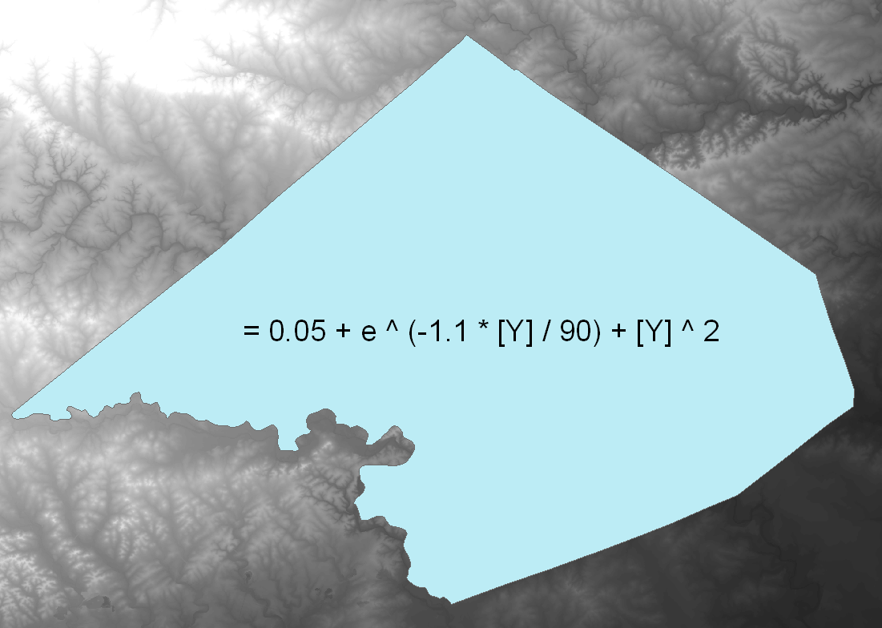
Continuous Cover: One Possibility

Slide 13
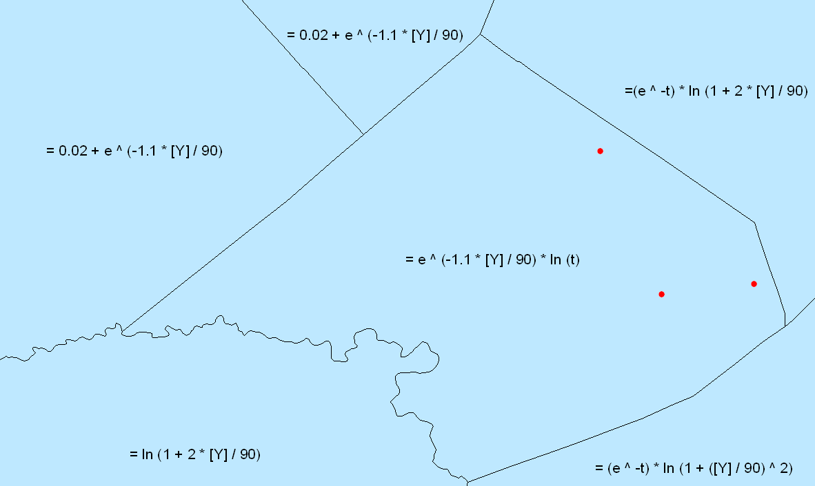
Issue Two – Spatial and Temporal Variability

Slide 14
Issue Three – Rule Encapsulation
Combine rules and data
Render values through a common mathematical interface

Slide 15
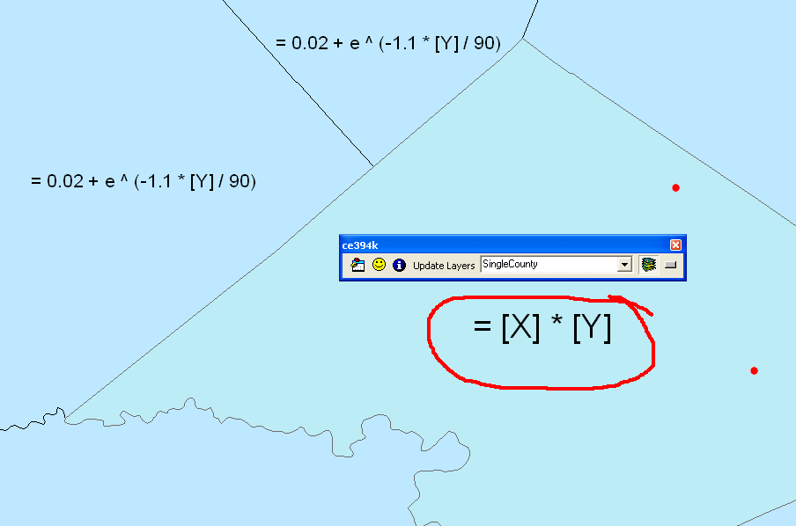

A Very, Very Simple Example

Slide 16
Future Plans
More general expression parser
Complete DEM retouch tool
Model infiltration and overland flow
Conduct comparative sampling/simulation trial

Slide 17
Questions?

Slide 18
Thank You!
References:
Chang, K T, 2007. Programming ArcObjects with VBA: A Task-Oriented Approach. CRC Press.
Maidment, D, 2009. Space and Time (PowerPoint).
Whisenant, S, 1999. Repairing Damaged Wildlands. Cambridge University Press.
Also: Innumerable message-board tips from people like “shark_boy27”

