Slide 1
SOIL MAP OF THE PECOS RIVER BASIN
SEDAT YALCINKAYA
NOVEMBER 24, 2009

Slide 2
OBJECTIVES
Processing the digital soil maps to obtain the input soil data for hydrologic modeling.
Comparison of different digital soil data (FAO, NATSGO, STATSGO, SSURGO)

Slide 3
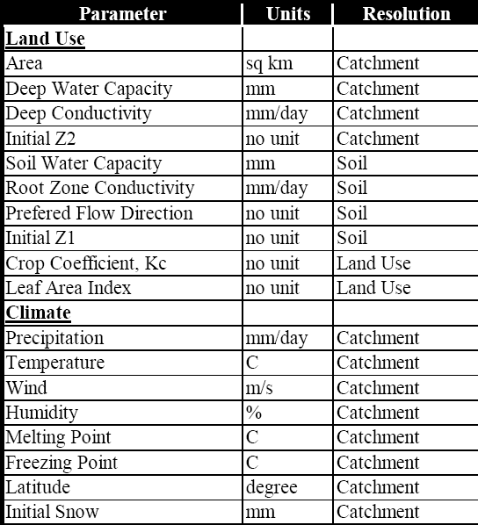
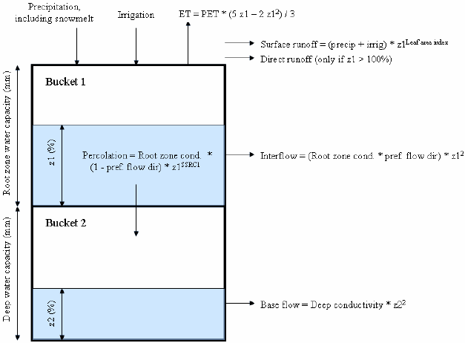
DIGITAL SOILS DATA FOR
HYDROLOGIC MODELLING
WEAP Model Structure (Soil Moisture Method)
Input Parameters

Slide 4
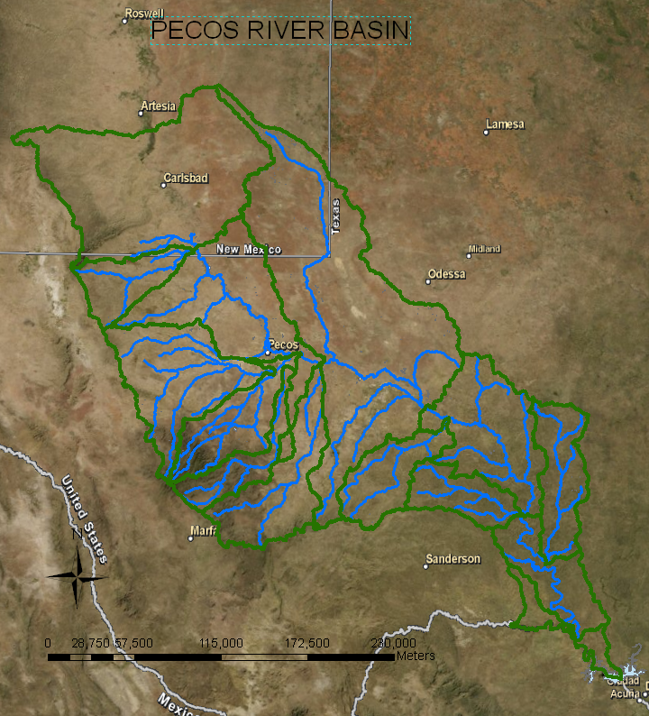
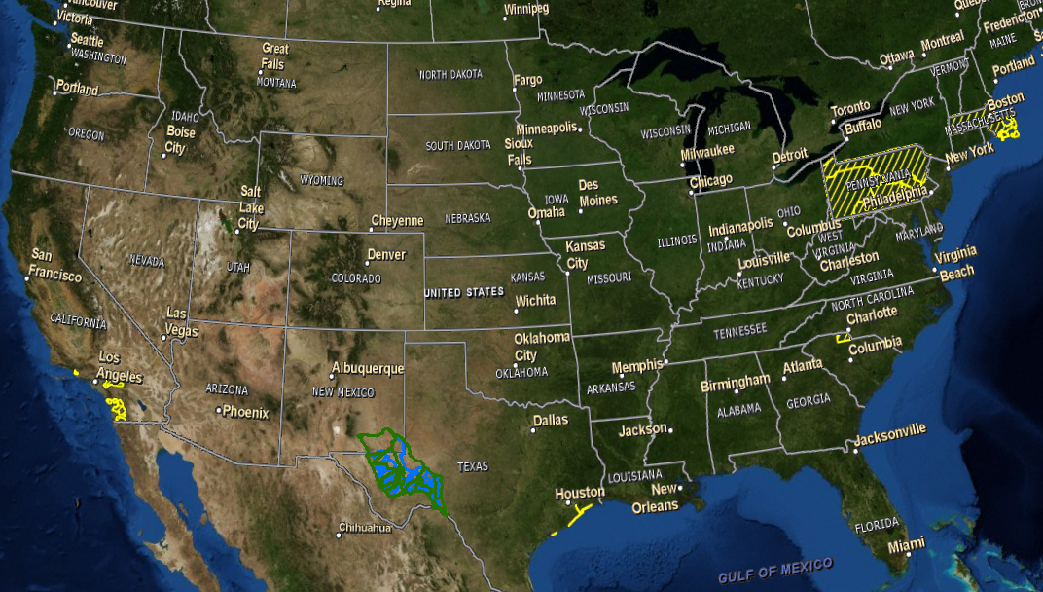
STUDY AREA
WATERSHEDS (HUC_8) | AREA (KM2)
13040212 | 1048.17619
13060011 | 11350.60629
13070001 | 6454.582529
13070002 | 2039.366686
13070003 | 2913.223075
13070004 | 5074.004481
13070005 | 1831.660091
13070006 | 3833.113807
13070007 | 16414.37423
13070008 | 4962.616022
13070009 | 2505.34438
13070010 | 1997.452143
13070011 | 2828.999238
13070012 | 2573.636942
TOTAL BASIN AREA | 65827.15611

Slide 5
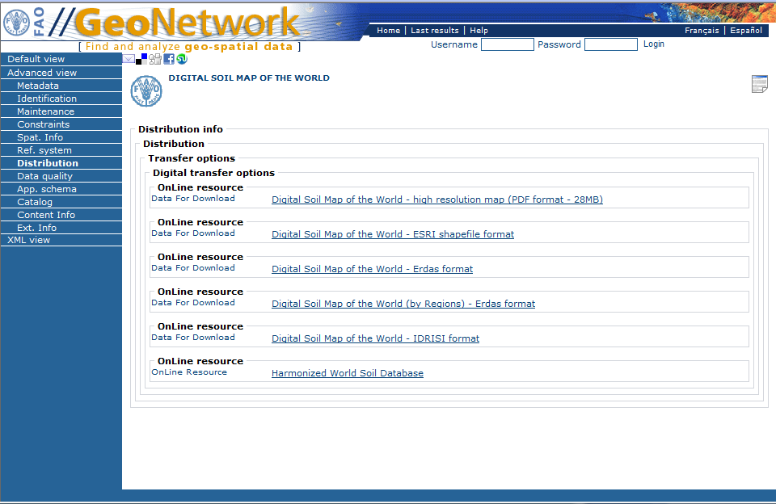
DATA SOURCE FOR SOILS
FAO: http://www.fao.org/geonetwork/srv/en/metadata.show
STATSGO: http://datagateway.nrcs.usda.gov/
Available at US and state levels
SSURGO: http://soildatamart.nrcs.usda.gov/
          http://datagateway.nrcs.usda.gov/
Available at County level
Tabular data are not reader friendly. They must be imported in an MS Access database template.

Slide 6
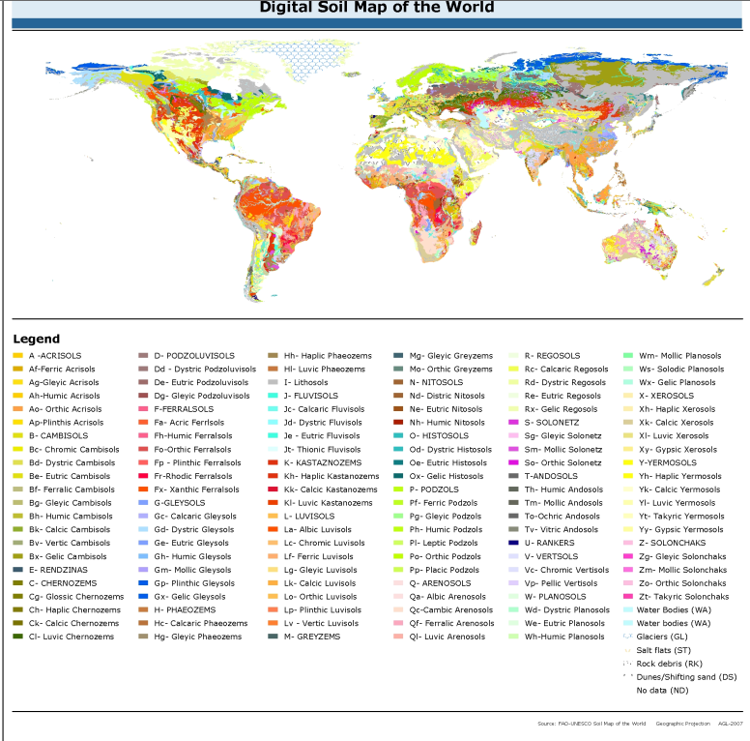
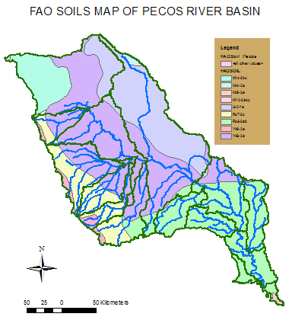
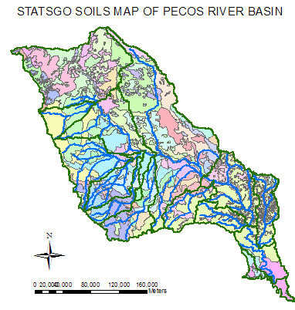
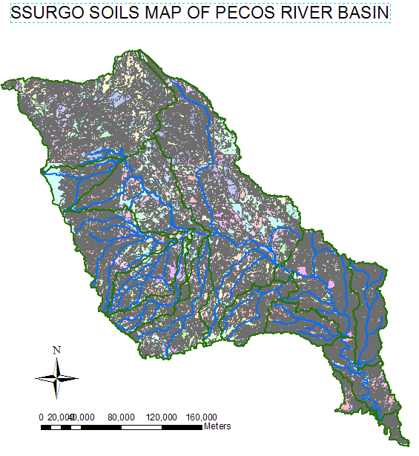
SPATIAL DATA

Slide 7
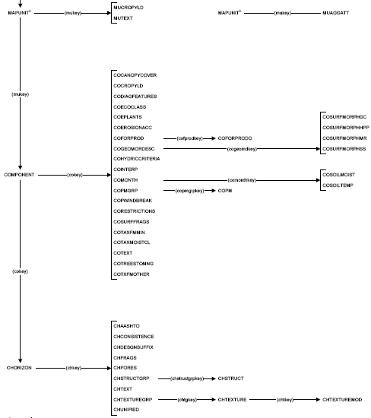
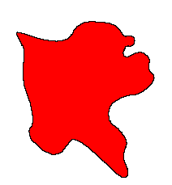
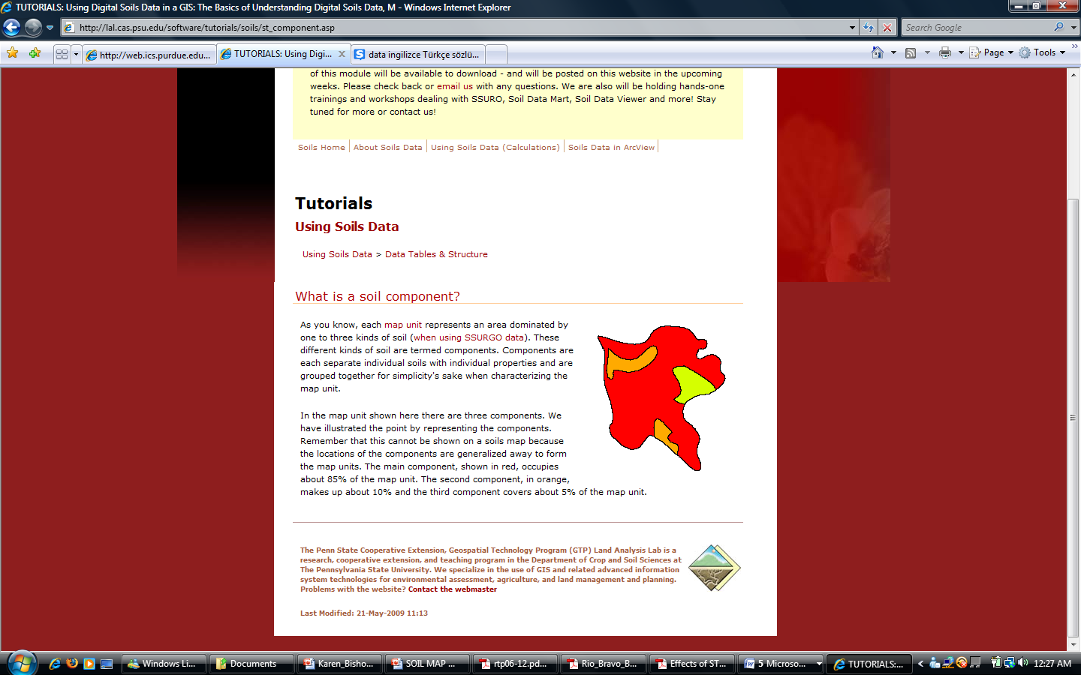
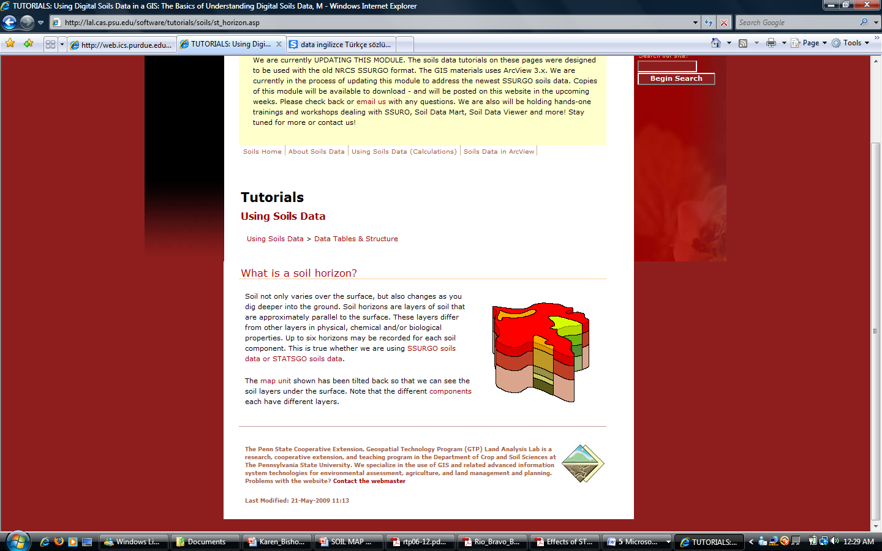
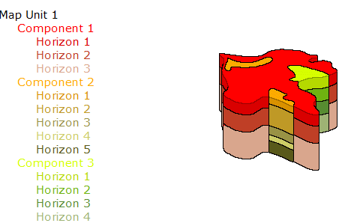
RELATIONSHIP BETWEEN SPATIAL & TABULAR DATA
mukey
cokey
Mapunit
Component
Horizon

Slide 8
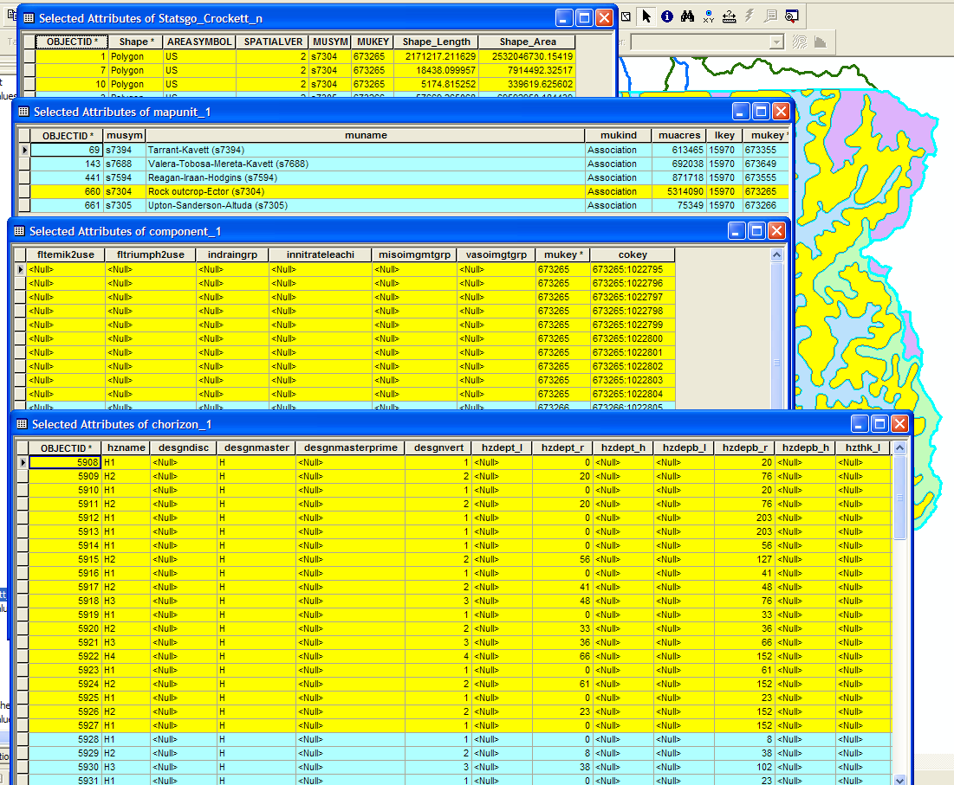
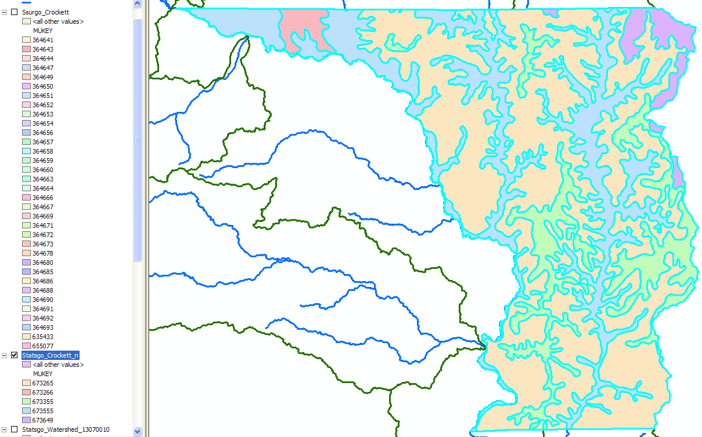
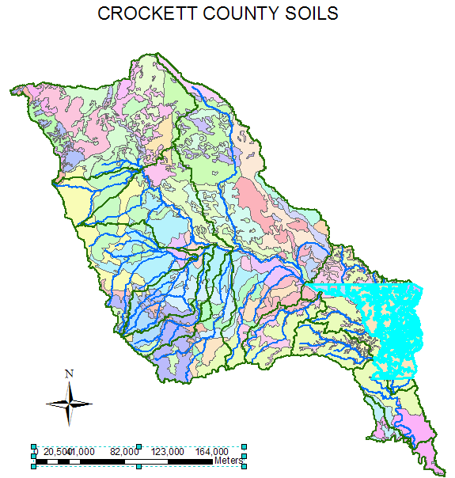
ATTRIBUTES TABLE-STATSGO
3 polygons share the same mapunit (mukey 673265)
Mapunit s7304 has 10 components in different percentages
First component (cokey 673265:1022795) has 2 layers

Slide 9
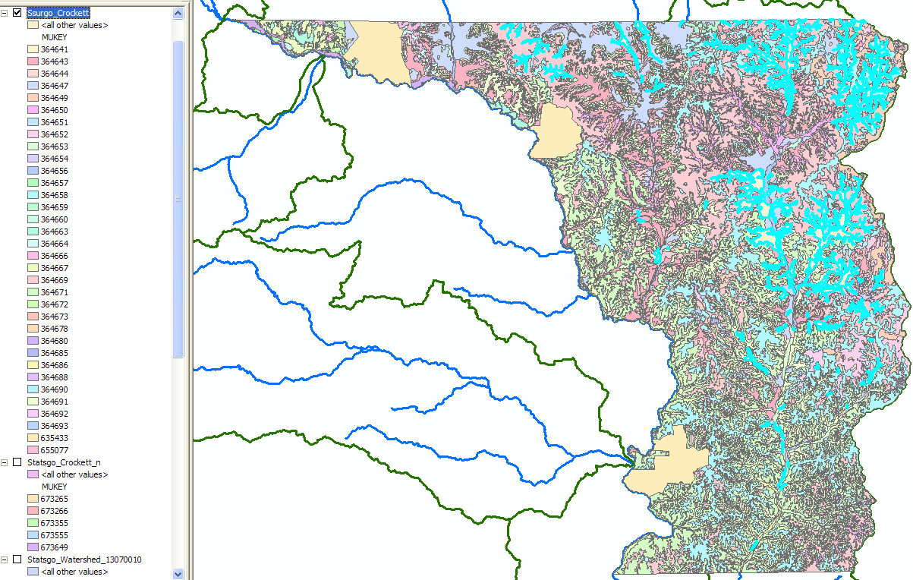
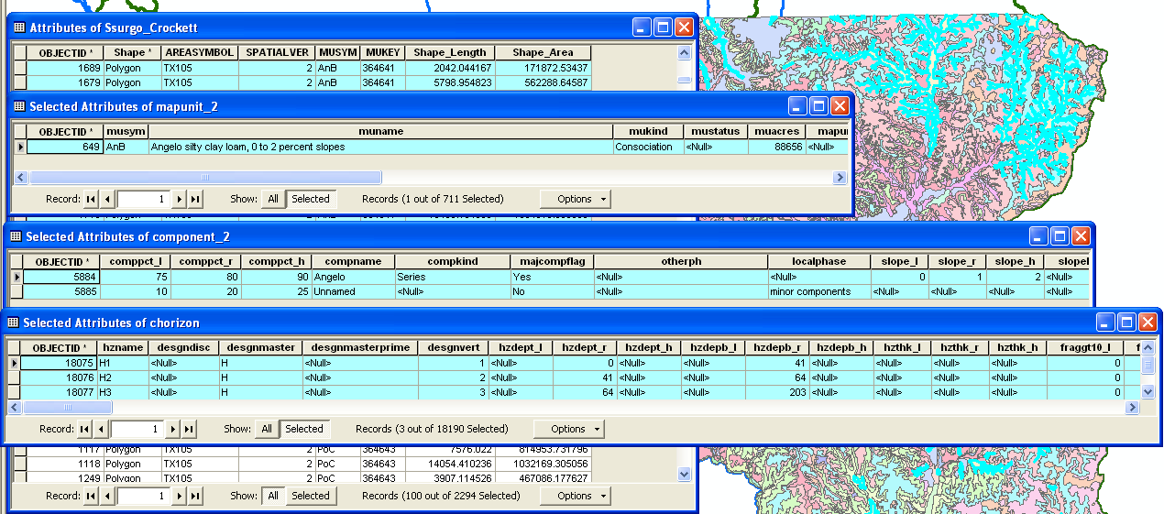
ATTRIBUTES TABLE-SSURGO
100 polygons represent one mapunit
 | SSURGO | STATSGO
POLYGON | 2294 | 12
MAP UNIT | 34 | 5
COMPONENT | 87 | 38
This mapunit (mukey:364641) represents 2 components

Slide 10
RESULTS
FAO – UN,
Generalized Worldwide soil map
FAO
1/5.000.000
NATSGO
1:7.500.000
(Under development)
STATSGO
1/250.000
SSURGO
1:12.000 to 1:31.680
FAO
(Least detailed)
NATSGO
STATSGO
SSURGO
(Most detailed)
NRCS of USDA, just for US
Level of use
Detail level of information

Slide 11
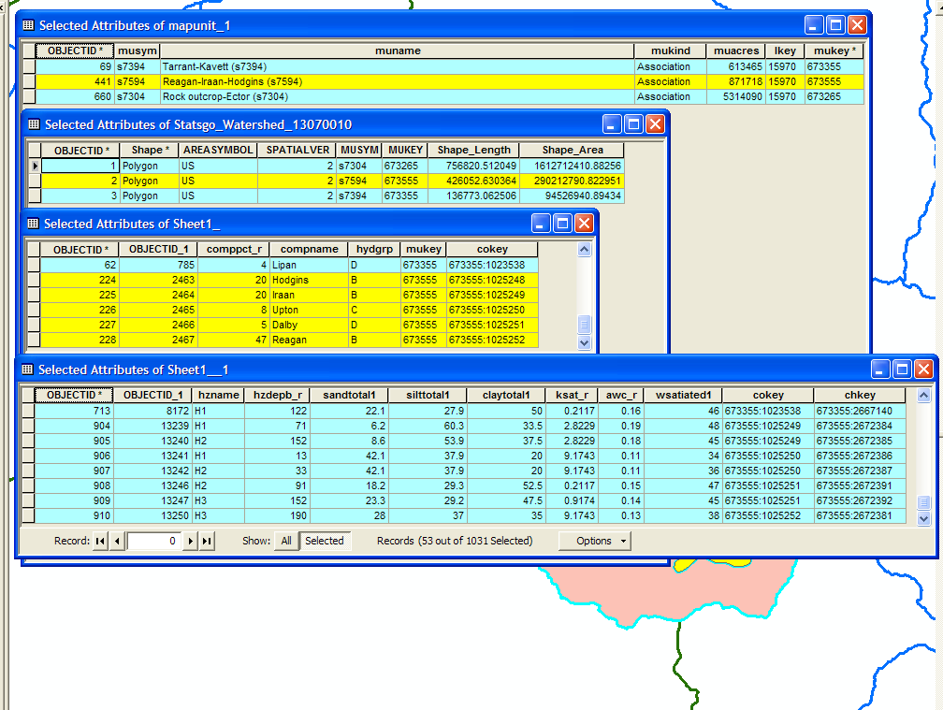
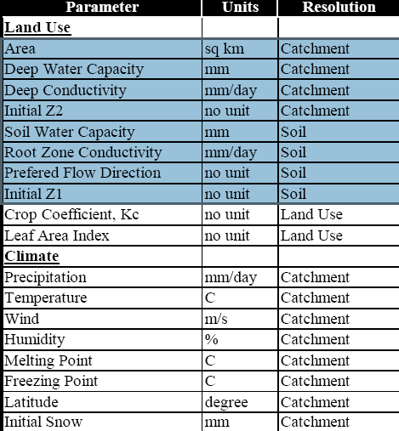
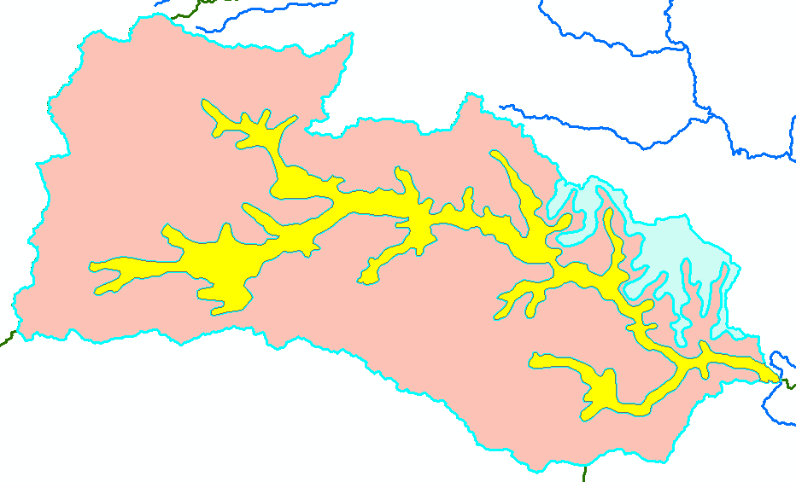
RESULTS
It might be good for my purpose to study with NATSGO, but it is still under development.
FAO is easy to use for my model. First, I need to know the contents of its attribute table. I am currently working on this.
STATSGO is also good for my model, however I need to spend a lot of time for calculation of average values.
SSURGO is definitely much more detailed than I need.

Slide 12
QUESTIONS?

