Slide 1
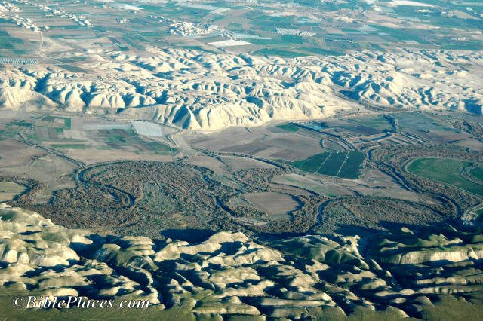
Hydrology of the Jordan River Basin
Georges Comair
GIS for Water Resources
UT Austin-12/02/10

Slide 2
Preview
Location
Watershed delineation
Volume of water available for run-off
Dead Sea water balance

Slide 3
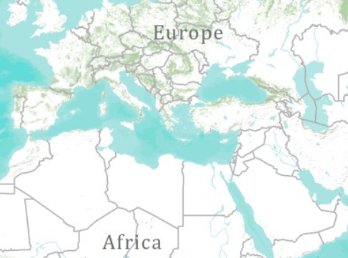
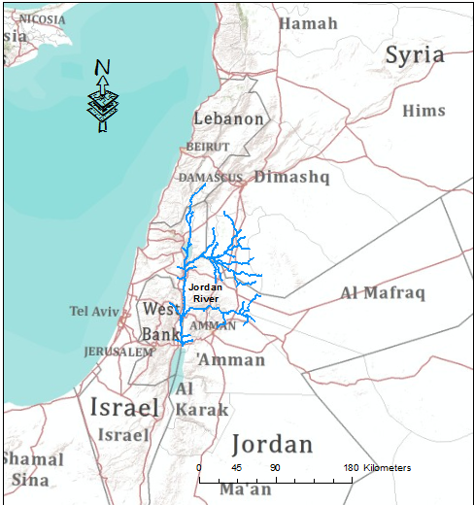


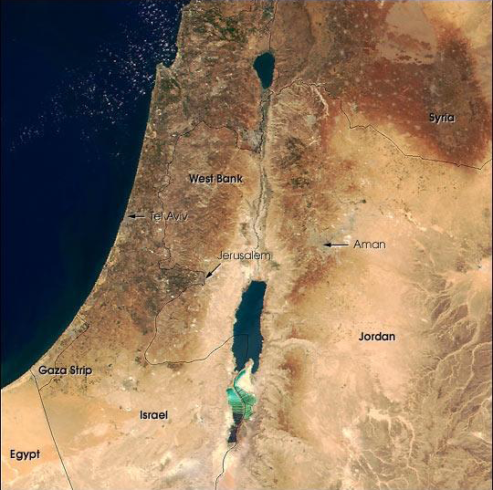
Location
NASA

Slide 4
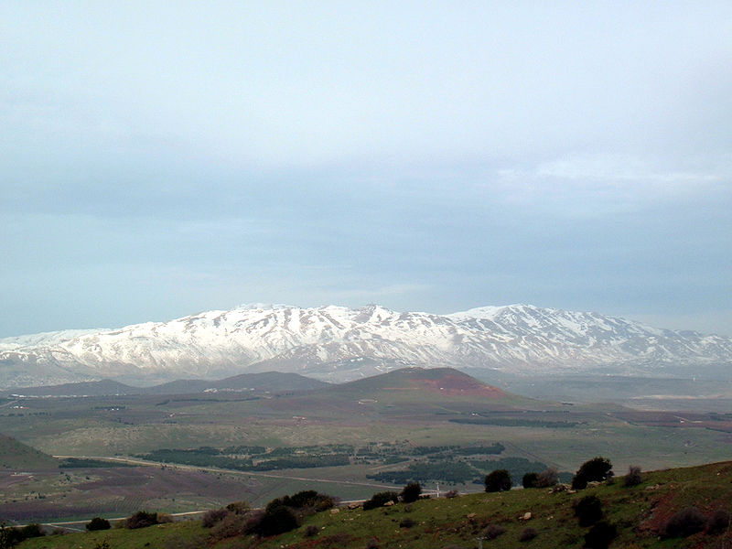
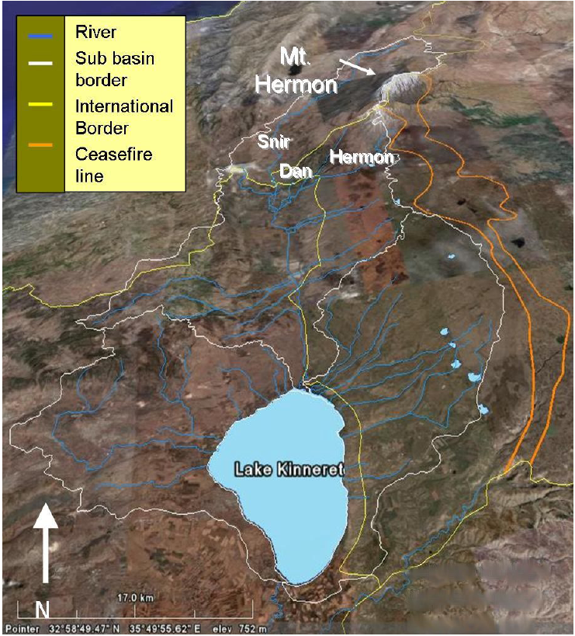
The upper Jordan River catchment
Jordan River
wikipedia
googleEarth

Slide 5
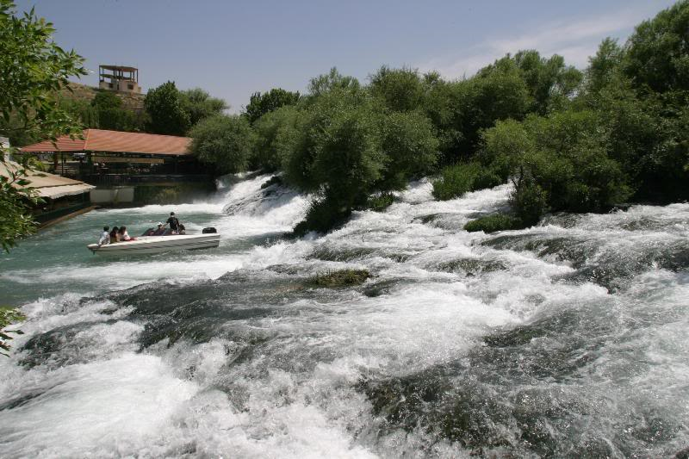
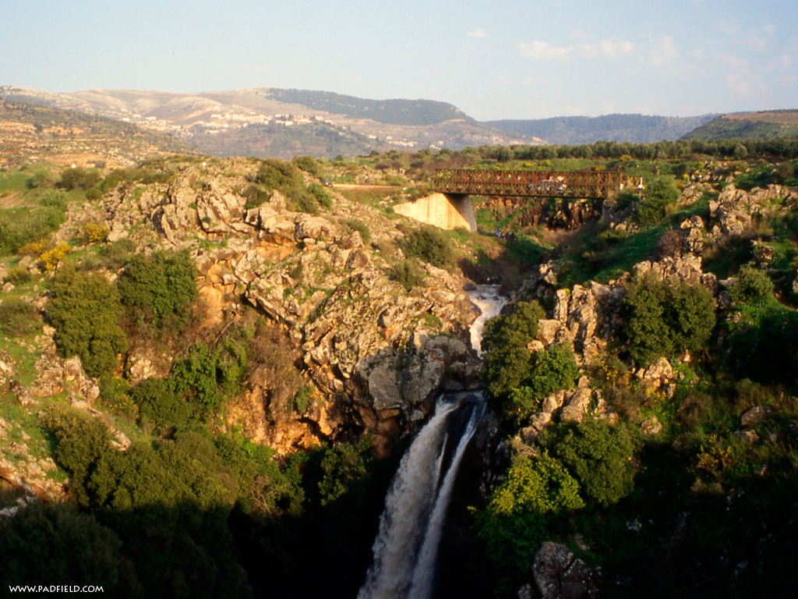
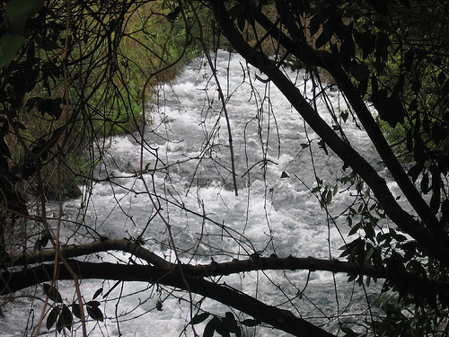
Rivers of the upper Jordan Basin
Snir (Hasbani)
Hermon (Banias)
Dan
wikipedia
wikipedia
wikipedia

Slide 6
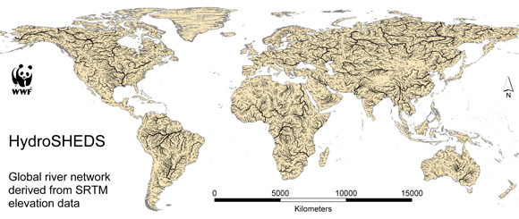
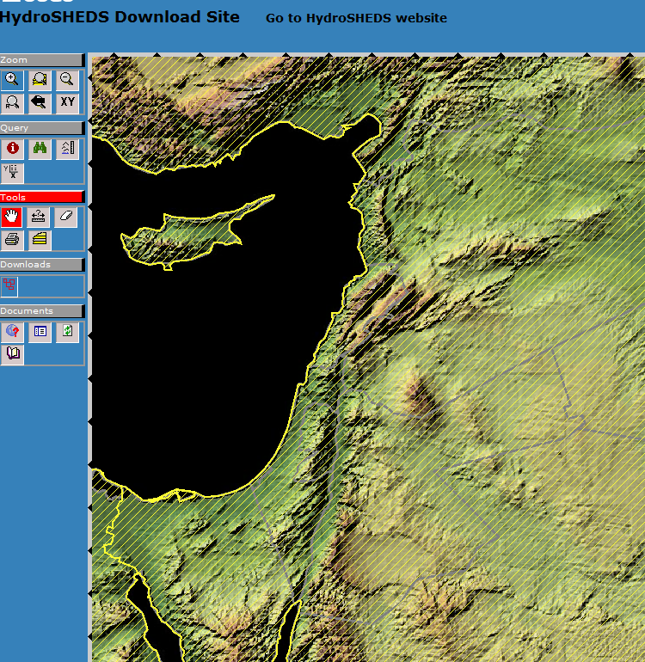
HydroSHEDS Download Site

Slide 7
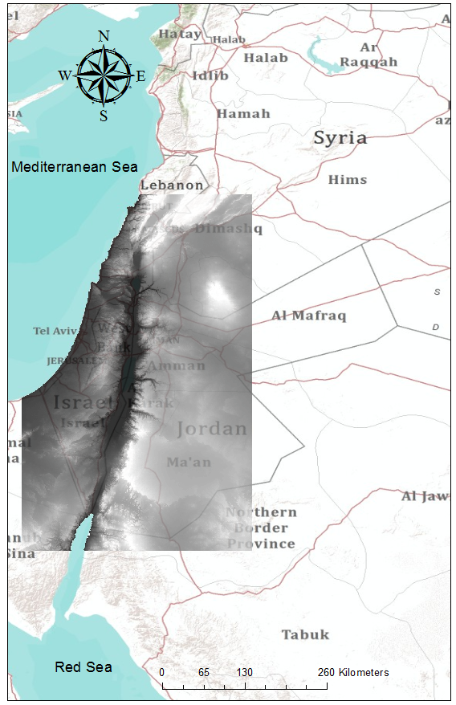
Watershed delineation

Slide 8
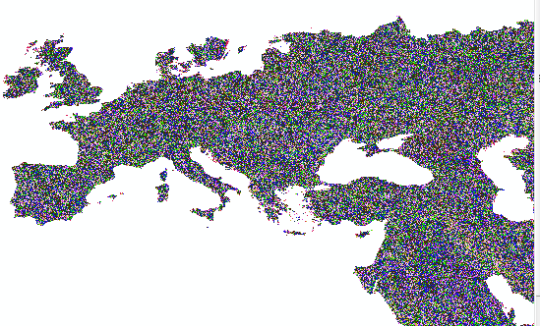
Drainage directions from Hydrosheds
15 sec DEM

Slide 9
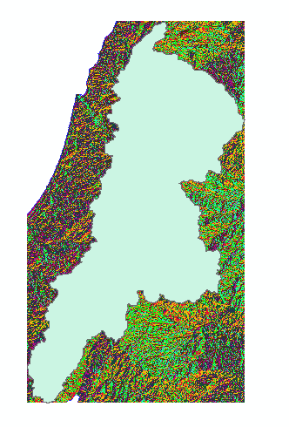
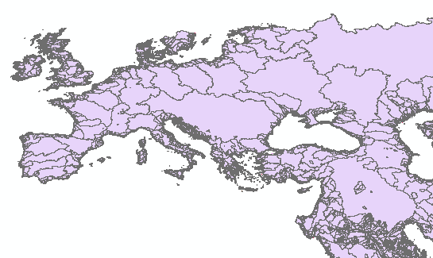

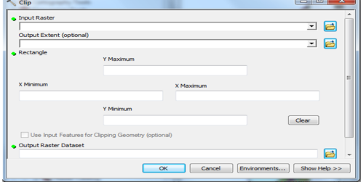
Flow accumulation
HydroSHEDS World Basins
Clipped DEM

Slide 10
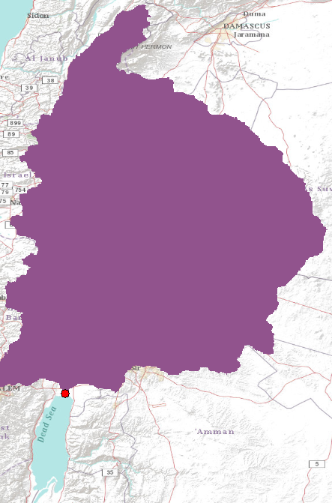
Isolating the watershed

Slide 11
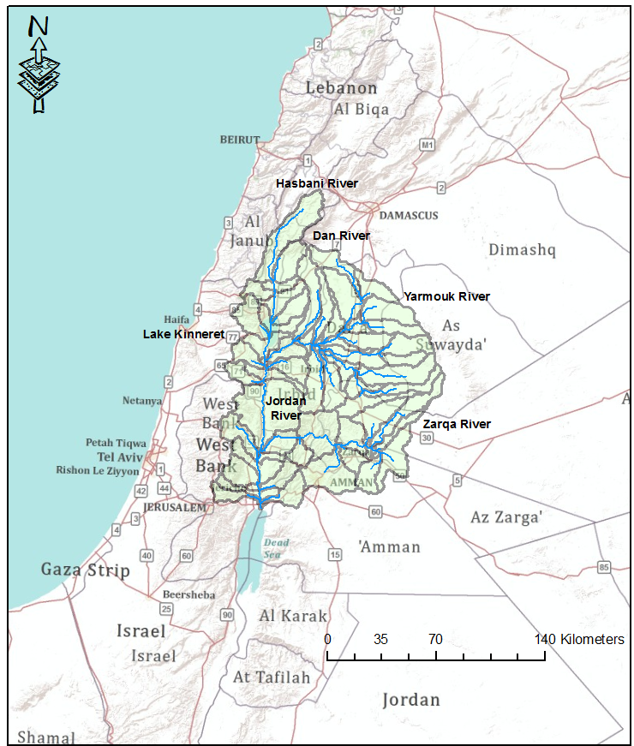

Slide 12
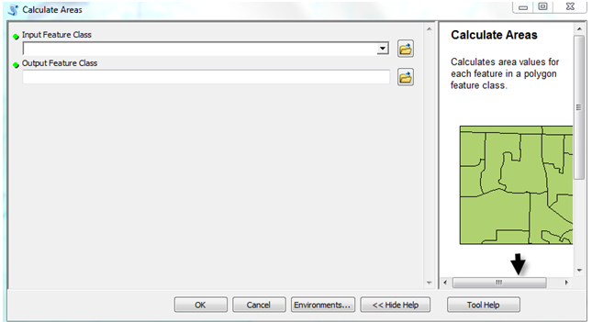
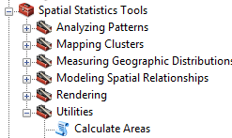
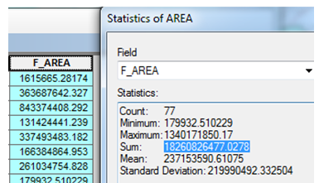
Check the total basin area
18,261 km²

Slide 13
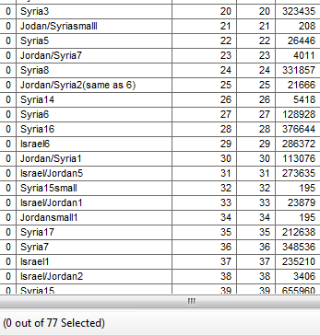
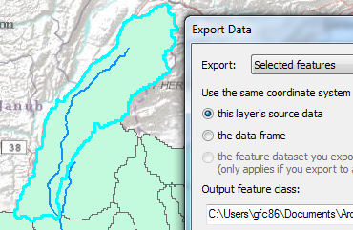
Subwatersheds for each country
Lebanon
Israel

Slide 14

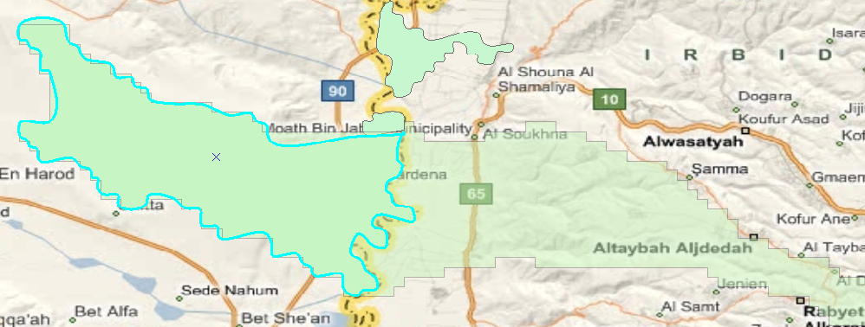
Transboundary catchments

Slide 15
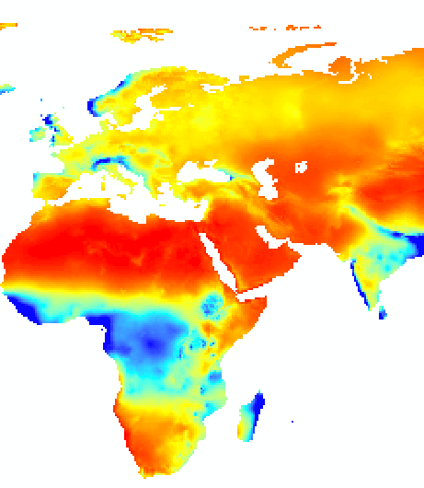
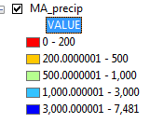
Average annual precipitation for the globe on a 0.5 X 0.5 degree global grid

Slide 16

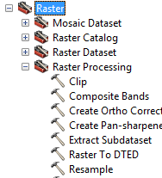
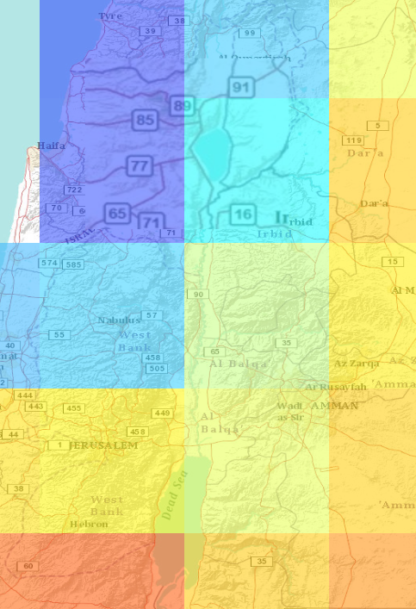
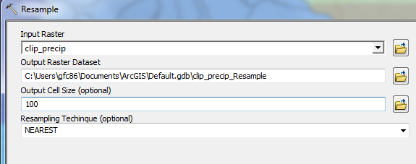

Slide 17
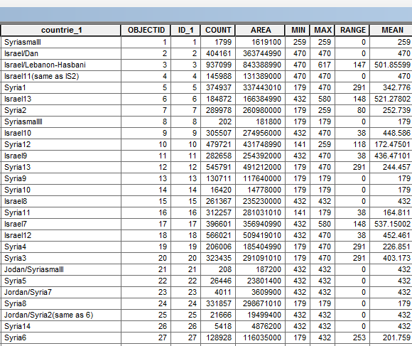
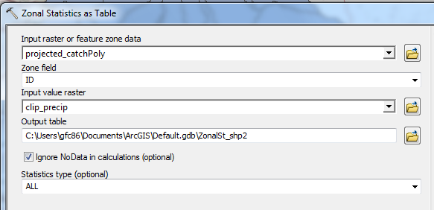
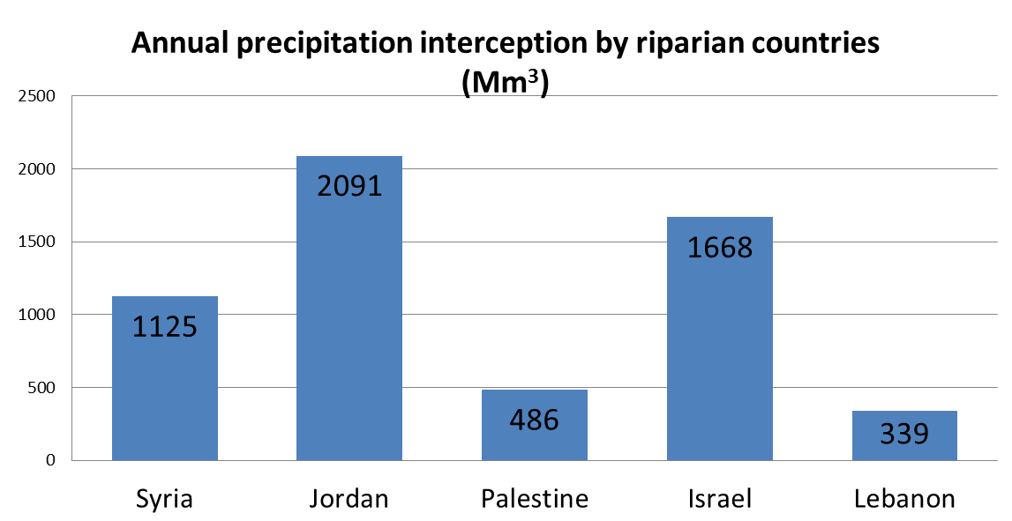
Calculating volume of potential run-off

Slide 18
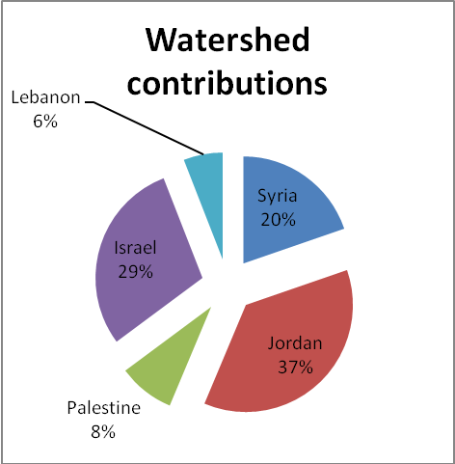
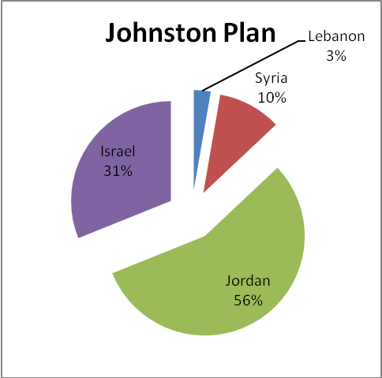
Contributions of each country in %

Slide 19
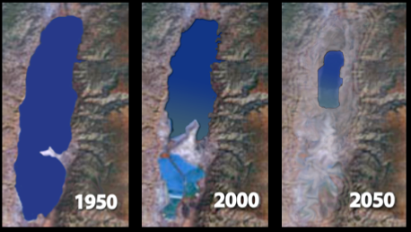
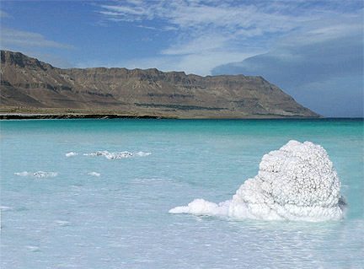
The Dead Sea water balance
meddead.org/Save_Dead_Sea.html
deadseabody.com

Slide 20
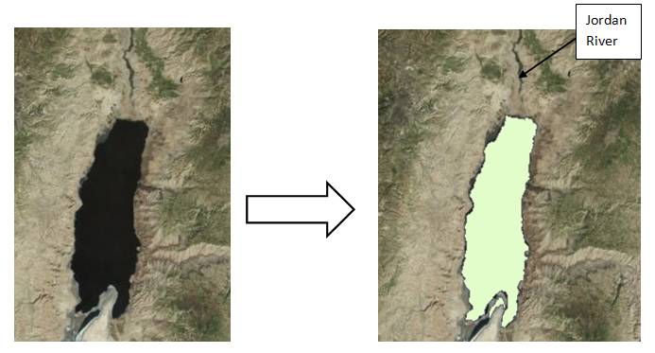
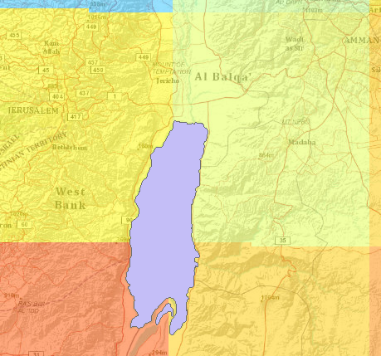

Slide 21
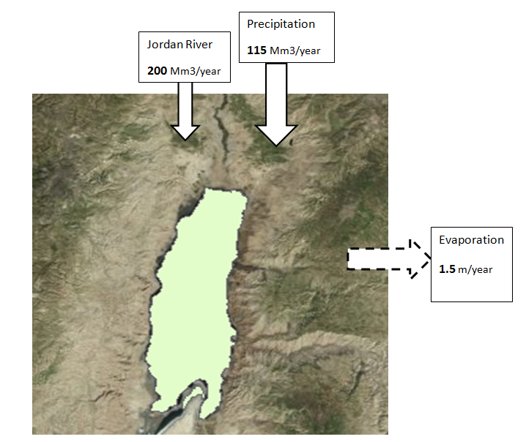

Slide 22
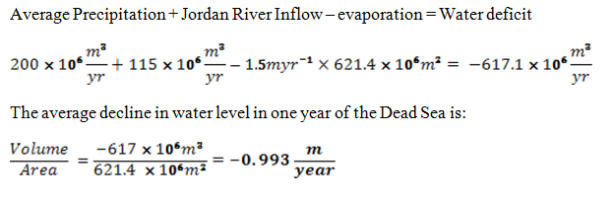
Results and comparison
“The rate of water level drop over the last 10 years is about 0.9 m/yr, representing an annual water deficit of about 600 million cubic meters” Itay Gavrieli, 2005

Slide 23
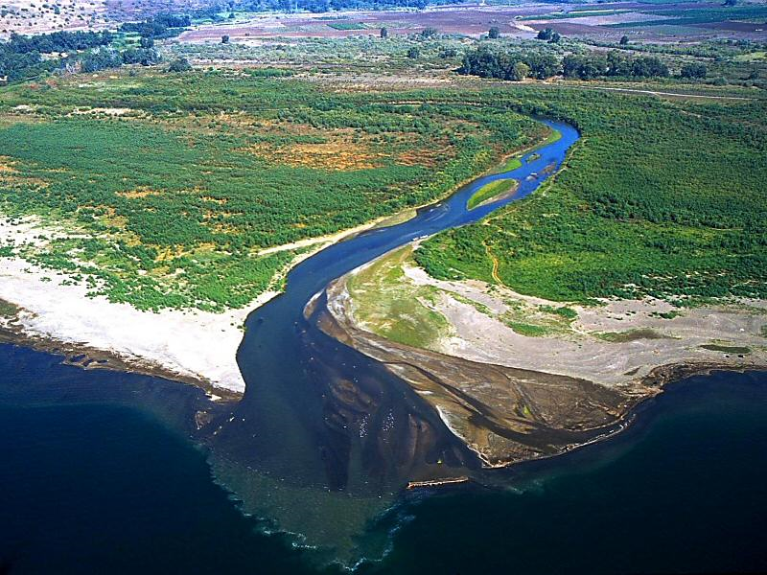
QUESTIONS ?
Jerusalemperspective.com

