Slide 1
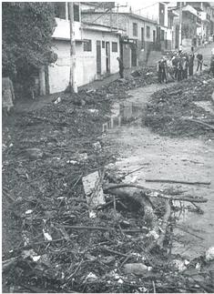
Flooding in San Salvador
Carlos Felipe Gutierrez
Fall 2010

Slide 2
Outline
The problem
Objectives
Obtaining main drainages
Data Acquisition
Analysis
What was achieved
What has to be done

Slide 3
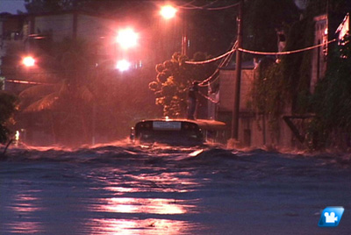
The Problem
Severe flooding causes fatalities and property damages every year
Overpopulation of the city from 0.5 million to 1.5 million
People living in constant danger

Slide 4
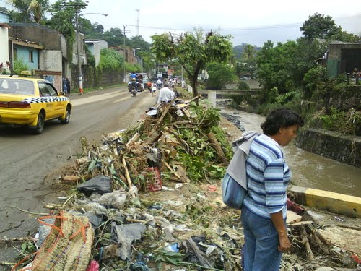

Slide 5
Objectives
Identify main drainage rivers
Identify major flood spots
Obtain values of rainfall that would cause flood for a particular place

Slide 6
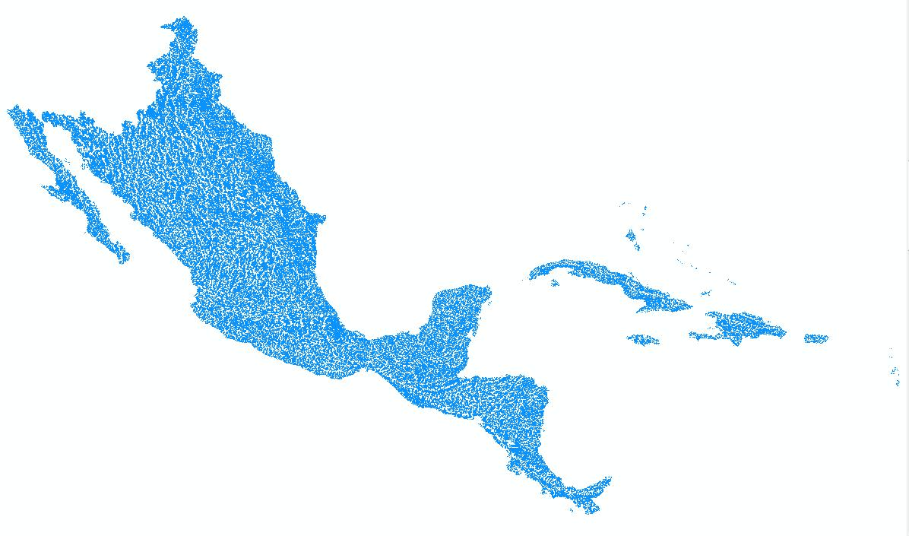
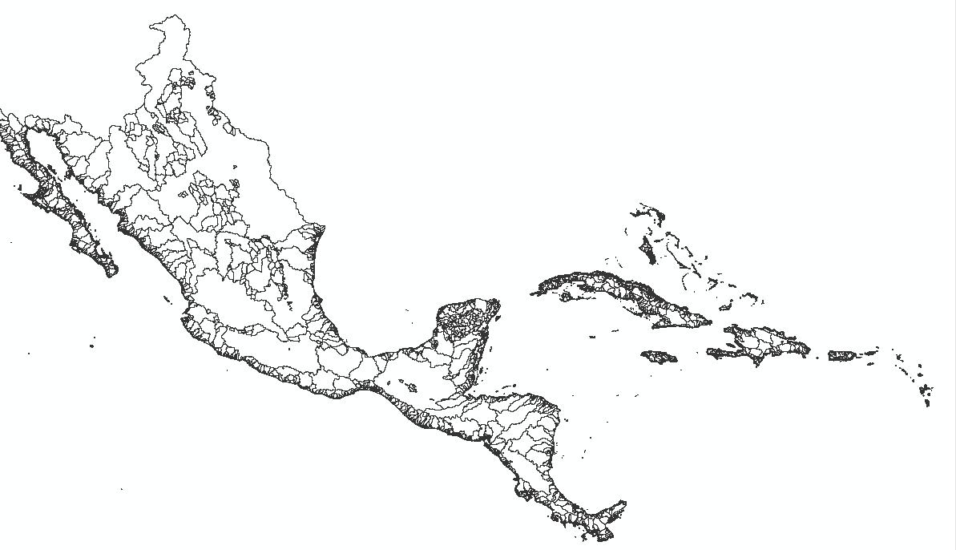
Obtaining Main Drainages

Slide 7
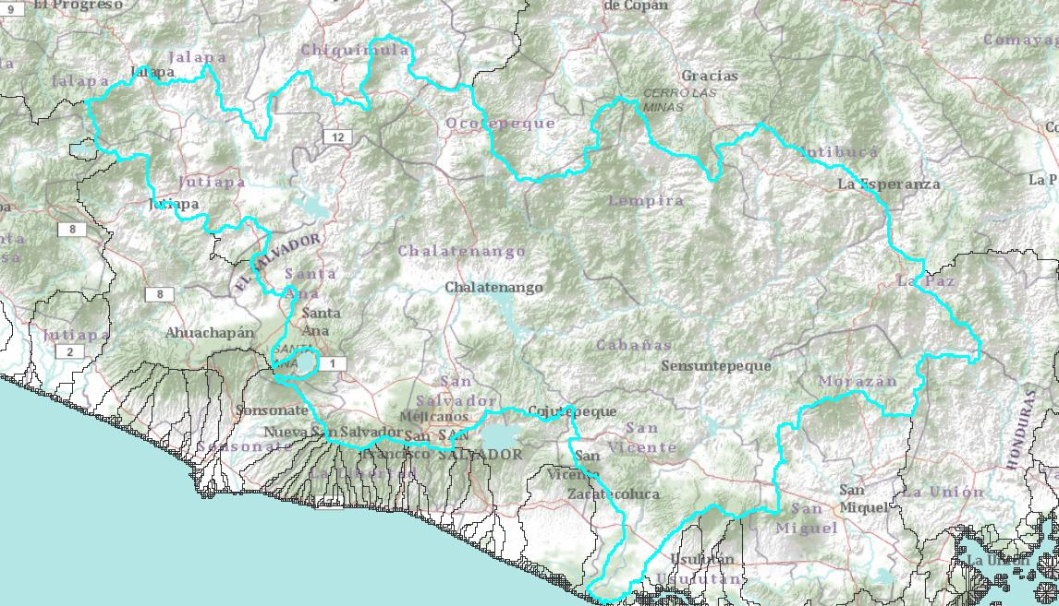
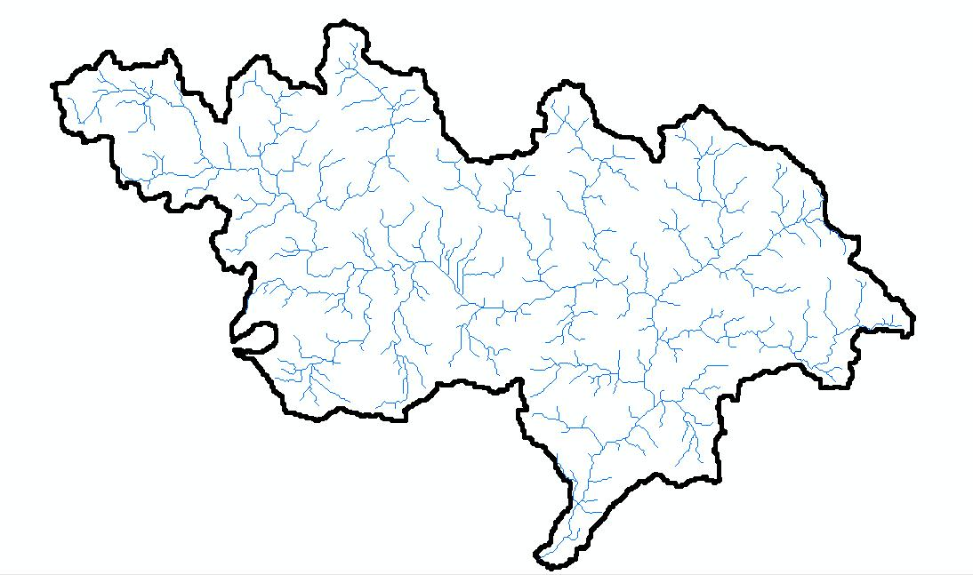
Include a basemap

Slide 8
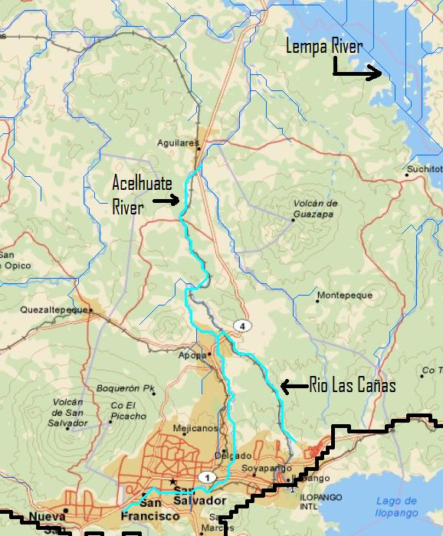
Main Drainage of the Metropolitan Area of San Salvador

Slide 9
Data Acquisition
National Service of Territorial Studies (SNET)
Very limited data:
- 1 stream gage station
- 3 continuous rain gage stations
- 3 intermittent rain gage stations
Bureaucracy
Reading studies made by SNET (Water related disasters)

Slide 10
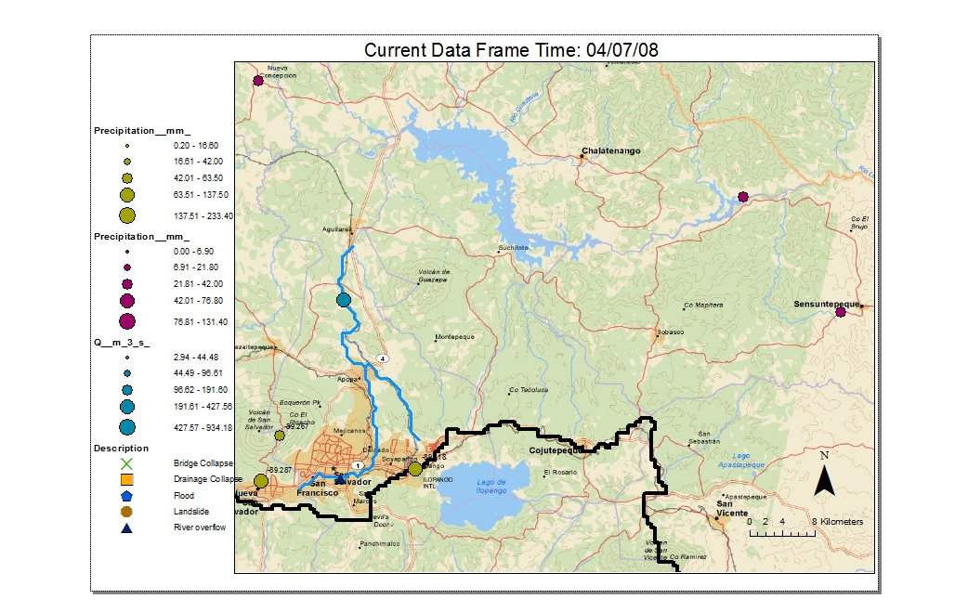

Slide 11
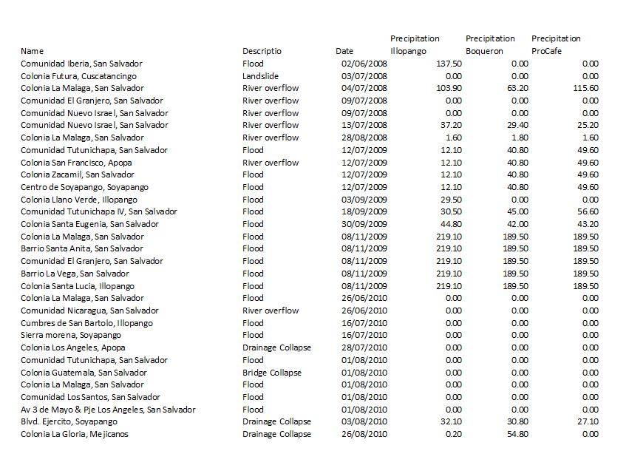
Analysis

Slide 12
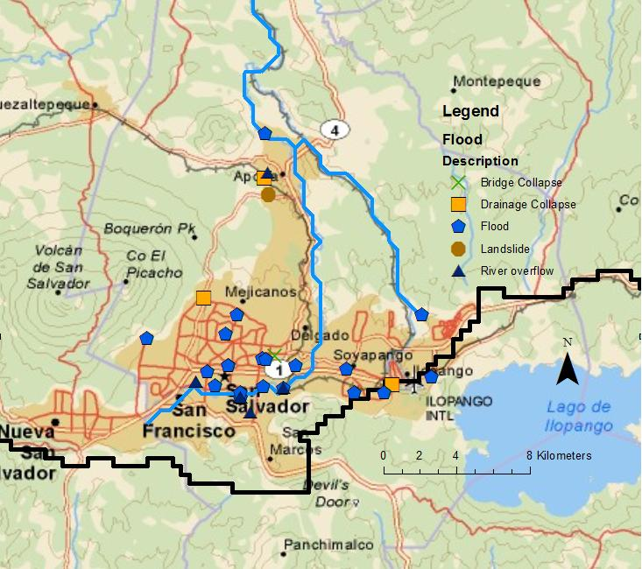
Flood spots

Slide 13
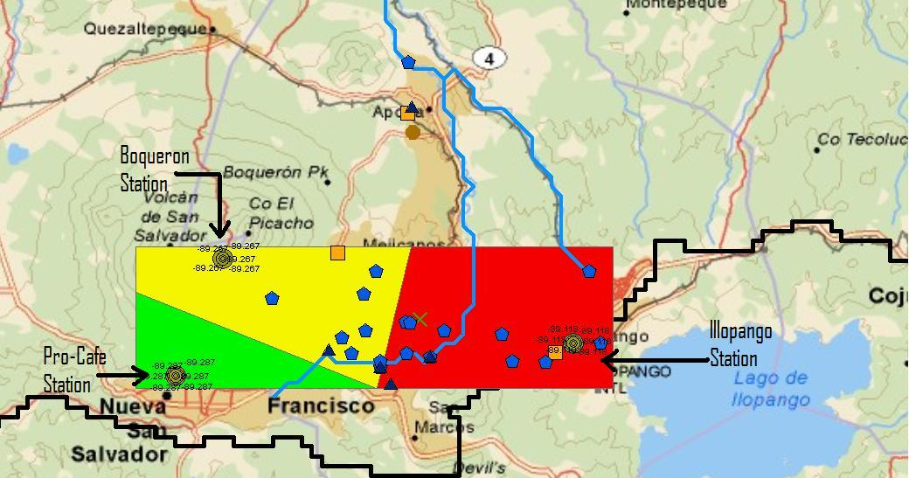
Which rain stations use?

Slide 14
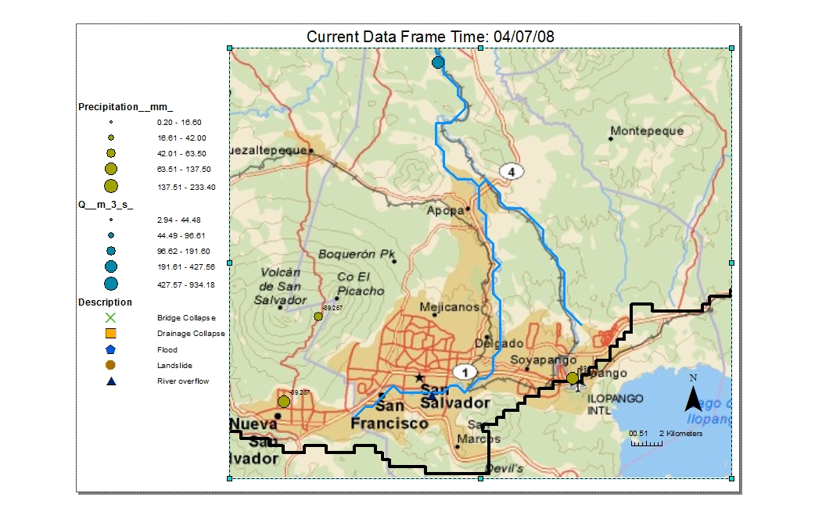
Rain quantity creates floods
http://www.youtube.com/watch?v=ue1vJPS7cPs

Slide 15
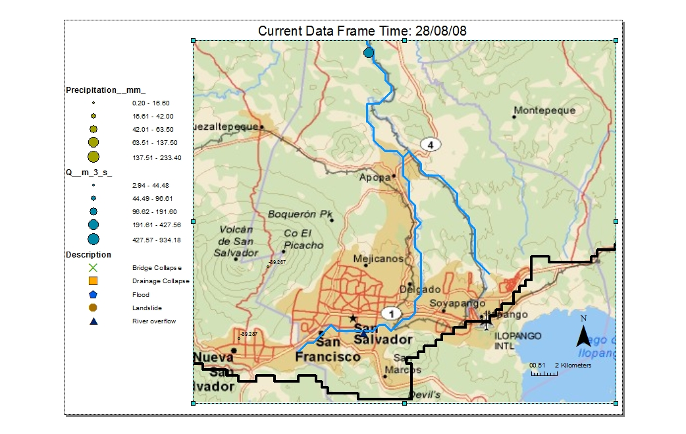
Not always

Slide 16
What was achieved
Identified the drainage rivers
-Acelhuate River and Las Cañas River
-Manmade drainages were not available for me
Identified major flood spots
-La Malaga, La Vega, Santa Anita
-Comunidad Tutunichapa
-Soyapango close to Las Cañas River
-Colonia Escalon, Mejicanos (North west)
Realized how limited the data is

Slide 17
What needs to be done
Stream gages throughout the city
24 hour continuous rain gages
Estimate how the impervious cover is growing
Make the data available!!!
More strict design

Slide 18

Question?
https://webspace.utexas.edu/cfg328/www/Term%20Paper.htm
azsakufel@mail.utexas.edu

