Slide 1
Land Use and Water Quality in the Hudson River
Amy Gao
GIS in Water Resources
November 16, 2010

Slide 2
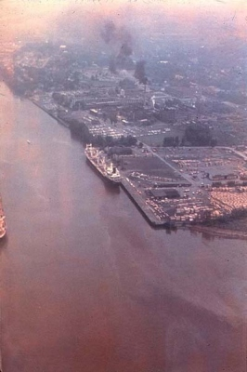
Hudson River in New York
New York ranked 18th among the states in toxic water pollution.
The Hudson River Watershed ranked 29th out all US waters for receiving the greatest amount of toxic pollution.
The Hudson River Watershed ranked 2nd in New York State for receiving the most toxic pollution.
Pollution around the Port of Albany,
four decades ago
Notes:
New York ranked 18th among the states in toxic water pollution with more than 8.1 million pounds being dumped into the state's waters.
The Hudson River Watershed ranked 29th out all US waters for receiving the greatest amount of toxic pollution with 2,136,597 pounds.
The Hudson River Watershed ranked 22nd for the most polluted waters when direct discharges and estimated sewer discharges of toxic chemicals were factored in with 6,343,557 pounds.
The Hudson River Watershed ranked 2nd in New York State for receiving the most toxic pollution; First in estimated discharges including toxics from wastewater treatment plants.
A total of 403,053 pounds of carcinogens, persistent toxic metals, and reproductive toxins were discharged into the Hudson River Watershed for those five years.

Slide 3
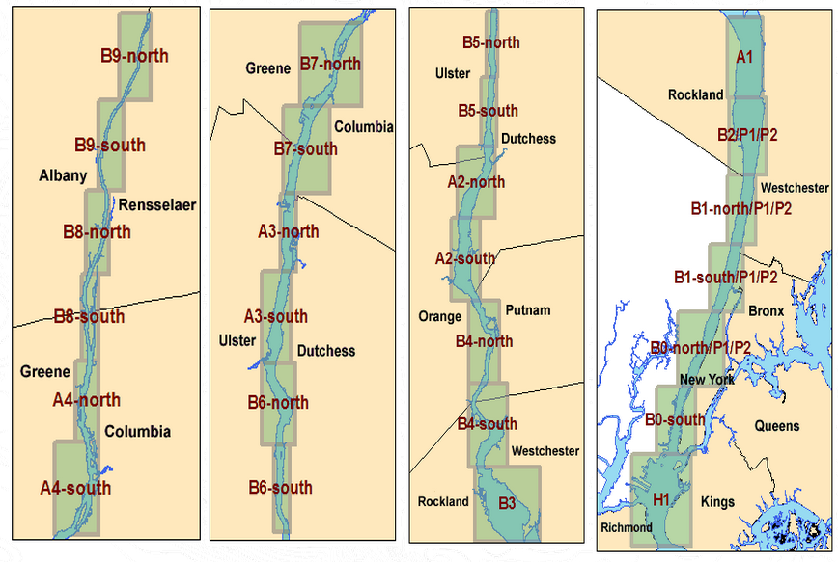
Pollution Sources
River sediments
Metals:
  Industrial and domestic wastewater discharges
  Runoff (CSO’s)
Polycyclic Aromatic Hydrocarbons (PAH)
  Automobile exhaust
  Industrial emissions
  Burning wood, charcoal and tobacco
NYSDEC Hudson River Estuary Program

Slide 4
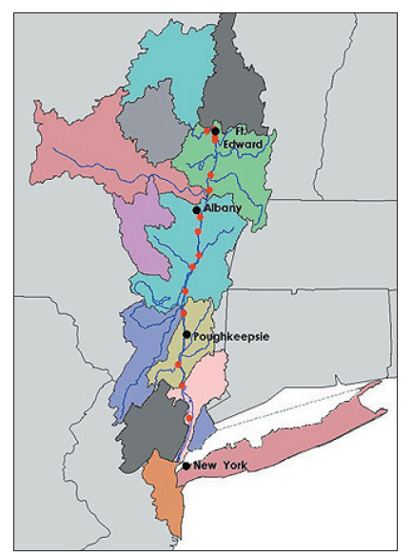
Objective
How does land use along the Hudson River affect the metal and PAH concentrations?

Slide 5
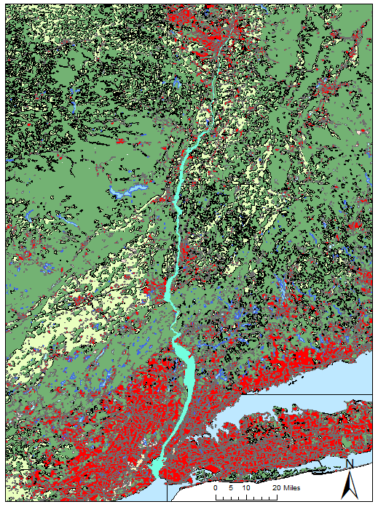
Land Use Along Hudson River
13.7% is urban, industrial, and commercial land
Notes:
Used merged tool in data management tool to merge all 6 USGS data layers together.

Slide 6
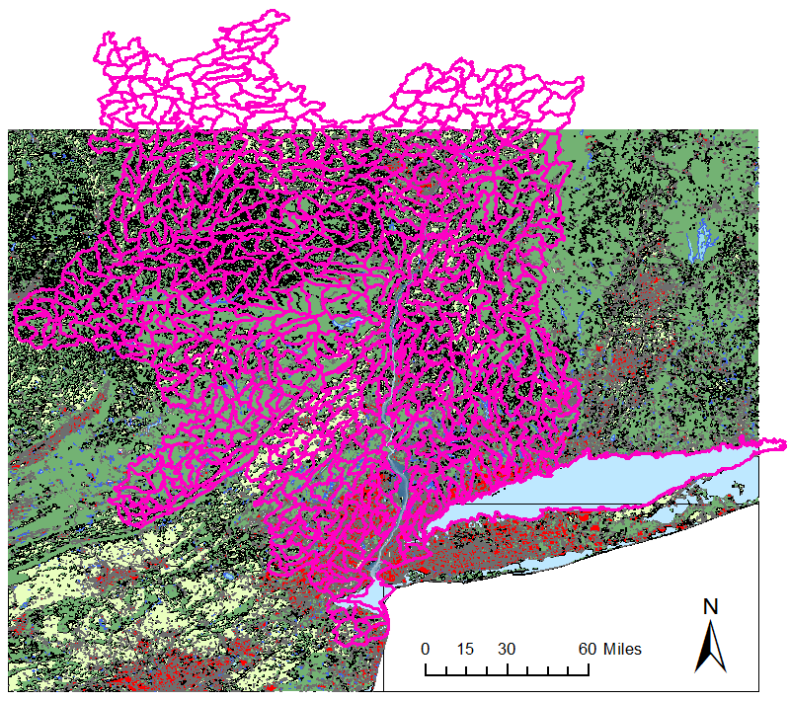
Lower Hudson River Basin
Geographical and hydrological idea of drainage into the Hudson River
Notes:
USDA merged counties to get lower Hudson River Basin

Slide 7
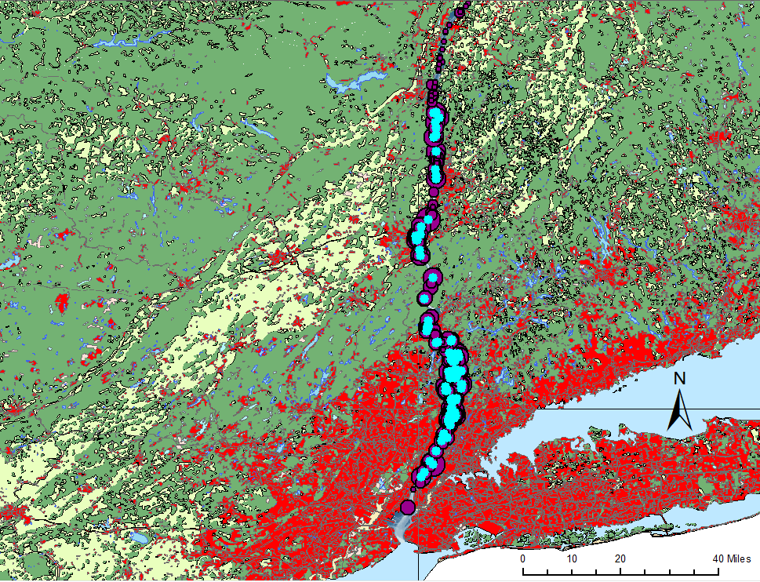
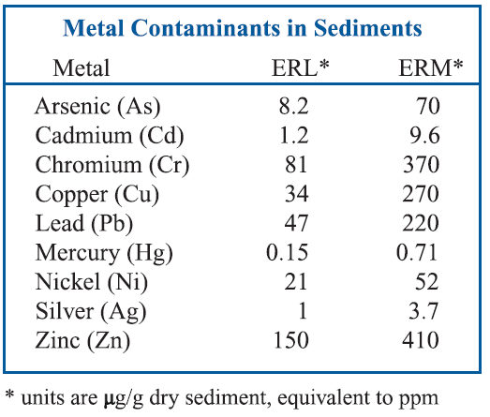
Metals in Hudson River
Arsenic – 30%
Notes:
They defined ERL values as the lowest concentration of a metal that produced adverse effects in 10% of the data reviewed. Similarly, the ERM designates the level at which half of the studies reported harmful effects.

Slide 8
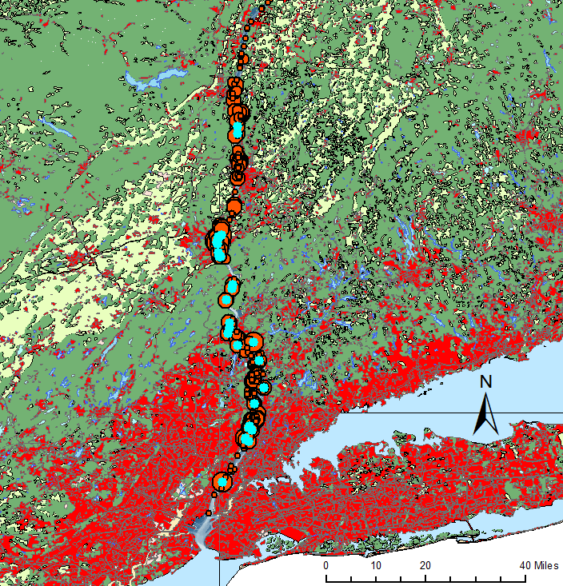

Cadmium – 10%
Chromium – 3%

Slide 9

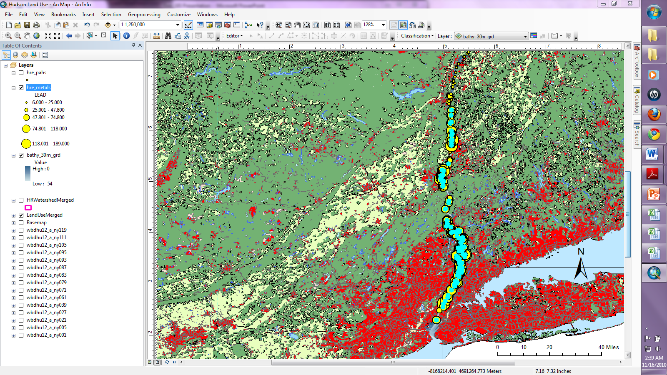
Copper – 61%
Lead – 43%

Slide 10
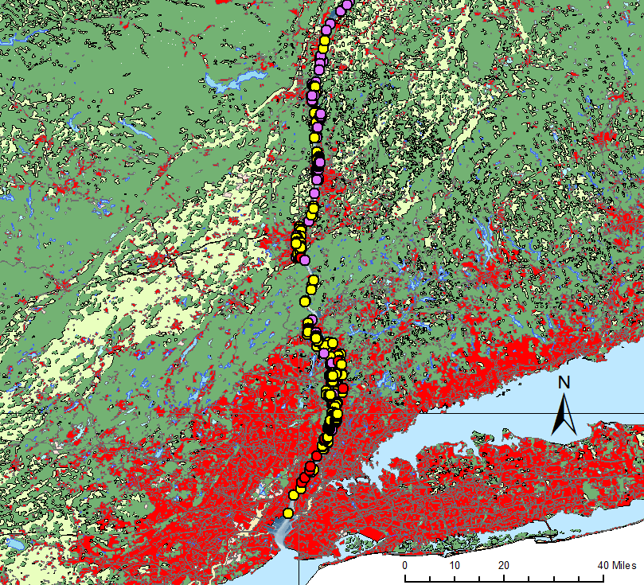
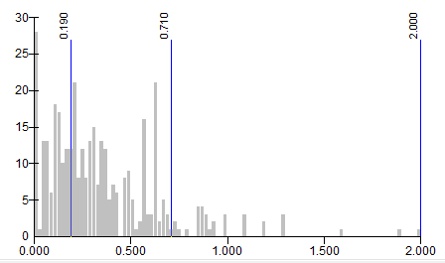
Mercury – 72%

Slide 11
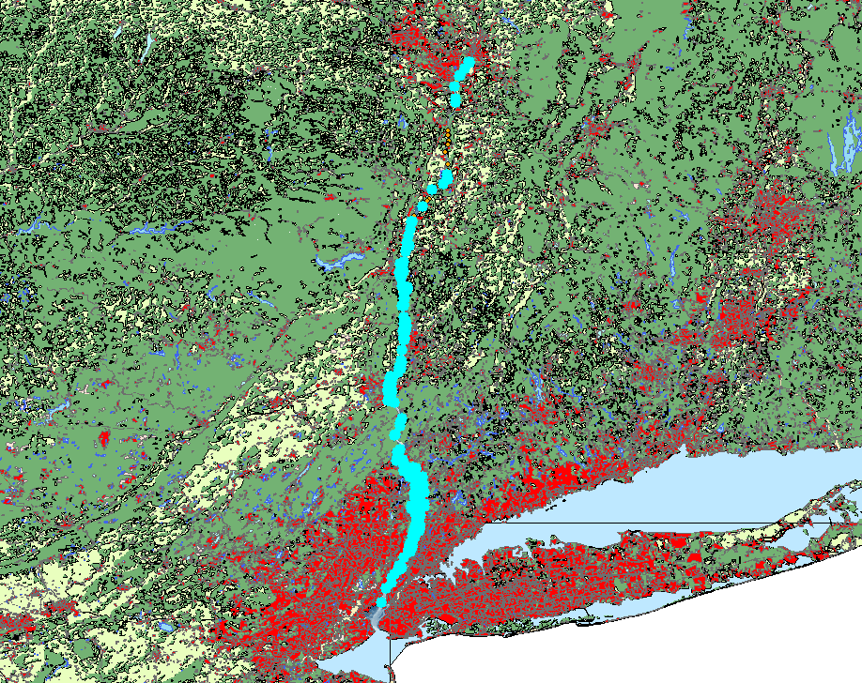
Metals Summary

Slide 12
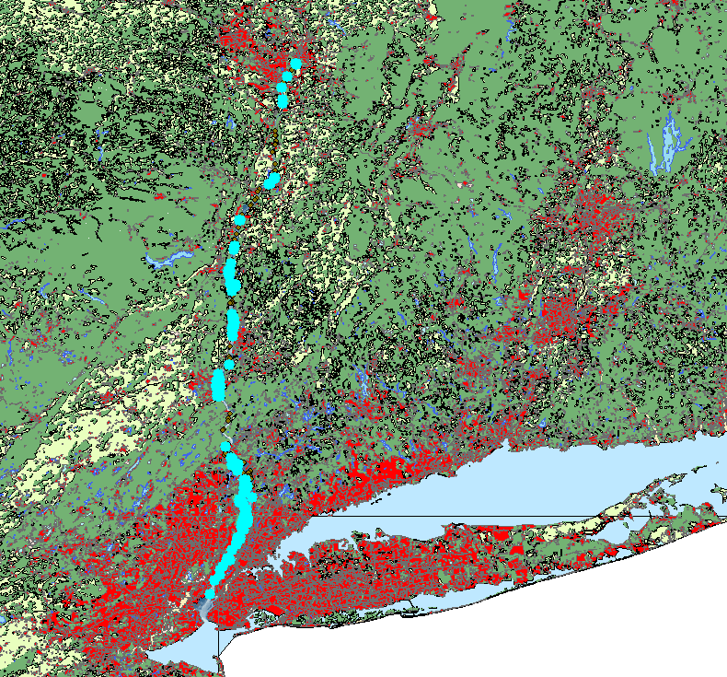
Polycyclic Aromatic Hydrocarbons

Slide 13
Conclusion
Highly urban and industrialized areas correlate with higher concentrations of metals
Highly urban and industrialized areas correlate with higher concentrations of PAH

Slide 14
Future Work
Convert land use polygons into raster data
Use the “Extract by Mask” Spatial Analysis tool to extract the cells of the land use raster that correspond to the area of the Hudson River Basin
More accurate correlations between land use and contaminants

