Slide 1
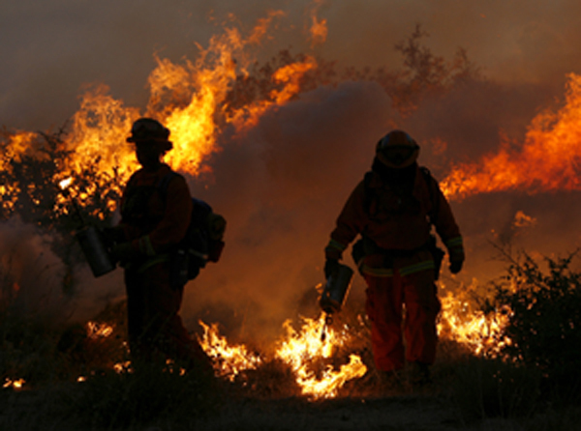
The Effect of Wildfires on Water Quality from Watershed Systems of Southern California
Presented to CE 394K.3 GIS in Water Resources
Carolina B. Mendez
November 16, 2010
www.americanobserver.net

Slide 2
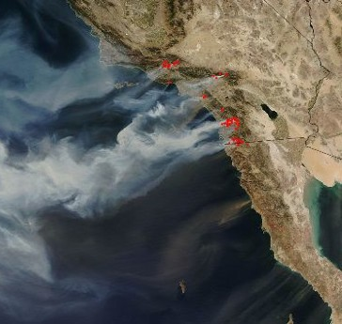
Wildfires
Increased erosion
Mobilization of particle-bound
contaminants
Post-fire: watershed recovers
Accumulation of mercury observed 1 year after fire; mobilization of mercury noted during second season.
(Burke et al., 2010)
www.map.sdsu.edu

Slide 3
Objective
Use GIS tools to investigate the effect of wildfires on water quality from a watershed system in Southern California
USGS and USEPA data
CUAHSI HydroDesktop
ArcMap

Slide 4
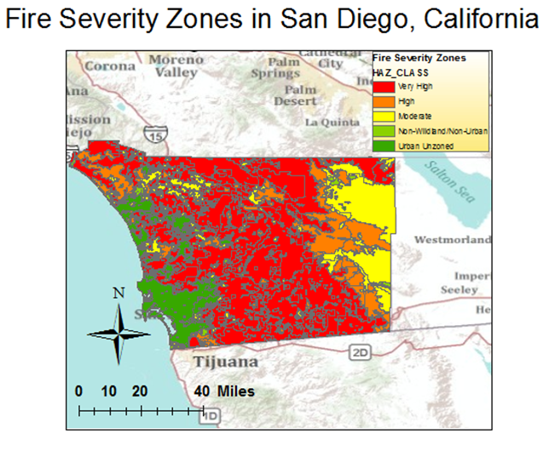
Fires in San Diego County

Slide 5
Mercury
Water quality: 1910 to 2010
Atrazine
Total Organic Carbon
Copper
Lead
Arsenic

Slide 6
Water quality: 1960 to 2010
Atrazine
Total Organic Carbon
Mercury
Copper
Lead
Arsenic

Slide 7
Water quality: 1980 to 2010
Atrazine
Total Organic Carbon
Mercury
Copper
Lead
Arsenic

Slide 8
Water quality: 1990 to 2010
Atrazine
Total Organic Carbon
Mercury
Copper
Lead
Arsenic

Slide 9
1980-2010 or 1990-2010 data set?
Total Organic Carbon
Mercury
1980-2010
1980-2010
1990-2010
1990-2010

Slide 10
Attribute tables
Fire Data
Water Quality Data

Slide 11
To-do List
Choose 1980-2010 or 1990-2010 data set
Locate watershed in San Diego County
Choose upstream and downstream gages
Correlate fire event to water quality data

