Slide 1
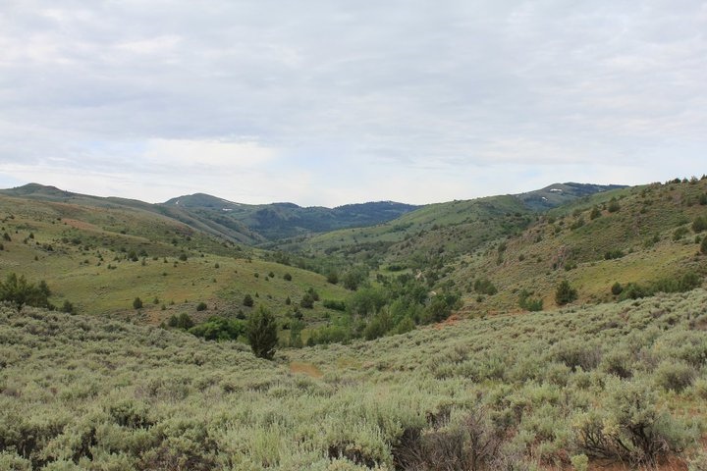
Does lithology control stream profiles?
Case Study in Reynolds Creek, Idaho
Lindsay Olinde
Jackson School of Geosciences
UT- Austin

Slide 2
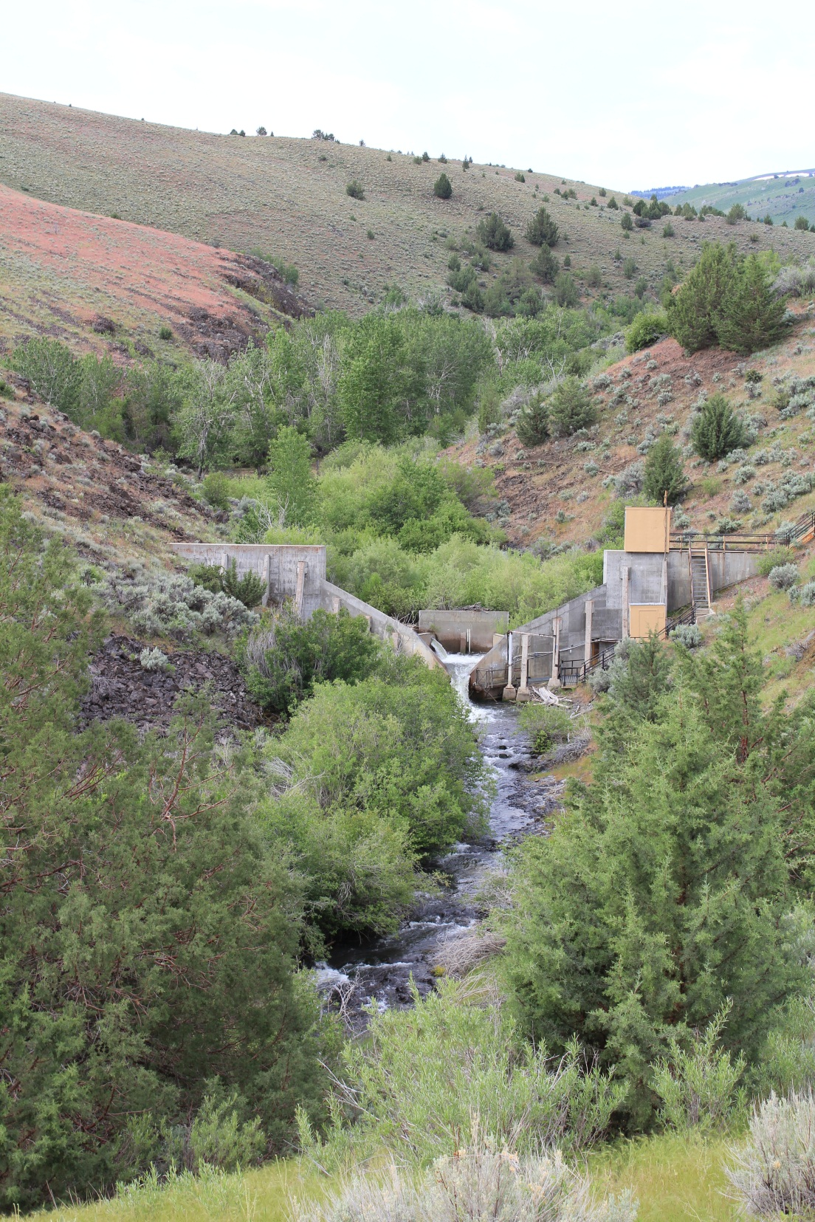
Outline
Background
Approach
Preliminary Results
Questions

Slide 3
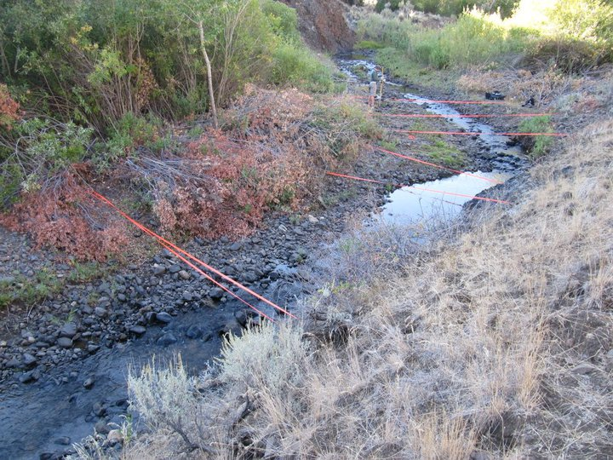
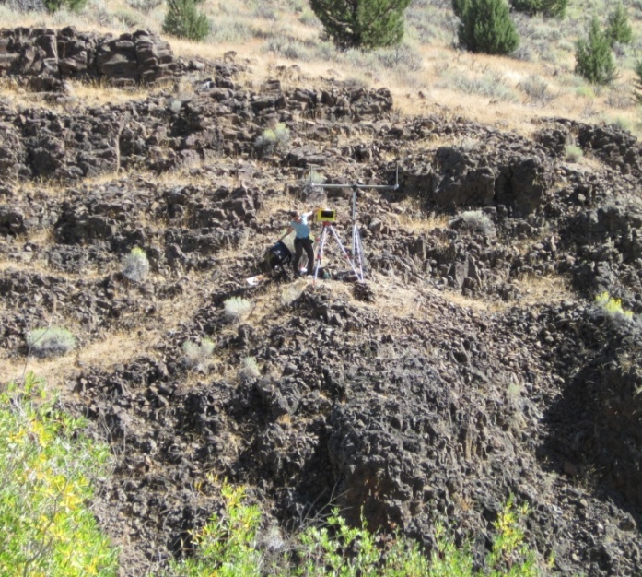
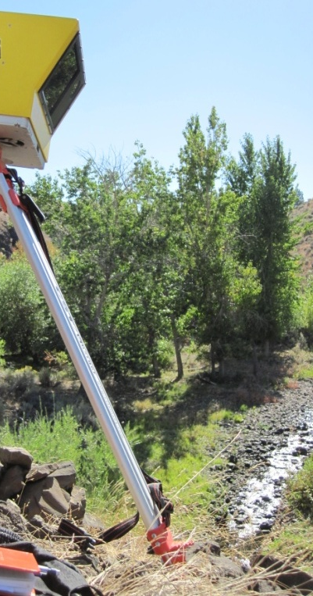
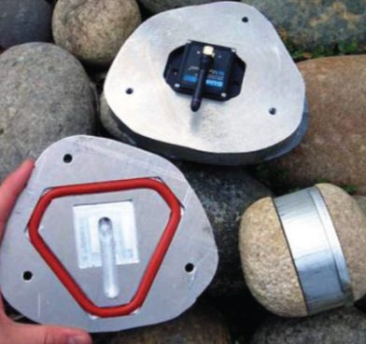
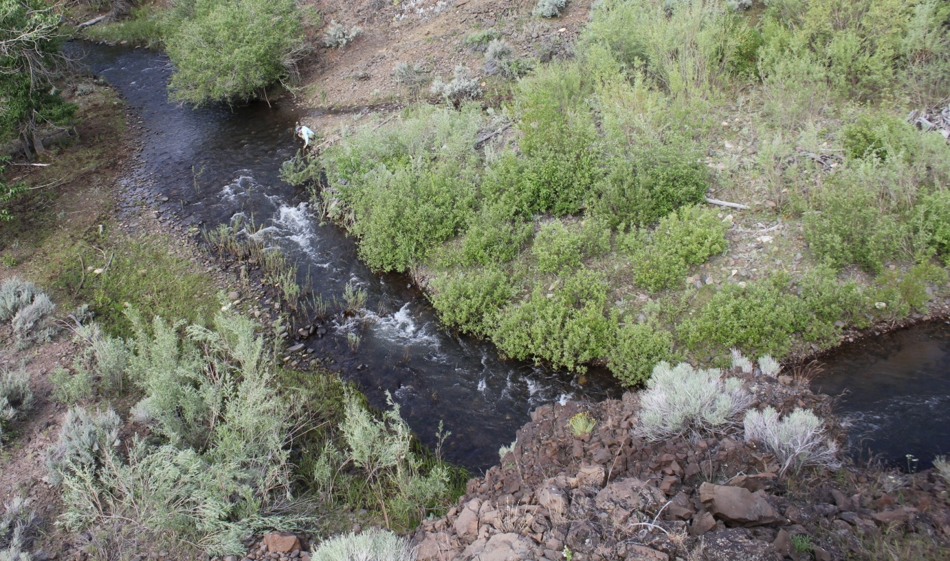
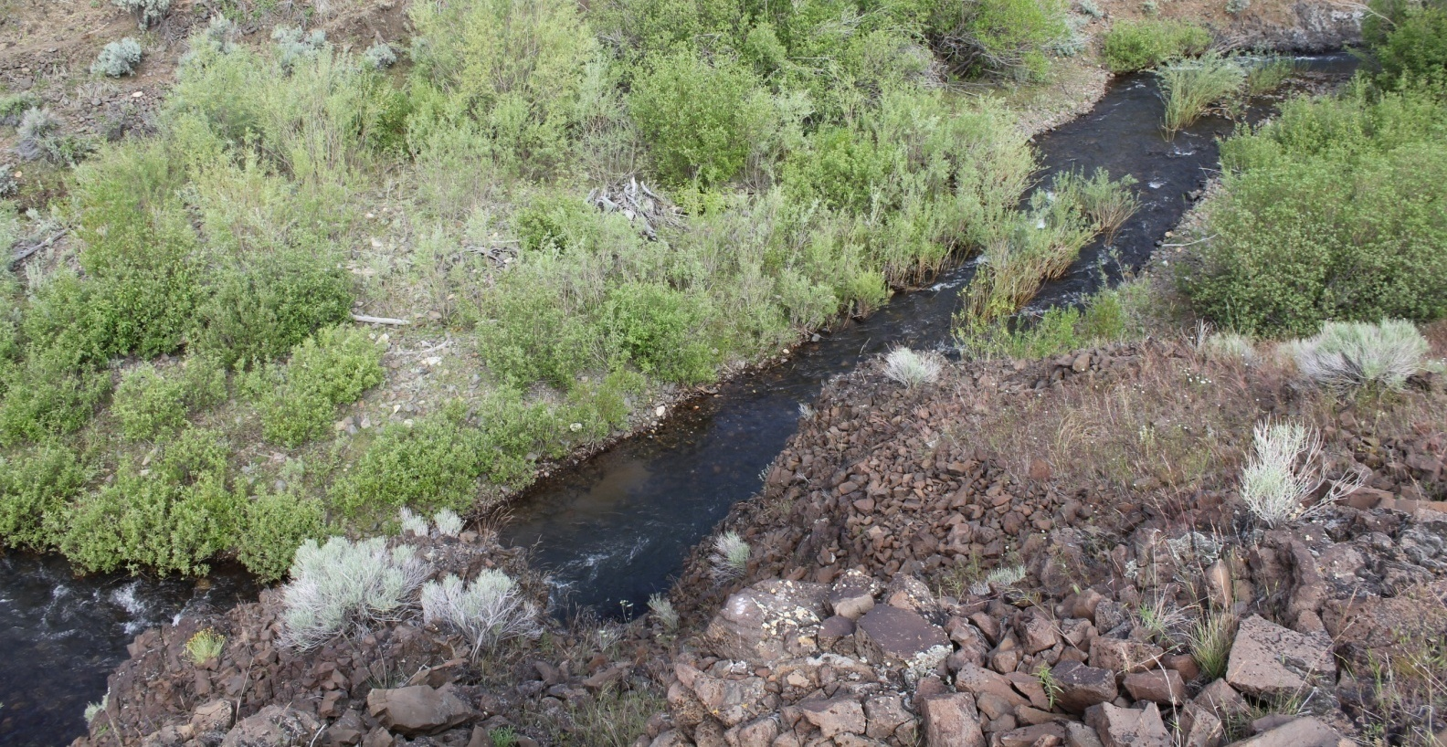
Reynolds Creek
- An experiment in channel evolution

Slide 4
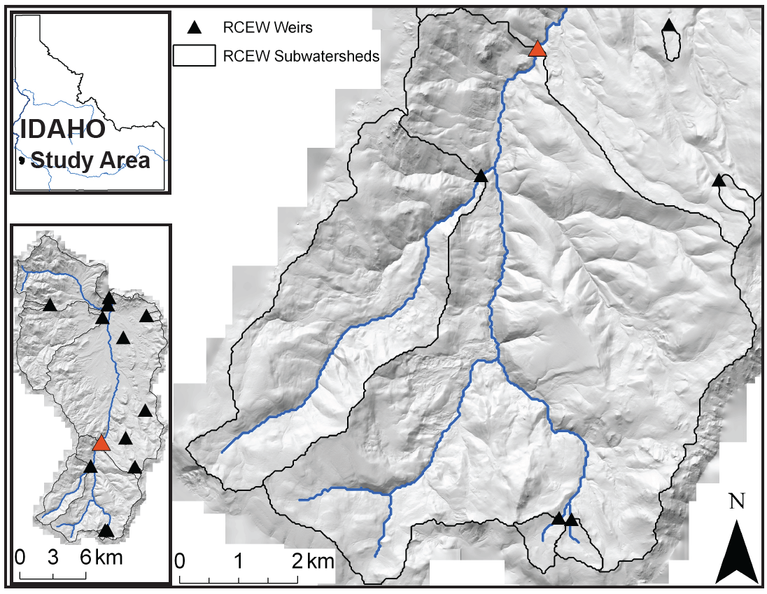
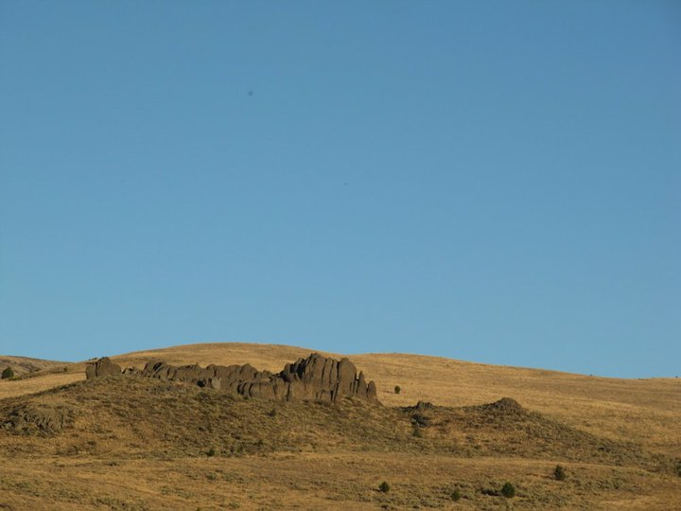
Topography
Mechanics
CURVATURE + LITHOLOGY

Slide 5

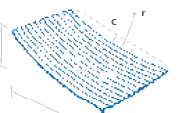
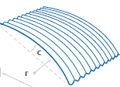
What is curvature?
Why do we care?
Convex: + Curvature
SLOPE
SEDIMENT TRANSPORT
rate of sediment breakdown
controls profile curvature
Concave: -̶ Curvature
Slope of the slope. How quickly slope changes.
Curvature images: http://www.stratco.com.au/products/roofing_walling/types/CGI_Pre_curving/CGI_Pre_curving.asp

Slide 6
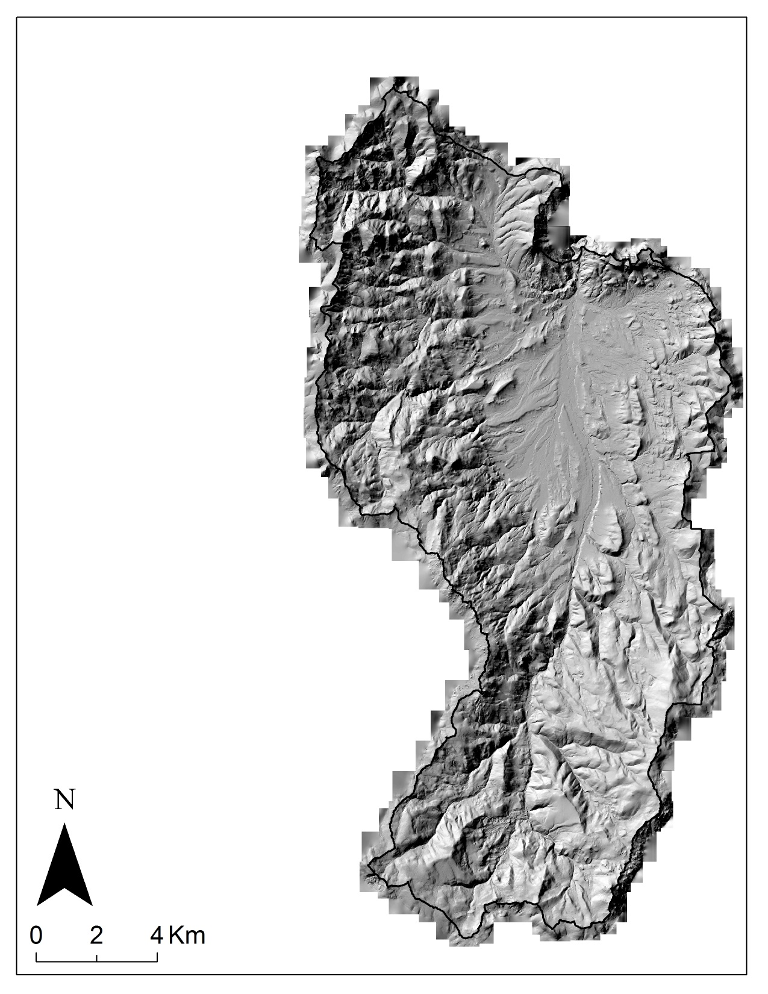
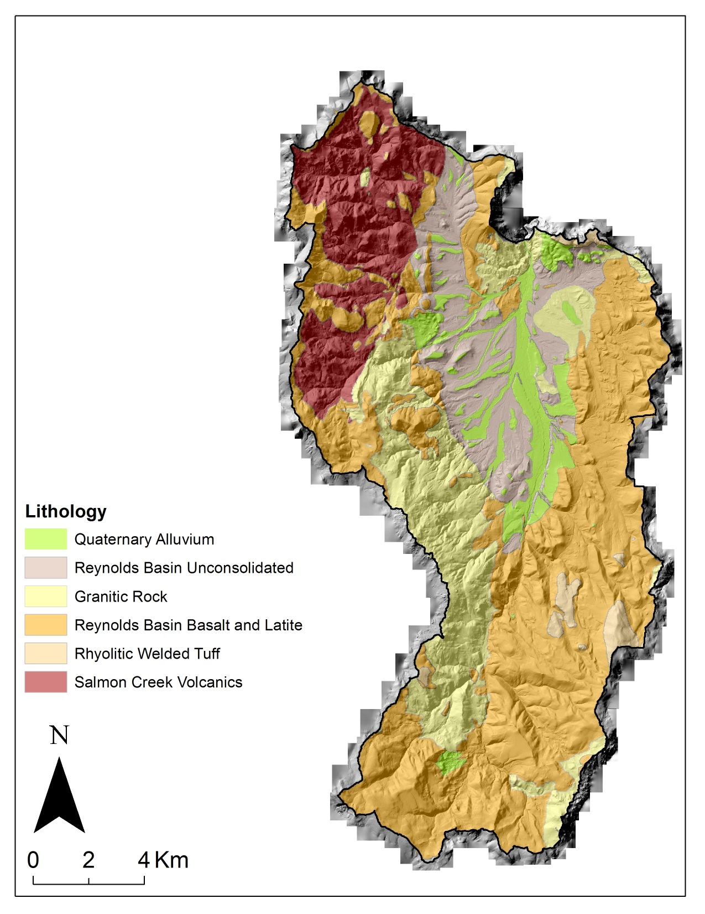
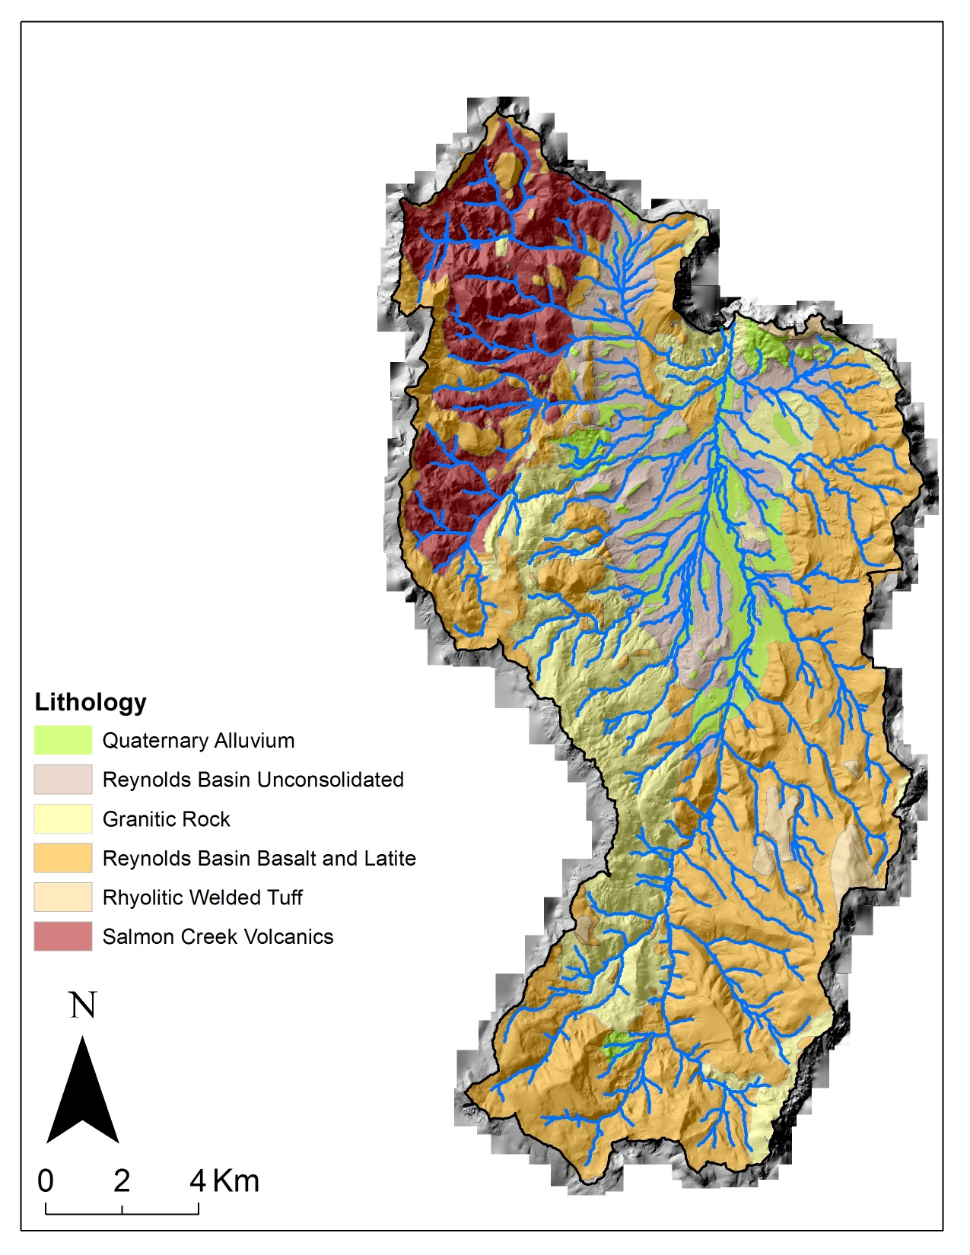
Datasets
LiDAR
Geologic Map
Stream Network
Notes:
Map with geologic map

Slide 7
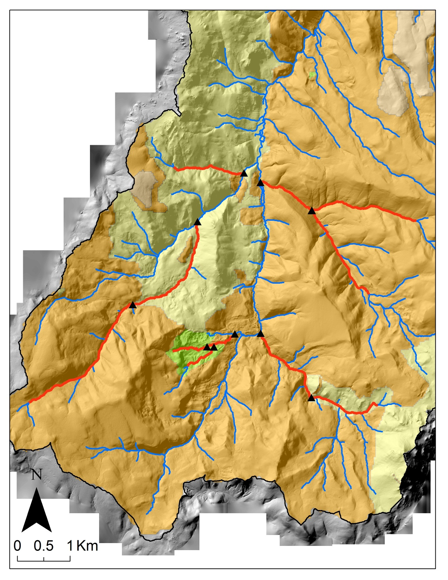


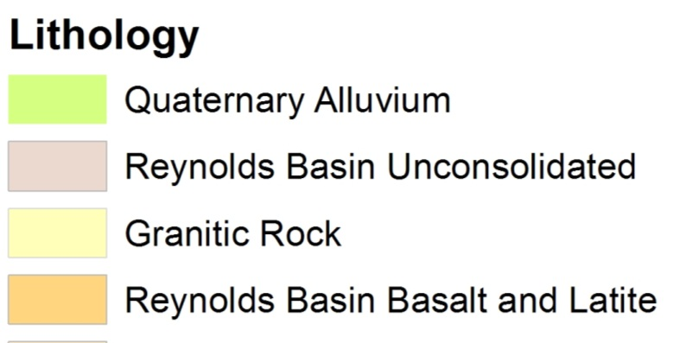
3D Profile Processing
Datasets
Streams: Batch Dissolve: DONE
Profile Curvature of 2m Elevation
3D: Convert Streams to Plot Curvature
LiDAR
Geologic Map
Stream Network
+
Streams of Interest
Notes:
Map with geologic map

Slide 8
Preliminary Results!

Slide 9
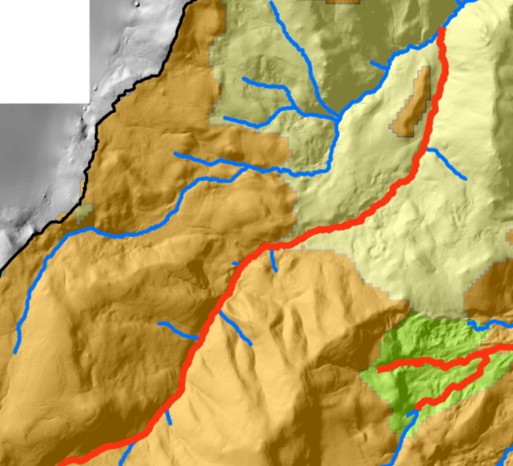
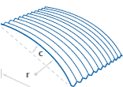
+ curvature
Basalt
Granite
Curvature images: http://www.stratco.com.au/products/roofing_walling/types/CGI_Pre_curving/CGI_Pre_curving.asp

Slide 11
What’s Next
Does lithology strongly control profile curvature here?
Finish profile curvature plots
Between
A
vs. B
Same
Within 1
A vs. B
Same

Slide 12
Questions?

