Slide 1
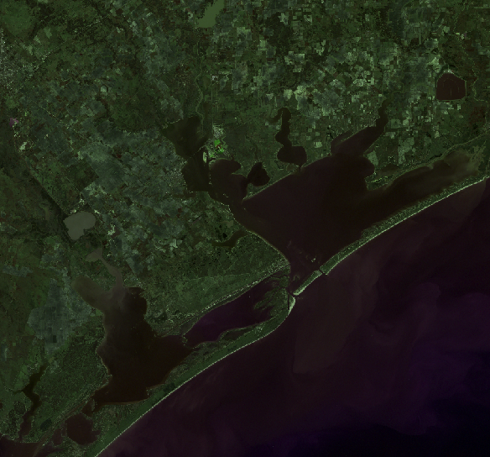
Remote Sensing of Chlorophyll in Matagorda Bay and Surroundings
Claire G. Griffin
GIS in Water Resources
Fall 2010

Slide 2
Outline
Utility of Remote Sensing for Water Quality Data
Matagorda Bay
Data
Image Processing
Mapping Chlorophyll
Implications

Slide 3
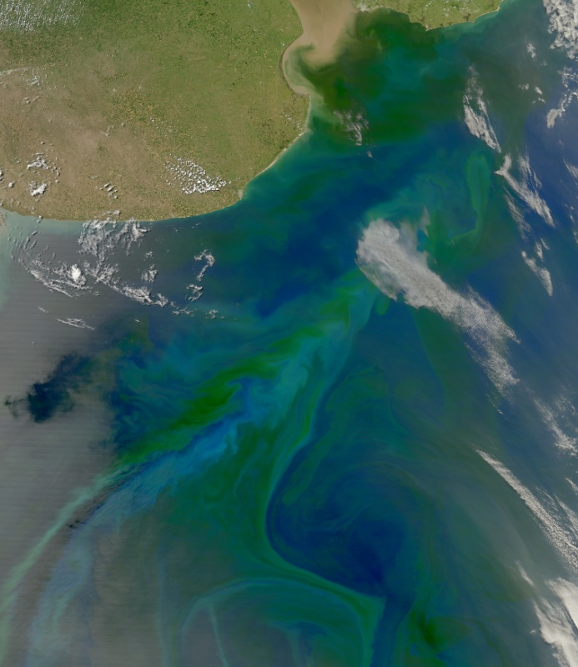
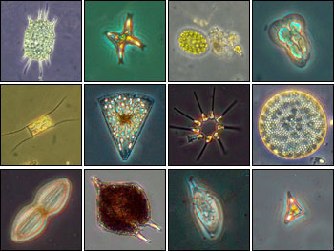
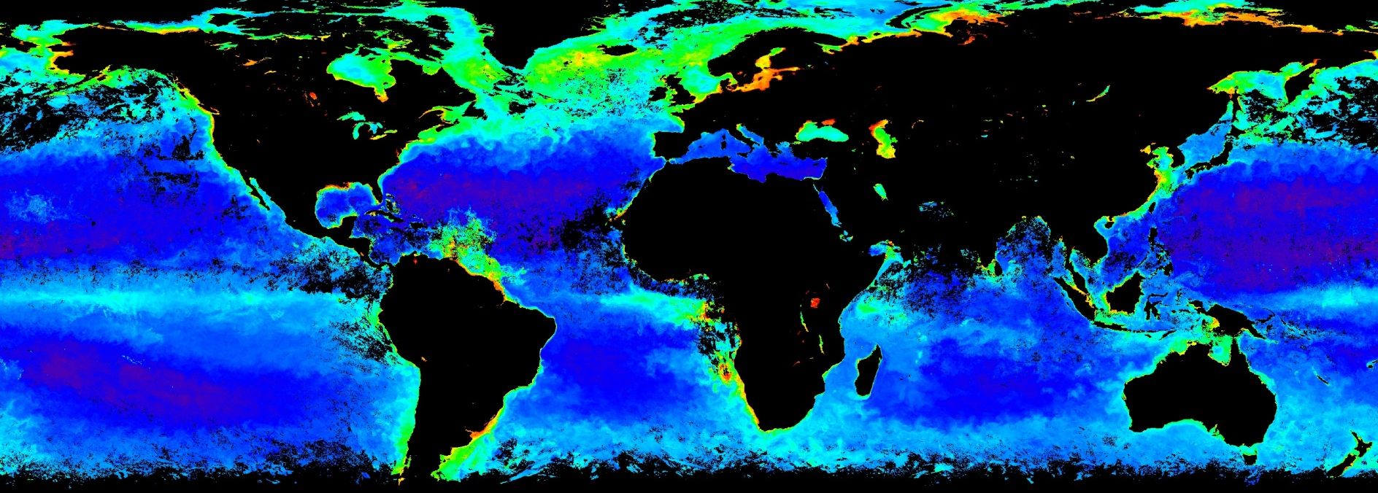
Chlorophyll
Notes:
Relating microscopic organisms to global datasets – cool!
Open water chlorophyll vs coastal
freshwater inputs make it complicated – SSC and organic matter have spectral characteristics

Slide 4
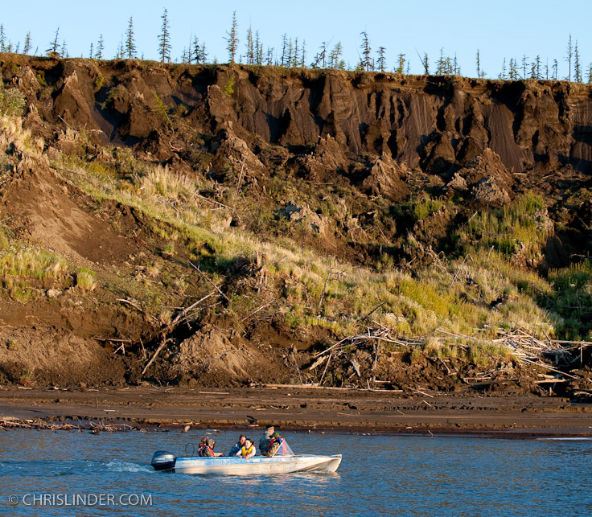
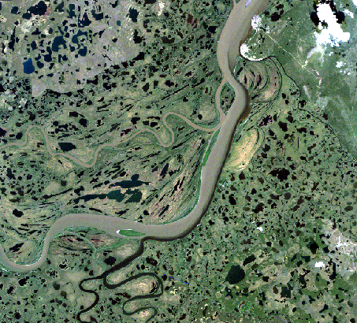
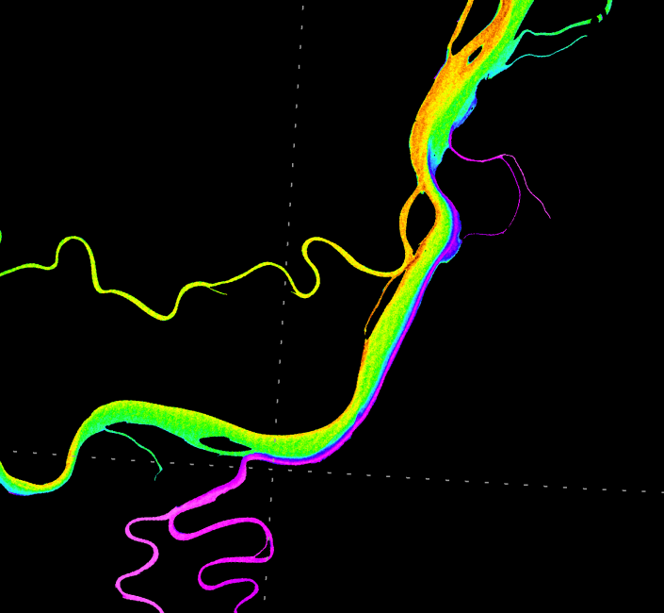
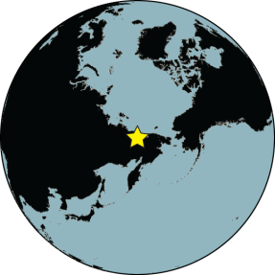
Remote Sensing of Water Quality
Location-specific, empirical algorithms
Continuous data, spatially explicit maps, access to remote areas

Slide 5
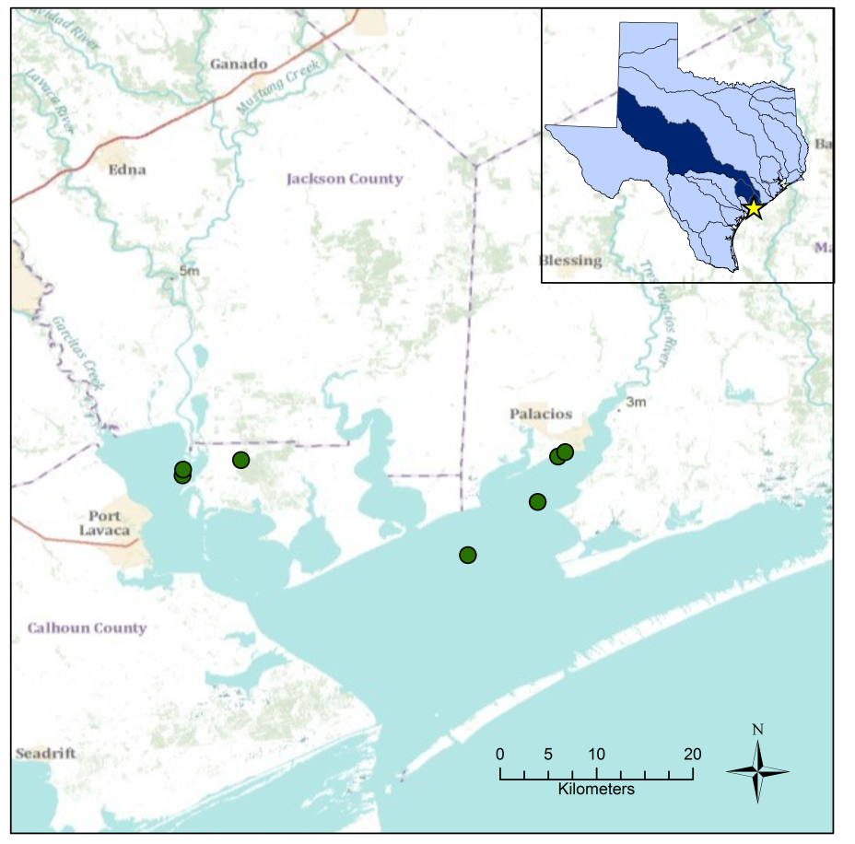
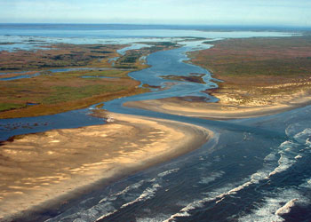
Matagorda Bay
3rd largest estuary
Connected to Lavaca and Tres Palacios Bays
Lavaca River and Colorado River

Slide 6
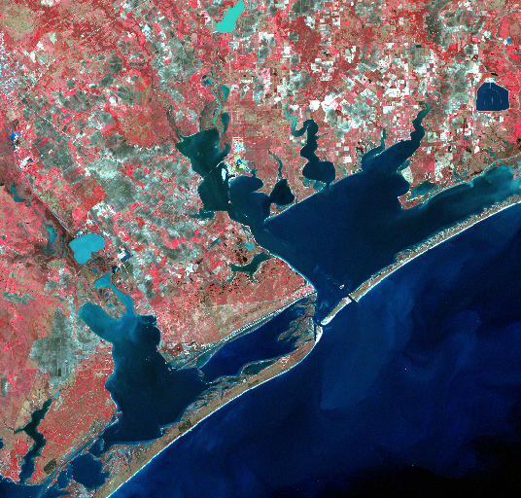
Data
Chlorophyll from TCEQ and TCOON
70 sites
  20 corresponded with Landsat scenes
17 Landsat Scenes

Slide 7
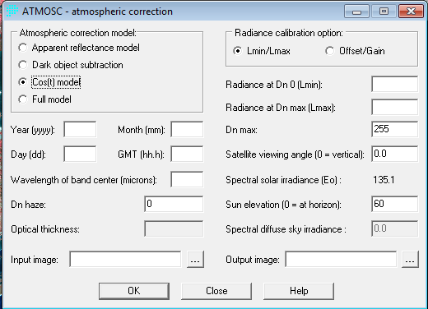
Image Processing
Download from USGS
Window to include only Matagorda Bay
Atmospheric Correction

Slide 8
Mapping Chlorophyll
Regress combinations of bands against Chl-a
Extract reflectances from Landsat data
Validate with data from other dates
Apply best algorithm to Landsat imagery

Slide 9
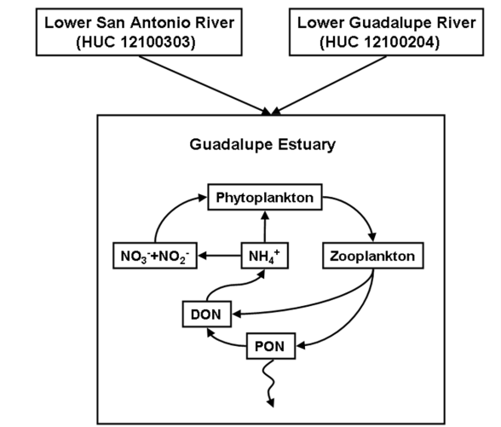
Implications and Uses
Monitoring potential
Tracking change
Relating to watershed characteristics
From Arismendez et al. (2009)

Slide 10
Questions?

