Slide 1
ArcGIS for the Recreational User
By Laura Gundlach
A Technologically Enhanced Trip into the Yellowstone Backcountry

Slide 2
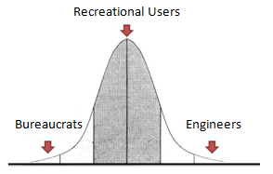
Motivations
Discover ways in which ArcGIS can be used to enhance “normal” life
  Develop a Non-Scientific/Non-Engineering inquiry that is self-interested

Slide 3
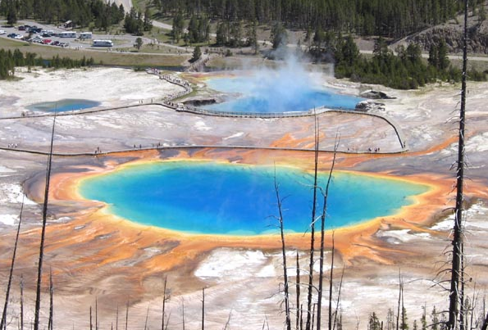
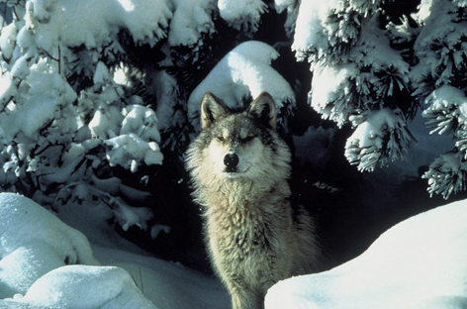
Yellowstone
World’s Oldest (and best!) National Park
  2/3 of the World’s Thermal Features
  Beautiful Mountainous Landscapes
  Several Charismatic Megafauna

Slide 4
Objectives
Use ArcGIS tools to view Englemann Spruce/Subalpine Fir
  Remote (5km away from the road)
  Bear “Free” (Out of Bear Management Areas)
  Above 9,000 ft
  Accessible by Trails / Near Backcountry Campsites
  Nearby Fly Fishing (Lakes/Rivers)

Slide 5
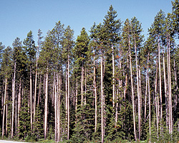
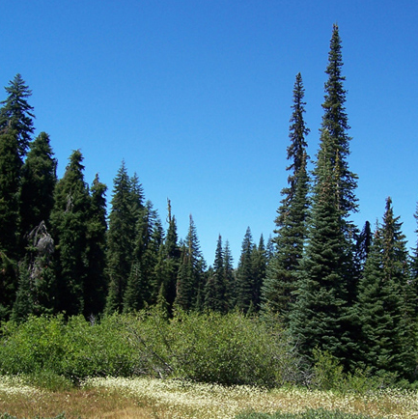
Subalpine Fir
Lodgepole Pine

Slide 6
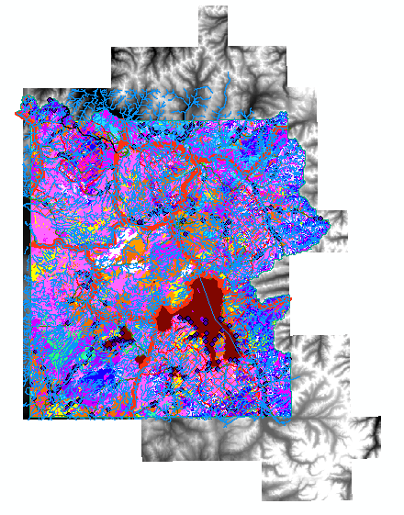
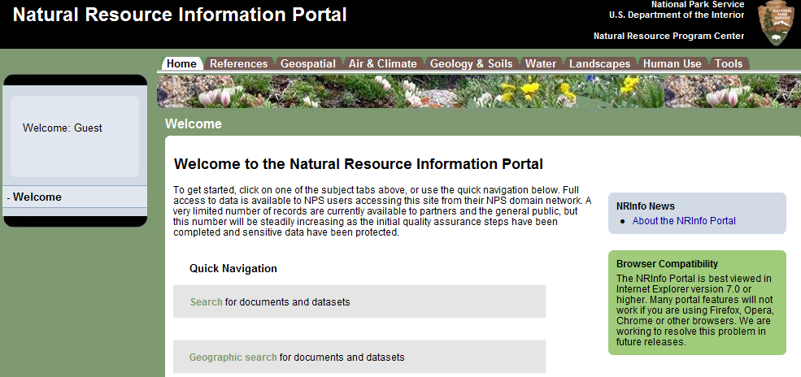
Data
Natural Resource Information Panel
  LOTS of Data from National Parks
  Search Geographically or by Keyword
Available Data-
Vegetation
Streamflow
Watersheds
Roads
Boundaries
Trails
Elevation
Aspect
Bear Management
Bathymetry
Percent Burned
And Much More!!!

Slide 7
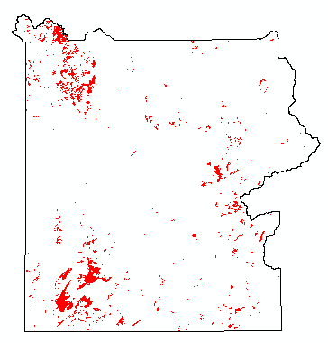
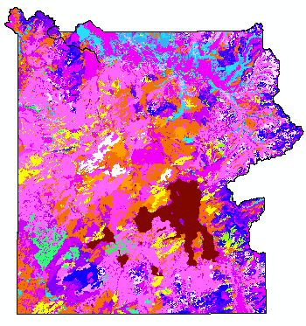
Englemann Spruce / Subalpine Fir
  Selected Targets from Attribute Table
  New Layer from Selection
  Raster to Polygon
Target Vegetation in Red
Yellowstone Vegetation

Slide 8
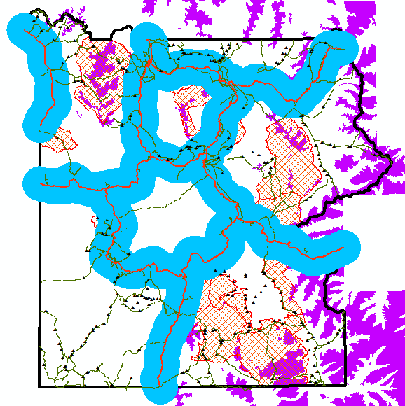
Criteria
Remote – 5km
Blue “Intestines”
Analysis/Proximity/Buffer
Bear Free
Red Cross-Hatched Polygons
Bear Management
For each of the 3 Polygon Layers…
Analysis/Overlay/Intersect
and
Analysis/Overlay/Erase
Trails
Green PolyLines
High Elevation
Purple Polygons
Spatial /Reclass/Reclassify
Raster to Polygon
Legally Campable
Small Black Triangles

Slide 9
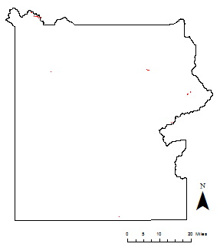

Slide 10
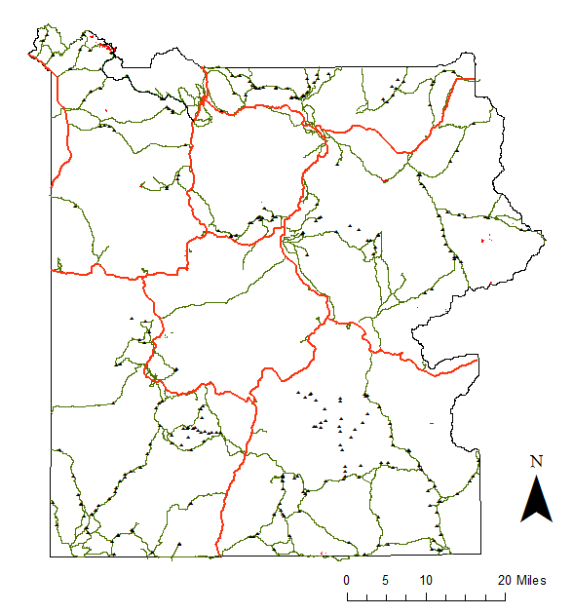
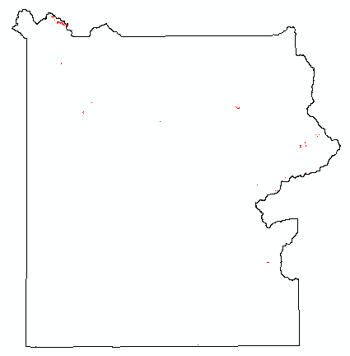
Only
1.62 mi²!

Slide 11
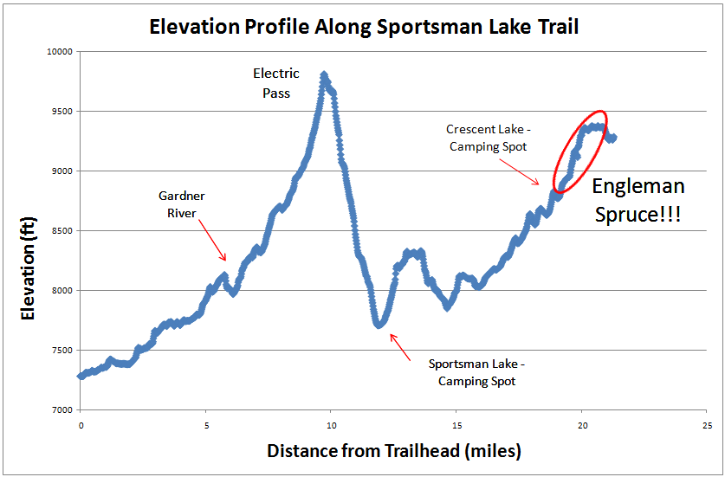
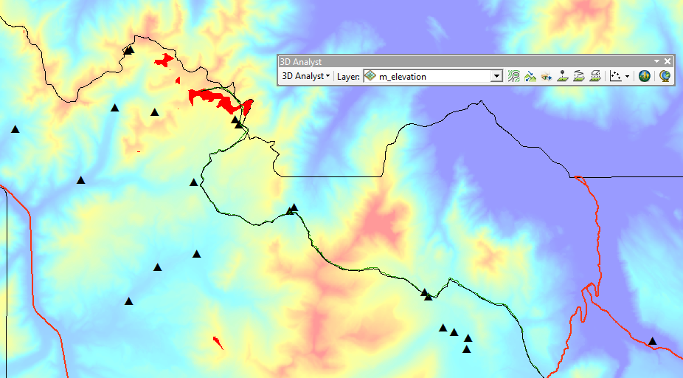
Elevation Profile
Englemann Spruce!!!
Crescent Lake
Camping Spots
Electric Peak
Sportsman Lake
Electric
Pass

Slide 12
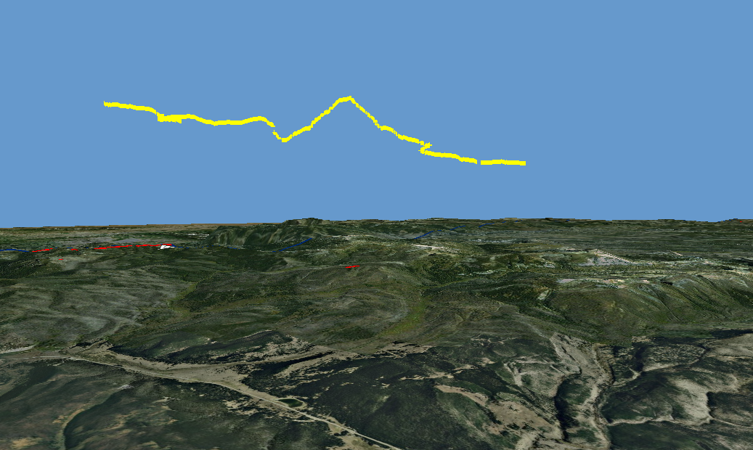
ArcGlobe
Using 3D Analyst/Functional Surface/Add Surface Information, I added z-values to the selected trail
Added the trail into ArcGlobe to view the Elevation Profile in 3D
That doesn’t look right…
- Convert Elevation from
feet to meters

Slide 13
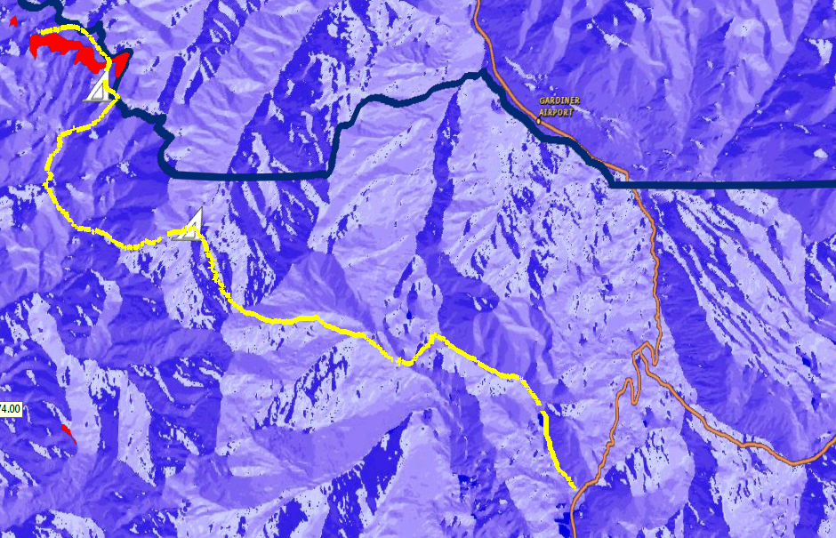
Max Elevation 9,820 ft
Max Elevation Gain
(One way) 2,537 ft
Distance to Campsite
12.7 mi
Red Polygons show Spruce/Fir
Blue Shading shows Aspect
White triangles show Campsites

Slide 14
Future Work
Find Backcountry Waterfalls and add them as Points
Conduct Line of Sight Analysis at the high point along Electric Pass
Finish Report!

Slide 15
Conclusions
Performing this classical GIS analysis gives great insight into why the program was developed
  “Easily” reproduced elevation profile earlier developed by hand with topo maps
It is possible to convince a layman that ArcGIS is a useful and fun tool
  Especially when you start with the fly and float tool in ArcGlobe
It might not be worth it to hike 44 miles just to see the Englemann Spruce…

Slide 16
References
National Resource Information Portal - http://nrinfo.nps.gov
The Yellowstone Backcountry Page - http://www.yellowstonestereoviews.com/backcountry/home.html
Hiking Yellowstone National Park – Bill Schneider
Mapping the Distribution of Yellowstone Water Resources - http://www.topoimagery.com/making/yswater/index.html
Planning a Trip to Yellowstone Park - http://www.geology.und.edu/gerla/gge220/yellowstone/yellowstone.html

