Slide 1

Effects of Freshwater Inflows on Estuarine Structure and Function
Aubrey Lashaway
November 18, 2010
GISWR 394K.3
**Collaborators: Dr. Deana Erdner and Qiyuan Liu

Slide 2
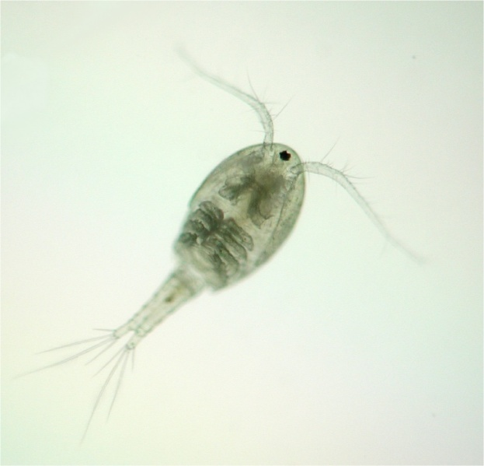
Report Outline
Research Description
GISWR Project Focus
Remaining Goals

Slide 3
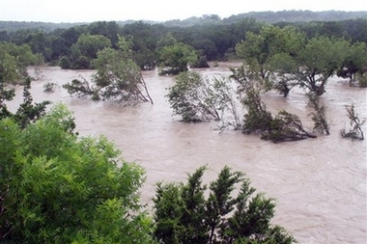
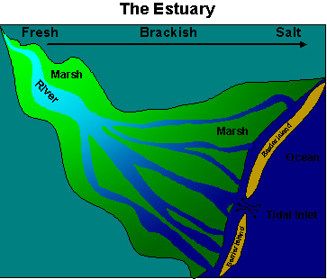
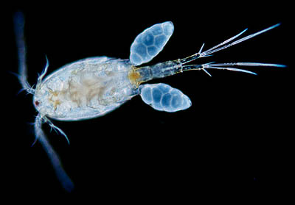
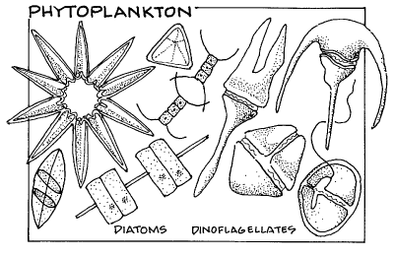
Research Description
South Texas ideal location
Variable Rainfall
Nutrient Pulses
Altered Plankton Composition

Slide 4
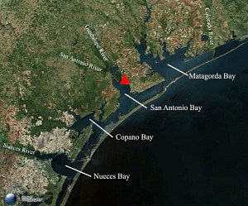
Research Description
Microcosm experiments
  Copepod population density Δ
Guadalupe Estuary
Mission-Aransas NERR
Nueces Delta
Gulf of Mexico

Slide 5
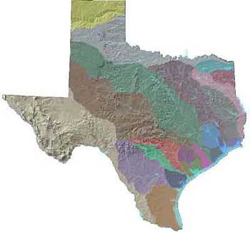
Research Description
Mission-Aransas NERR Watershed Boundary
1 of 2 Texas estuaries labeled as “low risk”

Slide 6
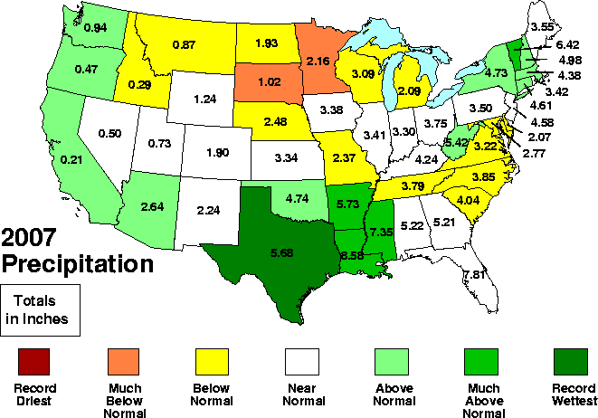
GISWR Project
July 2007 Texas precipitation
  Extreme freshwater inflow to MANEER
**Some stations averaged MUCH more!

Slide 7
GISWR Project
Precipitation
  Jan-June ≈ 30 inches; 13.95 inches above normal
  July 4 = 11.5 inches
Discharge

Slide 8
↑ Precipitation
↑ Discharge
↑ Nutrients
↑ Freshwater Inflow
↓ Salinity

Slide 9
GISWR Project
SWMP stations
Copano Bay East and West
  Salinity

Slide 10
GISWR Project

Slide 11
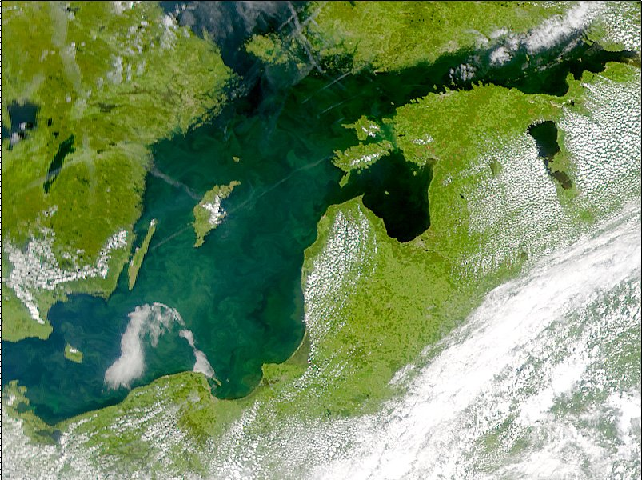
Remaining Goals
Creating Stream Network
Interpolation of Salinity
Interpolation of biological data (e.g. chlorophyll)

Slide 12
Questions? And References
Baird, D. 2009. An assessment of the functional variability of selected coastal ecosystems in the context of local environmental changes. – ICES Journal of Marine Science, 66: pp. 1520–1527.
Caliman, A., Carneiro, L.S., Santangelo, J.M., Guariento, R.D., Suhett, A.L., Pires, A.P., Marinho, C.C., Lopes, P.M., Quesada, L.B., Sanches, L.F., Azevedo, F.D., Siqueira, V.S., Farjalla, V.F., Bozelli, R.L., and Esteves, F.A. 2010. Temporal Coherence among Tropical Coastal Lagoons: A Search for Patterns and Mechanisms. Brazilian Journal of Biology.
Cavazos, T. 1998. Large-Sclae Circulation Anomalies Conducive to Extreme Precipitation Events and Derivation of Daily Rainfall in Northeastern Mexico and Southeastern Texas. Journal of Climate. Vol 12: pp. 1506-1523.
Harley, C.D.G., Randall Hughes, A., Hultgren, K.M., Miner, B.G., Sorte, C.J.B., Thornber, C.S., Rodriguez, L.F., Tomanek, L. and Williams, S.L. 2006. The impacts of climate change in coastal marine systems. Ecology Letters. 9: pp. 228–241.
Miller, C.J., Roelke, D.L., Davis, S.E., Li, H., and Gable, G. 2008. The role of inflow magnitude and frequency on plankton communities from the Guadalupe estuary, Texas, USA: findings from microcosm experiments. Estuarine, Coastal, and Shelf Science. 80 (2008) pp. 67-73.
Norkko, A., Thrush, S.F., Hewitt, J.E., Cummings, V.J., Norkko, J., Ellis, J.I., Funnell, G.A., Schultz, D., MacDonald, L. 2002. Smothering of estuarine sandflats by terrigenous clay: the role of wind-wave disturbance and bioturbation in site-dependent macrofaunal recovery, Marine Ecology Progress Series 234. pp. 23–41.
Orlando Jr. S.P., Rozas, L.P., Ward, G.H., Klein, C.J. 1993. Salinity characteristics of Gulf of Mexico Estuaries. National Oceanic and Atmospheric Administration, Office of Ocean Resources Conservation and Assessment, Silver Spring, Maryland.
Paerl, H.W., Bales, J.D., Ausley, L.W., Buzzelli, C.P., Crowder, L.B., Eby, L.A., Fear, J.M., Go, M., Peierls, B.L., Richardson, T.L., and Ramus, J.S. 2001. Ecosystem impacts of three sequential hurricanes (Dennis, Floyd, and Irene) on the United States' largest lagoonal estuary, Pamlico Sound, NC. Proceedings of the National Academy of Sciences. 98(10): pp. 5655-5660.
Pinckney, J.L., Paerl, H.W., Harrington, M.B., and Howe, K.E. 1998. Annual cycles of phytoplankton community structure and bloom dynamics in the Neuse River Estuary, North Carolina. Marine Biology 131: pp. 371-381.
Roelke, D.L. 2000. Copepod food-quality threshold as a mechanism influencing phytoplankton succession and accumulation of biomass, and secondary productivity: a modeling study with management implications. Ecological Modeling. 134. pp. 245–274.
Salen-Picard, C., Arlhac D., and Alliot, E. 2003. Responses of a Mediterranean soft bottom community to short-term (1993–1996) hydrological changes in the Rhone river. Marine Environmental Research 55. pp. 409–427.
Tyler, M.A. 1986. Flow-induced variation in transport and deposition pathways in the concentration: the effect on phytoplankton dominance and anoxia. In: Wolfe, D. A. (ed.)Estuarine variability. Academic Press, New York, pp. 161-175.
Turek, J.G., Goodger, T.E., Bigford, T.E., Nichols, J.S. 1987. Influence of freshwater inflows on estuarine productivity. U.S. Department of Commerce. Northeast Fisheries Center.Woods Hole, Massachusetts.

