Slide 1
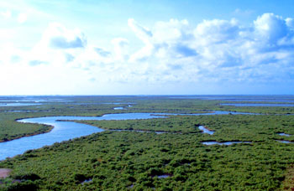
Influences of Storm Events on Mission-Aransas Estuary and the Recovery
Qiyuan Liu
(Coworker - Aubrey Lashaway)

Slide 2
Overview
What: Mission-Aransas Estuary
Why: Objectives for the project
How: Results
What’s next: Future work

Slide 3
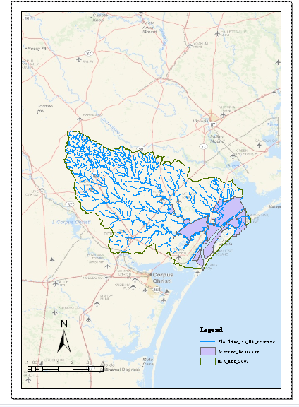
Mission-Aransas National Estuarine Research Reserve (MA-NERR)

Slide 4
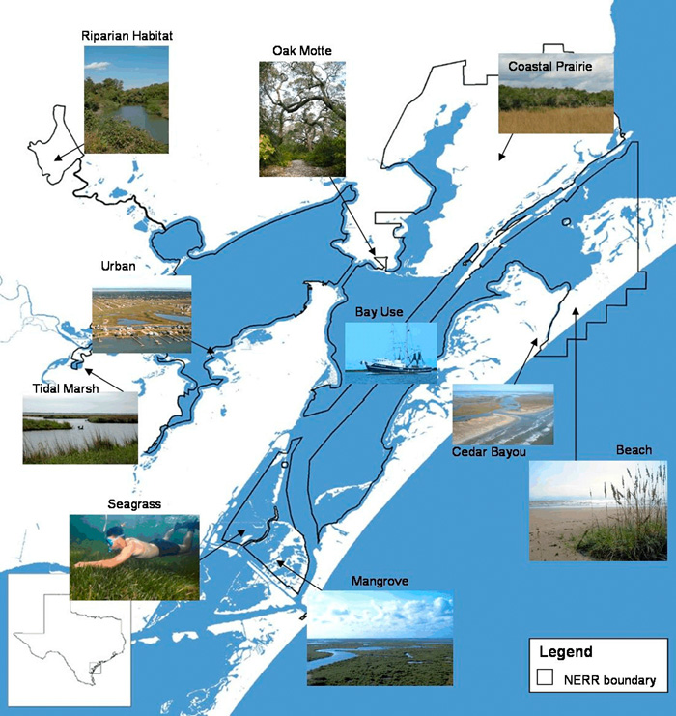
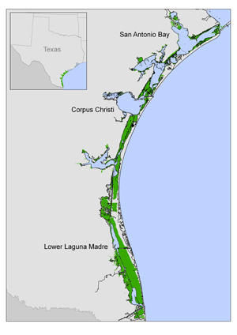

Slide 5
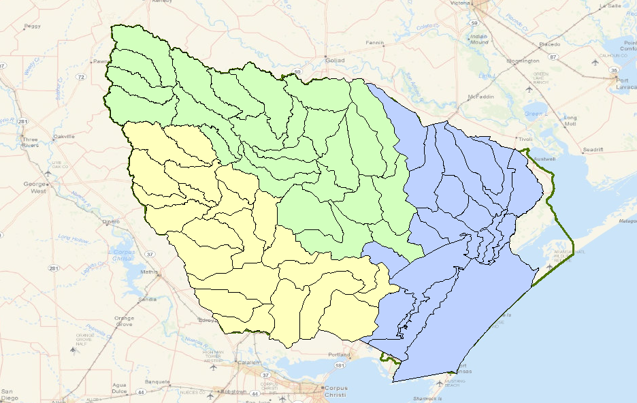
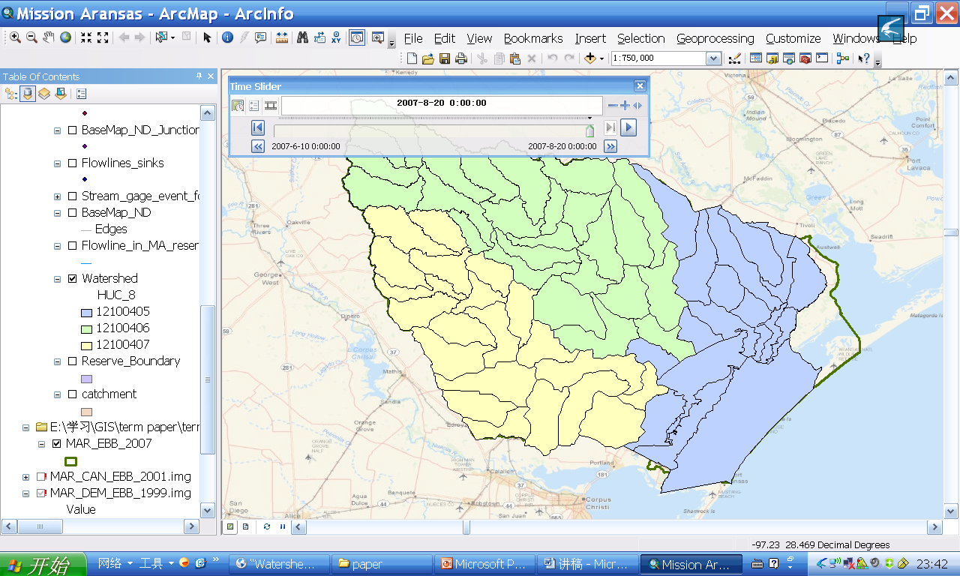
Copano Subwatershed
Misssion Subwatershed
Aransas Subwatershed

Slide 6
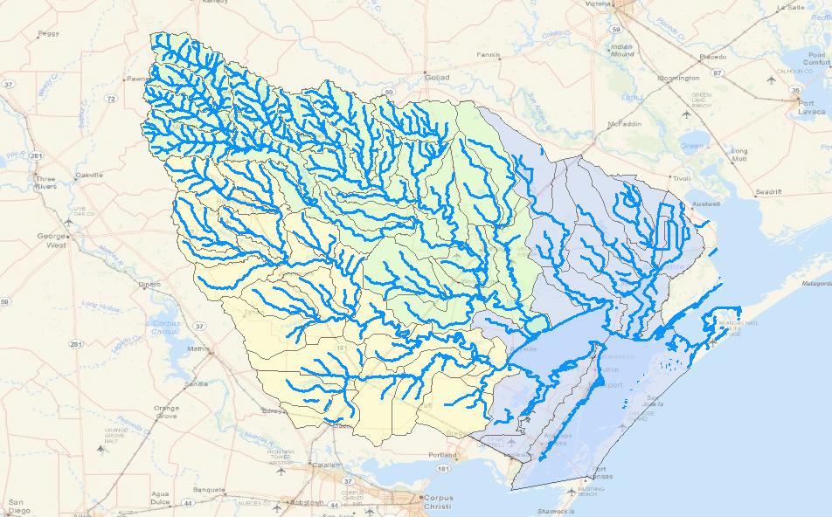
Copano Subwatershed
Misssion Subwatershed
Aransas Subwatershed

Slide 7
Advantages of target area
Relatively pristine ecosystem
Texas’s climate: variable

Slide 8
Extreme weather events
Amount and timing of rainfall
Freshwater inflows
Abrupt changes in estuary
Abiotic factors: water quality
Biotic factors: diversity & function

Slide 9
Goals & Methods:
Precipitation & Stream discharge
Water quality
before & after storm
Influence of up-stream watersheds storm events on estuary and recovery

Slide 10
Precipitation – Storm Event

Slide 11
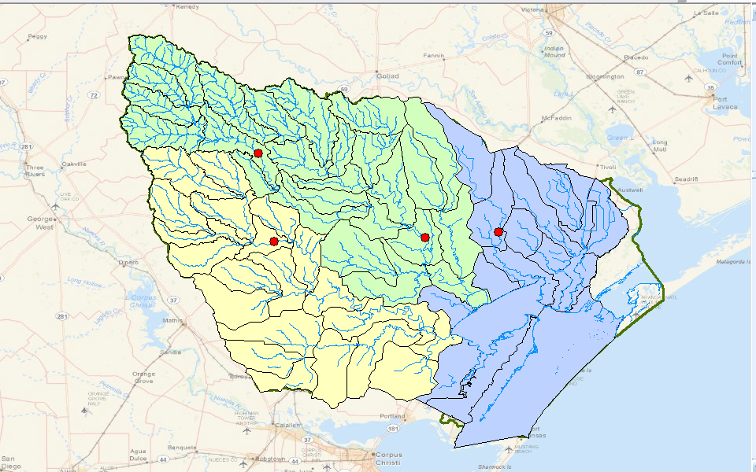
Stream Discharge Gauge Stations
Medio CK nr beeville, TX
Aransas RV nr Skidmore, TX
Copano Ck nr Refugio, TX
Mission RV at Refugio, TX

Slide 12
Stream Discharge

Slide 13
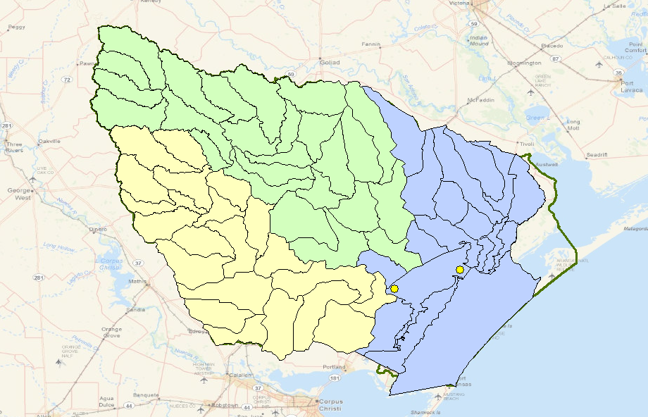
Water Quality Gauge Stations
Copano Bay East
Copano Bay West

Slide 14
Salinity

Slide 15
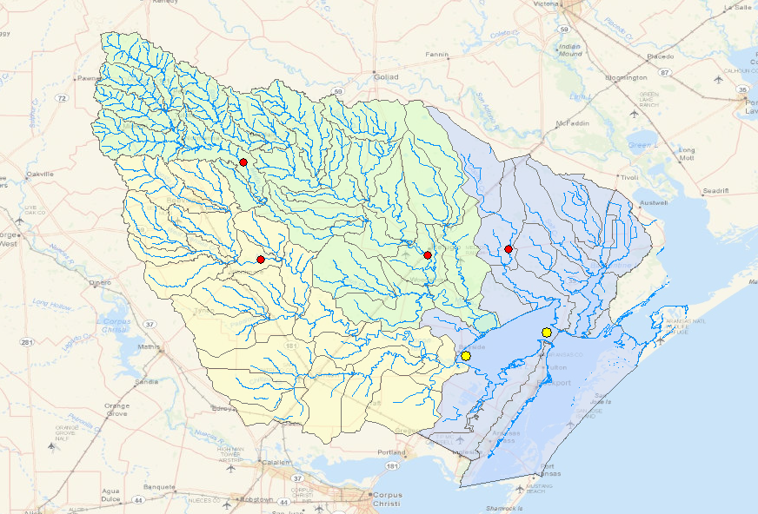
Stream Discharge Gauges
Water Quality
Gauge Stations

Slide 16
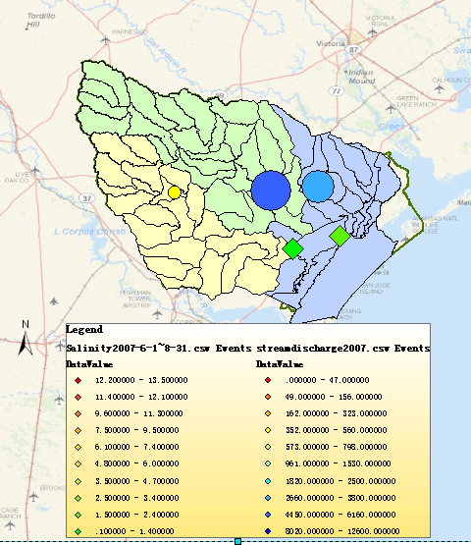
Stream Discharge and Salinity 2007-7-8 00:00

Slide 17
July 4th, 2007

Slide 18
Dissolved Oxygen

Slide 19
Stream Discharge & DO

Slide 20
Conclusions
Storm events can greatly influence the water quality such as salinity, DO, etc in downstream estuary.
There would be a delay in the change of water quality after a storm event.
It will take about 5 months for an estuary to recover from storm, with little permanent effect

Slide 21
Future Work
Compare the change in salinity in different gauge stations which serve different functions in the estuary.
Provide interpolation of salinity in estuary before and after storm
Storm influences on estuarine ecosystem – biodiversity, composition and function of communities.

Slide 22
Thank you!

